Slide 3

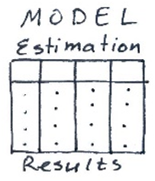
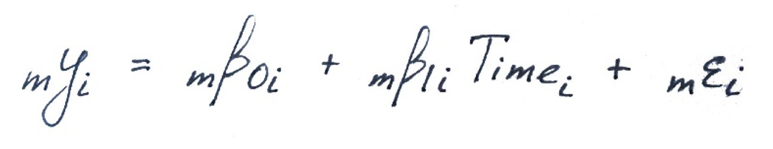
Original vision
Aggregation Phase: Coordinate statistical analysis of the primary data
Analysis Phase: Facilitate the analysis of the secondary data
ELSA
…
MAP
primary
secondary

Slide 4

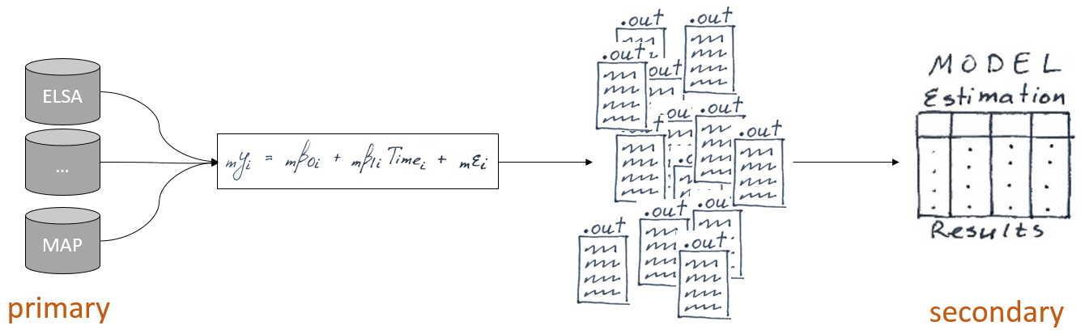
Phase 2

