Slide 1

Big Data, Big Analysis:
A Collaborative Modeling Framework for Multi-study Replication
Andriy V. Koval
University of Victoria
William H. Beasley
University of Oklahoma
Andrea Piccinin
University of Victoria
Graciela Muniz-Terrera
University of Edinburgh
Scott Hofer
University of Victoria
Convention of Canadian Psychological Association | Victoria, BC | June 10, 2016

Slide 4
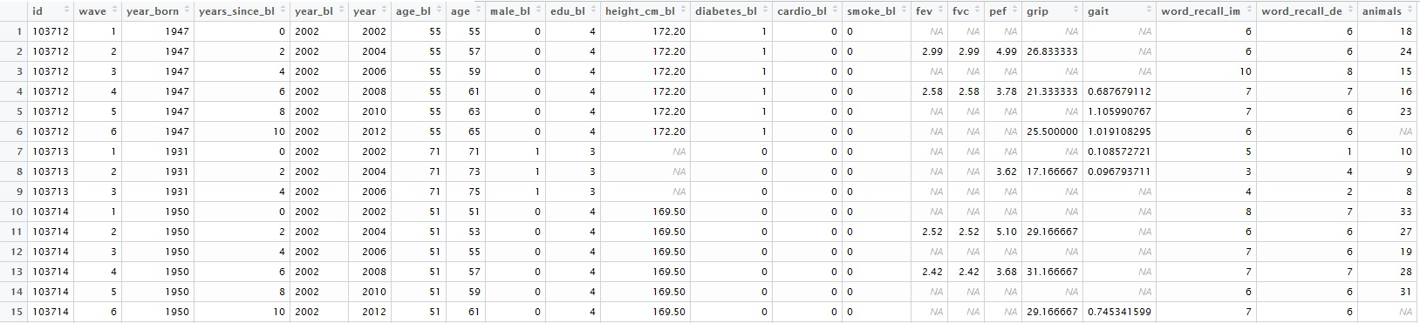
EAS
Wide
Long

Slide 5

EAS
Image credit: https://support.novell.com/techcenter/articles/ana19920502.html

Slide 6
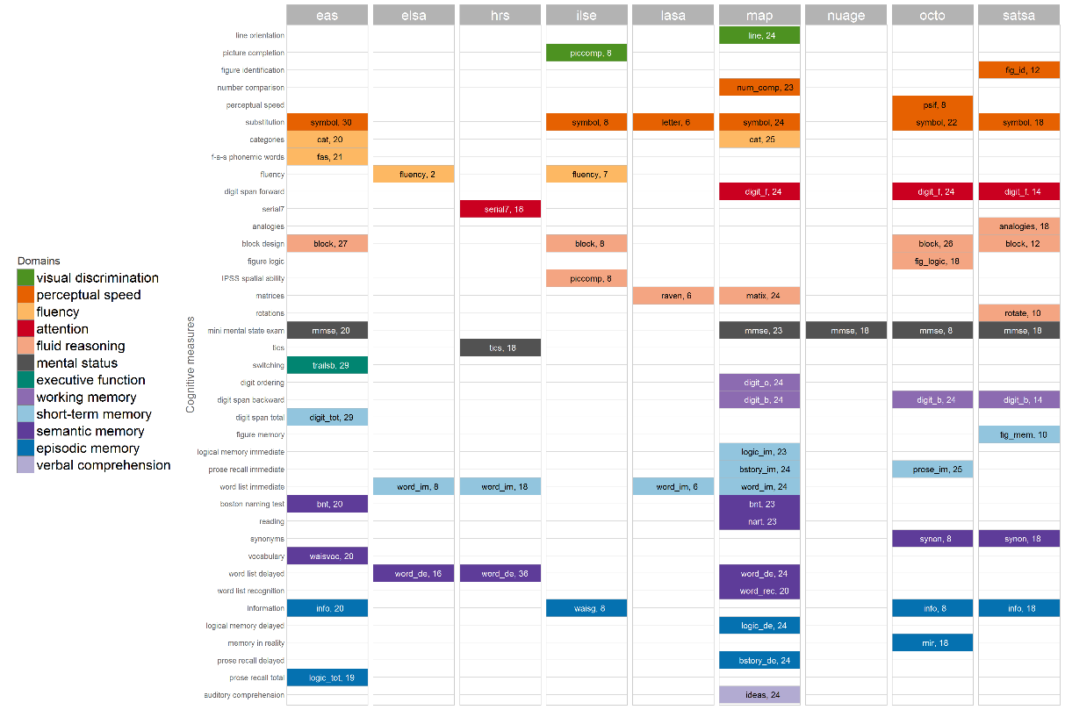

Slide 7
EAS
ELSA
HRS
ILSE
LASA
MAP
NuAge
OCTO
SATSA

Slide 9
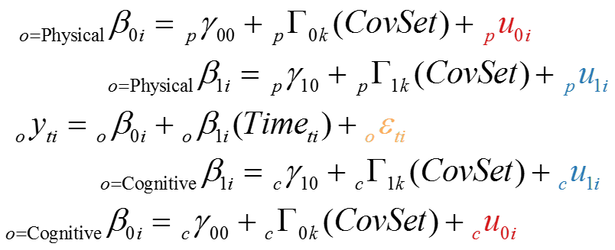
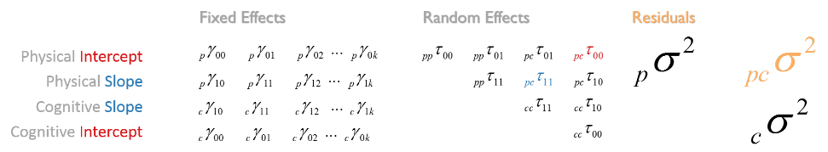

Slide 10
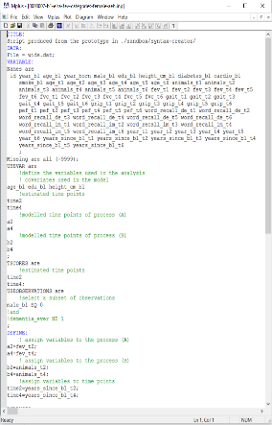
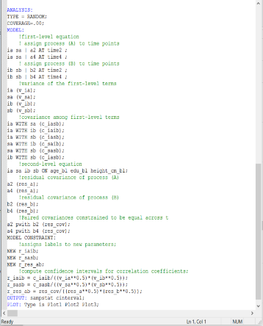

Slide 11
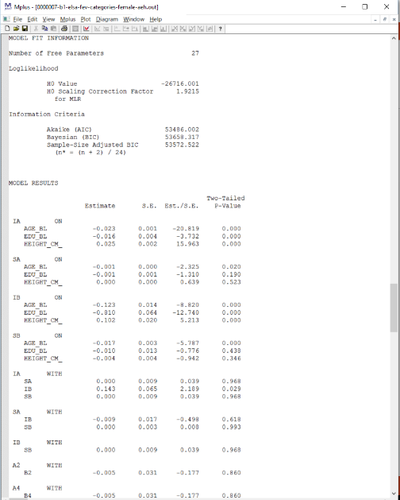
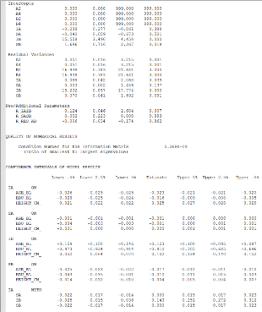
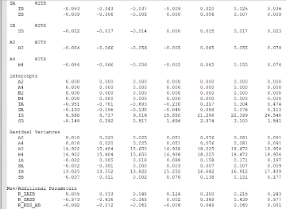

Slide 12
