Slide 1
Support Visuals
https://github.com/ialsa/ialsa-2018-amsterdam

Slide 2
Model A
Matrix of states and transitions
1,1
1,2
1,3
1,4
MMSE: 27-30
MMSE: 23-26
MMSE: 0-22
None
1
No
CI
2
Mild
CI
3
Mod-Sev CI
2,1
2,2
2,3
2,4
Cognitive Impairment
Mild
3,1
3,2
3,3
3,4
Moderate to Severe
4
Dead
4,1
4,2
4,3
4,4
Dead
Submodels are defined by covariates on transitions
A1:
forward ~ age + male + edu + height + bmi + gait
backward ~ age + male + edu + height + bmi + gait
dead ~ age + male + edu + height + bmi + gait

Slide 3
Model A
Matrix of states and transitions
1,1
1,2
1,3
1,4
MMSE: 27-30
MMSE: 23-26
MMSE: 0-22
No
1
No
CI
2
Mild
CI
3
Mod-Sev CI
2,1
2,2
2,3
2,4
Cognitive Impairment
Mild
Moderate
to
Severe
3,1
3,2
3,3
3,4
4
Dead
4,1
4,2
4,3
4,4
Dead
Sub-models are defined by covariates on transitions
A1:
forward ~ age + male + edu + height + bmi + gait
backward ~ age + male + edu + height + bmi + gait
dead ~ age + male + edu + height + bmi + gait

Slide 4
1,1
1,2
1,3
1,4
2,1
2,2
2,3
2,4
3,1
3,2
3,3
3,4
4,1
4,2
4,3
4,4

Slide 6
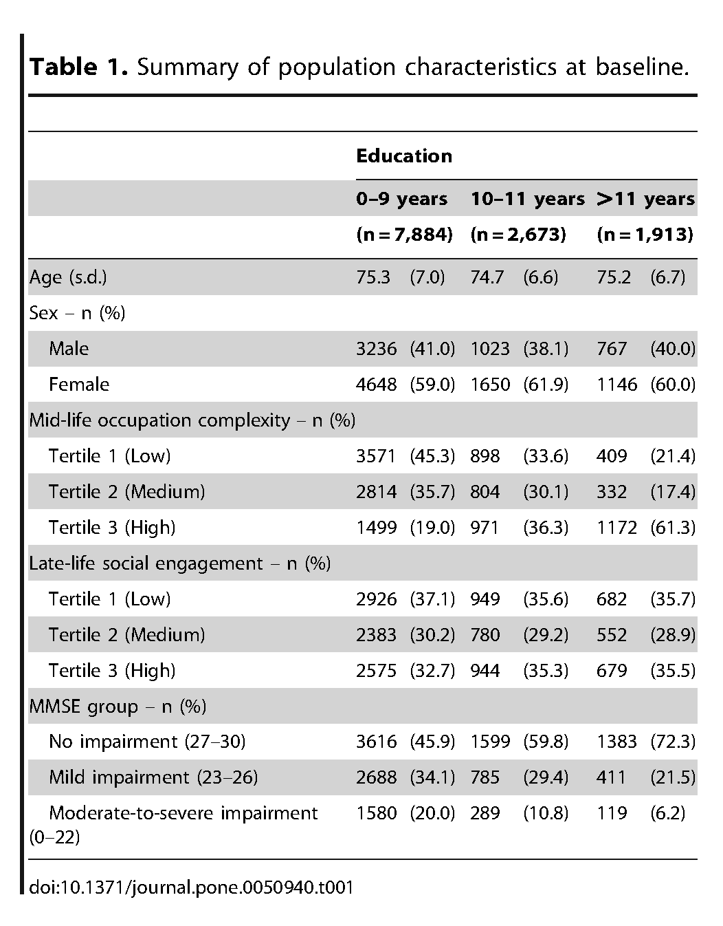
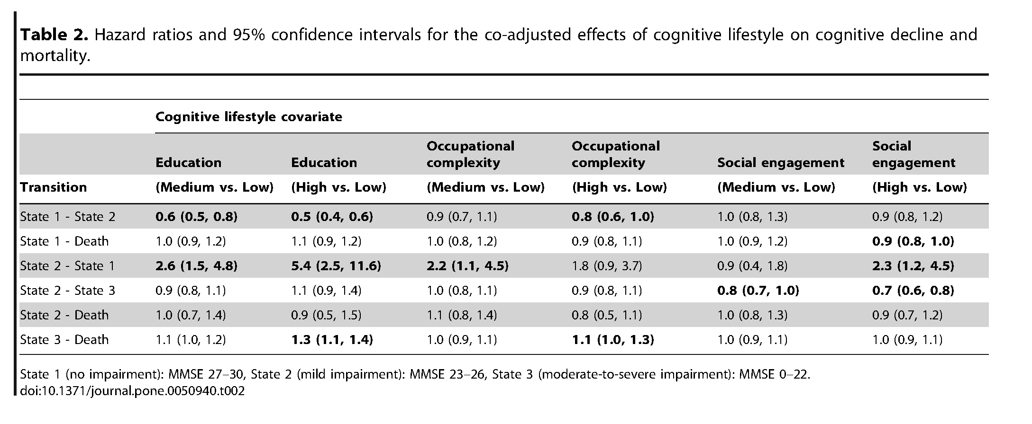
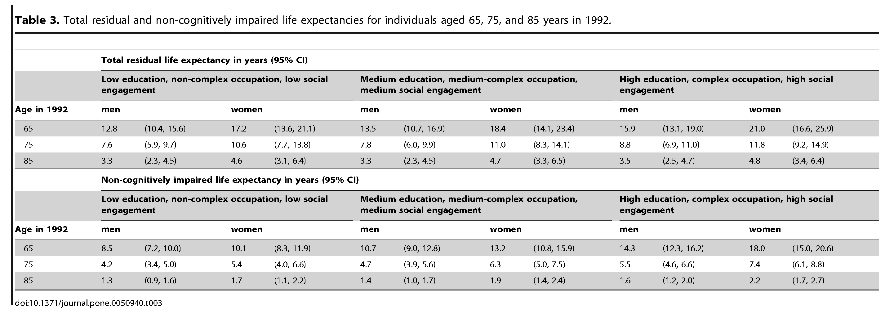

Slide 7
Project Plan

Slide 8
ialsa-2018-amsterdam
fgsf

Slide 9
greeter
tuner
encoder
validator
modeler
IALSA
Study
Curator
Ξ
+
MODEL
dto-0
dto-1
dto-2
dto-3
ds
raw
meta
greeted
tuned
encoded
missing
multistate
corrected
valid
estimation
PRODUCED
COMPONETNS

