Slide 1


Visual tools for big analyses:
Cross-study replication of bivariate growth models
Andriy Koval ( UVic)
Cassandra Brown (UVic)
William Beasley (OU)
CENTRE ON AGING COLLOQUIUM SERIES
Optimizing Aging & Health: Methods & Applications
13-October-2015

Slide 2
Sequence of speakers
The speakers will each address the following questions in their pairs ( approximate number of minutes in parenths)
Scott (5-7)
Big picture of Portland. Why many studies?
Andrey(10-15)
How can we organize the workflow?
Will (5-10)
How can we optimize the workflow?
Andrey(5-7)
What can we learn so far? 5D, BISER, Forrest
Cassandra (30-40)
How can we explore questions in this framework: varying wave count (RADC) study

Slide 4
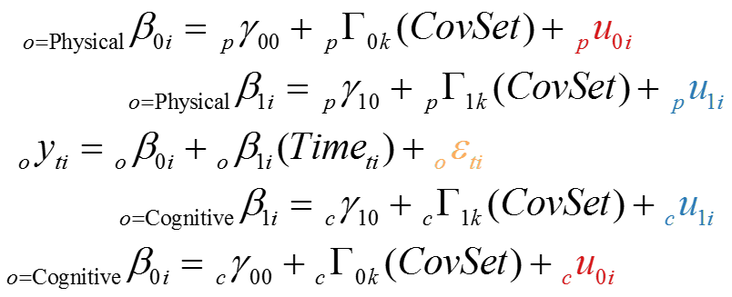
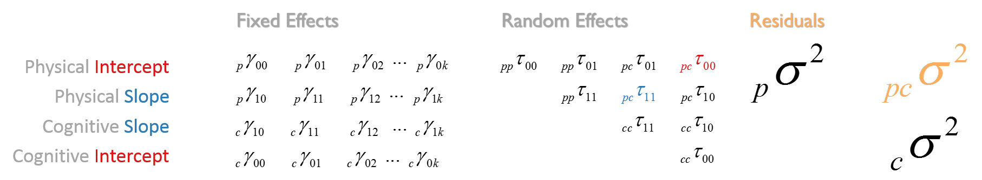

Slide 5
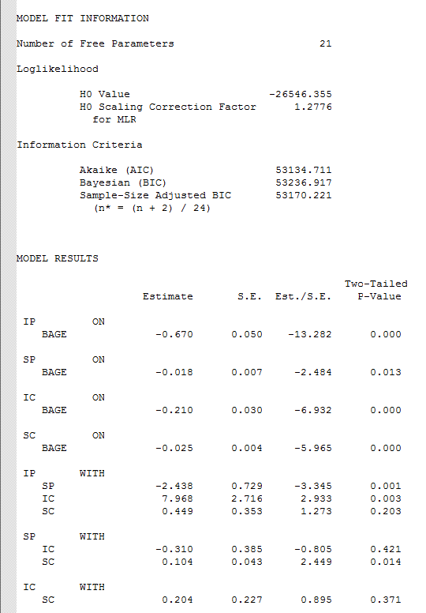

Slide 6
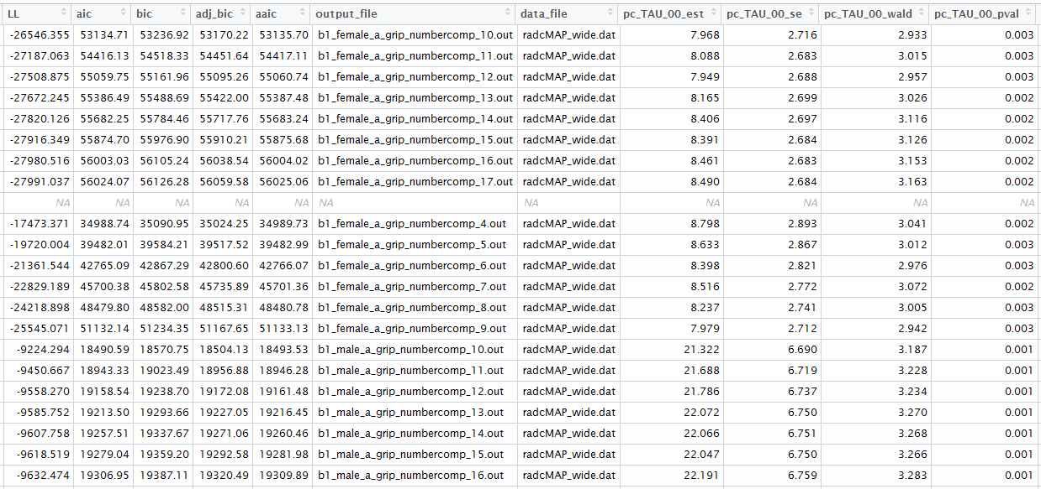

Slide 7
Exploratory Graphical Devices

Slide 8
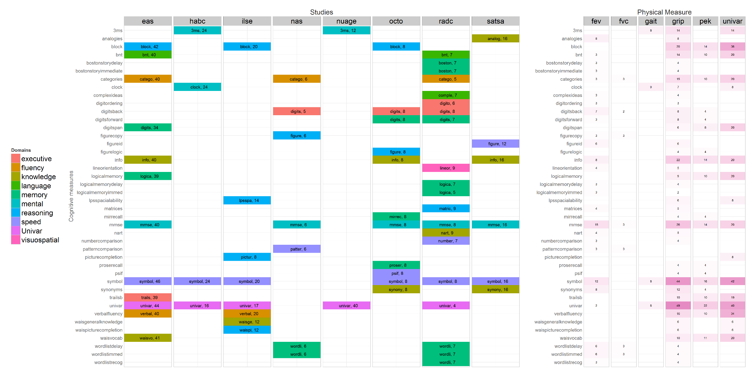

Slide 10
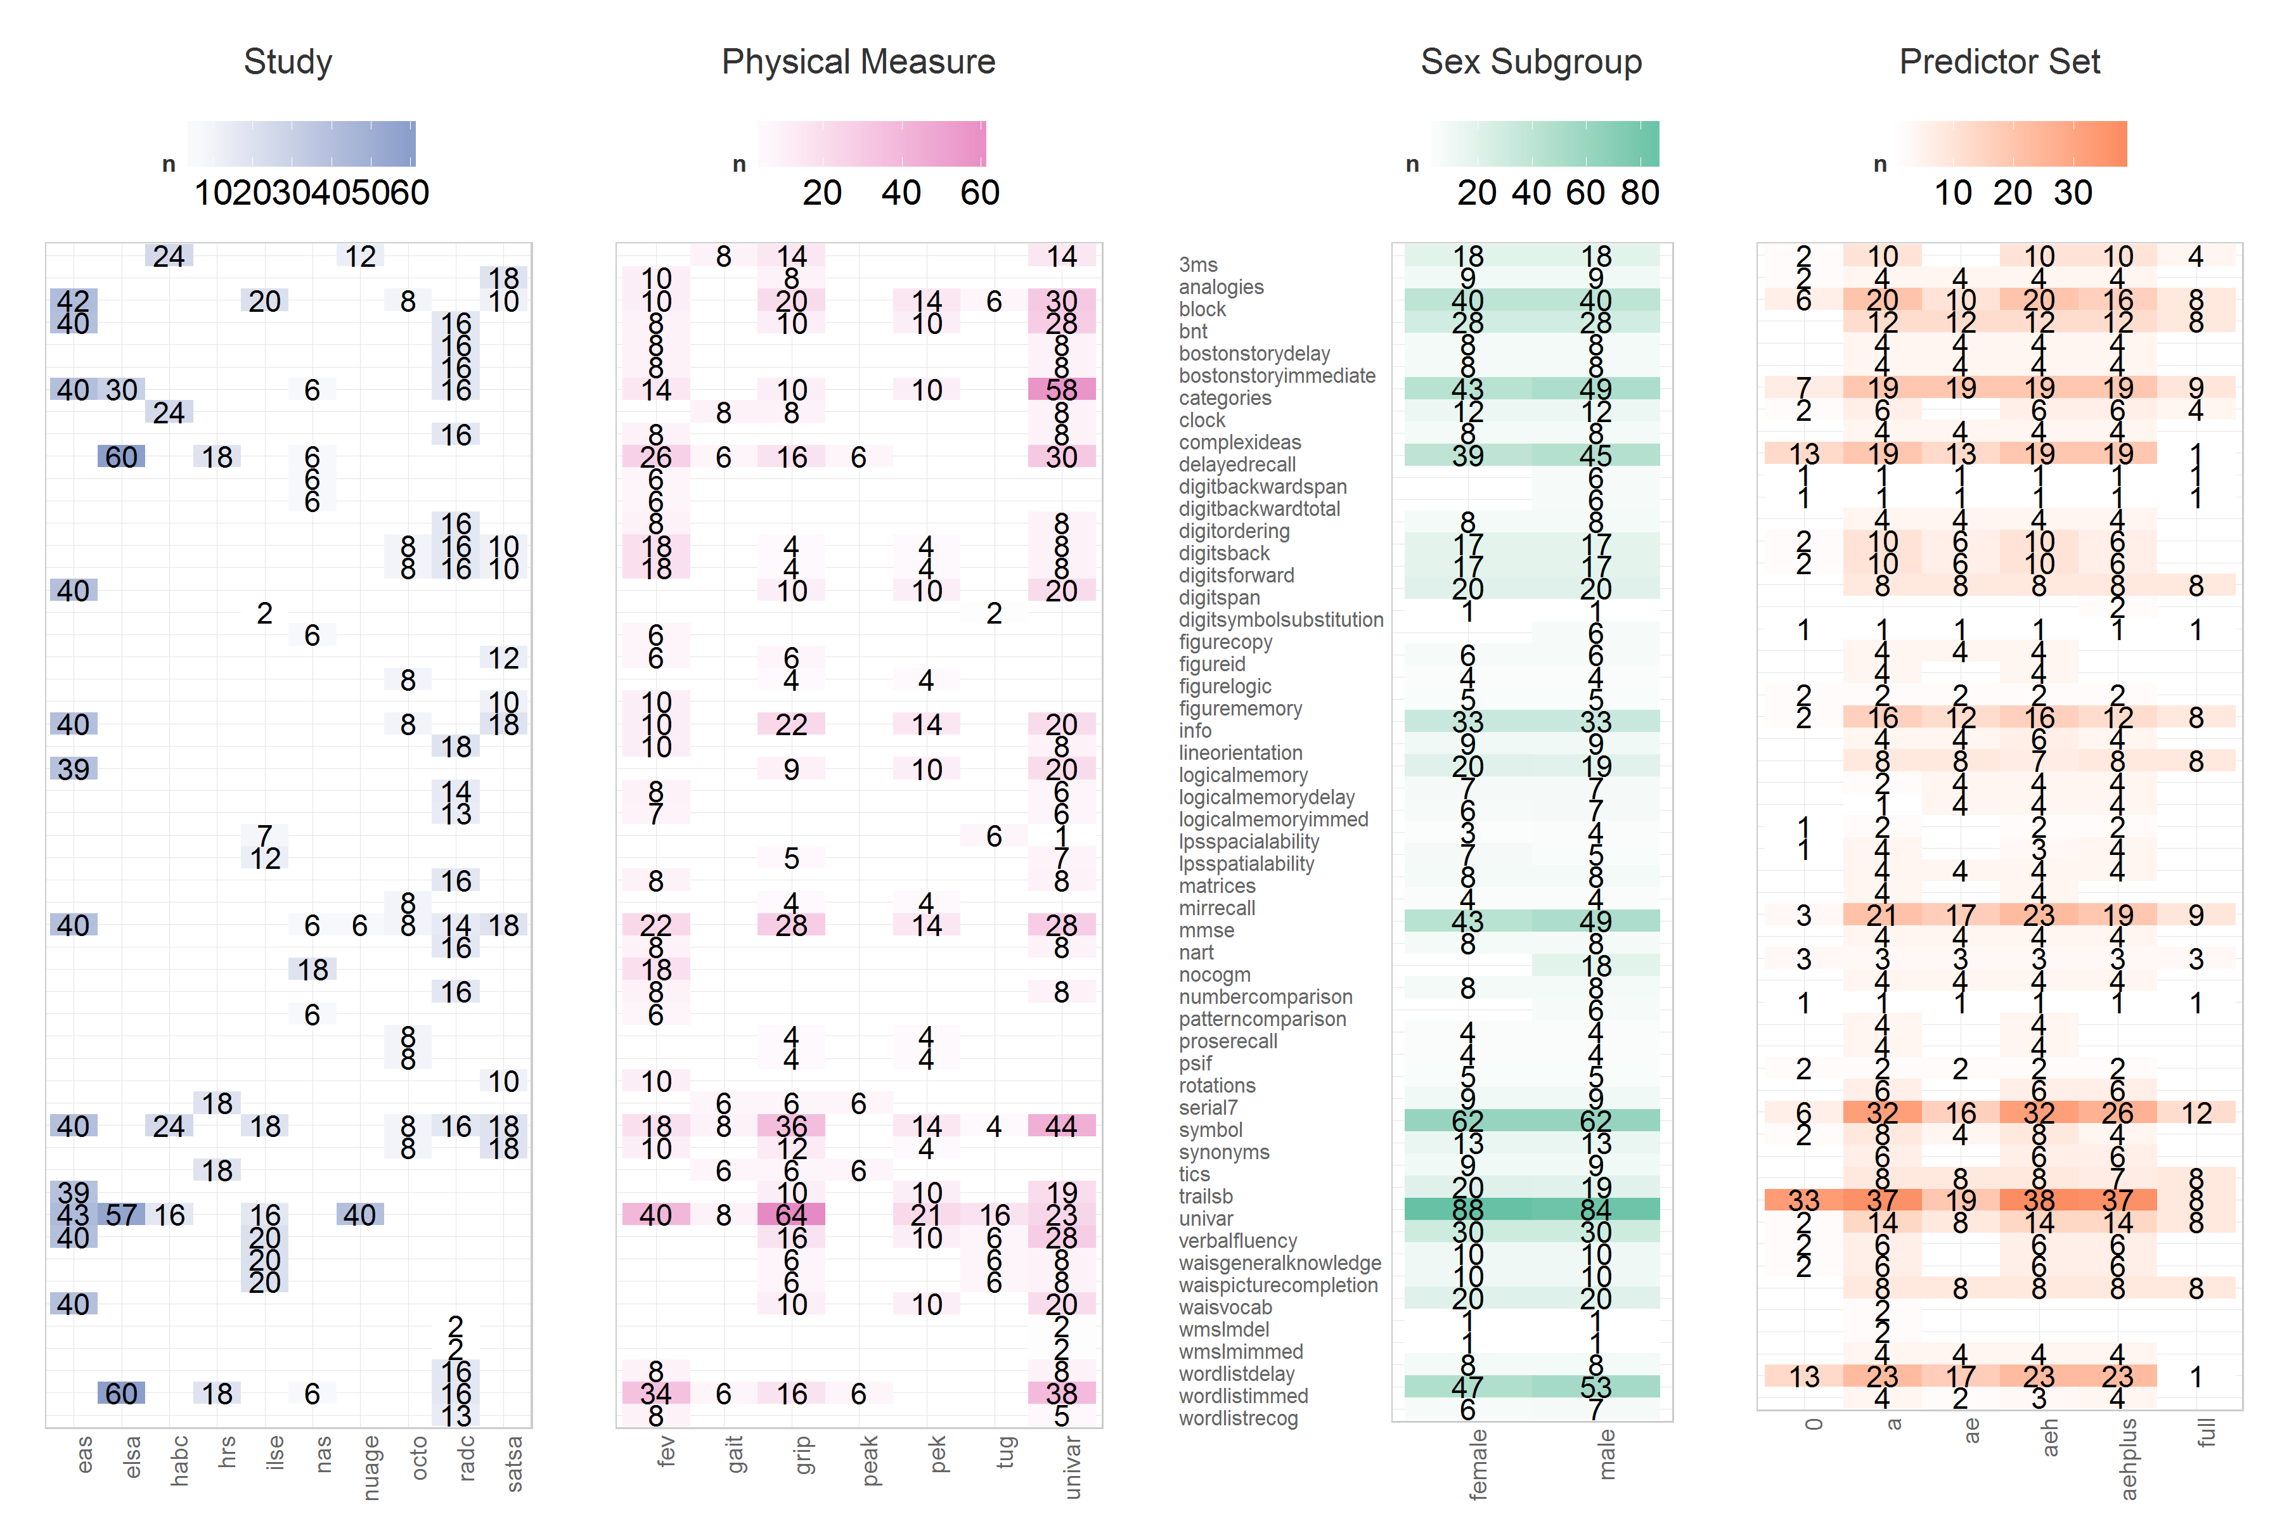

Slide 11
…
…
…
…
…
…
How can we optimize the workflow across studies?

Slide 12
…
…
…
…
…
…
Pre-Conference Survey
Catalog
IalsaSynthesis
Reports
Goal of these four steps: automate many menial tasks
Have more fun.
Produce fewer errors.
Complete faster.
Address more ambitious research questions.
Notes:
We start with many possibilities for analysis in each study, as each may contain unique set of measures.
PRECONFERENCE SURVEY collects information about the measures in each study
And enumerates a list of (bivariate) modes that humans will use to implement the objectives of the conference

Slide 13
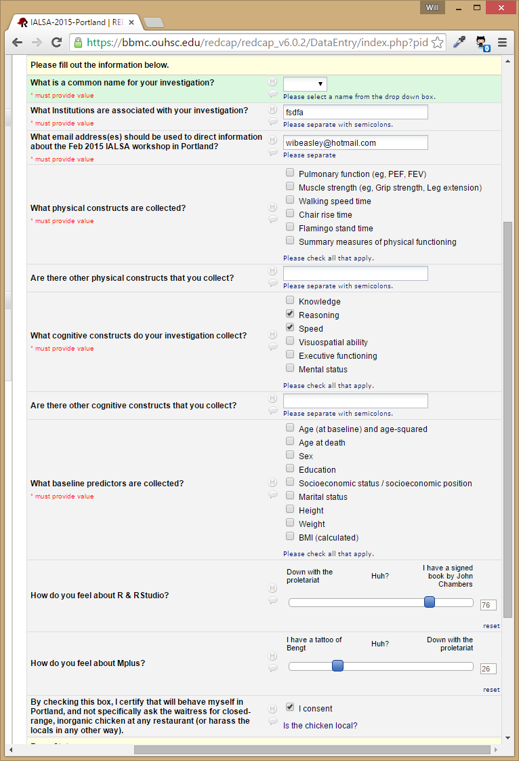
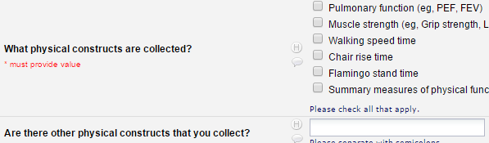
Pre-Conference Survey Example
Notes:
Each study responds with their available measures that could contribute to a meta-analysis. Here’s a pre-conference survey demo (with simplified items so it will fit on a page).

Slide 14
…
…
…
…
…
…
Pre-Conference Survey
Catalog
IalsaSynthesis
Reports
Notes:
REDCap prject,
Starts off as a to-do list for the modelers to follow, the roadmap of the conference
Develops into a collector of results

Slide 15
…
…
…
…
…
…
Pre-Conference Survey
Catalog
IalsaSynthesis
Reports

Slide 16
…
…
…
…
…
…
Pre-Conference Survey
Catalog
IalsaSynthesis
Reports
within
study
across
studies
A1
A2
progress
B1
B2
analysis
Example of A1, A2

Slide 17
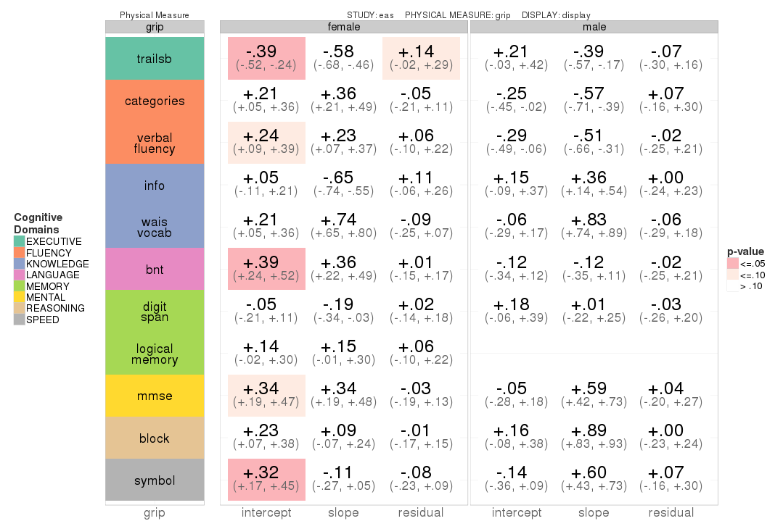

Slide 18
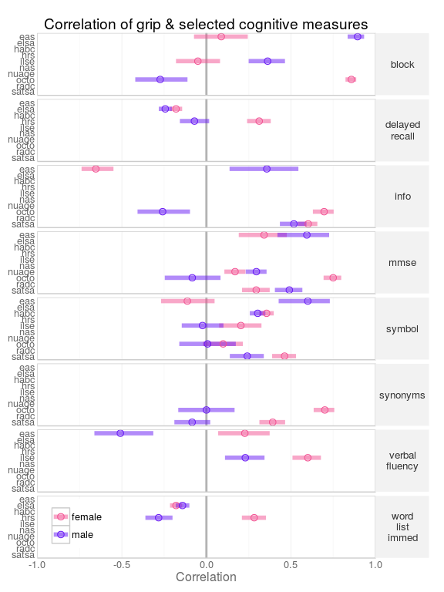

Slide 19
RADC: Extending wave counts
Rush MAP study
Began in 1997, rolling enrollment
Northeastern Illinois, residents of continuous care communities
Up to 17 waves of data, few people actually have this number
Decision about how many waves to include
Notes:
Working RUSH Memory and Aging Project study data as part an IALSA project examining concurrent change in measures of physical and cognitive ability over time. Because only one person actually had 17 years of data the models. Information is not available for all partipants at each wave

Slide 20
Participants
Follow up year
 | Women | Men
0 | 961 | 336
1 | 850 | 280
2 | 724 | 234
3 | 598 | 196
4 | 486 | 166
5 | 386 | 126
6 | 338 | 109
7 | 283 | 88
8 | 233 | 77
9 | 180 | 54
10 | 121 | 39
11 | 63 | 19
12 | 32 | 5
13 | 23 | 2
14 | 17 | 2
15 | 13 | 2
16 | 1 | 0
Notes:
The number of participants for whom the data is available at this time point.

Slide 21
Question
Do the number of waves included in the growth model impact the conclusions?
Examine cognitive and physical outcomes with increasing numbers of waves included
Notes:
Bivariate growth models simultaneously model trajectories for two dependent variables separately, but also allow the correlations between both intercept (baseline level) and slope parameters (change over time) of both variables to be examined.

Slide 22
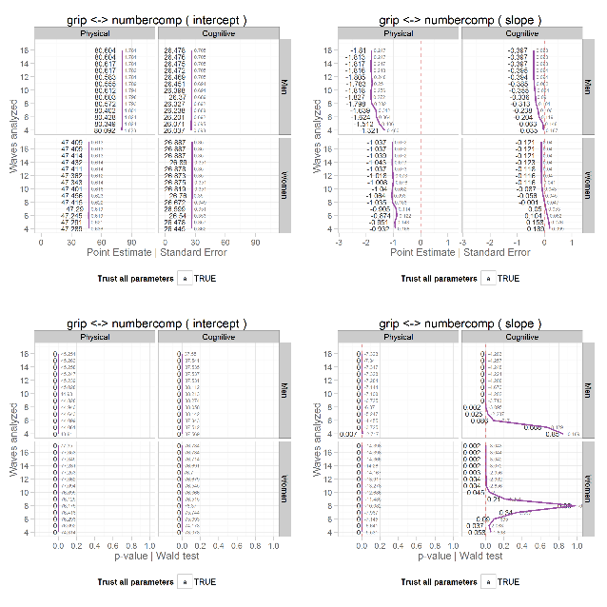
Plots
KB profiles
Left column: Intercepts (baseline)
Right column: Slope (rate of change)
Vertical facet: Gender
Horizontal facet: Outcome measures
X-axis: Numerical value
Y-axis: Waves included in analysis
Labels: Estimate|S.E.|Est./S.E. |P-Value

Slide 23
Intercepts
Intercepts show little change over the number of waves used in the analysis.
Across all outcome pairs this remains true
Intercepts are the baseline levels of the outcome measure
Fluctuations over the number of waves might indicate model misspecification

Slide 24
Grip-Category Fluency
Slope column, physical facet
Regardless of the number of waves analyzed we see a steady decline in grip strength for both sexes.
Women: The straight vertical purple line suggests a consistent rate of decline regardless of waves count included.
Men: The curvature of the line between wave count 4 and 8 hints at an accelerated rate of decline between those time points.
Notes:
Women: at a rate of about 1 unit decrease per unit of time (1 lbs of grip pressure per year).
Men: start a rate of decline of about 1.3 pounds per year, then this increases to almost 2 lbs loss of grip pressure per year.

Slide 25
Grip-Category Fluency
Slope column, significance row, cognitive facet
Slopes become significant once at least 9-10 waves are included
If we analyze fewer than 9 waves of data we fail to detect a significant decline in category fluency test performance.
Men require fewer waves (9) of data in the analysis to detect a significant decline than women (10).
Notes:
If we analyze fewer than 9 waves of data we fail to detect a significant decline in category fluency test performance.
However, category fluency shows a non-significant positive slope and then a non-significant negative slope until 9 waves of data are included for men and 10 waves of data are included for women. This also suggests that if you had 9 wave of data for men and women you would reach the conclusion that men are declining it category fluency performance but women are not over time, controlling for baseline age.

Slide 26
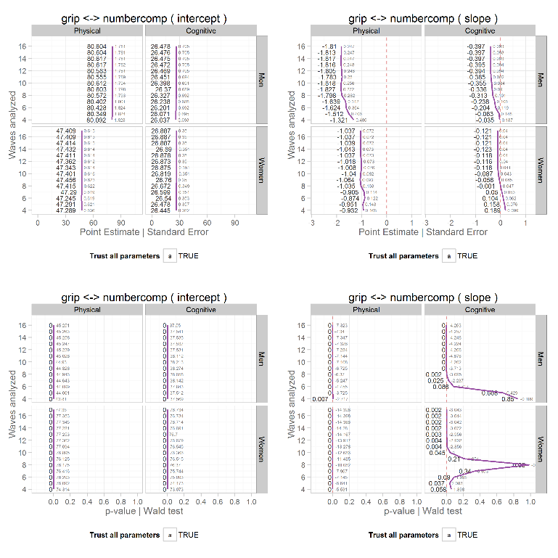
Grip-
Number Comparison
KB fans
Slope column, significance, cognitive facet
Men: We can detect a significant decline in number comparison task performance once at least 7 waves are included.
Women: Both positive (wave 5) and negative slopes (wave 9+) reached significance.
Notes:
Now we will move to a different album. Slopes were significant at

Slide 27
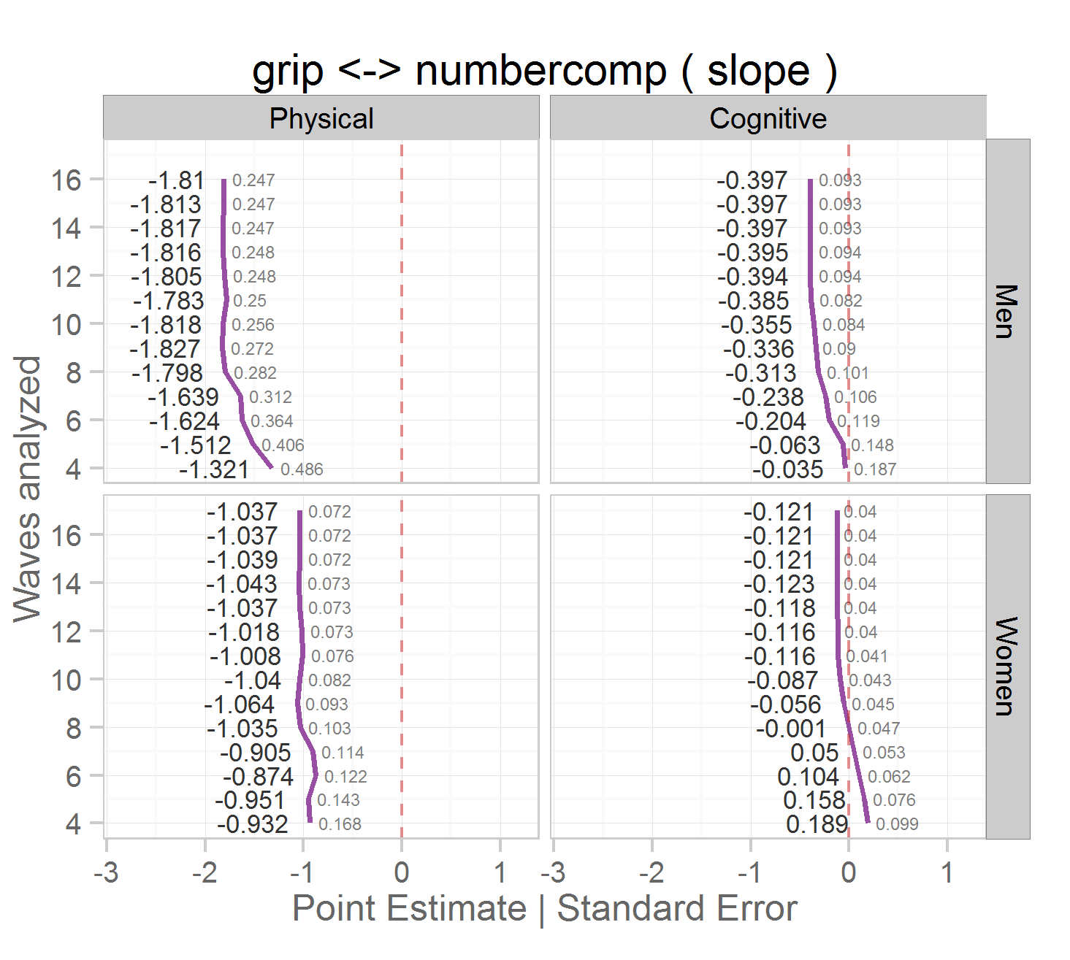
Grip-
Number Comparison
Zoom on top right cell
Facets: cognitive, women.
Changing signs of the slope suggests non-linearity in the observed data.
We explore the observed and modeled data in the next series of dynamic plots.
Notes:
Now we will move to a different album. For men the slope is negative regardless of the number of waves of data included but the decline in number comparison performance does not become significant until at least 7 waves are included.

Slide 28
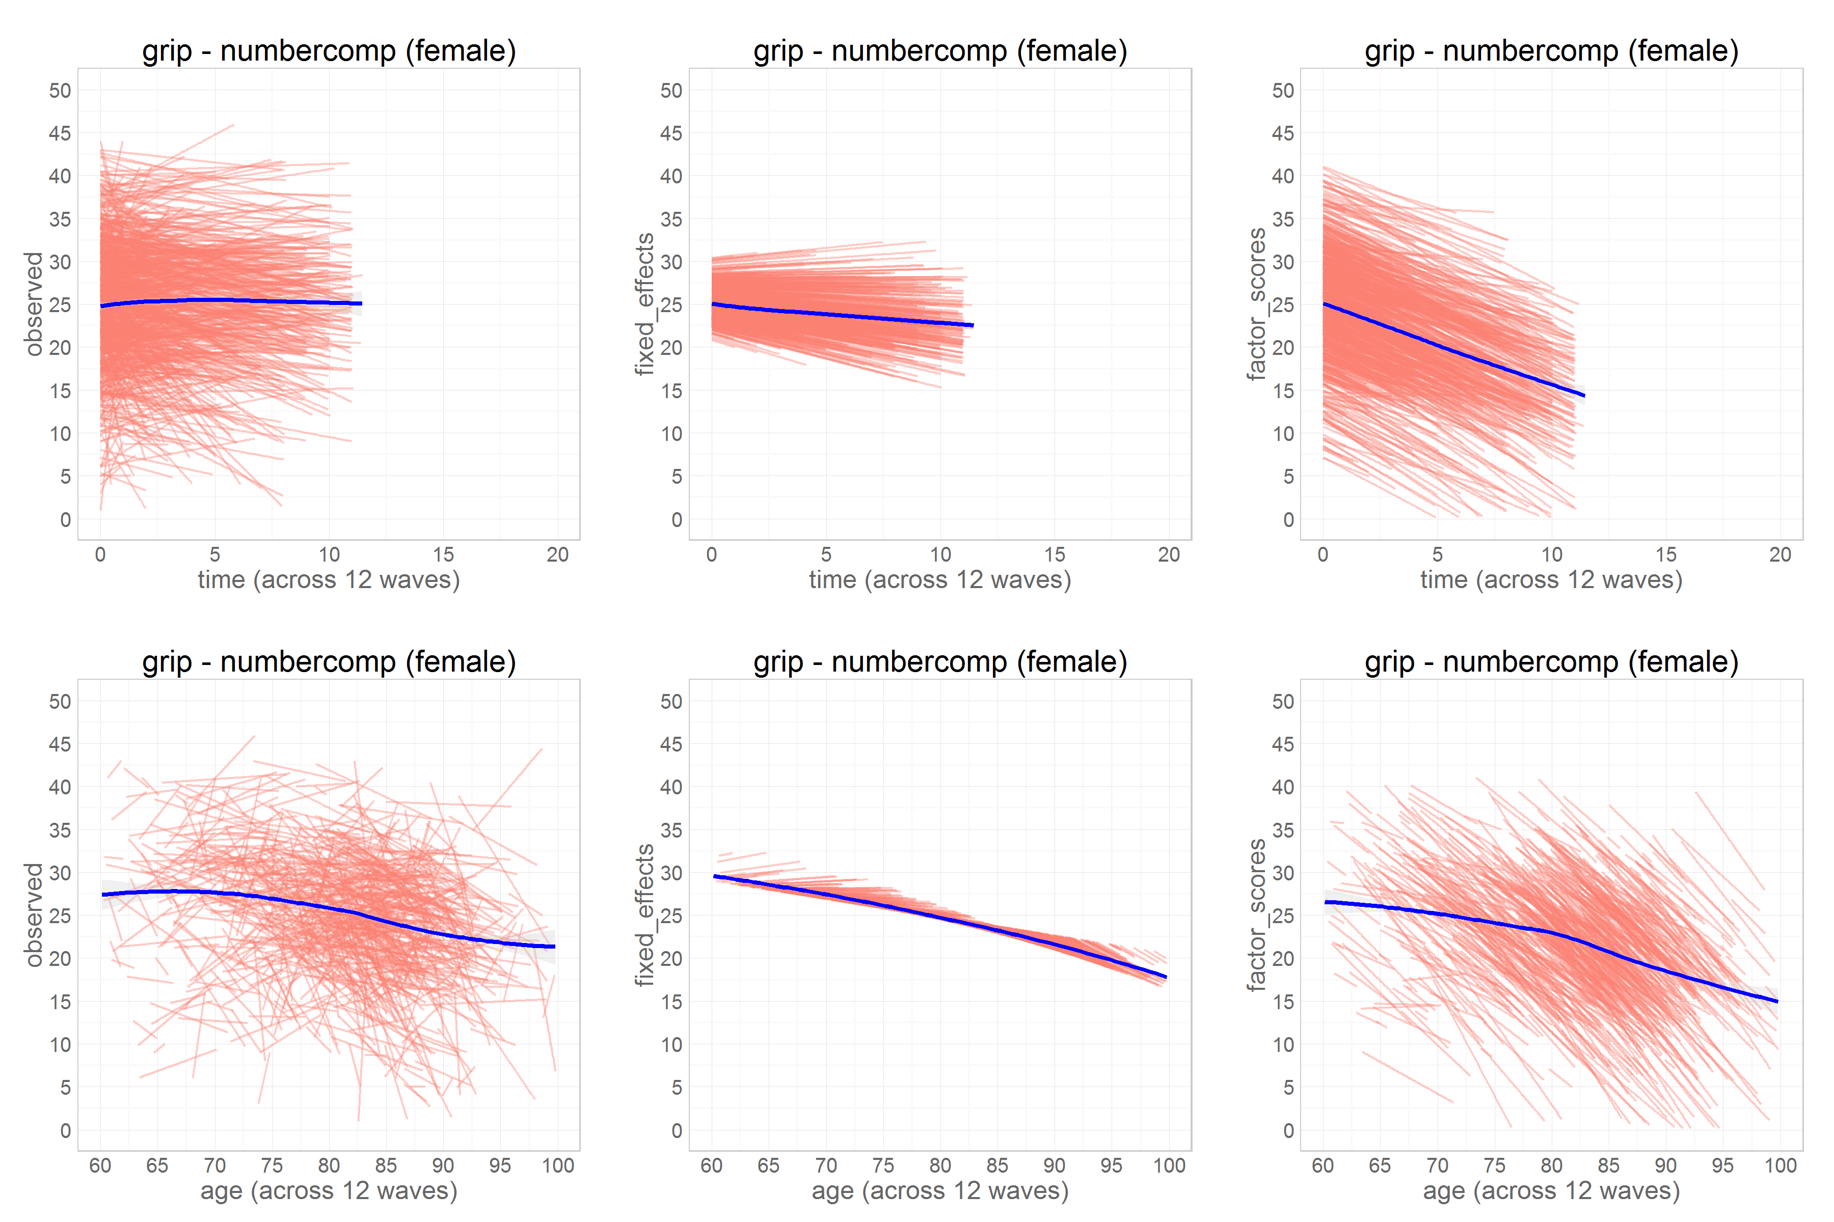
Kb Fans: grip-NUMBERCOMP
Red lines: trajectories of individuals across time.
Y-axis: performance on the number comparison task
X-axis: time metric
Top row: time in study*
Bottom row: biological age
Blue lines: smooth average
Notes:
Note that this is number comparison only.
*Time in study, controlling for baseline age was used in model estimate.

Slide 29
Kb Fans: grip-NUMBERCOMP
Left column: observed trajectories
Middle column: predicted trajectories reconstructed from the fixed effects (.out files) estimated by Mplus.
Right column: trajectories reconstructed from factor scores (gh5. file) created during model estimation in Mplus.
Notes:
Note that this is number comparison only.
*Time in study, controlling for baseline age was used in model estimate.
Predicted trajectories calculated from the Mplus *.out files containing the fixed effects (slope, intercept, the two coefficients of age on slope and intercept). These are predictions for every person of that age in the sample. If they have the same age and same time in study as another participant they would be predicted to have the same trajectory on this graph.
Right column: When we run the model the model spits out two things one of them is the .out file and the other is the .gh5 files. Now we are getting the gh5 file which retains the exact observations that are used in modeling and also contains things called factor scores because it considers each individual person as a factor. These are reported in the gh5. files. This is where we are a little unsure what we are talking about.

Slide 30
Kb Fans: grip-NUMBERCOMP
Left, age
The curvilinear shape of the trajectory is evident
Supports our hypothesis from Kb profile graph
Small increase in performance between ages and 60 and 65 likely represent practice effects
Decline begins ~67 yrs
Accelerates ~82 yrs
Notes:
Violation of the linearity assumption

Slide 31
Kb Fans: grip-NUMBERCOMP
Middle, age
The blue line (smoothed average) becomes steeper as more waves are included in the analysis.
It appears that women show a practice effect but decline sooner (~67)
Men do not show a practice effect but decline later (~80)
There are fewer men than women
Notes:
Hypothesis: Before 82 you can exhibit training effects or steady progression but around 82 the learning effect does not compensate for deterioration.
If we don’t observe participants for enough waves we see the learning effect of increasing number comparison performance but do not detect the decline.

Slide 32
Kb Fans: grip-NUMBERCOMP
Right
Trajectories reconstructed from the estimated factor scores (Mplus .gh5 file)

Slide 33
Questions/Discussion
Q1: What exactly do factor scores reconstruct?
Q2: At what wave count do trajectories become unreliable?

