Slide 1
Klepto
A game where resources are plentiful but you never can have enough
By Stephan Almisry

Slide 2
Genre Specifications
Klepto is a fighting game with platforming elements at its core, with resource gathering and crafting elements incorporated into the gameplay to enhance the player in their fighting experience.
The fighting style will be similar to the Super Smash Brothers series as well as TowerFall while the crafting elements will draw from games such as Spelunky

Slide 3
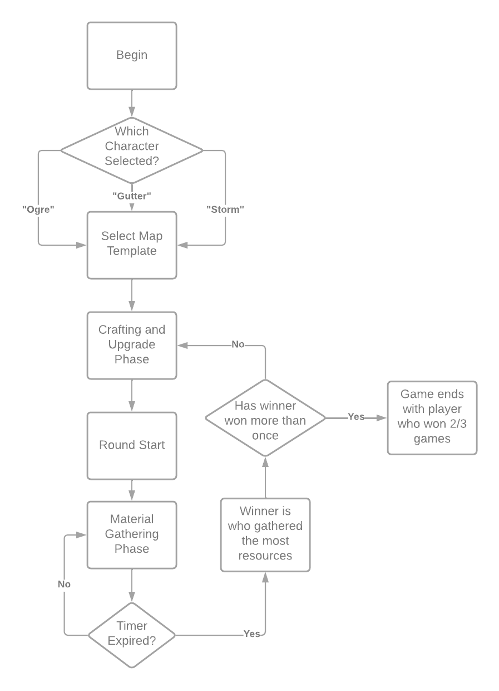
How the Gameplay Will Work
In Klepto, the player(s) will have three options at the start of the game to select which character they want to play. After selecting their choice, the players get some resources to start with to upgrade their characters. Once chosen, any remaining resources will be discarded, and the players will be placed in the same map to gather as many resources as possible while preventing the other player from doing so. The round ends once the time expires and the player who gathered the most resources will win for the round

Slide 4
Upgrade Phase
In this phase, players will use the resources that they have gathered in order to upgrade their characters as well as create new equipment to use against their foes or speed up their own gathering process.

Slide 5
Resource Gathering Phase
In this phase, players will be placed in similar but separate maps (this may be changed later) to gather resources. Each character will have different gathering rates in tandem with their speed characteristic as well as their weight specifications.
I.E: Speedy characters can gather fast but at a low rate since they are light while heavy characters gather slow but at a high rate
Players can use their attacks or special equipment to help themselves or hinder the opponent during this phase. If the health of the player is reduced to 0, they leave their materials they gathered behind and go back to camp

