Slide 1
Monster Farmer Project

Slide 2
Overview
Genre: RPG, Simulation, Farming
Inspiration: Pokemon, Ooblets
Main Mechanic: Taking care of monsters that will battle each other Pokemon-style with moves (maybe types?).
Why you want to win: The player will be investing time and emotional labor (if they get attached) into their monsters so they will want them to do well in battle.

Slide 3
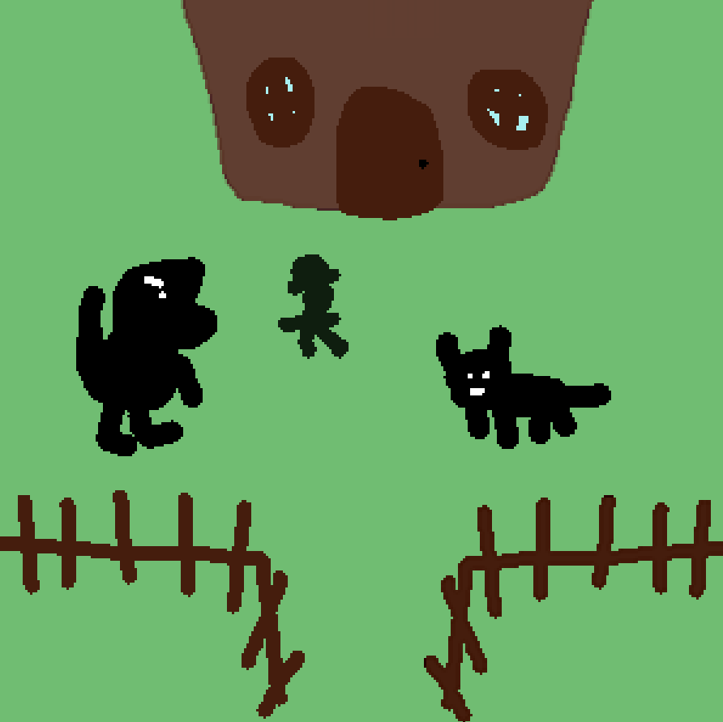
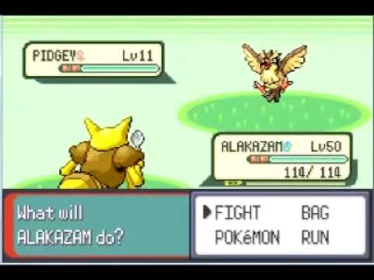
Visual Samples

Slide 4
Gameplay Flowchart
Farming Aspect:
Battling Aspect:
Player Battles Another Farmer
Player Chooses a Move to Use
Feed and Care for Monster
Monster Gains Battle Stats from Care
Process Continues Until Player Wins or Loses
Move is Used
Monster Sleeps to Recover Energy
Other Monster’s Move is Used

Slide 5
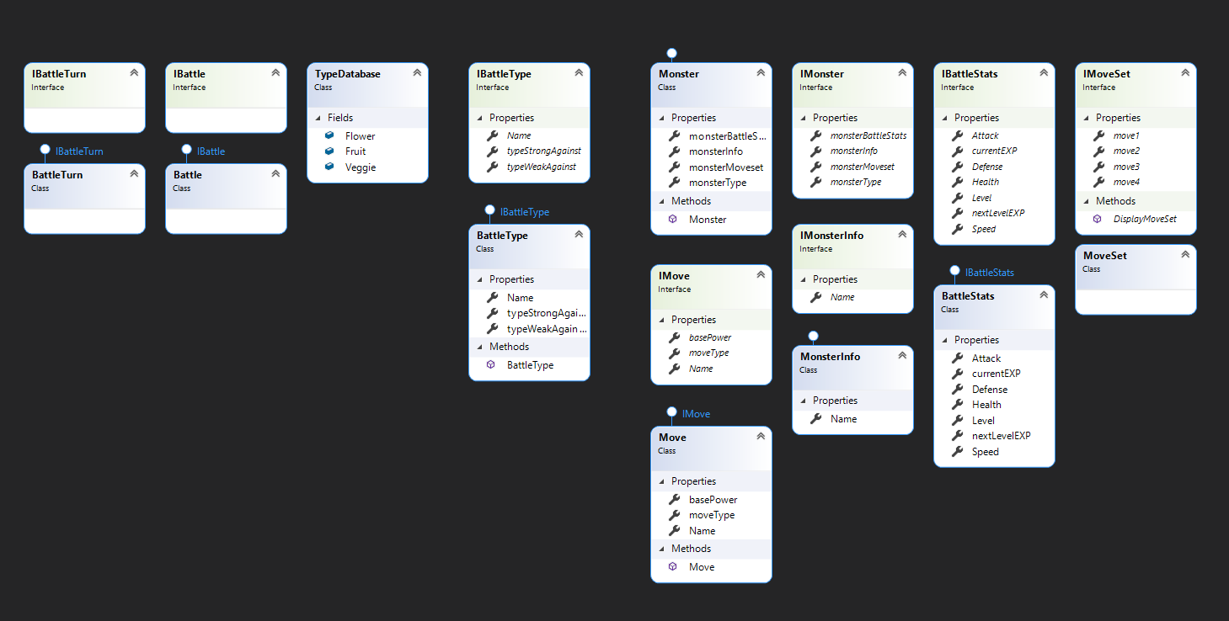
In-Progress UML (Mainly for Battling)
Things to think about:
Battle being a do while
loop until someone wins?
How will turn-based
combat work? Will it be like normal pokemon (mons take turns attacking) or something different?
Will monsters gain battle stats from farming and battling? How do I not make the player feel like neither part of the game is useless/ less fun?

