Slide 1
Tactical RPG Project

Slide 2
Overview
Genre: RPG, Strategy
Inspiration: Fire Emblem, Advance Wars
Main Mechanic: Selecting units on grid and having them move to fight enemies
Why you want to win: The player will feel accomplished by making the best decisions with their units in terms of positioning and attacking.

Slide 3
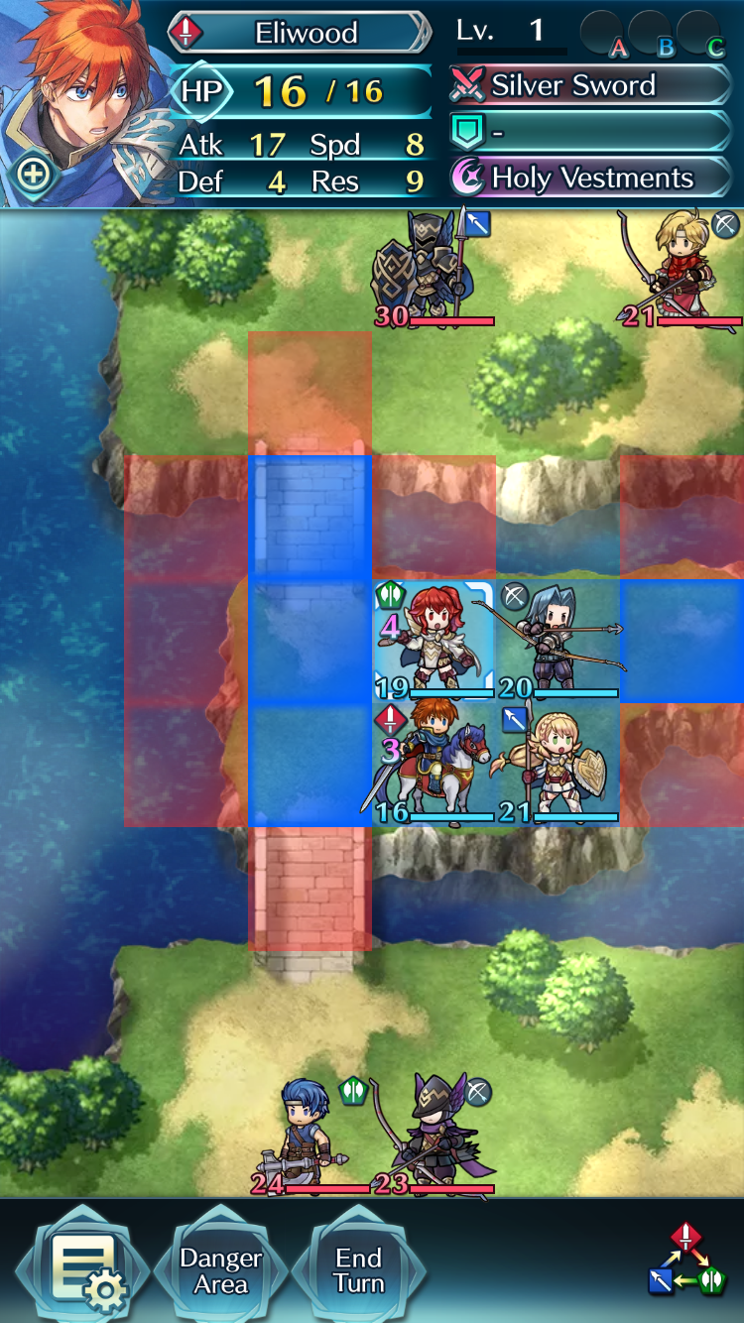
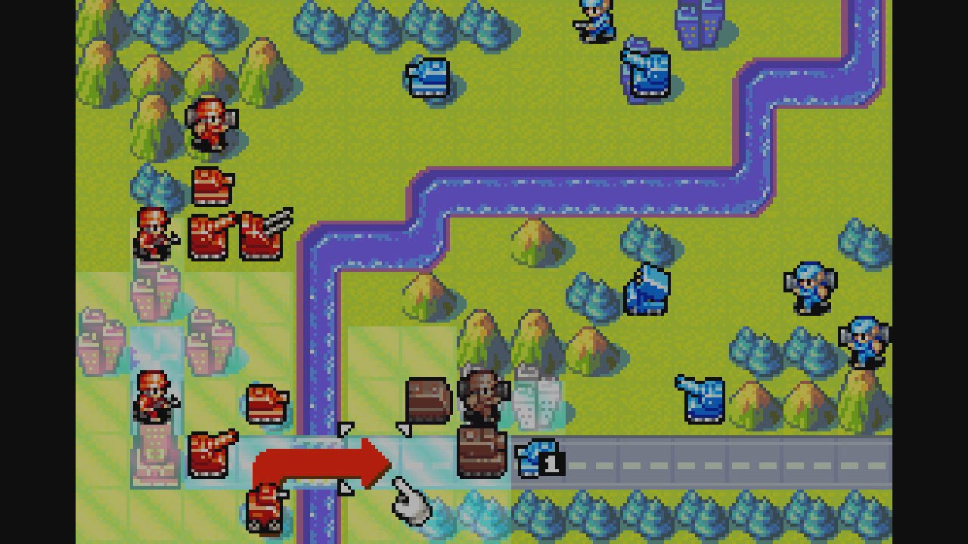
Visual Samples (Inspiration Games):

Slide 4
Gameplay Flowchart
Player Turn:
Enemy Turn:
Move Unit to New Spot
AI Moves Unit to New Spot
Select Unit
AI Selects Unit
Unit Attacks Enemy Unit (if possible)
Unit Attacks Player Unit (if possible)
Turns continue until either player or enemy has no more units left

