Slide 1
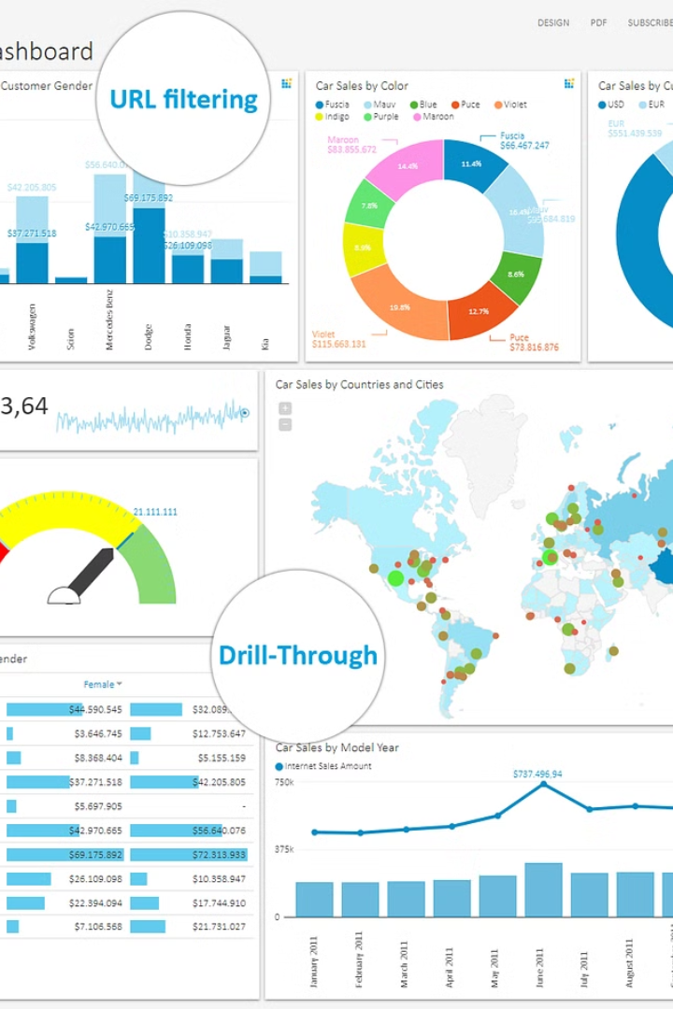
Employee Attrition and Performance Dashboard
This dashboard provides a comprehensive overview of employee attrition and performance metrics. It enables organizations to identify trends, spot problem areas, and make informed decisions to improve employee retention and productivity.
by Jayent Singh Parihar

Slide 2

Introduction
1
Understand Attrition Drivers
2
Monitor Performance Indicators
Analyze factors contributing to employee turnover, such as job satisfaction, work-life balance, and career growth opportunities.
Track key metrics like productivity, sales, and customer satisfaction to identify high-performing and underperforming teams.
3
Enable Data-Driven Decisions
Leverage the insights from the dashboard to make informed decisions and implement effective employee retention strategies.

Slide 3
Problem Statement
High Attrition Rates
Uneven Performance
Organizations face challenges with high employee turnover, leading to increased hiring and training costs, as well as disruptions in operations.
Some teams or departments may be underperforming, while others excel, making it difficult to optimize overall organizational efficiency.
Lack of Visibility
Strategic Decisions
Limited access to comprehensive employee data and analytics can hinder the ability to identify root causes and implement effective solutions.
Executives and HR leaders require a centralized platform to make data-driven decisions and implement targeted employee retention and performance improvement initiatives.

Slide 4
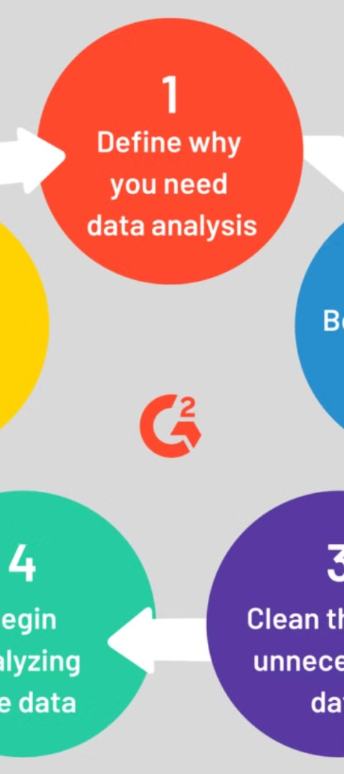
Approach
1
Data Collection
Gather relevant employee data from various sources, including HR records, performance reviews, and exit interviews.
2
Data Cleaning & Integration
Clean and consolidate the data to ensure consistency and accuracy, creating a unified dataset for analysis.
3
Exploratory Data Analysis
Analyze the data to identify patterns, trends, and correlations that can provide insights into employee attrition and performance.

Slide 5
Architecture
Data Sources
Data Processing
Analytics and Visualization
Integrate data from HR systems, performance management tools, and other relevant sources to create a comprehensive view of employee information.
Leverage data warehousing and ETL processes to ensure data quality, consistency, and accessibility for analysis.
Employ advanced analytics techniques and interactive dashboards to provide actionable insights and facilitate data-driven decision-making.

Slide 6
Exploratory Data Analysis (EDA) Report
1
Identify Attrition Hotspots
2
Detect Performance Trends
Analyze employee turnover rates across different departments, job roles, and demographic factors to pinpoint areas of concern.
Evaluate metrics like sales figures, customer satisfaction, and team productivity to recognize high-performing and underperforming teams.
3
Uncover Correlations
4
Recommend Interventions
Investigate potential relationships between employee attributes, job characteristics, and attrition or performance patterns.
Based on the insights from the EDA, propose targeted strategies to address employee retention and performance improvement opportunities.

Slide 7
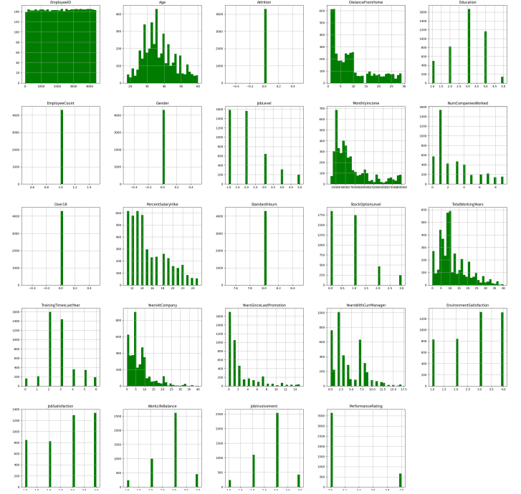
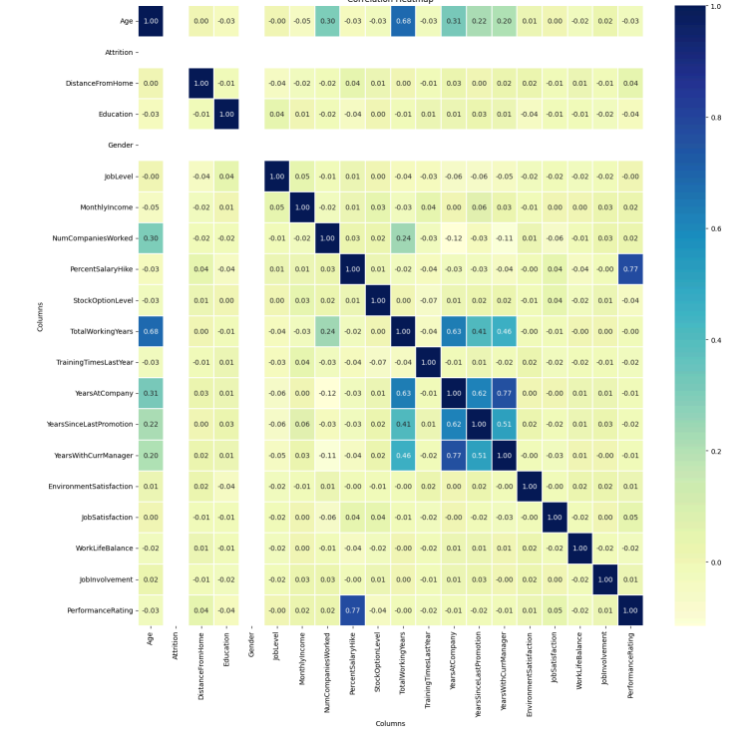
Exploratory Data Analysis (EDA) Report

Slide 8
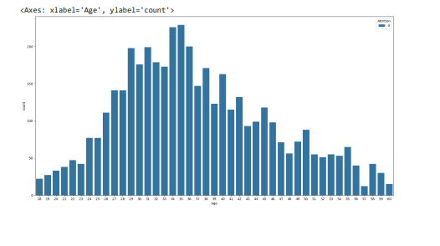
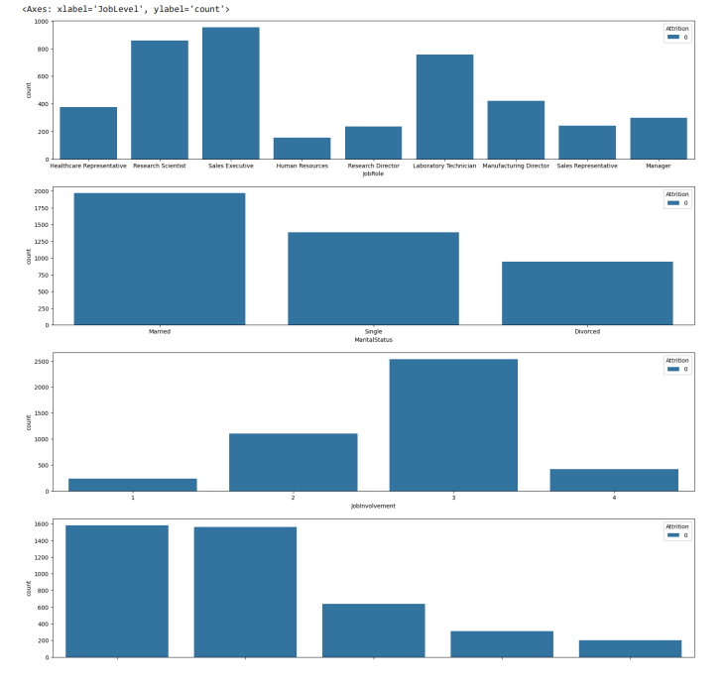
Exploratory Data Analysis (EDA) Report

Slide 9
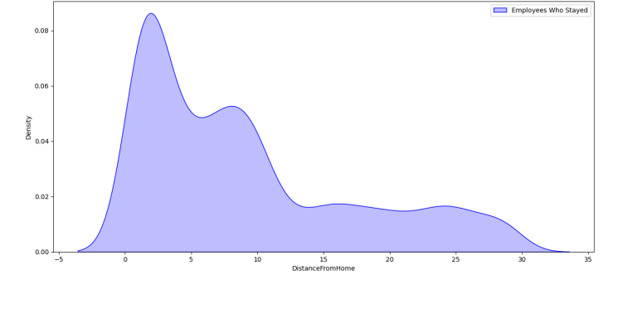
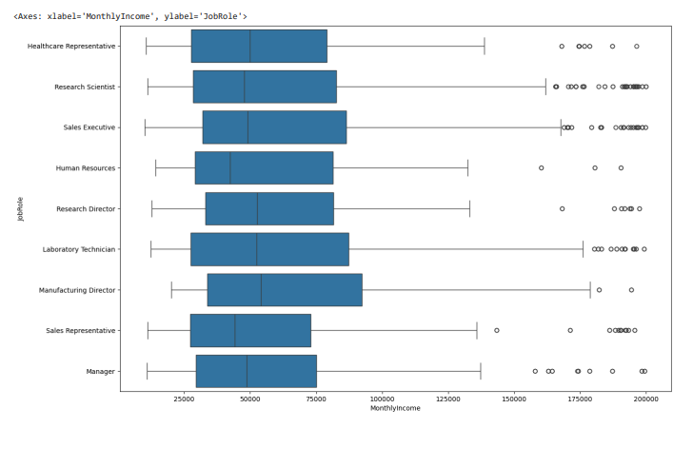
Exploratory Data Analysis (EDA) Report

Slide 10




Dashboard
Attrition Metrics
Performance Tracking
Workforce Insights
Retention Strategies
Monitor employee turnover rates, reasons for leaving, and other key attrition indicators.
Analyze productivity, sales, customer satisfaction, and other performance metrics by team and individual.
Gain visibility into employee demographics, tenure, promotions, and other relevant workforce data.
Develop and track the effectiveness of employee engagement, development, and recognition initiatives.

Slide 11
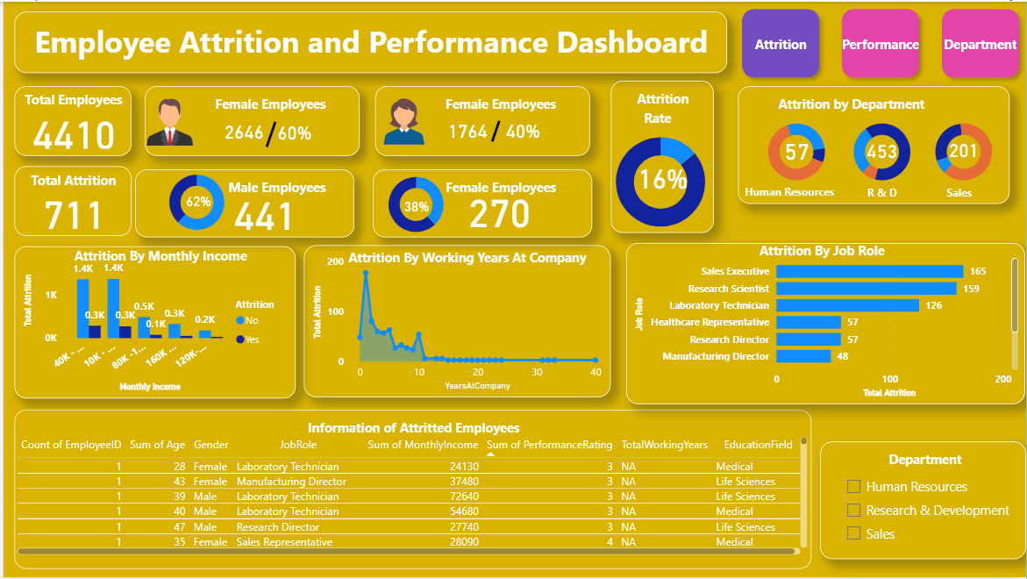
Dashboard

Slide 12
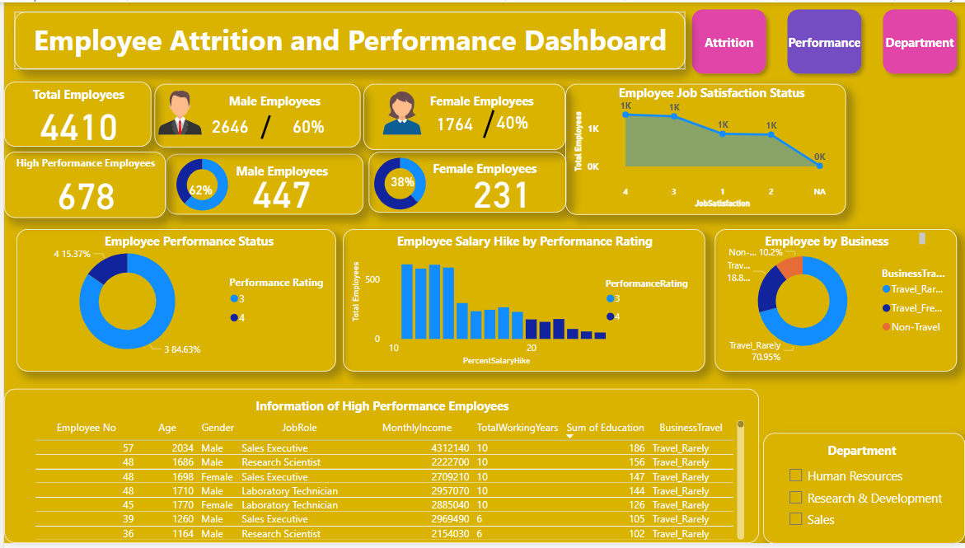
Dashboard

Slide 13
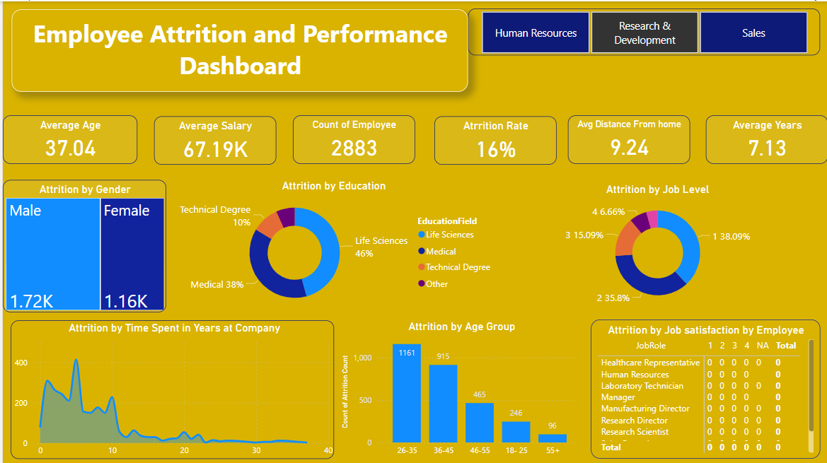
Dashboard

Slide 14

THANK YOU

