Slide 1
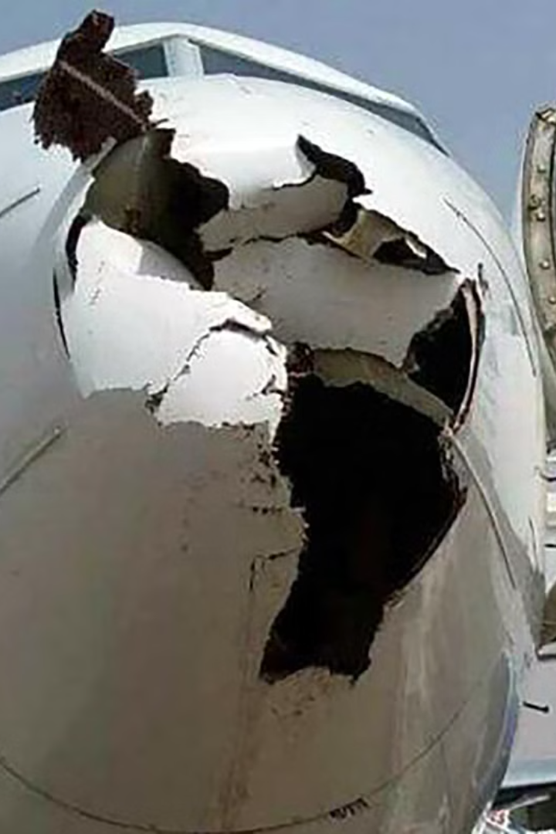

Data Visualization of Bird Strikes between 2000 – 2011
Bird strikes pose a significant threat to aviation safety worldwide. This presentation will explore the causes, impacts, and potential solutions to the growing problem of bird strikes on aircraft operations.
by Jayent Singh Parihar

Slide 2
Introduction to Bird Strikes
Bird strikes pose a significant risk to aviation safety worldwide, with the potential to cause damage to aircraft and endanger passengers and crew. Understanding the patterns and trends of bird strikes is crucial for aviation authorities, airports, and airlines to implement effective preventive measures and mitigate risks.
In this analysis, we delve into the data of bird strikes that occurred between 2000 and 2011, aiming to uncover insights and trends that can inform decision-making and improve aviation safety protocols. By visualizing the data, we seek to identify key patterns, such as seasonal variations, geographical hotspots, and aircraft types most prone to bird strikes.
The period from 2000 to 2011 was chosen for analysis as it provides a substantial timeframe to capture long-term trends while allowing for a comprehensive examination of bird strike incidents. The dataset encompasses a wide range of information, including the date and location of each incident, the type of aircraft involved, and the species of birds encountered.
Through data visualization techniques, we aim to provide stakeholders in the aviation industry with actionable insights to enhance bird strike prevention strategies, allocate resources effectively, and ultimately ensure the safety of air travel for passengers and crew. By understanding the dynamics of bird strikes during this period, we can better prepare for future challenges and contribute to the ongoing efforts to improve aviation safety worldwide.
by Jayent Singh Parihar

Slide 3
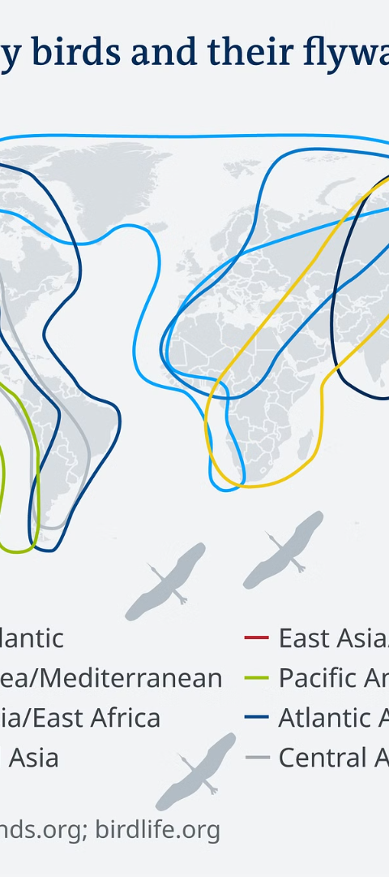
Problem Statement
1
Increasing Occurrences
2
Safety Risks
Bird strike incidents have been on the rise due to factors like expanding bird populations and increased air traffic.
Bird strikes can cause substantial damage to aircraft, leading to aborted take-offs, emergency landings, and in severe cases, loss of life.
3
Economic Impacts
The aviation industry incurs significant costs each year in repairs, flight delays, and other expenses due to bird strike events.

Slide 4
Approach
Data Collection
1
Gather comprehensive data on bird strike incidents from various aviation authorities and databases.
2
Data Preprocessing
Clean, standardize, and integrate the data to ensure consistency and quality for analysis.
Exploratory Analysis
3
Conduct in-depth exploration of the data to identify patterns, trends, and key factors contributing to bird strikes.

Slide 5

Structure of Dataset
The dataset records include information about aircraft types, altitude, bird strike incidents, flight dates, and aircraft damage indications, along with specific details such as the number of engines, airline/operators, and the phase of flight.
Additionally, it encompasses environmental conditions, effects on flight, costs, altitude, injuries, and the size and species of wildlife involved in the incidents.

Slide 6
Architecture
Data Ingestion
Data Processing
Analytics and Insights
Integrate bird strike data from multiple sources into a centralized data lake.
Clean, transform, and enrich the data using advanced data engineering techniques.
Leverage machine learning and statistical modeling to uncover patterns and insights from the data.

Slide 7
Exploratory Data Analysis (EDA) Report
The EDA report delves into the historical trends and patterns of bird strike incidents between 2000 and 2011, providing valuable insights to aviation authorities and airport operators.

Slide 8
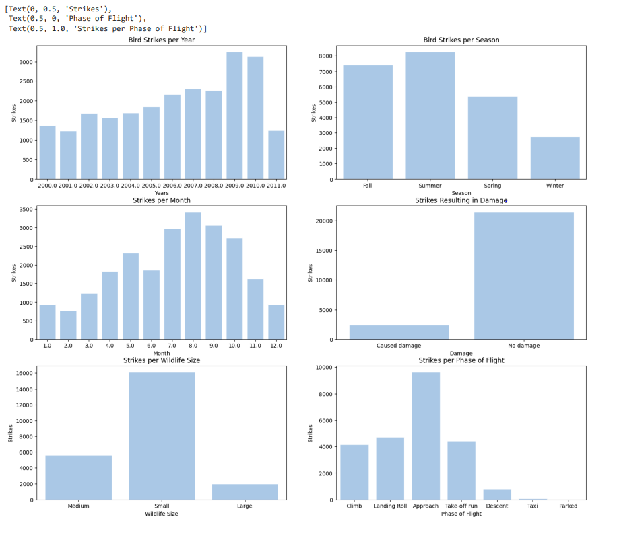
Exploratory Data Analysis (EDA) Report

Slide 9
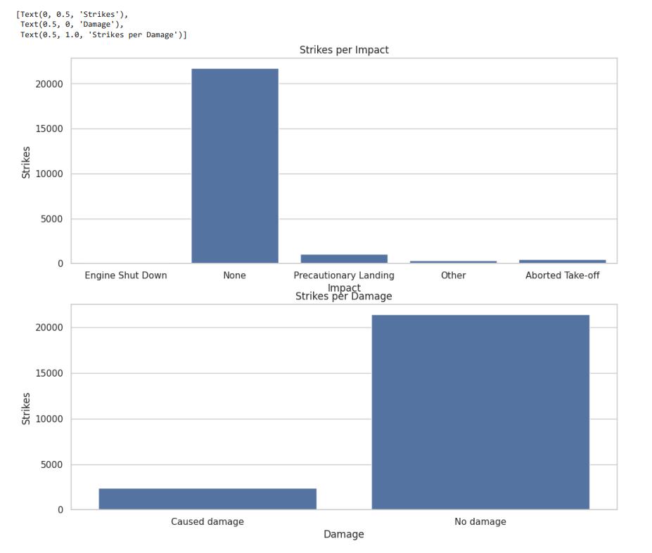
Exploratory Data Analysis (EDA) Report

Slide 10
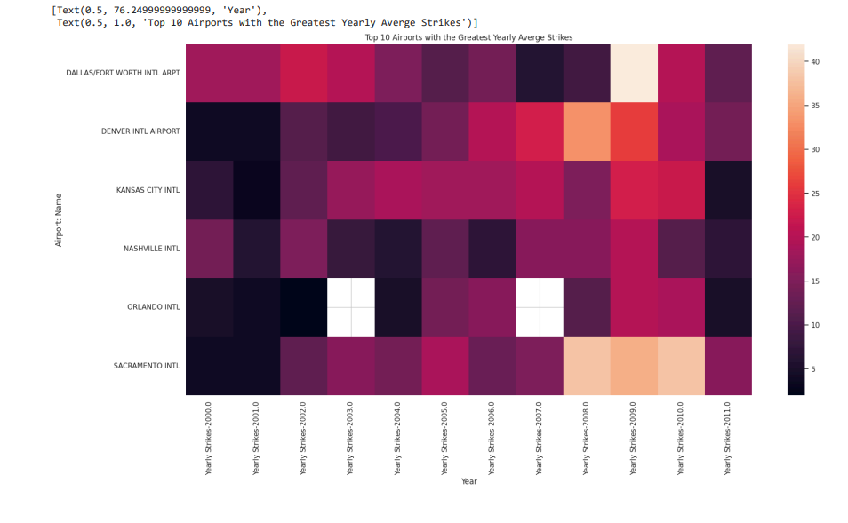
Exploratory Data Analysis (EDA) Report

Slide 11
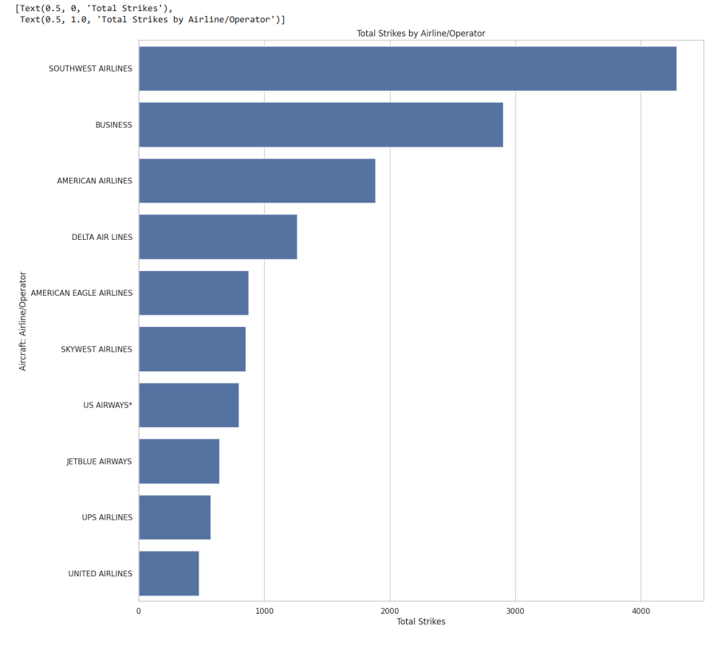
Exploratory Data Analysis (EDA) Report

Slide 12
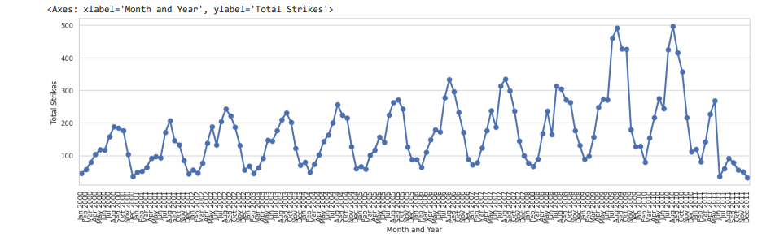
Exploratory Data Analysis (EDA) Report

Slide 13
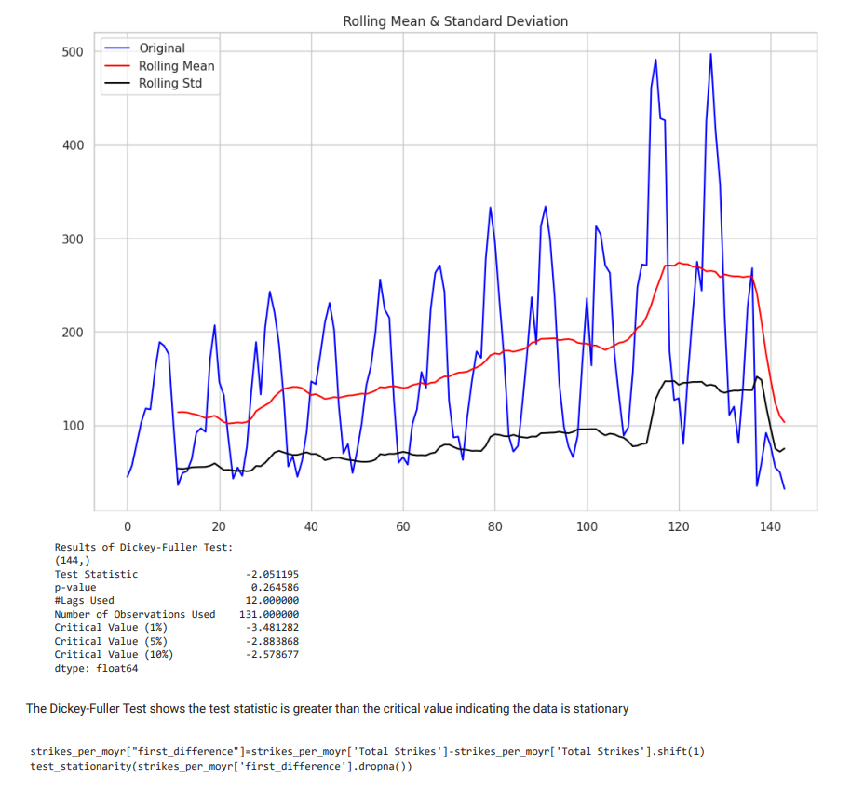
Exploratory Data Analysis (EDA) Report

Slide 14
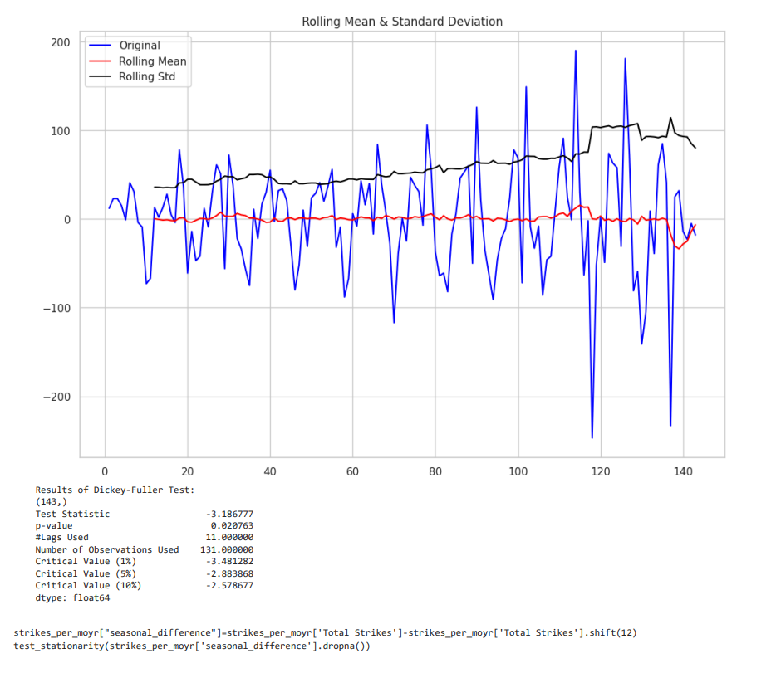
Exploratory Data Analysis (EDA) Report

Slide 15
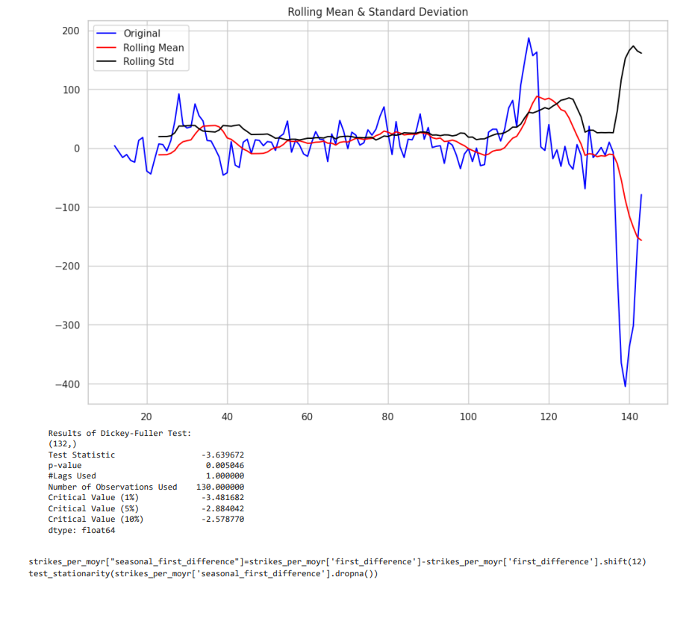
Exploratory Data Analysis (EDA) Report

Slide 16
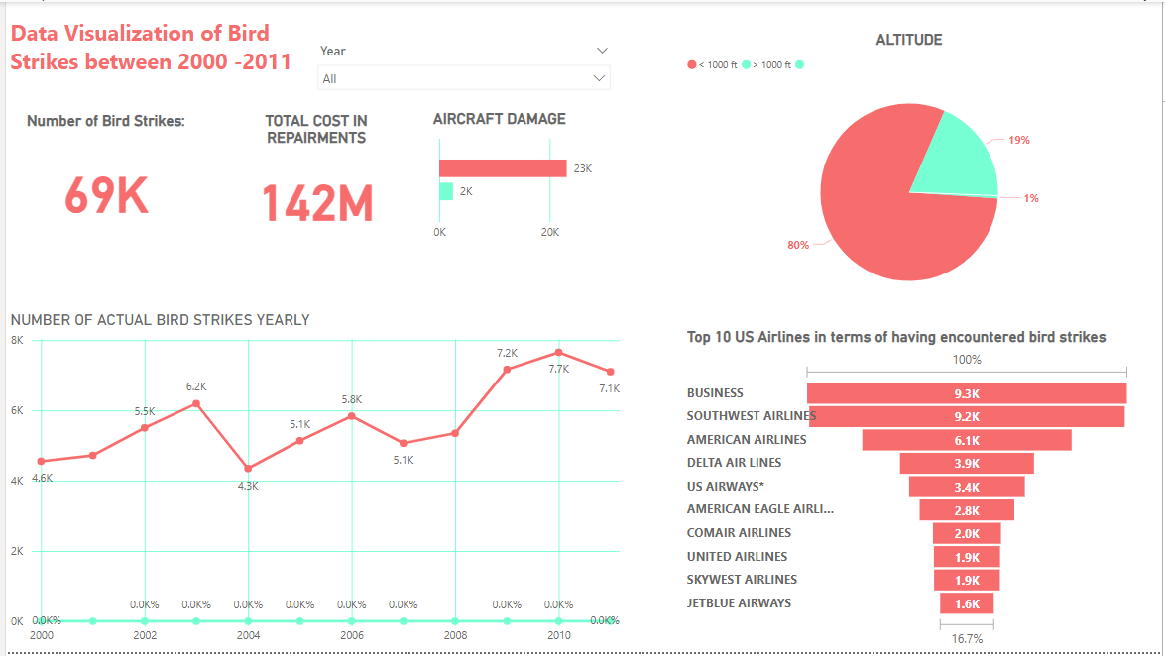
Dashboard
The interactive dashboard provides a comprehensive view of bird strike incidents, enabling stakeholders to visualize trends, identify hotspots, and make data-driven decisions.

Slide 17
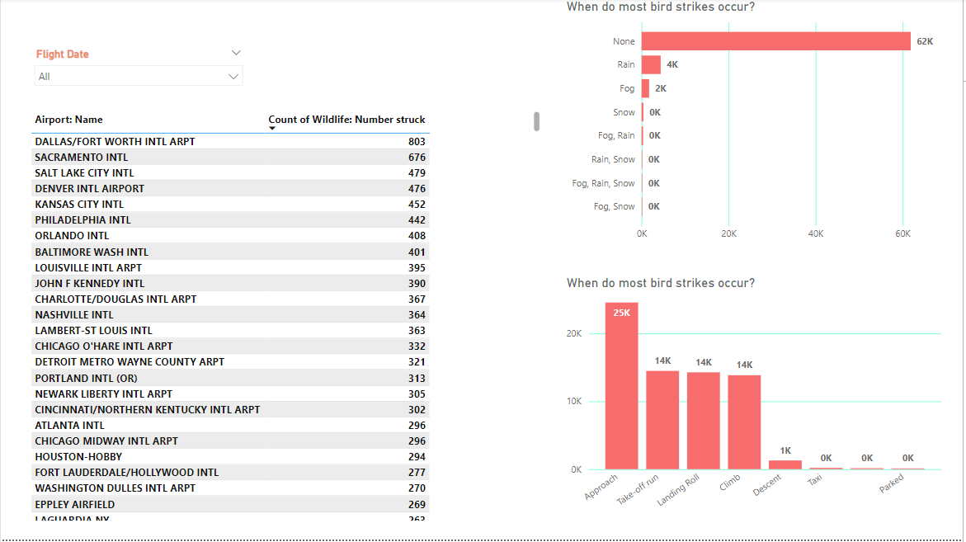
Dashboard
The interactive dashboard provides a comprehensive view of bird strike incidents, enabling stakeholders to visualize trends, identify hotspots, and make data-driven decisions.

Slide 18
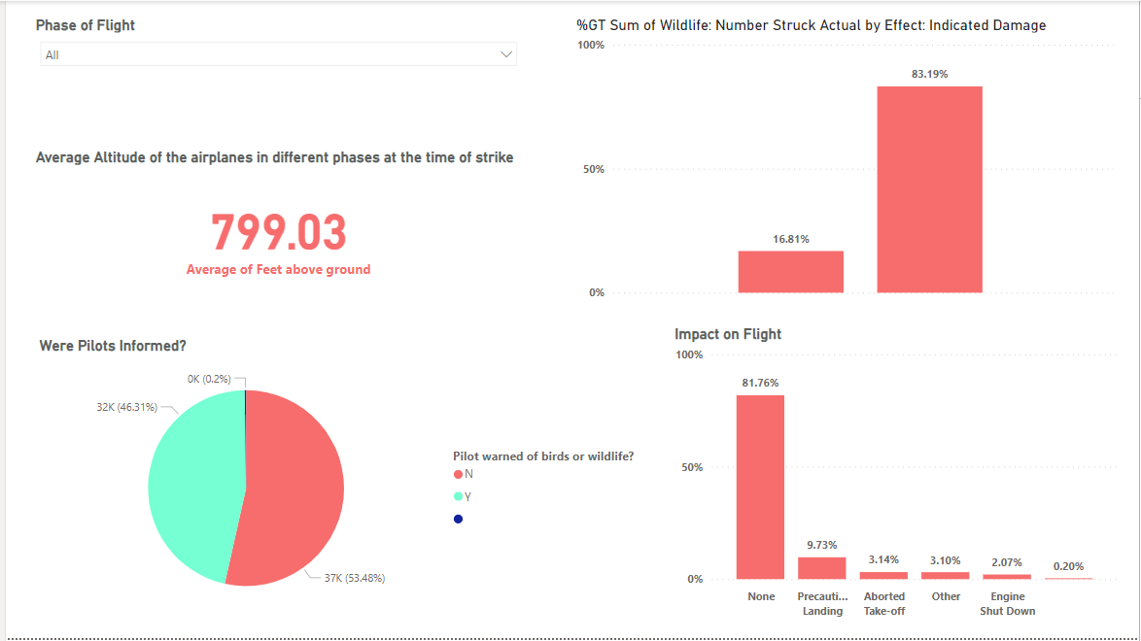
Dashboard
The interactive dashboard provides a comprehensive view of bird strike incidents, enabling stakeholders to visualize trends, identify hotspots, and make data-driven decisions.

Slide 19
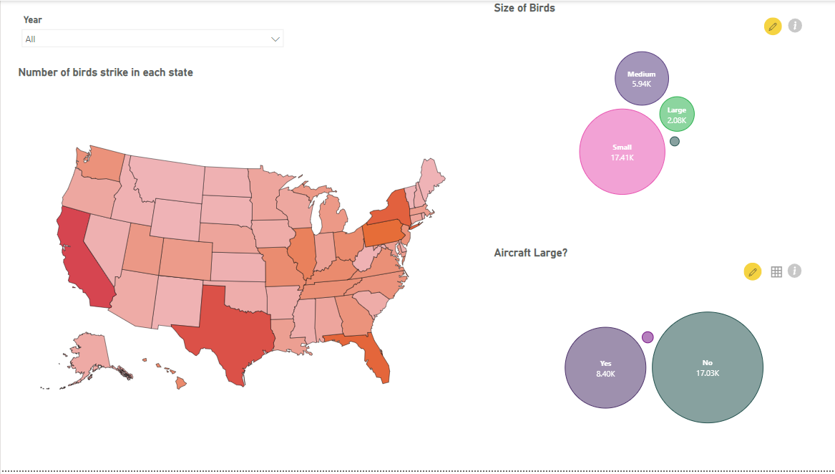
Dashboard
The interactive dashboard provides a comprehensive view of bird strike incidents, enabling stakeholders to visualize trends, identify hotspots, and make data-driven decisions.

Slide 20
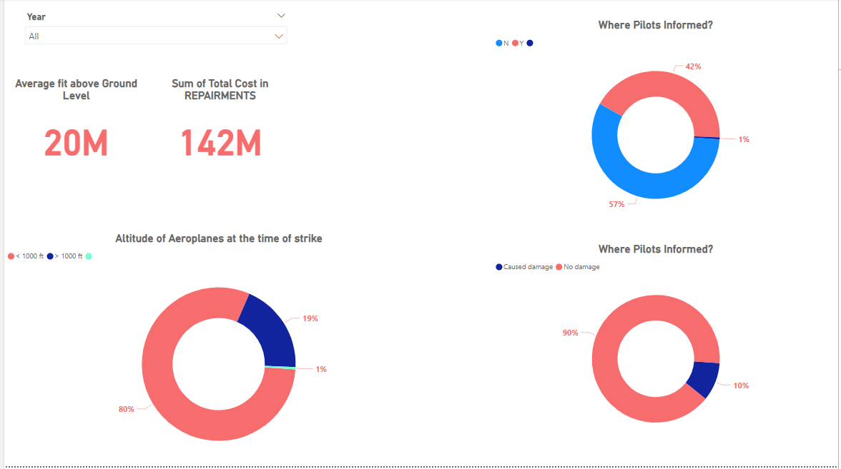
Dashboard
The interactive dashboard provides a comprehensive view of bird strike incidents, enabling stakeholders to visualize trends, identify hotspots, and make data-driven decisions.

Slide 21



Data Source and Methodology
Data Sources
Methodology
Visualization
Aggregated data from multiple aviation authorities and incident reporting systems.
Rigorous data cleaning, normalization, and advanced statistical analysis to uncover key insights.
Leveraged interactive dashboards and reports to effectively communicate findings.

Slide 22




thank you
Gratitude
Expressing appreciation for collaboration and insights provided.
Future Collaboration
Discussing possibilities for continued partnership and exploration.
Acknowledgment
Recognizing the importance of shared efforts and contributions.

