Slide 1
COMBINATIONAL CIRCUITS AND ITS APPLICATIONS IN INDUSTRY
BY AKASH KUMAR GUPTA
Kasura Technologies Private Limited

Slide 2
CONTENTS
INTRODUCTION
TYPES OF COMBINATIONAL CIRCUITS
CONCLUSION
THANK YOU
1
2
3
4

Slide 3
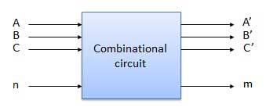
INTRODUCTION
Combinational Circuits are circuits made up of different types of logic gates. A logic gate is a basic building block of any electronic circuit. The output of the combinational circuit depends on the values at the input at any given time. The circuits do not make use of any memory or storage device.

Slide 4
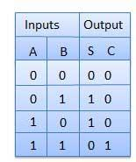
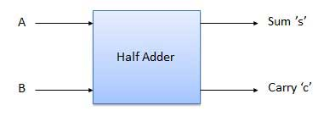
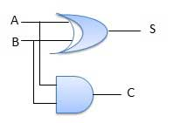
HALF ADDER
Half adder is a combinational logic circuit with two inputs and two outputs. The half adder circuit is designed to add two single bit binary number A and B. It is the basic building block for addition of two single bit numbers. This circuit has two outputs carry and sum.

Slide 5
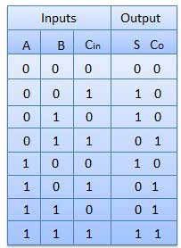
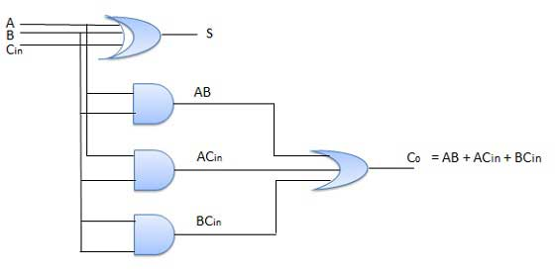
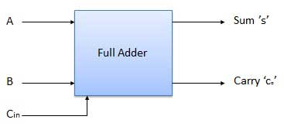
FULL ADDER
Full adder is developed to overcome the drawback of Half Adder circuit. It can add two one-bit numbers A and B, and carry c. The full adder is a three input and two output combinational circuit.

Slide 6
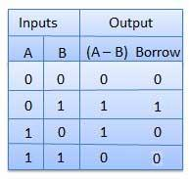
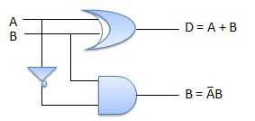
HALF SUBTRACTOR
Half subtractor is a combination circuit with two inputs and two outputs (difference and borrow). It produces the difference between the two binary bits at the input and also produces an output (Borrow) to indicate if a 1 has been borrowed. In the subtraction (A-B), A is called as Minuend bit and B is called as Subtrahend bit.

Slide 7
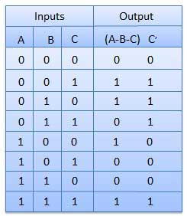
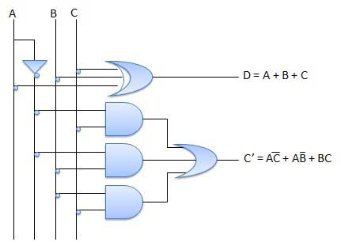
FULL SUBTRACTOR
The disadvantage of a half subtractor is overcome by full subtractor. The full subtractor is a combinational circuit with three inputs A,B,C and two output D and C'. A is the 'minuend', B is 'subtrahend', C is the 'borrow' produced by the previous stage, D is the difference output and C' is the borrow output.

Slide 8
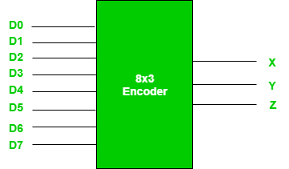
ENCODERS
Encoder is a combinational circuit which is designed to perform the inverse operation of the decoder. An encoder has n number of input lines and m number of output lines. An encoder produces an m bit binary code corresponding to the digital input number. The encoder accepts an n input digital word and converts it into an m bit another digital word.
D7 | D6 | D5 | D4 | D3 | D2 | D1 | D0 | X | Y | Z
0 | 0 | 0 | 0 | 0 | 0 | 0 | 1 | 0 | 0 | 0
0 | 0 | 0 | 0 | 0 | 0 | 1 | 0 | 0 | 0 | 1
0 | 0 | 0 | 0 | 0 | 1 | 0 | 0 | 0 | 1 | 0
0 | 0 | 0 | 0 | 1 | 0 | 0 | 0 | 0 | 1 | 1
0 | 0 | 0 | 1 | 0 | 0 | 0 | 0 | 1 | 0 | 0
0 | 0 | 1 | 0 | 0 | 0 | 0 | 0 | 1 | 0 | 1
0 | 1 | 0 | 0 | 0 | 0 | 0 | 0 | 1 | 1 | 0
1 | 0 | 0 | 0 | 0 | 0 | 0 | 0 | 1 | 1 | 1

Slide 9
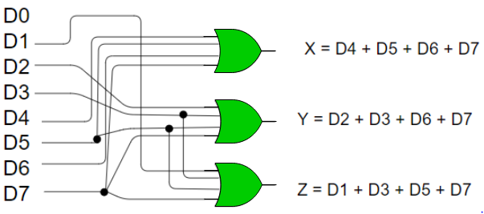
ENCODERS

Slide 10
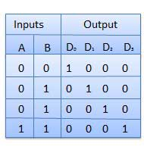
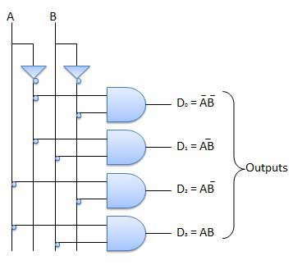
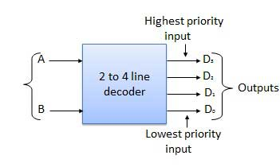
DECODERS
2 to 4 Line Decoder -
The block diagram of 2 to 4 line decoder. A and B are the two inputs where D through D are the four outputs. Truth table explains the operations of a decoder. It shows that each output is 1 for only a specific combination of inputs.

Slide 11
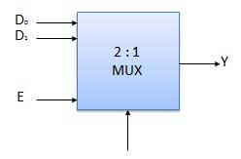
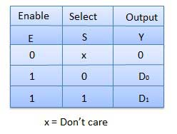
MULTIPLEXERS
Multiplexer is a special type of combinational circuit. There are n-data inputs, one output and m select inputs with 2m = n. It is a digital circuit which selects one of the n data inputs and routes it to the output. The selection of one of the n inputs is done by the selected inputs. Depending on the digital code applied at the selected inputs, one out of n data sources is selected and transmitted to the single output Y. E is called the strobe or enable input which is useful for the cascading. It is generally an active low terminal that means it will perform the required operation when it is low.

Slide 12
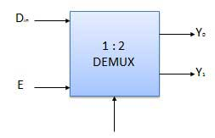
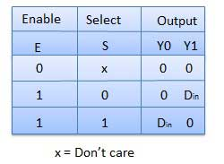
DEMULTIPLEXERS
A demultiplexer performs the reverse operation of a multiplexer i.e. it receives one input and distributes it over several outputs. It has only one input, n outputs, m select input. At a time only one output line is selected by the select lines and the input is transmitted to the selected output line. A de-multiplexer is equivalent to a single pole multiple way switch.

Slide 13
CONCLUSION
Combinational logic is used in computer circuits to perform Boolean algebra on input signals and on stored data. Practical computer circuits normally contain a mixture of combinational and sequential logic. For example, the part of an arithmetic logic unit, or ALU, that does mathematical calculations is constructed using combinational logic.

Slide 14
THANK YOU!

