Slide 1
MICROCONTROLLER-8051 AND ITS WORKING
AKASH KUMAR GUPTA
Kasura Technologies Private Limited

Slide 2
CONTENTS
INTRODUCTION
DIFFERENCE BETWEEN MICROCONTROLLER AND MICROPROCESSOR
PIN CONFINGURATIONS
INTERRUPTS
CONCLUSION
1
2
3
4
5

Slide 3
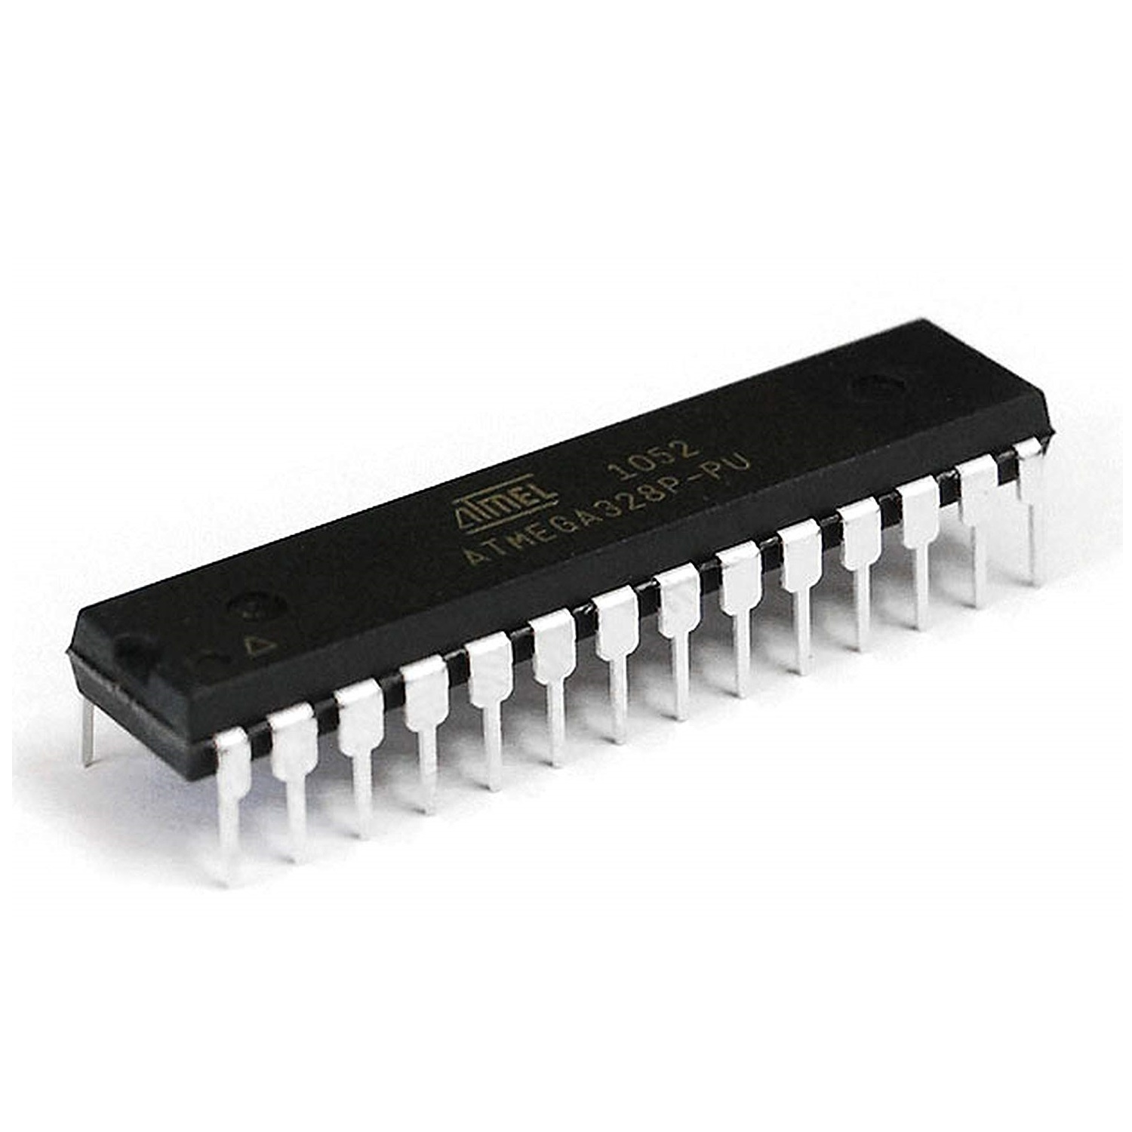
INTRODUCTION
A microcontroller is a small and low-cost microcomputer, which is designed to perform the specific tasks of embedded systems like displaying microwave’s information, receiving remote signals, etc.
The general microcontroller consists of the processor, the memory (RAM, ROM, EPROM), Serial ports, peripherals (timers, counters), etc.

Slide 4
DIFFERENCE BETWEEN MICROCONTROLLER AND MICROPROCESSOR
Microcontroller | Microprocessor
Microcontrollers are used to execute a single task within an application. | Microprocessors are used for big applications.
Its designing and hardware cost is low. | Its designing and hardware cost is high.
Easy to replace. | Not so easy to replace.
It is built with CMOS technology, which requires less power to operate. | Its power consumption is high because it has to control the entire system.
It consists of CPU, RAM, ROM, I/O ports. | It doesn’t consist of RAM, ROM, I/O ports. It uses its pins to interface to peripheral devices.

Slide 5
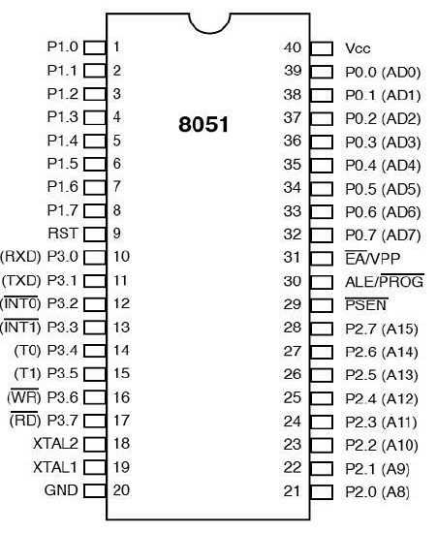
PIN CONFIGURATIONS

Slide 6
INTERRUPTS
Interrupts are the events that temporarily suspend the main program, pass the control to the external sources and execute their task. It then passes the control to the main program where it had left off.
8051 has 5 interrupt signals, i.e. INT0, TFO, INT1, TF1, RI/TI. Each interrupt can be enabled or disabled by setting bits of the IE register and the whole interrupt system can be disabled by clearing the EA bit of the same register.
Timer 0 overflow interrupt- TF0
Timer 1 overflow interrupt- TF1
External hardware interrupt- INT0
External hardware interrupt- INT1
Serial communication interrupt- RI/TI

Slide 7
CONCLUSION
Microcontrollers are widely used in various different devices such as −
Light sensing and controlling devices like LED.
Temperature sensing and controlling devices like microwave oven, chimneys.
Fire detection and safety devices like Fire alarm.
Measuring devices like Volt Meter.

Slide 8
THANK YOU !

