Slide 1
MICROPROCESSOR-8085 AND ITS WORKING
AKASH KUMAR GUPTA
Kasura Technologies Private Limited

Slide 2
CONTENTS
INTRODUCTION
CONFIGURATIONS
FLAG REGISTER
ARCHITECTURE
PIN DIAGRAM
INTERRUPTS
CONCLUSION
1
2
3
4
5
6
7

Slide 3
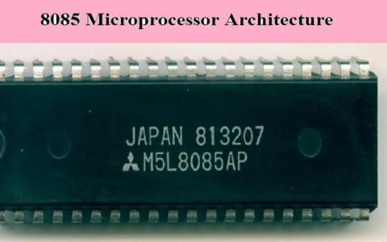
INTRODUCTION
The Intel 8085 ("eighty-eighty-five") is an 8-bit microprocessor produced by Intel and introduced in March 1976. It is a software-binary compatible with the more-famous Intel 8080 with only two minor instructions added to support its added interrupt and serial input/output features. However, it requires less support circuitry, allowing simpler and less expensive microcomputer systems to be built.

Slide 4
CONFIGURATIONS
It has the following configuration −
8-bit data bus
16-bit address bus, which can address upto 64KB
A 16-bit program counter
A 16-bit stack pointer
Six 8-bit registers arranged in pairs: BC, DE, HL
Requires +5V supply to operate at 3.2 MHZ single phase clock

Slide 5
FLAG REGISTER
Flag register -
It is an 8-bit register having five 1-bit flip-flops, which holds either 0 or 1 depending upon the result stored in the accumulator.
These are the set of 5 flip-flops −
Sign (S)
Zero (Z)
Auxiliary Carry (AC)
Parity (P)
Carry (C)
Its bit position is shown in the following table −
D7 | D6 | D5 | D4 | D3 | D2 | D1 | D0
S | Z | X | AC | X | P | X | CY

Slide 6
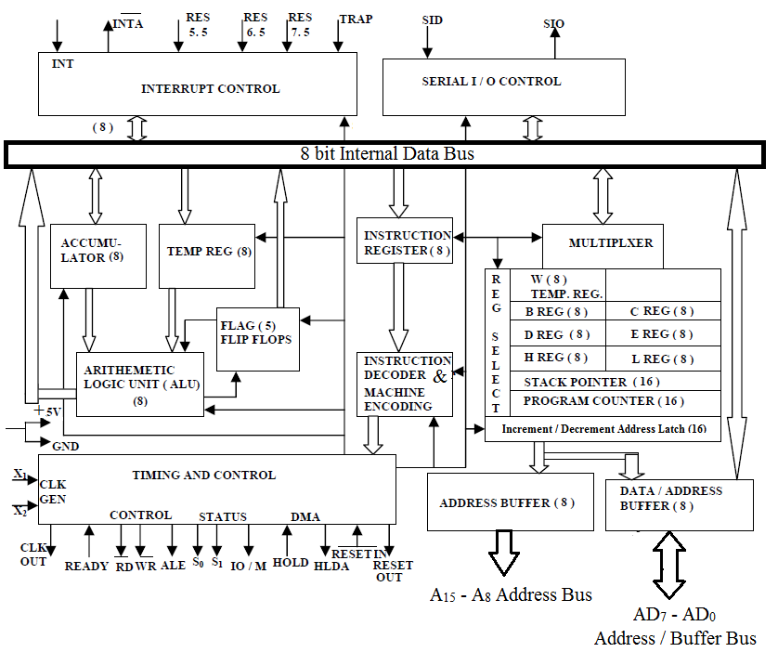
ARCHITECTURE

Slide 7
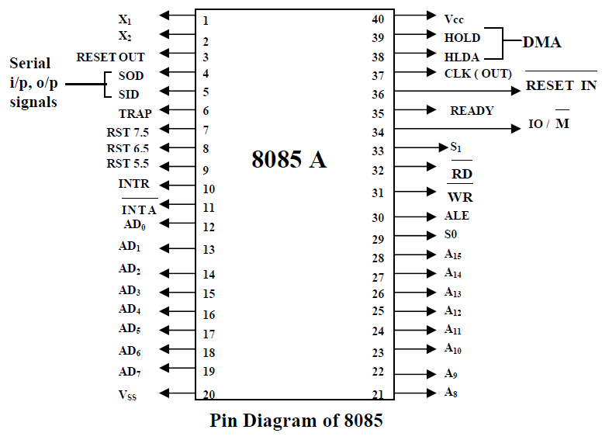
PIN DIAGRAM

Slide 8
INTERRUPTS
TRAP - It is a non-maskable interrupt, having the highest priority among all interrupts. By default, it is enabled until it gets acknowledged. In case of failure, it executes as ISR and sends the data to backup memory. This interrupt transfers the control to the location 0024H.
RST7.5 - It is a maskable interrupt, having the second highest priority among all interrupts. When this interrupt is executed, the processor saves the content of the PC register into the stack and branches to 003CH address.
RST 6.5 - It is a maskable interrupt, having the third highest priority among all interrupts. When this interrupt is executed, the processor saves the content of the PC register into the stack and branches to 0034H address.
RST 5.5 - It is a maskable interrupt. When this interrupt is executed, the processor saves the content of the PC register into the stack and branches to 002CH address.
INTR - It is a maskable interrupt, having the lowest priority among all interrupts. It can be disabled by resetting the microprocessor.

Slide 9
CONCLUSION
8085 is pronounced as "eighty-eighty-five" microprocessor. It is an 8-bit microprocessor designed by Intel in 1977 using NMOS technology.
It is used in washing machines, microwave ovens, mobile phones, etc.

Slide 10
THANK YOU !

