Slide 1
SEQUENTIAL CIRCUITS AND ITS APPLICATIONS IN INDUSTRY
BY AKASH KUMAR GUPTA
Kasura Technologies Private Limited

Slide 2
CONTENTS
1
INTRODUCTION
ASYCHRONOUS SEQUENTIAL CIRCUITS
SYCHRONOUS SEQUENTIAL CIRCUITS
APPLICATION IN INDUSTRY
CONCLUSION
2
3
4
5

Slide 3
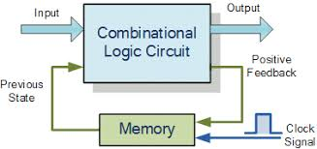
INTRODUCTION
Sequential circuits are essentially combinational circuits with feedback.
What are Combinational circuits?
Combinational Circuits are circuits made up of different types of logic gates. A logic gate is a basic building block of any electronic circuit. The output of the combinational circuit depends on the values at the input at any given time. The circuits do not make use of any memory or storage device.
Sequential Circuits :-

Slide 4
ASYCHRONOUS SEQUENTIAL CIRCUITS
Asynchronous sequential circuits do not use clock signals. Instead, the circuit is driven by the pulses of the inputs which means the state of the circuit changes when the inputs change. The change of internal state occurs when there is a change in the input variable.
Advantage –
No clock signal, hence no waiting for a clock pulse to begin processing inputs, therefore fast(Lower Power Consumption).
Disadvantage –
Some asynchronous circuits may require extra power for certain operations.
Example – Latch

Slide 5
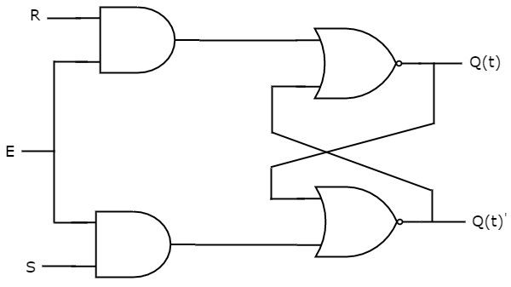
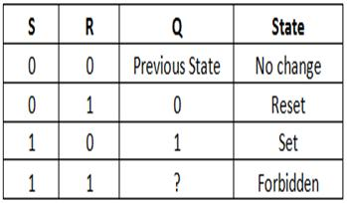
LATCH
Latches operate with enable signal, which is level sensitive.
SR Latch
SR Latch is also called as Set Reset Latch. This latch affects the outputs as long as the enable, E is maintained at ‘1’.

Slide 6
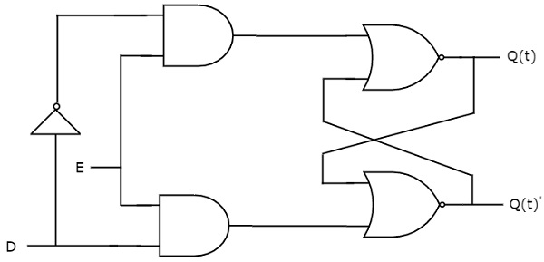
LATCH
D Latch
There is one drawback of SR Latch. That is the next state value can’t be predicted when both the inputs S and R are one. So, we can overcome this difficulty by D Latch. It is also called as Data Latch.
D | Q(t+1)
0 | 0
1 | 1

Slide 7
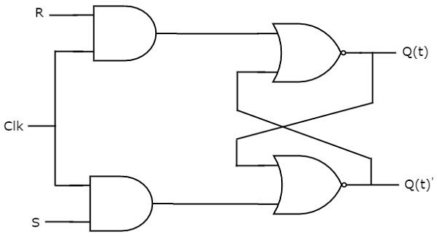
SYCHRONOUS SEQUENTIAL CIRCUITS
If all the outputs of a sequential circuit change affect with respect to active transition of clock signal, then that sequential circuit is called as Synchronous sequential circuit.
SR Flip-Flop
SR flip-flop operates with only positive clock transitions or negative clock transitions. Whereas, SR latch operates with enable signal.
S | R | Qt+1
0 | 0 | Qt
0 | 1 | 0
1 | 0 | 1
1 | 1 | -

Slide 8
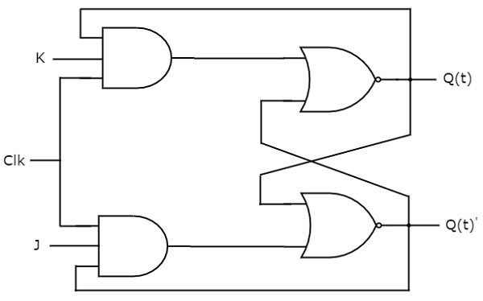
SYCHRONOUS SEQUENTIAL CIRCUITS
JK Flip-Flop -
JK flip-flop is the modified version of SR flip-flop. It operates with only positive clock transitions or negative clock transitions.
Present Inputs |  | Present State | Next State
J | K | Qt | Qt+1
0 | 0 | 0 | 0
0 | 0 | 1 | 1
0 | 1 | 0 | 0
0 | 1 | 1 | 0
1 | 0 | 0 | 1
1 | 0 | 1 | 1
1 | 1 | 0 | 1
1 | 1 | 1 | 0

Slide 9
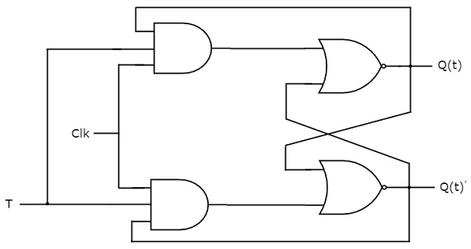
SYCHRONOUS SEQUENTIAL CIRCUITS
T Flip-Flop –
T flip-flop is the simplified version of JK flip-flop. It is obtained by connecting the same input ‘T’ to both inputs of JK flip-flop. It operates with only positive clock transitions or negative clock transitions.
Inputs | Present State | Next State
T | Q t | Q t+1
0 | 0 | 0
0 | 1 | 1
1 | 0 | 1
1 | 1 | 0

Slide 10
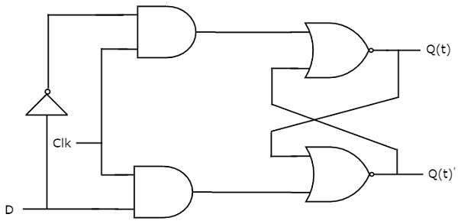
SYCHRONOUS SEQUENTIAL CIRCUITS
D Flip-Flop -
D flip-flop operates with only positive clock transitions or negative clock transitions. Whereas, D latch operates with enable signal. That means, the output of D flip-flop is insensitive to the changes in the input, D except for active transition of the clock signal.
D | Q(t + 1)
0 | 0
1 | 1

Slide 11
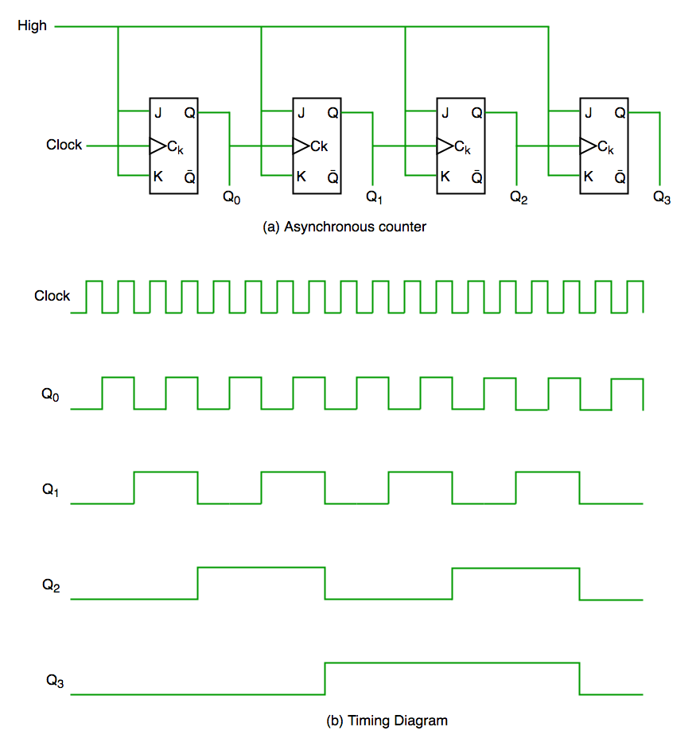
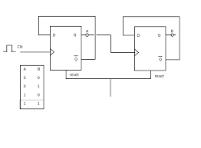
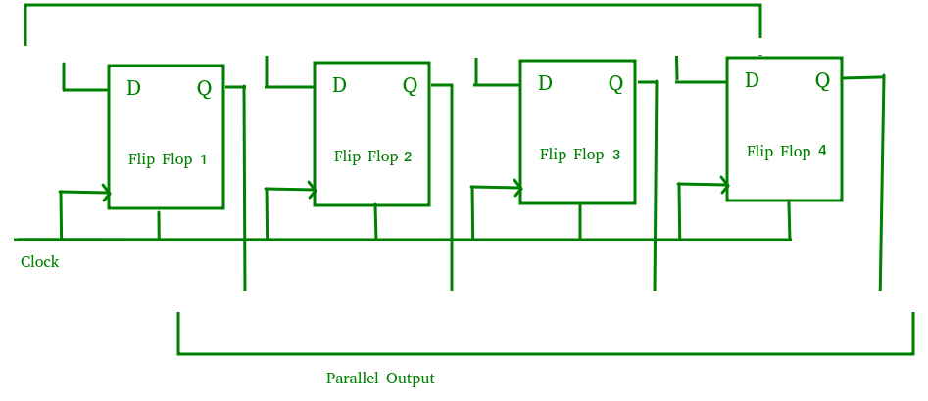
APPLICATION IN INDUSTRY
Counters Frequency Dividers Shift Registers Storage Registers

Slide 12
CONCLUSION
In brief, Latches and Flip flop are used to store binary data.
The stored data can be changed by applying varying inputs.
Flip-flops and latches are fundamental building blocks of digital electronics systems used in computers, communications, and many other types of systems.

Slide 13
THANK YOU!

