Slide 1
VLSI DESIGN FLOW
AKASH KUMAR GUPTA
Kasura Technologies Private Limited

Slide 2
CONTENTS
INTRODUCTION
VLSI DESIGN FLOW
PHASE I
PHASE II
PHASE III
CONCLUSION
1
2
3
4
5
6

Slide 3
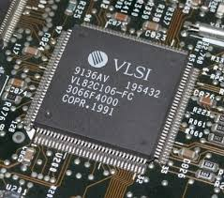
INTRODUCTION
Very-large-scale integration (VLSI) is the process of creating an integrated circuit (IC) by combining thousands of transistors into a single chip. VLSI began in the 1970s when complex semiconductor and communication technologies were being developed. The microprocessor is a VLSI device.

Slide 4
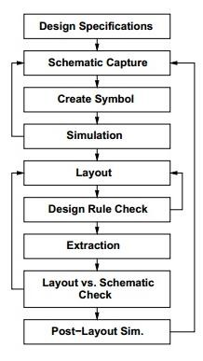
VLSI DESIGN FLOW

Slide 5
PHASE I
DESIGN SPECIFICATIONS –
SCHEMATIC CAPTURE -
CREATE SYMBOL -
H/A
H/A
A
H/A
SUM
B
CARRY

Slide 6
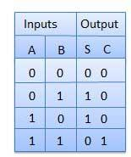
PHASE II
SIMULATION - It will check whether the given circuit is working properly or not.
LAYOUT –
DESIGN RULE CHECK -> SUM = A XOR B CARRY = A AND B
A
H/A
SUM
B
CARRY

Slide 7
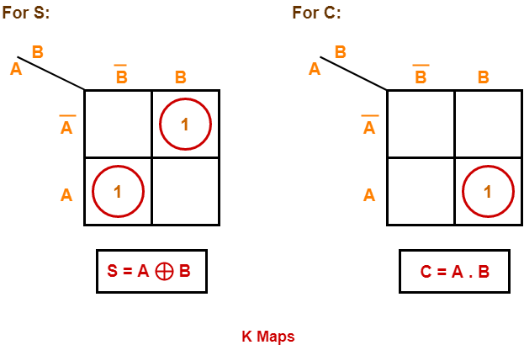
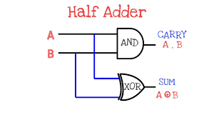
PHASE III
EXTRACTION –
LAYOUT VS SCHEMATIC CHECK - TRUE
POST LAYOUT SIMULATION -

Slide 8
CONCLUSION
Ease of installation and maintenance
Reasonable design flow
VLSI Design Flow complexity increases as time progresses

Slide 9
THANK YOU !

