Slide 1
Knapsack Problem:
*Your Name Here*

Slide 2
Knapsack Problem:
There are two versions of the problem.
1) 0-1 knapsack problem. ✔
2) Fractional knapsack problem.

Slide 3
What is Knapsack:
The 0–1 Knapsack Problem belongs to Combinatorial Optimization Problems. In such problems, we try to “maximize” (or “minimize”) some “quantity”, while satisfying some constraints. For example, the Knapsack problem is to maximize the obtained profit without exceeding the knapsack capacity.

Slide 4
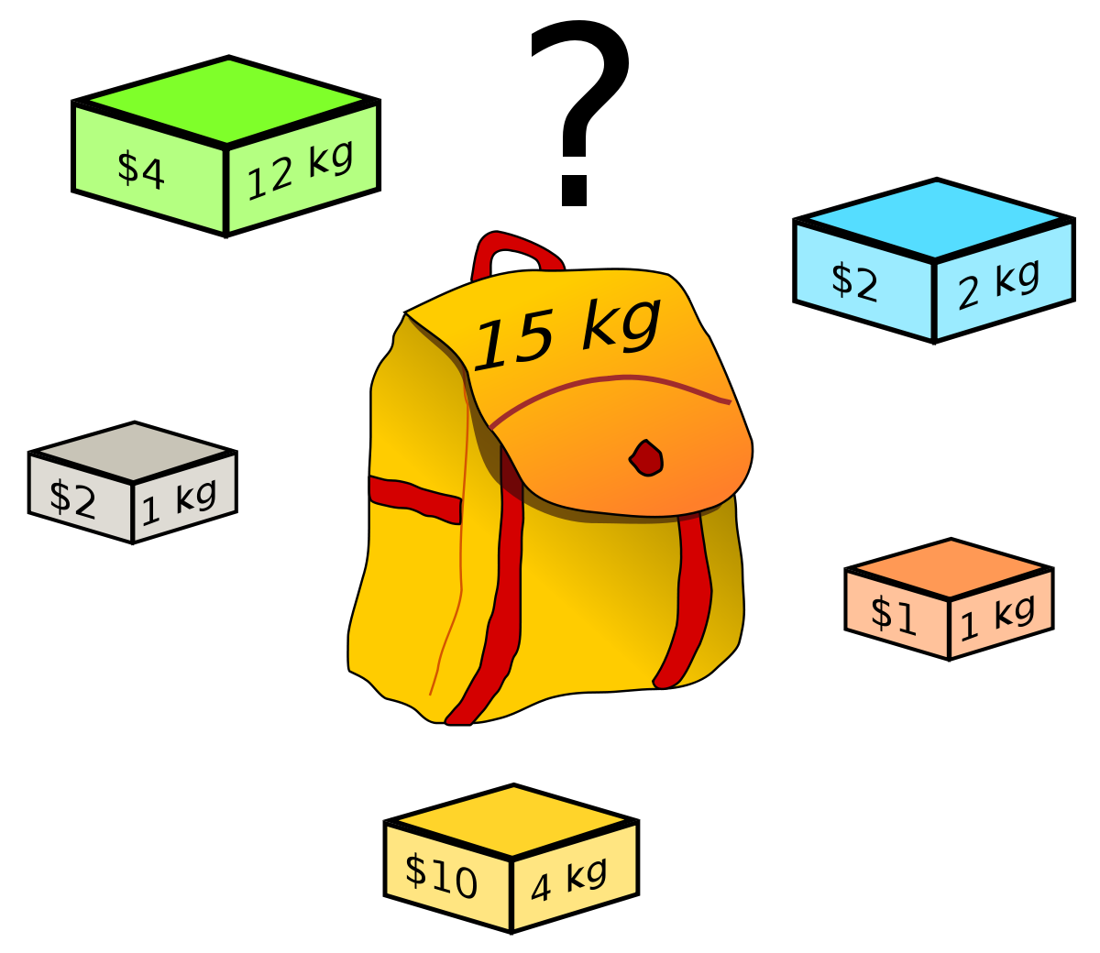
Example:

Slide 5
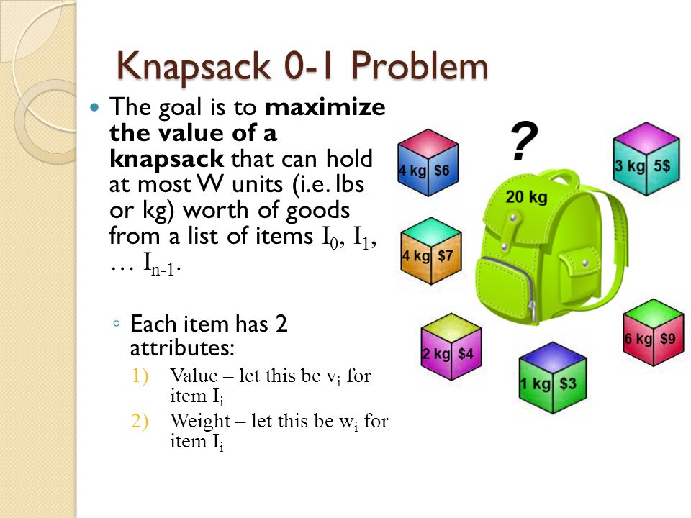

Slide 6
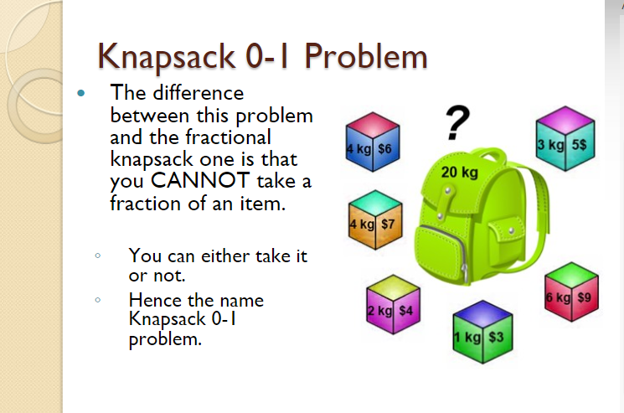

Slide 7
Solution Of Knapsack Problem:
Greedy algorithms build a solution part by part. This approach is mainly used to solve optimization problems.
Greedy method is easy to implement and quite efficient in most of the cases. There are three criteria to solve the 0/1 knapsack problem:
• Select object with maximum Profit.
• Select object with minimum Weight.
• Select object with maximum Density (Profile/Weight)

Slide 8
ALGORITHM AND TIME COMPLEXITY
What is the time complexity of 0-1 Knapsack?
Time complexity of 0-1 Knapsack problem is O(nW) where, n is the number of items and W is the capacity of knapsack.

Slide 9
What Actually Project is?
A transportation company has to transport items. If item has some weight and each truck can carry items with total some limited weight, this project will give the ideal amount for the trucks to carry as much weight as possible.

Slide 10

"Let our advance worrying become advance thinking and planning.”

