Slide 1
Knapsack OR rucksack Problem:
Group Members:
Muhammad Asad
Ali Hassan Ghori
Uzair Mehmood
Ahsan Ishtiaq
Mohsin Ali

Slide 2
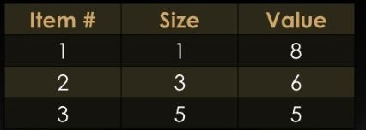
What is Knapsack:
In a rucksack problem, we are given a set of n items, where each item i is specified by a size s_{i} and a value v_{i} .We are also given a size bound S, the size of our knapsack.

Slide 3
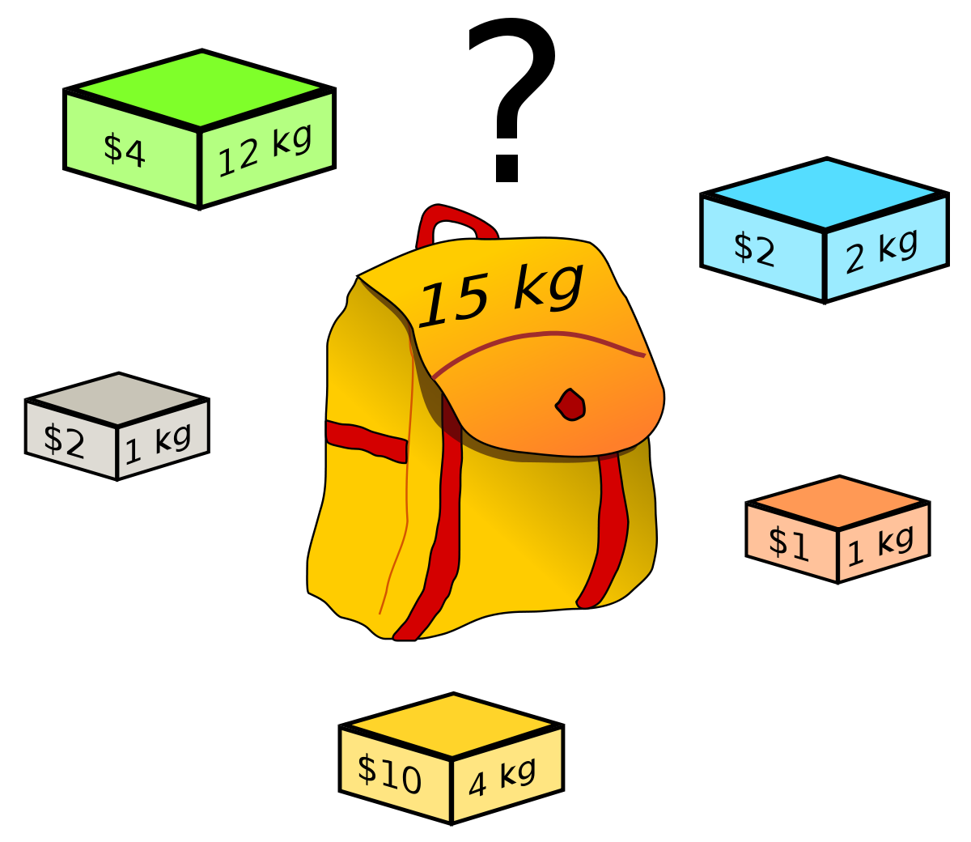
Example:

Slide 4
Knapsack Problem:
There are two versions of the problem.
1) 0-1 knapsack problem.
2) Fractional knapsack problem.
a. Bounded Knapsack Problem.
b. Unbounded Knapsack Problem

Slide 5
Solution Of Knapsack Problem:
Greedy Algorithm: Keep taking most valuable items until maximum weight is reached or taking the largest value of each item by calculating V_{i} = value_{i} / size_{i} .
Dynamic Algorithm: Solve each sub problem once and store their solutions in an array.

Slide 6
Solution Of Knapsack Problem:
Kee

Slide 7

"Let our advance worrying become advance thinking and planning.”

