Slide 1

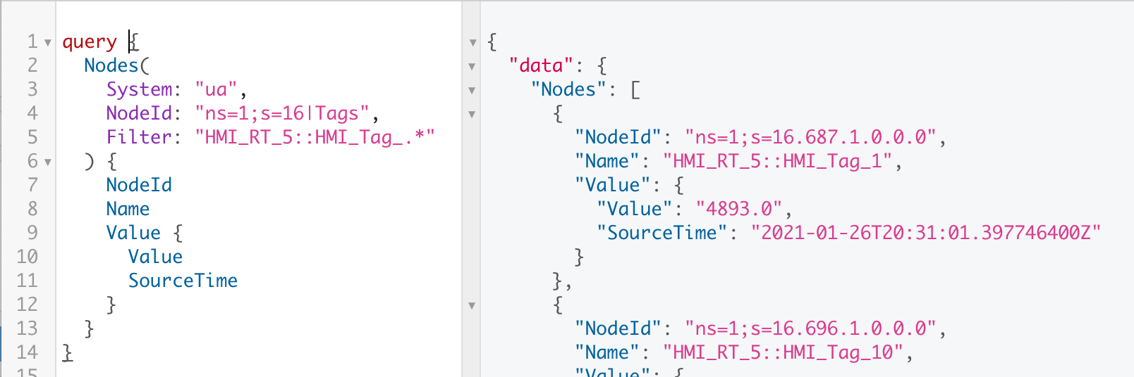
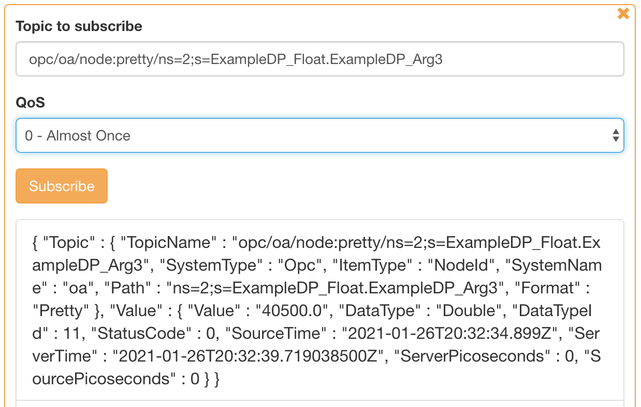
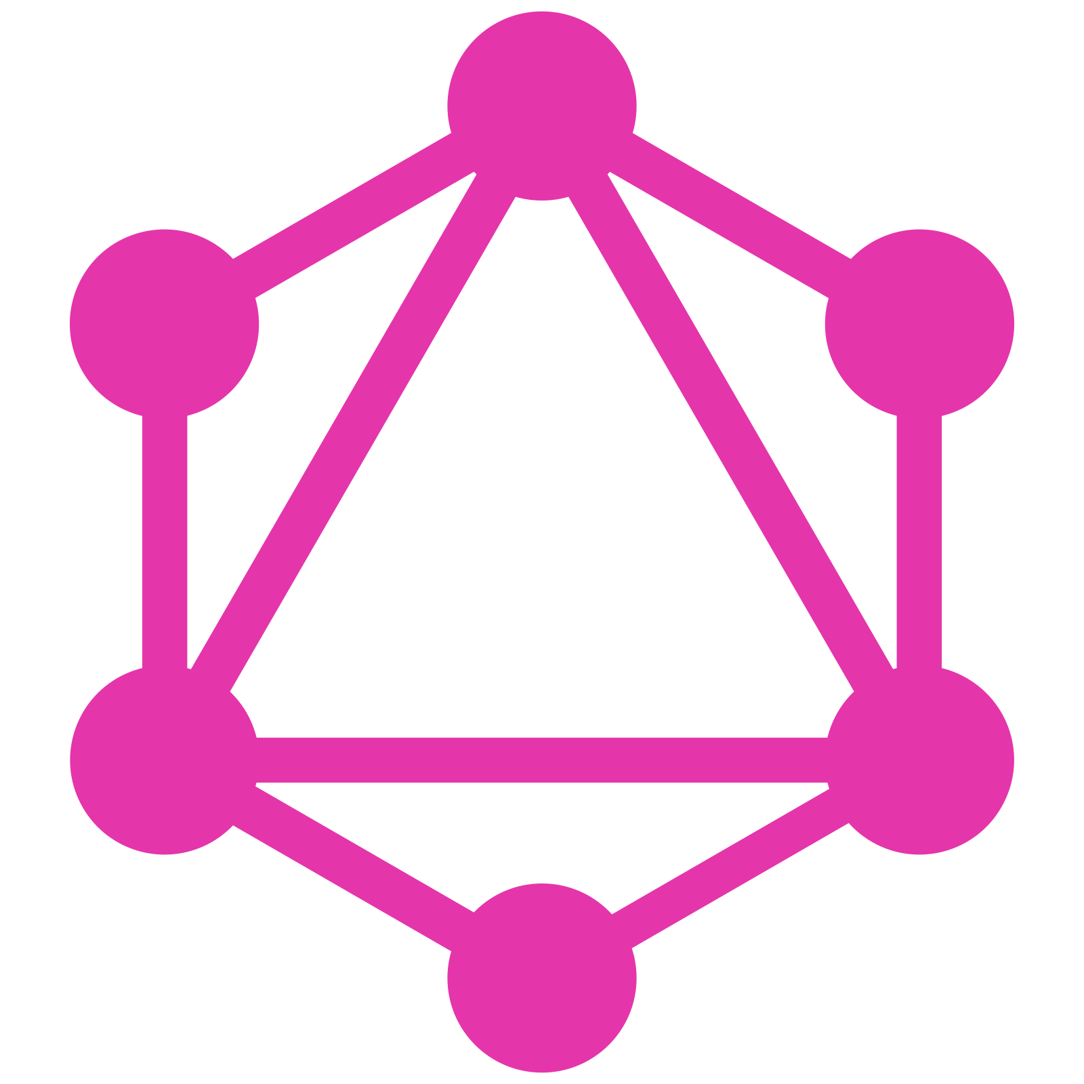

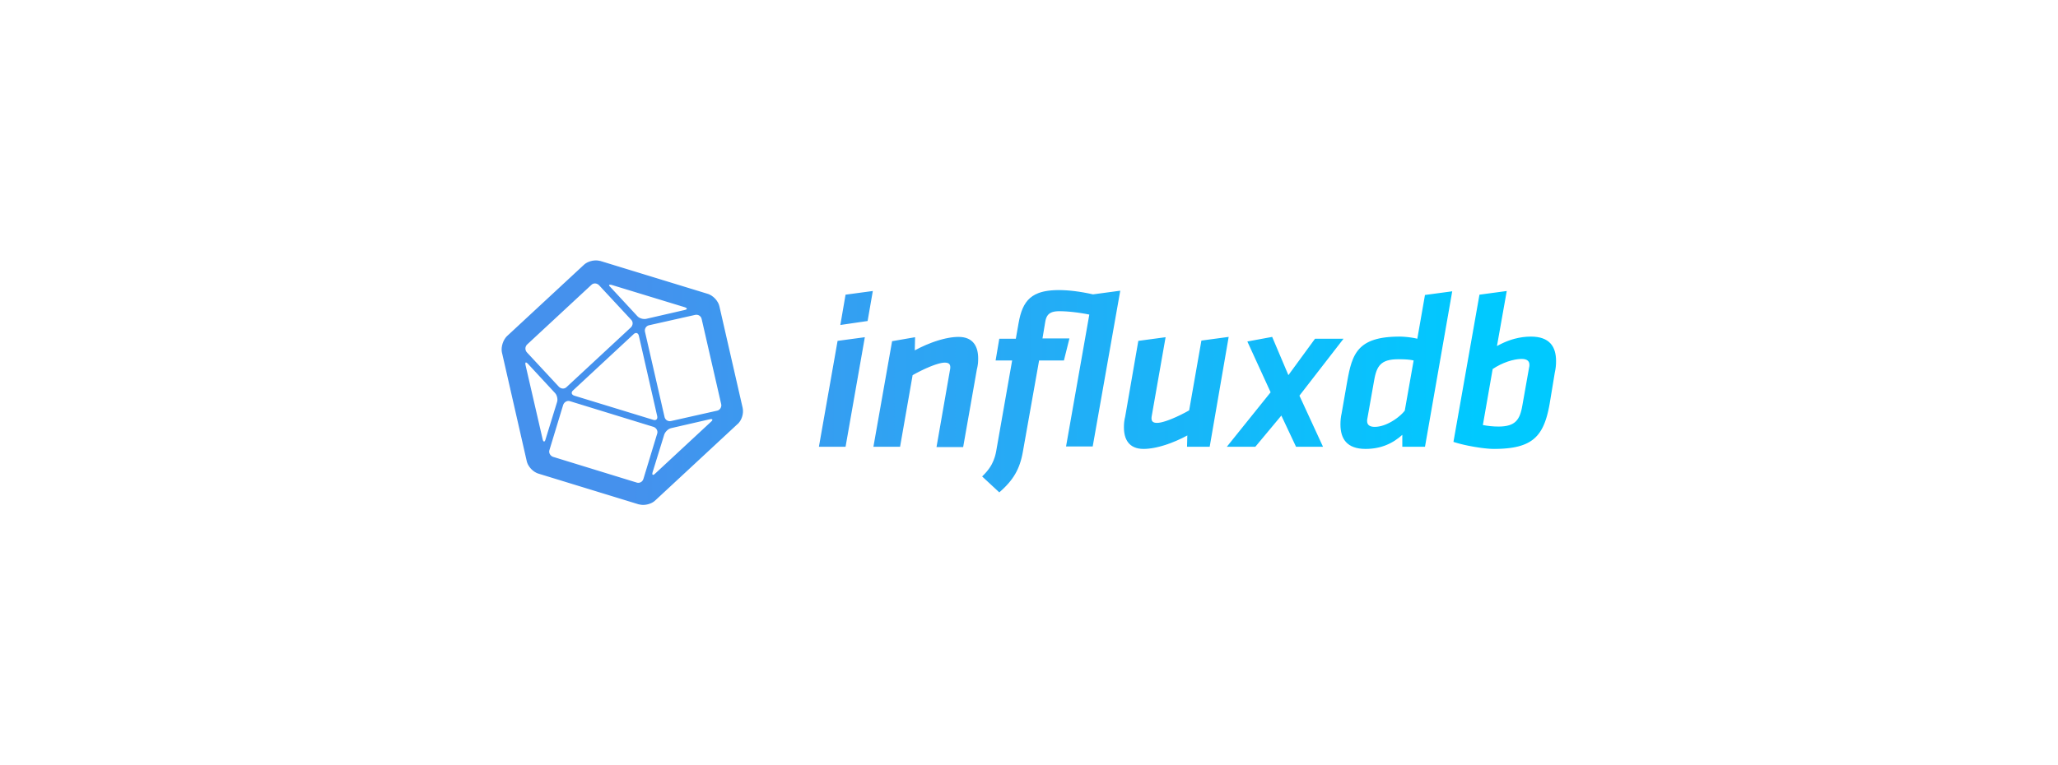
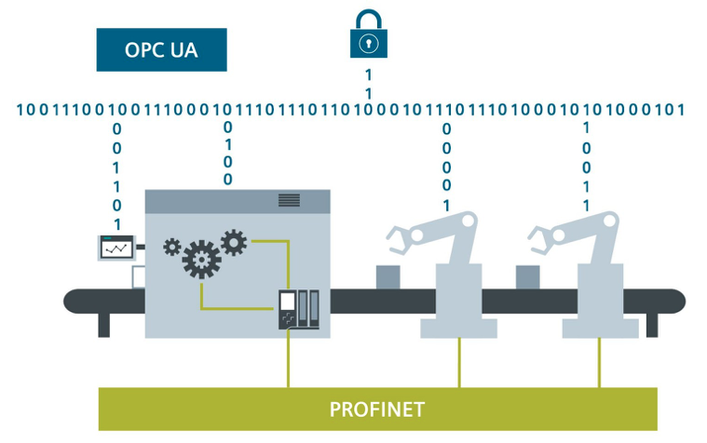

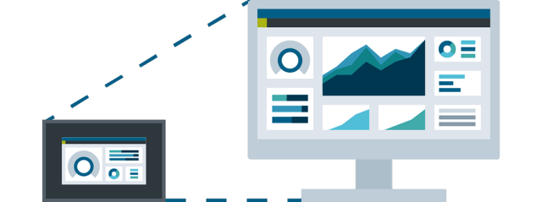

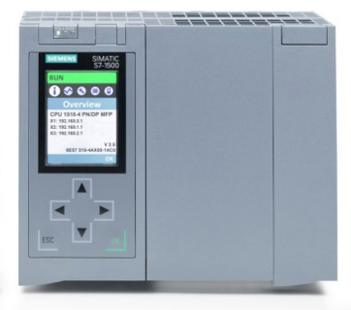
GraphQL
Query Tags
Mutate Tags
Subscribe Tags
Subscribe Tags
Publish Tags
HTTP
Websocket
TCP
Gateway
Reactive, Asynchronous
Single Host or Clustered
Database Logger
Query via GraphQL
GraphQL
Broker
OPC UA Clients
OPC UA Servers
WinCC Unified
Source: https://new.siemens.com

Slide 2
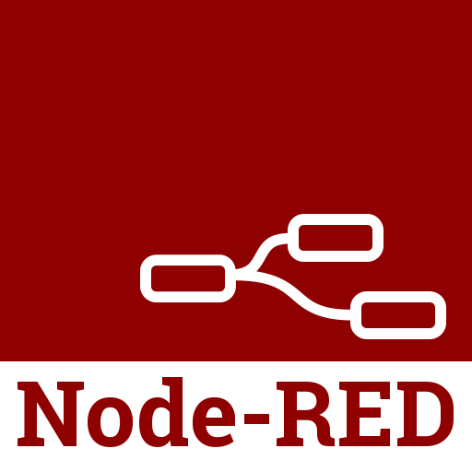
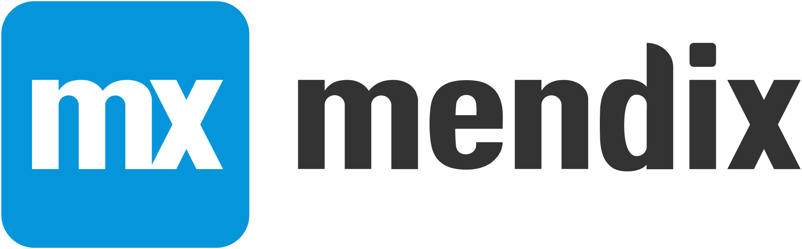








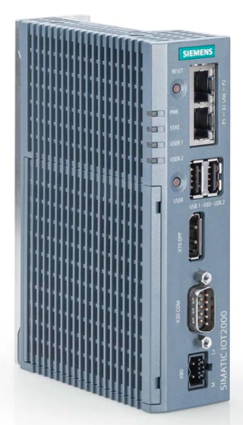





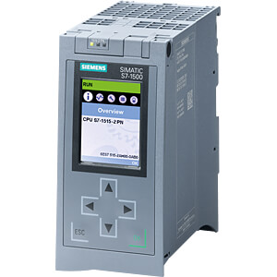
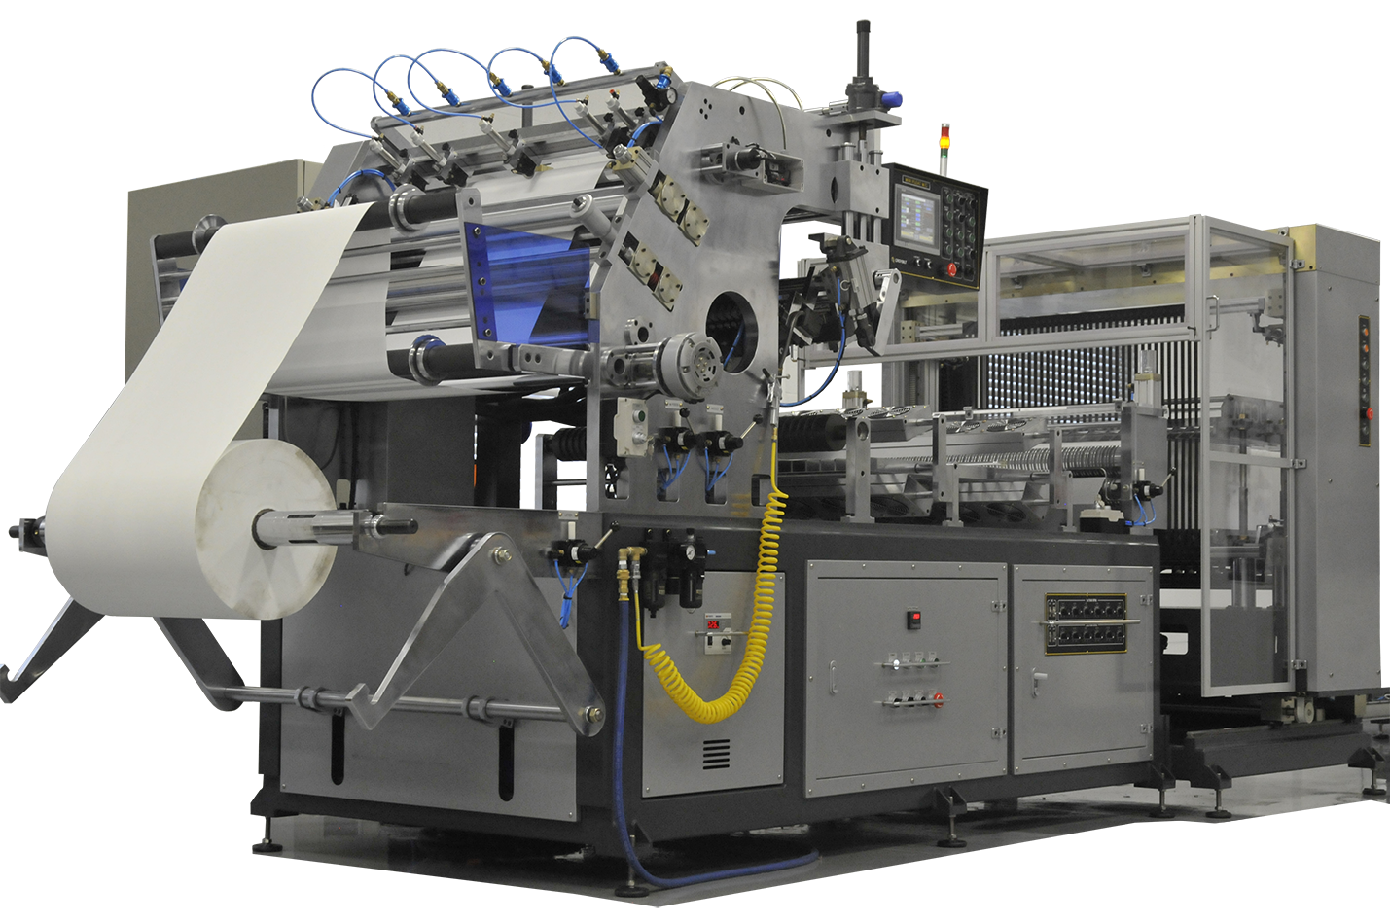
Gateway
Reactive, Asynchronous
Single Host or Clustered
GraphQL
Broker
SQL
OPC UA
OPC UA
OPC UA
Database Logger
Query via GraphQL
DDS Data Distribution Service
EtherNet/IP/KNX/Modbus, …
WinCC Unified

