Slide 1

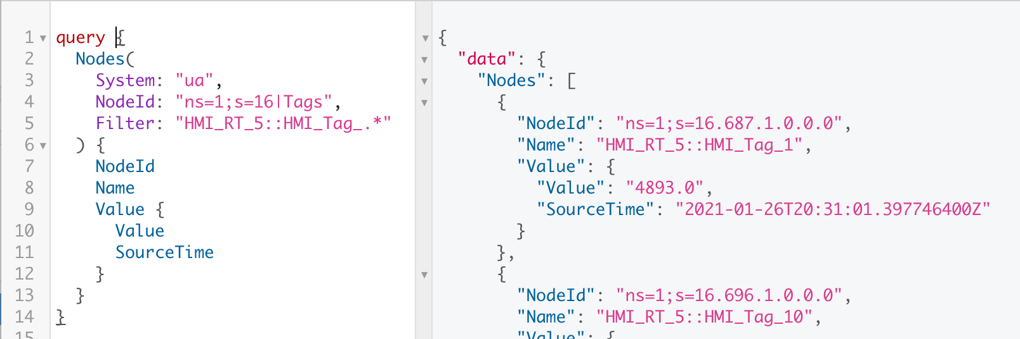
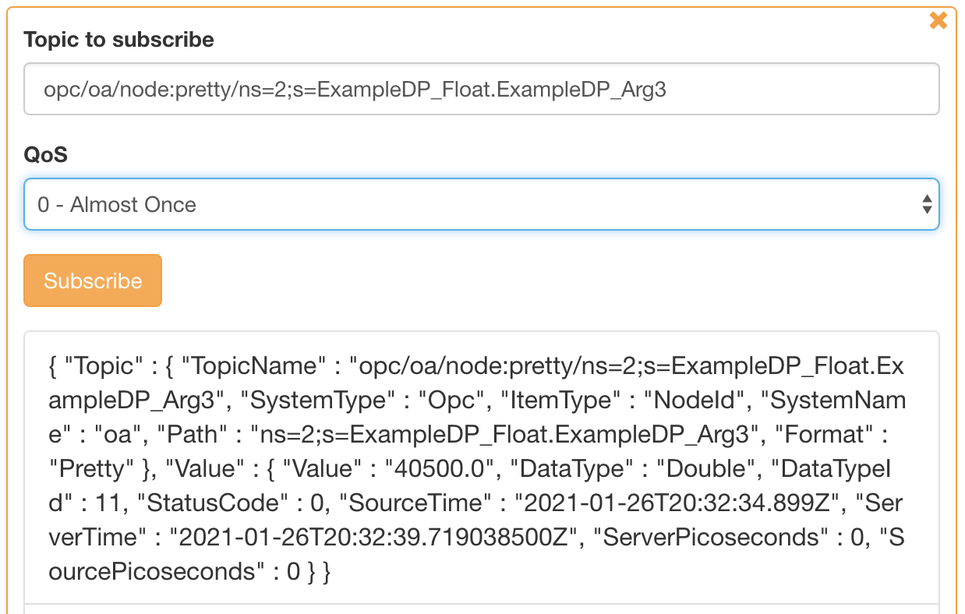



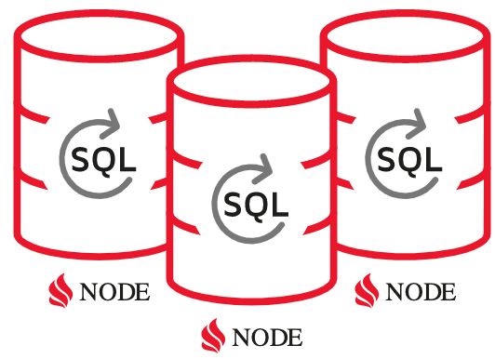
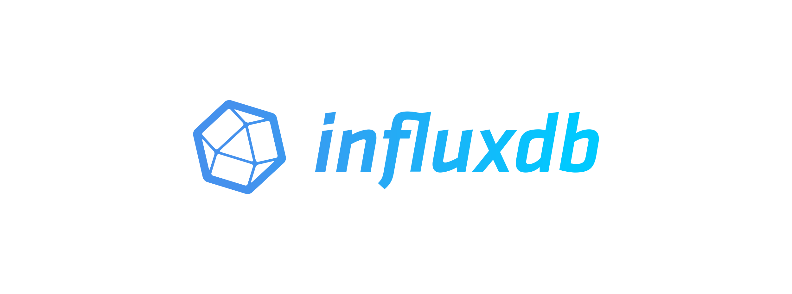




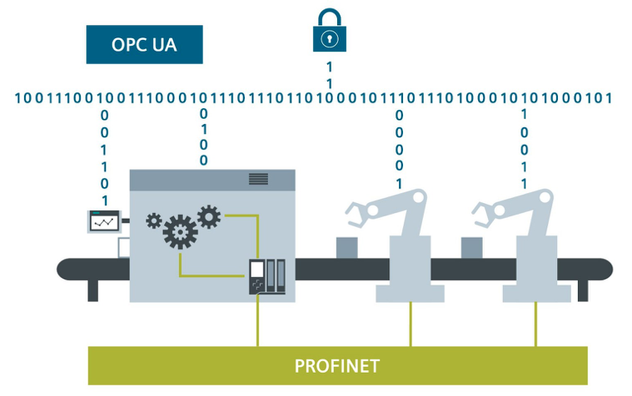
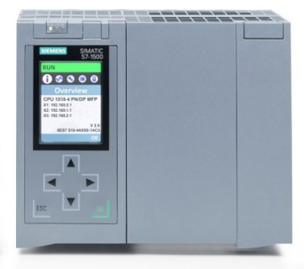
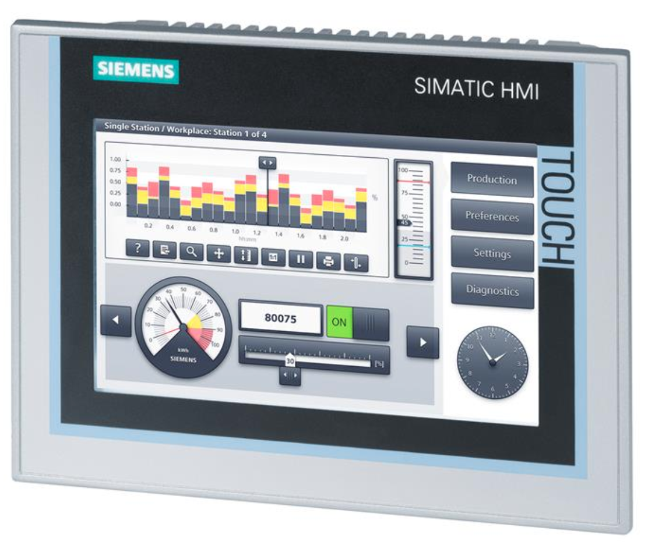


GraphQL
Query Tags
Mutate Tags
Subscribe Tags
Subscribe Tags
Publish Tags
HTTP
Websocket
TCP
Gateway
Reactive, Asynchronous
Single Host or Clustered
In-Memory Data Grid
Broker
Database Logger
Query via GraphQL
GraphQL
Distributed ANSI SQL with Joins
OpenDDS
OPC UA Servers
BACnet/IP
DDS
ModBus
ROS2
KNX
S7
Siemens
Comfort Panels
WinCC Unified
…
Source: https://new.siemens.com

