Slide 1

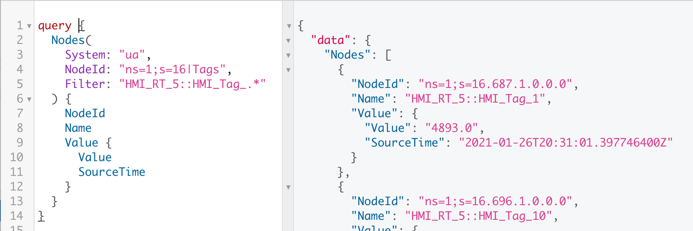
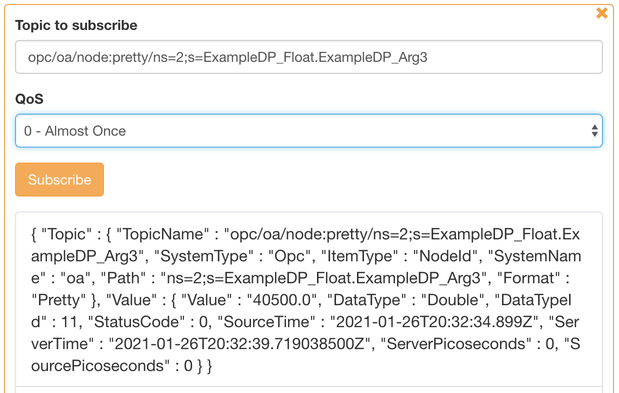
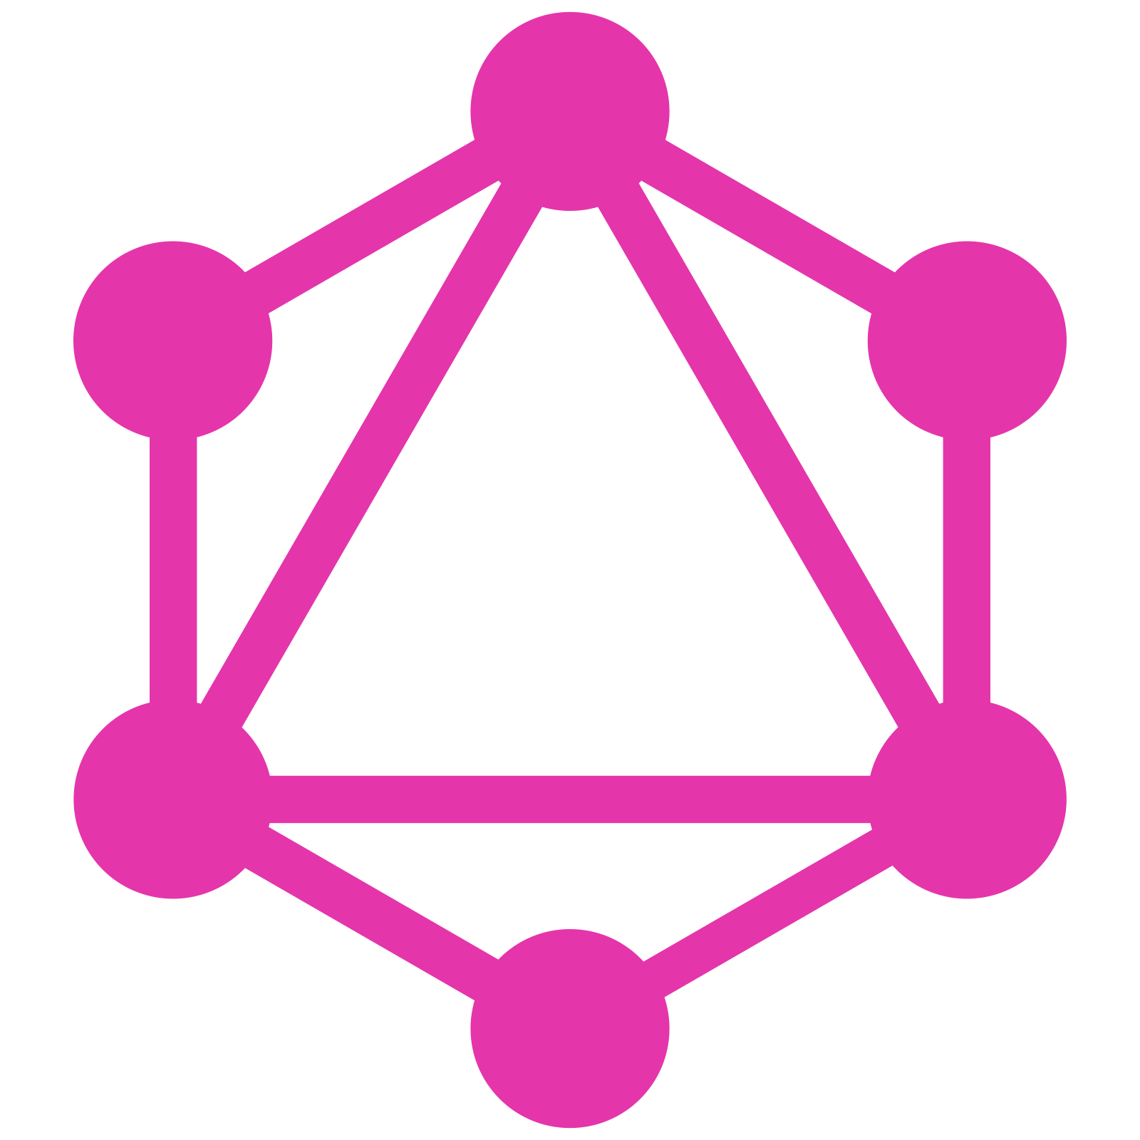

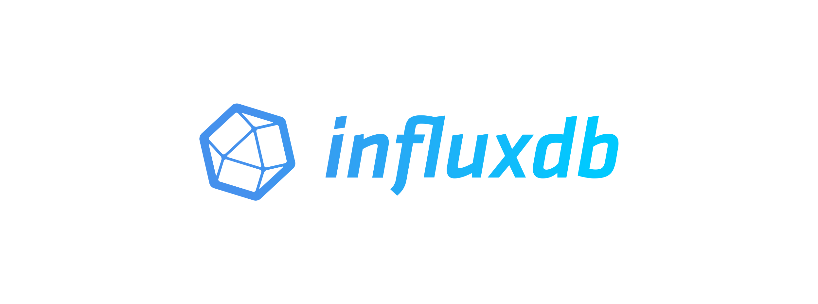




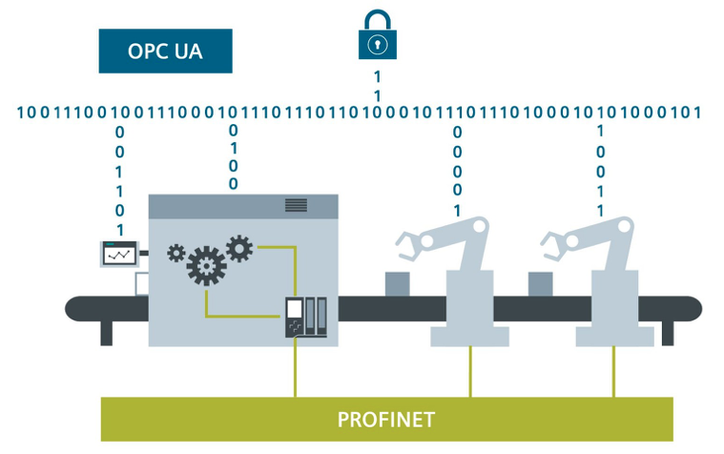
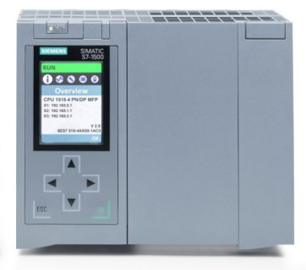
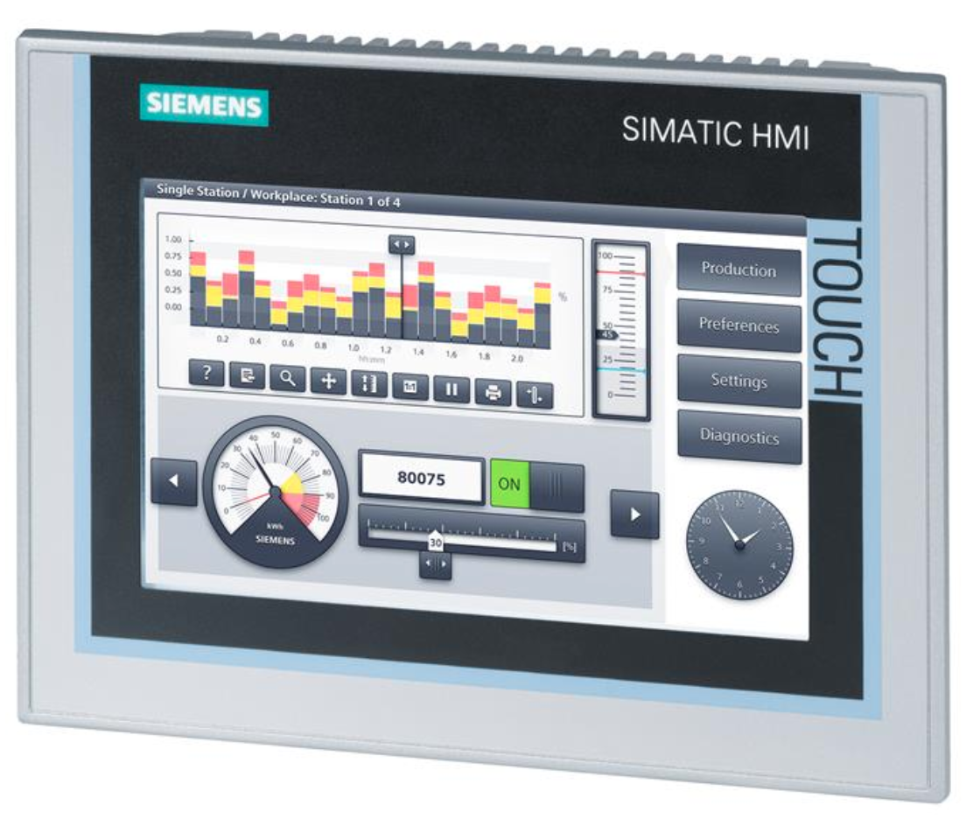


GraphQL
Query Tags
Mutate Tags
Subscribe Tags
Subscribe Tags
Publish Tags
HTTP
Websocket
TCP
Gateway
Reactive, Asynchronous
Single Host or Clustered
Broker
Database Logger
Query via GraphQL
GraphQL
OpenDDS
OPC UA Servers
BACnet/IP
DDS
ModBus
ROS2
KNX
S7
Siemens
Comfort Panels
WinCC Unified
…
Source: https://new.siemens.com

