Slide 1
LOAN APPROVAL PREDICTOR
Optimized, transparent, scalable loan approvals.

Slide 2
Business Problem
The Loan Approval Predictor optimizes lending decisions using a Random Forest Classifier, ensuring accuracy, automation and fairness. By analyzing key factors like prior defaults, income ratios and credit scores, it reduces default risk, streamlines operations and promotes equitable lending. This solution enhances efficiency, minimizes losses and fosters trust through transparent, data-driven insights.

Slide 3
Project Objectives
1. Enhance loan approval accuracy by leveraging historical data and predictive modeling techniques.
2. Minimize default risk by identifying high-risk applicants through classification algorithms.
3. Promote fairness in lending by analyzing biases in loan approval decisions and improving accessibility.
4. Streamline decision-making by automating loan approval predictions to reduce processing time.
5. Improve model interpretability to ensure stakeholders understand key factors influencing loan approvals.

Slide 4
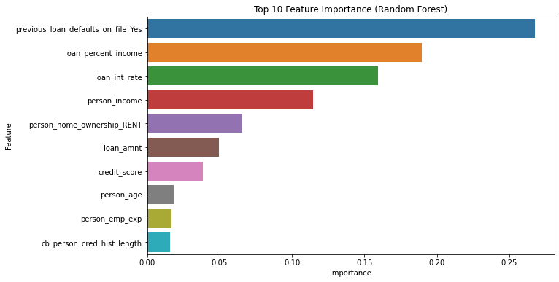
Features leveraging historical data to achieve high accuracy

Slide 5
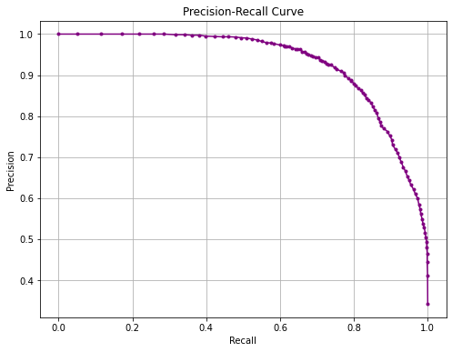
Model’s performance in identifying high-risk applicants

Slide 6
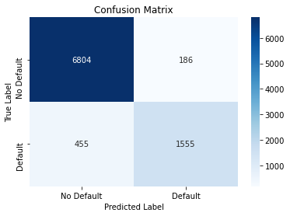
Model’s classification performance

Slide 7
Interpretation of the Matrix
AUC Score (0.943):
The ROC curve evaluates the performance of a binary classification model by plotting the True Positive Rate against the False Positive Rate at different thresholds. With an AUC of 0.943, the model demonstrates strong predictive capability, effectively distinguishing loan defaults from approvals while minimizing false positives.

Slide 8
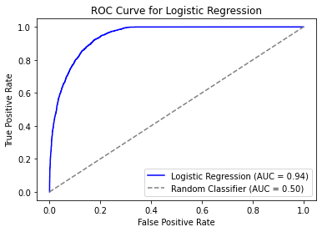
Comparing Logistic Regression & Random Forest

Slide 9
Interpretation
The ROC curve evaluates the performance of a binary classification model by plotting the True Positive Rate (TPR) against the False Positive Rate (FPR) at various thresholds. With an AUC score of 0.943, the model demonstrates high discriminatory power, effectively distinguishing between loan defaults and approvals. The diagonal reference line represents random guessing (AUC = 0.5) for comparison, highlighting the model’s superior predictive accuracy.

Slide 10
Key Insights
Model Performance: Random Forest Classifier, optimized with RandomizedSearchCV, delivers strong accuracy, precision, recall, and ROC AUC. SMOTE improves default detection in imbalanced loan_status data.
Key Predictors: Feature Importance Plot highlights previous_loan_defaults_on_file, loan_percent_income, credit_score as top drivers, reflecting risk and financial stability.
Default Risk: SMOTE and recommended Precision-Recall Curve enhance default detection, minimizing financial losses.
Fairness: Encoded demographics (person_gender, person_education) enable bias analysis.

Slide 11
Recommendations
Handle Class Imbalance: Use oversampling, class weighting, or resampling to balance loan
approval data.
Ensure Fair Lending: Apply fairness metrics and analyze demographic predictions to prevent bias.
Optimize Thresholds: Adjust classification thresholds to improve default detection and minimize false
positives.
Apply Cross-Validation: Evaluate model performance across subsets for consistency in predictions.
Align with Lending Standards: Integrate industry benchmarks like credit scores and loan-to-income
ratios.
Deploy & Monitor Model: Use real-time predictions and continuously track performance for accuracy.
Improve Transparency: Provide clear explanations, highlight key features, and build stakeholder trust.
Streamline Operations: Automate workflows and ensure scalability for high-volume loan processing.

