Slide 1
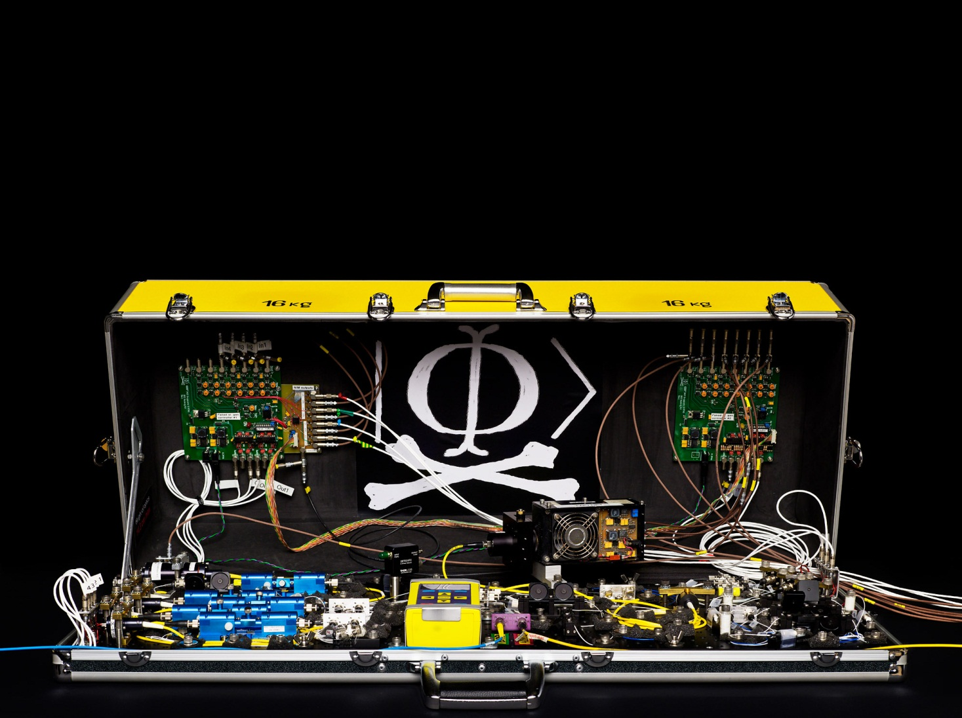


Talk at QCRYPT conference, Zurich, Switzerland, September 12-16, 2011
Loopholes in implementations
of quantum cryptography
Vadim Makarov
Photo © 2010 NTNU Info / Geir Mogen

Slide 2
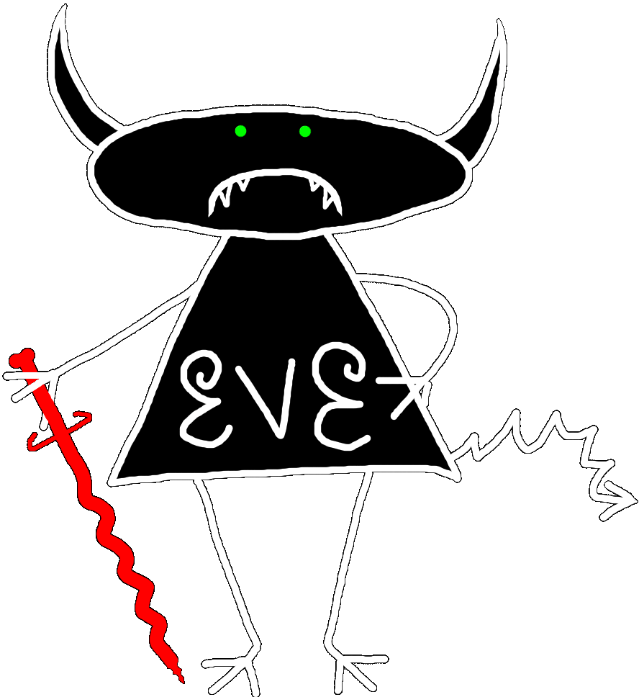



Security model of QKD
Alice
Bob
1
R
0
0
0.11
QBER
Security is based on the laws of physics and model of equipment

Slide 3
Stages of secure technology
Quantum
cryptography
1. Idea / theory / proof-of-the-principle
2. Initial implementations
3. Weeding out implementation loopholes
(spectacular failures patching)
4. Good for wide use
1970–1993
1994–2005
◄ Now!

Slide 4
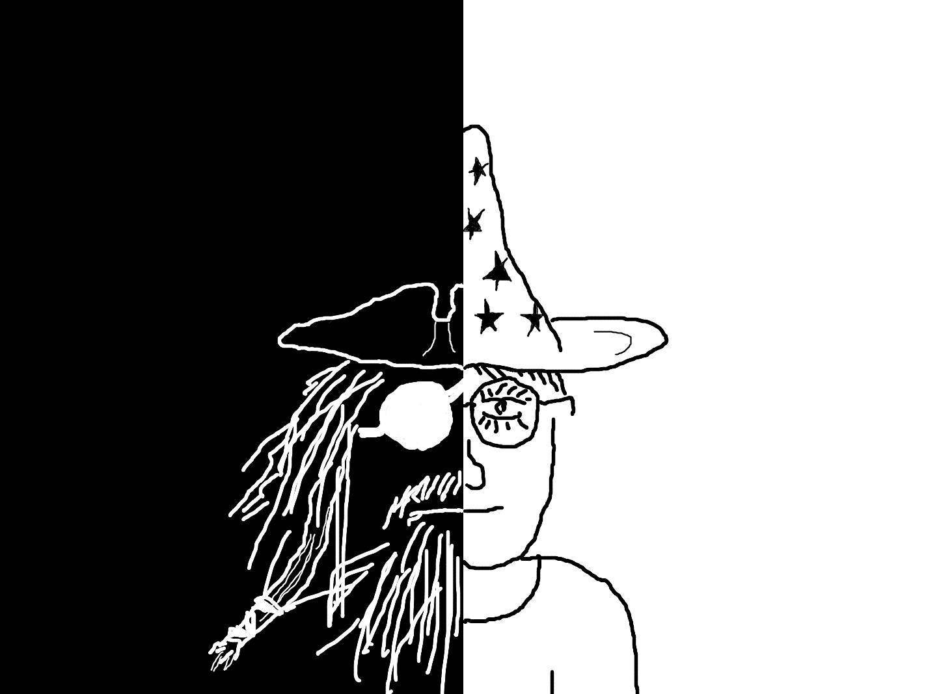
Tasks of a quantum hacker
Discover vulnerabilities
Demonstrate attacks
Countermeasures
Security proofs

Slide 5
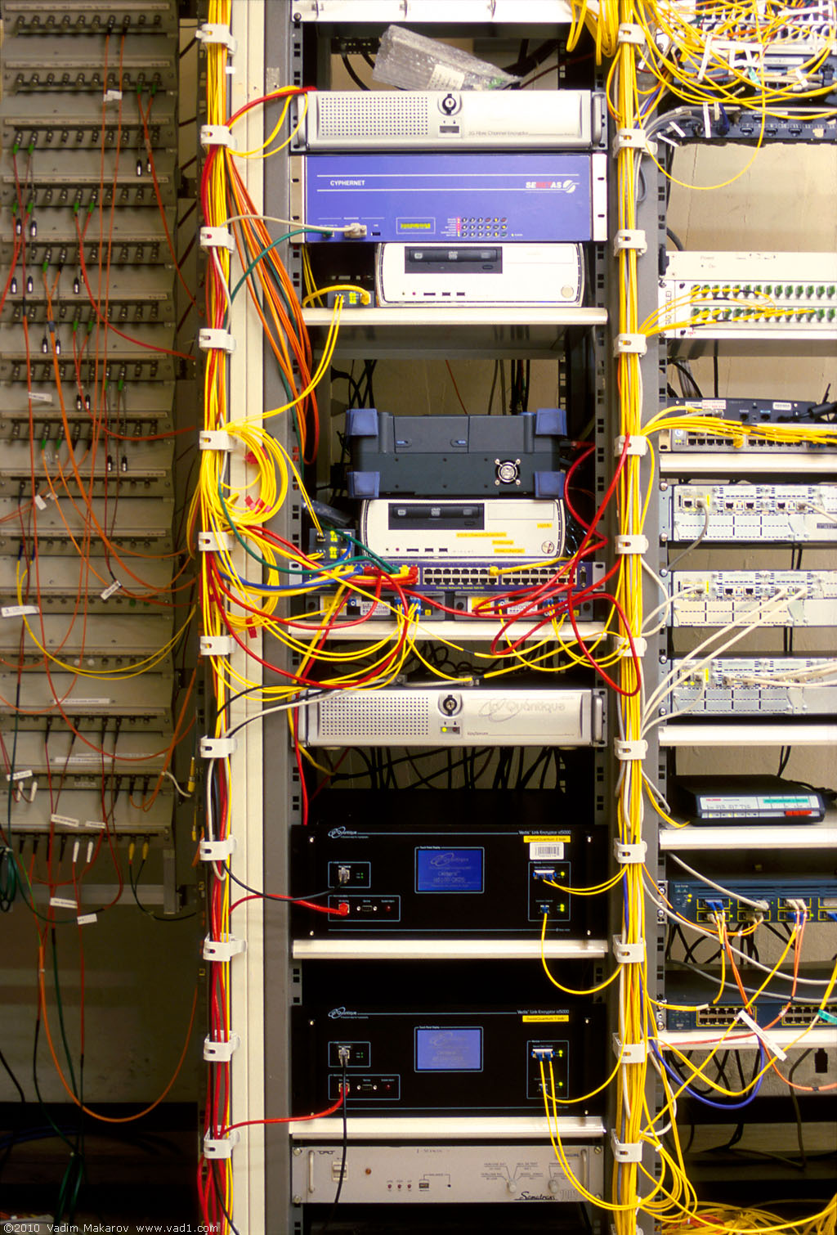
Commercial QKD
Classical encryptors:
L2, 2 Gbit/s
L2, 10 Gbit/s
L3 VPN, 100 Mbit/s
WDMs
Key manager
QKD to another node (3 km)
QKD to another node (17 km)
Photo © 2010 Vadim Makarov
www.swissquantum.com

Slide 6
Attack | Target component | Tested system | Demonstrated eavesdr. (% key)? | Keeps full key rate?
Time-shift | detector | ID Quantique | no (fraction) | no
Y. Zhao et al., Phys. Rev. A 78, 042333 (2008)
Phase-remapping | phase modulator | ID Quantique | no (full inf.-th.) | yes (@ transm.≪1)
F. Xu, B. Qi, H.-K. Lo, New J. Phys. 12, 113026 (2010)
Faraday-mirror | Faraday mirror | (theory) | (full inf.-th.) | yes (@ transm.≪1)
S.-H. Sun, M.-S. Jiang, L.-M. Liang, Phys. Rev. A 83, 062331 (2011)
Channel calibration | detector | ID Quantique | no (full inf.-th.) | yes
N. Jain et al., Phys. Rev. Lett. 107, 110501 (2011)
Detector control | detector | ID Quantique, MagiQ Tech. | no (100%) | yes
L. Lydersen et al., Nat. Photonics 4, 686 (2010)
Detector control | detector | research syst. | yes (100%) | yes
I. Gerhardt et al., Nat. Commun. 2, 349 (2011)
Deadtime | detector | research syst. | yes (98.8%) | no, 1/4
H. Weier et al., New J. Phys. 13, 073024 (2011)

Slide 7
Attack | Target component | Tested system | Demonstrated eavesdr. (% key)? | Keeps full key rate?
Time-shift | detector | ID Quantique | no (fraction) | no
Y. Zhao et al., Phys. Rev. A 78, 042333 (2008)
Phase-remapping | phase modulator | ID Quantique | no (full inf.-th.) | yes (@ transm.≪1)
F. Xu, B. Qi, H.-K. Lo, New J. Phys. 12, 113026 (2010)
Faraday-mirror | Faraday mirror | (theory) | (full inf.-th.) | yes (@ transm.≪1)
S.-H. Sun, M.-S. Jiang, L.-M. Liang, Phys. Rev. A 83, 062331 (2011)
Channel calibration | detector | ID Quantique | no (full inf.-th.) | yes
N. Jain et al., Phys. Rev. Lett. 107, 110501 (2011)
Detector control | detector | ID Quantique, MagiQ Tech. | no (100%) | yes
L. Lydersen et al., Nat. Photonics 4, 686 (2010)
Detector control | detector | research syst. | yes (100%) | yes
I. Gerhardt et al., Nat. Commun. 2, 349 (2011)
Deadtime | detector | research syst. | yes (98.8%) | no, 1/4
H. Weier et al., New J. Phys. 13, 073024 (2011)
Every attack
breaks QKD security!

Slide 8
Attack | Target component | Tested system | Demonstrated eavesdr. (% key)? | Keeps full key rate?
Time-shift | detector | ID Quantique | no (fraction) | no
Y. Zhao et al., Phys. Rev. A 78, 042333 (2008)
Phase-remapping | phase modulator | ID Quantique | no (full inf.-th.) | yes (@ transm.≪1)
F. Xu, B. Qi, H.-K. Lo, New J. Phys. 12, 113026 (2010)
Faraday-mirror | Faraday mirror | (theory) | (full inf.-th.) | yes (@ transm.≪1)
S.-H. Sun, M.-S. Jiang, L.-M. Liang, Phys. Rev. A 83, 062331 (2011)
Channel calibration | detector | ID Quantique | no (full inf.-th.) | yes
N. Jain et al., Phys. Rev. Lett. 107, 110501 (2011)
Detector control | detector | ID Quantique, MagiQ Tech. | no (100%) | yes
L. Lydersen et al., Nat. Photonics 4, 686 (2010)
Detector control | detector | research syst. | yes (100%) | yes
I. Gerhardt et al., Nat. Commun. 2, 349 (2011)
Deadtime | detector | research syst. | yes (98.8%) | no, 1/4
H. Weier et al., New J. Phys. 13, 073024 (2011)

Slide 9
How avalanche photodiodes (APDs) work
I
Linear mode
Geiger mode
I
I_{th}
P_{th}
Popt
Quenching
I_{th}
Single photon
V
Breakdown
voltage V_{br}

Slide 10
Faked-state attack in APD linear mode
Identical bases & bit values
Eve
Bright
state
Alice
.Bob´
.Alice´
Bob
Listen, do same,
get same final key
Classical post-processing
Bob chooses same basis as Eve:
Bob chooses different basis:
“0”
I
0
“0
”
I
0
I
th
I
th
Click!
t
t
“1
”
I
1
“1
”
I
1
I
th
I
th
t
t
L. Lydersen, C. Wiechers, C. Wittmann, D. Elser, J. Skaar, V. Makarov, Nat. Photonics 4, 686 (2010)

Slide 11
Launching bright pulse after the gate...
V_{APD}
V_{br}
afterpulses,
increased QBER
V_{bias}
0
t
bright C. Wiechers et al., New J. Phys. 13, 013043 (2011)
< 120 photons L. Lydersen et al., arXiv:1106.2119
Add CW light...
Bias to APD
(V_{bias})
V_{APD}
V_{br}
Detector blind!
Zero dark count rate
R_{bias}
V_{bias}
V_{HV} ≈ 40 V
0
t
L. Lydersen et al., Nat. Photonics 4, 686 (2010)

Slide 12
Full detector control
ID Quantique Clavis2
V
3
,
s
2
e
t
a
1
G
0
W
m
2
⧫
808 μW
,
⧫
647 μW
t
n
1.5
u
o
i
p
t
1
n
a
I
n
i
0.5
m
u
l
0
l
i
r
(never clicks)
(always clicks)
o
t
Logic 1
t
u
c
p
e
t
t
u
e
o
Logic 0
D
-10
0
10
20
30
-10
0
10
20
30
Time, ns
Time, ns
L. Lydersen, C. Wiechers, C. Wittmann, D. Elser, J. Skaar, V. Makarov, Nat. Photonics 4, 686 (2010)

Slide 13
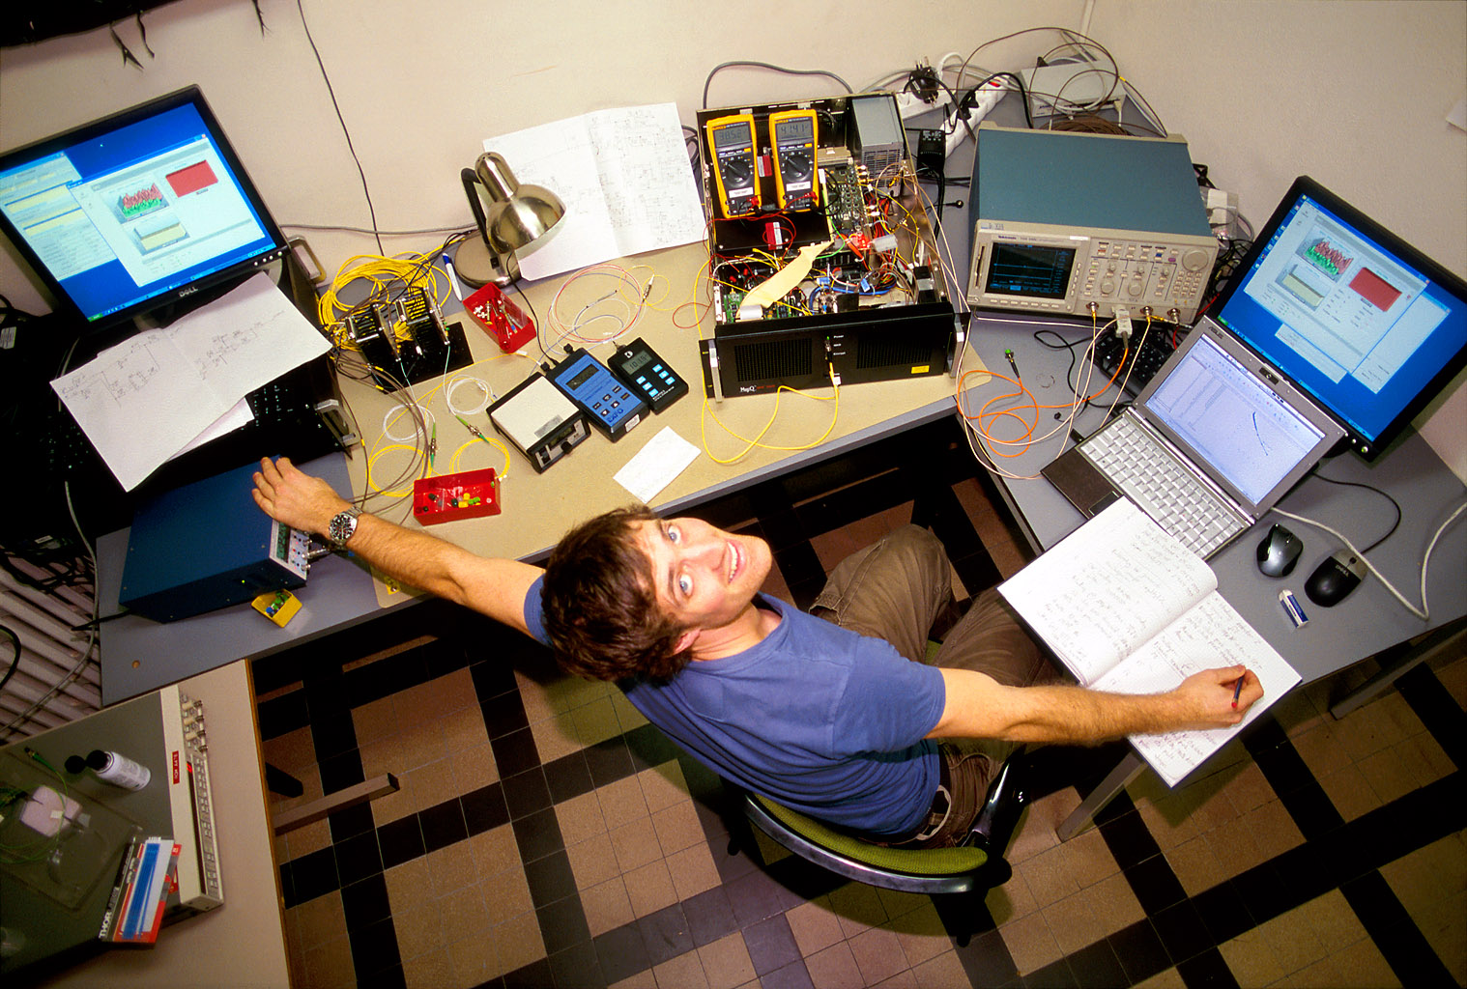
Lars Lydersen testing MagiQ Technologies QPN 5505
Photo © 2010 Vadim Makarov

Slide 14
Proposed full eavesdropper
Eve
Optical
Alice
Bob´
Alice´
amplifier
Bob
Basis
Basis
Detection result
Bit in
Blinding laser

Slide 15
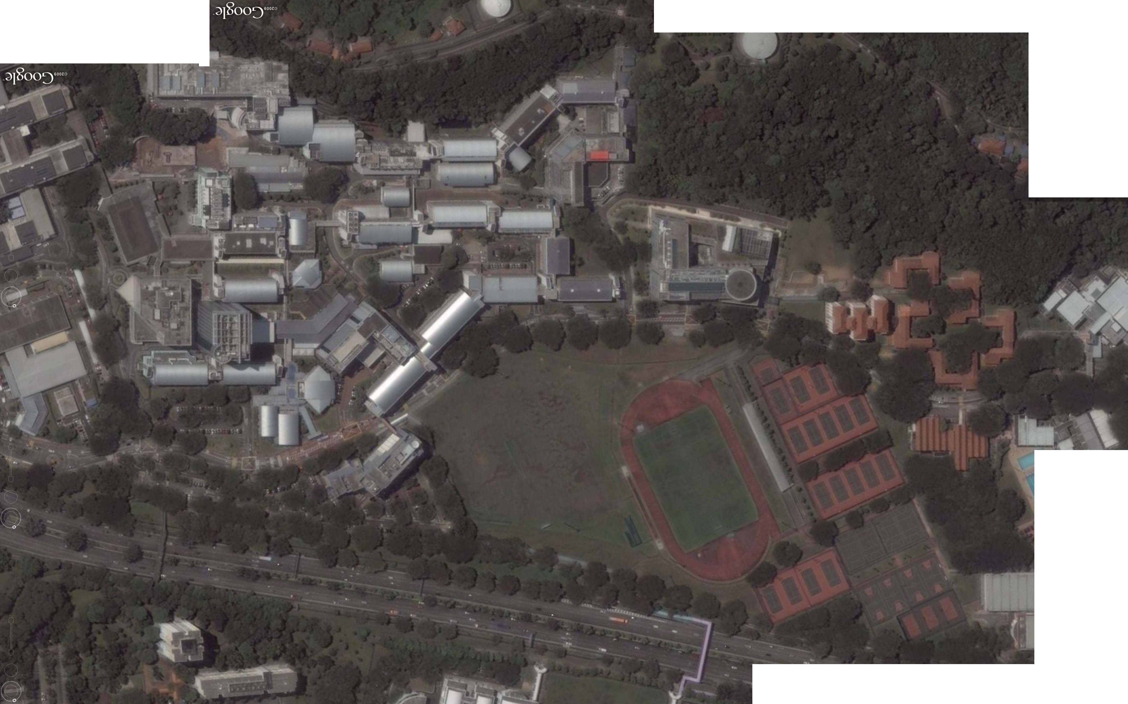
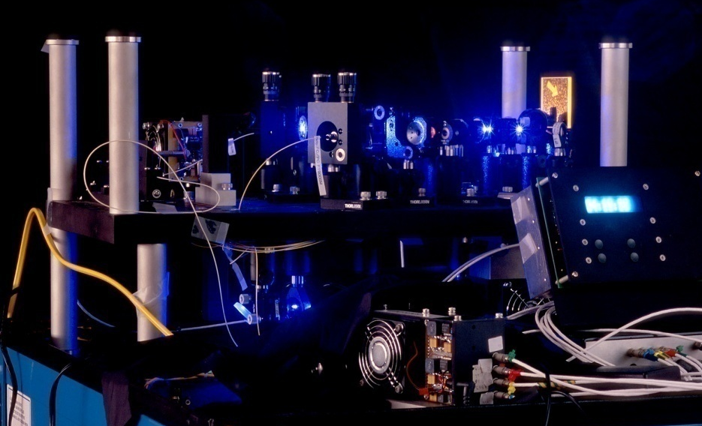
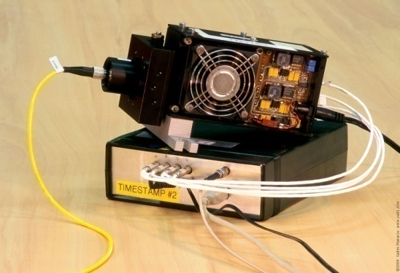
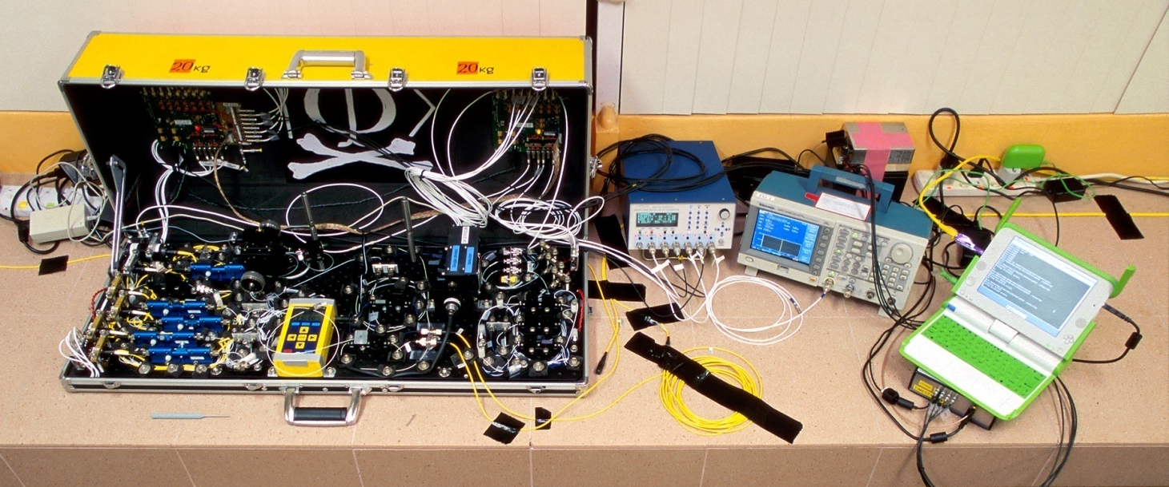
Eavesdropping 100% key on installed QKD line on campus of the National University of Singapore, July 4-5, 2009
290 m of fiber
Eve
S13
S14
Bob
Alice
S12
S15
Image © 2009 DigitalGlobe
I. Gerhardt, Q. Liu et al.,
Nat. Commun. 2, 349 (2011)

Slide 16
Eve does not affect QKD performance
Without eavesdropping
During eavesdropping
3000
2000
Raw key bit rate, s^{–1}
1000
0
10
8
QBER, %
6
4
2
0
0
100
200
300
0
100
200
300
Time, s
Time, s
I. Gerhardt, Q. Liu, A. Lamas-Linares, J. Skaar, C. Kurtsiefer, V. Makarov, Nat. Commun. 2, 349 (2011)

Slide 17
Detector control demo. Now I am blind, now I click...
Input
illumination
0
Time
Bright CW illumination
keeps detector blinded
⇩
no click
Faked state
⇩
single click
Faked state
@1/2 power
⇩
no click
1
Detector
output
0

Slide 18

Faking violation of Bell inequality
Polarization
analyser A
Polarization
analyser B
PBS
λ/2
BS
Source of
entangled photons
BS
λ/2
PBS
PBS
PBS
I. Gerhardt, Q. Liu et al., arXiv:1106.3224

Slide 19

Faking violation of Bell inequality
Polarization
analyser A
Polarization
analyser B
PBS
λ/2
BS
Faked
state
generator
Faked
state
generator
BS
λ/2
PBS
PBS
Pattern generator
PBS
I. Gerhardt, Q. Liu et al., arXiv:1106.3224

Slide 20
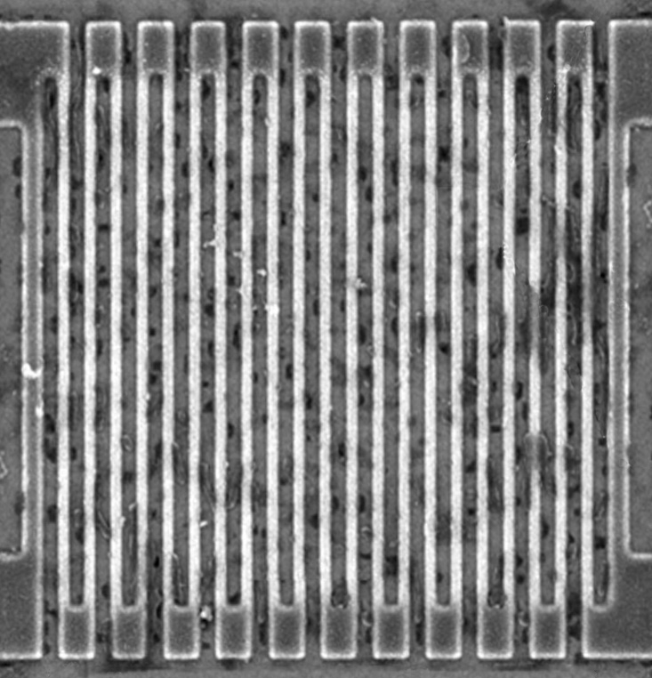
Controlling superconducting nanowire single-photon detectors
Comparator input
voltage, a.u.
1. Blind (latch)
0
2. Control
0
1
0
2
0
3
0
Time, ns
Normal single-
photon click
14 mW pulse
7 mW pulse
L. Lydersen, M. K. Akhlaghi, A. H. Majedi, J. Skaar, V. Makarov, arXiv:1106.2396

Slide 21
Responsible disclosure is important
2009
Example: hacking commercial systems
ID Quantique got a detailed vulnerability report
  reaction: requested time, developed a patch
MagiQ Technologies got a detailed vulnerability report
  reaction: informed us that QPN 5505 is discontinued
Results presented orally at a scientific conference
Public disclosure in a journal paper
  L. Lydersen et al., Nat. Photonics 4, 686 (2010)
2010

Slide 22
Can we eavesdrop on commercial systems?
ID Quantique’s Cerberis:
Dual key agreement
QKD
BB84
QKD
PKI
RSA-2048
PKI
Key
Key
Symmetric
cipher
AES-256
Symmetric
cipher
Photo © 2010 Vadim Makarov

Slide 23
Countermeasures
Kill the hacker
Illegal
Does not solve the problem

Slide 24
Countermeasures (technical)
“Quick and intuitive” patches
Lead away from provable security model of QKD
Can often be defeated by hacking advances
Integrate imperfection into security proof
May require
deep modification of protocol, hardware, and security proof
Z. L. Yuan, J. F. Dynes, A. J. Shields, Appl. Phys. Lett. 98, 231104 (2011); comment: L. Lydersen,
V. Makarov, J. Skaar, arXiv:1106.3756
L. Lydersen et al., arXiv:1106.2119
Ø. Marøy et al., Phys. Rev. A 82, 032337 (2010)
L. Lydersen et al., Phys. Rev. A 83, 032306 (2011)
H.-K. Lo, M. Curty, B. Qi, arXiv:1109.1473

Slide 25
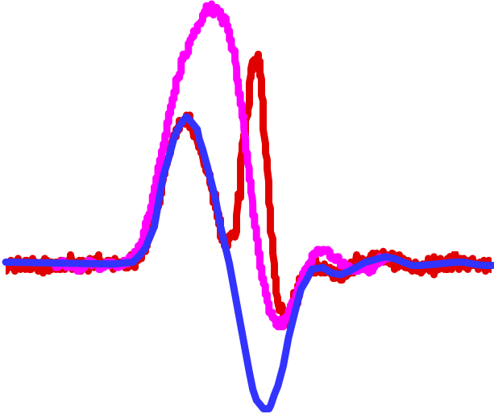
Patch via “correct detector settings”
3.5 ns
Gate
1 R_{bias} = 0
R_{bias}
Gain
modulation
@ R_{bias} = 0
V_{bias}
Bias
tee
Avalanche
3 Monitor I_{bias}
for “anomalously
high” values
2 Comparator
threshold
just above
cap. signal
50 Ω
Capacitive signal
4 Accept clicks
in narrow
time window
Z. L. Yuan, J. F. Dynes, A. J. Shields, Appl. Phys. Lett. 98, 231104 (2011); L. Lydersen, V. Makarov, J. Skaar, arXiv:1106.3756
Z. L. Yuan, J. F. Dynes, A. J. Shields, Nat. Photonics 4, 800 (2010); L. Lydersen et al., ibid. 801.

Slide 26
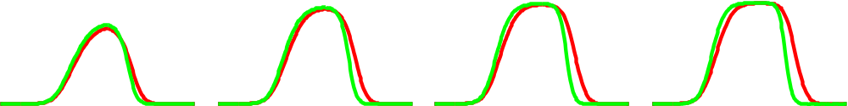
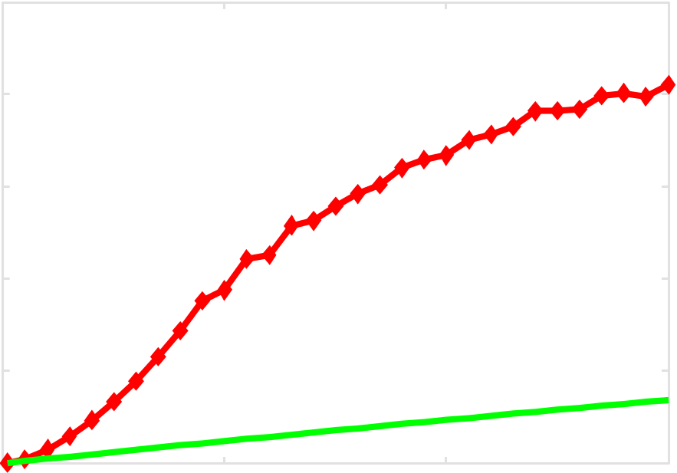
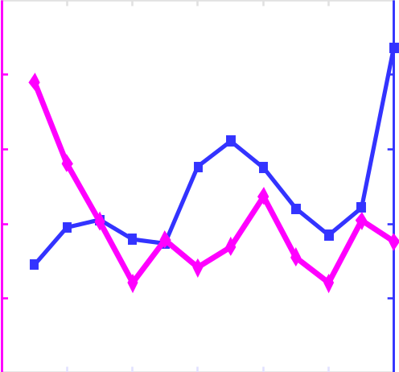
Oops! Superlinearity of gated APD
μ = 20
μ = 40
μ = 60
μ = 80
1
Detection
probability
0
0
5
Time, ns
Expected det. prob. Actual det. prob.
1
20
0.01
Detection
probability @ 4 ns
18
16
QBER, %
Transmittance
14
12
0
10
0
0
50
μ
100
150
0
μ
120
L. Lydersen et al., arXiv:1106.2119

Slide 27
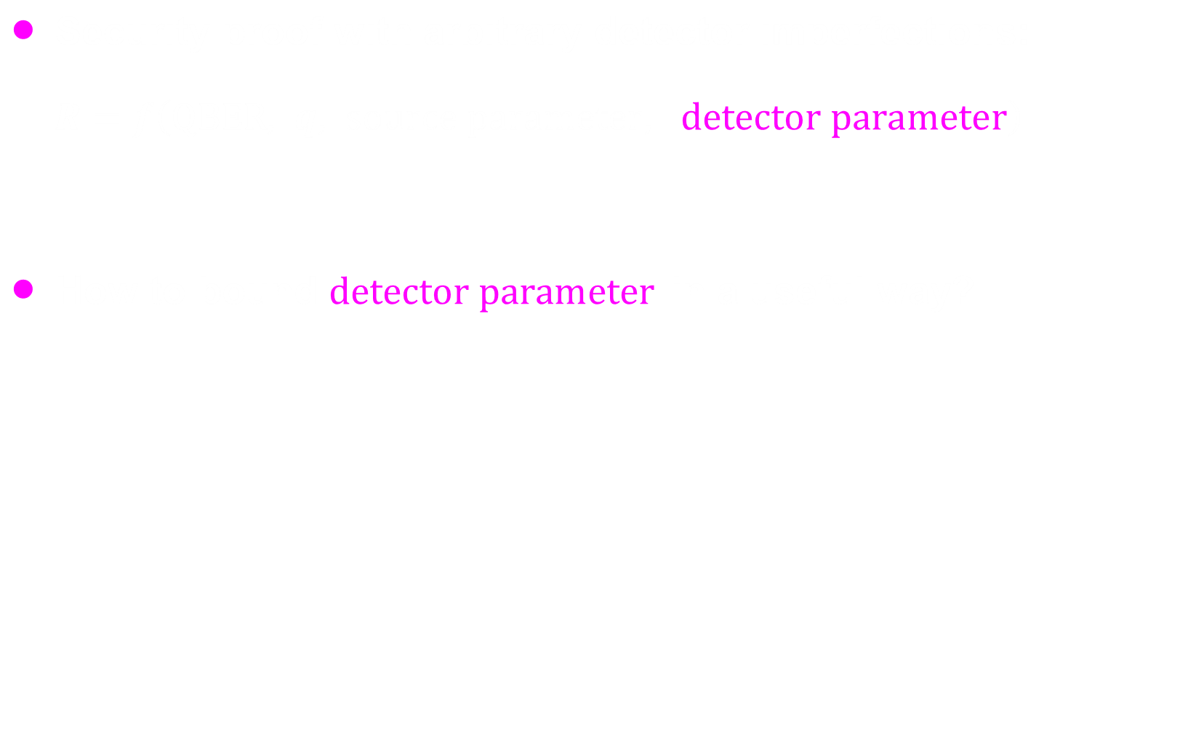
Integrate into security proof
Ø. Marøy, L. Lydersen, J. Skaar, Phys. Rev. A 82, 032337 (2010)
Detector sensitivity
Time
Bit-mapped gating:
Bob’s basis choice
Random
Random
Time
L. Lydersen, V. Makarov, J. Skaar, Phys. Rev. A 83, 032306 (2011)

Slide 28
Countermeasures
“Quick and intuitive” patches
Lead away from provable security model of QKD
Can often be defeated by hacking advances
Integrate imperfection into security proof
May require
deep modification of protocol, hardware, and security proof
Z. L. Yuan, J. F. Dynes, A. J. Shields, Appl. Phys. Lett. 98, 231104 (2011); comment: L. Lydersen,
V. Makarov, J. Skaar, arXiv:1106.3756;
L. Lydersen et al., arXiv:1106.2119
Ø. Marøy et al., Phys. Rev. A 82, 032337 (2010)
L. Lydersen et al., Phys. Rev. A 83, 032306 (2011)
H.-K. Lo, M. Curty, B. Qi, arXiv:1109.1473

Slide 29


