Slide 1

QUANTOP
Danmarks Grundforskningsfond - Quantum Optics Center
Quantum memory and teleportation with atomic ensembles
Eugene Polzik
Niels Bohr Institute
Copenhagen University

Slide 2
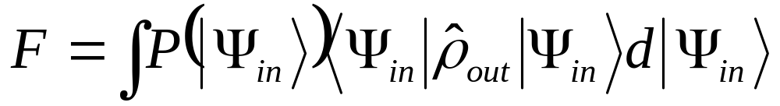
We concentrate on:
deterministic high fidelity* state transfer
Fidelity of quantum transfer
State overlap averaged over
the set of input states
Interface matter-light as quantum channel
^{*)} Fidelity higher than any classical measure-recreate protocol
can achieve

Slide 3
Light – matter
quantum interface
K. Hammerer, A. Sørensen, E.P.
Reviews of Modern Physics, 2010
arXiv:0807.3358
Probabilistic entanglement
distribution (DLCZ and the like)
Deterministic
transfer of
quantum states
between
light and matter
Homodyning – based
protocols (99% detectors)
Photon counting – based protocols
typical efficiency 10-50%
Hybrid approaches
(Schrödinger cats and the like)

Slide 4


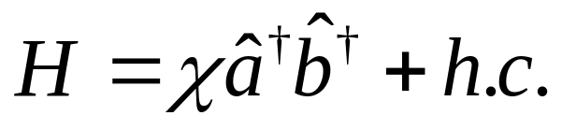
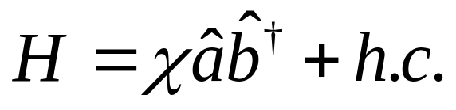



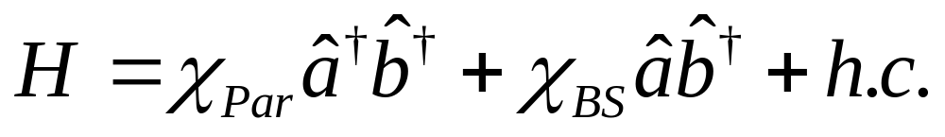
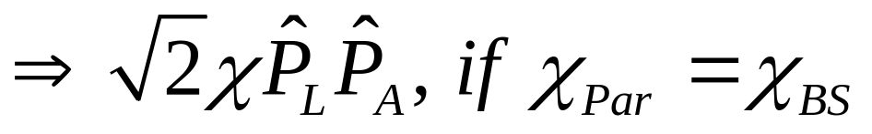
Quantum interface – basic interactions
Light-Atoms Entanglement
Light-to-Atoms mapping (memory)
Innsbruck, Copenhagen, GIT,
Caltech, Harvard, Heidelberg
Aarhus, Harvard, Caltech, GIT
X-type = double
Λ interaction
Rochester, Copenhagen, Caltech, Garching, Arisona…

Slide 5

Quantum memory beyond classical benchmark
Quantum memory for light
Atoms
Fidelity of quantum storage
State overlap
averaged over
the set of input states

Slide 6
Classical benchmark fidelity for state transfer
for different classes of states:
Coherent states (2005)
N-dimentional Qubits (1982-2003)
NEW! Displaced squeezed states (2008)
Fidelity exceeds the classical benchmark
memory preserves entanglement

Slide 7

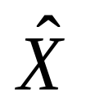
Classical benchmark fidelity for state transfer is known for the classes of states:
1. Coherent states
Best classical fidelity for
coherent states is 50%
Experimental
demonstrations of F>F_{Cl}:
Light to light teleportation Caltech’98 F=58%
Light to matter teleportation
Copenhagen’06 F=58%
3. Displaced squeezed states:
M.Owari, M.Plenio, E.P., A.Serafini, M.M.Wolf
New J. of Physics (2008); Adesso, Chiribella (2008)
2. Qubits
Best classical fidelity 2/3
Experimental demonstration:
Ion to ion teleportation
NIST’04; Innsbruck’04
F=78%

Slide 8
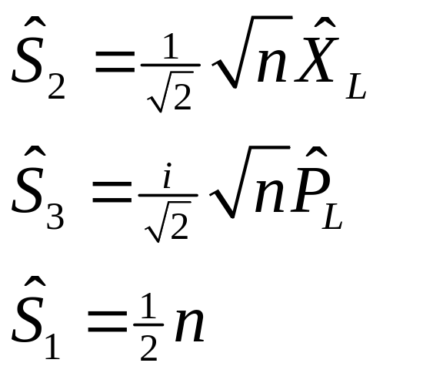
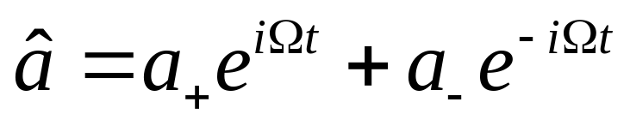
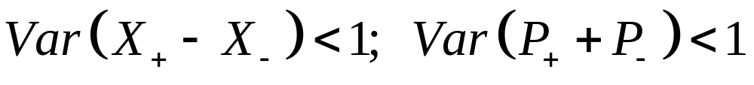
Stokes operators and canonical variables
S₂ measurement
-45⁰
45⁰
Polarizing
Beamsplitter 45⁰/-45⁰
x
Polarizing
cube
Quantum field: EPR entangled

Slide 9
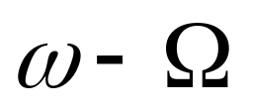

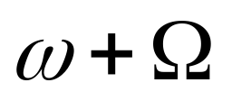
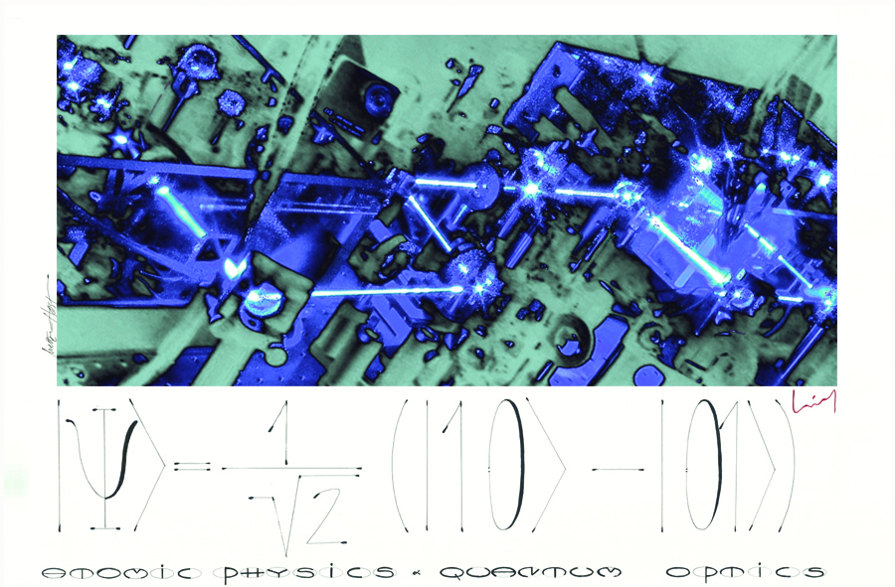

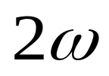
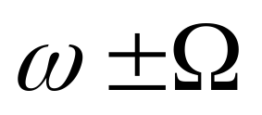
Two-mode squeezed = EPR entangled mode
SHG
OPO

Slide 10

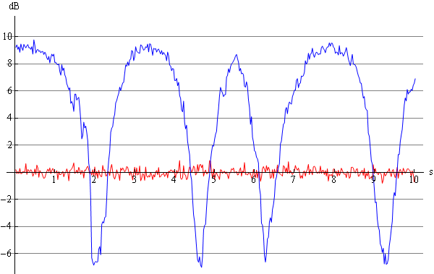

Atom-compatible EPR state
Atomic memory compatible
squeezed light source
Bo Metholt Nielsen, Jonas
Neergaard
- 6 dB
two mode squeezed = EPR entangled light

Slide 11
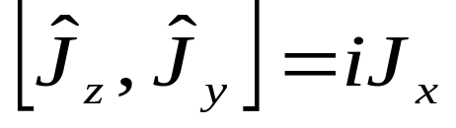
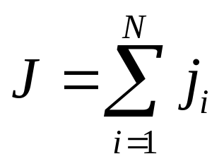

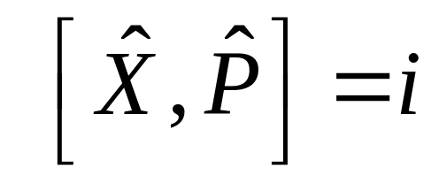




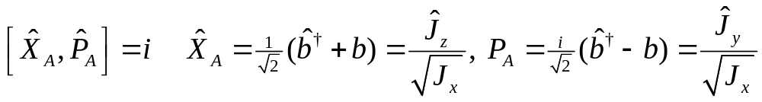
Spin polarized ensemble as T=0⁰ Harmonic oscillator
Cesium
6P_{3/2}
Harmonic oscillator
in the ground state
at room temperature
J_{z}~X
J_{y}~P
J_{x}
m_{F}=4
F=4
m_{F}=3
6S_{1/2}
F=3

Slide 12
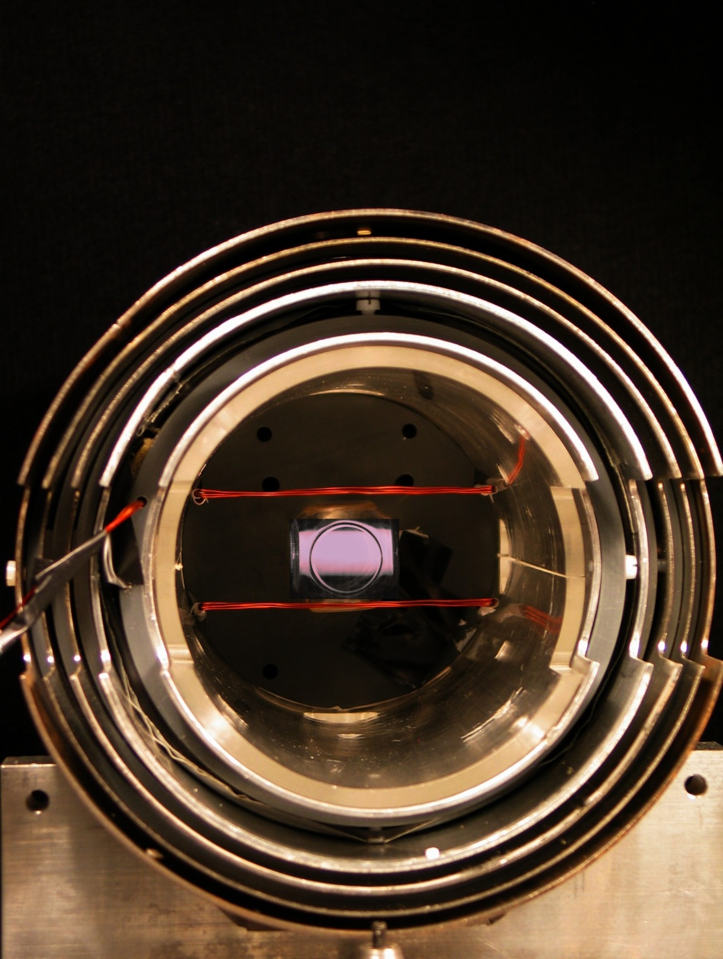

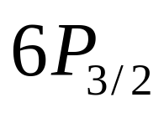
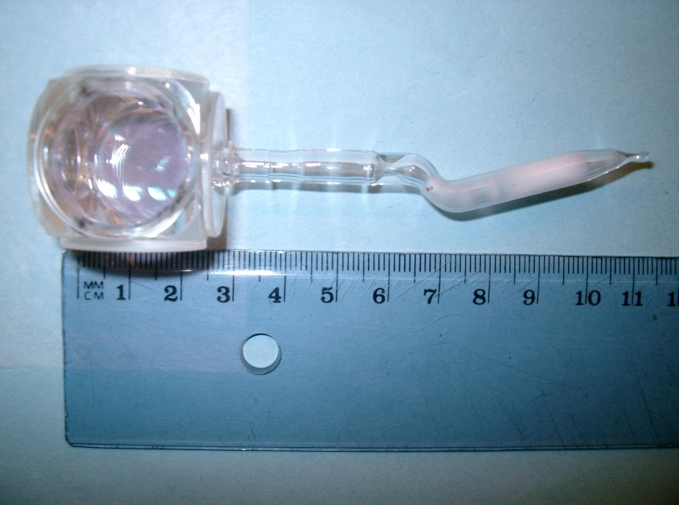
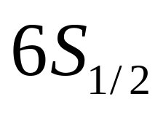

10¹² Room Temperature atoms
Cesium
Harmonic oscillator
in a ground state
99.8%
initialization to
ground state
4
3
2

Slide 13
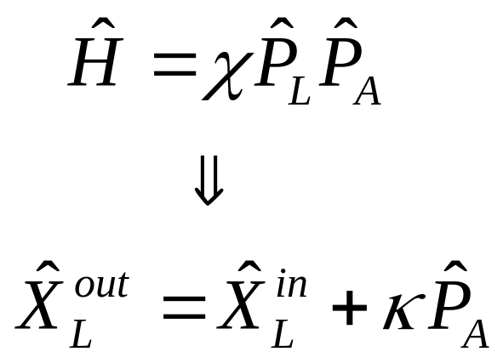
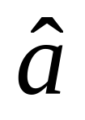
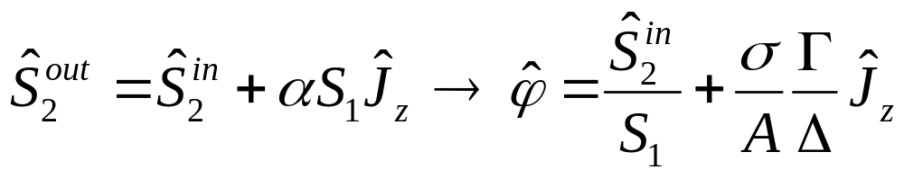
Quantum nondemolition interaction:
1. Polarization rotation of light
-45⁰
45⁰
Polarizing
Beamsplitter 45⁰/-45⁰
x
Quantum field
Polarizing
cube
Polarization
of light

Slide 14
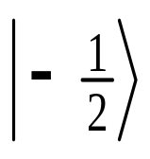
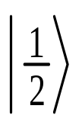

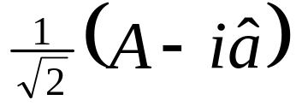
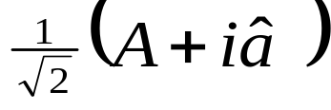
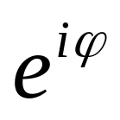
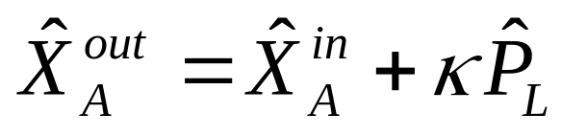
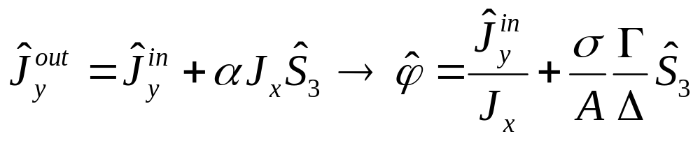
Quantum nondemolition interaction:
2. Dynamic Stark shift of atoms
Z
Atoms
Strong field A(t)
atoms
Quantum field - a
x
Z-quantization
Polarizing
cube
y
Atomic
spin
rotation

Slide 15
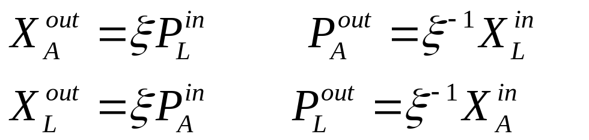
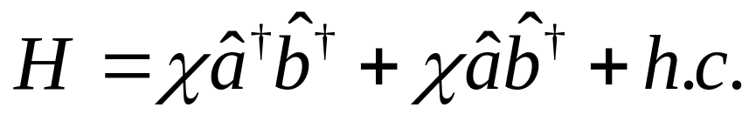
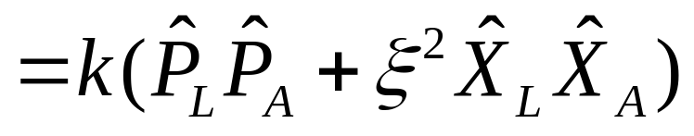
Stronger coupling:
atom-photon state swap
plus squeezing
Photons_{OUT}
Atoms_{IN}
Photons_{IN}
Atoms_{OUT}
W. Wasilewski et al,
Optics Express 2009
1
2

Slide 16

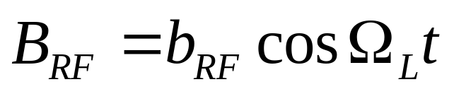
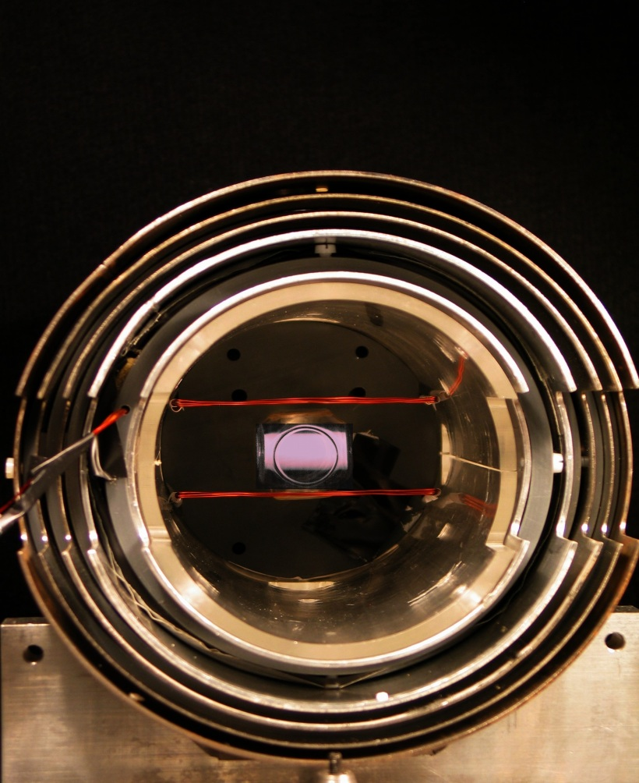
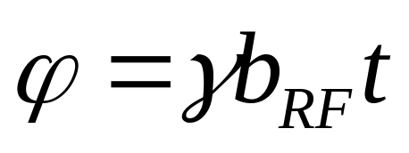
Quantum feedback onto atoms
Its just a ~π/√N pulse
B_{RF}
Goal: rotate atomic spin ~ to
measured photonic operator value
B

Slide 17
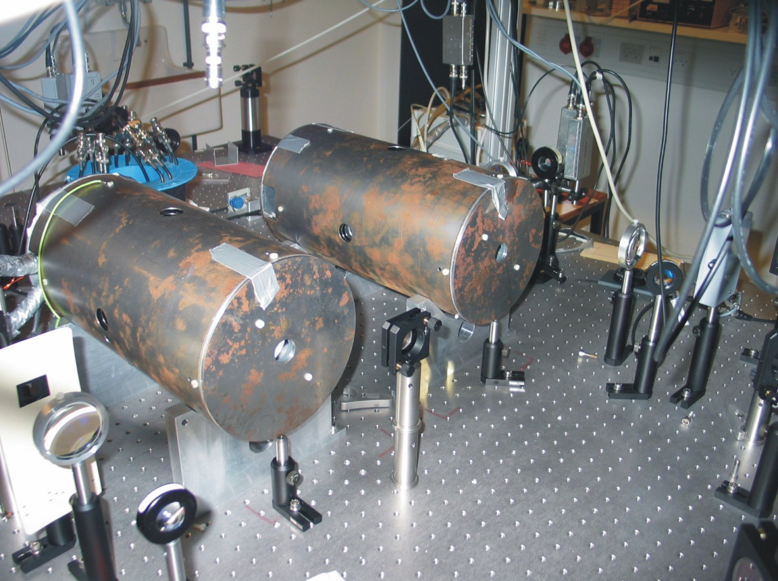
Storage of two entangled photonic modes
in two distant atomic memories
1
2
Detectors
K. Jensen, W. Wasilewski, H. Krauter, T. Fernholz, B. M. Nielsen,
M. Owari, M. B. Plenio, A. Serafini, M. M. Wolf, and E. S. Polzik.
Nature Physics 7 (1), pp.13-16 (2011)

Slide 18
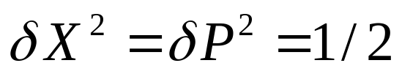
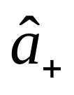
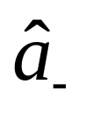
Displaced two-mode squeezed (EPR) states
Coherent
EPR entangled = two-mode squeezed
Displaced two-mode squeezed

Slide 19
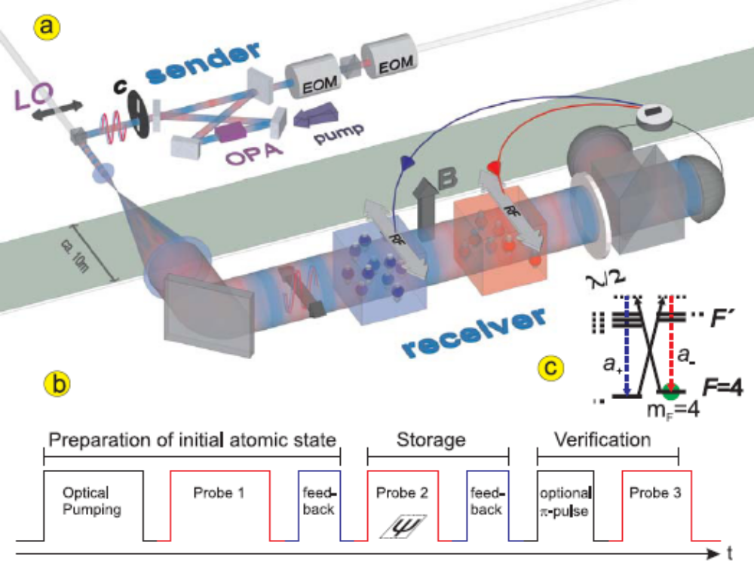

Slide 20
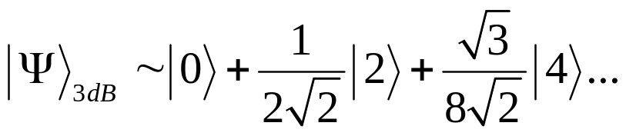



Memory in atomic Zeeman coherences
10¹² Cs atoms at RT
in a ”magic” cell
Cesium
Example: 3 dB (factor of 2) spin squeezed state
+
+
4
3

Slide 21
Storing ± Ω modes in superpositions
of atomic Zeeman coherences
~ 1000 MHz
M_{F} = 5,4,3
M_{F} = -3
M_{F} = 4
- 320 kHz
320 kHz
M_{F} = -4
M_{F} = 3

Slide 22
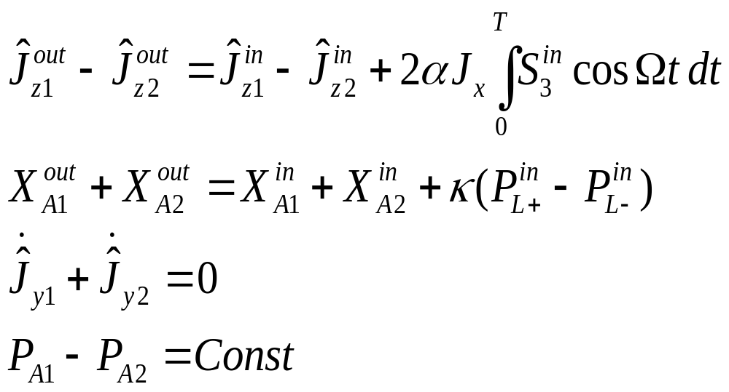


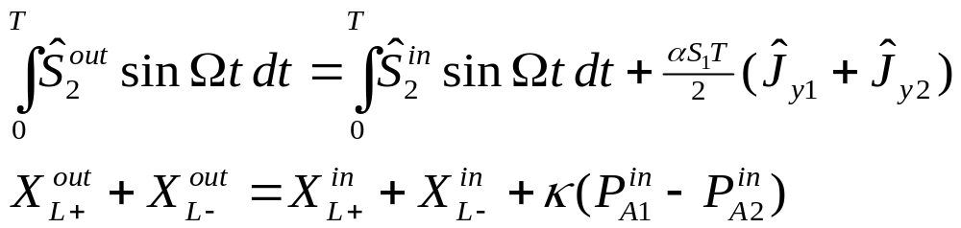
Two halves of entangled mode of light
are stored in two atomic memories
Cell 1
Cell 2

Slide 23
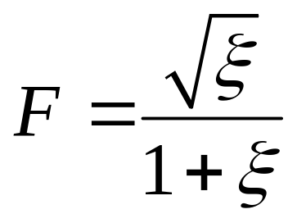
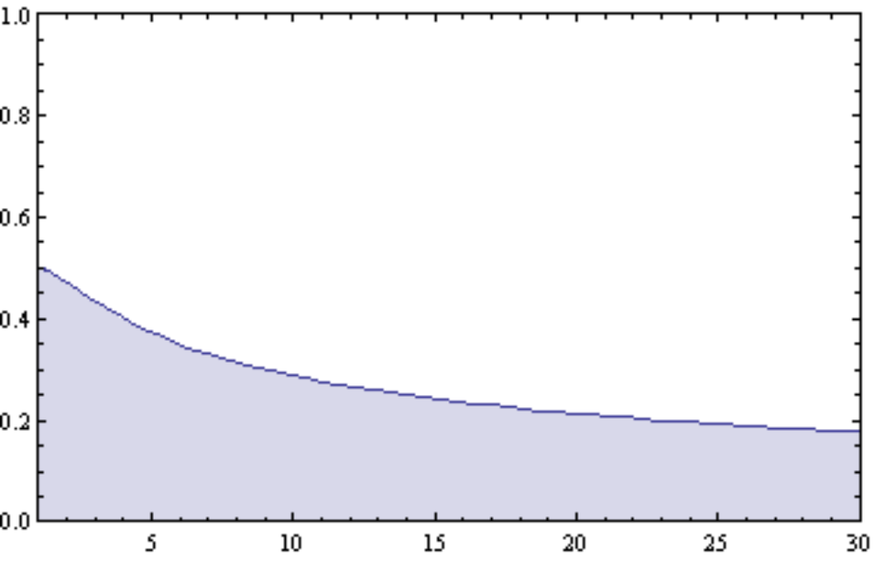
Squeezed states – classical benchmark fidelity:
M.Owari et al New J. Phys. 2008
ξ⁻¹
Best classical fidelity vs degree of
squeezing for arbitrary displaced
states
ξ⁻¹ – squeezed variance
ξ⁻¹

Slide 24

Strong
field
Squeezed
light source
Input
pulse
Readout
pulse
Optical pumping
and squeezing
of atomic state
Rf feedback
Π-pulse

Slide 25
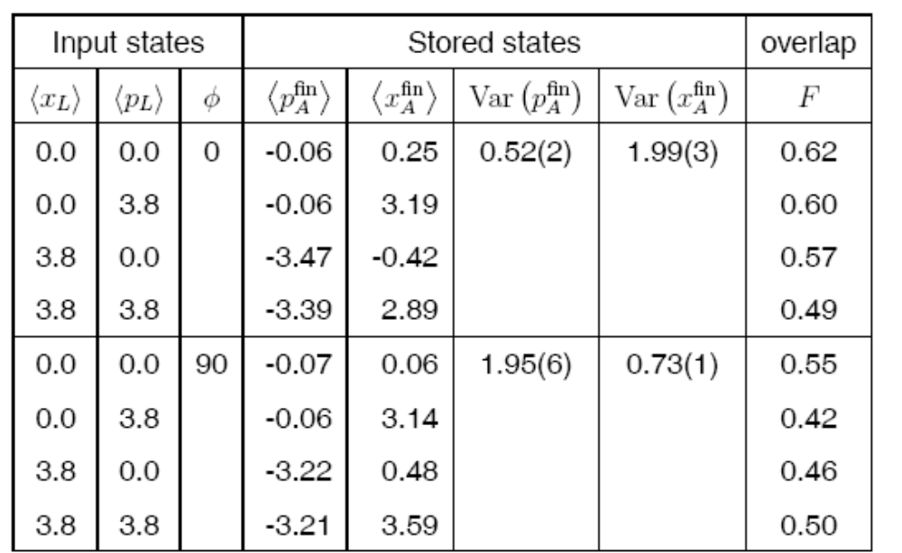
Alphabet of input states, 6 dB squeezed and displaced
0
3.8
7.6
Vacuum state variances = 0.5
Memory added noise: 0.47(6) in X_{A} , 0.38(11) in P_{A}
Ideally should be: 0.36 in X_{A} and 0 in P_{A}
Imperfections:
Transmission from the source to memory 0.8
Transmission through the memory input window 0.9
Detection efficiency 0.79

Slide 26

CV entangled states stored with F > F_{classical}
1 msec storage

Slide 27


Lars Madsen
Kasper
Jensen
Hanna
Krauter
Thomas Fernholz
Wojtek
Wasilewski

Slide 28



Entanglement
of two macroscopic objects.
Nature, 413, 400 (2001)
Einstein-Podolsky-Rosen (EPR) entanglement
x
10¹² spins in each ensemble
y
z
y
z
Spins which are “more parallel” than that
are entangled
x

Slide 29

Entanglement generated by dissipation and steady state
entanglement of two macroscopic
ensembles
Forever entangled
Driving
field
10¹² atoms at RT
10¹² atoms at RT
H. Krauter, C. Muschik, K. Jensen,
W. Wasilewski, J. Pedersen, I. Cirac, E. S. Polzik, PRL, August 17, 2011
arXiv:1006.4344

Slide 30


Collective dissipation: forward scattering
Driving
field
~ 1000 MHz
M_{F} = 5,4,3
M_{F} = 4
M_{F} = -4
320 kHz
M_{F} = -3
M_{F} = 3

Slide 31



Lindblad equation for dissipative dynamics of atoms
Standard form of Lindblad equation for dissipation
~ 1000 MHz
M_{F} = 5,4,3
Trace over
non-observed
fields
M_{F} = 4
M_{F} = -4
320 kHz
M_{F} = -3
M_{F} = 3

Slide 32



Pushing entanglement towards steady state
Entangling drive
Spin noise
probe
Optical pumping
Optical pumping
t
50 msec!

Slide 33


Steady state entanglement generated by
dissipation and
continuous
measurement
Pump, repump,drive and
continuous measurement
time
We use the continuous
measurement
(blue time function) to
generate continuous
entangled state
Pure
dissipation
Macroscopic
spin
Steady state
entanglement
kept for hours
Variance of the yellow
measurement conditioned
on the result of the
blue measurement

Slide 34


Steady state entanglement generated
by dissipation and continuous measurement
Entanglement
maintained for
1 hour

Slide 35


Quantum teleportation between distant atomic memories
H.Krauter, J. M. Petersen, T. Fernholz, D.Salart
C.Muschik
I.Cirac
Bell
measurement
1
2
B

Slide 36

Classical
communication
H=μa₋†b†+...
H=νa₊b†+…
Bell
measurement
Atoms 1 – photons
entanglement
generation
Atoms 2 – photons
beamsplitter
320 kHz
M_{F} = -3
M_{F} = -4
M_{F} = -3

Slide 37



Process tomography
with coherent states
Deterministic
unconditional
and broadband teleportation
Variance of the teleported atomic state
Rate of teleportation 100Hz
Success probability 100%
Classical feedback gain
Classical
bound
Quantum benchmark for storage and transmission of coherent states. K. Hammerer, M.M. Wolf, E.S. Polzik, J.I. Cirac, Phys. Rev. Lett. 94,150503 (2005).

Slide 38



PRL 2010
Photonic state
│0.3> -│3.0>
Growing material cats
N>>>1
m_{F}=4
F=4
m_{F}=3
6S_{1/2}

Slide 39

Outlook – scalable quantum network

Slide 40


