Slide 1
WDM-QKD with high throughput key distillation engine
A. Tanaka, K. Yoshino, S. Takahashi, Y. Nambu, A. Tajima
NEC
A. Tomita
Hokkaido University
M. Fujiwara, S. Miki, T. Yamashita, Z. Wang, M. Sasaki
NICT

Slide 2
Contents
1. Future perspective of QKD network
2. Issues addressed from the experience
of Tokyo QKD Network
3. WDM-QKD system
4. Evolution to Secure Photonic Network
“Layer integration”
5. Summary

Slide 3





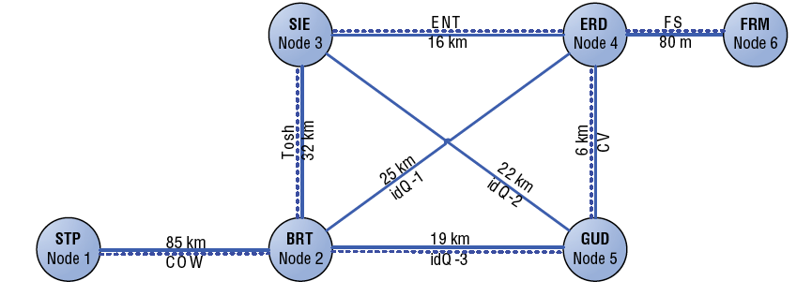


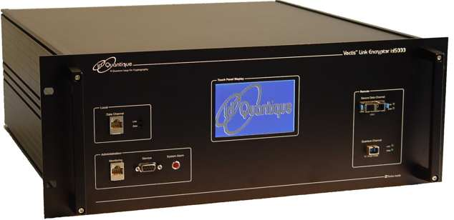
Field experiments
Movie by QKD-OTP
~50km
100k 1M
Tokyo QKD Network
Voice by QKD-OTP
Secure key rate [bps]
~30km
1k
~20km
Year
2000
2005
2010

Slide 4




Roadmap
Quantum Phase III
Key exchange infrastructure for photonic network
10M
User domain
User domain
Secure key rate [bps]
Critical infrastructure protection
② Multi-user networking
Widen applications
100k 1M
Dedicated P-to-P lines
①Reliability test
Security certification
Tokyo QKD Network
年
2010
2015
2020

Slide 5
(1) Dedicated P-to-P lines
Tightly protected state secrets
Reliability test
- Stable operation over a long span of time
- Security assurance in practical conditions

Slide 6






Identify side-channels : QKD link, L2-, L3-switches
KM Server
Layer 3 switch
Communication Layer
Layer 2 switch
Key Management Layer
KM agent
Quantum Layer

Slide 7

Devise countermeasures and patch loopholes
KM Server
Layer 3 switch
Communication Layer
Layer 2 switch
Key Management Layer
KM
agent
Quantum Layer

Slide 8
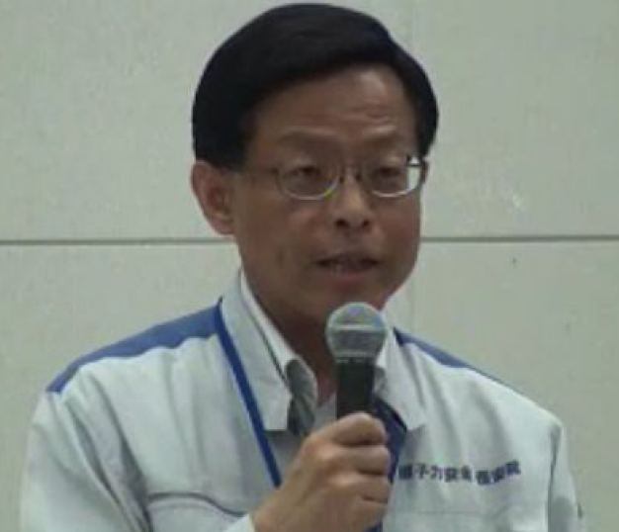

(1) Dedicated P-to-P lines
Also protect private secrets
Deputy Vice-Minister (Ministry of Economy, Trade & Industry)
He is a competent official,
who is in charge of the nuclear power plants,
But he was fired in this July…
(His extramarital affair became public)
If his emails and voice communications could have been tightly protected, he might have not lost his position….

Slide 9
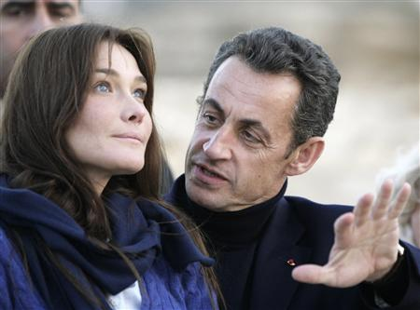

Unconditionally secure communications must be also appreciated by …
But too much side-channels….

Slide 10
Quantum Phase III of NICT
NICT Laboratories
Commissioned Research
Quantum ICT Lab
Theory on security certification
by NTT, Mitsubishi, Hokkaido U,
Tohoku U, & TITech
Layer integration
Security Fundamentals Lab
Mission-critical NW architecture
by NEC & Hokkaido U.
Derive a common denominator for
Security certification standards
E.g. Commonly accepted definition of the secure key rate ??
- Finite size effect in the key distillation
- Fluctuation of QKD channel characteristics

Slide 11
(2) Extension to multi-user QKD network
IP over photonic network
User domain
User domain
10M
Secure key rate (bps)
To widen applications
- Multicasting
- Signature
…..
100k 1M
Tokyo QKD Network
2010
2015
2020

Slide 12
How to balance the competing features?
IP over photonic network
QKD network
Open-control
- IP routers
- Link to anyone
Closed-control
- Link only to users with
pre-established secret
Convenience vs Restriction
User domain
User domain
Notes:
12

Slide 13
Trusted node
Electrical
Optical
Optical
Notes:
13

Slide 14




Trusted node
Physically protected server
“Key management agent”
Notes:
14

Slide 15
Trusted node
“Key management agent”
should be physically protected.
It is a regression for open controlled networks.
- Many classically authenticated lines are needed
for communications among KM agents.
- They would bring high complexity as well as
more side-channels.
Notes:
15

Slide 16

All optical node
Optical
Optical
Optical
- Can offer flexible and scalable on-demand connectivity
- Less side-channels
Notes:
16

Slide 17
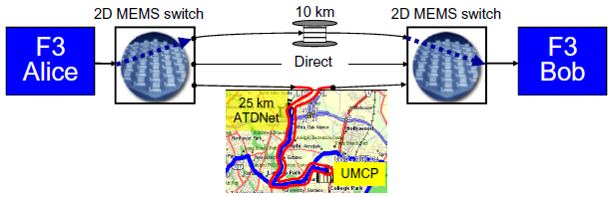
T.E. Chapuran, et al. New J. Phys. 11, 105001 (2009).
QKD network with reconfigurable optical add drop multiplexer (ROADM), and MEMS switching
F3 : One-way BB84
R. J. Hughes, et al,
Proc. SPIE 5893, 589301 (2005).
Highly automated, adaptive control to respond to sudden changes occurring when an optical path is switched to a very different path.

Slide 18
All optical node
Optical
Optical
Optical
Bottle neck
Large loss in optical switches 20~30km fiber
Secure key rate is still very low.
Very transparent optical switches need to be developed.
"Photon router"
Notes:
18

Slide 19
Transparent QKD network
More open controlled
"Photon router"
Optical switches with 1dB loss
< 5km fiber
Notes:
19

Slide 20
Scalable multi-user QKD network
- QKD clusters and small number of strong hubs
- Most of nodes in the clusters have only 2 or 3 links
- No isolated nodes
Secure key can be relayed over the entire network
only by a few hops.
Notes:
20

Slide 21
Scalable multi-user QKD network
QKD cluster
Hub (key management center)
- Photon routers
- Compact QKD systems
- APDs
- Trusted nodes
- WDM-QKD systems
- SSPDs for long distance QKD
High cost and control complexity must be absorbed
by small number of hubs.
Notes:
21

Slide 22
Roadmap
Quantum Phase III
Key exchange infrastructure for photonic network
10M
User domain
User domain
Secure key rate [bps]
Critical infrastructure protection
② Multi-user networking
Widen applications
100k 1M
Dedicated P-to-P lines
①Reliability test
Security certification
Tokyo QKD Network
年
2010
2015
2020

Slide 23
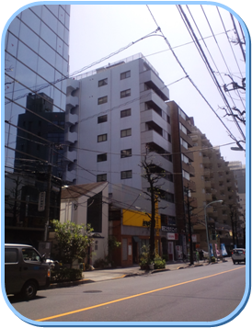

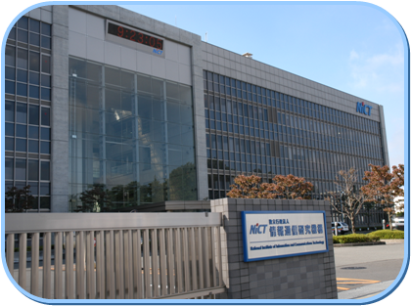
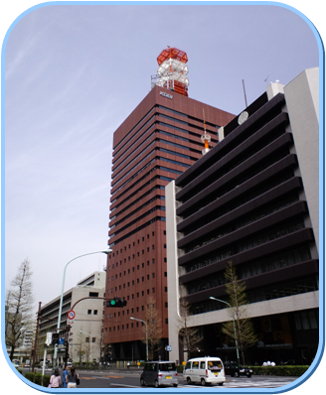
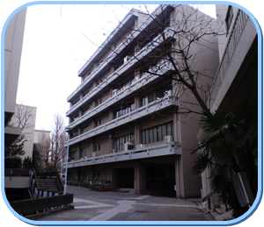
Tokyo QKD Network (2010~)
In part of NICT open test bed network
“Japan Giga Bit Network”
Hakusan
12 km
45 km
13 km
Hongo
Koganei
Otemachi

Slide 24









Tokyo QKD Network

Slide 25
Hakusan
12 km
45 km
Otemachi
Koganei
Hongo
13 km
Mitsubishi
① BB84
Mitsubishi
② BB84
NEC-NICT
NEC-NICT
NTT-NICT
③ DPS-QKD
NTT-NICT
All Vienna
④ BBM92
All Vienna
TREL
TREL
⑤ BB84
⑥ SARG04
IDQ
IDQ

Slide 26
Logical Structure
Koganei-1
NEC-NICT
Otemachi-1
②
45km (14.5dB)
NTT-NICT
MELCO
24km (13dB)
③
90km (27dB)
①
All Vienna
TREL
IDQ
Koganei-3
④
Koganei-2
⑤
Otemachi-2
⑥
Hongo
1km
(1dB)
45km
(14.5dB)
13km
(11dB)

Slide 27
All Vienna system
Entanglement QKD employing BBM92
Koganei-1
Otemachi-1
1km
(1dB)
Koganei-3
Koganei-2
Otemachi-2
Hongo

Slide 28
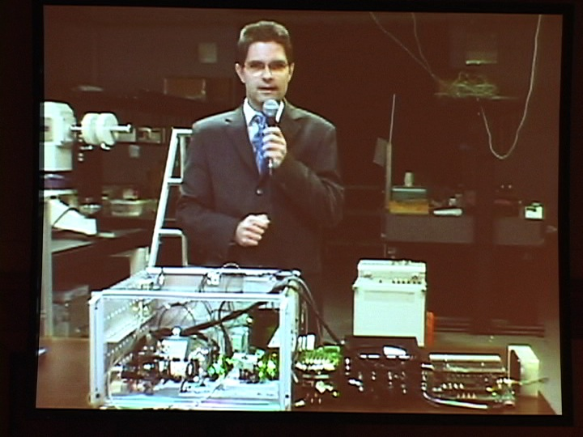
- Next generation QKD using quantum entanglement
- More robust against side-channels than
non-entangled schemes.
All Vienna

Slide 29
Toshiba Research Europe Ltd (TREL)
GHz clocked decoy-state BB84
Koganei-1
Otemachi-1
45km
(14.5dB)
Koganei-3
Koganei-2
Otemachi-2
Hongo

Slide 30
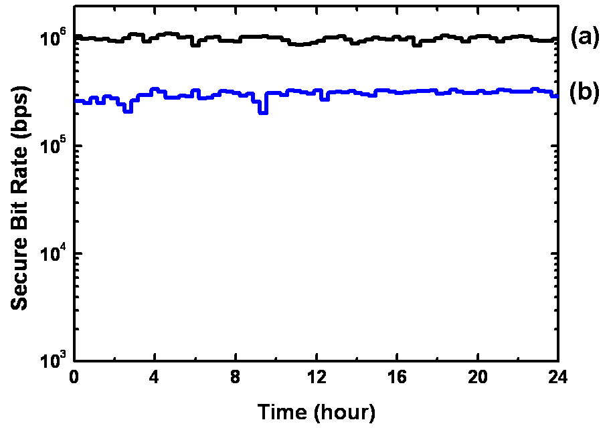
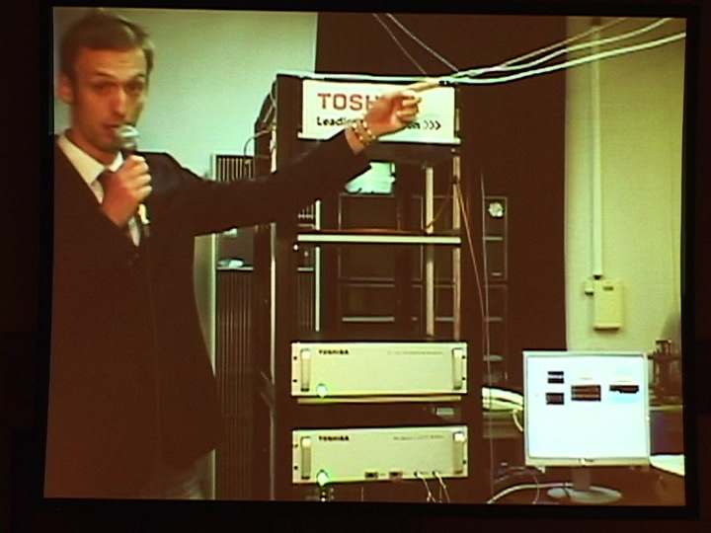
Toshiba Research Europe Ltd (TREL)
World record
304 kbps at 45 km
(14.5dB loss)
- Excellent APDs
- Active stabilization

Slide 31
ID Quantique system
Stable long-term operation in the 13 km link
Koganei-1
Otemachi-1
13km
(11dB)
Koganei-3
Koganei-2
Otemachi-2
Hongo

Slide 32
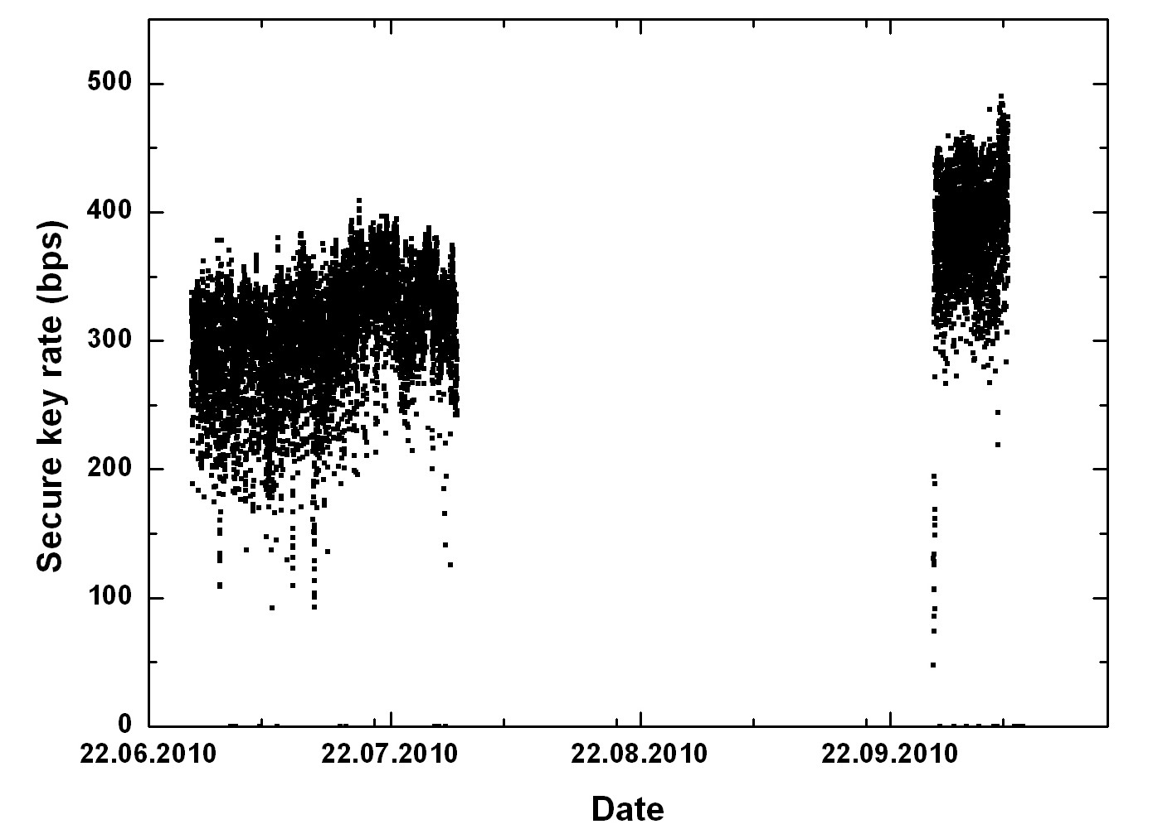
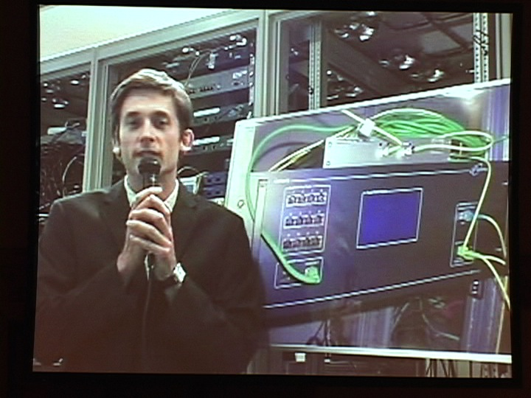
ID Quantique system
Commercial QKD system
"Cerberis"
(SARG04 protocol)
Fibers were
not available.
Long term stability
over a 45 day period

Slide 33
NTT-NICT system
1GHz-clocked DPS-QKD
for a long-distance over 90km
Koganei-1
Otemachi-1
90km
(27dB)
Koganei-3
Koganei-2
Otemachi-2
Hongo
Superconducting photon detector of NICT

Slide 34
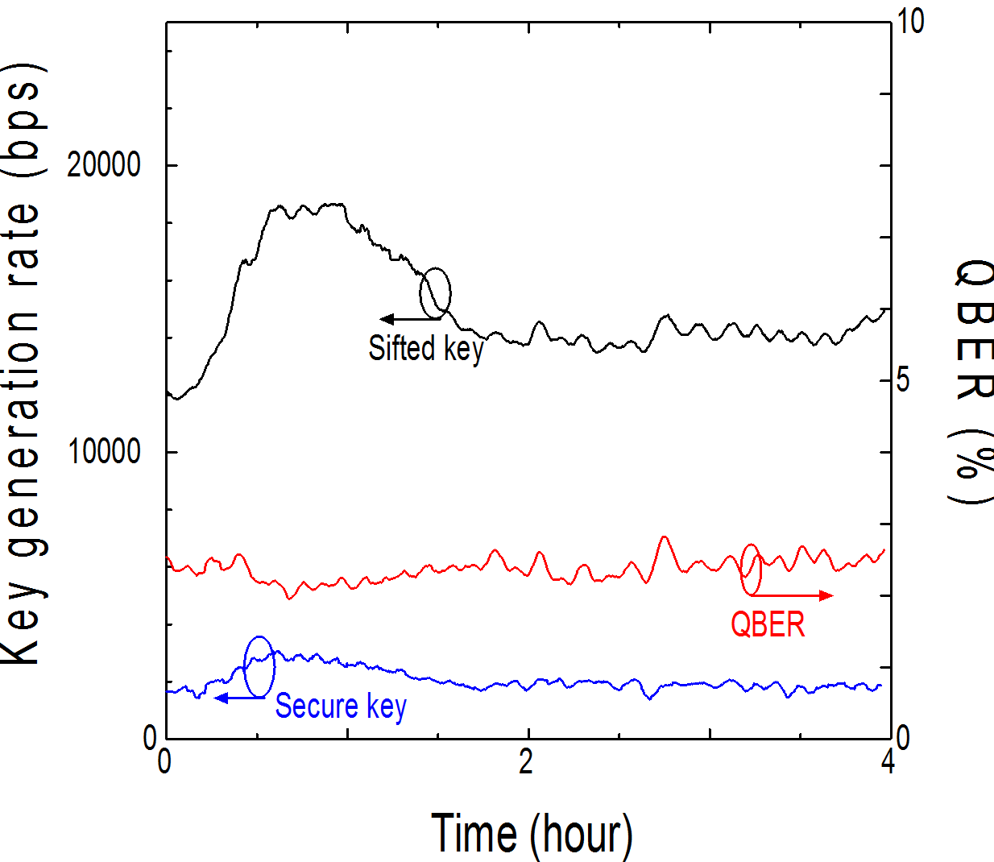
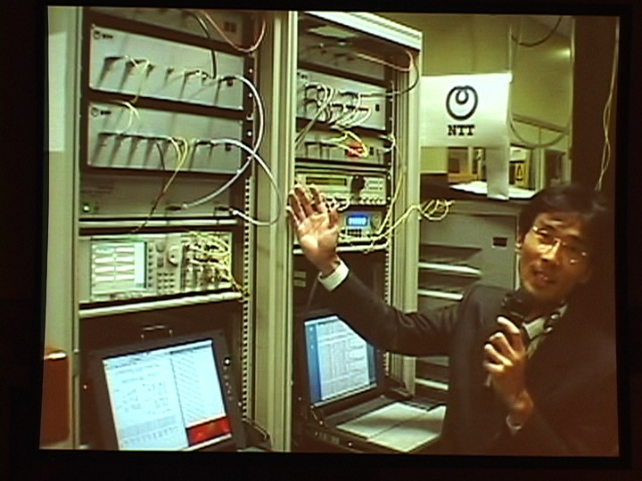
Secure key rate ~ 2.1 kbps
OTP encryption of
voice data over 90 km

Slide 35
Mitsubishi
Decoy-state BB84 (100MHz clock) in a 24km loop back link
Koganei-1
Otemachi-1
24km
(13dB)
Koganei-3
Koganei-2
Otemachi-2
Hongo

Slide 36
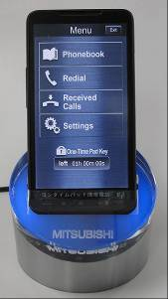



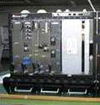
OTP smart-phone using QKD
Single downloading to a 2GB-SD card supports
10 day continuous conversation by OTP.
Encoded at 1 kB/s
⊕
⊕
Cellular network
Secure key
Secure key
QKD

Slide 37
NEC-NICT system
GHz clocked decoy-state BB84 with SSPD
Koganei-1
45km
(14.5dB)
Otemachi-1
Koganei-3
Koganei-2
Otemachi-2
Hongo

Slide 38
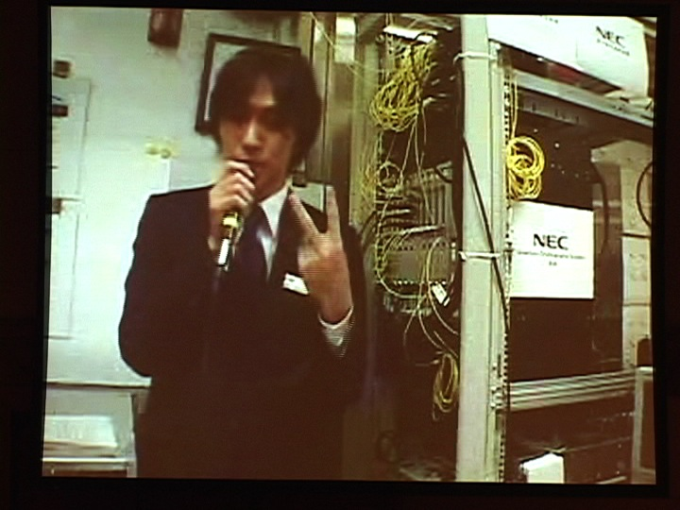
NEC-NICT system
WDM and key distillation engine

Slide 39
Logical Structure
Koganei-1
NEC-NICT
Otemachi-1
②
45km (14.5dB)
Trusted node
NTT-NICT
MELCO
24km (13dB)
③
90km (27dB)
①
All Vienna
TREL
IDQ
Koganei-3
④
Koganei-2
⑤
Otemachi-2
⑥
Hongo
1km
(1dB)
45km
(14.5dB)
13km
(11dB)

Slide 40
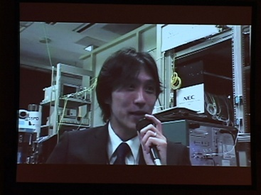
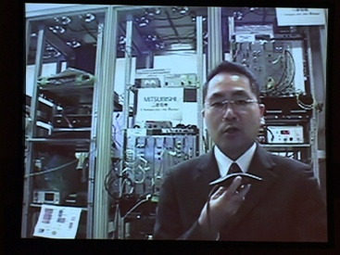



KM Server
Secure TV conference
Communication Layer
Key Management Layer
KM Agent
Secure key
NEC-NICT
NTT- NICT
Mitsubishi
Quantum Layer
All Vienna
TREL
IDQ

Slide 41
KM Server
Secure TV conference
Communication Layer
Key Management Layer
KM Agent
P-to-P quantum back bone links.
Secure key in its own way.
Key format can be arbitrary.
Secure key
NEC-NICT
NTT- NICT
Mitsubishi
Quantum Layer
All Vienna
TREL
IDQ

Slide 42
KM Server
Secure TV conference
Communication Layer
Key Management Layer
KM Agent
KMA at each site works as a trusted node.
Resizes and saves the key material, and stores QBER and key rates.
Key relay is performed by OTP-capsulation in a hop-by-hop fashion.
Secure key
NEC-NICT
NTT- NICT
Mitsubishi
Quantum Layer
All Vienna
TREL
IDQ

Slide 43
Interface compatible with SECOQC QBB-LI
KM Server
KM Agent
Japanese original functions
for the centralized
key management
KM Agent
API
API
Function calls used in
SECOQC QBB-LI
API
API
PC
PC
QKD Alice
QKD Bob

Slide 44
KM Server
Secure TV conference
Communication Layer
KMS gathers link information from KMAs,
organizes a routing table, and
provisions secure paths to KMAs.
Key Management Layer
KM Agent
Secure key
NEC-NICT
NTT- NICT
Mitsubishi
Quantum Layer
All Vienna
TREL
IDQ

Slide 45
KM Server
Secure TV conference
Communication Layer
Various applications
- Secure TV conferencing
- Key downloading to mobile phones
Key Management Layer
KM Agent
Secure key
NEC-NICT
NTT- NICT
Mitsubishi
Quantum Layer
All Vienna
TREL
IDQ

Slide 46
45km
90km
24km
45km
http://qict.nict.go.jp/eng/index.html
Video
- detecting Eve
- rerouting
NEC-NICT
NTT- NICT
Mitsubishi
All Vienna
TREL
IDQ

Slide 47
Tokyo QKD Network
M. Sasaki et al., Optics Express 19, 10387 (2011).
- Key relay
- Secure TV conferencing
- Stress test of centralized key management
in various accidental conditions
- Security protection of the key management layer
Done
Done
Not enough at all
Not yet
E.g. Layer 2 switches were partly exposed to
the external network.

Slide 48
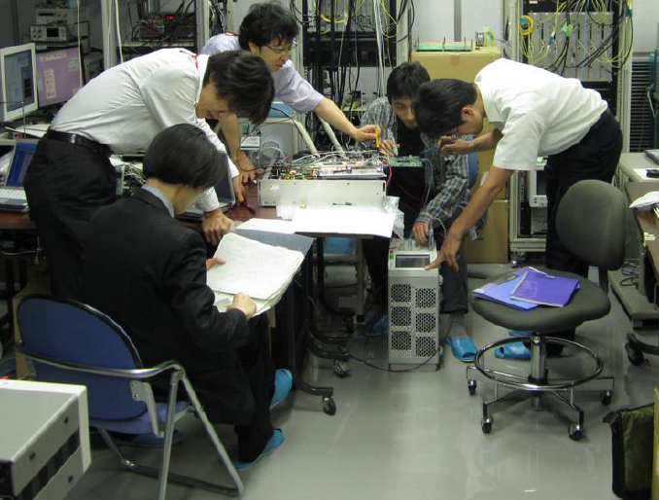
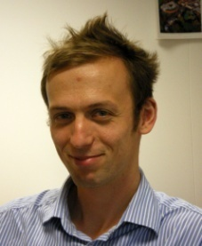
Layer 2 switch
KM agent

Slide 49

- TV screen was frozen quite often,
- Could not eliminate a howling sound
on the night before the demo
Who cares about
the security of
L2 switches …..

Slide 50
Security protection of the key management layer
More frequent authentication
of L2 switches is needed.
Layer 2 switch
Secure
key

Slide 51
Increase the key rate for stress-free QKD services !
Trusted-node QKD network
- Secure keys are consumed not only for data encryption
but also for key capsulation.
- The speed of key relay is restricted by the slowest QKD link.
A primary factor is the repetition rate of single photon detection.
Further improvement > GHz range is quite difficult at present.
Therefore we should also consider multiplexing QKD channels with the best available devices.

Slide 52
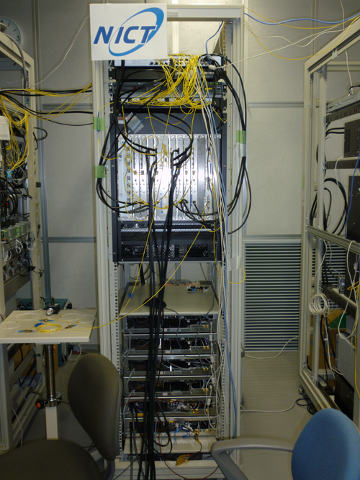
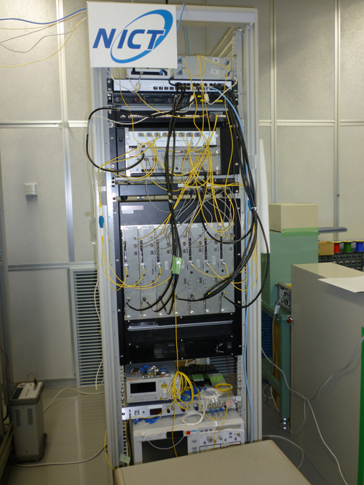
WDM-QKD system

Slide 53
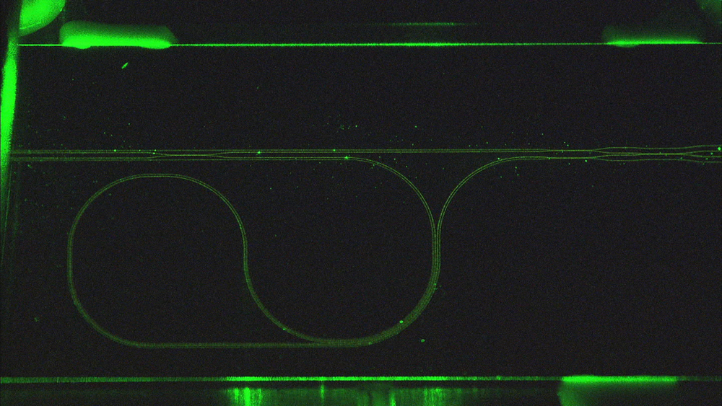
Compact optical transmission block
- mass productivity
- reliability
- controllability
Planar lightwave circuit (PLC)

Slide 54
Encoder
Random No.
Random No.
IM : Z0, Z1
PM : X0, X1
Decoy states
1.244 GHz
400ps
ATT
50ps
PLC
Temperature controlled
within 10m℃ for the visibility & delay tuning
Signal : 0.5 photons/pulse
Decoy : 0.2 photons/pulse
0.0 photons/pulse
Z0
Z1
X0
Time-bin signals
X1

Slide 55
Decoder
Passive PLC (2x4 MZI )
Z
X
X
PLC
Z
- No modulator
- No complex timing control
- Robust against Trojan horse attack
- Polarization independent interferometer
with temperature tuning
Polarization drift is not a matter!

Slide 56
Drawback of passive PLC decoder
Half of the key data are lost. (~3dB loss)
Time window
time
Z0
Z0
Satellite
Satellite
Z1
Z1

Slide 57
Drawback in the passive PLC decoder
Half of the key data are lost. (~3dB loss)
Time window
X0
X0
Satellite
time
Satellite
X1
X1

Slide 58
Clock and frame synchronization
Synchronization signal at 1570nm
Sync.
Sync.
W
D
M
W
D
M
clock
Clock & Frame
LD
Encoder
Decoder
Quantum signal at 1550nm
Quantum and synchronization signals
are transmitted in the same fiber for
precise & automatic synchronization
How to suppress Raman scattered photons from the synch-signals.
Tanaka, et al., Opt. Express, 16, 11354 (2008).

Slide 59
Whole system
Alice
Bob
1.244 GHz
Sync.
Clock &
Frame
Sync.
W
D
M
W
D
M
clock
Clock & Frame
LD
Encoder
Decoder
RN
Photon
clicks
RN
Controller
Classical communications
Controller
RN
RN
Raw data
Key distillation
Key distillation
Control
Final key
Control
Final key
IA Server
IA Server
KM Agent
KM Agent

Slide 60
WDM-QKD system
Sync.
W
D
M
W
D
M
Sync.
clock
Clock & Frame
LD
Encoder
Decoder
PD
PD
LD-λ1
Encoder
ATT
λ₁
λ₁
PD
PD
PD
PD
LD-λ2
λ₂
λ₂
PD
Encoder
ATT
PD
PD
PD
LD-λn
Encoder
ATT
λ_{n}
λ_{n}
PD
PD

Slide 61
PD
PD
LD-λ1
Encoder
ATT
PD
PD
PD
PD
LD-λ2
Encoder
ATT
W
W
PD
D
D
M
M
PD
PD
PD
LD-λn
Encoder
ATT
PD
PD
WDM system can easily be large, complex and of high cost.
Design a cost-effective system !

Slide 62
A PLC-interferometer and temperature controller are shared by maximally
8 wavelength channels at each of Alice and Bob.
LD
Temp.
Contr.
Temp.
Contr.
LD
LD
LD
Z
LD
PLC
PLC
X
LD
LD
X
LD
Z
It can reduce the size, cost and control complexity.

Slide 63
Compensation of
wavelength-dependent phase mismatches
Signal
states
Decoy
states
Phase shifters
λ₁
LD-λ₁
ATT
Temp.
Contr.
λ₂
Δθ (λ₂)
LD-λ₂
ATT
W
D
M
W
D
M
W
D
M
PLC
λ₈
Δθ (λ₈)
LD-λ₈
ATT

Slide 64
Colorless interferometer
Interference extinction ratio > 20dB
30
25
20
15
Temperature tuned
wavelength
10
5
Extinction ratio [dB]
0
-
5
With phase compensation
-
10
Without phase compensation
-
15
-
20
1544.5
1545.3
1546.1
1546.9
1547.7
1548.5
1549.3
1550.1
1550.9
Wavelength [nm]
λ₁ ,…, λ₈ allocated on ITU-T 100-GHz grid

Slide 65
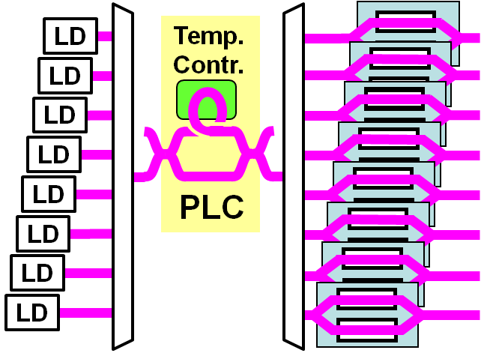
Alice
Bob
1.244 GHz
Sync.
Sync.
Clock &
Frame
Clock & Frame
W
D
M
clock
PD
Temp.
Contr.
W
PD
D
PD
W
D
M
M
…
W
PD
PD
D
…
M
PD
PD
PD
W
PD
PLC
W
D
PD
M
…
D
…
PD
M
PD
Photon
clicks
RN
RN
Controller
Controller
RN
RN
Raw data
Key distillation
Key distillation

Slide 66
PD
W
PD
D
…
PD
LD-λ1
Encoder
ATT
M
W
PD
D
PD
M
…
LD-λ2
Encoder
ATT
PD
W
W
W
D
D
D
PD
M
M
M
W
PD
D
…
PD
M
W
PD
LD-λn
Encoder
ATT
PD
D
…
M
Data size
PD
- 2bit for Z0, Z1, X0, & X1
- 2bit for the decoy states x 1.25GHz x 8 wavelengths
- 1bit for key distillation
RN
50 Gbps
RN
Photon clicks
Controller
Controller
RN
RN
Raw data
Key distillation
Key distillation

Slide 67
Key Distillation Engine
Frame synchronization
Basis reconciliation
Error
Privacy
Communication
Random permutation
correction
amplification
control
Mem.
Mem.
Mem.
Mem.
Mem.
Classical
commun
XFP1
FPGA
FPGA
FPGA
FPGA
FPGA
XFP
10GbE
IF
1A
2
3
4
5
FPGA
PCle
XFP8
1B
SW
PC control
Mem.
- 9 ports of 10GbE IF and 6 FPGAs
- 5G byte memory to store RN data

Slide 68
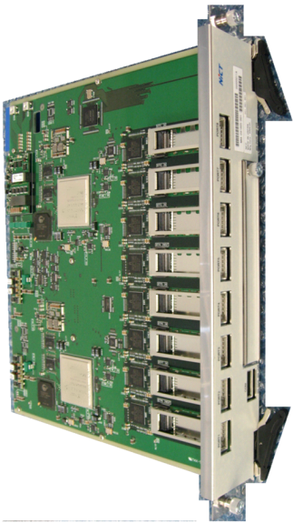
Key Distillation Engine
QBER<3.5%
n=1M bits
k=750 kbit
10Mbps counts
50Gbps pulses
LDPC
Toeplitz matrix
Extract
detected
signals
F-synch
Basis Rec
Random P
Error
correction
Privacy
amp
Raw
key
Sifted
key
1Mbps
5Mbps
3.7Mbps
0.5 ph/pulse
Total loss -27dB
Discard
Discard
Discard

Slide 69
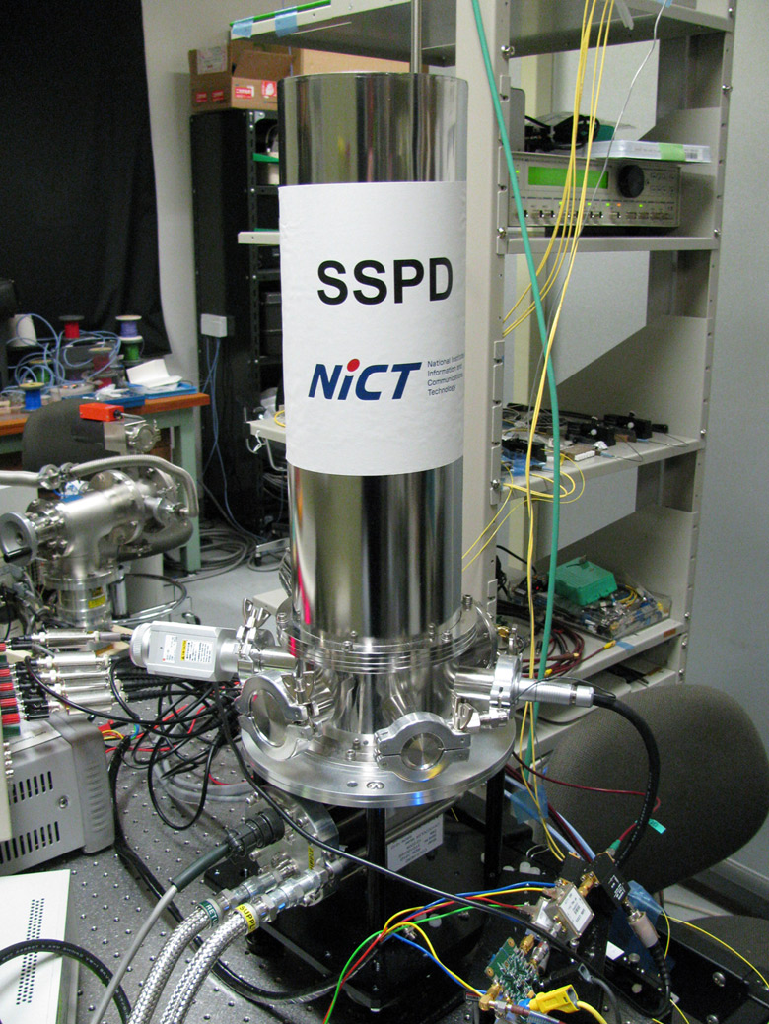
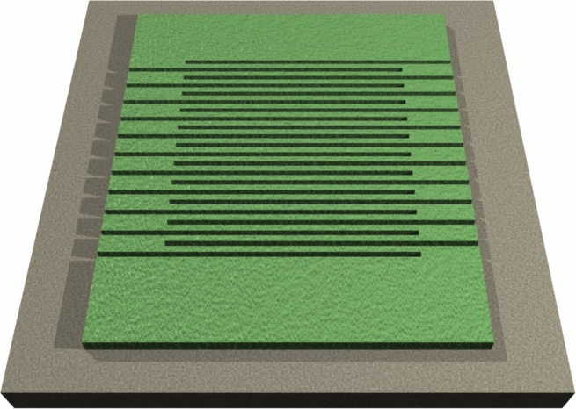
Superconducting Nano-wire Single PD
Closed-cycle cryo-cooler
at 3K (T_{c}~ 10K)

Slide 70
Nanowire
MgO substrate
15μm x 15μm
400μm
20μm
Gradient index lenses
SM fiber

Slide 71
Au mirror
100nm
SiO cavity
250nm
MgO substrate
400μm
NbN wire
20μm
Gradient index lenses
SM fiber

Slide 72
4-channel SSPD in a closed-cycle cryo-cooler
S. Miki, et al., Opt. Lett. 35, 2133 (2010).
16%

Slide 73
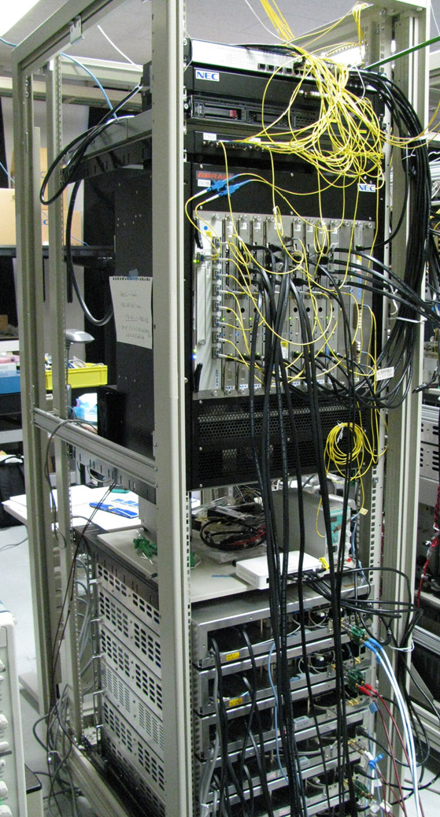
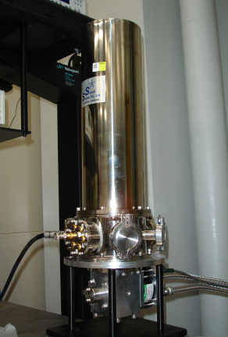
Performance
Combined with QKD system
Stand-alone
45km transmission
DE>16%
DCR~100c/s
DE<7%
DCR~500c/s
Time window
Background photons

Slide 74
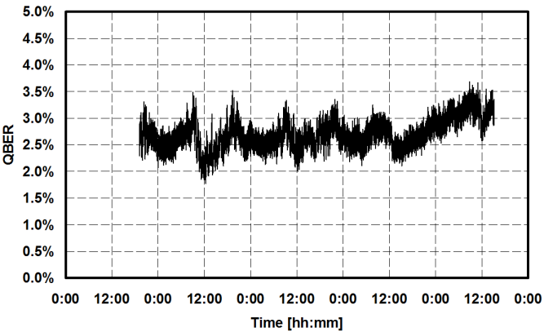
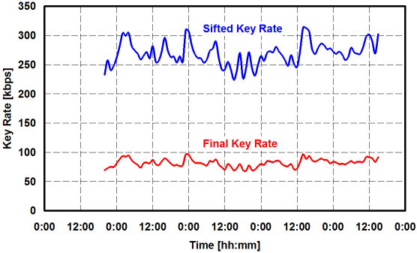
- Single wavelength
channel with SSPD
- 45 km transmission
(14.5 dB loss)
- 4 day operation
QBER ~ 2.7%
Secure key rate
~ 82 kbps

Slide 75
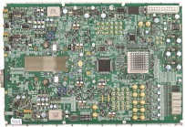
InGaAs APD system
Low noise readout
V
DC
Drv
InGaAs APD
Self-training discriminator
BEF
A-D
Z
-
1
AVG
＋
-
1
Clock
(1.2GHz)
Logic
1/n
circuit
Dec
Signal
Detector board
Adaptive noise compensation

Slide 76
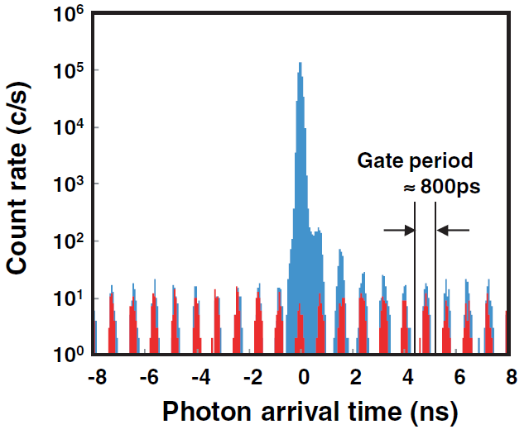
Temporal histogram around the illuminated gate
When the light is irradiated
After-pulses
Dark counts

Slide 77
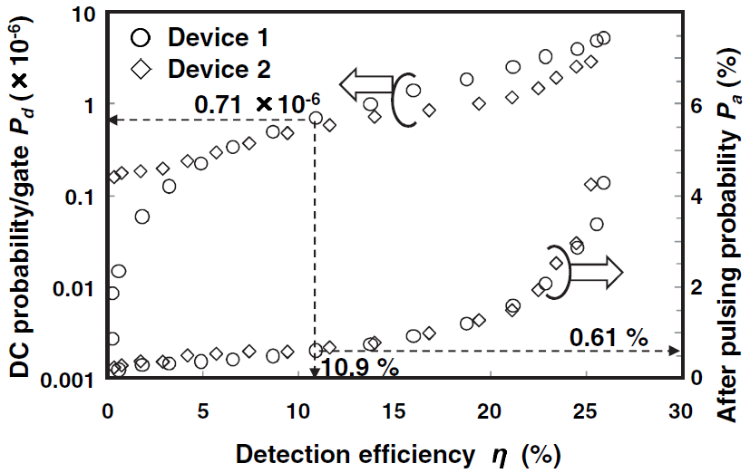
The best result reported to date for a 1550nm SAPD
- After-pulse prob ~ 0.61%
- Dark count prob ~ 0.71 ×10⁻⁶ (DCR~1 kHz)
- Detection efficiency ~ 10.9%

Slide 78
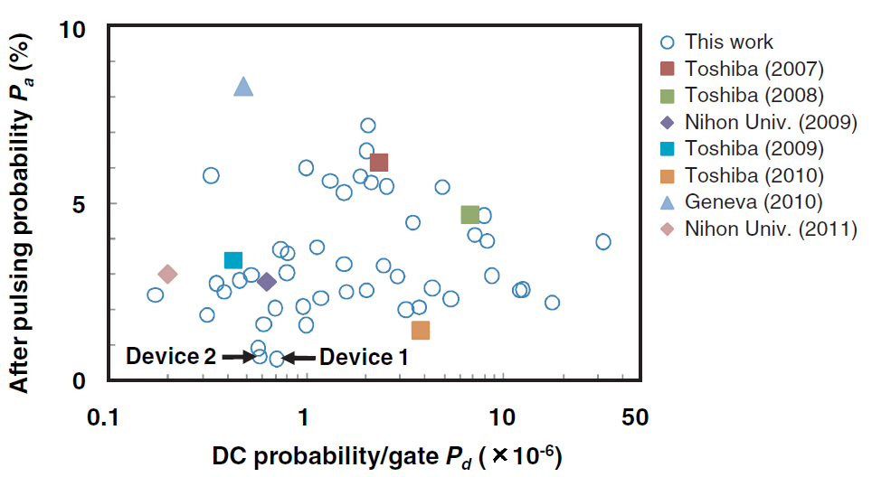
Very low noise
Y. Nambu, to appear in Optics Express (2011)

Slide 79
3 λ- WDM QKD
Sync.
Clock & Frame
Sync.
APD
clock
W
D
M
SSPD
W
SSPD
APD
Temp.
Contr.
D
M
W
SSPD
W
D
M
SSPD
D
M
APD
W
SSPD
PLC
APD
SSPD
D
W
SSPD
M
D
SSPD
M
All the 8 LDs emit light
 | Wavelength[nm] | Detector
λ₁ | 1549.32 | APD
λ₂ | 1550.12 | SSPD
λ₃ | 1550.92 | SSPD

Slide 80
3 λ-WDM QKD in a 45km installed fiber (14.5dB loss)
QBER
for 12 hours

Slide 81
Sifted and secure key rates

Slide 82
3 λ- WDM QKD over a 45km field fiber
 | Wavelength[nm] | Detector | QBER [%] | Secure key rate [kbps]
λ₁ | 1549.32 | APD | 3.03 | 91.11
λ₂ | 1550.12 | SSPD | 3.02 | 40.56
λ₃ | 1550.92 | SSPD | 2.32 | 76.18
208 kbps
When 8 λ channels are fully equipped, the secure key rate would reach 1.5Mbps for a 10dB loss channel.
K. Yoshino et al., submitted to APL
A. Tanaka et al., ECOC2011.

Slide 83
A bit more about SSPD
The performance of SSPD is very sensitive to the bias current.
This may be influenced by peripheral electronics.

Slide 84
Afterpulse-like phenomenon in SSPD
Dark counts
Signal~100k c/s
Signal~700k c/s
Signal~1M c/s
Time flow
Afterpulse-like phenomenon is seen at a higher count rate.

Slide 85
Signal~100k c/s
Most of previous
QKD experiments
Signal~1M c/s
GHz clocked QKD
experiments
Time flow
Afterpulses at ~ 175ns

Slide 86
Afterpulse-like phenomenon
The after-pulses are not an intrinsic phenomenon to the nano-wire, but were caused by the readout circuit.
Optical fiber
DC voltage source
100 kΩ
Readout amplifier
3dB Att (B=3GHz)
Counter
Bias Tee
LNA-550
LNA-100
50 Ω
SSPD

Slide 87
Afterpulse-like phenomenon
Back-reflected electronic pulses from the readout amplifier accumulate in the nano-wire.
Optical fiber
DC voltage source
100 kΩ
Readout amplifier
3dB Att (B=3GHz)
Counter
LNA-550
LNA-100
50 Ω
SSPD
Many reflected pulses effectively increased the bias current.
The nano-wire became more sensitive to the dark counts.

Slide 88
Reflection
coefficient
Optical fiber
DC voltage source
100 kΩ
0 2 4 6 8 10
Frequency (MHz)
Counter
LNA-550
LNA-100
50 Ω
SSPD
New amplifier
5840A
SHF 74B
900 MHz
LFP filter
600 MHz
LFP filter

Slide 89
Optical fiber
DC voltage source
100 kΩ
5840A
SHF 74B
900 MHz
LFP filter
600 MHz
LFP filter
Counter
50 Ω
SSPD
Small reflection coefficient
0 2 4 6 8 10
Frequency (MHz)

Slide 90
Signal 700k c/s
(a)
Previous
Noise 383 c/s
0 2 4 6 8 10
Frequency (MHz)
After-pulses at ~ 175ns
Signal 1M c/s
Counting threshold
New
Noise 130 c/s
0 2 4 6 8 10
Frequency (MHz)
After-pulses suppressed

Slide 91
Transmission test with a single channel SSPD
Threshold voltage is adjusted to have the same DE
V_{th}(previous) > V_{th}(new)
 | Previous | New
Counting rate (c/s) | 660 k
Detection efficiency (%) | 15.1
Dark count rate (c/s) | 600 | 800
QBER (%) | 2.43±0.12 | 1.36±0.08
Secure key rate (estimated with 14.5dB loss fiber) | 249kbps | 321kbps
M. Fujiwara, to appear in Optics Express (2011)

Slide 92
Scalable multi-user QKD network
- Trusted nodes
- WDM-QKD systems
- Low noise GHz clocked APD
- SSPDs for long distance QKD
Notes:
92

Slide 93
Transparent QKD cluster
Notes:
93

Slide 94
Photon router
Optical
Optical
Optical
PLC-based thermo-optic matrix switch
Reduce losses
Present Year 2014
~ 4dB <1dB
(20km-fiber) (5km-fiber)
Notes:
94

Slide 95
Scalable multi-user QKD network
Planar configuration
Notes:
95

Slide 96
Vertical structure of network layers
Notes:
96

Slide 97
Evolution to Secure Photonic Network
User domain
User domain
10M
Secure key rate (bps)
Cross layer integration
100k 1M
Tokyo QKD Network
2010
2015
2020

Slide 98


Photonic network
User domain
Control plane
IP network
Optical path network

Slide 99
IP network
Optical cross connect
(OXC)
Optical path network
WDM
WDM optical network is tightly integrated with
IP network via optical cross connect .

Slide 100
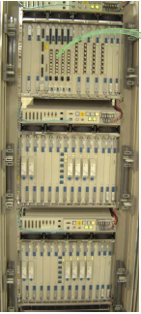
User domain
User domain
IP router
IP network
Optical cross connect
(OXC)
Optical path network
The OXCs operate with IP routers to set up
a desired optical path by wavelength switching.

Slide 101
Routing, signaling, and link management
according to user requests
Multi-Protocol
Label Switching
Control plane

Slide 102

From closed control to an open-controlled network
Operator
Hacker
Network
control
system
User
Interworking
Control plane
Control plane
Path provisioning
Network
Carrier A
Carrier B
Malicious hacker may access the confidential control signals and hijack the network.
Seriously damages the entire network

Slide 103
Secure Photonic Network
- Label Switching
- Key management
Control plane
Optical path network
Secure key
QKD network

Slide 104
Secure Photonic Network
- Label Switching
- Key management
Control signal
QKD-OTP
Control plane
Secure path
provisioning
Hacking & hijacking
of the NW will be
prevented.
Optical path network
Secure key
QKD network

Slide 105
Secure Photonic Network
- Label Switching
- Key management
Control signal
QKD-OTP
Control plane
Optical packet
Optical path network
QKD-OTP
QNRC
OCDM
…
Secure key
QKD network

Slide 106
Secure Photonic Network
- Label Switching
- Key management
Control signal
QKD-OTP
Control plane
IPsec
Modern crypto
IP network
Optical packet
Optical path network
QKD-OTP
QNRC
OCDM
…
Secure key
QKD network

Slide 107
Secure Photonic Network
K. Kitayama, et al.,
Security in Photonic Networks: Threats and Security Enhancement,
to appear in J. Lightwave Technology (2011).
- Likely security threats in photonic network
- Conceptual model
- Case study : digital cinema distribution

Slide 108
Digital cinema distribution
Protect the copyright of first-run films
Distributor
Theater
Digital
master
Encryption
(AES)
Cinema
package
Content delivery
Temporal
storage
Real-time
decryption
Symmetric keys
Symmetric
keys
Encryption of
license (RSA)
Content
Key
Key
delivery
Content
Key
Content key-
decryption (RSA)
Source-site
Projection-site
Broadband
real time
contents
Encryption
(QNRC)
Content delivery
Real-time
decryption
Content
Content
Symmetric keys
Symmetric
keys
Encryption of
content key (OTP)
Content
Key
Key
delivery
Content
Key
Content key-
decryption (OTP)
QKD network

Slide 109
QKD-assisted secure multi-casting
over the photonic network
Secure key
QKD network

Slide 110
Tokyo QKD Network

Slide 111
Tokyo QKD Network
Add a new link

Slide 112
Butterfly network

Slide 113




We want to securely multicast contents from two sources to two receivers
Two receivers

Slide 114




Perform QKD in each link

Slide 115




OTP in butterfly network
Only one route is available !

Slide 116




OTP in butterfly network
(1) Allow Source 1 to send X₁, while Source 2 should wait.
“Time sharing”

Slide 117


OTP in butterfly network
(2) Then Source 2 sends X₂ by using a new key c’.
OTP is a non-clonable key.

Slide 118
Key consumption
Two keys c and c’.
Is it only the way?

Slide 119


Network coding
・Information signal is not like a car.
・Two data X₁ and X₂ can be superposed at the nodes,
converted to a new data Z, and transmitted.
・Both receivers can decode X₁ and X₂,
by X₂=Z⊕X₁ and X₁=Z⊕X₂.

Slide 120



Network coding
Network coding enables efficient multicasting with less secure keys.

Slide 121
QKD-assisted secure multi-casting
over the photonic network
IP network
Network coding
Optical path network
Secure key
QKD network

Slide 122
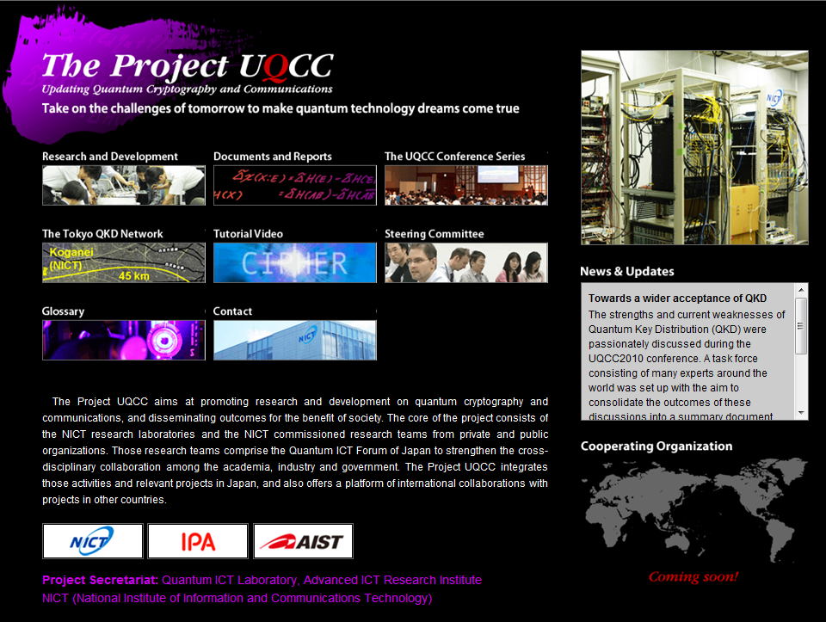
http://www.uqcc.org/

Slide 123
The Project UQCC
(Updating Quantum Cryptography and Communications)
UQCC Conference
Foreign institutes and organizations
Collaboration
Quantum ICT Forum
NICT Research Laboratories
NICT Commissioned Research
Other projects and institutes in Japan
Quantum ICT Laboratory
Secure photonic network technology
Security Fundamentals
Laboratory
Nano ICT Laboratory
Quantum repeater technology
Space Communication
Systems Laboratory
JGN-X
(NICT open test-bed network)
Tokyo QKD Network
Practical use and commercialization

Slide 124
Secure Photonic Network
User domain
User domain
10M
Architecture
(Trusted & All
optical nodes)
Secure key rate (bps)
Secure TV
conferencing
100k 1M
Dedicated P-to-P lines
- State secrets
- Private secrets
Tokyo QKD Network
Big market in daily life "happy ignorance"
2010
2015
2020
2025

Slide 125

Good luck for Qcrypt conference series!
By courtesy of K. Nakagawa
Thank you for your attention.

