Slide 1
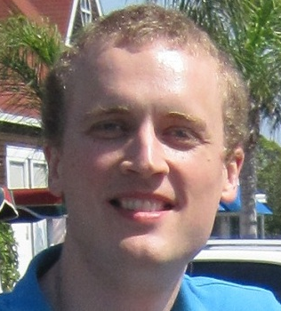
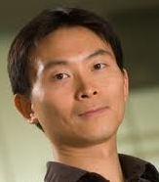
Randomness expansion from untrusted quantum devices
Carl A. Miller
University of Michigan, Ann Arbor
Based on “Universal security for randomness expansion from the
spot-checking protocol” (arXiv:1411.6608), with Yaoyun Shi.

Slide 2
The question
Can we generate provable
random numbers?
?
10110111101101000010010001111101001001001001111010100 ….

Slide 3
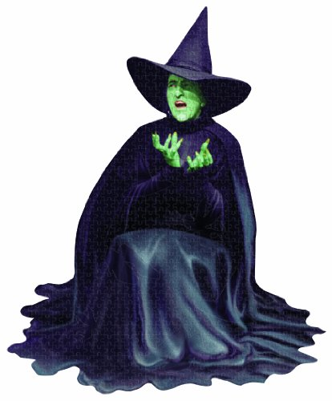


Why it matters
Security of protocols like RSA breaks down if randomness is bad.
[Lenstra+ 12, Heninger+ 12]
P,Q
P,Q (primes)

Slide 4
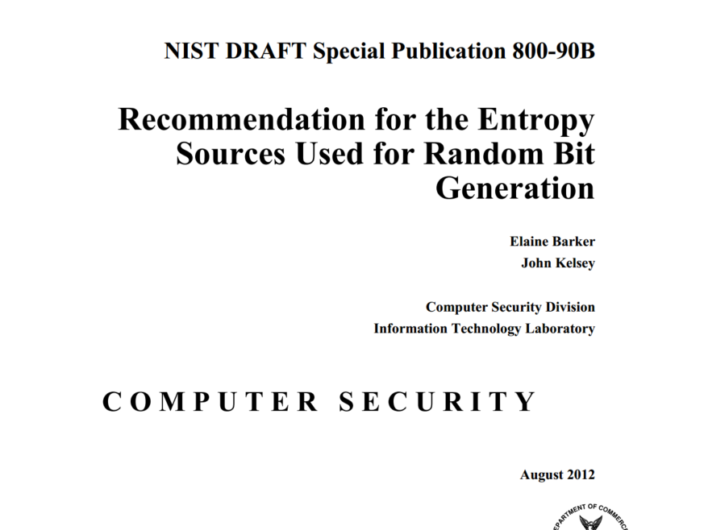
Existing solutions
“[We assume] that the developer understands the behavior of the entropy source and has made a good-faith effort to produce a consistent source of entropy.”
Can we generate randomness without assuming good faith?

Slide 5
Quantum random number generation
Untrusted-device randomness expansion
Untrusted-device randomness amplification
Semi-device-independent random number generation.
Contextuality-based randomness expansion.
Randomness extraction.

Slide 6
Quantum random number generation
Untrusted-device randomness expansion
Untrusted-device randomness amplification
Semi-device-independent random number generation.
Randomness extraction
Small uniform seed + untrusted device -> uniform randomness
10101111011000100110110011110110011011110111111111010000101000100111111010101010111010101010 ….
0 0 1 1 1 0 1 1
Only assumption: Non-communication.

Slide 7
Results

Slide 8
Timeline
Colbeck
Us
2006 2007 2008 2009 2010 2011 2012 2013 2014 2015
Colbeck proposed a protocol based on repeating a nonlocal game.
0
1
1
1
0
0
…
1
1
…

Slide 9
Timeline
Colbeck
Pironio+
Us
started
2006 2007 2008 2009 2010 2011 2012 2013 2014 2015
Pironio+: analysis & experiment.
I started working in quantum information.
0
1
1
1
0
0
…
1
1
…

Slide 10
Timeline
The challenge of the entangled adversary
Quantum information can be locked – accessible only to entangled adversaries. [E.g., DiVincenzo+ 04]
Colbeck
Pironio+
Us
0
0
0
1
0
1
started
2006 2007 2008 2009 2010 2011 2012 2013 2014 2015
Pironio+: analysis & experiment.
I started working in quantum information.
0
1
1
1
0
0
1
…
1
1
0
…
0
0
…
1
1
…

Slide 11
Timeline
Colbeck
Pironio+
Us
started
2006 2007 2008 2009 2010 2011 2012 2013 2014 2015
Pironio+: analysis & experiment.
I started working in quantum information.
0
1
1
1
0
0
…
1
1
…

Slide 12
Timeline
Colbeck
Pironio+
Pironio+
Fehr+
Coudron+
Us
started
2006 2007 2008 2009 2010 2011 2012 2013 2014 2015
Pironio+, Fehr+, Coudron+ proved security against unentangled adversary.
Methods: Classical statistical arguments (e.g., Azuma’s inequality).
0
1
1
1
0
0
…
1
1
…

Slide 13
Timeline
Colbeck
Pironio+
Pironio+
Fehr+
Vazirani+
Coudron+
Us
started
2006 2007 2008 2009 2010 2011 2012 2013 2014 2015
Vazirani-Vidick proved full security against an entangled adversary (no error
tolerance).
Method: Insecurity implies communication paradox.
0
1
1
1
0
0
…
1
1
…

Slide 14
Timeline
Colbeck
Pironio+
Pironio+
Fehr+
Vazirani+
Coudron+
Us
started
Miller+
2006 2007 2008 2009 2010 2011 2012 2013 2014 2015
We proved full security, with error-tolerance >1.4%.
Method: Constraints on
X |-> Tr [ X^{1+ε}]
for adversary-output states.
0
1
1
1
0
0
…
1
1
…

Slide 15
Timeline
Colbeck
Pironio+
Pironio+
Fehr+
Vazirani+
Coudron+
Coudron+
Chung+
Us
started
Miller+
2006 2007 2008 2009 2010 2011 2012 2013 2014 2015
Coudron+ and Chung+ proved unbounded rate of expansion.
0
1
1
1
0
0
…
1
1
…
11011 1010010001011101010001011101101010001111111010100010 ….

Slide 16
Timeline
Colbeck
Pironio+
Pironio+
Fehr+
Vazirani+
Coudron+
Coudron+
Chung+
Us
started
Miller+
Miller+
2006 2007 2008 2009 2010 2011 2012 2013 2014 2015
Coudron+ and Chung+ proved unbounded rate of expansion.
Our current paper: Covers all nonlocal games, maximal noise tolerance.
0
1
1
1
0
0
…
1
1
…

Slide 17
Current Result

Slide 18
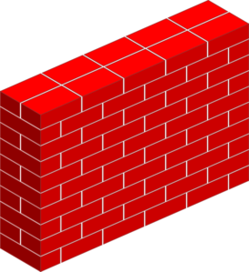
Randomness Expansion
The spot-checking protocol
(Coudron-Vidick-Yuen 2013,
Vazirani-Vidick 2012)
Let G = nonlocal game, a = fixed input.
Run the device N times. During “game rounds,” play G. Otherwise, just input a.
If the average score during game rounds was < C, abort.
Otherwise, apply randomness extractor.
0
0
1
0
0
0
0
0
1
0
0
0
0
1
0
0
0
0
0
0
0
0
[Several authors]: Security proof against an unentangled adversary.
Small resources, high rate
Game rounds occur with probability δ.
Not fully secure
1
1
0
1
0
1
1
1
11011 1010010001011101010001011101101010001111111010100010 ….

Slide 19
Randomness Expansion
The spot-checking protocol
(Coudron-Vidick-Yuen 2013,
Vazirani-Vidick 2012)
Let W_{G,a} = optimal score among devices that are deterministic on a.
Thm (CVY 13): The protocol is secure against an unentangled adversary if C > W_{G,a}.
Thm (MS 15): The protocol is secure against any adversary if
C > W_{G,a}.
Best possible!
Let G = nonlocal game, a = fixed input.
Run the device N times. During “game rounds,” play G. Otherwise, just input a.
If the average score during game rounds was < C, abort.
Otherwise, apply randomness extractor.
0
0
1
0
0
0
0
0
1
0
0
0
0
1
0
0
0
0
0
0
0
0
[Several authors]: Security proof against an unentangled adversary.
Small resources, high rate
Game rounds occur with probability ε.
Not fully secure
1
1
0
1
0
1
1
1
11011 1010010001011101010001011101101010001111111010100010 ….

Slide 20
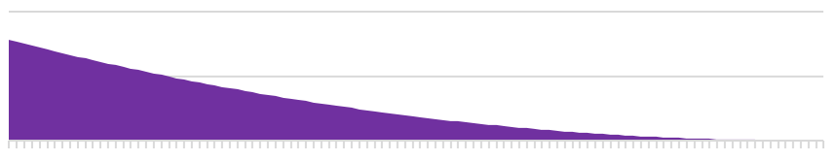
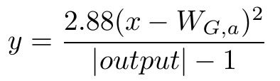
Randomness Expansion
How much randomness (MS 15)
[Several authors]: Security proof against an unentangled adversary.
noise threshold vs.
# of random bits per round
W_{G,a}
W_{G}
11011 1010010001011101010001011101101010001111111010100010 ….

Slide 21
Proof Techniques

Slide 22
Randomness Expansion
A Mathematical Preliminary
Consider the function f(X) = Tr [ |X|^{1+ε}].
- If X is a density operator, f measures how deterministic X is. (Smaller = more random.)
- f is “almost” a norm on Hermitian operators.
[Several authors]: Security proof against an unentangled adversary.

Slide 23
Randomness Expansion
A Mathematical Preliminary
The function Tr [ |X|^{1+ε}] is uniformly convex. [Ball+ 94]
[Several authors]: Security proof against an unentangled adversary.
S
11011 1010010001011101010001011101101010001111111010100010 ….
T
(S+T)/2
Gap is Ω(ε ).

Slide 24
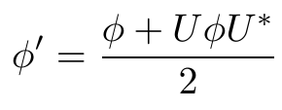
Randomness Expansion
A Mathematical Preliminary
Consequence [MS 15]: Suppose φ |−> φ’ is the result of a binary measurement.
The more disturbance caused by a measurement, the more randomness it adds.
Call this the (1+ε)−uncertainty principle.
[Several authors]: Security proof against an unentangled adversary.
11011 1010010001011101010001011101101010001111111010100010 ….
φ
φ’
Gap = increase
in randomness.
Uφ U*

Slide 25
Randomness Expansion
How do we prove security for this protocol?
Let G = nonlocal game, a = fixed input.
Run the device N times. During “game rounds,” play G. Otherwise, just input a.
If the average score during game rounds was < C, abort.
Otherwise, apply randomness extractor.
0
0
1
0
0
0
0
0
1
0
0
0
0
1
0
0
0
0
0
0
0
0
[Several authors]: Security proof against an unentangled adversary.
Small resources, high rate
Not fully secure
1
1
0
1
0
1
1
1
11011 1010010001011101010001011101101010001111111010100010 ….

Slide 26
Randomness Expansion
How do we prove security for this protocol?
A starting point:
Suppose π is a function such that any device satisfies
H ( output | input = a) >=
π (P ( win ))
Prop (easy): In the non-adversarial IID case, the protocol produces at least π ( C) N extractable bits.
π = “simple rate curve”
Let G = nonlocal game, a = fixed input.
Run the device N times. During “game rounds,” play G. Otherwise, just input a.
If the average score during game rounds was < C, abort.
Otherwise, apply randomness extractor.
0
0
1
0
0
0
0
0
1
0
0
0
0
1
0
0
0
0
0
0
0
0
[Several authors]: Security proof against an unentangled adversary.
Small resources, high rate
Not fully secure
1
1
0
1
0
1
1
1
11011 1010010001011101010001011101101010001111111010100010 ….

Slide 27


Randomness Expansion
What about non-IID?
1
1+ε
Compare:
* von Neumann entropy (H)
* Renyi entropy (H_{1+ε}).
H_{1+ε} proves extractable bits in the non-IID case!
But it’s hard to relate to the winning probability.
[Several authors]: Security proof against an unentangled adversary.
?!!
P ( win )
11011 1010010001011101010001011101101010001111111010100010 ….

Slide 28
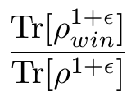
Randomness Expansion
What about non-IID?
1
1+ε
Compare:
* von Neumann entropy (H)
* Renyi entropy (H_{1+ε}).
H_{1+ε} proves extractable bits in the non-IID case!
But it’s hard to relate to the winning probability.
Def: the (1+ε)-winning probability of a device is
where ρ = adversary’s state.
[Several authors]: Security proof against an unentangled adversary.
P ( win )
P_{1+ε} (win )
11011 1010010001011101010001011101101010001111111010100010 ….

Slide 29
Randomness Expansion
What about non-IID?
1
1+ε
Def: π is a strong rate curve for the game G on input a if for all devices D,
H_{1+ε} (output on input a | adversary )
is greater than or equal to
π (P_{1+ε} (win )) + O_{dev.-ind.}(ε).
Thm [MS 15]: If π is a strong rate curve, then the spot-checking protocol produces N ⋅ π (C) extractable bits. (N = # of rounds, C = noise threshold.)
[Several authors]: Security proof against an unentangled adversary.
P ( win )
P_{1+ε} (win )
11011 1010010001011101010001011101101010001111111010100010 ….

Slide 30
Randomness Expansion
How do we prove strong rate curves?
Pre-apply the measurement for input a.
Want: High P_{1+ε} (win ) implies high H_{1+ε}.
Create a new device by pre-measuring w/ input a.
If this brings the score down significantly, then a significant amount of state disturbance has occurred. (1+ε)−uncertainty principle says that randomness was generated!
So if P_{1+ε}(win) is significantly larger than W_{G,a}, we have randomness.
[Several authors]: Security proof against an unentangled adversary.
P_{1+ε}(win) vs.
P_{1+ε}(win) <= W_{G,a}
11011 1010010001011101010001011101101010001111111010100010 ….

Slide 31
Randomness Expansion
The universal rate curves
Thm: For any (G,a) the function
is a strong rate curve.
Noise tolerance for CHSH game: 10.3%!
[Several authors]: Security proof against an unentangled adversary.
W_{G,a}
W_{G}
11011 1010010001011101010001011101101010001111111010100010 ….

Slide 32
Addendum: DI-QKD

Slide 33
Randomness Expansion
Device-independent Quantum Key Distribution
Our proof can be adapted to give another proof of DI-QKD.
1. Do step 1 of the spot-checking protocol. Communicate to check score.
[Several authors]: Security proof against an unentangled adversary.
11011 1010010001011101010001011101101010001111111010100010 ….
010011101…
110110000…

Slide 34
Randomness Expansion
Device-independent Quantum Key Distribution
Our proof can be adapted to give another proof of DI-QKD.
1. Do step 1 of the spot-checking protocol. Communicate to check score.
2. Have Alice make an optimal guess at Bob’s bits using her bits.
[Several authors]: Security proof against an unentangled adversary.
11011 1010010001011101010001011101101010001111111010100010 ….
010011101…
011011100…

Slide 35
Randomness Expansion
Device-independent Quantum Key Distribution
Our proof can be adapted to give another proof of DI-QKD.
1. Do step 1 of the spot-checking protocol. Communicate to check score.
2. Have Alice make an optimal guess at Bob’s bits using her bits.
3. Perform information reconciliation.
[Several authors]: Security proof against an unentangled adversary.
11011 1010010001011101010001011101101010001111111010100010 ….
010011101…
010011101…

Slide 36
Randomness Expansion
Device-independent Quantum Key Distribution
Our proof can be adapted to give another proof of DI-QKD.
1. Do step 1 of the spot-checking protocol. Communicate to check score.
2. Have Alice make an optimal guess at Bob’s bits using her bits.
3. Perform information reconciliation.
4. Perform randomness extraction.
This works if step 1 generates more entropy than is lost at step 3.
[Several authors]: Security proof against an unentangled adversary.
11011 1010010001011101010001011101101010001111111010100010 ….
111011100…
111011100…

Slide 37
Open Problems

Slide 38
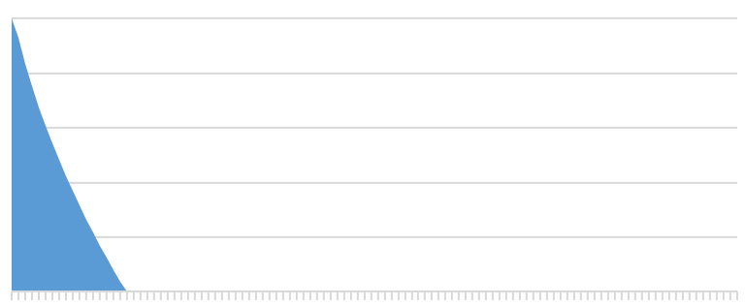
Randomness Expansion
Prove the best possible rate curves
We have two families of rate curves, neither optimal. What are the best rate curves?
Can we match the classical-adversary rate curves?
[Several authors]: Security proof against an unentangled adversary.
W_{G,a}
W_{G}
11011 1010010001011101010001011101101010001111111010100010 ….

Slide 39
Randomness Expansion
Parallel randomness expansion
Give inputs to the boxes all at once. Can we still verify randomness?
011010
110101110111011010001000100001001101
01101011
111101
01010010110101011110101111101010101000100000
[Several authors]: Security proof against an unentangled adversary.
0010010 101110101000000001101111011010111010010010
010111
10101000
11111000001010101001010110101100000
11011 1010010001011101010001011101101010001111111010100010 ….

Slide 40

Randomness Expansion
[Several authors]: Security proof against an unentangled adversary.

Slide 41
Randomness expansion from untrusted quantum devices
Carl A. Miller
University of Michigan, Ann Arbor
With thanks to Zhu Cao, Dong-Ling Deng, Patrick Ion, Kihwan Kim,
Christopher Portmann, Karl Winsor, Xiao Yuan, and Qi Zhao.

