Slide 1
Randomness Extraction Beyond the Classical World
Kai-Min Chung
Academia Sinica, Taiwan
Based on joint works with Xin Li, Yaoyun Shi, and Xiaodi Wu
Notes:
A new way of extracting pure randomness from physics systems

Slide 2
Original Motivation from 90’s
Randomness is extremely useful resource
  Randomized algorithm, Distributed algorithm, Cryptography,…
Typically assume perfect uniform sources
  Unbiased, independent random bits
  Unrealistic strong assumption?
Can we rely on weak sources/assumptions?
Notes:
While I believe I don’t need to motivate this problem. It’s nice to review the original motivation from the 80’s in computer science

Slide 3
Randomness Extraction Paradigm
Extract uniform randomness from weak random sources
  Source = classical distribution over {0,1}^{n}
  Correlated and biased (unstructured), guarantee some entropy
Impossible given a single such source
  Even with n-1 bits of entropy
  Several proposed extraction approaches
This talk: extraction approaches beyond classical settings
  Quantum-proof seeded extractors
  Quantum-proof multi-source extractors
  Physical randomness extractors
  (or, randomness amplification for any weak sources)
Notes:
Say weak souce just classical distrubtion of correlated and biased bits, no, structure, but guarantee some entropy
The advantage is that it’s very general. The disadvantage is that it’s impossible.
Say, exciting question,
well-studied question in classical setting.
Past few years I explore several settings beyond classical setting
Focus on first one! Used in the rest
We present our recent progress beyond classical setting

Slide 4


Classical Seeded Extractors [NZ96]
Add short uniform seed as catalyst for extraction
n-bit weak random source X
uniform
$$Ext$$
d-bit seed
m almost uniform bits
(k,$ε$)-extractor:
X has $≥$ k-bits “entropy” $⟹$ Ext(X,U_{d}) “$ε$-close” to uniform
Goal: minimize seed length d, maximize output length m
Notes:
Say that a very nice way to get around impossibility is this
Say that we’ll discuss other ways, but this has many applications

Slide 5
Pervasive Applications
Diverse topics in Theoretical Computer Science
  Cryptography, Derandomization [Sis88, NZ93,…], Distributed algorithms [WZ95], Data structures [Ta02], Hardness of Approximation [Zuc93,…]
Many applications in Cryptography
  Bounded-storage model [Lu02,V03], PRG [HILL89], Biometrics [DRS04], Leakage-resilient crypto [DP09]…
Also in Quantum Cryptography
  Privacy amplification [BBR88], Randomness expansion, Physical randomness extractors,…
Notes:
Network extractors [KLRZ08], Non-malleable codes [DKO13],

Slide 6




Privacy Amplification [BBR88]
Alice & Bob share secret weak random source X
Goal: extract uniform key Z against eavesdropper Eve
uniform Y
Alice
Bob
X
X
Eve
Z=Ext(X,Y)
Z=Ext(X,Y)
Need strong extractor: (Z, Y) $≈_{ε}$ (U_{m}, Y)
Need explicit construction
Notes:
Name:
Bennett, Brassard, Crepeau
Mention they share weak key, want to agree on a uniform key via a public channel, against adversary Eve.
Mention we also need more.
Consider privacy amplification is used in a larger protocol, such as QKD
Adversary gets learn side information about X, which can be quantum

Slide 7
Handle Side Information
Eve may hold (quantum) side info E about X
  e.g., when used as sub-protocol in QKD
uniform Y
Alice
Bob
X
X
Eve
Z=Ext(X,Y)
Z=Ext(X,Y)
E
Need Ext against side info: (Z, Y, E) $≈_{ε}$ (U_{m}, Y, E)

Slide 8
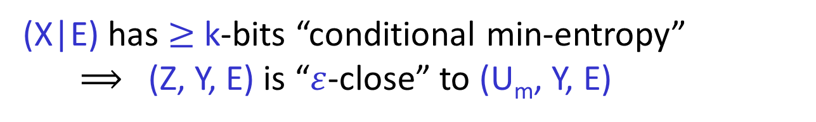


Quantum-Proof Strong Extractors
Want: Ext works against quantum side info
k-source X
Eve
uniform
$$Ext$$
E
Seed Y
$≈$uniform
Output Z = Ext(X,Y)
(k,$ε$)-quantum-proof strong extractor:
(X|E) has $≥$ k-bits “conditional min-entropy”
$⟹$ (Z, Y, E) is “$ε$-close” to (U_{m}, Y, E)

Slide 9
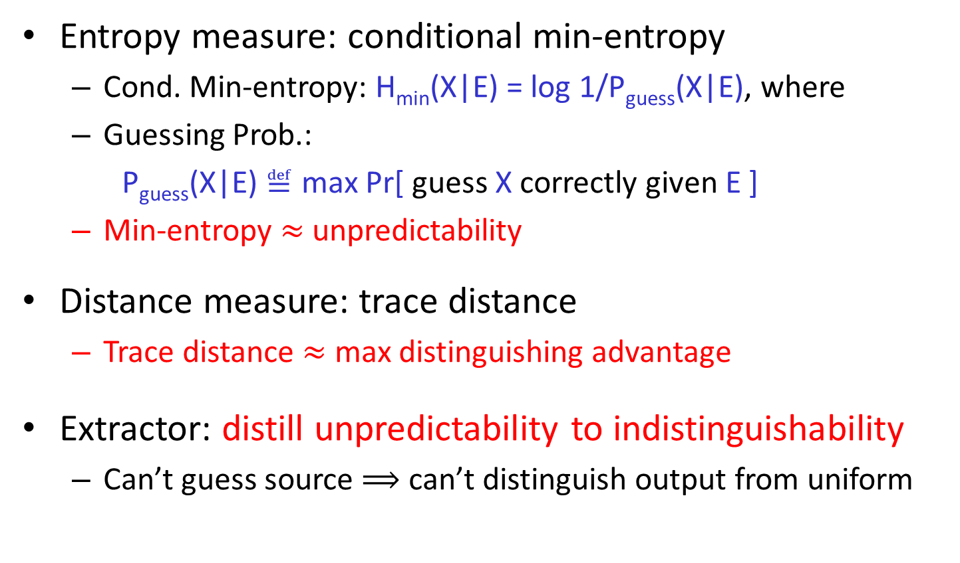
Entropy & Distance: Operational Def.
Entropy measure: conditional min-entropy
  Cond. Min-entropy: H_{min}(X|E) = log 1/P_{guess}(X|E), where
  Guessing Prob.:
  P_{guess}(X|E) $≝$ max Pr[ guess X correctly given E ]
  Min-entropy $≈$ unpredictability
Distance measure: trace distance
  Trace distance $≈$ max distinguishing advantage
Extractor: distill unpredictability to indistinguishability
  Can’t guess source $⟹$ can’t distinguish output from uniform
Notes:
Network extractors [KLRZ08], Non-malleable codes [DKO13],

Slide 10
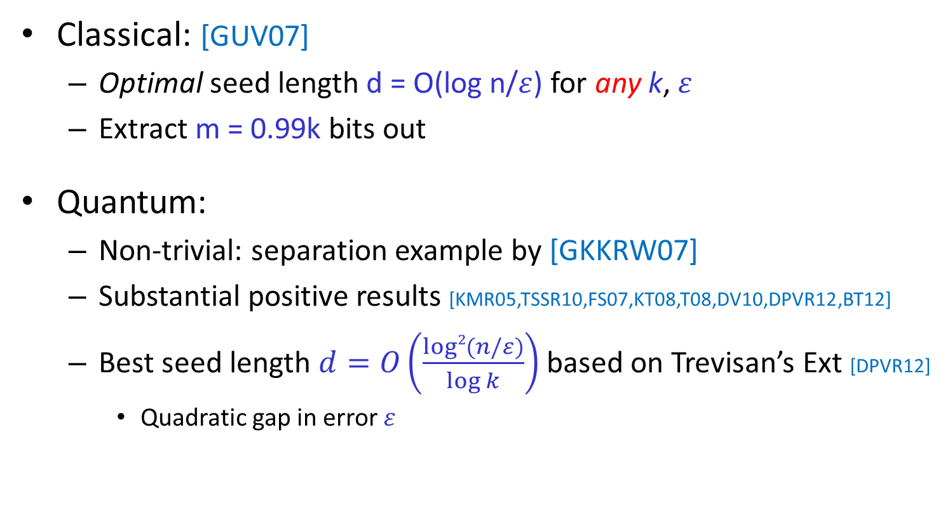
What Do We Know?
Classical: [GUV07]
  Optimal seed length d = O(log n/$ε$) for any k, $ε$
  Extract m = 0.99k bits out
Quantum:
  Non-trivial: separation example by [GKKRW07]
  Substantial positive results [KMR05,TSSR10,FS07,KT08,T08,DV10,DPVR12,BT12]
  Best seed length $d=O\left(\frac{log2{(n/ε)}}{\log{k}}\right)$based on Trevisan’s Ext [DPVR12]
    Quadratic gap in error $ε$
Notes:
Gavinsky
De Portmann Vidick Renner
Nisan Zuckerman,
Radhakrishnan and Ta-shma
Lu, Reingold, Vadhan, Wigderson,
Guruswami, Ulman, Vadhan
Mention that in general, want to give a sense of the literature, so simplify story
citation

Slide 11
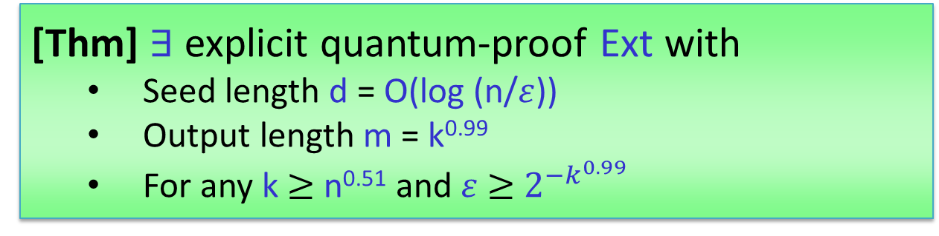
Our Results [CW15]
Optimal seed length for wide range parameters
Revisit “block-sampling-&-extraction” framework [NZ96,Z97,SZ99]
  Show it can be made quantum-proof
  Improve by a new win-win type construction
[Thm] $∃$ explicit quantum-proof Ext with
  Seed length d = O(log (n/$ε$))
  Output length m = k^{0.99}
  For any k $≥$ n^{0.51} and$ε$ $≥$ $2^{−k^{0.99}}$
Notes:
Network extractors [KLRZ08], Non-malleable codes [DKO13],

Slide 12
Quantum-proof Multi-source Ext
Notes:
Importance: used underlying all other method

Slide 13



What If We Don’t Have Uniform Seed?
Multi-source extractor: use multiple indep. sources
$$…$$
X₁
X_{t}
$$Ext$$
$≈$uniform output
Z
(t,k,$ε$)-multi-source extractor:
X_{i} has $≥$ k-bit entropy $⟹$ Ext(X₁,…,X_{t}) $ε$-close to uniform
Notes:
Say that a very nice way to get around impossibility is this
Say that we’ll discuss other ways, but this has many applications

Slide 14
Privacy Amp. w/o Perfect Randomness
Suppose Alice & Bob have no perfect local randomness
weak source Y
Alice
Bob
X
X
Eve
Z=Ext(X,Y)
Z=Ext(X,Y)
Notes:
Name:
Bennett, Brassard, Crepeau

Slide 15

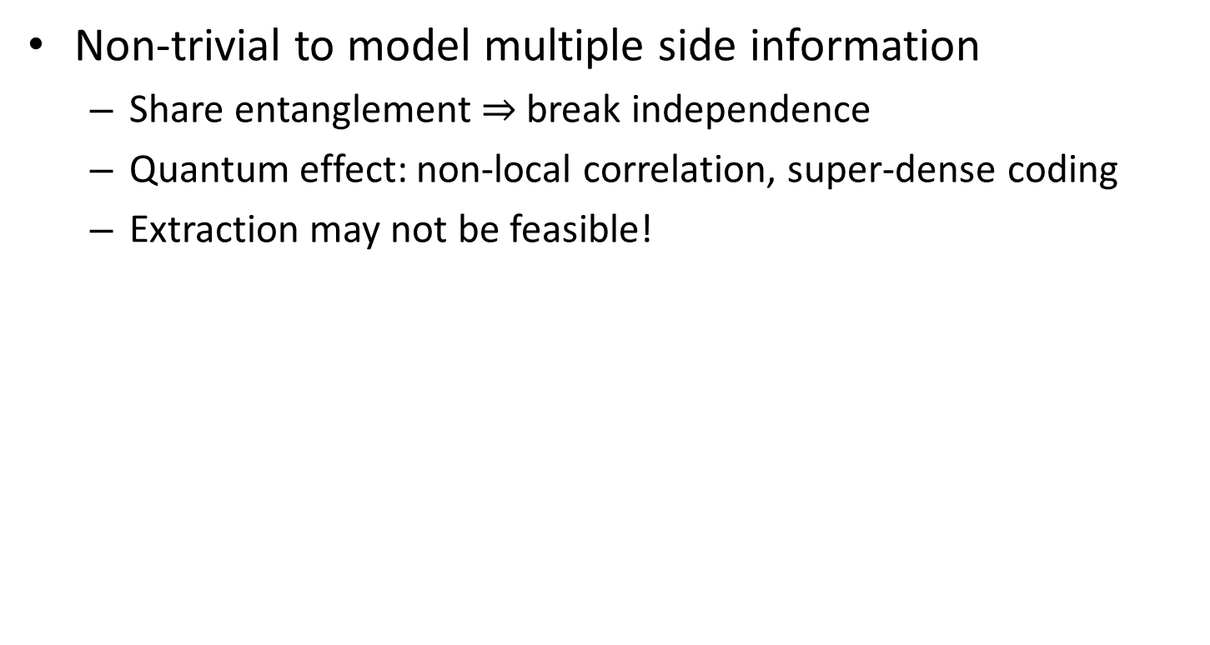


Quantum-Proof Multi-source Ext
Non-trivial to model multiple side information
  Share entanglement $⇒$ break independence
  Quantum effect: non-local correlation, super-dense coding
  Extraction may not be feasible!
$$…$$
X₁
X_{t}
Eve
Eve
$$Ext$$
E₁
E_{t}
$≈$uniform output
Z
Notes:
One natural way to think about it is that
Side info of each source is generated locally, and collected by an adversary Eve.

Slide 16


IA & BS Model for Two-sources [KK12]
Independent Adversary (IA) Model
  Require E₁ and E₂ to be independent as well
Bounded Storage (BS) Model
  Allow entangled (local) side info, put size restriction on E₁, E₂
Classical DEOR Ext works for both models [KK12]
k₁-source X₁
k₂-source X₂
Eve
Eve
$$Ext$$
E₁
E₂
$≈$uniform
Output Z = Ext(X₁,X₂)
Notes:
This question is only studied by Kasher and Kempe
Say first study by [KK12]!!!
Kasher, Kempe

Slide 17
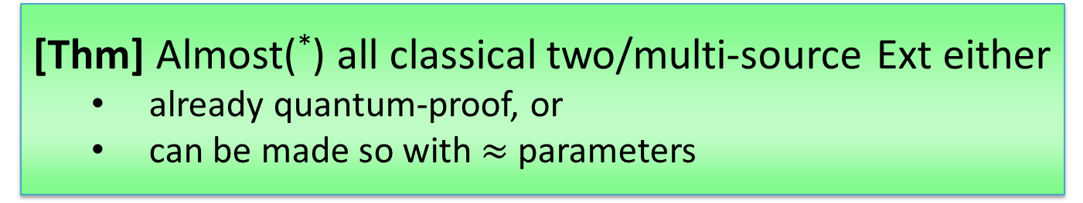
Our Results [CLW15]
General Entanglement (GE) Model
  Unify both IA and BS models
  Allow entanglement as BS, but NO size restriction
  Key: new measure of entropy, avoid “interference” issue
Generic techniques to prove GE security
[Thm] Almost(*) all classical two/multi-source Ext either
  already quantum-proof, or
  can be made so with $≈$ parameters
(*) except improved two-source Ext of [Li15] (based on [CZ15])
Notes:
Chattopadhyay∗
Network extractors [KLRZ08], Non-malleable codes [DKO13],

Slide 18
Physical Randomness Extractors
Notes:
Importance: used underlying all other method

Slide 19



What If We Are Paranoid about Independence Assumption?
Cannot be verified & don’t know how to guarantee
“Device-independent Extractors”
  Extract randomness from quantum power without trust
source
device
device
device
Eve
X
D₁
D₂
D_{t}
$$Ext$$
E
$≈$uniform output
Z
Accept/Reject
Notes:
Randomness extractors crucially require it
Can we avoid independence assumption
DI framework provide a potential way.
In addition to the source, Extractor also get access to a set of untrusted device as resource for extraction

Slide 20
What If We Are Paranoid about Independence Assumption?
Cannot be verified & don’t know how to guarantee
“Device-independent Extractors”
  Extract randomness from quantum power without trust
  Randomness expansion: seeded setting
    still require uniform seed and independence
  Randomness amplification: Santha-Vazirani (SV) source
    Structured source with high min-entropy
Does randomness extraction remain feasible without any independence or structural assumptions?

Slide 21
Physical Randomness Extractor (PRE)
DI extraction for general weak source
We construct quantum-secure PRE [CSW14]
  Only require O(1) bits min-entropy; minimal assumptions!
No-signaling-secure PRE (ongoing work) [CSW15]
  Physics interpretation [GMD+13]: stronger dichotomy theorem
source
device
device
device
Eve
X
D₁
D₂
D_{t}
$$Ext$$
E
$≈$uniform output
Z
Accept/Reject
Notes:
Motivated by this randomness extraction view, we define physical randomness extractors.
This is the usual DI framework, but model the source X as a general weak source

Slide 22
Our Explicit Construction of Quantum-proof Seeded Extractor
Notes:
Say very high level, tell you how the construction looks like, and how it works

Slide 23

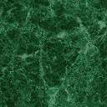

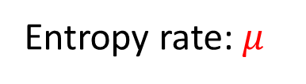

Block Sampling & Extraction [NZ96,SZ99,Zuc97]
Entropy rate: $μ$
(n,k=$μ$n) source
Block-Sampling (one by one) :
Preserve entropy rate in blocks
Gain block structure
Block-Extraction (one by one):
Seed = seed for the last short block (“free”)
Block/seed size grows exponentially $⇒$ $≤$ O(log n) blocks
$⟹$ Seed length: O(log²n) for sampling!
Notes:
Why need two steps: because sampling cannot improve the entropy rate.

Slide 24
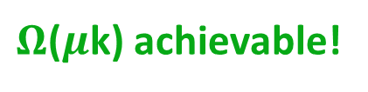
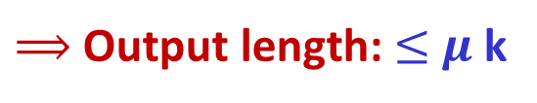

Block Sampling & Extraction [NZ96,SZ99,Zuc97]
Entropy rate: $μ$
(n,k=$μ$n) source
Block-Sampling (one by one) :
Preserve entropy rate in blocks
|
|
Residual source entropy: by chain rule $≥$ k $−$
|
|
$⇒$ $≤$ k
$⇒$ Entropy of $≤μ$k
$⟹$ Output length: $≤$ $μ$ k
$Ω$($μ$k) achievable!
$⟹$ Seed length: O(log²n) for sampling!
Notes:
Why need two steps: because sampling cannot improve the entropy rate.

Slide 25
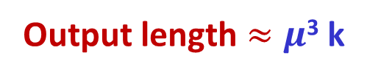
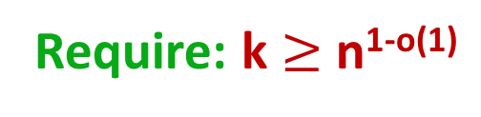
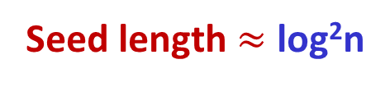


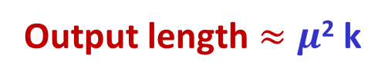
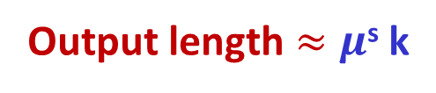



Self Composition [NZ96,SZ99,Zuc97]
Entropy rate: $μ$
What we have achieved:
Ext₁:
Seed length $≈$ log²n
Output length $≈$ $μ$ k
Self composition gives:
Ext₂:
Seed length $≈$ log log n log n
Output length $≈μ$² k
Self composition again:
Ext₃:
Seed length $≈$ log log log n log n
Output length $≈μ$³ k
$$…$$
Self composition s = log*n times:
Ext_{s}:
Seed length $≈$ log^{(s)}n log n
Output length $≈μ$^{s} k
= O(log n)
need > 1
Require: k $≥$ n^{1-o(1)}
Notes:
Why need two steps: because sampling cannot improve the entropy rate.

Slide 26
Win-win argument
Entropy rate: $μ$
(n,k=$μ$n) source
W₁
W₂
W₃
W₄
W₁
W₂
W₃
W₄
Z
Notes:
We sample blocks much longer than k.
Assume that residual source still has enough entropy left, say, 1%.
Then extract W1 from the blocks.
If residual source indeed has 1% entropy -> W1 is uniform
If residual source does not have 1% entropy,
Then the blocks have 99% of entropy, and the length is much shorter.
The source is condense, the entropy rate is increased
Continue
How to explain???
First show the whole picture, with intuitive explanation of win-win
Then discuss parameter
Easy: length shrink exponentially fast by a parameter alpha we can control
How about entropy loss?
Also a parameter we can control: assume residual entropy is \gamma k, then we loss \gamma k
Where do we pay in alpha and gamma: output length

Slide 27
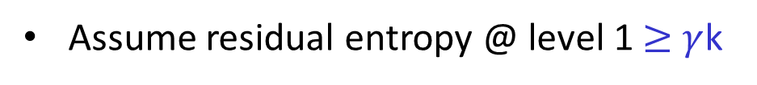
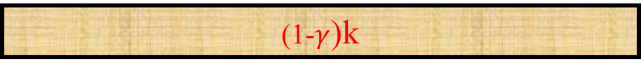
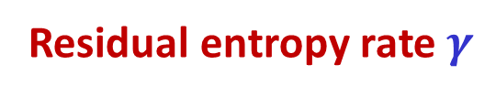
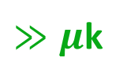
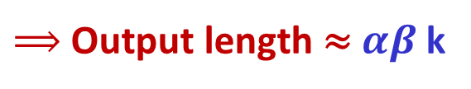
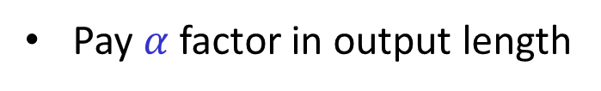
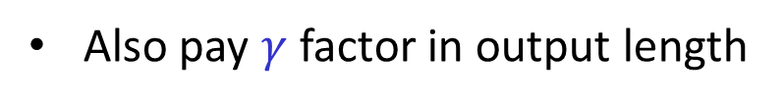
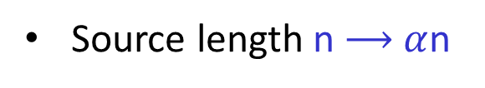
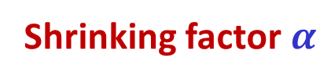
Controlling the Parameters
Entropy rate: $μ$
(n,k=$μ$n) source
(1-$γ$)k
W₁
Shrinking factor $α$
Source length n $⟶$ $α$n
Pay $α$ factor in output length
Residual entropy rate $γ$
Assume residual entropy @ level 1 $≥$ $γ$k
By win-win, if false, then entropy @ level 2 $≥$ (1-$γ)$k
Also pay $γ$ factor in output length
$⟹$ Output length ≈ $αβ$ k
$≫μ$k
Notes:
How to explain???
First show the whole picture, with intuitive explanation of win-win
Then discuss parameter
Easy: length shrink exponentially fast by a parameter alpha we can control
How about entropy loss?
Also a parameter we can control: assume residual entropy is \gamma k, then we loss \gamma k
Where do we pay in alpha and gamma: output length

Slide 28
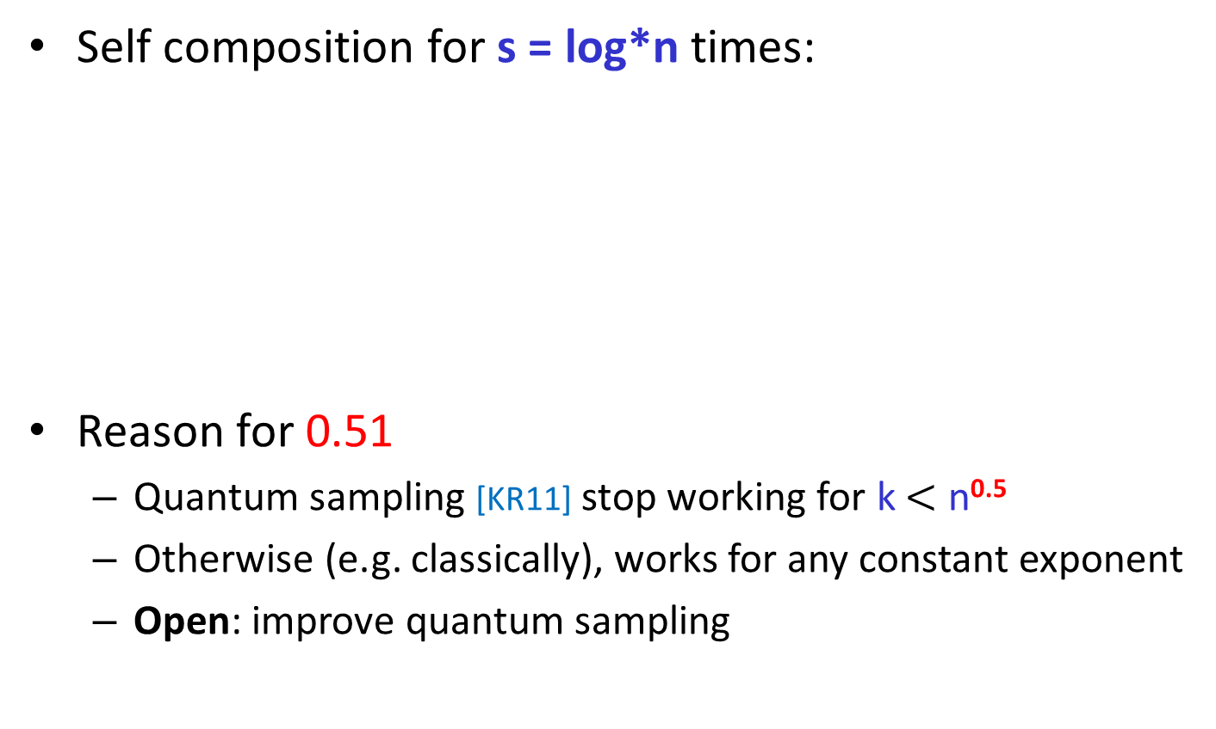
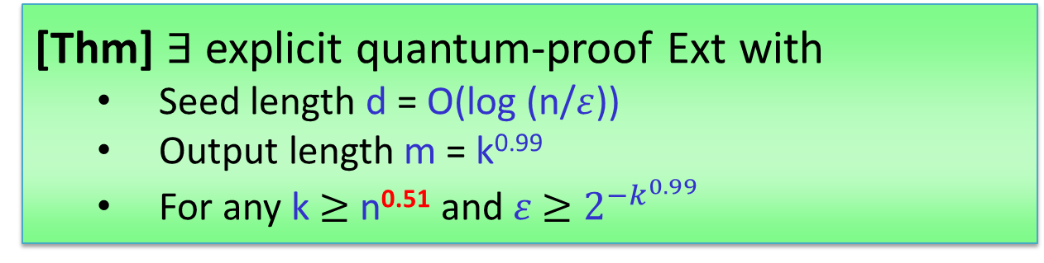
Summary
Self composition for s = log*n times:
Reason for 0.51
  Quantum sampling [KR11] stop working for k $<$ n^{0.5}
  Otherwise (e.g. classically), works for any constant exponent
  Open: improve quantum sampling
[Thm] $∃$ explicit quantum-proof Ext with
  Seed length d = O(log (n/$ε$))
  Output length m = k^{0.99}
  For any k $≥$ n^{0.51} and$ε$ $≥$ $2^{−k^{0.99}}$
Notes:
If have time, say classical we do get and new

Slide 29
Open Questions

Slide 30
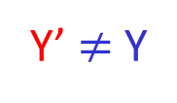
Privacy Amplification with
Man-in-the-Middle (MIM) Adversary
Eve holds side info E about X & launch MIM attack
  Can arbitrarily modify, insert, delete, and reorder message
Well-studied problem classically [MW97,DW09,RW03, KR09,CKOR10,DLWZ11,CRS12,Li12,Li15]
Motivate quantum-proof non-malleable Ext
Eve
uniform Y
Y’ $≠$ Y
Alice
E
Bob
X
X
Open!
for quantum E
Z=Ext(X,Y)
Z’=Ext(X,Y’)

Slide 31
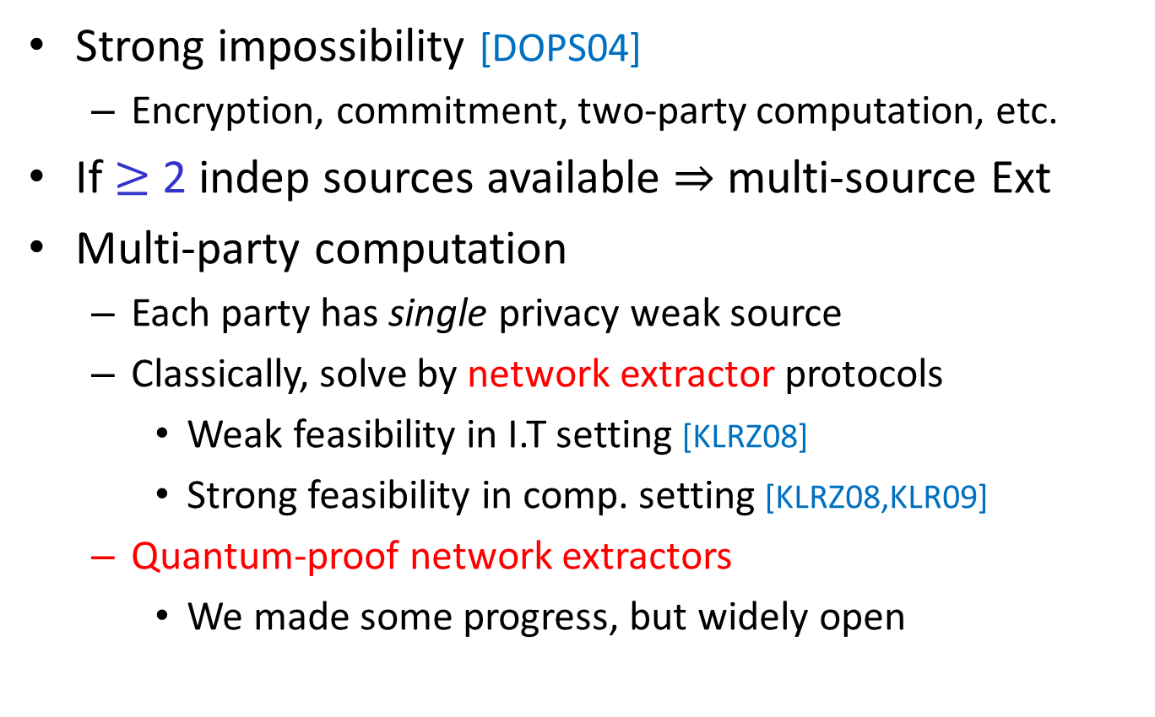
Cryptography w/ Imperfect Randomness
Strong impossibility [DOPS04]
  Encryption, commitment, two-party computation, etc.
If $≥$ 2 indep sources available $⇒$ multi-source Ext
Multi-party computation
  Each party has single privacy weak source
  Classically, solve by network extractor protocols
    Weak feasibility in I.T setting [KLRZ08]
    Strong feasibility in comp. setting [KLRZ08,KLR09]
  Quantum-proof network extractors
    We made some progress, but widely open

Slide 32
QCrypt against Quantum Side Info
Significant gap in our understanding between cryptography against classical vs. quantum side info
  Seeded and multi-source extractors
  Privacy amplification, non-malleable extractors
  Network extractors
  Leakage-resilient cryptography, etc
It’s time to bridge the gap!

Slide 33

Thank you! Questions?

Slide 34
Self Composition [NZ96,SZ99,Zuc97]
Entropy rate: $μ$
What we have achieved:
Ext₁:
Seed length $≈$ log²n
Output length $≈$ $μ$ k
Self composition gives:
Ext₂:
Seed length $≈$ log log n log n
Output length $≈μ$² k
Self composition again:
Ext₃:
Seed length $≈$ log log log n log n
Output length $≈μ$³ k
Idea: Ext₂ use Ext₁ to extract
(n,k=$μ$n) source
Notes:
Why need two steps: because sampling cannot improve the entropy rate.

Slide 35
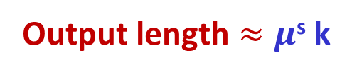



Self Composition [NZ96,SZ99,Zuc97]
Entropy rate: $μ$
What we have achieved:
Ext₁:
Seed length $≈$ log²n
Output length $≈$ $μ$ k
Self composition gives:
Ext₂:
Seed length $≈$ log log n log n
Output length $≈μ$² k
$$…$$
Self composition s = log*n times:
Ext_{s}:
Seed length $≈$ log^{(s)}n log n
Output length $≈μ$^{s} k
= O(log n)
need > 1
Require: k $≥$ n^{1-o(1)}
Notes:
Why need two steps: because sampling cannot improve the entropy rate.

