Slide 1

Quantum Stein’s lemma for correlated states and asymptotic entanglement transformations
Fernando G.S.L. Brandão and Martin B. Plenio
arXiv 0810.0026 (chapter 4)
arXiv 0902.XXXX
QIP 2009, Santa Fe

Slide 2
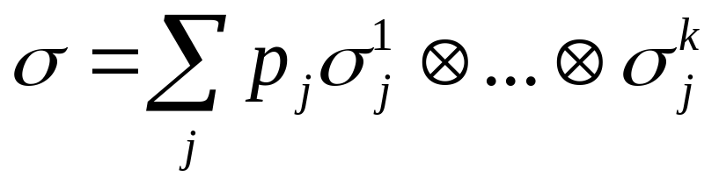
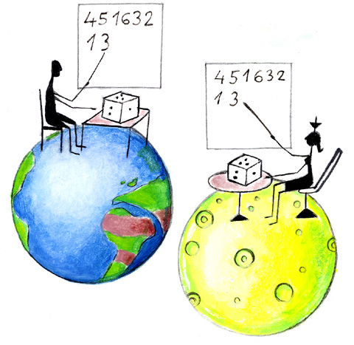
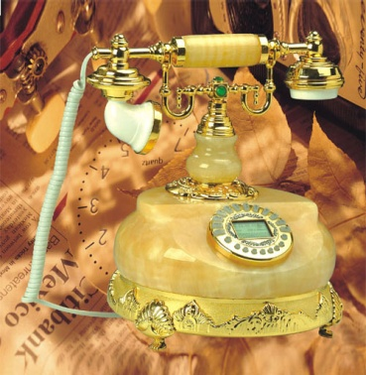
Multipartite entangled states
Non-entangled states
Can be created by LOCC
(Local Operations and Classical Communication)

Slide 3
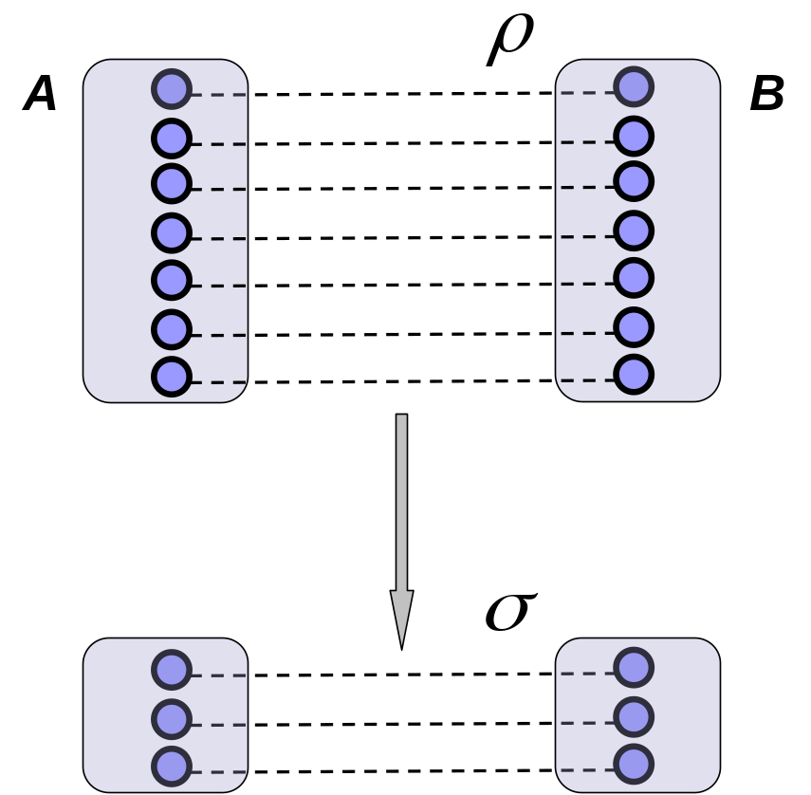
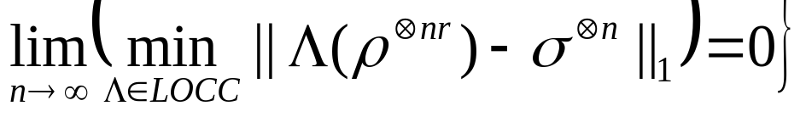

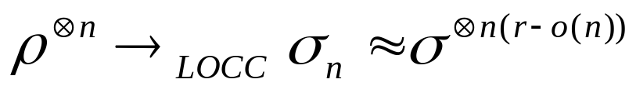
Multipartite entangled states
LOCC asymptotic entanglement conversion
r is an achievable rate if
LOCC optimal conversion rate

Slide 4


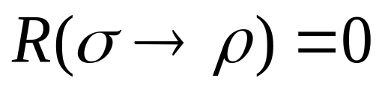
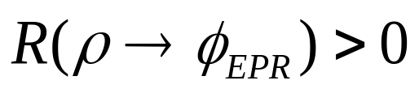

Asymptotically non-entangled states
is asymptotically non-entangled if there is a state such that
Is every entangled state asymptotically entangled?
For distillable states:
Hence, they must be asymptotically entangled
For bound entangled states,
Are they asymptotically entangled?
(Horodecki, Horodecki, Horodecki 98)

Slide 5
Asymptotically non-entangled states
is asymptotically non-entangled if there is a state such that
Is every entangled state asymptotically entangled?
For distillable states:
Hence, they must be asymptotically entangled
For bound entangled states,
Are they asymptotically entangled?
(Horodecki, Horodecki, Horodecki 98)

Slide 6
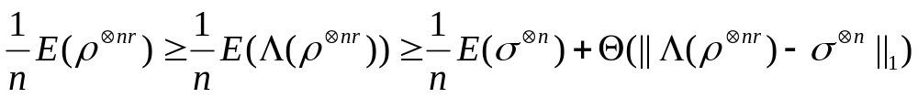
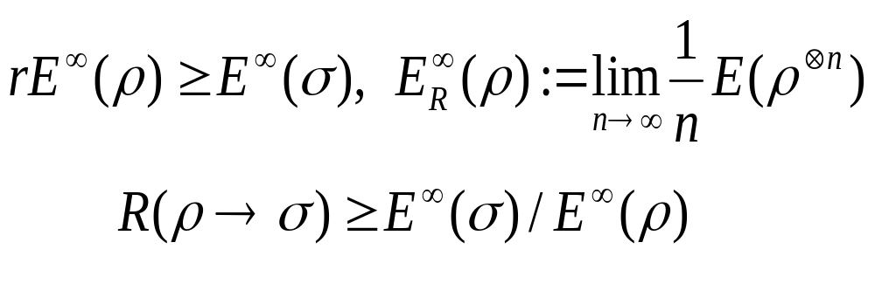
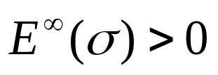

Asymptotically non-entangled states
We can use entanglement measures to analyse the problem:
Let r be an achievable rate:
LOCC monotonicity
Asymptotic continuity
If , then is asymptotically entangled

Slide 7
Asymptotically non-entangled states
We can use entanglement measures to analyse the problem:
Let r be an achievable rate:
LOCC monotonicity
Asymptotic continuity
If , then is asymptotically entangled

Slide 8
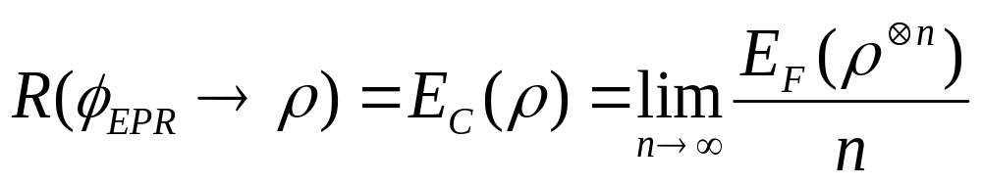
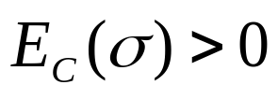
Asymptotically non-entangled states
Every bipartite entangled state is
asymptotically entangled
(Yang, Horodecki, Horodecki, Synak-Radtke 05)
Entanglement cost:
Bennett, DiVincenzo, Smolin, Wootters 96, Hayden, Horodecki, Terhal 00
for every bipartite entangled states

Slide 9
Asymptotically non-entangled states
This talk: Every multipartite entangled state is asymptotically entangled
The multipartite case is not implied by the bipartite:
there are entangled states which are separable across
any bipartition
ex: State derived from the Shift Unextendible-Product-Basis
(Bennett, DiVincenzo, Mor, Shor, Smolin, Terhal 98)

Slide 10
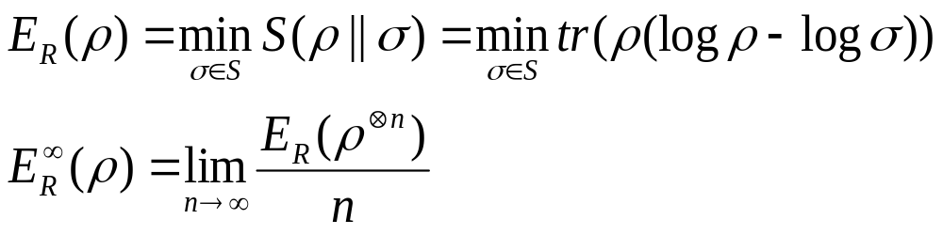
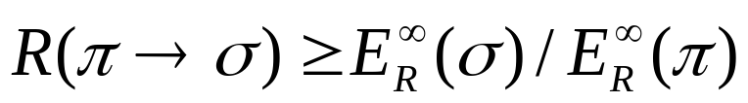
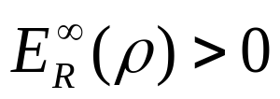
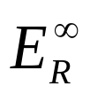

Asymptotically non-entangled states
Regularized relative entropy of entanglement:
(Vedral and Plenio 98, Vollbrecht and Werner 00)
Rest of the talk: for every entangled state
We show that by linking to a certain quantum
hypothesis testing problem
Same result has been found by Marco Piani, with different techniques

Slide 11


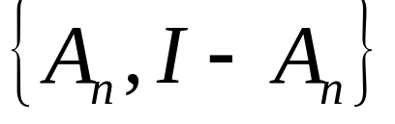
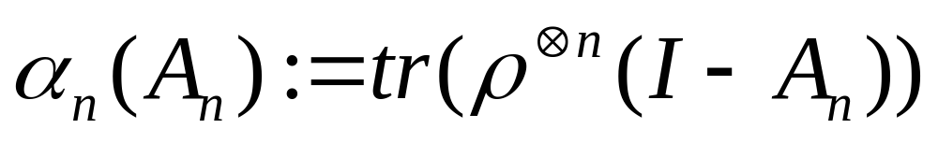
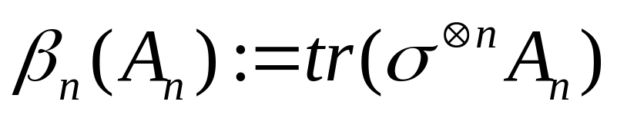
Quantum Hypothesis Testing
Given n copies of a quantum state, with the promise that it is described either by or , determine the identity of the state.
Measure two outcome POVM .
Error probabilities
- Type I error:
- Type II error:
Alternative hypothesis
Null hypothesis

Slide 12
Quantum Hypothesis Testing
Given n copies of a quantum state, with the promise that it is described either by or , determine the identity of the state.
Measure two outcome POVM
Error probabilities
- Type I error:
- Type II error:
The state is
The state is

Slide 13
Quantum Hypothesis Testing
Given n copies of a quantum state, with the promise that it is described either by or , determine the identity of the state
Measure two outcome POVM
Error probabilities
- Type I error:
- Type II error:
Several different instances depending on the constraints imposed in the error probabilities: Chernoff distance, Hoeffding bound, Stein’s Lemma, etc...

Slide 14
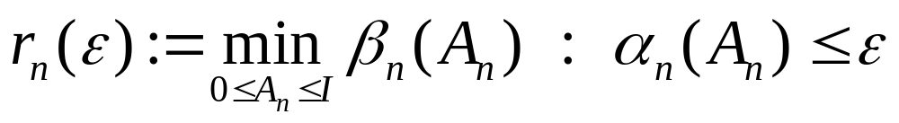
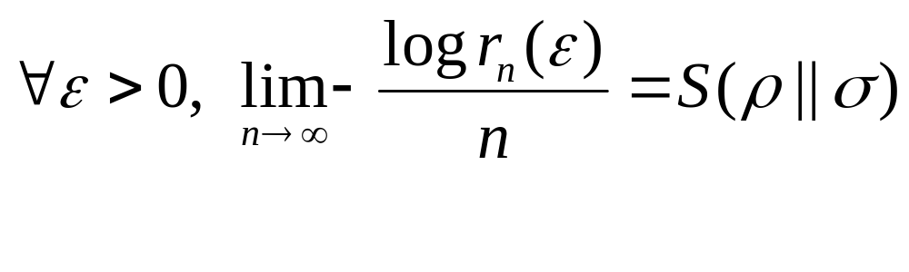
Quantum Stein’s Lemma
(Hiai and Petz 91; Ogawa and Nagaoka 00)
Asymmetric hypothesis testing
Quantum Stein’s Lemma

Slide 15
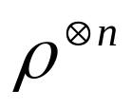

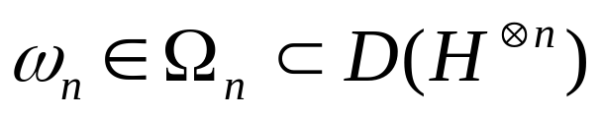
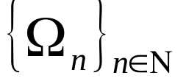
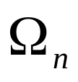
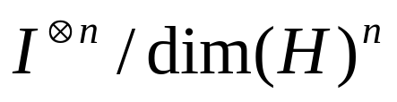
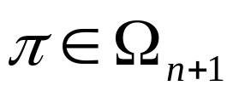
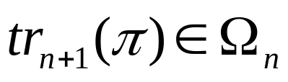
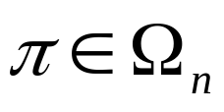
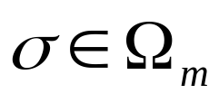
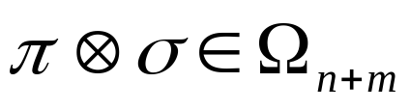
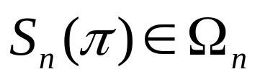
A generalization of Quantum Stein’s Lemma
Consider the following two hypothesis
- Null hypothesis: For every we have
- Alternative hypothesis: For every we have an unknown
state , where satisfies
1. Each is closed and convex
2. Each contains the maximally mixed state
3. If , then
4. If and , then
5. If , then

Slide 16
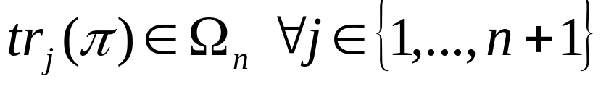
A generalization of Quantum Stein’s Lemma
Consider the following two hypothesis
- Null hypothesis: For every we have
- Alternative hypothesis: For every we have an unknown
state , where satisfies
1. Each is closed and convex
2. Each contains the maximally mixed state
3. If , then
4. If and , then
5. If , then

Slide 17
A generalization of Quantum Stein’s Lemma
Consider the following two hypothesis
- Null hypothesis: For every we have
- Alternative hypothesis: For every we have an unknown
state , where satisfies
1. Each is closed and convex
2. Each contains the maximally mixed state
3. If , then
4. If and , then
5. If , then

Slide 18
A generalization of Quantum Stein’s Lemma
Consider the following two hypothesis
- Null hypothesis: For every we have
- Alternative hypothesis: For every we have an unknown
state , where satisfies
1. Each is closed and convex
2. Each contains the maximally mixed state
3. If , then
4. If and , then
5. If , then

Slide 19
A generalization of Quantum Stein’s Lemma
Consider the following two hypothesis
- Null hypothesis: For every we have
- Alternative hypothesis: For every we have an unknown
state , where satisfies
1. Each is closed and convex
2. Each contains the maximally mixed state
3. If , then
4. If and , then
5. If , then

Slide 20
A generalization of Quantum Stein’s Lemma
Consider the following two hypothesis
- Null hypothesis: For every we have
- Alternative hypothesis: For every we have an unknown
state , where satisfies
1. Each is closed and convex
2. Each contains the maximally mixed state
3. If , then
4. If and , then
5. If , then

Slide 21
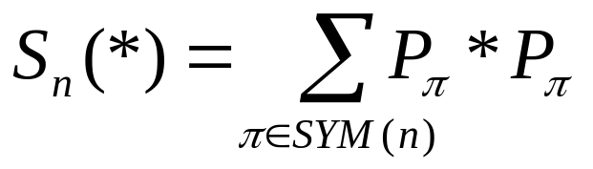
A generalization of Quantum Stein’s Lemma
Consider the following two hypothesis
- Null hypothesis: For every we have
- Alternative hypothesis: For every we have an unknown
state , where satisfies
1. Each is closed and convex
2. Each contains the maximally mixed state
3. If , then
4. If and , then
5. If , then

Slide 22
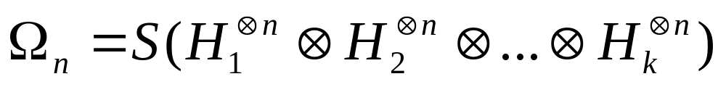
A generalization of Quantum Stein’s Lemma
Consider the following two hypothesis
- Null hypothesis: For every we have
- Alternative hypothesis: For every we have an unknown
state , where satisfies
1. Each is closed and convex
2. Each contains the maximally mixed state
3. If , then
4. If and , then
5. If , then

Slide 23

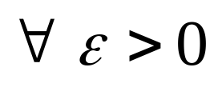
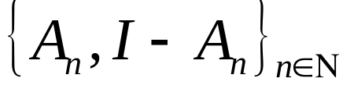
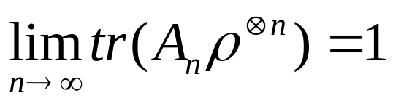
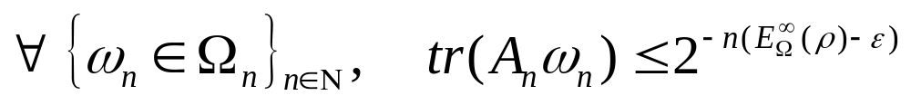
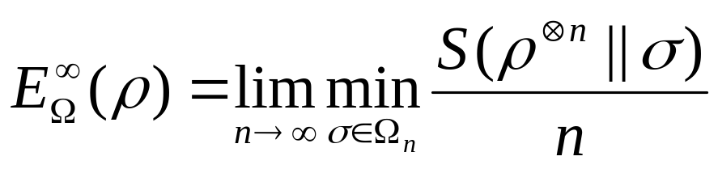
A generalization of Quantum Stein’s Lemma
theorem: Given satisfying properties 1-5 and
- (Direct Part) there is a s.t.

Slide 24
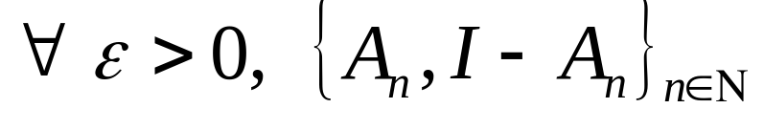
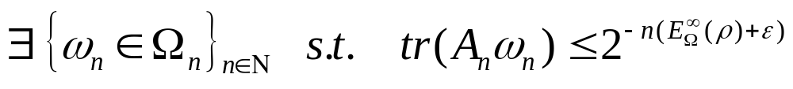
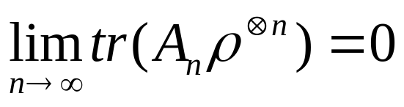
A generalization of Quantum Stein’s Lemma
theorem: Given satisfying properties 1-5 and
- (Strong Converse) , if

Slide 25
A generalization of Quantum Stein’s Lemma
theorem: Given satisfying properties 1-5 and
- (Strong Converse) , if
Proof: Exponential de Finetti theorem (Renner 05) + duality convex optimization + quantum Stein’s lemma; see arXiv 0810.0026

Slide 26

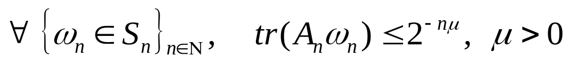
Corollary: strict positiveness of E_{R}∞
For an entangled state we construct a sequence of POVMs s.t.

Slide 27

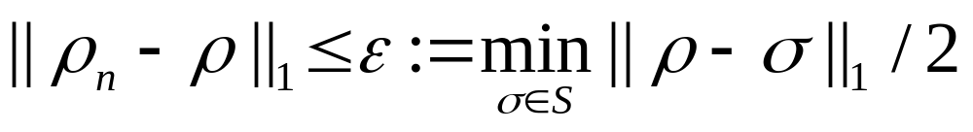
Corollary: strict positiveness of E_{R}∞
How we construct the A_{n}’s : we measure each copy with a local informationally complete POVM M to obtain an empirical estimate of the state. If
we accept, otherwise we reject
M

Slide 28

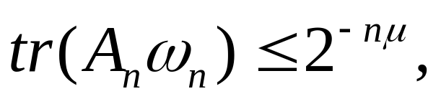
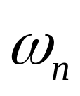
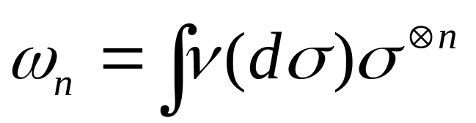

Corollary: strict positiveness of E_{R}∞
By Chernoff-Hoeffding’s bound, it’s clear that for some
for of the form
, with supported on separable states

Slide 29
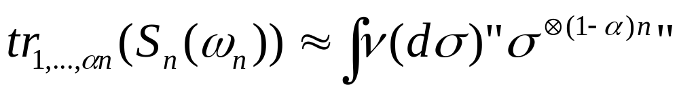



Corollary: strict positiveness of E_{R}∞
In general, by the exponential de Finneti theorem,
for
We show that
which implies the result
x
(Renner 05)
almost power states

Slide 30





Corollary: strict positiveness of E_{R}∞
Let’s show that
We measure an info-complete
POVM on all copies of
expect the first
The estimated state is close
from the post-selected state with
probability
As we only used LOCC, the post-selected state must be separable and
hence far apart from
M

Slide 31
Thank you!
x

