Slide 1
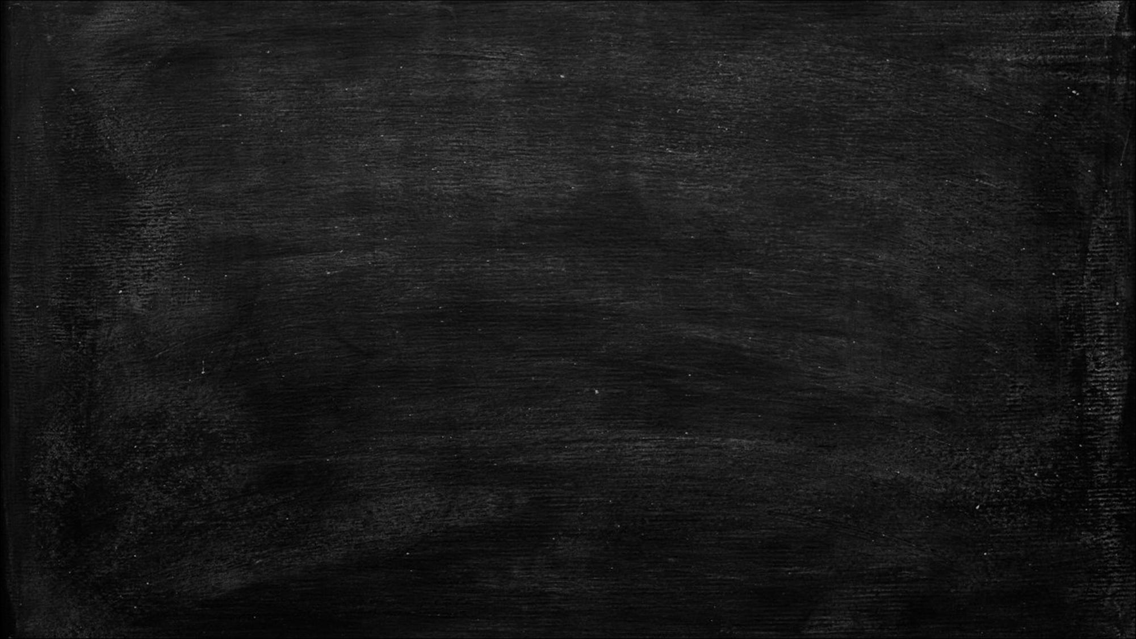
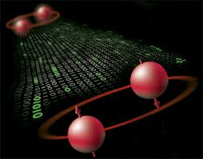


Quantum locally-testable codes
Dorit Aharonov
Lior Eldar
Hebrew University in Jerusalem

Slide 2
Table of contents
Locally testable codes and their importance in CS
Motivating quantum LTCs
Define quantum LTC
Our results
Concluding remarks

Slide 3



Locally testable codes
Error-correcting codes – we are interested in rate / distance.
In LTCs, in addition: given an input word determine:
  In the codespace
  Far from it
We want a random local constraint to decide between the two with good probability S - the soundness of the code.

Slide 4
Born as a nice feature of codes
Basic motivation: rapid filtering of “catastrophic” errors, without decoding.
Born out of property testing: property “in the codespace” [RS ’92,FS ’95].
Turnkey for proofs of the PCP theorem:
  [ALMSS ‘98,D ‘06]

Slide 5
Now a field of its own…
Hadamard code: [BLR ’90]
Other LTC codes: Long code [BGS ’95], Reed-Muller code [AK+ ’03].
LTCs with almost constant rate - [D ’06,BS ‘08]
Can one achieve constant rate, distance and query complexity ?
  This is the c^3 conjecture, believed to be false.

Slide 6
Motivating quantum LTCs

Slide 7

What about Quantum Locally testable codes?
Are there inherent quantum limitations on the quantum analog?
Can we construct quantum LTCs with similar parameters to the classical ones (with linear soundness)?
Are they as useful as classical LTC codes?

Slide 8
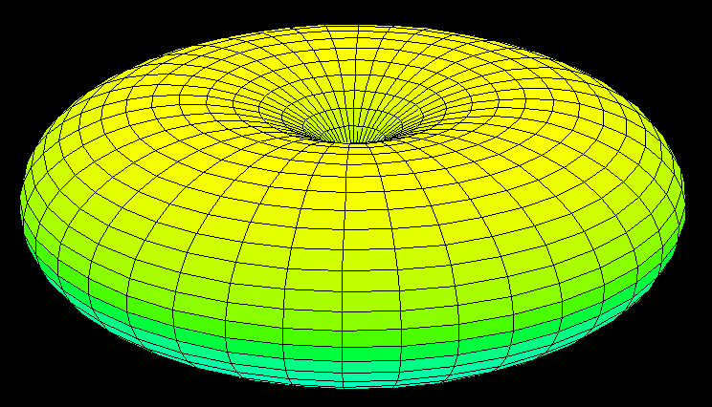
The Toric code example
Toric code [Kitaev ’96]:
Long strings of errors make only two constraints violated!
Are there constructions with better soundness?

Slide 9
Why study quantum LTCs?
Find robust (“self-correcting”) memories:
  Give high energy - penalty to large errors
Help resolve the quantum version of PCP? [AAV ’13]
  (quantum) PCP of proximity?
Help understand multi-particle entanglement.
  Is there a barrier against quantum LTCs?

Slide 10

In the rest of the talk
Contrary to classical LTCs!
Define quantum LTCs
Thm. 1: quantum LTCs on “expanding” codes have poor soundness.
Thm. 2: quantum LTCs on ANY code have limited soundness.
Checked the “usual suspects”
Is there a fundamental limitation?
2-D Toric
4-D Toric
Tillich-Zemor?
Reed-Solomon

Slide 11
Introducing: quantum LTCs

Slide 12


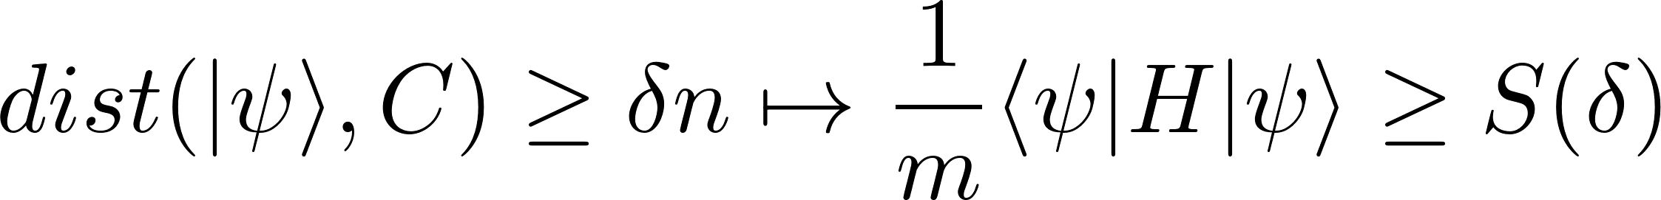
quantum LTCs – probability of “getting caught” is energy.
N qubits
A set of k-local projections
C = ker(H).
Number of queried bits ➔ locality of Hamiltonian
Soundness: Prob. Of violating a constraint ➔ energy
Generalizes “standard” distance between codewords

Slide 13
Our Results

Slide 14
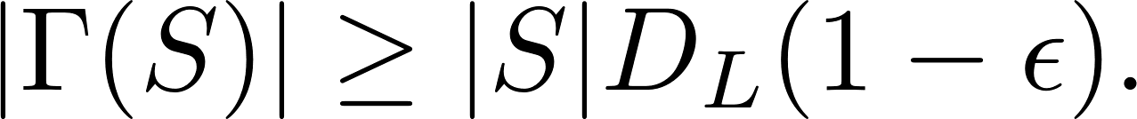
Thm.1: Expansion chokes-off local testability
C - a stabilizer code w/ constant distance.
Suppose its generating set induces a bi-partite graph that is an ε-small-set expander .
S
qubits
projections
Theorem 1: There exists δ₀ such that for any δ<δ₀ all words of distance δ from C, have S(δ)=O(εδ).

Slide 15
Counter-intuitive: qLTCs fail where its supposedly easiest!
S(δ)/k(=locality)
[relative violation]
Classical LTCs (expanding)
Thm.1 Expanding stabilizer
qLTCs are severely limited
Can even generate “good” classical codes with high soundness in this range!
1
0
δ₀
1/2
1
δ[distance]
Easiest range, <<1/k
Gets harder here!

Slide 16



Thm.1 : proof preliminary
Stabilizer qLTCS have a simple structure
Suppose stabilizer C is generated by group
To determine local testability: verify that for all
  If
  then
Large distance from the code
High prob. Of being rejected

Slide 17
Thm.1 : Driving force: monogamy of entanglement
S - qudits corresponding to some check term C.
By small-set expansion, of all incident check terms on S, a fraction O(ε) examine more than one qudit in S.
Conclusion: there exists a qudit q in S, such that all but a fraction O(ε) of the check terms Cj on q intersect S just on q.
But [Cj,C]=0 for all j.
Let E(C) = C|_{q} (and identity otherwise)
C|_{q} violates a mere O(ε) fraction of the check terms on q.
Take tensor-product of E(C)’s on “far-away” qudits.
C
C2
S
q
C1

Slide 18
Thm.2: soundness of stabilizer qLTCs is sub-optimal regardless of graph.
Theorem 2: For any stabilizer C with constant distance, there exist constants 1>δ₀>0 γ>0 such that for any δ < δ₀ we have S(δ)< αkδ(1-γ).
“Technical” attenuation of any quantum “parity check”.
Attenuation induced by the geometry of the code.

Slide 19
There is trouble, even without expansion
S(δ)/k
Classical LTCs (expanding)
Thm.2 Upper-bound for any stabilizer qLTC
1
Thm.1 Expanding stabilizer qLTCs
0
δ₀
1/2
1
δ

Slide 20
Thm.2 : proof idea
We saw that high expansion limits local testability.
How about low-expansion?
  Classically: high overlap between constraints.
  A large error, is examined by “few” unique check terms.
Need to handle the error weight:
  Find an error whose weight is minimal in the coset.
  Take the ratio of #violations / minimal weight.

Slide 21
Thm.2: proof idea (cntd.)
Strategy: choose a random error in far-away islands, calibrate error rate in a given island to be, say 1/10.
Some islands experience at least 2 errors, thereby “sensing” the expansion error.(1/poly(k))
Only very rarely, does the number of errors in an island top k/2. (~exp(-k))

Slide 22
Concluding remarks

Slide 23
Overall picture
S(δ)/k
Some classical codes
4-D Toric Code
1
Thm.2
2-D Toric Code
0
δ₀
1/2
1
δ
Thm.1

Slide 24
Summary
qLTCs are the natural analogs of classical LTCs
No known qLTCs with S(δ)=Ω(δ), even with exponentially small rate.
We show that soundness of stabilizer qLTCs is limited in two respects:
  Crippled by expansion – contrary to classical intuition
  Always sub-optimal, regardless of expansion.

Slide 25
Open questions
Is there a fundamental limit to quantum local testability, and if so, is it constant or sub-constant?
Can one construct strong quantum LTCs, even with exponentially small rate, and vanishing distance?
What is the relation between quantum LTCs and quantum PCP-like systems (e.g. NLTS), that contain robust forms of entanglement?

Slide 26
Thank you!

