Slide 1
The Bose-Hubbard model is QMA-complete
Andrew M. Childs David Gosset Zak Webb
arXiv: 1311.3297
Institute for Quantum Computing
University of Waterloo

Slide 2
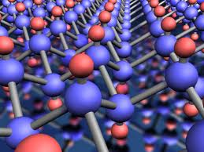
Solving for the ground energy of a quantum system can be viewed as a quantum constraint satisfaction problem. How difficult is it?
Image source: http://www.condmat.physics.manchester.ac.uk/imagelibrary/

Slide 3



The computational difficulty of computing the ground energy has been studied for many broad classes of Hamiltonians
Class of Hamiltonians
Ground energy problem
Complexity
Local
k-local Hamiltonian problem
QMA-complete for $k≥2$
[Kitaev 1999]
[Kempe, Regev 2003]
[Kempe, Kitaev, Regev 2006]
Frustration-free
Quantum k-SAT (testing frustration-freeness)
Contained in P for $k=2$
QMA₁-complete for $k≥3$
[Bravyi 2006]
[G. , Nagaj 2013 ]
Stoquastic (no “sign problem”)
Stoquastic k-local Hamiltonian
problem
Contained in AM
MA-hard
[Bravyi et. al. 2006]
Fermions or Bosons
QMA-complete
[Liu, Christandl, Verstraete 2007]
[Wei, Mosca, Nayak 2010]

Slide 4


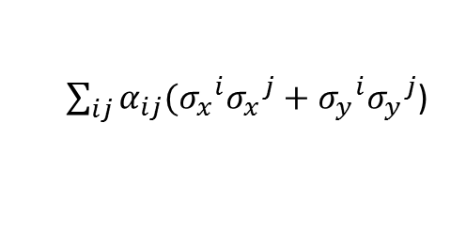

Systems with QMA-complete ground energy problems can be surprisingly simple
2-local Hamiltonian on a 2D grid [Oliveira Terhal 2008]
$$h_{ij}$$
$$H_{i,i+1}$$
2-local Hamiltonian on a line with qudits
[Aharonov et. al 2009] [Gottesman Irani 2009]
$$\vec{B_{i}}$$
Hubbard model on a 2D grid with site-dependent magnetic field
[Schuch Verstraete 2009].
Versions of the XY, Heisenberg, and other models with adjustable coefficients
E.g.,
$\sum_{ij}{α_{ij}({σ_{x}^{}}^{i}{σ_{x}^{}}^{j}+{σ_{y}^{}}^{i}{σ_{y}^{}}^{j}}$)
[Cubitt Montanaro 2013]

Slide 5
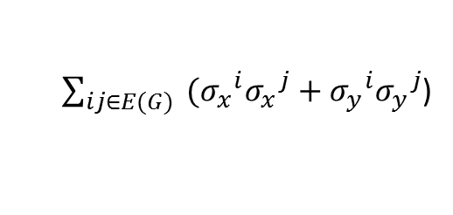
…However, the complexity of many natural models from condensed matter physics is still not understood, e.g., the XY model on a graph
$\sum_{ij∈E(G)}{ ({σ_{x}^{}}^{i}{σ_{x}^{}}^{j}+{σ_{y}^{}}^{i}{σ_{y}^{}}^{j}}$)

Slide 6
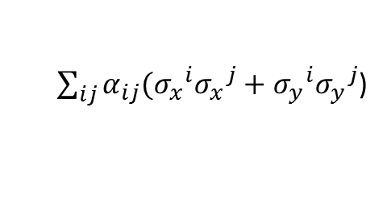
…However, the complexity of many natural models from condensed matter physics is still not understood, e.g., the XY model on a graph
Unfortunately, proof techniques using perturbation theory * require coefficients which grow with system size, e.g., [Cubitt Montanaro 2013]
*[Kempe Kitaev Regev 2006], [Oliveira Terhal 2008]
$\sum_{ij∈E(G)}{ ({σ_{x}^{}}^{i}{σ_{x}^{}}^{j}+{σ_{y}^{}}^{i}{σ_{y}^{}}^{j}}$)
Allowed to scale polynomially with n
$\sum_{ij}{α_{ij}({σ_{x}^{}}^{i}{σ_{x}^{}}^{j}+{σ_{y}^{}}^{i}{σ_{y}^{}}^{j}}$)

Slide 7
…However, the complexity of many natural models from condensed matter physics is still not understood, e.g., the XY model on a graph
Unfortunately, proof techniques using perturbation theory * require coefficients which grow with system size, e.g., [Cubitt Montanaro 2013]
In this work we consider a model of interacting Bosons on a graph with no adjustable coefficients…
*[Kempe Kitaev Regev 2006], [Oliveira Terhal 2008]
$\sum_{ij∈E(G)}{ ({σ_{x}^{}}^{i}{σ_{x}^{}}^{j}+{σ_{y}^{}}^{i}{σ_{y}^{}}^{j}}$)
Allowed to scale polynomially with n
$\sum_{ij}{α_{ij}({σ_{x}^{}}^{i}{σ_{x}^{}}^{j}+{σ_{y}^{}}^{i}{σ_{y}^{}}^{j}}$)

Slide 8
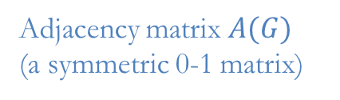
The Bose-Hubbard model on a graph
Adjacency matrix $A(G)$
(a symmetric 0-1 matrix)
Bosons move between adjacent vertices and experience an energy penalty if two or more particles occupy the same site.

Slide 9
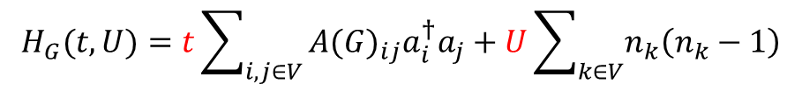
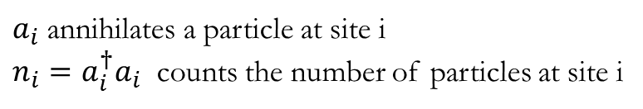
The Bose-Hubbard model on a graph
Adjacency matrix $A(G)$
(a symmetric 0-1 matrix)
Bosons move between adjacent vertices and experience an energy penalty if two or more particles occupy the same site.
$$H_{G}(t,U)=t\sum_{i,j∈V}{{A(G)}_{ij}a_{i}^{†}a_{j}}+U\sum_{k∈V}{n_{k}\left(n_{k}−1\right)}$$
Conserves total number of particles
Movement
Repulsive on-site interaction
$a_{i}$ annihilates a particle at site i
$n_{i}=a_{i}^{†}a_{i}$ counts the number of particles at site i

Slide 10
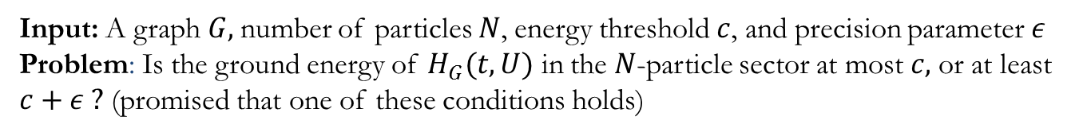
The Bose-Hubbard model on a graph
Adjacency matrix $A(G)$
(a symmetric 0-1 matrix)
Bosons move between adjacent vertices and experience an energy penalty if two or more particles occupy the same site.
$$H_{G}(t,U)=t\sum_{i,j∈V}{{A(G)}_{ij}a_{i}^{†}a_{j}}+U\sum_{k∈V}{n_{k}\left(n_{k}−1\right)}$$
Conserves total number of particles
Movement
Repulsive on-site interaction
(t,U)-Bose-Hubbard Hamiltonian problem
Input: A graph $G,$number of particles $N$, energy threshold $c$, and precision parameter $ε$
Problem: Is the ground energy of $H_{G}(t,U)$ in the $N$-particle sector at most $c,$or at least $c+ε ?$ (promised that one of these conditions holds)

Slide 11


Complexity of (t,U)-Bose Hubbard Hamiltonian
Theorem: (t,U)-Bose Hubbard Hamiltonian is QMA-complete for all $t,U>0$.
$$t$$
QMA-complete [our results]
$$U$$

Slide 12
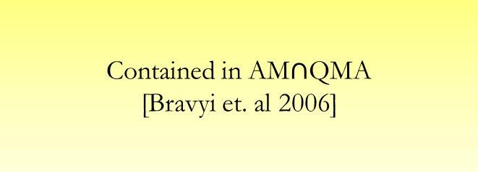
Complexity of (t,U)-Bose Hubbard Hamiltonian
Theorem: (t,U)-Bose Hubbard Hamiltonian is QMA-complete for all $t,U>0$.
$$t$$
QMA-complete [our results]
$$U$$
Contained in AM$∩$QMA [Bravyi et. al 2006]
“Stoquastic”

Slide 13
Complexity of (t,U)-Bose Hubbard Hamiltonian
Theorem: (t,U)-Bose Hubbard Hamiltonian is QMA-complete for all $t,U>0$.
$$t$$
QMA-complete [our results]
Contained in
QMA
$$U$$
Contained in AM$∩$QMA [Bravyi et. al 2006]
“Stoquastic”

Slide 14
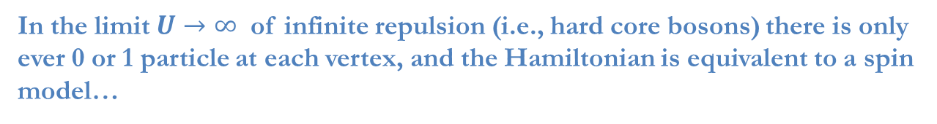
Complexity of (t,U)-Bose Hubbard Hamiltonian
Theorem: (t,U)-Bose Hubbard Hamiltonian is QMA-complete for all $t,U>0$.
$$t$$
QMA-complete [our results]
Contained in
QMA
$$U$$
Contained in AM$∩$QMA [Bravyi et. al 2006]
“Stoquastic”
In the limit $U→∞$ of infinite repulsion (i.e., hard core bosons) there is only ever 0 or 1 particle at each vertex, and the Hamiltonian is equivalent to a spin model…

Slide 15
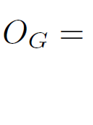
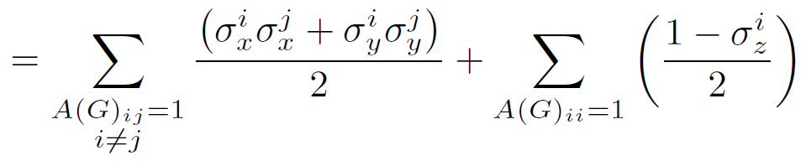
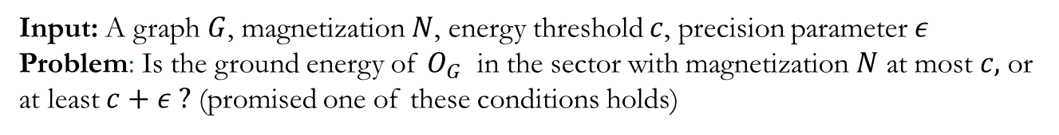
A related class of 2-local Hamiltonians
Conserves total magnetization (Hamming weight)
XY Hamiltonian problem
Input: A graph $G$, magnetization $N$, energy threshold $c$, precision parameter $ε$
Problem: Is the ground energy of $O_{G}$ in the sector with magnetization $N$ at most $c,$or at least $c+ε ?$ (promised one of these conditions holds)
Theorem: XY Hamiltonian is QMA-complete.

Slide 16
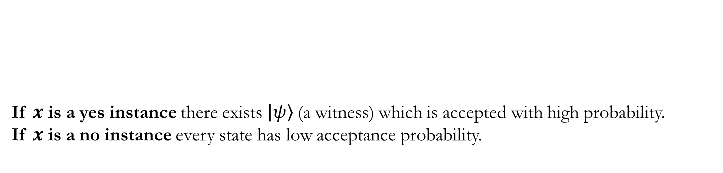


Quantum Merlin Arthur
QMA: class of decision problems where yes instances can be efficiently verified on a quantum computer.
Every instance $x$ of a problem in QMA has a verification circuit
If $x$ is a yes instance there exists $|ψ〉$(a witness) which is accepted with high probability.
If $x$ is a no instance every state has low acceptance probability.
$${|0〉}^{⊗n_{a}}$$
W_{m-1}W_{m-2}…W₀
$$|ψ〉$$
Ground energy problems are usually contained in QMA
(witness $=$ ground state ; verification circuit $=$ energy measurement)
Proving QMA-hardness is more involved…

Slide 17


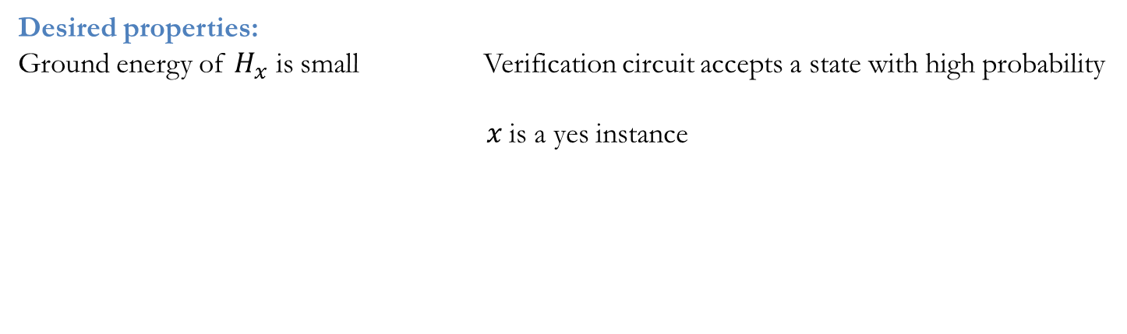


Proving QMA-hardness for ground energy problems
QMA Verification circuit for $x$
Hamiltonian
$${|0〉}^{⊗n_{a}}$$
W_{m-1}W_{m-2}…W₀
$$H_{x}$$
$$|ψ〉$$
Desired properties:
Ground energy of $H_{x}$ is small Verification circuit accepts a state with high probability
$x$ is a yes instance

Slide 18
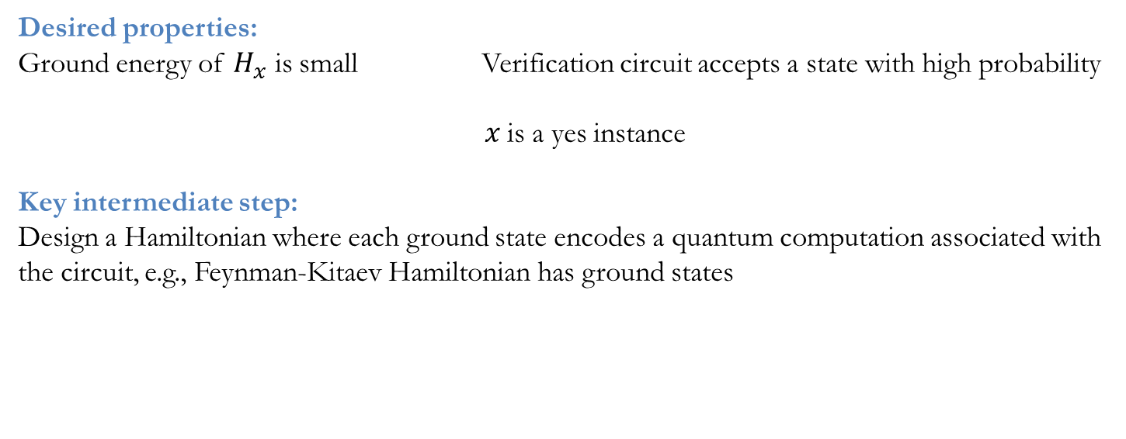
Proving QMA-hardness for ground energy problems
QMA Verification circuit for $x$
Hamiltonian
$${|0〉}^{⊗n_{a}}$$
W_{m-1}W_{m-2}…W₀
$$H_{x}$$
$$|ψ〉$$
Desired properties:
Ground energy of $H_{x}$ is small Verification circuit accepts a state with high probability
$x$ is a yes instance
Key intermediate step:
Design a Hamiltonian where each ground state encodes a quantum computation associated with the circuit, e.g., Feynman-Kitaev Hamiltonian has ground states

Slide 19
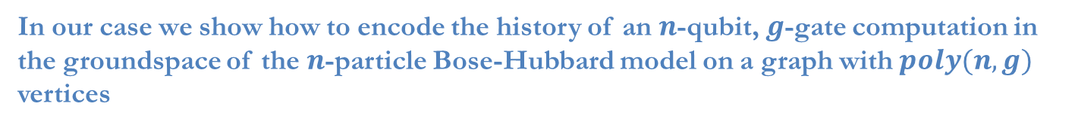
Proving QMA-hardness for ground energy problems
QMA Verification circuit for $x$
Hamiltonian
$${|0〉}^{⊗n_{a}}$$
W_{m-1}W_{m-2}…W₀
$$H_{x}$$
$$|ψ〉$$
Desired properties:
Ground energy of $H_{x}$ is small Verification circuit accepts a state with high probability
$x$ is a yes instance
Key intermediate step:
Design a Hamiltonian where each ground state encodes a quantum computation associated with the circuit, e.g., Feynman-Kitaev Hamiltonian has ground states
In our case we show how to encode the history of an $n$-qubit, $g$-gate computation in the groundspace of the $n$-particle Bose-Hubbard model on a graph with $poly(n,g)$ vertices

Slide 20
Encoding one qubit with one particle
When $n=1$ the Hamiltonian is just the adjacency matrix of the graph. We use a variant of the Feynman-Kitaev circuit-to-Hamiltonian mapping which outputs a symmetric 0-1 matrix.

Slide 21
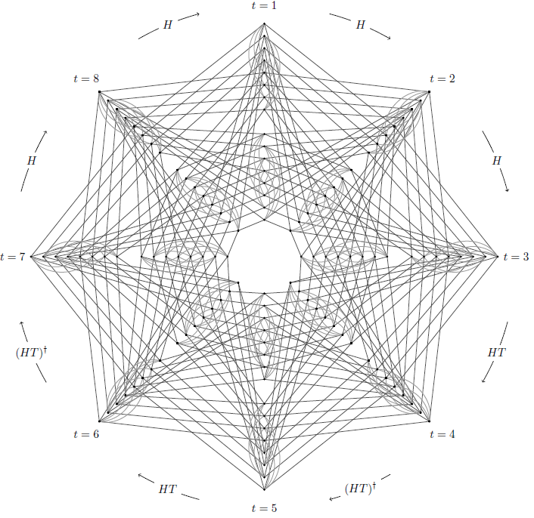




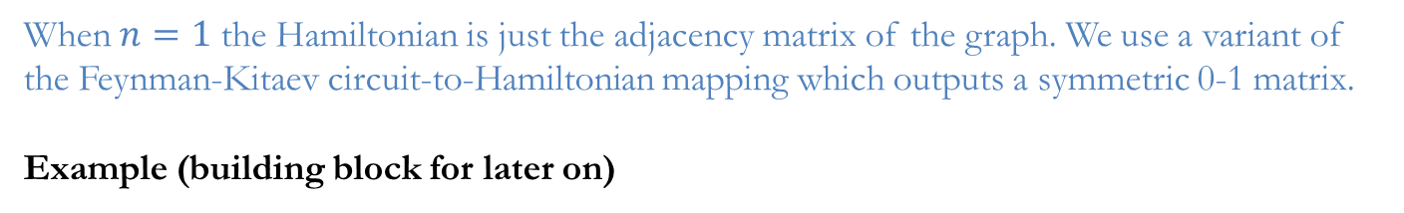
Encoding one qubit with one particle
When $n=1$ the Hamiltonian is just the adjacency matrix of the graph. We use a variant of the Feynman-Kitaev circuit-to-Hamiltonian mapping which outputs a symmetric 0-1 matrix.
Example (building block for later on)
H
H
HT
(HT)†
HT
(HT)†
H
H
Vertices are labeled
$$\left(z,t,j\right) z∈\left\{0,1\right\} t,j∈[8]$$

Slide 22
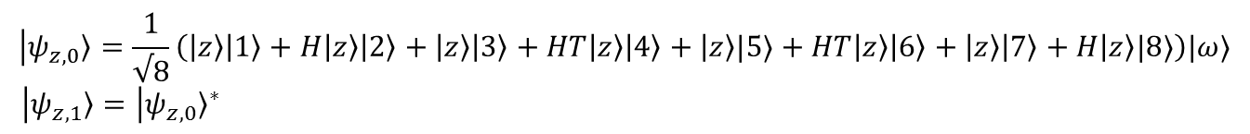

Encoding one qubit with one particle
When $n=1$ the Hamiltonian is just the adjacency matrix of the graph. We use a variant of the Feynman-Kitaev circuit-to-Hamiltonian mapping which outputs a symmetric 0-1 matrix.
Example (building block for later on)
H
H
HT
(HT)†
HT
(HT)†
H
H
Vertices are labeled
$$\left(z,t,j\right) z∈\left\{0,1\right\} t,j∈[8]$$
Groundstates of the adjacency matrix:
$$|ψ_{z,0}〉=\frac{1}{√8}\left(|z〉|1〉+H|z〉|2〉+|z〉|3〉+HT|z〉|4〉+|z〉|5〉+HT|z〉|6〉+|z〉|7〉+H|z〉|8〉\right)|ω〉$$
$|ψ_{z,1}〉={|ψ_{z,0}〉}^{∗}$
a specific state
for $z∈\left\{0,1\right\}.$
encodes the computation where the circuit is complex-conjugated

Slide 23
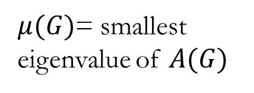
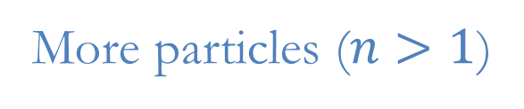


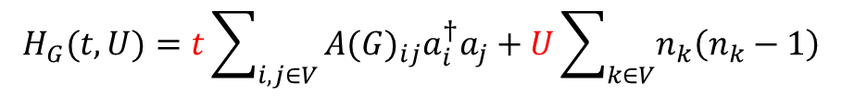
More particles ($n>1$)
$$H_{G}(t,U)=t\sum_{i,j∈V}{{A(G)}_{ij}a_{i}^{†}a_{j}}+U\sum_{k∈V}{n_{k}\left(n_{k}−1\right)}$$
$μ(G)$= smallest eigenvalue of $A(G)$
$≥ntμ(G)$
$≥$0

Slide 24
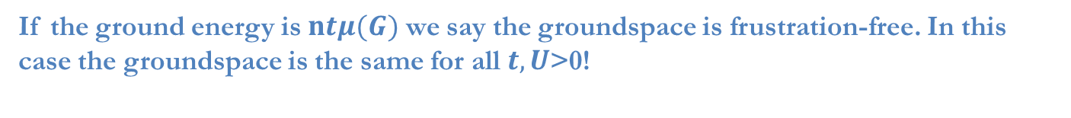
More particles ($n>1$)
$$H_{G}(t,U)=t\sum_{i,j∈V}{{A(G)}_{ij}a_{i}^{†}a_{j}}+U\sum_{k∈V}{n_{k}\left(n_{k}−1\right)}$$
$μ(G)$= smallest eigenvalue of $A(G)$
$≥ntμ(G)$
$≥$0
If the ground energy is $ntμ(G)$ we say the groundspace is frustration-free. In this case the groundspace is the same for all$t,U$>0!

Slide 25
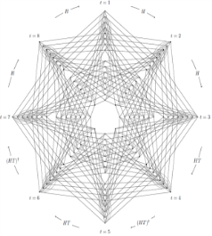
More particles ($n>1$)
$$H_{G}(t,U)=t\sum_{i,j∈V}{{A(G)}_{ij}a_{i}^{†}a_{j}}+U\sum_{k∈V}{n_{k}\left(n_{k}−1\right)}$$
$μ(G)$= smallest eigenvalue of $A(G)$
$≥ntμ(G)$
$≥$0
If the ground energy is $ntμ(G)$ we say the groundspace is frustration-free. In this case the groundspace is the same for all$t,U$>0!
We design a class of graphs where the frustration-free $n$-particle ground states encode $n$-qubit computations. These graphs are built out of multiple copies of

Slide 26
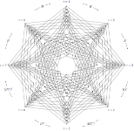


Graphs for two-qubit gates
Two qubit gate $U$
A graph shaped like this
$$U$$
4096 vertex graph made from 32 copies of

Slide 27
Graphs for two-qubit gates
Two qubit gate $U$
A graph shaped like this
$$U$$
4096 vertex graph made from 32 copies of
Single-particle ground states encode a qubit and one out of four possible locations

Slide 28
Graphs for two-qubit gates
Two qubit gate $U$
A graph shaped like this
$$U$$
4096 vertex graph made from 32 copies of
Single-particle ground states encode a qubit and one out of four possible locations

Slide 29
Graphs for two-qubit gates
Two qubit gate $U$
A graph shaped like this
$$U$$
4096 vertex graph made from 32 copies of
Single-particle ground states encode a qubit and one out of four possible locations

Slide 30
Graphs for two-qubit gates
Two qubit gate $U$
A graph shaped like this
$$U$$
4096 vertex graph made from 32 copies of
Single-particle ground states encode a qubit and one out of four possible locations

Slide 31
Graphs for two-qubit gates
Two qubit gate $U$
A graph shaped like this
$$U$$
4096 vertex graph made from 32 copies of
Single-particle ground states encode a qubit and one out of four possible locations

Slide 32
Graphs for two-qubit gates
Two qubit gate $U$
A graph shaped like this
$$U$$
4096 vertex graph made from 32 copies of
Single-particle ground states encode a qubit and one out of four possible locations

Slide 33
Graphs for two-qubit gates
Two qubit gate $U$
A graph shaped like this
$$U$$
4096 vertex graph made from 32 copies of
Single-particle ground states encode a qubit and one out of four possible locations

Slide 34
Graphs for two-qubit gates
Two qubit gate $U$
A graph shaped like this
$$U$$
4096 vertex graph made from 32 copies of
Single-particle ground states encode a qubit and one out of four possible locations

Slide 35
Graphs for two-qubit gates
Two qubit gate $U$
A graph shaped like this
$$U$$
4096 vertex graph made from 32 copies of
Single-particle ground states encode a qubit and one out of four possible locations

Slide 36
Graphs for two-qubit gates
Two qubit gate $U$
A graph shaped like this
$$U$$
4096 vertex graph made from 32 copies of
Single-particle ground states encode a qubit and one out of four possible locations
Two-particle frustration-free ground states have the form
$$\frac{1}{√2}|both particles on the left,φ〉+\frac{1}{√2}|both particles on the right ,Uφ〉$$

Slide 37
Graphs for two-qubit gates
Two qubit gate $U$
A graph shaped like this
$$U$$
4096 vertex graph made from 32 copies of
Single-particle ground states encode a qubit and one out of four possible locations
Two-particle frustration-free ground states have the form
$$\frac{1}{√2}|both particles on the left,φ〉+\frac{1}{√2}|both particles on the right ,Uφ〉$$

Slide 38
Graphs for two-qubit gates
Two qubit gate $U$
A graph shaped like this
$$U$$
4096 vertex graph made from 32 copies of
Single-particle ground states encode a qubit and one out of four possible locations
Two-particle frustration-free ground states have the form
$$\frac{1}{√2}|both particles on the left,φ〉+\frac{1}{√2}|both particles on the right ,Uφ〉$$

Slide 39








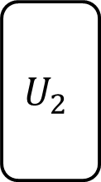



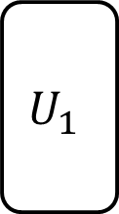
Constructing a graph from a verification circuit
Connect up the graphs for two-qubit gates to mimic the circuit, e.g.,
$$U_{1}$$
$$U_{2}$$
Good news: there are two-particle ground states which encode computations
$$,φ$$
$$+$$
$$,U_{1}φ$$
$$+$$
$$,U_{1}φ$$
$$+$$
$$,U_{1}φ$$
$$+$$
$$,U_{1}φ$$
$$+$$
$$,{U_{2}U}_{1}φ$$
Bad news: there are other two-particle ground states where the particles are in regions of the graph where they shouldn’t be.
To get rid of the bad states, we develop a method for enforcing “occupancy constraints”, i.e. penalizing certain configurations of the particles. To prove our results we establish spectral bounds without using perturbation theory.

Slide 40
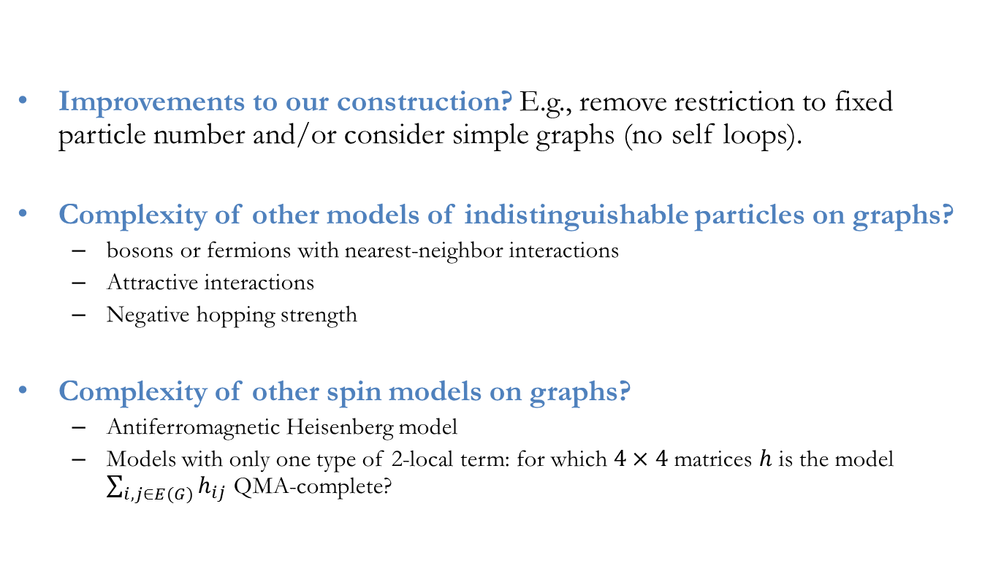
Open questions
Improvements to our construction? E.g., remove restriction to fixed particle number and/or consider simple graphs (no self loops).
Complexity of other models of indistinguishable particles on graphs?
bosons or fermions with nearest-neighbor interactions
Attractive interactions
Negative hopping strength
Complexity of other spin models on graphs?
Antiferromagnetic Heisenberg model
Models with only one type of 2-local term: for which $4×4$ matrices $h$ is the model $\sum_{i,j∈E(G)}{h_{ij}}$ QMA-complete?

