Slide 1
Effcient quantum protocols for XOR functions
Shengyu Zhang
The Chinese University of Hong Kong

Slide 2



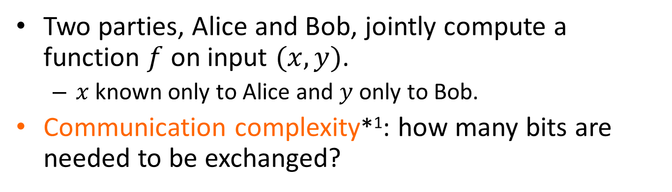


Communication complexity
$$x$$
$$y$$
$F(x,y)$
Two parties, Alice and Bob, jointly compute a function $f$ on input $(x,y)$.
$x$ known only to Alice and $y$ only to Bob.
Communication complexity*¹: how many bits are needed to be exchanged?
*1. A. Yao. STOC, 1979.

Slide 3
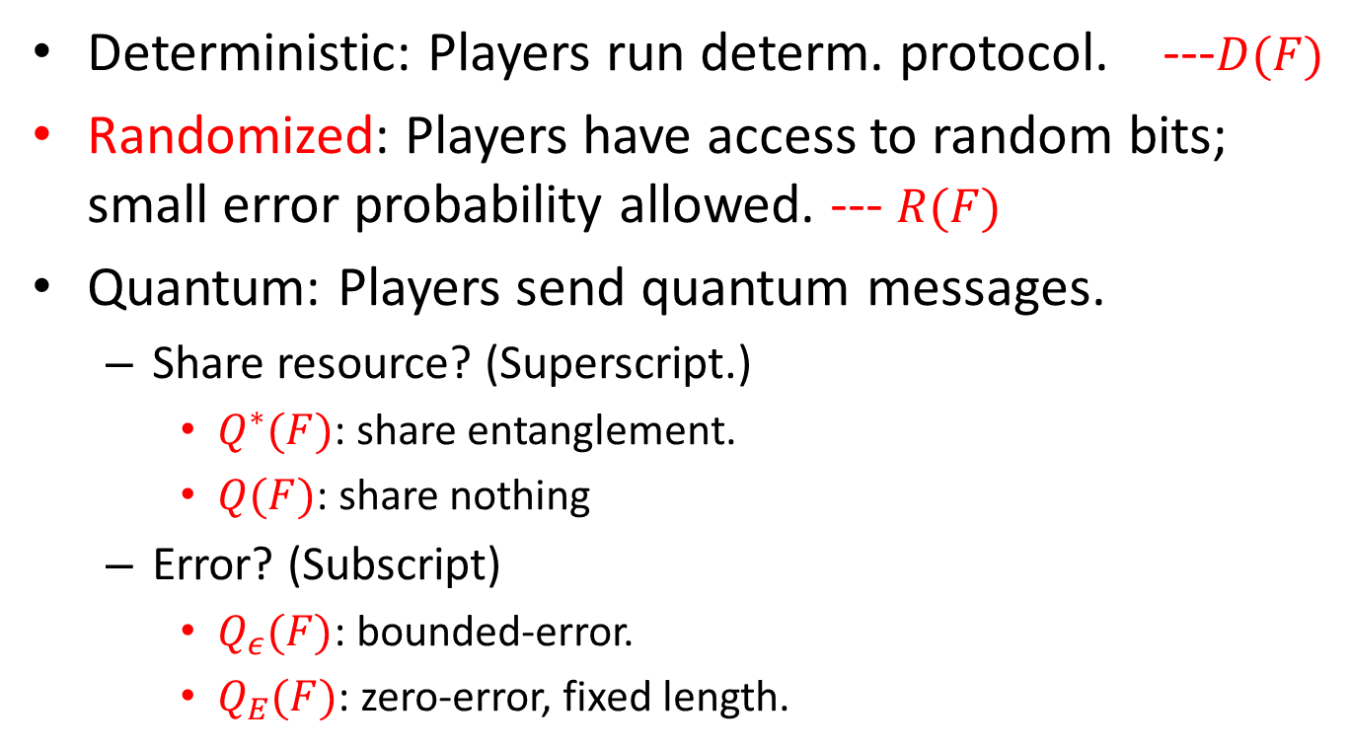
Computation modes
Deterministic: Players run determ. protocol. ---$D(F)$
Randomized: Players have access to random bits; small error probability allowed. --- $R(F)$
Quantum: Players send quantum messages.
Share resource? (Superscript.)
$Q_{}^{∗}(F)$: share entanglement.
$Q(F)$: share nothing
Error? (Subscript)
$Q_{ε}(F)$: bounded-error.
$Q_{E}(F)$: zero-error, fixed length.

Slide 4
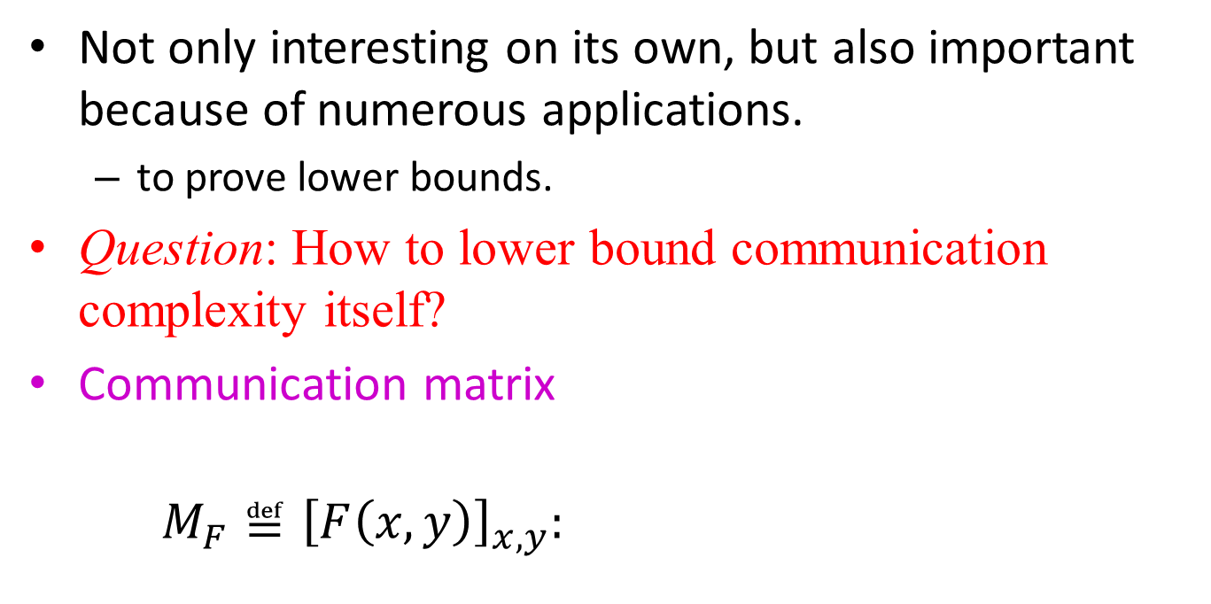



Lower bounds
Not only interesting on its own, but also important because of numerous applications.
to prove lower bounds.
Question: How to lower bound communication complexity itself?
Communication matrix
$M_{F}≝{\left[F\left(x,y\right)\right]}_{x,y}:$
$$y$$
$$↓$$
$$x→$$
$$F(x,y)$$

Slide 5
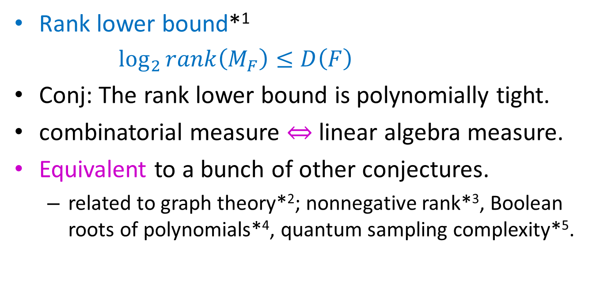

Log-rank conjecture
Log Rank Conjecture*²
Rank lower bound*¹
$\log_{2}{rank\left(M_{F}\right)}≤D\left(F\right)$
Conj: The rank lower bound is polynomially tight.
combinatorial measure $⇔$ linear algebra measure.
Equivalent to a bunch of other conjectures.
related to graph theory*²; nonnegative rank*³, Boolean roots of polynomials*⁴, quantum sampling complexity*⁵.
$$≤\log^{O\left(1\right)}{rank\left(M_{F}\right)}$$
*1. Melhorn, Schmidt. STOC, 1982.
*2. Lovász, Saks. FOCS, 1988.
*3. Lovász. Book Chapter, 1990.
*4. Valiant. Info. Proc. Lett., 2004.
*5. Ambainis, Schulman, Ta-Shma, Vazirani,
Wigderson, SICOMP 2003.

Slide 6
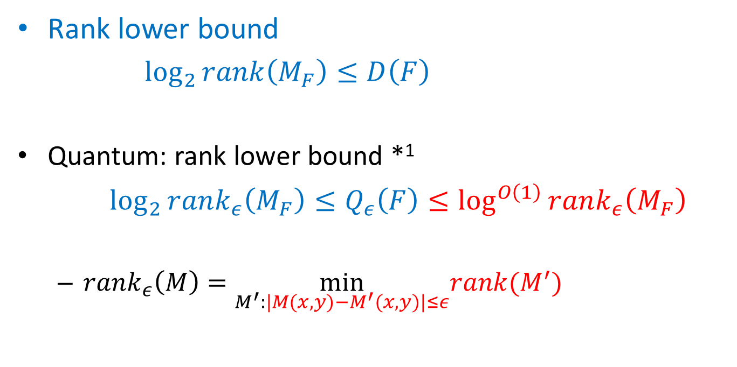
Log-rank conjecture: quantum version
Log Rank Conjecture
Rank lower bound
$\log_{2}{rank\left(M_{F}\right)}≤D\left(F\right)$
Quantum: rank lower bound *¹
$\log_{2}{rank_{ε}\left(M_{F}\right)}≤Q_{ε}\left(F\right)≤\log^{O\left(1\right)}{rank_{ε}\left(M_{F}\right)}$
$rank_{ε}\left(M\right)=\min_{M^{′}:|M(x,y)−M^{′}(x,y)|≤ε}rank(M^{′})$
$$≤\log^{O\left(1\right)}{rank\left(M_{F}\right)}$$
*1. Buhrman, de Wolf. CCC, 2001.

Slide 7
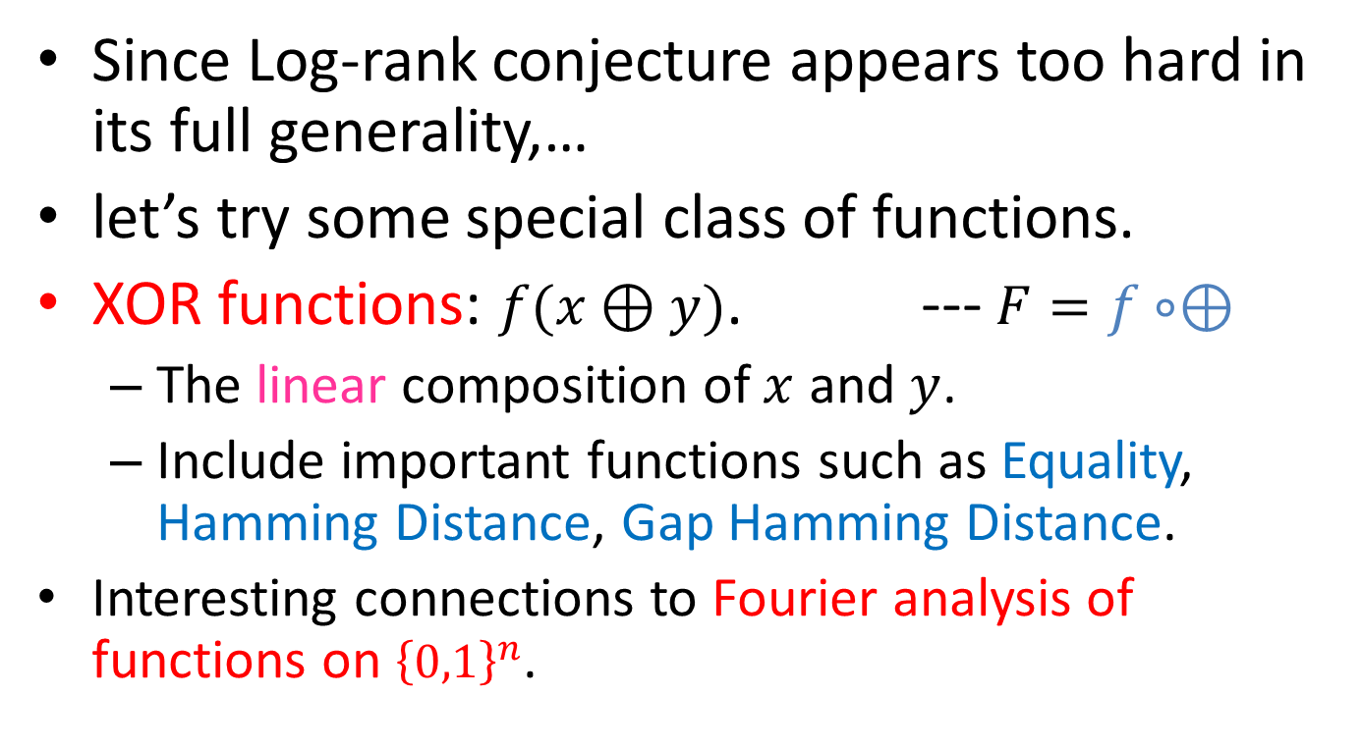
Log-rank conjecture for XOR functions
Since Log-rank conjecture appears too hard in its full generality,…
let’s try some special class of functions.
XOR functions: $f(x⊕y)$. ---$F=f∘⊕$
The linear composition of $x$ and $y$.
Include important functions such as Equality, Hamming Distance, Gap Hamming Distance.
Interesting connections to Fourier analysis of functions on ${\left\{0,1\right\}}^{n}$.

Slide 8
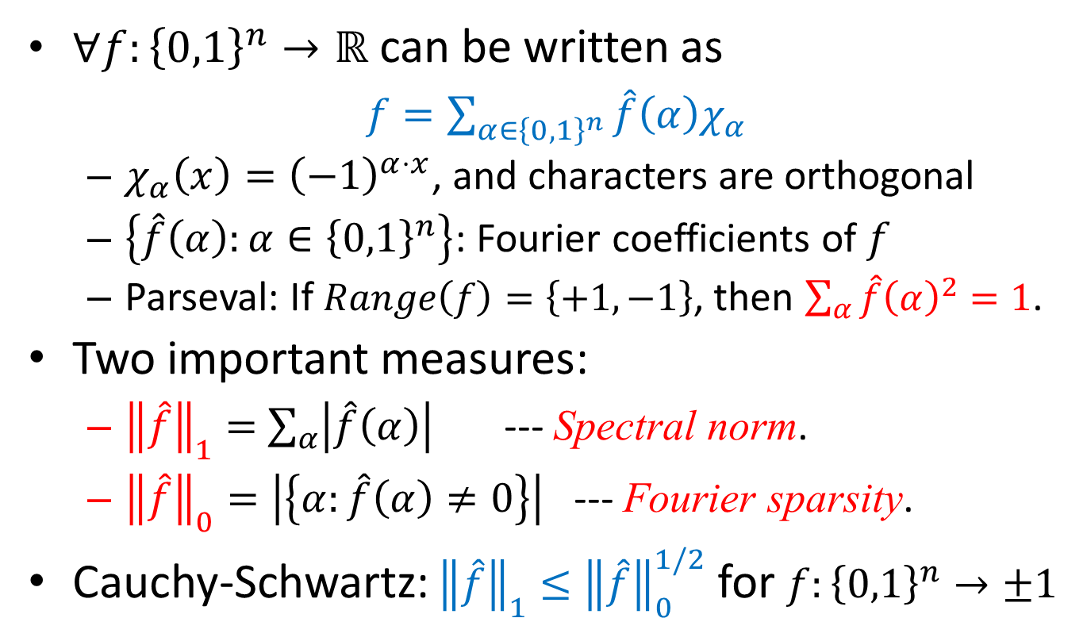
Digression: Fourier analysis
$∀f:{\left\{0,1\right\}}^{n}→ℝ$ can be written as
$f=\sum_{α∈{\left\{0,1\right\}}^{n}}{\hat{f}\left(α\right)χ_{α}}$
$χ_{α}\left(x\right)={\left(−1\right)}^{α⋅x}$, and characters are orthogonal
$\left\{\hat{f}\left(α\right):α∈{\left\{0,1\right\}}^{n}\right\}$: Fourier coefficients of $f$
Parseval: If $Range\left(f\right)=\left\{+1,−1\right\}$, then $\sum_{α}{\hat{f}{\left(α\right)}^{2}}=1$.
Two important measures:
${\left\|\hat{f}\right\|}_{1}=$ $\sum_{α}{\left|\hat{f}\left(α\right)\right|}$ --- Spectral norm.
${\left\|\hat{f}\right\|}_{0}=\left|\left\{α:\hat{f}\left(α\right)≠0\right\}\right|$ --- Fourier sparsity.
Cauchy-Schwartz: ${\left\|\hat{f}\right\|}_{1}≤{\left\|\hat{f}\right\|}_{0}^{1/2}$ for $f:{\left\{0,1\right\}}^{n}→±1$

Slide 9
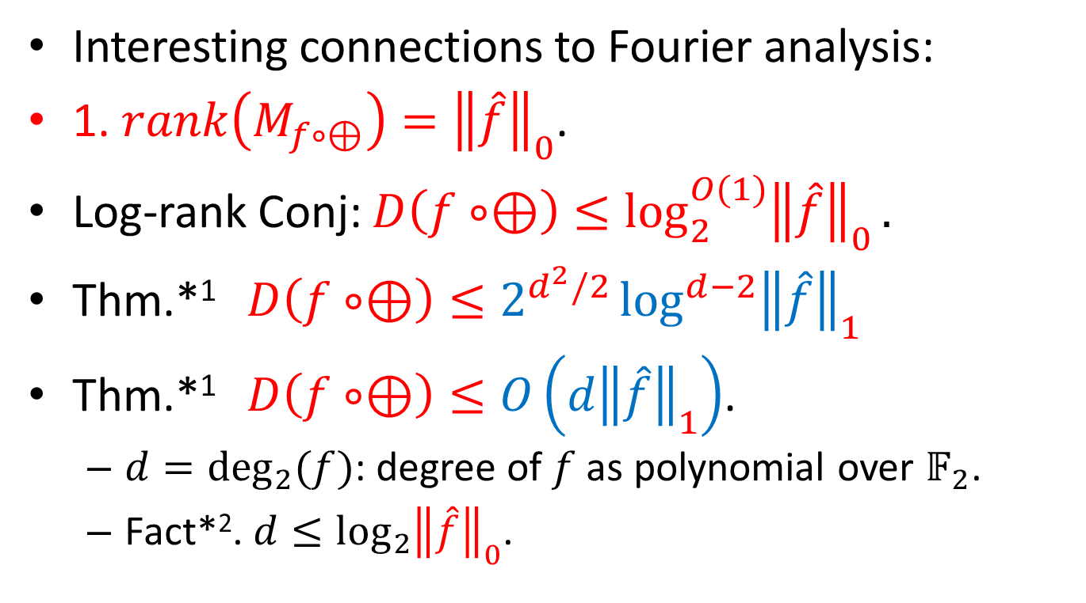
Log-rank Conj. For XOR functions
Interesting connections to Fourier analysis:
1. $rank\left(M_{f∘⊕}\right)={\left\|\hat{f}\right\|}_{0}$.
Log-rank Conj: $D\left(f∘⊕\right)≤\log_{2}^{O(1)}{{\left\|\hat{f}\right\|}_{0}}.$
Thm.*¹ $D\left(f∘⊕\right)≤2^{d^{2}/2}\log^{d−2}{{\left\|\hat{f}\right\|}_{1}}$
Thm.*¹ $D\left(f∘⊕\right)≤O\left(d{\left\|\hat{f}\right\|}_{1}\right)$.
$d=\deg_{2}{(f)}$: degree of $f$ as polynomial over $𝔽_{2}$.
Fact*². $d≤\log_{2}{{\left\|\hat{f}\right\|}_{0}}$.
*1. Tsang, Wong, Xie, Zhang, FOCS, 2013.
*2. Bernasconi and Codenotti. IEEE Transactions on Computers, 1999.

Slide 10

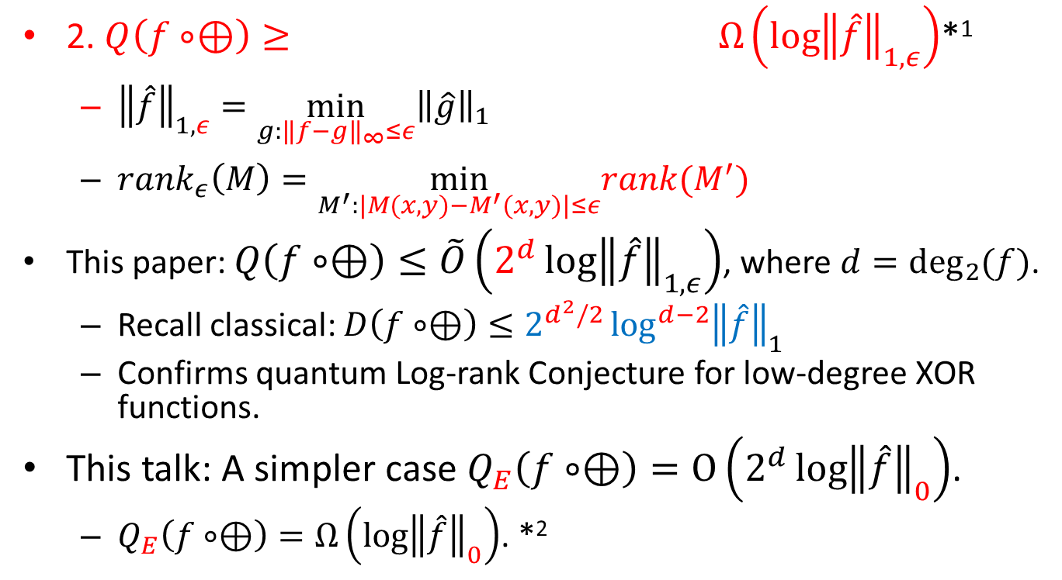
Quantum
$$Ω\left(\log{rank_{ε}\left(M_{f∘⊕}\right)}\right)≥$$
2. $Q\left(f∘⊕\right)≥ Ω\left(\log{{\left\|\hat{f}\right\|}_{1,ε}}\right)$*¹
${\left\|\hat{f}\right\|}_{1,ε}=\min_{g:{\left\|f−g\right\|}_{∞}≤ε}{\left\|\hat{g}\right\|}_{1}$
$rank_{ε}\left(M\right)=\min_{M^{′}:|M(x,y)−M^{′}(x,y)|≤ε}rank(M^{′})$
This paper: $Q\left(f∘⊕\right)≤\tilde{O}\left(2^{d}\log{{\left\|\hat{f}\right\|}_{1,ε}}\right)$, where $d=\deg_{2}{(f)}$.
Recall classical: $D\left(f∘⊕\right)≤2^{d^{2}/2}\log^{d−2}{{\left\|\hat{f}\right\|}_{1}}$
Confirms quantum Log-rank Conjecture for low-degree XOR functions.
This talk: A simpler case $Q_{E}\left(f∘⊕\right)=O\left(2^{d}\log{{\left\|\hat{f}\right\|}_{0}}\right)$.
$Q_{E}\left(f∘⊕\right)=Ω\left(\log{{\left\|\hat{f}\right\|}_{0}}\right)$. *²
*1. Lee and Shraibman. Foundations and Trends in Theoretical Computer Science, 2009.
*2. Buhrman and de Wolf. CCC, 2001.

Slide 11
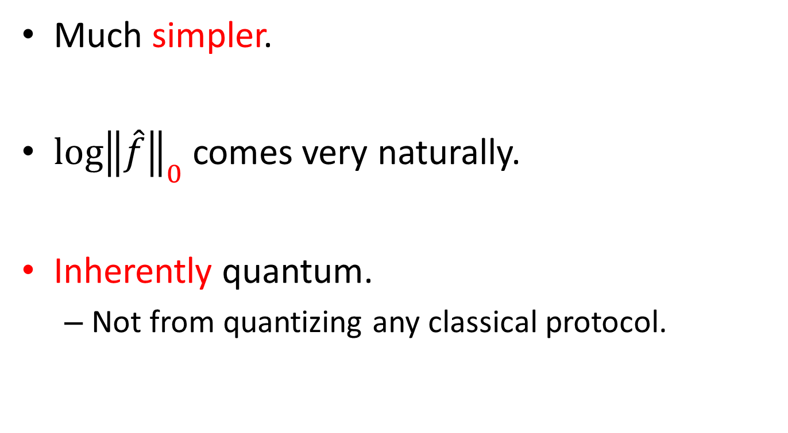
About quantum protocol
Much simpler.
$\log{{\left\|\hat{f}\right\|}_{0}}$ comes very naturally.
Inherently quantum.
Not from quantizing any classical protocol.

Slide 12



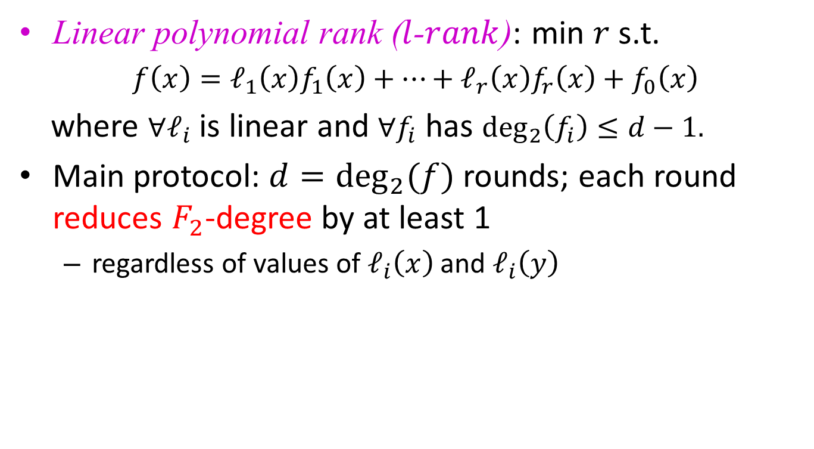

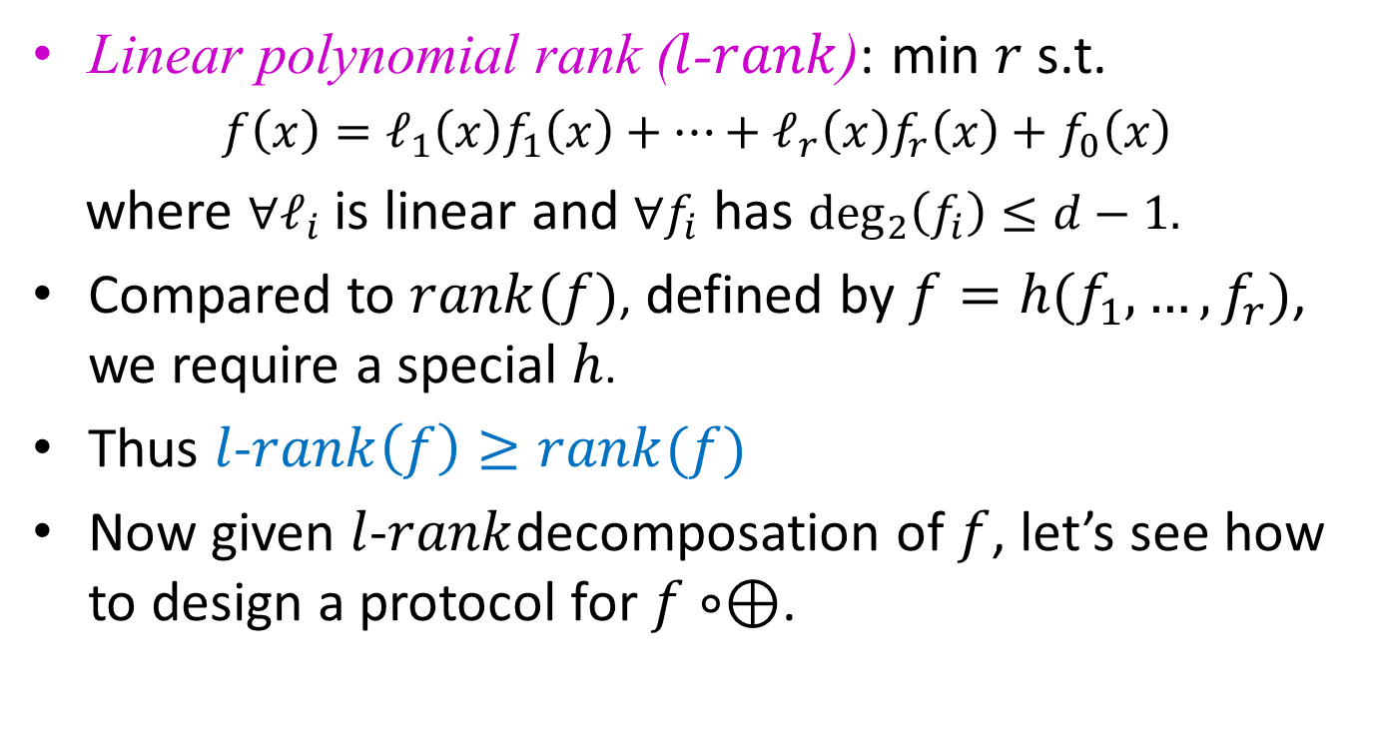
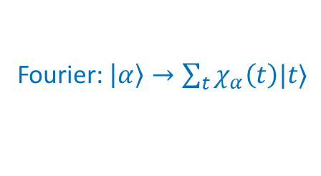

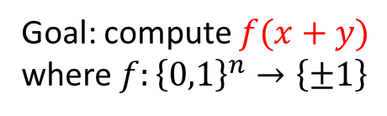

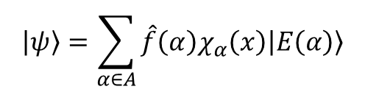


Goal: compute $f(x+y)$
where $f:{\left\{0,1\right\}}^{n}→\left\{±1\right\}$
$$\frac{|0〉+|1〉}{\sqrt{2}}⊗$$
$$|ψ〉=\sum_{α∈A}{\hat{f}\left(α\right)χ_{α}\left(x\right)|E\left(α\right)〉}$$
$$|ψ〉$$
Add phase $χ_{α}(y)$
$$|ψ′〉=\sum_{α∈A}{\hat{f}\left(α\right)χ_{α}\left(x\right)χ_{α}(y)|E\left(α\right)〉}$$
$$|ψ′〉$$
$$|E\left(α\right)〉→|α〉$$
$$\sum_{α∈A}{\hat{f}\left(α\right)χ_{α}\left(x+y\right)|α〉}$$
Fourier: $|α〉→\sum_{t}{χ_{α}\left(t\right)|t〉}$
$$\sum_{t}{\sum_{α∈A}{\hat{f}\left(α\right)χ_{α}\left(x+y\right)χ_{α}(t)|t〉}}$$
$=\sum_{t}{f\left(x+y+t\right)|t〉}$
$$\sum_{t}{\frac{|0〉+f(x+y+t)|1〉}{\sqrt{2}}|t〉}$$

Slide 13
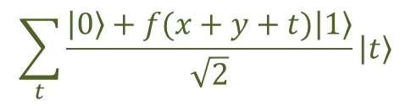

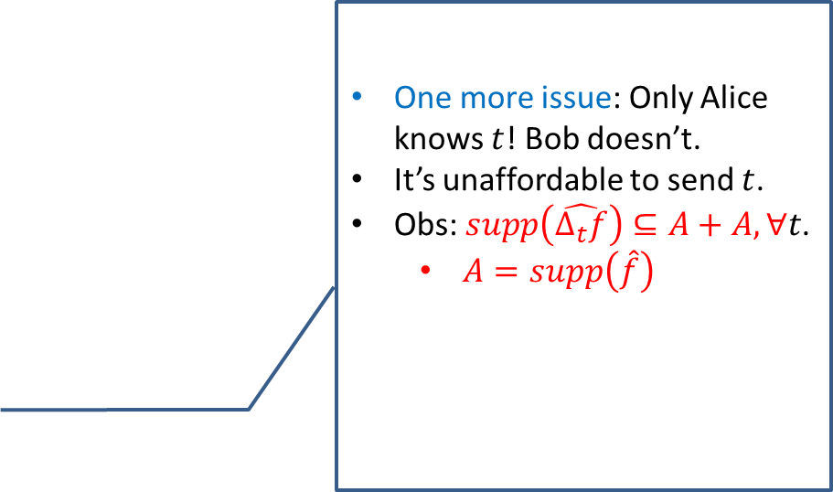

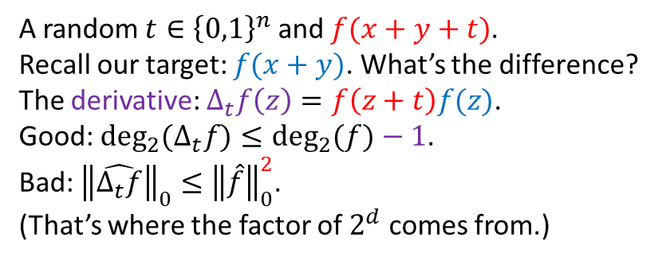

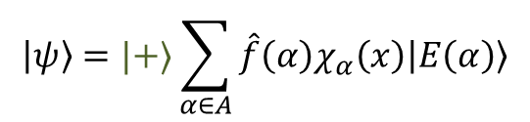

Goal: compute $f(x+y)$
where $f:{\left\{0,1\right\}}^{n}→\left\{±1\right\}$
$$|ψ〉=|+〉\sum_{α∈A}{\hat{f}\left(α\right)χ_{α}\left(x\right)|E\left(α\right)〉}$$
$$|ψ〉$$
Add phase $χ_{α}(y)$
$$|ψ′〉$$
Decoding + Fourier
$$\sum_{t}{\frac{|0〉+f(x+y+t)|1〉}{\sqrt{2}}|t〉}$$
One more issue: Only Alice knows $t$! Bob doesn’t.
It’s unaffordable to send $t$.
Obs: $supp\left(\hat{Δ_{t}f}\right)⊆A+A,∀t$.
$A=supp\left(\hat{f}\right)$
Measure$\{|+〉,|−〉\}$
Measure $t$
A random $t∈{\left\{0,1\right\}}^{n}$ and $f(x+y+t)$.
Recall our target: $f(x+y)$. What’s the difference?
The derivative: $Δ_{t}f\left(z\right)=f\left(z+t\right)f(z)$.
Good: $\deg_{2}{(Δ_{t}f)}≤\deg_{2}{(f)}−1$.
Bad: ${\left\|\hat{Δ_{t}f}\right\|}_{0}≤{\left\|\hat{f}\right\|}_{0}^{2}$.
(That’s where the factor of $2^{d}$ comes from.)

Slide 14



Goal: compute $f(x+y)$
where $f:{\left\{0,1\right\}}^{n}→\left\{±1\right\}$
$${\left\{0,1\right\}}^{n}$$
$$|ψ〉=|+〉\sum_{α∈A}{\hat{f}\left(α\right)χ_{α}\left(x\right)|E\left(α\right)〉}$$
$$|ψ〉$$
Add phase $χ_{α}(y)$
$$A+A$$
$$≝\left\{a+b:a,b∈A\right\}$$
$$|ψ′〉$$
Decoding + Fourier
$$\sum_{t}{\frac{|0〉+f(x+y+t)|1〉}{\sqrt{2}}|t〉}$$
One more issue: Only Alice knows $t$! Bob doesn’t.
It’s unaffordable to send $t$.
Obs: $supp\left(\hat{Δ_{t}f}\right)⊆A+A,∀t$.
$A=supp\left(\hat{f}\right)$
$$A$$
Measure$\{|+〉,|−〉\}$
Measure $t$
A random $t∈{\left\{0,1\right\}}^{n}$ and $f(x+y+t)$.
Recall our target: $f(x+y)$. What’s the difference?
The derivative: $Δ_{t}f\left(z\right)=f\left(z+t\right)f(z)$.
Good: $\deg_{2}{(Δ_{t}f)}≤\deg_{2}{(f)}−1$.
Bad: ${\left\|\hat{Δ_{t}f}\right\|}_{0}≤{\left\|\hat{f}\right\|}_{0}^{2}$.
(That’s where the factor of $2^{d}$ comes from.)

Slide 15
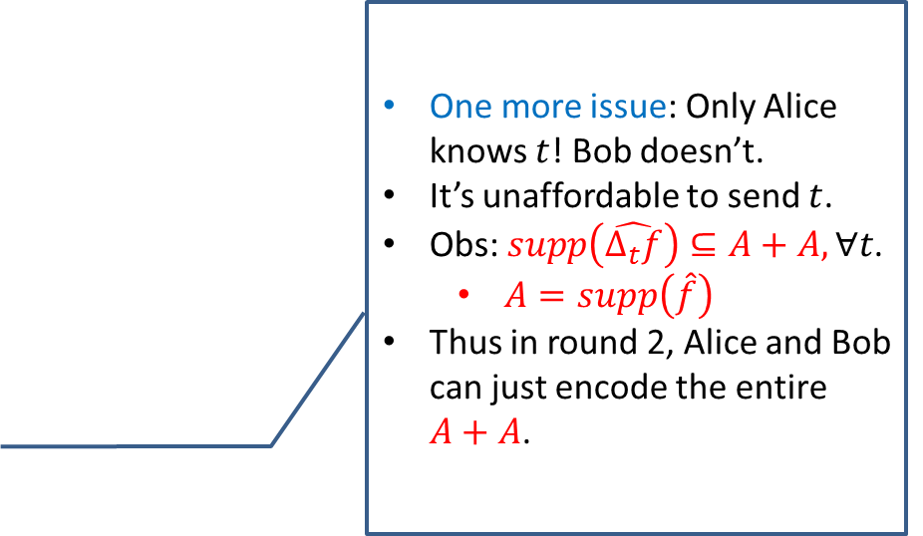
Goal: compute $f(x+y)$
where $f:{\left\{0,1\right\}}^{n}→\left\{±1\right\}$
$$|ψ〉=|+〉\sum_{α∈A}{\hat{f}\left(α\right)χ_{α}\left(x\right)|E\left(α\right)〉}$$
$$|ψ〉$$
Add phase $χ_{α}(y)$
$$|ψ′〉$$
Decoding + Fourier
$$\sum_{t}{\frac{|0〉+f(x+y+t)|1〉}{\sqrt{2}}|t〉}$$
One more issue: Only Alice knows $t$! Bob doesn’t.
It’s unaffordable to send $t$.
Obs: $supp\left(\hat{Δ_{t}f}\right)⊆A+A,∀t$.
$A=supp\left(\hat{f}\right)$
Thus in round 2, Alice and Bob can just encode the entire $A+A$.
Measure$\{|+〉,|−〉\}$
Measure $t$
A random $t∈{\left\{0,1\right\}}^{n}$ and $f(x+y+t)$.
Recall our target: $f(x+y)$. What’s the difference?
The derivative: $Δ_{t}f\left(z\right)=f\left(z+t\right)f(z)$.
Good: $\deg_{2}{(Δ_{t}f)}≤\deg_{2}{(f)}−1$.
Bad: ${\left\|\hat{Δ_{t}f}\right\|}_{0}≤{\left\|\hat{f}\right\|}_{0}^{2}$.
(That’s where the factor of $2^{d}$ comes from.)

Slide 16
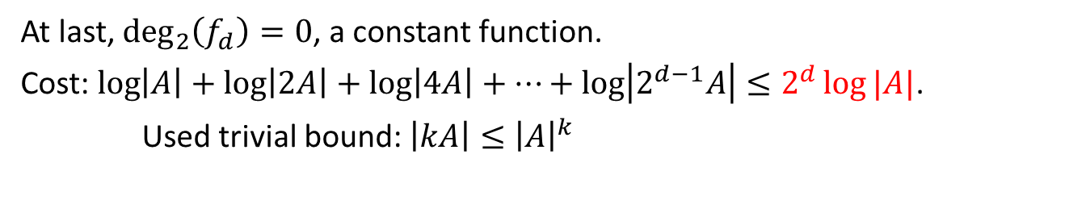
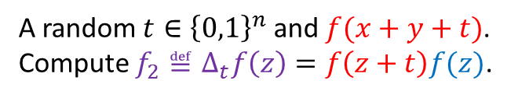
Goal: compute $f(x+y)$
where $f:{\left\{0,1\right\}}^{n}→\left\{±1\right\}$
$$|ψ〉=|+〉\sum_{α∈A}{\hat{f}\left(α\right)χ_{α}\left(x\right)|E\left(α\right)〉}$$
$$|ψ〉$$
Add phase $χ_{α}(y)$
$$|ψ′〉$$
Decoding + Fourier
$$\sum_{t}{\frac{|0〉+f(x+y+t)|1〉}{\sqrt{2}}|t〉}$$
Measure$\{|+〉,|−〉\}$
Measure $t$
A random $t∈{\left\{0,1\right\}}^{n}$ and $f(x+y+t)$.
Compute $f_{2}≝Δ_{t}f\left(z\right)=f\left(z+t\right)f(z)$.
At last, $\deg_{2}\left(f_{d}\right)=0$, a constant function.
Cost: $\log\left|A\right|+\log\left|2A\right|+\log\left|4A\right|+…+\log\left|2^{d−1}A\right|≤2^{d}\log{|A|}$.
Used trivial bound: $\left|kA\right|≤{\left|A\right|}^{k}$

Slide 17
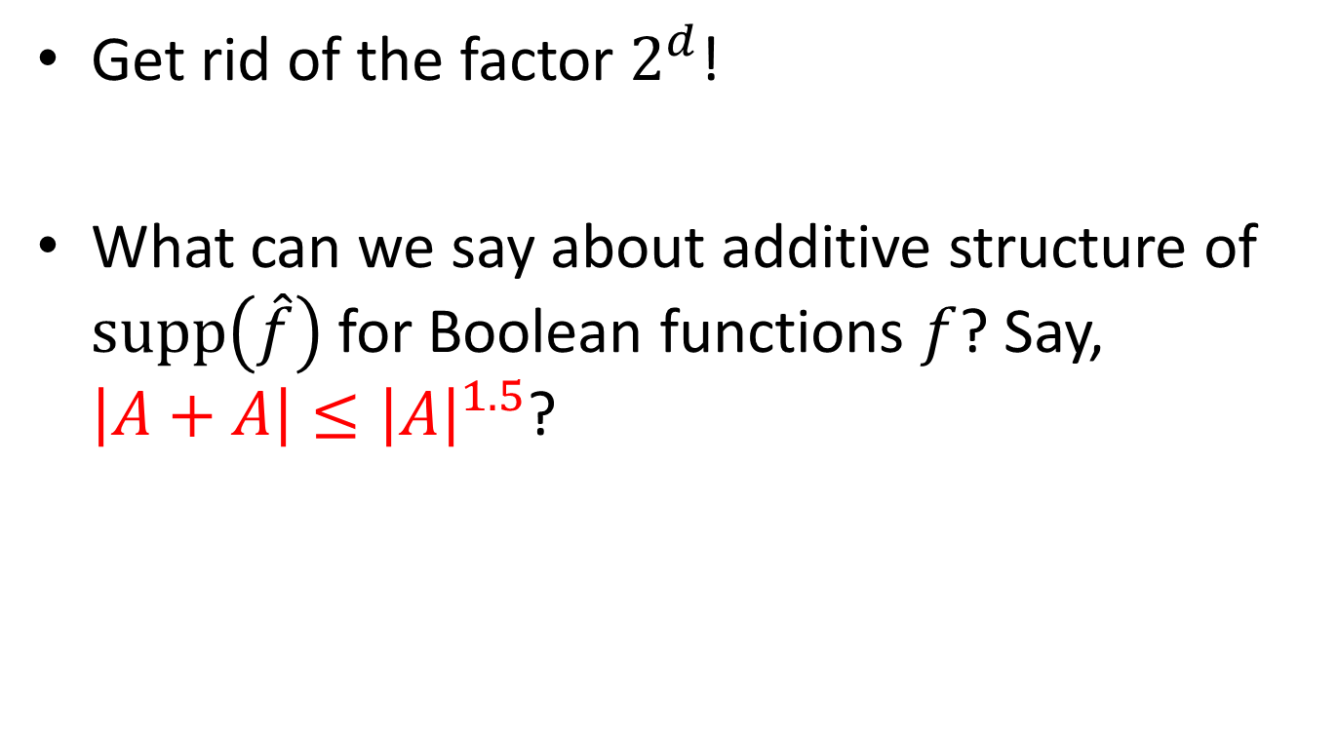
Open problems
Get rid of the factor $2^{d}$!
What can we say about additive structure of $supp\left(\hat{f}\right)$ for Boolean functions $f$? Say, $\left|A+A\right|≤{\left|A\right|}^{1.5}$?

Slide 18
Thanks

