Slide 1
Separations in
Query Complexity
Pointer Functions
Based
on
Andris Ambainis
University of Latvia
Joint work with: Kaspars Balodis, Aleksandrs Belovs
Troy Lee, Miklos Santha, and Juris Smotrovs

Slide 2
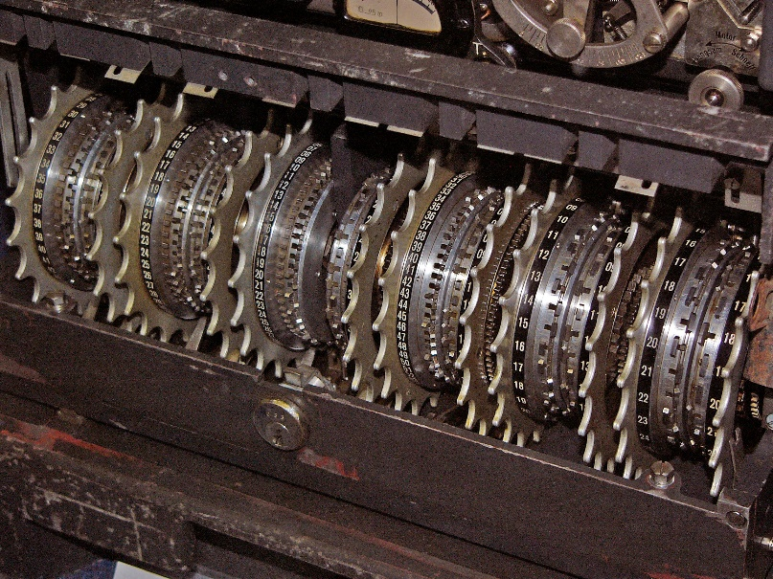
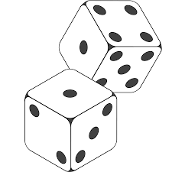
Models of Computation
Deterministic
Randomized
|Ψ⟩
Quantum
2 / 39

Slide 3
Query algorithms
Task: compute f(x₁, ..., x_{N}).
Input variables x_{i} accessed via queries.
Complexity = number of queries.
Provable lower bounds.

Slide 4
Computation
Models
D:
Deterministic
(Decision Tree)
x₁
x
2
x
2
0
x3
x3
1
0
1
0
1
Complexity:
on input:
in total:
Number of queries
Worst input
(length
(depth
of the
of the
path)
tree)
2 or
3
•
•
3

Slide 5
Computation
Models
R:
Randomized
(Probability distribution on decision trees)
x₁
x
2
x
2
0
x3
x3
1
1
1
0
0
1
0
1
0
Complexity:
on input:
in total:
Expected number of queries
Worst input
8/3
•
•
2 or
8/3

Slide 6
Quantum query model
Computation
Models
Q:
Quantum
(Quantum query algorithms)
U₀
Q
Q
U₁
…
U_{T}
U₀, U₁, …, U_{T} – independent of x₁, …, x_{N}.
Q – queries:
|i⟩ → (-1)^{xi}|i⟩.

Slide 7
Computation Models
D – deterministic (decision tree)
R – randomized
R₀ – zero error;
R₁ – one sided error;
R₂ – bounded error;
Q – quantum
Q_{E} – exact;
Q₂ – bounded error;
Q₂ vs R₂ vs D?

Slide 8
Separations for partial functions
Example: (modified) Deutsch-Jozsa problem
Reject if all input variables are zeroes
0
0
0
0
0
0
0
0
Accept if exactly half of the variables are ones
0
1
0
1
1
0
0
1
Q_{E}=1, R₁=1
D=N/2+1
0
0
0
0

Slide 9
Separations for partial functions
[Aaronson, A, tomorrow]:
FORRELATION (testing correlation between u and Fv);
Q₂=1, R₂=Ω(√N).
Total functions???

Slide 10
Total functions
Q vs D:
Grover on N elements: Q₂=O(√N), D=N.
R vs D:
R₀=O(N^{0.7537...}), D=N.
1996
1986

Slide 11
AND-OR Tree
AN D
OR
OR
AN D
AN D
AN D
AN D
x1
x2
x3
x4
x5
x6
x7
x8
[Snir’85,
Saks & Wigderson’86]:
R0 = R1 = R2 =
O(n^{0.7537...}),
D = n

Slide 12
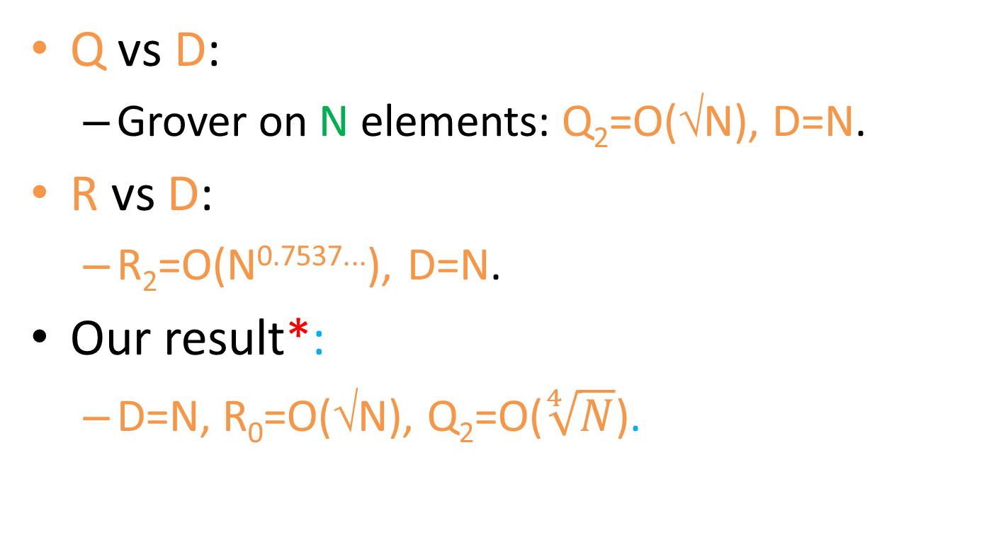
Total functions
Q vs D:
Grover on N elements: Q₂=O(√N), D=N.
R vs D:
R₂=O(N^{0.7537...}), D=N.
Our result*:
D=N, R₀=O(√N), Q₂=O($\sqrt[4]{N}$).
* up to log N factors

Slide 13
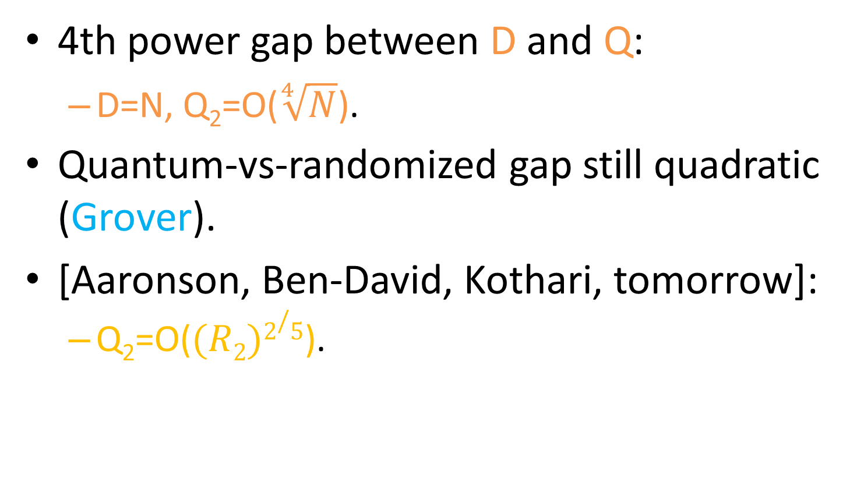
Two notes
4th power gap between D and Q:
D=N, Q₂=O($\sqrt[4]{N}$).
Quantum-vs-randomized gap still quadratic (Grover).
[Aaronson, Ben-David, Kothari, tomorrow]:
Q₂=O($(R2)2/5$).

Slide 14
Quantum exact vs. classical
[A, 2013]:
Q_{E} = O(N^{0.8675...}), R₂ = R₀ = D = N.
Our result 1:
Q_{E} = O(√N), R₀ = D = N.
Our result 2:
Q_{E} = O(N^{2/3}), R₂ =N.

Slide 15
Classical result
Our result:
R₂ = O(√N), R₀ = N.
The first separation between two types of randomized (with error and no error).

Slide 16
Go¨o¨s-Pitassi-Watson

Slide 17
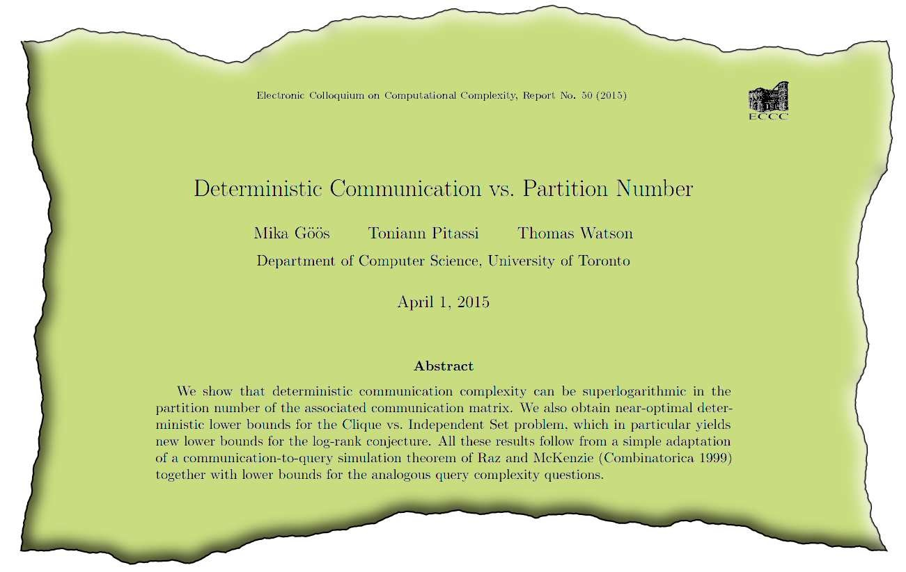
Paper

Slide 18
Goal
Clique vs Independent Set.
f with following properties:
D – large;
f=1 can be certified by values for a small number of variables.
Certificates are unambiguous.

Slide 19
D versus 1-certificates
Function of nm variables
f=1 iff there exists unique all-1 column
1
0
1
1
0
D=nm
1
n
0
1
0
0
0
1
1
1
0
m
short 1-certificates
BUT not unambiguous.

Slide 20
D versus 1-certificates
Function of nm variables
f=1 iff there exists unique all-1 column
1
0
1
1
0
D=nm
1
n
0
1
0
0
0
1
1
1
0
m
Should specify which 0 to choose from each column

Slide 21
Pointers
Introduction
1
Go¨ o¨ s-Pitassi-Watson
0
1
Paper
1
0
Goal
D versus 1-certificates
Pointers
Features
1
0
1
0
0
0
1
Our Modifications
1
R1 versus R0
1
0
R0 versus D
Conclusion
f=1 iff
there is an all-1 column b,
in b there is a unique r with non-zero pointer,
following the pointers from r, we traverse
exactly one zero in all other columns.

Slide 22
Pointers
1
0
1
1
0
1
0
1
0
0
0
1
1
1
0
D = nm and
unambiguous short 1-certificates.

Slide 23

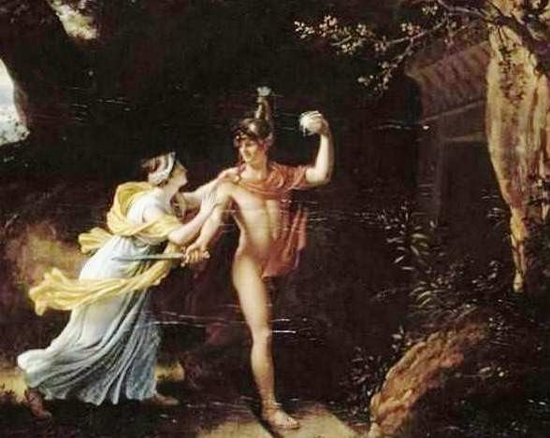
Features
Highly elusive
(flexible)
Still traversable
(if know where to start).

Slide 24
Our
Modifications

Slide 25
Binary
Tree
Instead of a list
0
0
0
0
1
0
0
0
we use a balanced binary tree
1
0
0
0
0
0
0
0
More elusive
Random access

Slide 26
Definition
1
1
1
1
0
1
0
0
0
1
0
0
1
0
1
f=1 iff
There is a (unique) all-1 column b;
in b, there is a unique element r with non-zero pointers;
for each j ≠ b, following a path T (j)
from r gives a zero in the jth column.

Slide 27
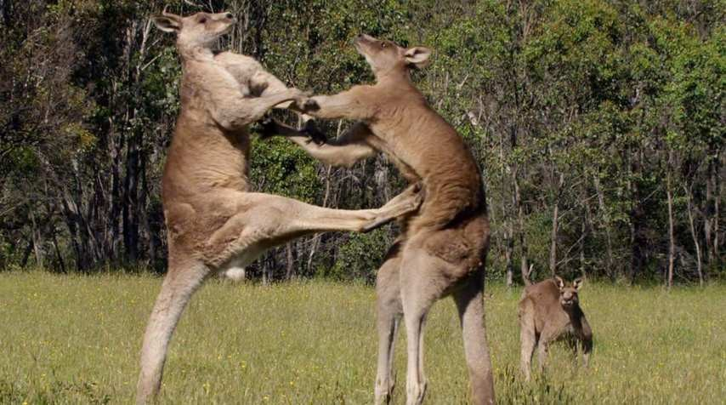
Q₂/R0
versus D

Slide 28
Definition
1
1
1
1
0
1
0
0
0
1
0
0
1
0
1
all the leaves back point to the all-1 column b.
Back pointers to columns.
F=1 iff

Slide 29
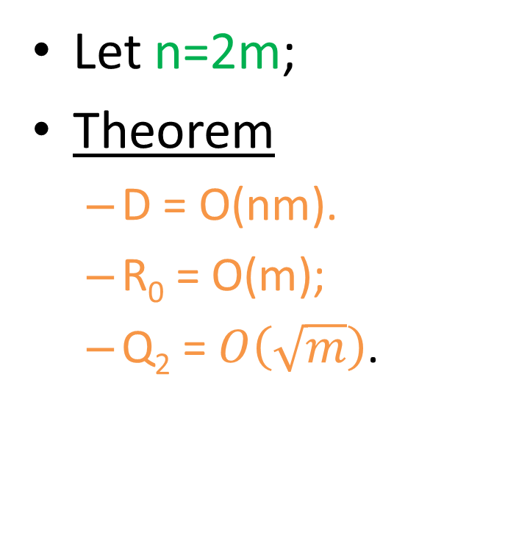
Summary
Let n=2m;
Theorem
D = O(nm).
R₀ = O(m);
Q₂ = $O\left(\sqrt{m}\right)$.
1
1
1
1
0
1
0
0
0
1
0
0
1
0
1

Slide 30
Lower
Bound
1
1
Adversary method.
Let n=2m.
If the k-th element is queried
in a column:
If k≤m, return
Otherwise, return with back
pointer to column k-m.
1
1
1
1
1
0
1
0
0
1
0
.
0
At the end, the column contains m and m
with back pointers to all columns 1, 2, ..., m.
1
0

Slide 31
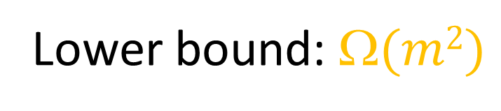
Lower
Bound
1
1
At the end, the column contains
m and m with back pointers to all columns 1, 2, ..., m.
1
1
1
1
0
1
1
0
1
0
The algorithm does not know
the value of the function until
it has queried >m elements in
each of m columns.
0
0
Lower bound: $(m2)$

Slide 32
Upper
Bound:
Informal
1
1
1
1
0
1
0
0
0
1
0
0
1
0
1
Each column contains a back pointer to the all-1 column
BUT there can be several back pointers
Which is the right one?

Slide 33
Upper
Bound:
Informal
1
We try each back pointer by quering
a few elements in the column,
and proceed to a column
where no zeroes were found.
1
1
1
0
0
Even if this is not the all-1 column,
we can find a column with fewer 0s,
with a high probability.
0
0

Slide 34
Upper
Bound:
Informal
1
Column with M zeroes
1
1
1
Column with M/2 zeroes
0
0
0
Column with M/4 zeroes
0
...

Slide 35
Upper
Bound:
Formal
Algorithm
Let c
be
the first column, and k ← n.
While k
> 1,
Let c ←ProcessColumn(c, k), and
k ← k/2.
ProcessColumn(column c,
integer k)
Query all elements in column c.
If
there
are
no zeroes, verify column c.
For each zero a:
Let j
be the back
pointer
of a.
in column j. (Probability <
Query O
(n/k) elements
1
(nm)²
that no zero found if there are > k/2 of them).
If no zero was found, return j.
Reject

Slide 36
Summary
Lower
Upper
bound
bound
for
for
a D algorithm is Ω(nm ).
a R₀ algorithm is O
(n + m).
Quadratic
separation between R₀ and D.
Grover: Q₂ algorithm with $O\left(\sqrt{n+m}\right)$ queries.
4th power
separation between Q₂ and D.

Slide 37
Conclusion

Slide 38
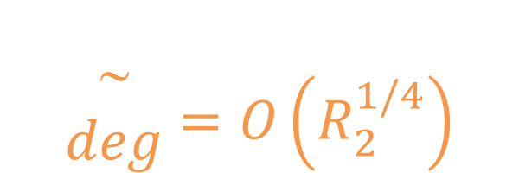
Results
Q₂ = O(D^{1/4}) Q₂ = O(R₀^{1/3})
Q_{E} = O(R₀^{1/2}) Q_{E} = O(R₁^{2/3})
R₁ = O(R₀^{1/2}) R₀ = O(D^{1/2})
$$\begin{matrix} \\ \begin{matrix} \\ deg\end{matrix}{=O\left(R_{2}^{1/4}\right)}\end{matrix}$$
Optimal

Slide 39

Open Problems
Can we resolve R2 ↔ D?
Known: R2 = Ω(D^{1/3}) and R2= O(D^{1/2}).
Can we separate R2 from R1?
The same about Q ↔ D
Known: Q = Ω(D^{1/6}) and Q = O(D^{1/4})
and QE ↔ D?
Known: QE = Ω(D^{1/3}) and QE = O(D^{1/2}).

Slide 40

Any
questions?

