Slide 1
Near Optimal Bounds on Bounded-Rounded Quantum Communication Complexity of Disjointness
Ankit Garg
Princeton Univ.
Joint work with
Mark Braverman Young Kun Ko
Princeton Univ. Princeton Univ.
Jieming Mao Dave Touchette
Princeton Univ. Univ. of Waterloo and Perimeter Institute

Slide 2
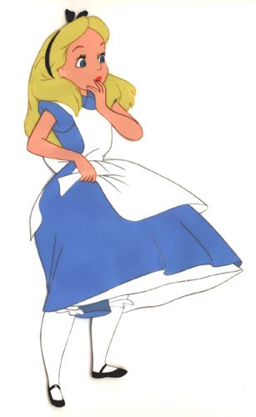




Quantum Communication Complexity
Classical inputs $x$ and $y$.
Goal: Compute classical function $F(x,y)$.
Communicate using quantum resources.
Alice
Bob
$$x$$
$$y$$

Slide 3

Quantum Protocols
Alice
Bob
$$x$$
$$y$$
Send C₁

Slide 4

Quantum Protocols
Alice
Bob
$$x$$
$$y$$
Send C₂

Slide 5
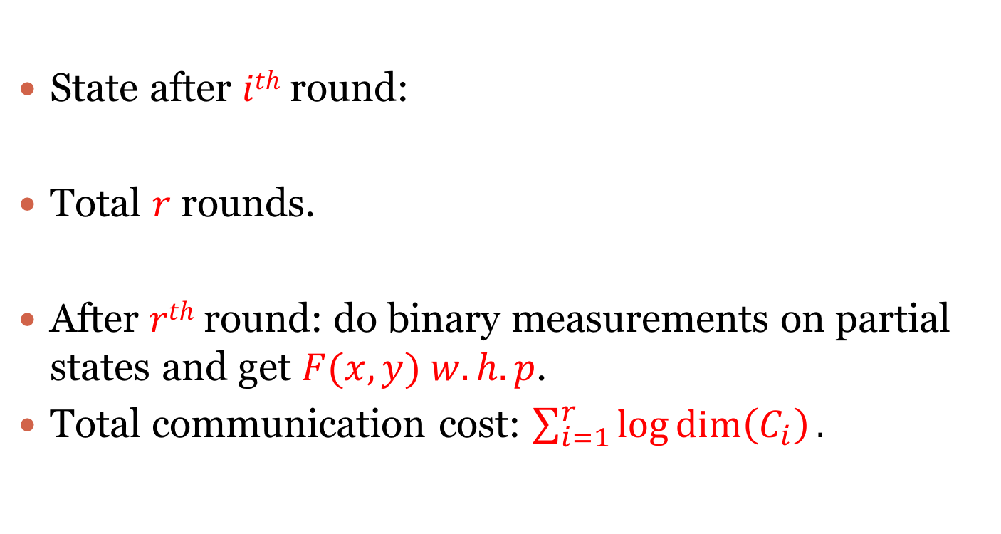
Quantum protocols
State after $ith$ round:
Total $r$ rounds.
After $rth$ round: do binary measurements on partial states and get $F(x,y) w.h.p$.
Total communication cost: $\sum_{i=1}^{r}{\log{\dim\left(C_{i}\right).}}$

Slide 6
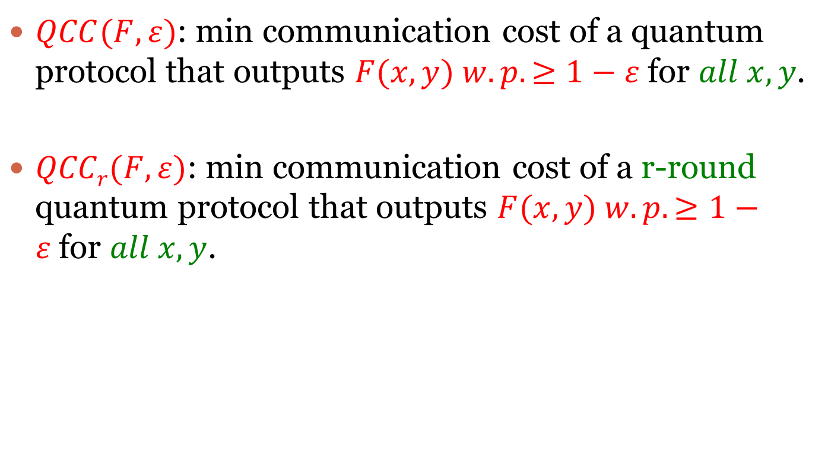
Quantum communication complexity [Yao ‘93]
$QCC(F,ε)$: min communication cost of a quantum protocol that outputs $F(x,y) w.p. ≥1−ε$for $all x,y$.
$QCCr(F,ε)$: min communication cost of a r-round quantum protocol that outputs $F(x,y) w.p. ≥1−ε$for $all x,y$.

Slide 7
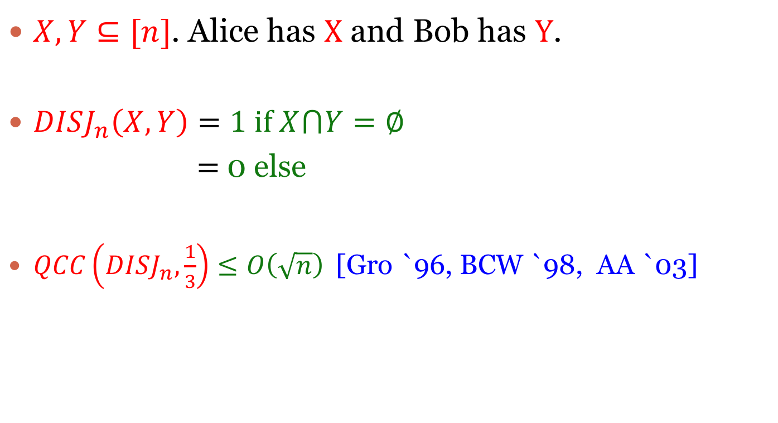
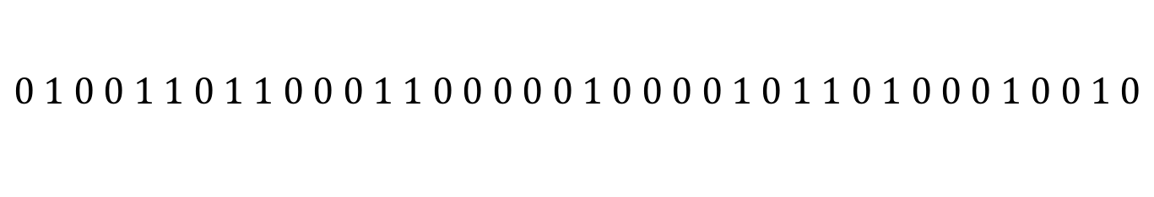
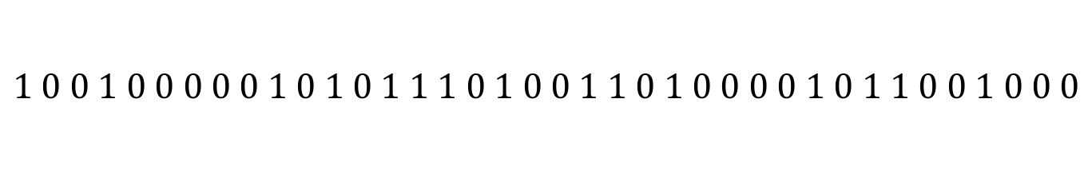
Disjointness
$X,Y⊆[n]$. Alice has X and Bob has Y.
$DISJ_{n}\left(X,Y\right)=1 if X⋂Y=∅$
$=$ 0 else
$QCC\left(DISJ_{n},\frac{1}{3}\right)≤O\left(\sqrt{n}\right)$[Gro `96, BCW `98, AA `03]
$$0 1 0 0 1 1 0 1 1 0 0 0 1 1 0 0 0 0 0 1 0 0 0 0 1 0 1 1 0 1 0 0 0 1 0 0 1 0$$
$$1 0 0 1 0 0 0 0 0 1 0 1 0 1 1 1 0 1 0 0 1 1 0 1 0 0 0 0 1 0 1 1 0 0 1 0 0 0$$

Slide 8
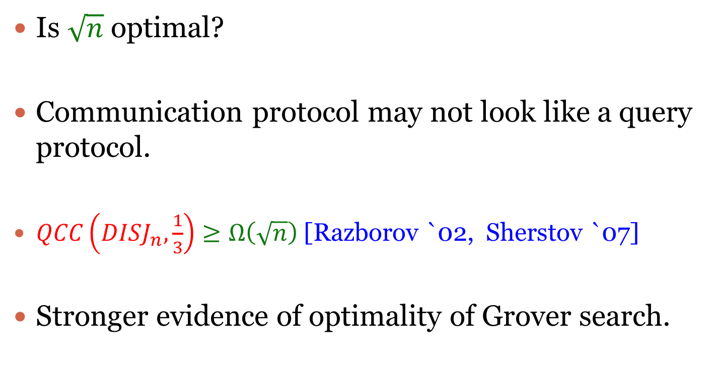
Disjointness
Is $\sqrt{n}$ optimal?
Communication protocol may not look like a query protocol.
$QCC\left(DISJ_{n},\frac{1}{3}\right)≥Ω\left(\sqrt{n}\right)$ [Razborov `02, Sherstov `07]
Stronger evidence of optimality of Grover search.

Slide 9

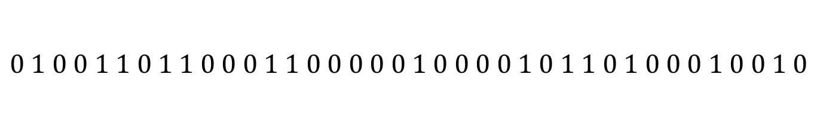

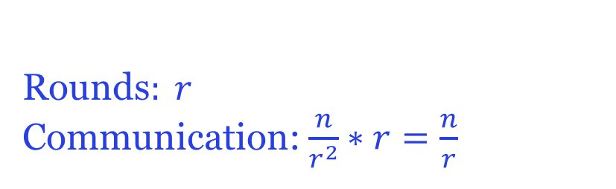
Disjointness
[BCW,AA] protocols for $DISJ_{n}$ involve $Θ(\sqrt{n})$ rounds of interaction.
What if only $r$ rounds of interaction are allowed?
$QCCr(DISJn , 1/3) ≤ O(n/r)$ $(r ≤\sqrt{n})$ [Folklore].
$⋯⋯$
$$0 1 0 0 1 1 0 1 1 0 0 0 1 1 0 0 0 0 0 1 0 0 0 0 1 0 1 1 0 1 0 0 0 1 0 0 1 0$$
$$1 0 0 1 0 0 0 0 0 1 0 1 0 1 1 1 0 1 0 0 1 1 0 1 0 0 0 0 1 0 1 1 0 0 1 0 0 0$$
Rounds$: r$
Communication: $\frac{n}{r^{2}}∗r=\frac{n}{r}$
$$r^{2}$$

Slide 10
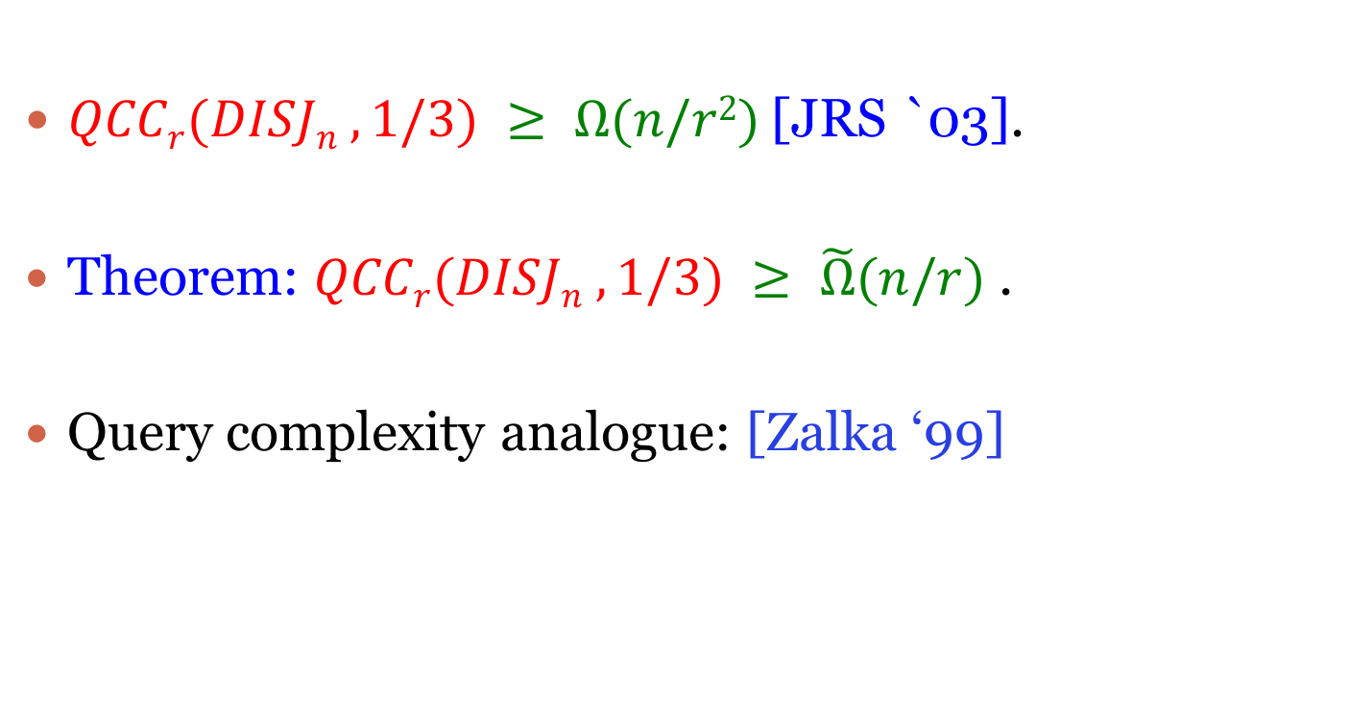
Disjointness
$QCCr(DISJn , 1/3) ≥ Ω(n/r2)$[JRS `03].
Theorem: $QCCr(DISJn , 1/3) ≥ \tilde{Ω}(n/r)$.
Query complexity analogue: [Zalka ‘99]

Slide 11
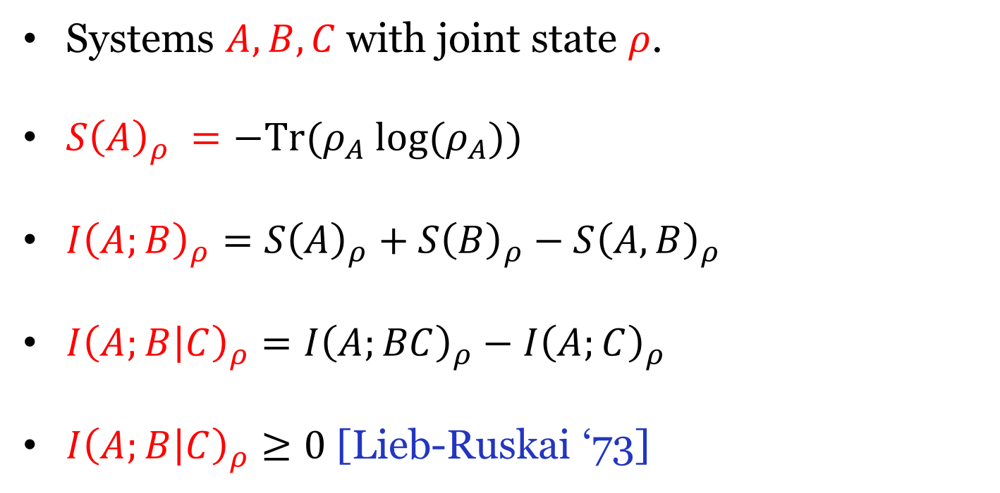
Quantum Information Theory 101
Systems $A,B,C$ with joint state $ρ$.
$S{\left(A\right)}_{ρ} =−Tr(ρ_{A} log⁡(ρ_{A}))$
$I{\left(A;B\right)}_{ρ}=S{\left(A\right)}_{ρ}+S{\left(B\right)}_{ρ}−S{\left(A,B\right)}_{ρ}$
$I{\left(A;B | C\right)}_{ρ}=I{\left(A;BC\right)}_{ρ}−I{\left(A;C\right)}_{ρ}$
$I{\left(A;B | C\right)}_{ρ}≥0$ [Lieb-Ruskai ‘73]

Slide 12



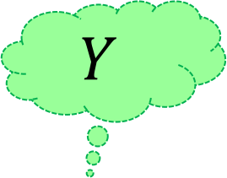
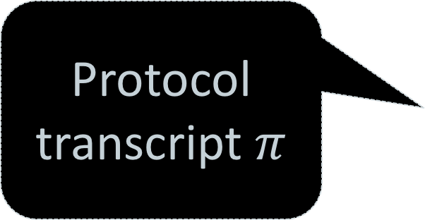
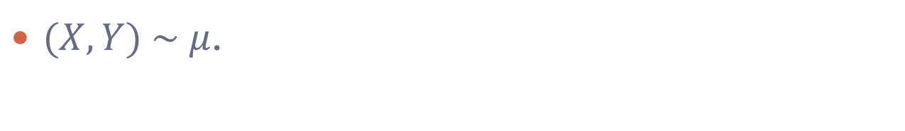
Classical Information Cost [CSWY `01, BJKS-04, BBCR-10]
$(X,Y) \sim μ$.
$$X$$
$$Y$$
Protocol transcript $π$
Protocol π
A
B
$$I(π, μ) = I(π;Y|X) + I(π;X|Y)$$
What Alice learns about $Y$ + What Bob learns about $X$

Slide 13



Quantum Information Cost
$(X,Y) \sim μ$.
$$X$$
$$Y$$
Quantum Protocol
Protocol π
A
B
Issues:
No concept of transcript.
Reversible computing.

Slide 14
Quantum Information Cost [Touchette `14]
Account for forgetting of information.

Slide 15

Quantum Information Cost [Touchette `14]
State after $ith$ round:
$${I(X;C_{i}|Y, B_{i})}_{ψ^{i}}+{I(Y;C_{i}|X, A_{i})}_{ψ^{i}}$$
Information sent by Alice
Information forgotten by Alice

Slide 16
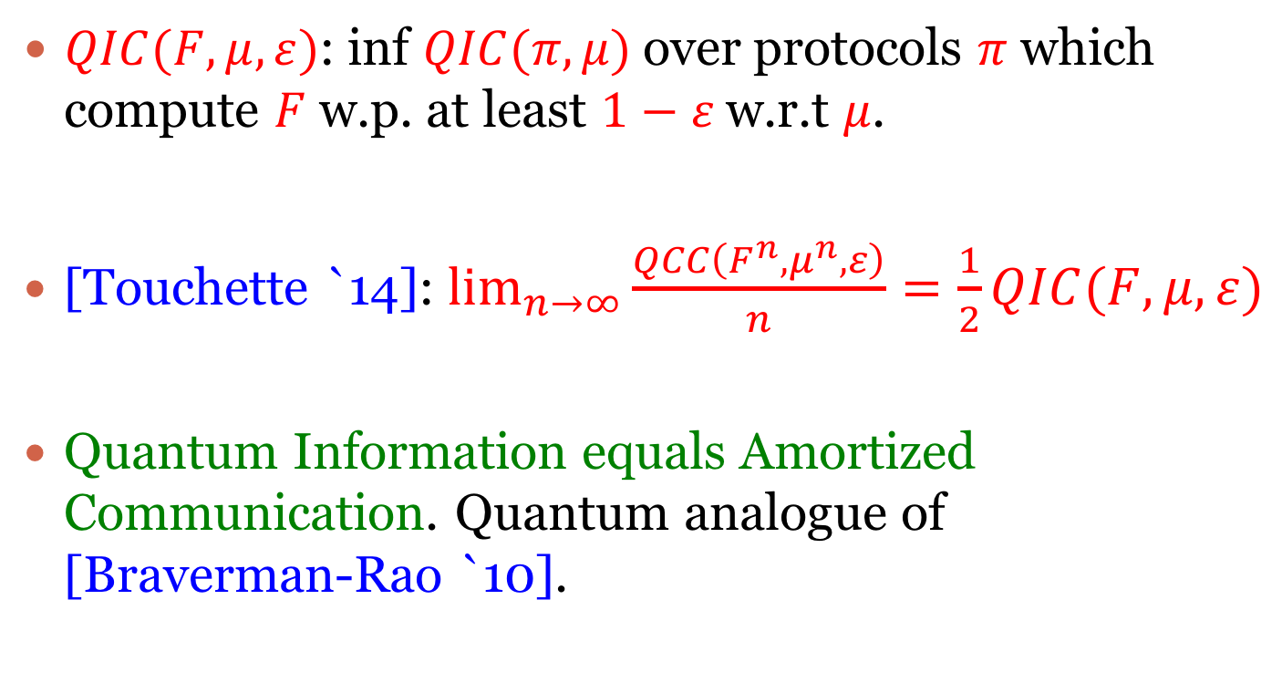
Quantum Information Complexity
$QIC(F,μ,ε)$: inf $QIC(π,μ)$over protocols $π$ which compute $F$ w.p. at least $1−ε$ w.r.t $μ$.
[Touchette `14]: $\lim_{n→∞}{\frac{QCC\left(F^{n},μ^{n},ε\right)}{n}=\frac{1}{2}QIC(F,μ,ε)}$
Quantum Information equals Amortized Communication. Quantum analogue of [Braverman-Rao `10].

Slide 17

$DISJ_{n}\underset{⇔}{}AND$
$DISJ_{n}\left(X,Y\right)=¬\bigvee_{i=1}^{n}{(X_{i}∧Y_{i})}$
Understand $QCC$ of $DISJn$.
Understand $QIC$ of $AND$.

Slide 18
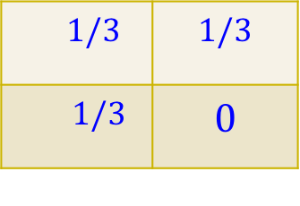
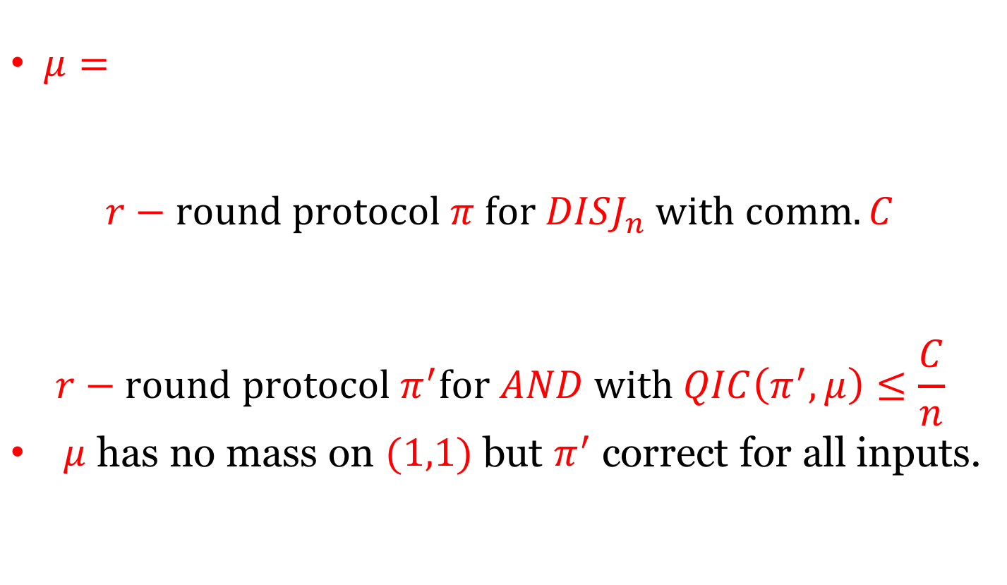
$DISJ_{n}\underset{⇔}{}AND$
$μ=$
$$r−round protocol π for DISJ_{n} with comm. C$$
$$r−round protocol π^{′}for AND with QIC\left(π^{′},μ\right)≤\frac{C}{n}$$
$μ$ has no mass on $(1,1)$ but $π^{′}$ correct for all inputs.
$1/3$ | $$1/3$$
$1/3$ | $$0$$

Slide 19

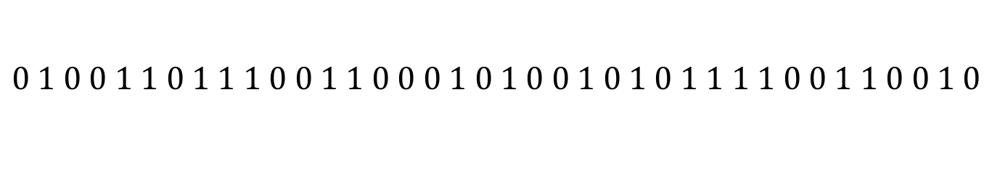
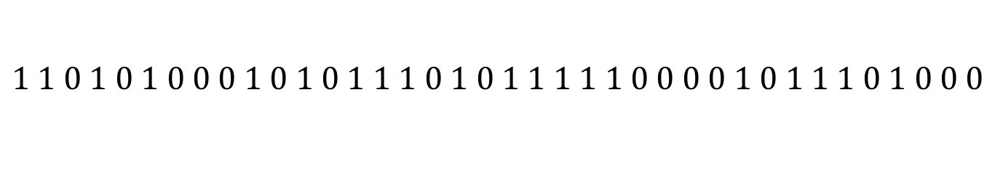
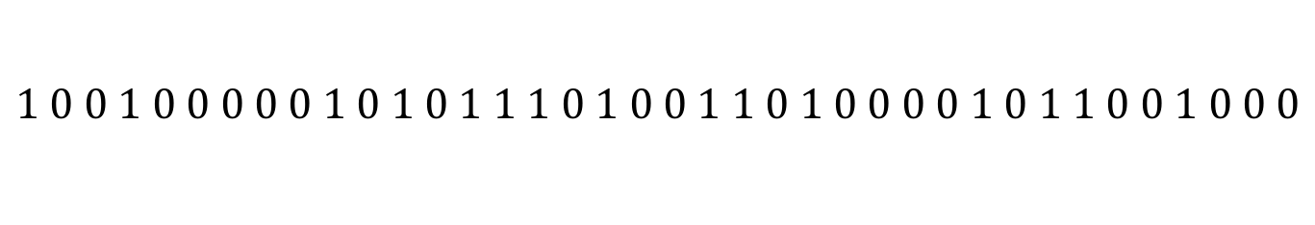
$DISJ_{n}\underset{⇔}{}AND$
What are the hard instances of $DISJ_{n}?$
$$0 1 0 0 1 1 0 1 1 1 0 0 1 1 0 0 0 1 0 1 0 0 1 0 1 0 1 1 1 1 0 0 1 1 0 0 1 0$$
$$1 1 0 1 0 1 0 0 0 1 0 1 0 1 1 1 0 1 0 1 1 1 1 1 0 0 0 0 1 0 1 1 1 0 1 0 0 0$$
$$0 1 0 0 1 1 0 1 1 0 0 0 1 1 0 0 0 0 0 1 0 0 0 0 1 0 1 1 0 1 0 0 0 1 0 0 1 0$$
$$1 0 0 1 0 0 0 0 0 1 0 1 0 1 1 1 0 1 0 0 1 1 0 1 0 0 0 0 1 0 1 1 0 0 1 0 0 0$$

Slide 20
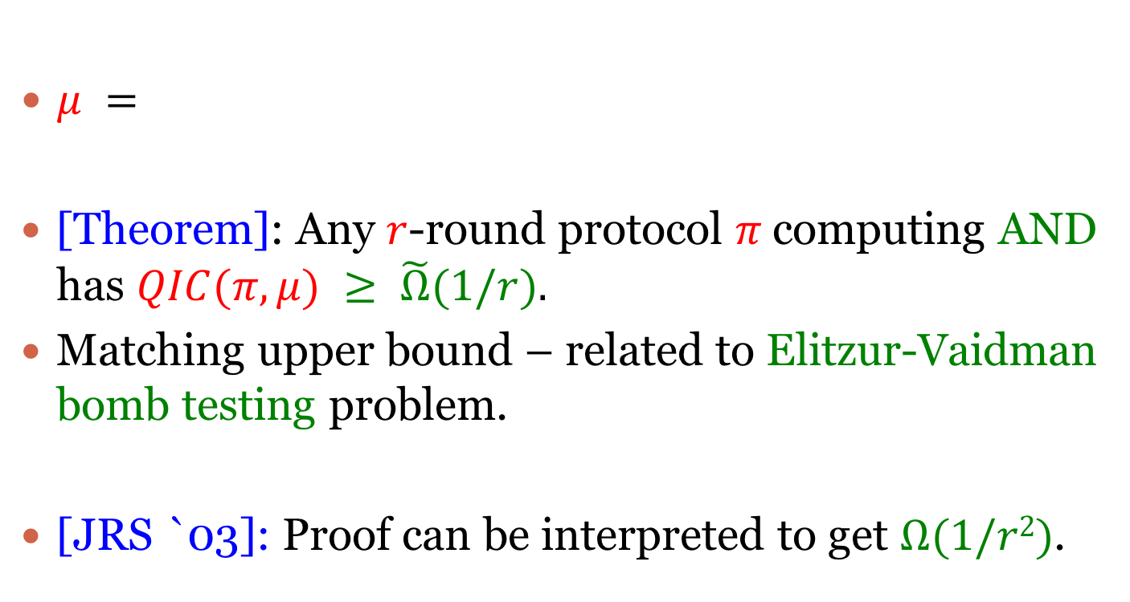
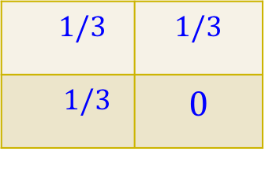
QIC of AND
$μ =$
[Theorem]: Any $r$-round protocol $π$computing AND has $QIC(π,μ) ≥ \tilde{Ω}(1/r).$
Matching upper bound – related to Elitzur-Vaidman bomb testing problem.
[JRS `03]: Proof can be interpreted to get $Ω(1/r2)$.
$1/3$ | $$1/3$$
$1/3$ | $$0$$

Slide 21
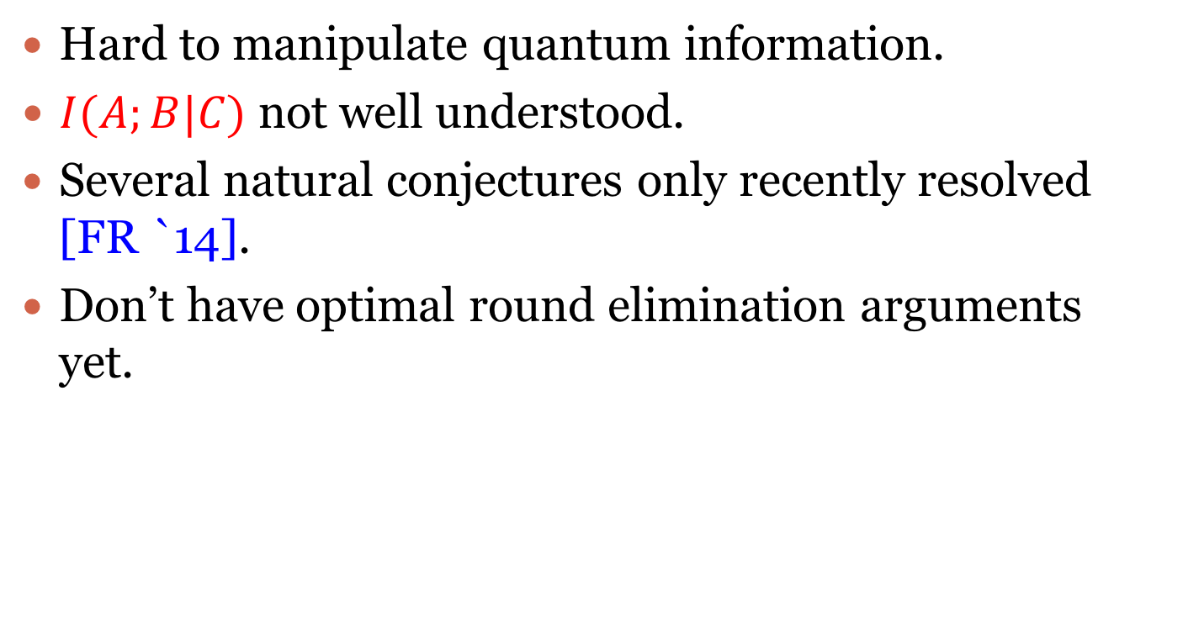
Why is it hard?
Hard to manipulate quantum information.
$I(A;B|C)$ not well understood.
Several natural conjectures only recently resolved [FR `14].
Don’t have optimal round elimination arguments yet.

Slide 22
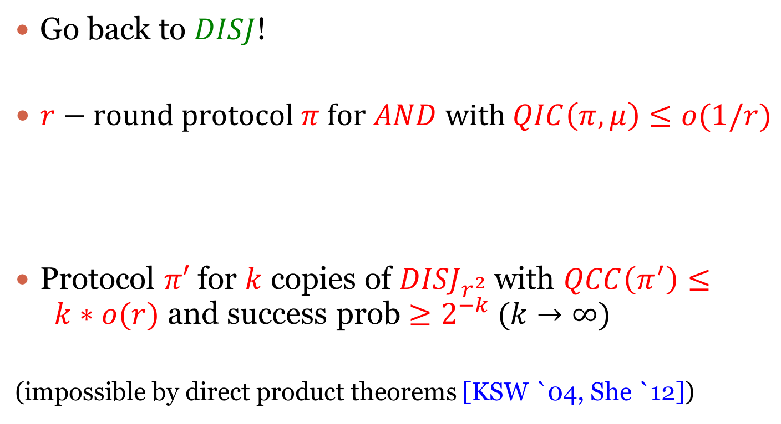
Proof idea
Go back to $DISJ$!
$r−round protocol π for AND with QIC\left(π,μ\right)≤o(1/r)$
Protocol $π′$ for $k$ copies of ${DISJ}_{r^{2}}$ with $QCC\left(π^{′}\right)≤ k∗o(r)$ and success prob $≥2^{−k}$ $(k→∞)$
(impossible by direct product theorems [KSW `04, She `12])

Slide 23
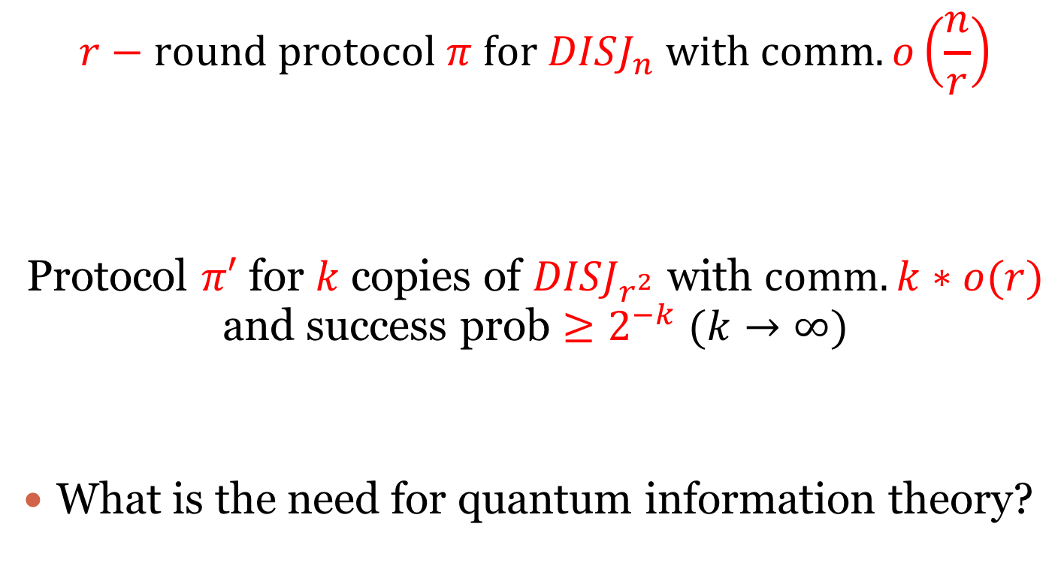
Complete reduction
$$r−round protocol π for DISJ_{n} with comm. o\left(\frac{n}{r}\right)$$
Protocol $π′$ for $k$ copies of ${DISJ}_{r^{2}}$ with $comm. k∗o(r)$ and success prob $≥2^{−k}$ $(k→∞)$
What is the need for quantum information theory?

Slide 24
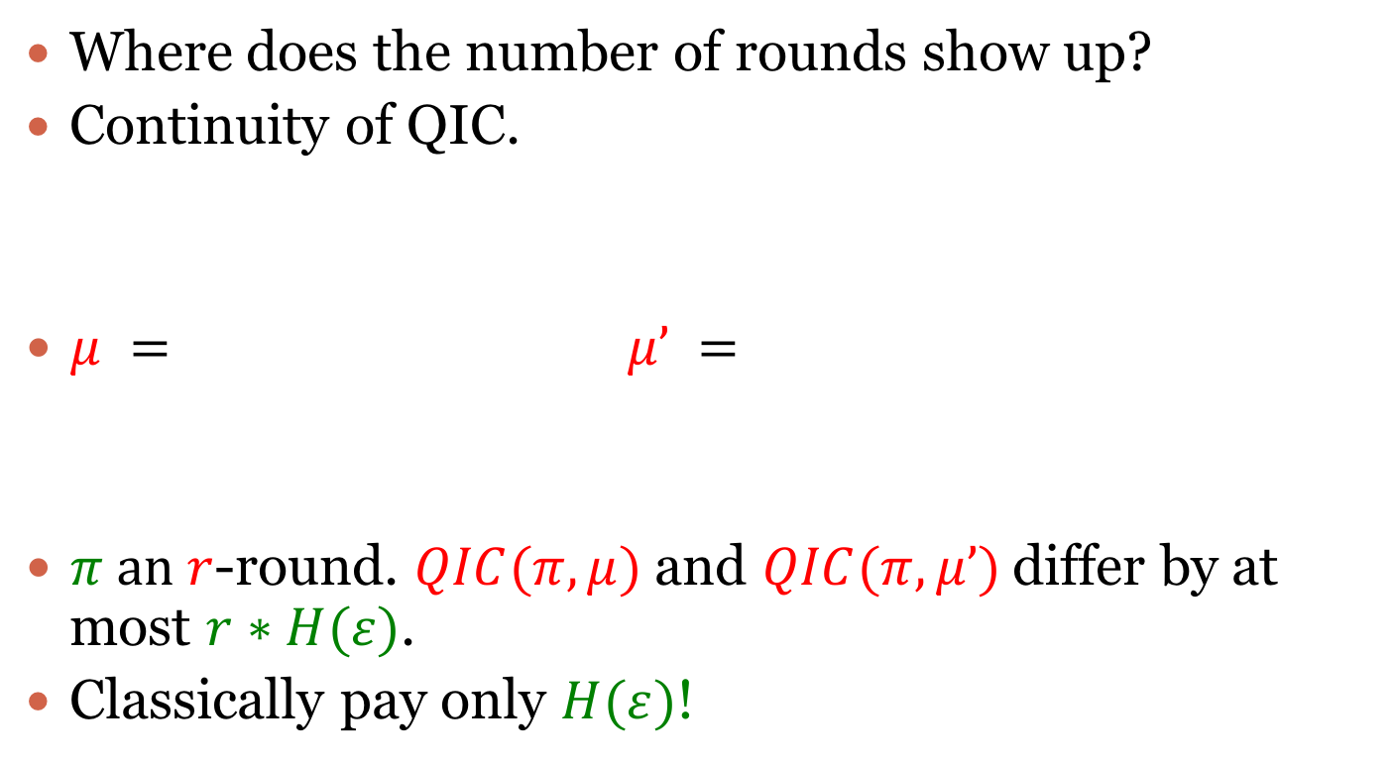
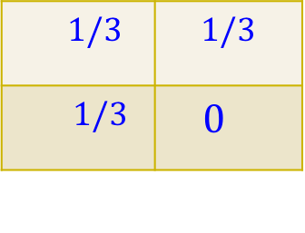
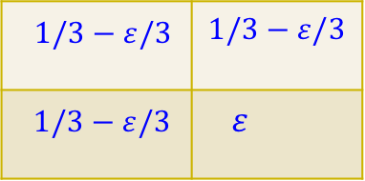
Continuity of QIC
Where does the number of rounds show up?
Continuity of QIC.
$μ =$ $μ’ =$
$π an r$-round. $QIC(π,μ)$ and $QIC(π,μ’)$differ by at most $r∗H(ε)$.
Classically pay only $H(ε)$!
$1/3$ | $$1/3$$
$1/3$ | $0$
$1/3−ε/3$ | $$1/3−ε/3$$
$1/3−ε/3$ | $ε$

Slide 25
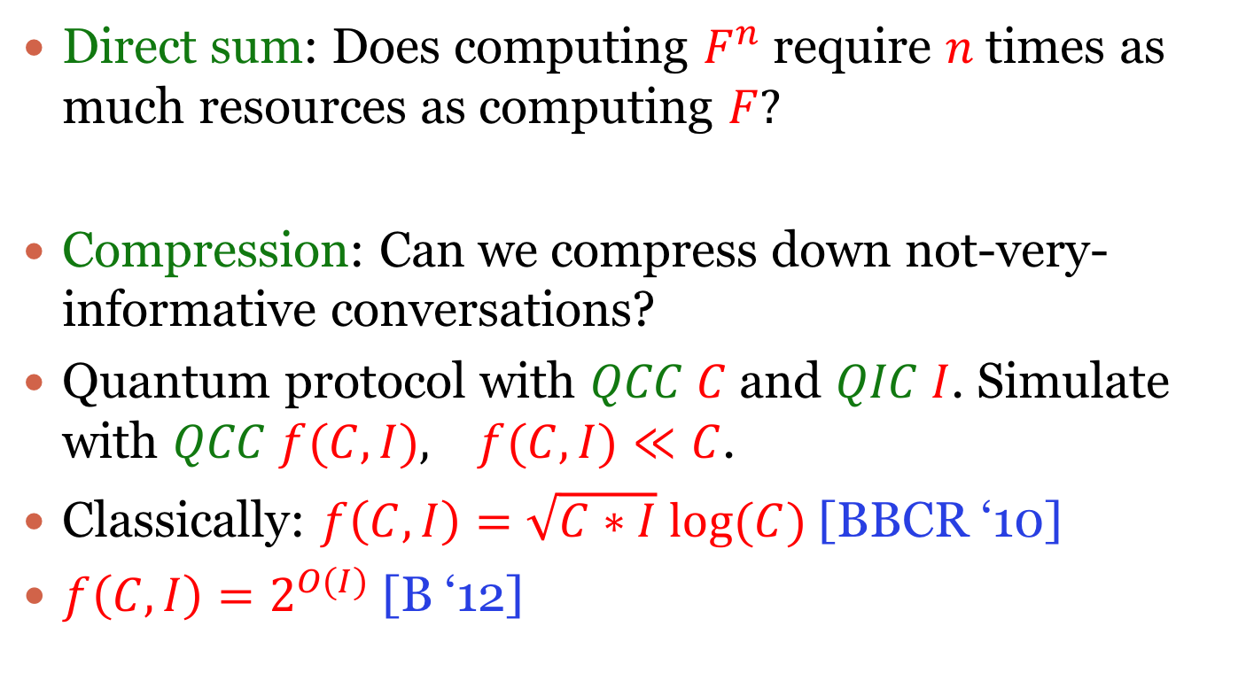
Conclusion and Open Problems
Direct sum: Does computing $F^{n}$ require $n$ times as much resources as computing $F?$
Compression: Can we compress down not-very-informative conversations?
Quantum protocol with $QCC C$ and $QIC I$. Simulate with $QCC f(C,I), f(C,I)≪C$.
Classically: $f\left(C,I\right)=\sqrt{C∗I} log⁡(C)$ [BBCR ‘10]
$f\left(C,I\right)=2^{O(I)}$ [B ‘12]

Slide 26
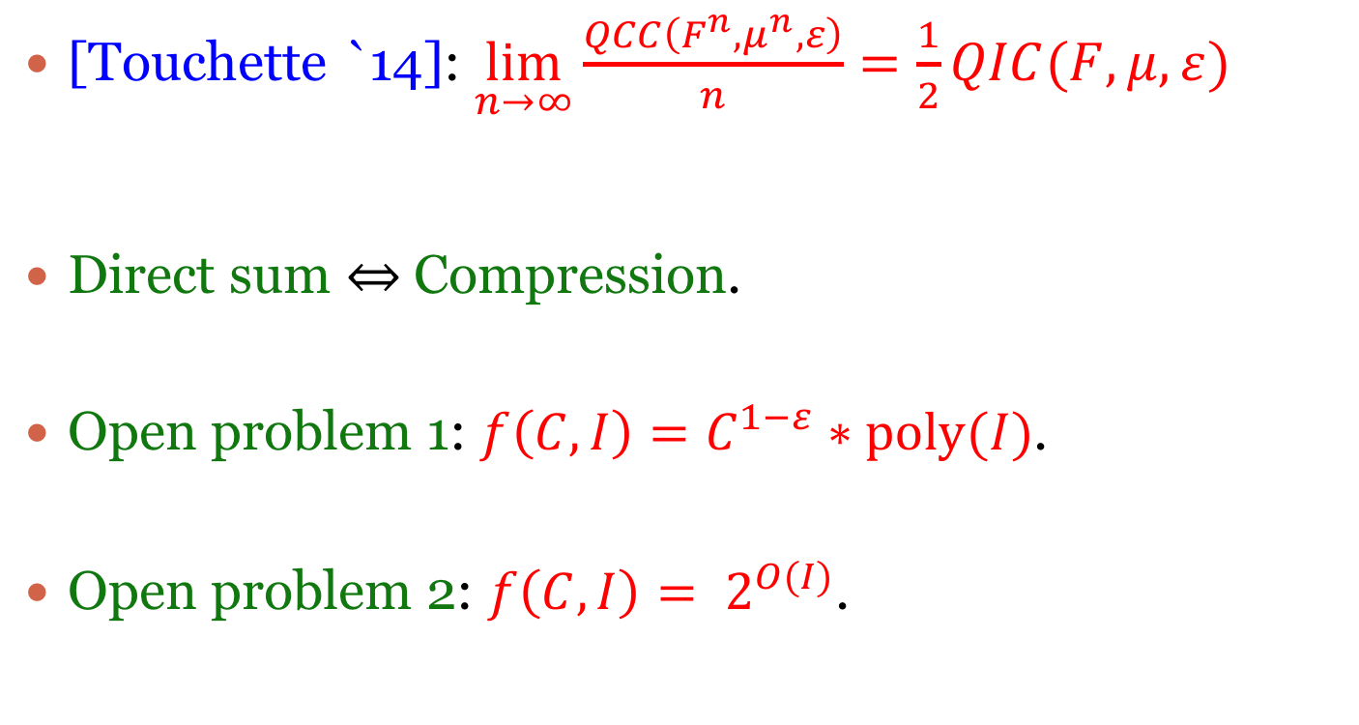
Conclusion and Open Problems
[Touchette `14]: $\lim_{n→∞}{\frac{QCC\left(F^{n},μ^{n},ε\right)}{n}=\frac{1}{2}QIC(F,μ,ε)}$
Direct sum Compression.
Open problem 1: $f\left(C,I\right)=C^{1−ε}∗poly(I)$.
Open problem 2: $f\left(C,I\right)= 2^{O(I)}$.
We prove this if the goal is to compute boolean functions.

Slide 27
Thank You

