Slide 1
The private capacities of a secret shared reference frame
Stephen Bartlett
Robert Spekkens
Patrick Hayden (McGill) with:
???
arXiv:quant-ph/0506260
PRA 75:052329 (2005)

Slide 2
Overview
Shared reference frames:
  Secret and not
Perfect privacy:
  Classical capacity ' 3 times quantum capacity
ε-privacy:
  Classical capacity ' quantum capacity

Slide 3


(Un)speakable information
Speakable:
  01001101000
Unspeakable:
Turn left at the Crab Nebula
Left? What is this “left”?
Other examples:
Phase reference, direction

Slide 4



Lots of previous work
There is a communication cost to establishing a shared RF
Direction alignment
Gisin and Popescu, PRL 83, 423 (1999)
Peres and Scudo, PRL 86, 4160 (2001)
Bagan et al., PRA 63, 052309 (2001)
Cartesian frame alignment
Chiribella et al., quant-ph/0405095
Bagan et al., quant-ph/0405082
Clock synchronization
Jozsa et al., PRL 85, 2010 (2000)
“Colour coding” – establishing a common ordering
von Korff and Kempe, quant-ph/0405086

Slide 5
RF’s as information resources
Distill to standard form
  Schuch et al. PRL 92:087904 (2004)
Quantum and classical communication
  Bartlett et al. PRL 91:027901 (2003)
Entanglement manipulation
  Verstraete/Cirac PRL 91:010404 (2003)
Key distribution
  Walton et al. PRL 91:087901 (2003)
  Boileau et al. PRL 92:017901 (2003)
Cryptographic consequences for missing/poor RF
  Kitaev et al. PRA 69:052326 (2004)
  Harrow et al. quant-ph/0506133

Slide 6
Today’s story
Secret shared references frames as a resource for cryptography
Alice and Bob share
a reference frame for
SU(2). Alice sends
Bob n spin ½ particles.
???
How many private cbits
and qubits can Alice
embed in her message?
Secret shared reference frame for SU(2) replaces secret key
Note: -2 secret reference frames ⇒ infinite secret key
-1 secret, 1 public reference frame ⇒ infinite secret key
  Bartlett, Rudolph, Spekkens PRA 70:032307 (2004)

Slide 7
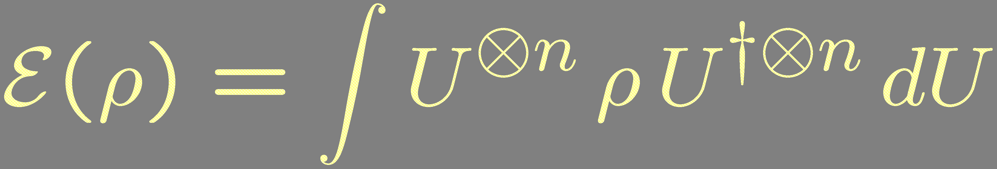
Alice and Eve’s views
ρ
n spin ½ particles
E(ρ)

Slide 8
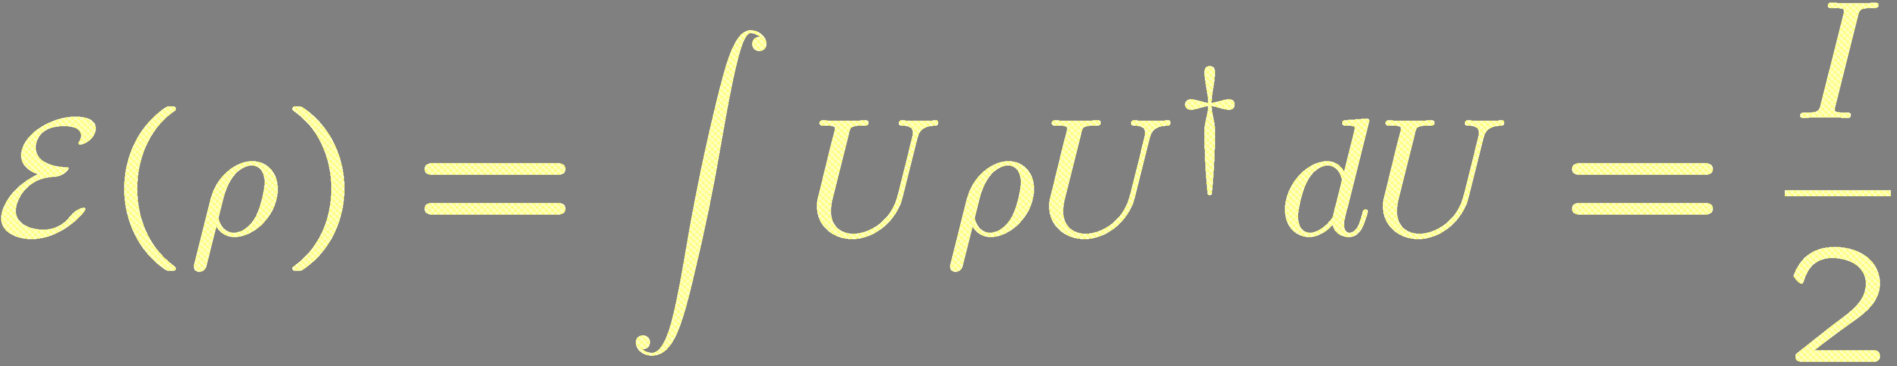
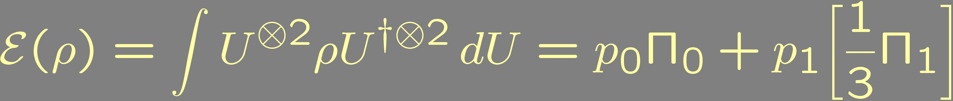
Representation theory:
It makes the heart sing
n=1: One spin sent
One private cbit or
One private qubit
n=2: Two spins sent
1-d
3-d
where p_{j} = Tr(ρ Π_{j}).
One private qutrit
Classical:|ii = 1/2|ψ₋i + 3^{1/2}/2|n_{i}i|n_{i}i, i=1,...,4
E(|iih i|) = I/4.
Two private cbits!

Slide 9
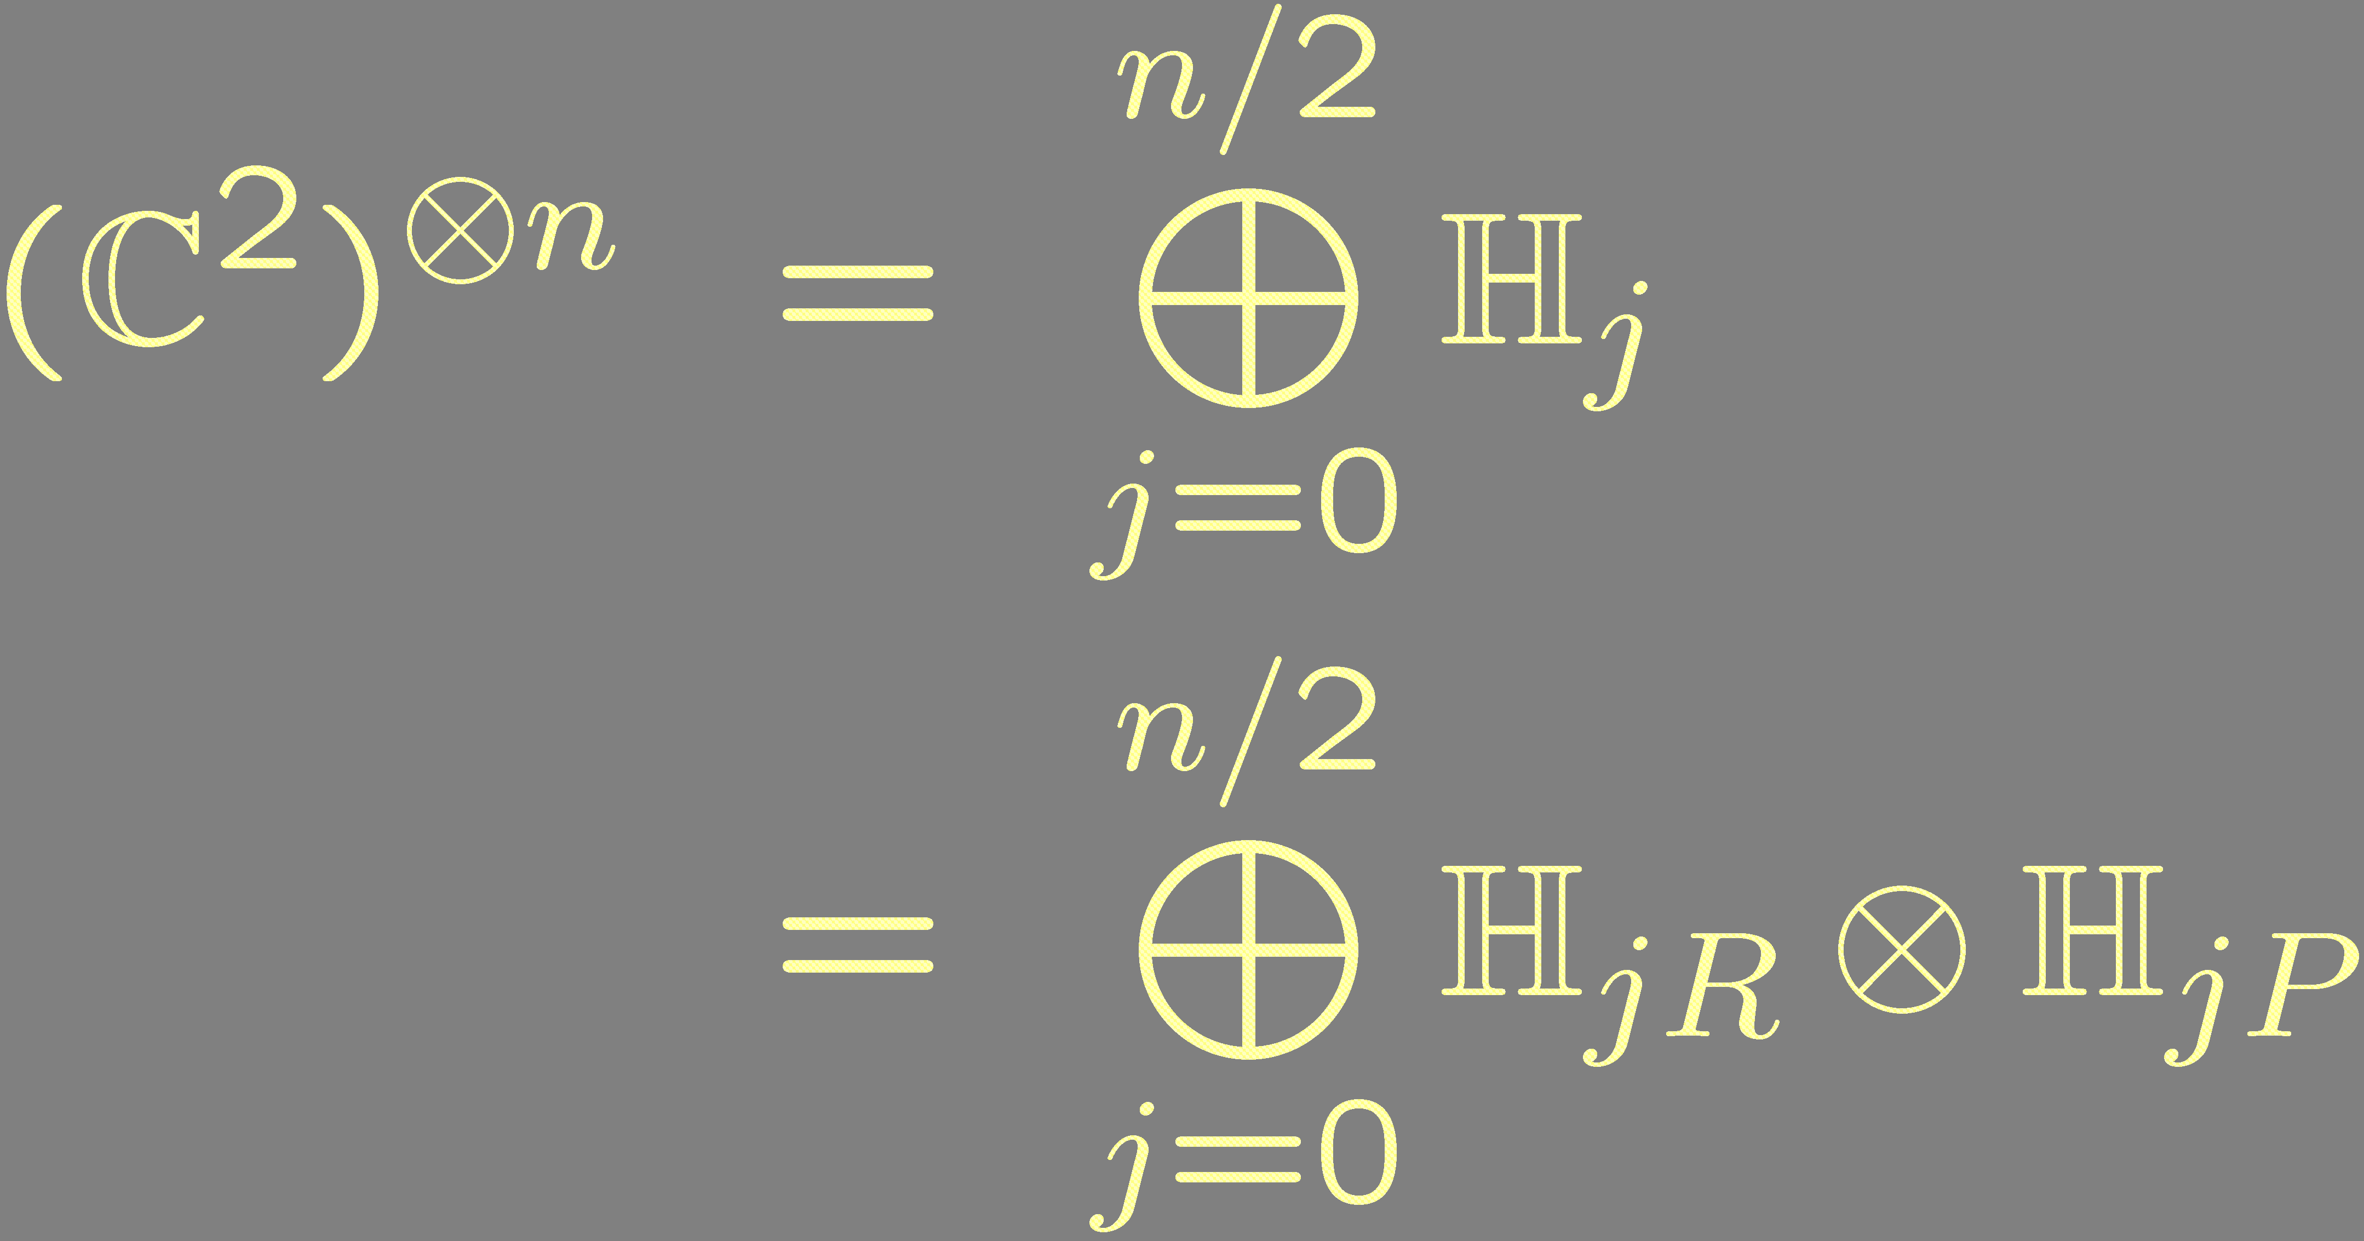
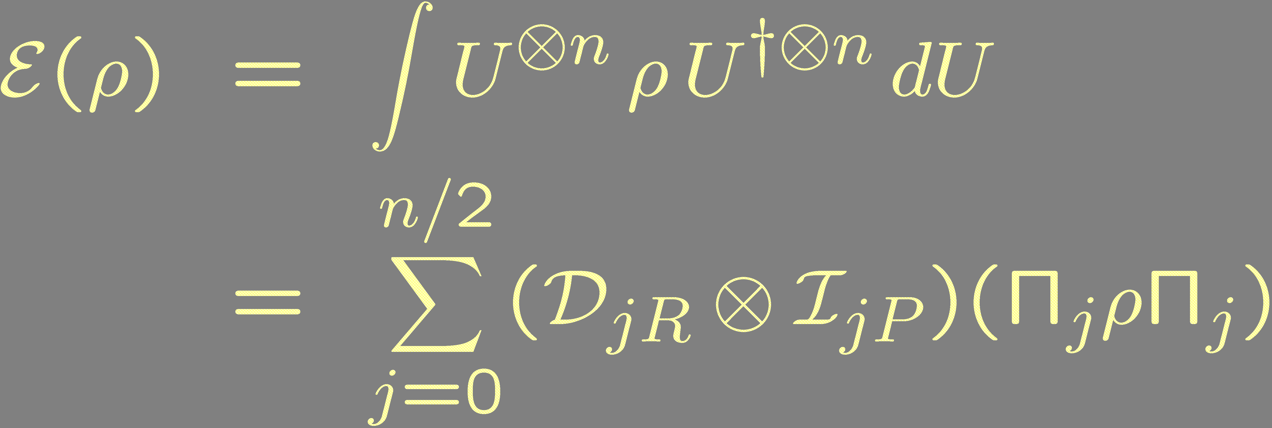
General decomposition of (C²)^{­ n}
(Addition of angular momenta)
(SU(2) acts irreducibly on H_{jR}
and trivially on H_{jP})
Projection on H_{j}
Depolarization of H_{jR}
[BRS 20004]: 1) Private qubits go in largest H_{jR}
2) Private cbits made by (Fourier ± superdense) method

Slide 10
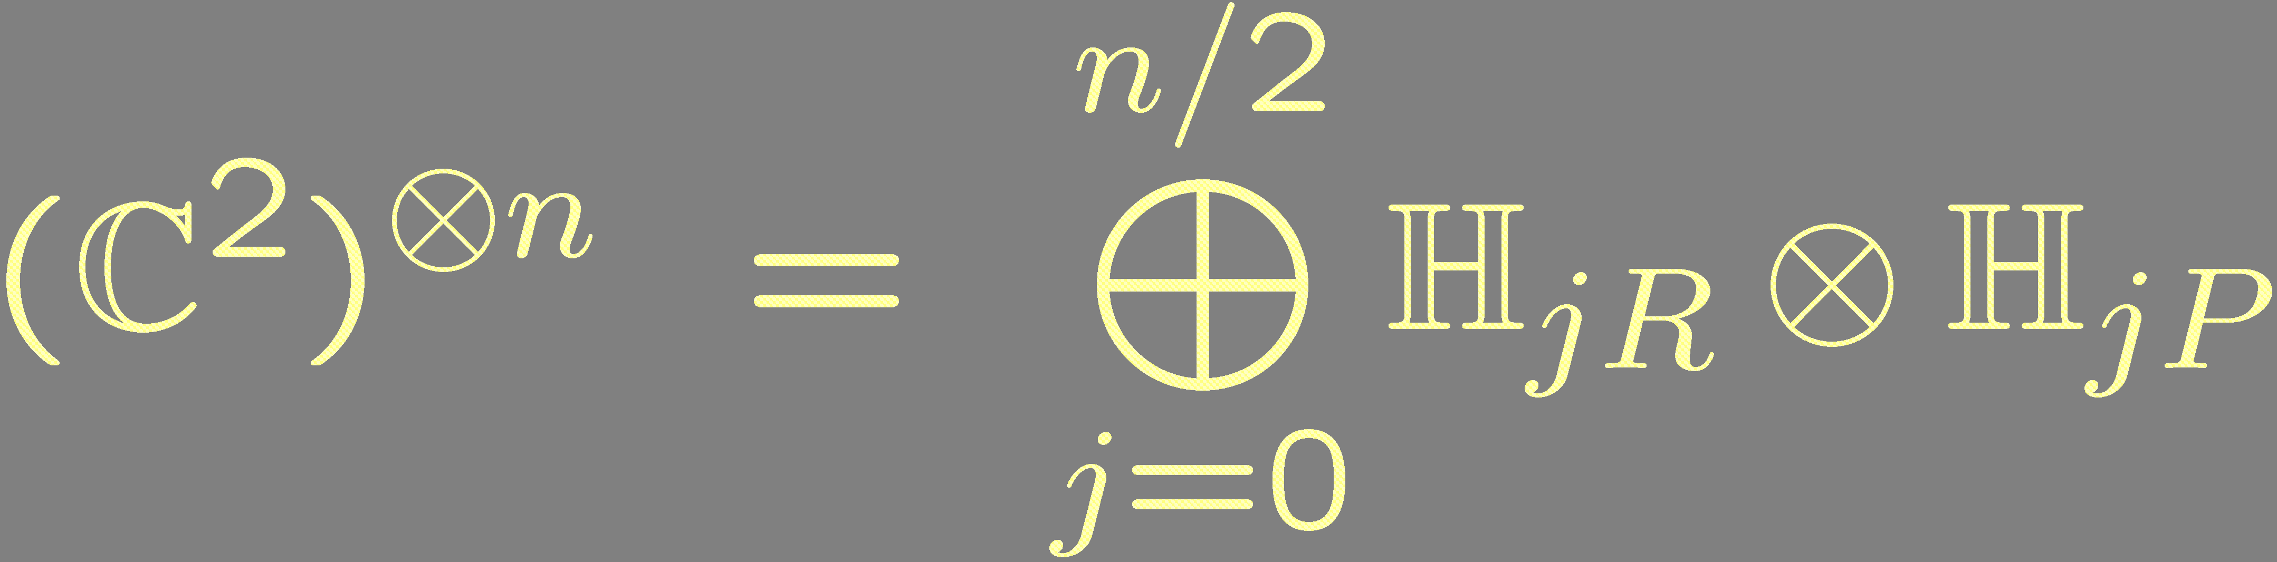
Fourier ± superdense in a nutshell
dim(H_{jR}) = 2j+1
dim(H_{jP}) > dim(H)_{jR} 8 j < n/2
Superdense coding OK:
H_{jR} depolarized
Fourier basis OK:
phases destroyed
Store quantum data in H_{jR} with j = n/2:
Get log(n+1) private qubits.
Store classical data using Fourier ± superdense method:
O(n) blocks (Fourier), each with O(n²) values (superdense)
Get log(Cn³) = 3 log n – const private cbits.
Asymptotically able to send three times as many private cbits as qubits

Slide 11
Conferences are worthwhile
QCMC 2004 in Glasgow:
  Rob Spekkens: “The private classical capacity of a secret frame is three times its private quantum capacity. You use the (Fourier ± superdense) method.”
  Me: “Superdense coding can used to send arbitrary quantum states, not just classical messages.” [HHL 03, HLW 04]
  Rob, Stephen Bartlett, me: “Huh. Think this (Fourier ± superdense) thing can be done for quantum states?”

Slide 12
“Huh. Think this can be done for quantum states?
Yes!
If only approximate (but arbitrarily small) indistinguishability is
allowed, then both the optimal private classical and quantum rates are both about 3 log(n).

Slide 13
Closing the gap
New version of security:
  There is a ρ₀ such that kE(φ) - ρ₀k₁ · δ for all messages φ. δ can be made arbitrarily small for sufficiently large n.
  Quantum capacity: True for all |φi 2 H_{L}. Number of private qubits is log(dim H_{L}).
  Classical capacity: True for an orthogonal set of states
  S = {φ_{i}}. Number of private bits is log |S|.
Two halves to the proof
  The private classical capacity remains
  ~3 log(n).
  The private quantum capacity
  triples from ~log(n) to ~3 log(n).
Not unstandard techniques
(Fano inequality cha cha.)
Not much more unstandard techniques
(Random subspace boogie.)

Slide 14
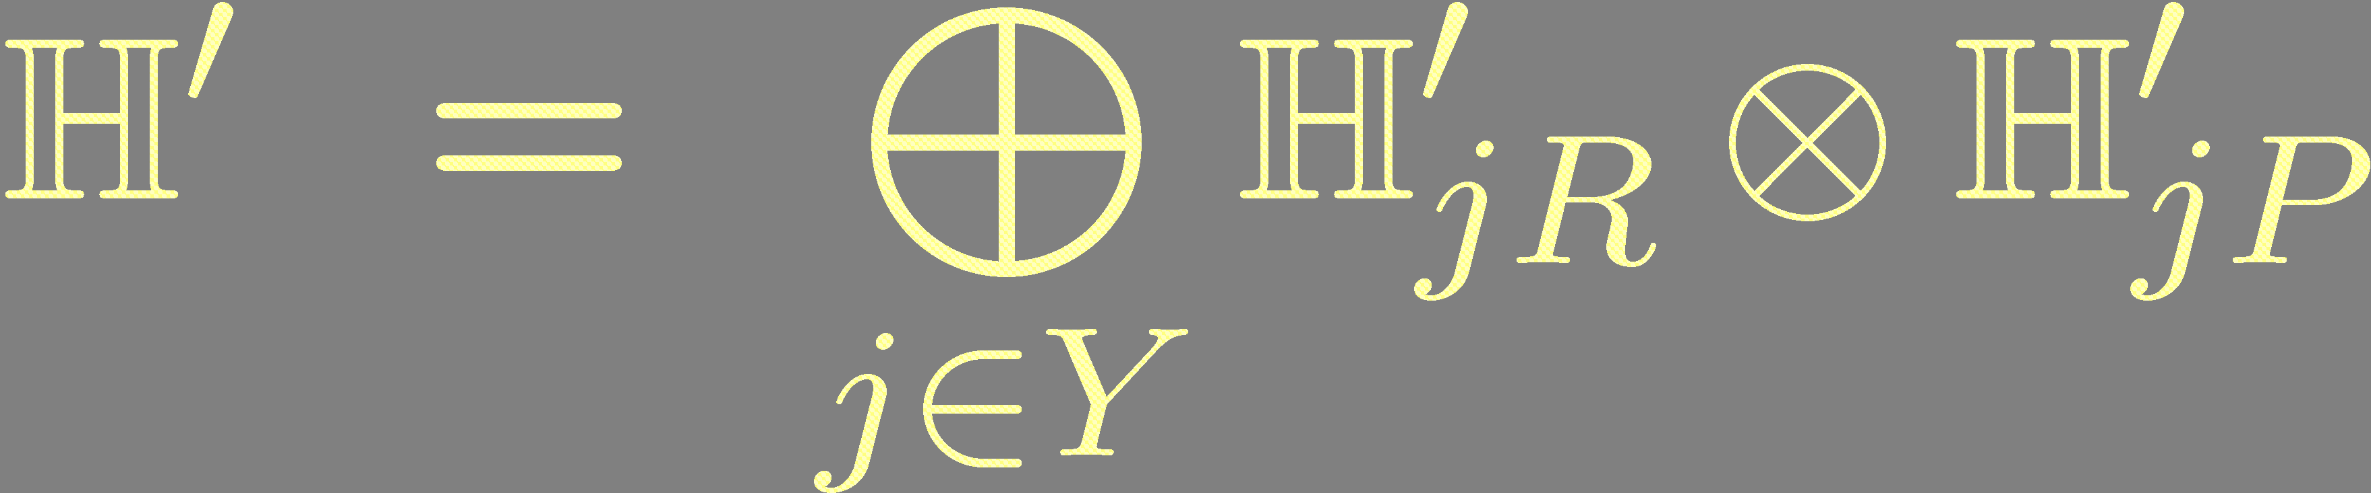
Random subspace boogie
Choose the encoding subspace H_{L} at random. How?
dim(H_{jR}) = 2j+1
dim(H_{jP}) > dim(H)_{jR} 8 j < n/2
Maximize dim(H’)
~ Cn³/α.
▪ Assume n is even.
Set j_{max} = n/2 – 1 and j_{min} = bn/3c.
▪ Restrict to j’s in Y = { j_{min}, j_{min}+1, ... , j_{max} }.
Depolarized subsystems
H_{jR}’ always bigger than H_{jP}’.
▪ Set D = 2 j_{min}+1, D_{α} = b D / α c, α > 1.
▪ Choose subspaces H_{jR}’ µ H_{jR} and H_{jP}’ µ H_{jP}
such that dim(H_{jR}’) = D and dim(H_{jP}’) = D_{α}.
Always same D, D_{α}
for ease of analysis.
▪ Working subspace is
Choose H_{L} at
random from H’.

Slide 15
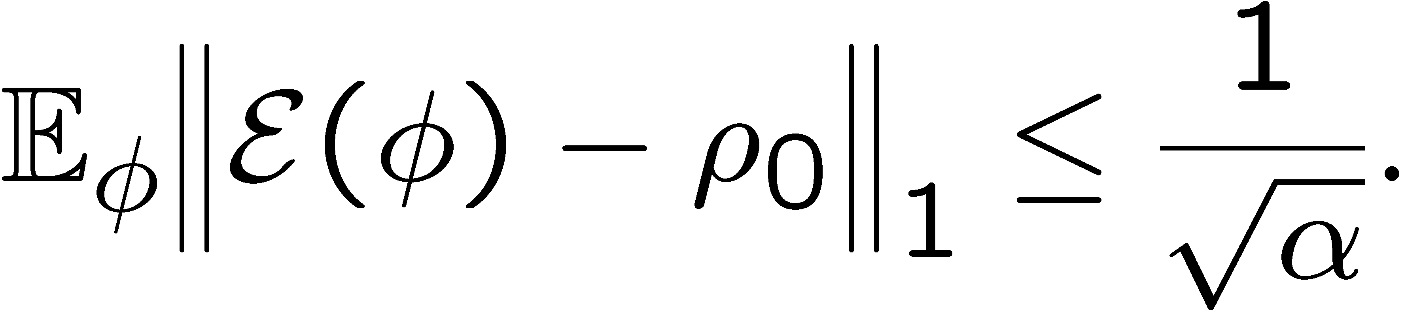
Random subspace boogie
state
dim(H_{jR}) = 2j+1
dim(H_{jP}) > dim(H)_{jR} 8 j < n/2
|Y| ~ n/6.
dim(H_{jR}’) ~ 2n/3.
dim(H_{jP}’) ~ 2n/(3α).
Choose H_{L} at random from H’.
Start simple: Choose |φi at random from H’.
What to expect?
▪ Nearly same weight in each sector H_{jR}’ ­ H_{jP}’:
Tr(φ H_{j1R}’ ­ H_{j1P}’ ) ' Tr( φ H_{j2R}’ ­ H_{j2P}’ ) for all j₁ and j₂.
▪ Reduced states on H_{jP}’ almost always maximally mixed if D À D_{α}.
Actually:

Slide 16
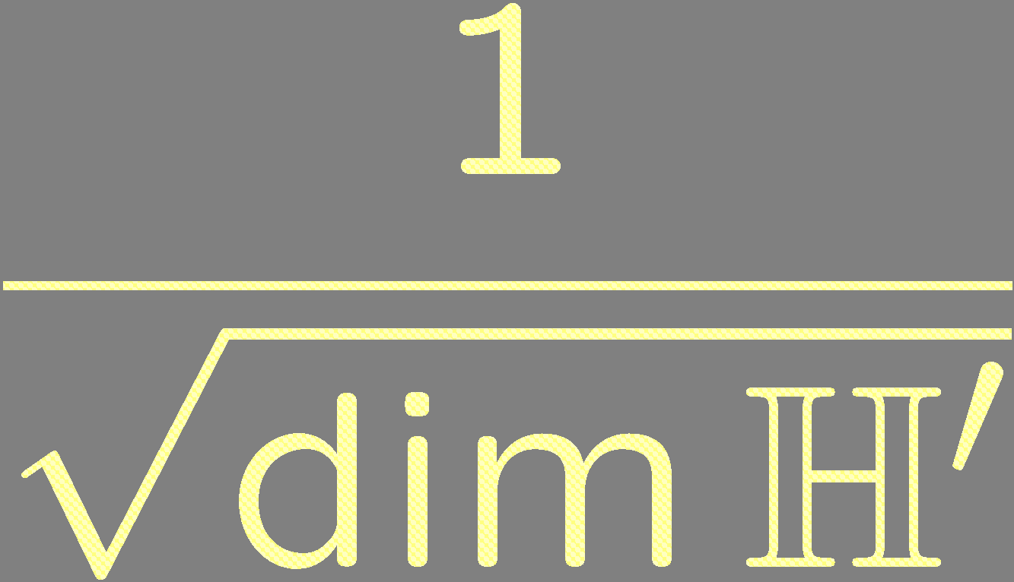
Random subspace boogie
|Y| ~ n/6.
dim(H_{jR}’) ~ 2n/3.
dim(H_{jP}’) ~ 2n/(3α).
Choose |φi at random from H’.
Essentially Gaussian
Actually:
P
Let f(φ) = k E(φ) - ρ₀ k₁. E_{φ} f(φ) · 1/√α
??
f(φ)
Why?|φi ~ ∑_{k=1}^{K} g_{k} |e_{k}i, where K = dim H’ and
g_{k} are independent and Gaussian with variance 1/K.

Slide 17
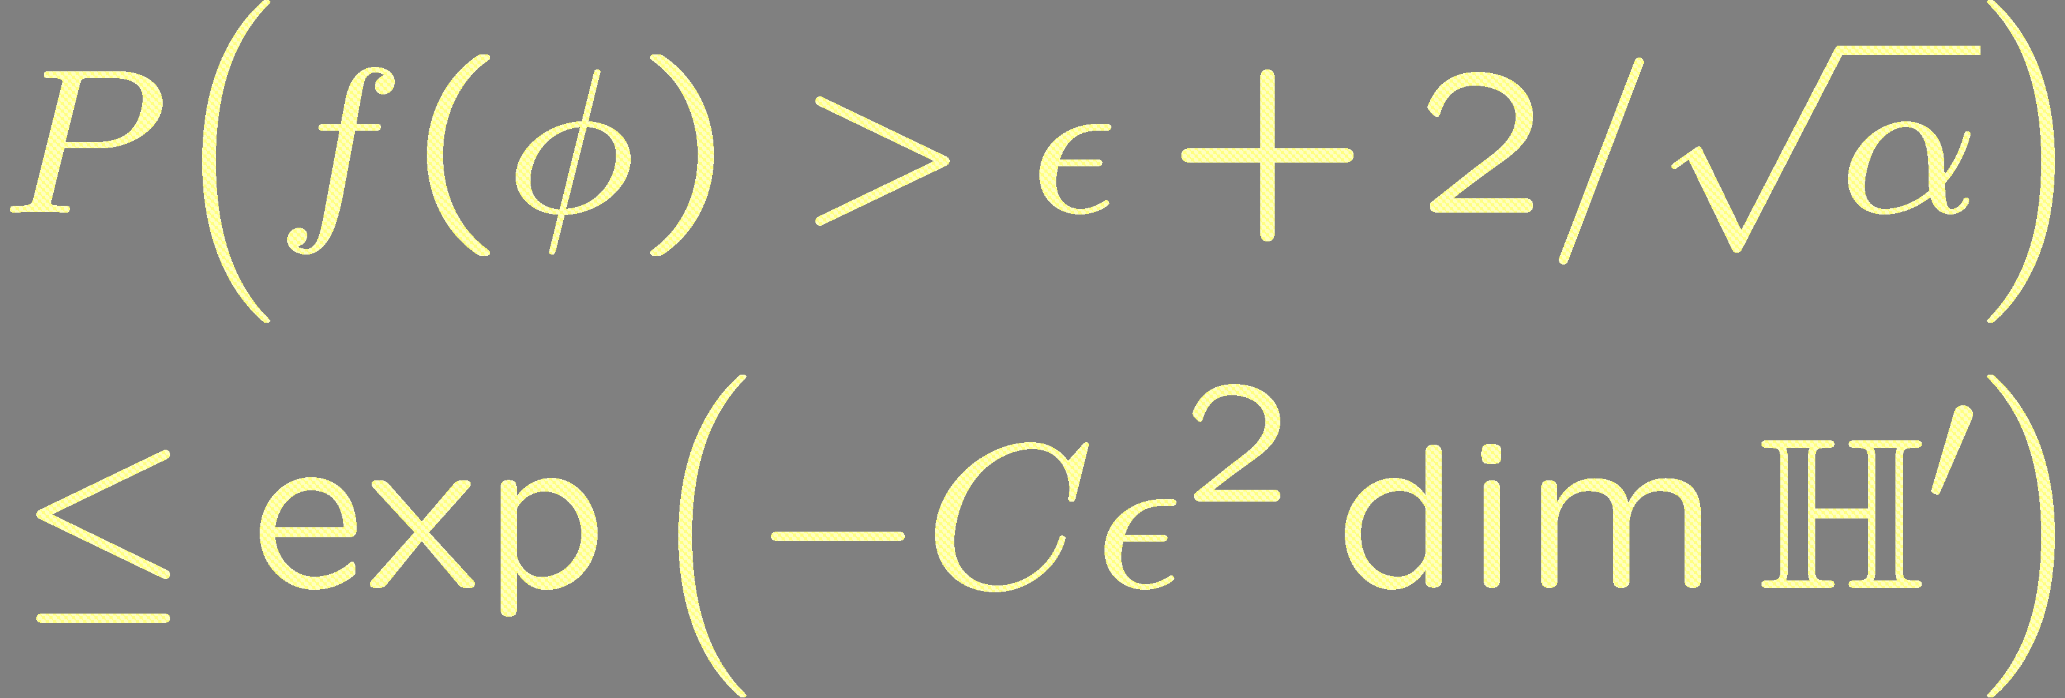

Random subspace boogie
H_{L}=US₀ ½ H’
Choose a fine net N of states on the
on unit sphere of fixed subspace S₀.
P( Not all states in UN have small f(φ)
· |N| P( One state doesn’t )
True for sufficiently fine N implies
true for all states in S.
THEOREM: There exists a subspace H_{L} of H’ with f(φ) · δ
for all |φi 2 H_{L} and such that log dim H_{L} = 3 log n + O( log δ).
ROUGHLY: 3 log n private qubits can be embedded in a
message of n spin ½ particles using a secret reference frame.

Slide 18
A bit of self-criticism
Transmitting m private qubits requires about exp(m/3) spins!
Likewise, the bound on the leaked information isn’t very good. Can go to zero exponentially with m, but not with the number of spins, n.

Slide 19
Conclusions
Showed that the private classical and quantum capacities of a secret SU(2) reference frame are equal
What about other types of shared reference frames?
  SU(d): similar argument if d ¸ 2
  S_{n}: what about reference orderings?
What about reference frames with finite precision?

