Slide 1


The Operational Meaning of Min- and Max-Entropy
http://arxiv.org/abs/0807.1338
Christian Schaffner – CWI Amsterdam, NL
joint work with
Robert König – Caltech, USA
Renato Renner – ETH Zürich, Switzerland
TexPoint fonts used in EMF.
Read the TexPoint manual before you delete this box.: AAAAAAAAAAAAAAAAA

Slide 2
Agenda
von Neumann Entropy
Min- and Max-Entropies
Operational Meaning
Conclusion

Slide 3
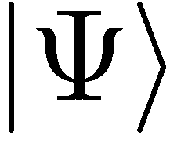
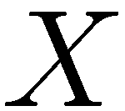
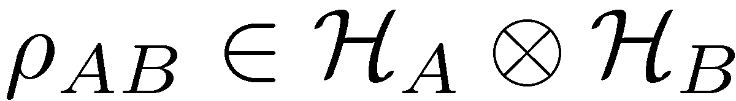
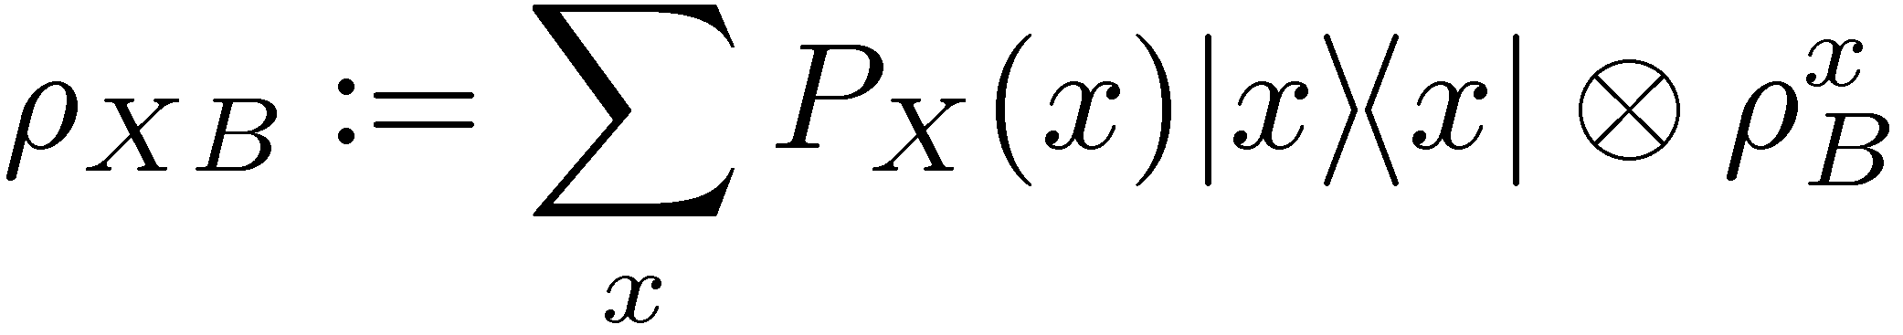
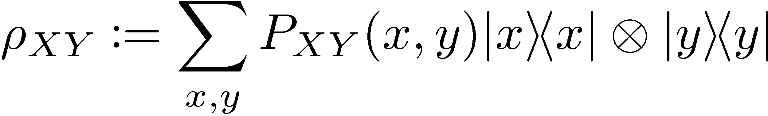
Notation
quantum setting:
finite-dimensional Hilbert spaces
classical-quantum setting:
classical setting:

Slide 4
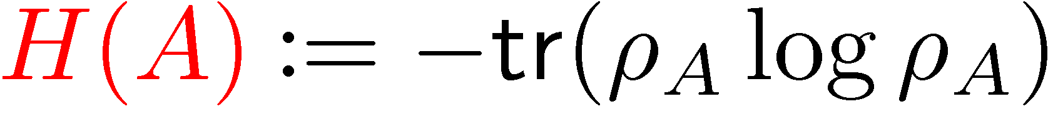
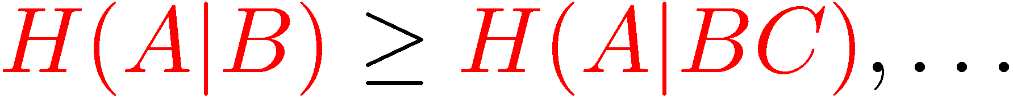
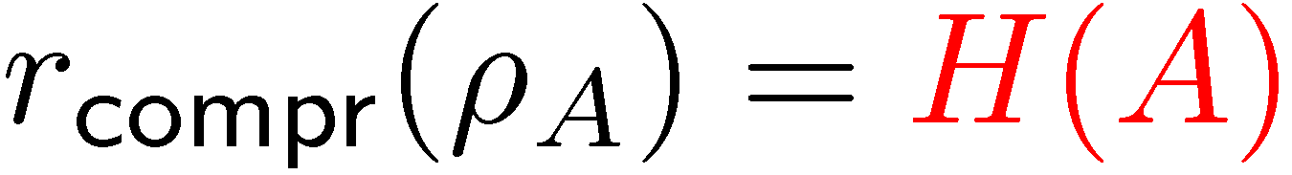
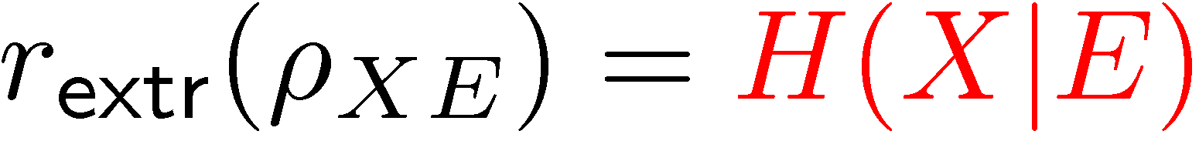
von Neumann Entropy
✓
simple definition
“handy” calculus
operational:
useful in many asymptotic iid settings:
data compression rate
channel capacities
randomness extraction rate
secret-key rate
….
one-shot setting?
✓
✓
✗

Slide 5
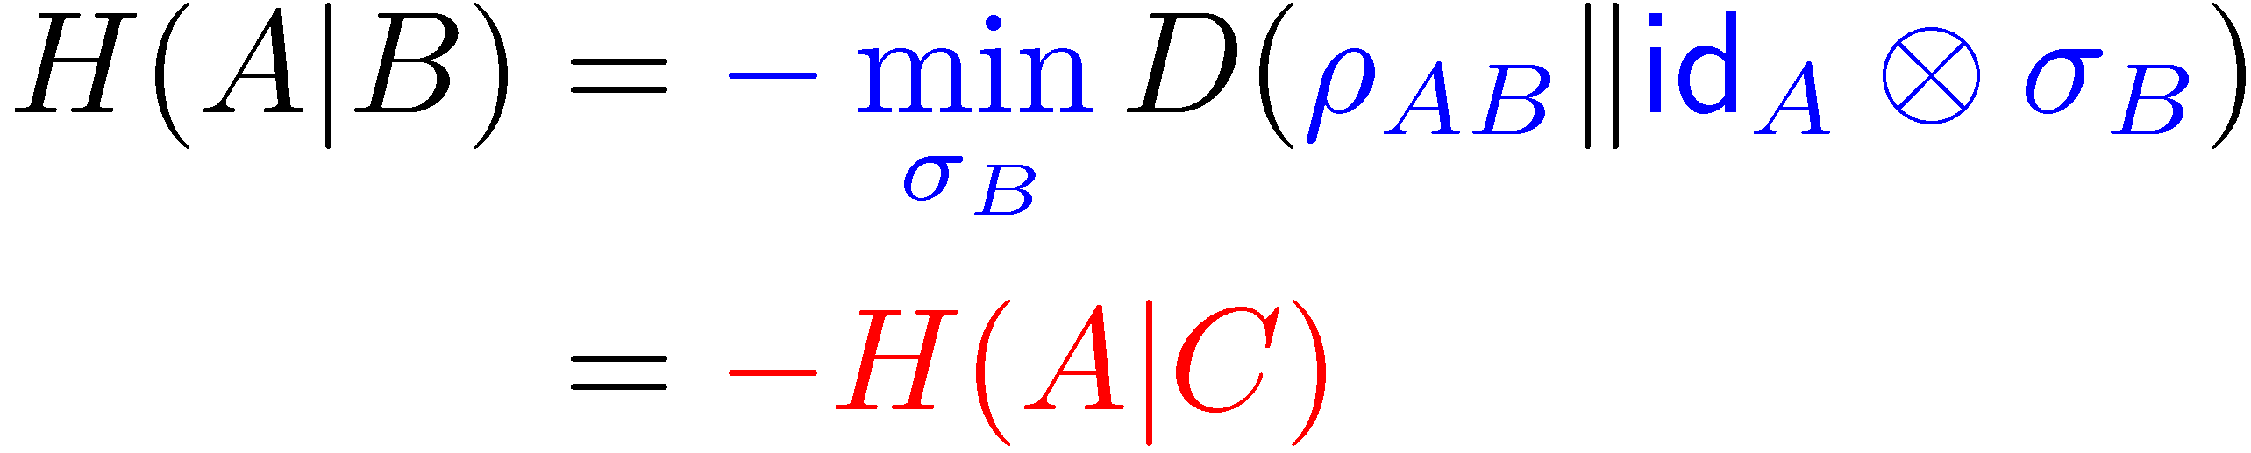
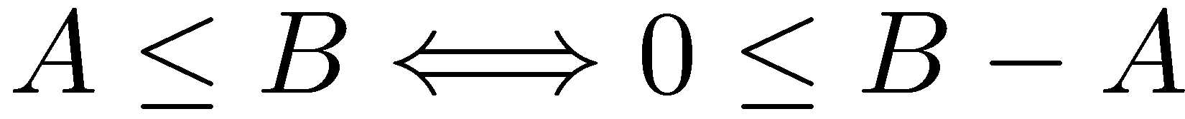

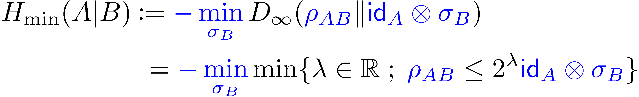
Conditional Min- and Max-Entropy
[Renner 05]
conditional von Neumann entropy:
conditional min-entropy:
conditional max-entropy:
Goal of this talk:
Understanding these quantities!
operator inequality:
for pure
for pure

Slide 6
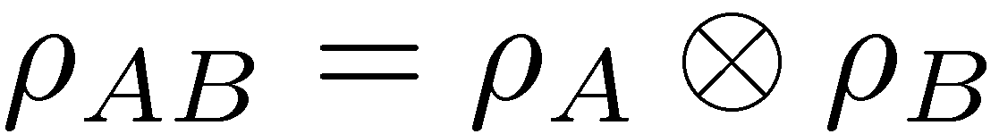
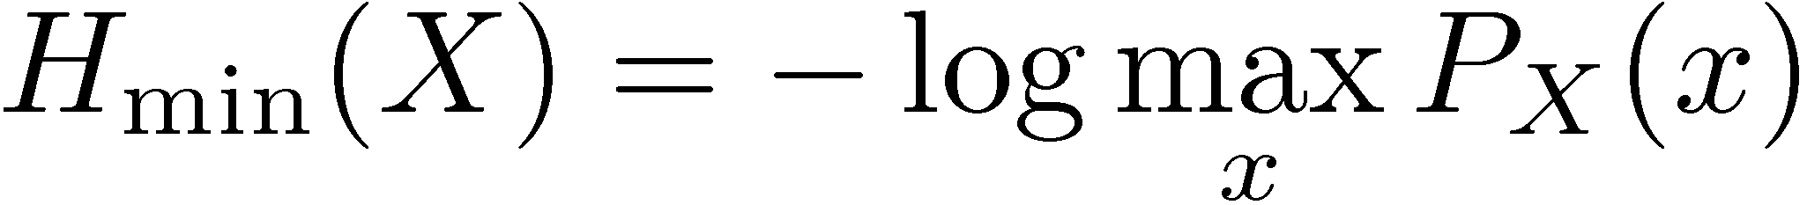
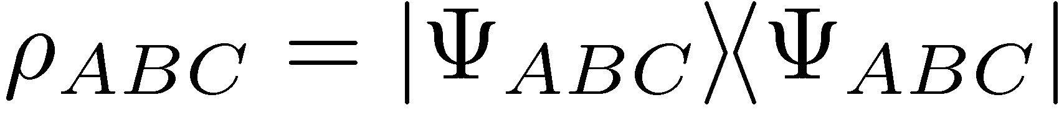
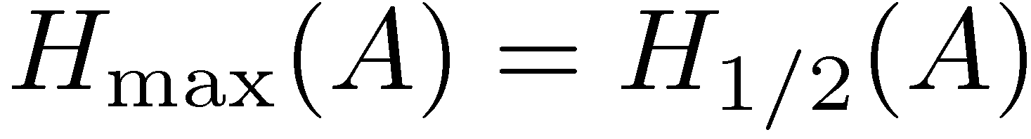
Warm-Up Calculations
for a product state
classically:
for product state:
measure for the rank of ½_{A}

Slide 7
Smooth Min-/Max-Entropies
“smooth” variants can be defined
handy calculus (as for von Neumann entropy)
operational interpretation in many one-shot scenarios:
Data Compression
Privacy Amplification (with applications in cryptography)
Decoupling
State Merging
…

Slide 8
Agenda
von Neumann Entropy
Min- and Max-Entropies
Operational Meaning
Conclusion

Slide 9
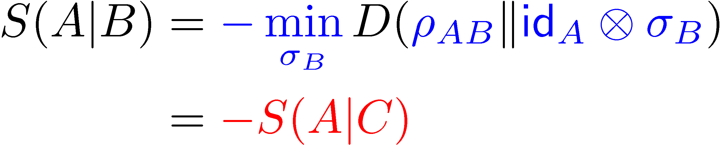
Conditional Min- and Max-Entropy
[Renner 05]
conditional van Neumann entropy:
conditional min-entropy:
conditional max-entropy:
Goal of this talk:
Understanding these quantities!
for pure
for pure

Slide 10
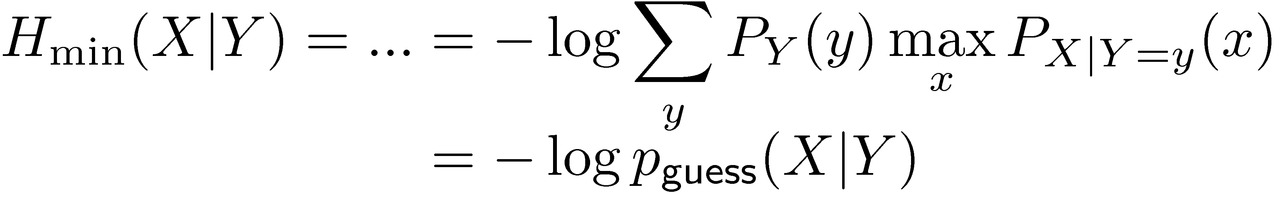
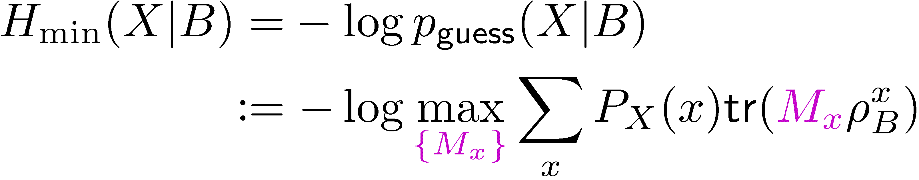
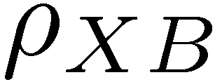
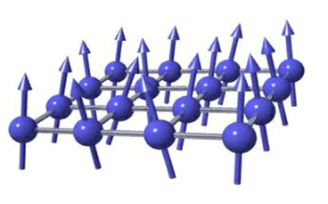
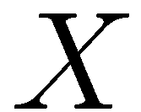
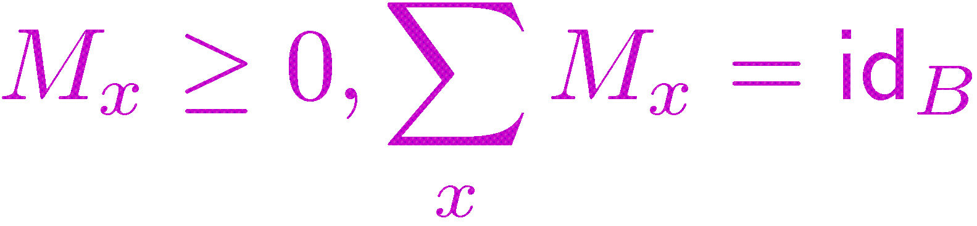
The Operational Meaning of Min-Entropy
for classical states: guessing probability
for cq-states: guessing probability
for a POVM {M_{x}}

Slide 11
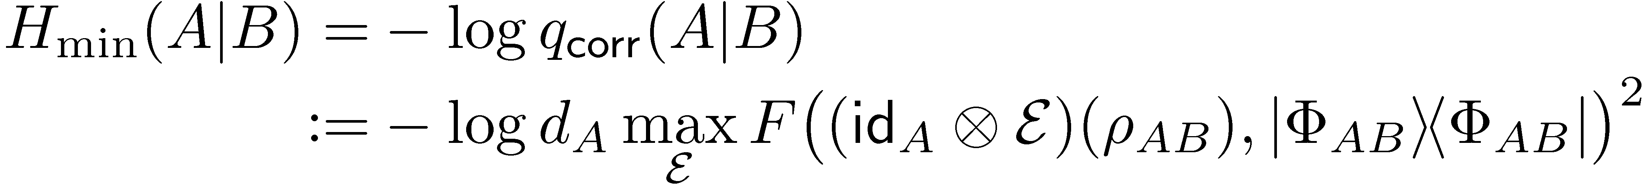
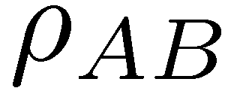
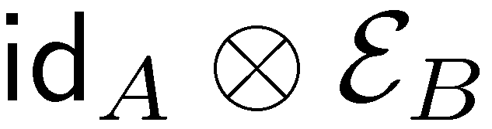
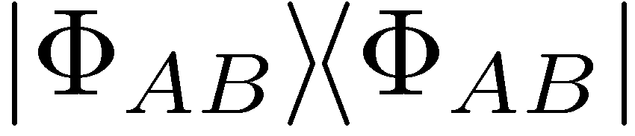
The Operational Meaning of Min-Entropy
for cq-states: guessing probability
for qq-states: achievable quantum correlation
F( , )²

Slide 12
Proof: Operational Interpr of Min-Entropy
for qq-states: achievable quantum correlation
F( , , )²
Proof uses:
duality of semi-definite programming
Choi-Jamiolkowski isomorphism

Slide 13
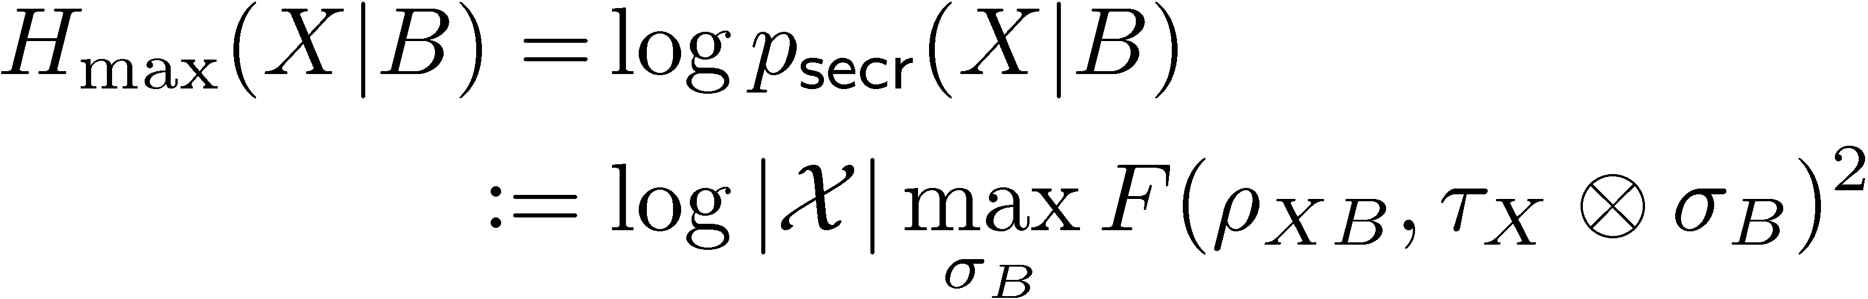
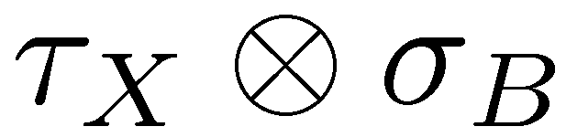
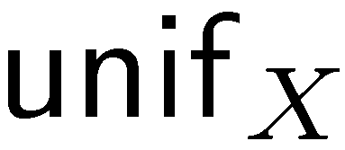
The Operational Meaning of Max-Entropy
for
for cq-states: security of a key
F( , )²

Slide 14

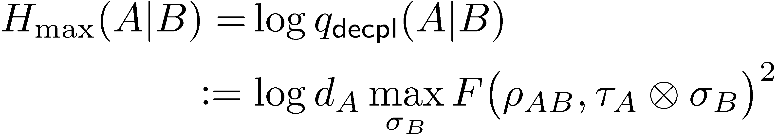
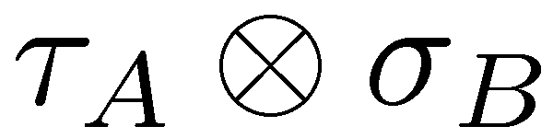
The Operational Meaning of Max-Entropy
for
for cq-states: security of a key
for qq-states: decoupling accuracy
F( , )²

Slide 15
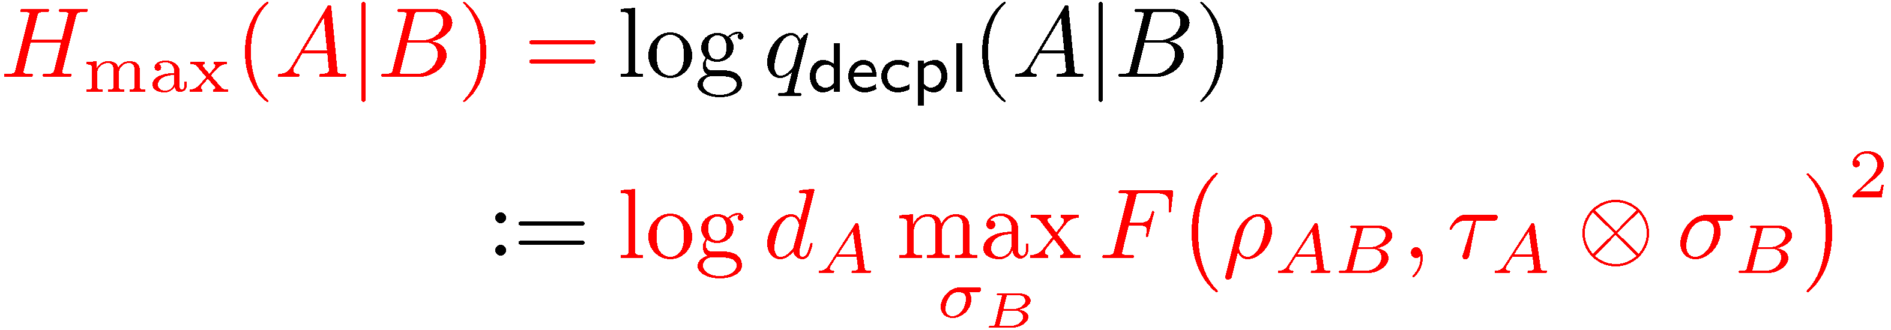
Proof: Operational Interpr of Max-Entropy
for
F( , )²
follows using
monotonicity of fidelity
unitary relation of purifications

Slide 16
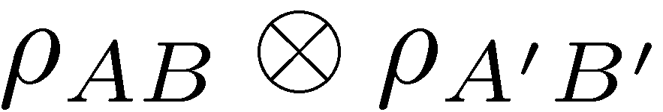
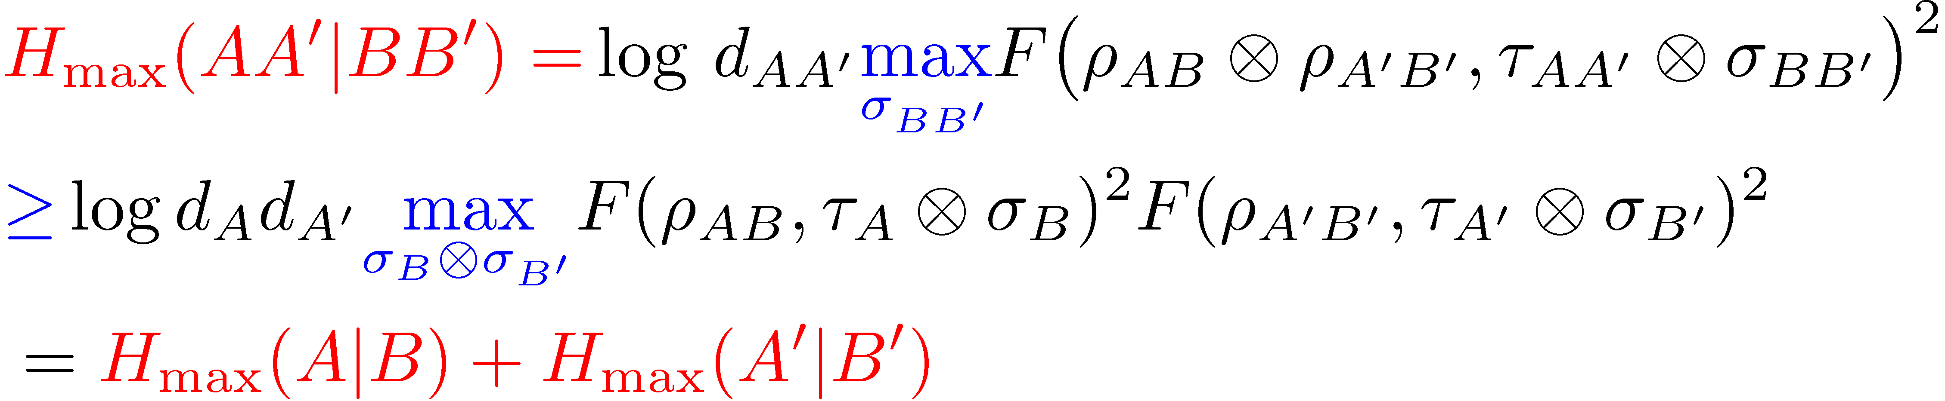
Implications of our Results
connections between operational quantities, e.g. randomness extraction
additivity of min-/max-entropies:
· follows from definition

Slide 17
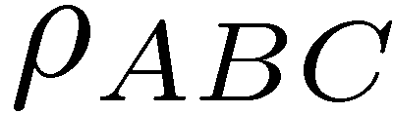
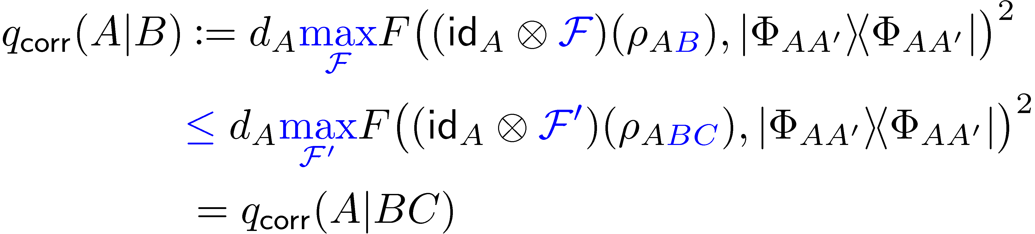
Implications of our Results
subadditivity of min-entropy:
implies subadditivity of von Neumann entropy
concrete applications in the noisy-quantum-storage model

Slide 18
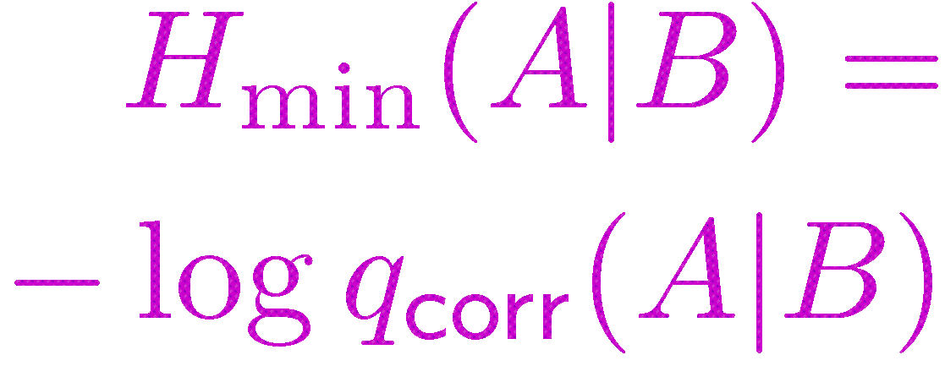
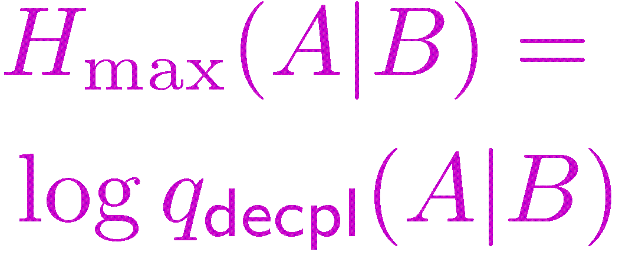
Summary

Slide 19
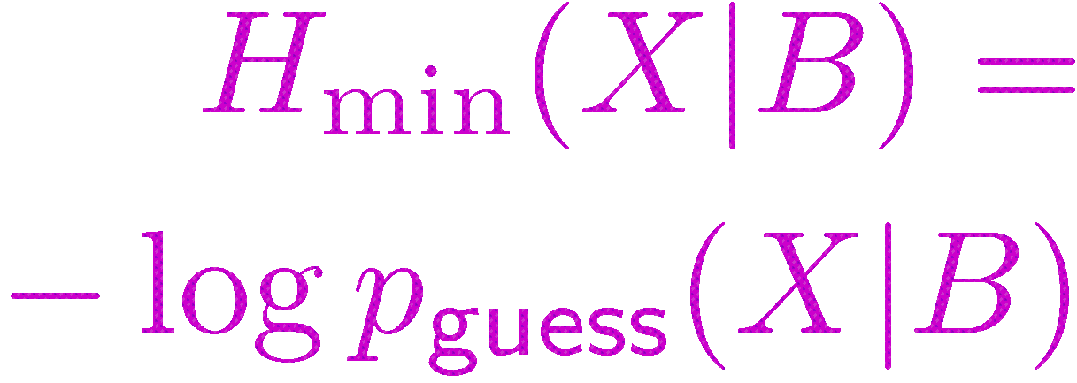
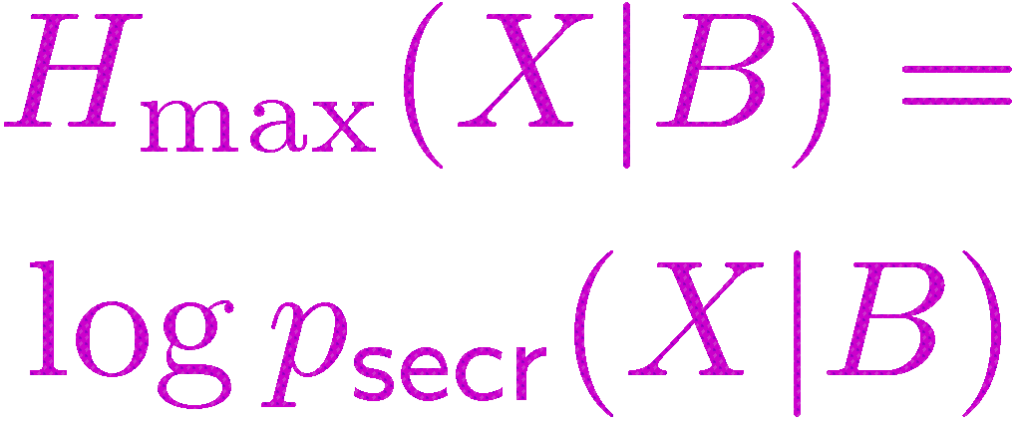
Summary

Slide 20
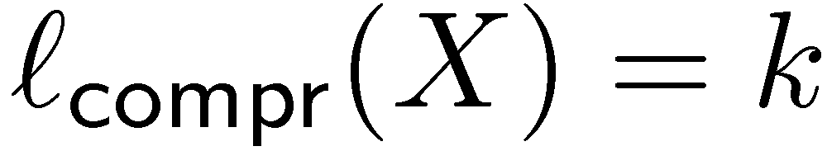
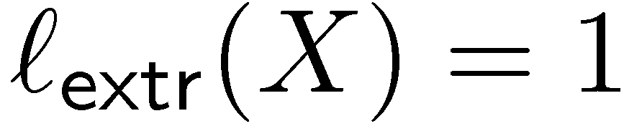
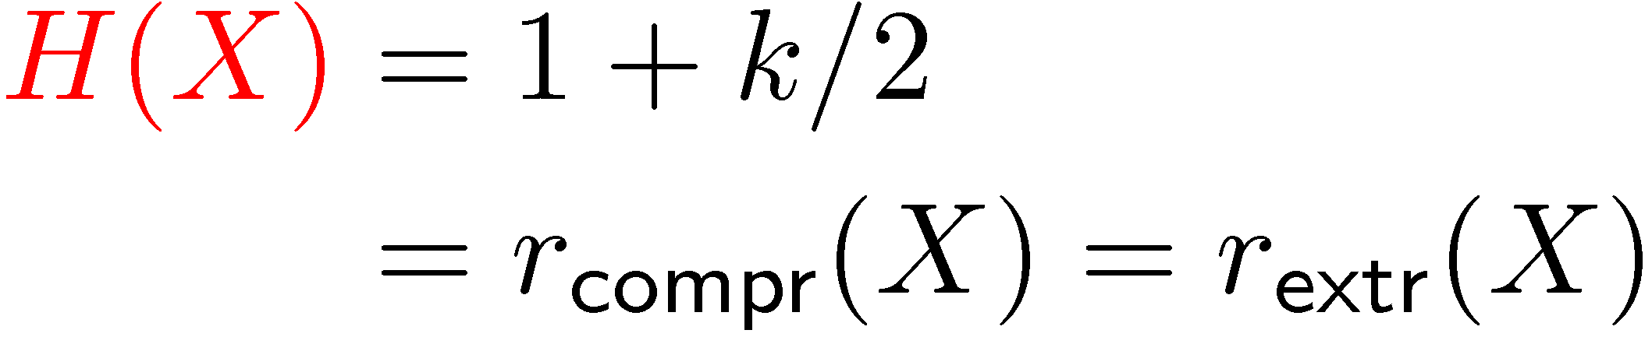
von Neumann Entropy
✓
simple definition
“handy” calculus
operational:
useful in many asymptotic iid settings
one-shot setting?
✓
✓
✗
data compression:
randomness extraction:
Shannon entropy:
…

Slide 21
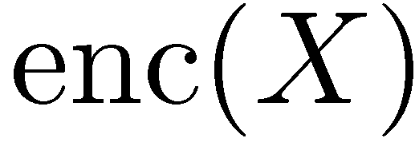
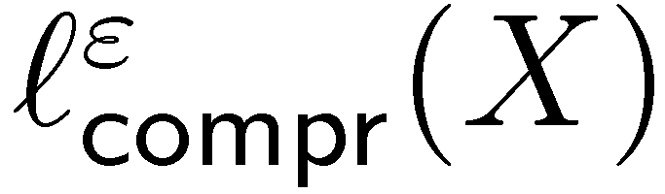
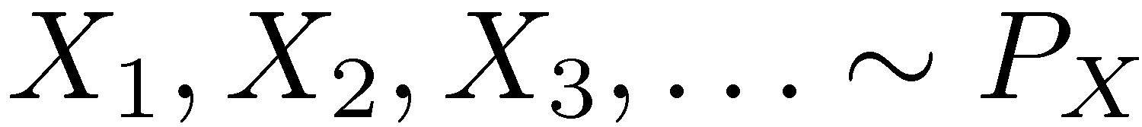
Information Theory
quantify the acquisition, transmission, storage of data
often analyzed in the asymptotic setting
common measure: Shannon / van Neumann entropy
Example: data compression
minimal encoding length:
[Shannon]: for iid

Slide 22
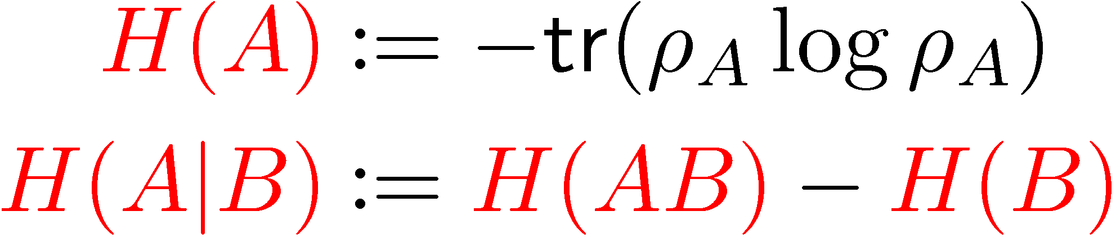
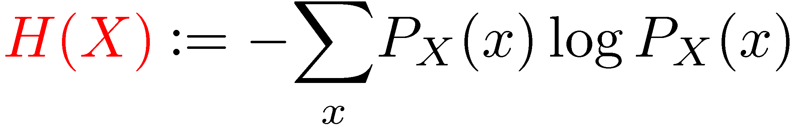
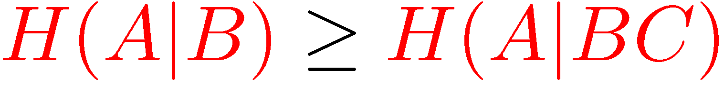
von Neumann Entropy
simple definition: for state
“handy” calculus:
chain rule:
strong subadditivity:
…

Slide 23



Operational Interpretation of van Neumann Entropy
data compression of a source:
randomness-extraction rate of a cq-state:
secret-key rate of a cqq-state:
…

Slide 24

Single-Shot Data Compression
minimal encoding length:
[Shannon]: for iid
*
[Renner,Wolf 04]:

Slide 25


Proof: using Duality of SDPs
primal semi-definite program (SDP)
for cq-states: guessing probability

Slide 26









Proof II: Choi-Jamiolkowski isomorphism
bijective
bijective
quantum operations

Slide 27




Proof III: Putting It Together
bijective
CPTP maps

Slide 28



Warm-Up Calculations
for a pure state
fine, but are these quantities useful ???

Slide 29
Open questions
operational meaning of smooth-min entropy
calculus for fidelity-based smooth min-entropy

Slide 30



Example: Channel Capacity
maximum number of transmittable bits:
[Shannon] (noisy-channel coding):

Slide 31

Single-Shot Channel Capacity
maximum number of transmittable bits:
[Shannon] (noisy-channel coding):
[Renner,Wolf,Wullschleger 06]:
with

Slide 32





Classical Min-Entropy without Conditioning

…
…
suggests “smoothing”:

Slide 33
Smooth Min- and Max-Entropy
[Renner 05]
where ±( , ) is the trace distance or (squared) fidelity
for a purification

Slide 34

Smooth-Min-Entropy Calculus
von Neumann entropy as special case:
strong subadditivity:
additivity:
chain rules:


Slide 35




Privacy Amplification
maximum number of extractable bits such that
[Renner, König 07]
with

Slide 36



Decoupling
maximum size of A’ such that
completely mixed state on A’
[Renner, Winter, Berta 07]
with

Slide 37



State Merging
minimal number of ebits required to transmit ½_{A} to B with LOCC
LOCC
[Renner, Winter, Berta 07]
maximal number of ebits generated by transmitting ½_{A} to B with LOCC
with
[Horodecki, Oppenheim, Winter 05]

