Slide 1
The computational complexity of entanglement detection
Mark M. Wilde
Louisiana State University
Based on 1211.6120 and 1308.5788
With Gus Gutoski, Patrick Hayden, and Kevin Milner

Slide 2
How hard is entanglement detection?
Given a matrix describing a bipartite state, is the state separable or entangled?
NP-hard for d x d, promise gap 1/poly(d) [Gurvits ’04 + Gharibian ‘10]
Quasipolynomial time for constant gap [Brandao et al. ’10]
Probably not the right question for large systems.
Given a description of a physical process for preparing a quantum state (i.e. quantum circuit), is the state separable or entangled?
Variants:
Pure versus mixed
State versus channel
Product versus separable
Choice of distance measure (equivalently, nature of promise)

Slide 3
Entanglement detection: The platonic ideal
NO
α
α
YES
β

Slide 4
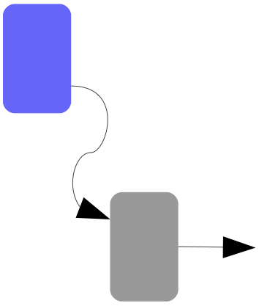
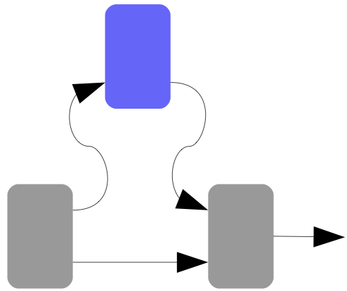
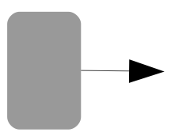
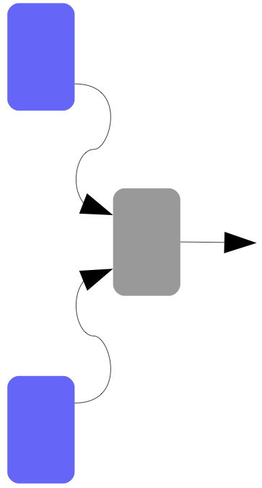
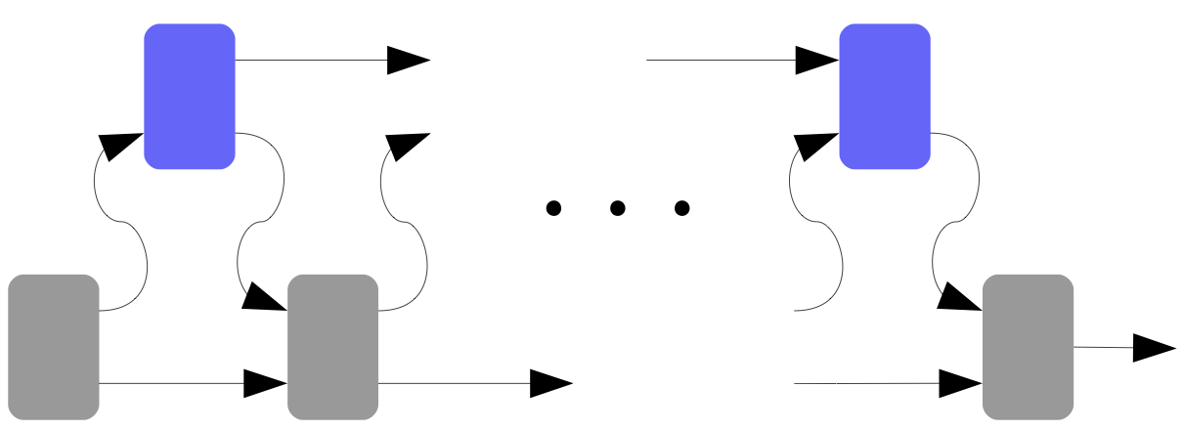
Some complexity classes…
P / BPP / BQP
P / BPP / BQP = QIP(0)
NP / MA / QMA
NP / MA / QMA = QIP(1)
AM / QIP(2)
Cryptographic variant: Zero-knowledge
Verifier, in YES instances, can “simulate” prover
ZK / SZK / QSZK = QSZK(2)
QMA(2)
QIP = QIP(3)
QIP = QIP(3) = PSPACE [Jain et al. ‘09]

Slide 5
Results: States
Pure state circuit
Product output?
Trace distance
BQP-complete
Mixed state circuit
Product output?
Trace distance
QSZK-complete
Mixed state circuit
Separable output?
1-LOCC distance (1/poly)
NP-hard
QSZK-hard
In QIP(2)

Slide 6
Results: Channels
Isometric channel
Separable output?
1-LOCC distance
QMA-complete
Isometric channel
Separable output?
Trace distance
QMA(2)-complete
Noisy channel
Separable output?
1-LOCC distance
QIP-complete

Slide 7
The computational universe through the entanglement lens

Slide 8
Results: States
Pure state circuit
Product output?
Trace distance
BQP-complete
Mixed state circuit
Product output?
Trace distance
QSZK-complete
Mixed state circuit
Separable output?
1-LOCC distance
NP-hard
QSZK-hard
In QIP(2)

Slide 9
Detecting mixed product states

Slide 10
Detecting mixed product states

Slide 11
Detecting mixed product states

Slide 12
Completeness: YES instances

Slide 13
Soundness: NO instances

Slide 14
Zero-knowledge (YES instances): Verifier can simulate prover output

Slide 15
QPROD-STATE is QSZK-hard

Slide 16
Reduction from co-QSD to QPROD-STATE

Slide 17
Results: States
Pure state circuit
Product output?
Trace distance
BQP-complete
Mixed state circuit
Product output?
Trace distance
QSZK-complete
Mixed state circuit
Separable output?
1-LOCC distance
NP-hard
QSZK-hard
In QIP(2)

Slide 18
Detecting mixed separable states
ρ_{AB} close to separable iff it has a suitable k-extension for sufficiently large k. [BCY ‘10]
Send R to the prover, who will try to produce the k-extension.
Use phase estimation to verify that the resulting state is a k-extension.

Slide 19
Summary
Entanglement detection provides a unifying paradigm for parametrizing quantum complexity classes
Tunable knobs:
State versus channel
Pure versus mixed
Trace norm versus 1-LOCC norm
Product versus separable

