Slide 1
Quantum 3-SAT is QMA₁-complete
David Gosset (Institute for Quantum Computing, University of Waterloo)
Daniel Nagaj (University of Vienna)
Long version: arXiv: 1302.0290 Short version : Proceedings of FOCS 2013

Slide 2
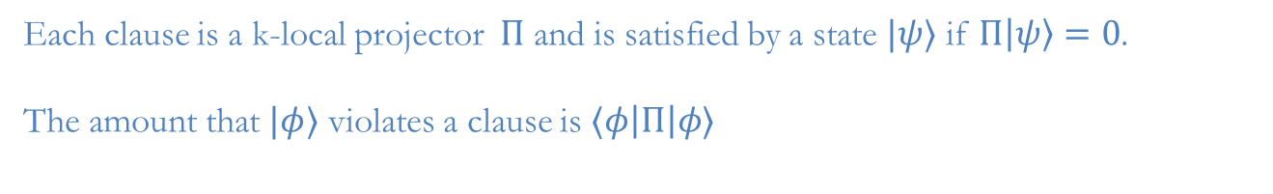
Quantum k-SAT (Bravyi 2006)
Each clause is a k-local projector $Π$ and is satisfied by a state $|ψ〉$ if $Π|ψ〉=0$. The amount that $|φ〉$ violates a clause is $〈φ\left|Π\right|φ〉$

Slide 3

Quantum k-SAT (Bravyi 2006)
Each clause is a k-local projector $Π$ and is satisfied by a state $|ψ〉$ if $Π|ψ〉=0$. The amount that $|φ〉$ violates a clause is $〈φ\left|Π\right|φ〉$
Quantum k-SAT
Given k-local projectors {$Π_{i}:i=1,…,r\}$. We are promised that either
(YES) There is a state $|ψ〉$ which satisfies $Π_{i}|ψ〉=0$ for each $i$
(NO) $〈φ\left|∑_{i}Π_{i}\right|φ〉≥1$ for all states $|φ〉$
and asked to decide which is the case.

Slide 4
Quantum k-SAT (Bravyi 2006)
Each clause is a k-local projector $Π$ and is satisfied by a state $|ψ〉$ if $Π|ψ〉=0$. The amount that $|φ〉$ violates a clause is $〈φ\left|Π\right|φ〉$
Quantum k-SAT
Given k-local projectors {$Π_{i}:i=1,…,r\}$. We are promised that either
(YES) There is a state $|ψ〉$ which satisfies $Π_{i}|ψ〉=0$ for each $i$
(NO) $〈φ\left|∑_{i}Π_{i}\right|φ〉≥1$ for all states $|φ〉$
and asked to decide which is the case.
Exactly satisfies each clause

Slide 5
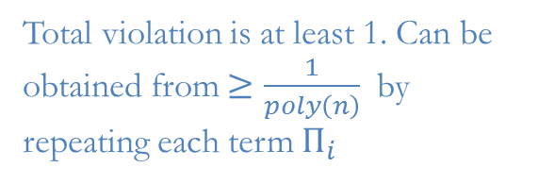
Quantum k-SAT (Bravyi 2006)
Each clause is a k-local projector $Π$ and is satisfied by a state $|ψ〉$ if $Π|ψ〉=0$. The amount that $|φ〉$ violates a clause is $〈φ\left|Π\right|φ〉$
Quantum k-SAT
Given k-local projectors {$Π_{i}:i=1,…,r\}$. We are promised that either
(YES) There is a state $|ψ〉$ which satisfies $Π_{i}|ψ〉=0$ for each $i$
(NO) $〈φ\left|∑_{i}Π_{i}\right|φ〉≥1$ for all states $|φ〉$
and asked to decide which is the case.
Exactly satisfies each clause
Total violation is at least 1. Can be obtained from $≥\frac{1}{poly\left(n\right)}$ by
repeating each term $Π_{i}$

Slide 6
Quantum k-SAT (Bravyi 2006)
Each clause is a k-local projector $Π$ and is satisfied by a state $|ψ〉$ if $Π|ψ〉=0$. The amount that $|φ〉$ violates a clause is $〈φ\left|Π\right|φ〉$
Quantum k-SAT
Given k-local projectors {$Π_{i}:i=1,…,r\}$. We are promised that either
(YES) There is a state $|ψ〉$ which satisfies $Π_{i}|ψ〉=0$ for each $i$
(NO) $〈φ\left|∑_{i}Π_{i}\right|φ〉≥1$ for all states $|φ〉$
and asked to decide which is the case.
Exactly satisfies each clause
Total violation is at least 1. Can be obtained from $≥\frac{1}{poly\left(n\right)}$ by
repeating each term $Π_{i}$
Classical k-SAT is the special case where all projectors are diagonal
Quantum k-SAT is a special case of k-local Hamiltonian where the Hamiltonian is frustration-free for yes instances

Slide 7
k
k-local Hamiltonian problem
Yes instances are frustration-free
Quantum k-SAT
All constraints are diagonal
Classical k-SAT

Slide 8

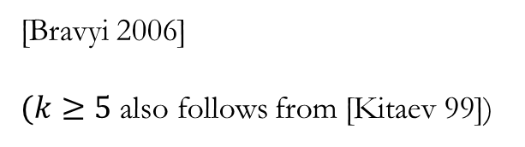




k
k-local Hamiltonian problem
Yes instances are frustration-free
Quantum k-SAT
All constraints are diagonal
Classical k-SAT
Complexity of quantum k-SAT
$$k=2$$
Contained in P
$$k=2$$
$$k=3$$
[Bravyi 2006]
$(k≥5$ also follows from [Kitaev 99])
$k≥$4
QMA₁-complete
$$k≥4$$

Slide 9
k
k-local Hamiltonian problem
Yes instances are frustration-free
Quantum k-SAT
All constraints are diagonal
Classical k-SAT
Complexity of quantum k-SAT
$$k=2$$
Contained in P
$$k=2$$
$$k=3$$
Contained in QMA₁
NP-hard
[Bravyi 2006]
$(k≥5$ also follows from [Kitaev 99])
$k≥$4
QMA₁-complete
$$k≥4$$

Slide 10
k
k-local Hamiltonian problem
Yes instances are frustration-free
Quantum k-SAT
All constraints are diagonal
Classical k-SAT
Complexity of quantum k-SAT
We prove quantum 3-SAT is QMA₁-hard (and therefore QMA₁-complete).
$$k=2$$
Contained in P
$$k=2$$
$$k=3$$
Contained in QMA₁
NP-hard
[Bravyi 2006]
$(k≥5$ also follows from [Kitaev 99])
$k≥$4
QMA₁-complete
$$k≥4$$

Slide 11

k
k-local Hamiltonian problem
Yes instances are frustration-free
Quantum k-SAT
All constraints are diagonal
Classical k-SAT
Complexity of quantum k-SAT
$$k=2$$
Contained in P
$$k=2$$
$$k≥3$$
QMA₁-complete
$$k≥4$$

Slide 12
Many authors have studied quantum SAT since Bravyi’s work
[Ji Wei Zeng 2011]
Characterization of the groundspace of yes instances of quantum 2-SAT
[Eldar Regev 2008]
Complexity of quantum 2-SAT with higher dimensional particles (qudits)
[Ambainis Kempe Sattath 2010] [Arad Sattath 2013]
[Schwarz Cubitt Verstraete 2013]
Quantum Lovász Local Lemma
[Sattath 2013]
“An almost sudden jump in quantum complexity”
[Laumann Läuchli Moessner Scardicchio Sondhi 2010] [Laumann Moessner Scardicchio Sondhi 2010] [Bravyi Moore Russell 2010] [Hsu Laumann Läuchli Moessner Sondhi 2013]
[Bardoscia Nagaj Scardicchio 2013]
Ensembles of random instances of quantum k-SAT

Slide 13
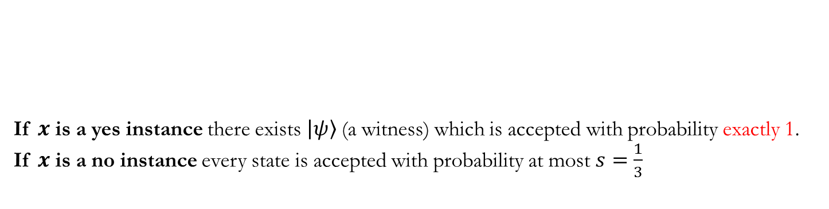


QMA₁
QMA₁ is a one-sided error version of QMA. This is the relevant class because quantum k-SAT is defined with one-sided error.
QMA₁ verification circuit
If $x$ is a yes instance there exists $|ψ〉$(a witness) which is accepted with probability exactly 1.
If $x$ is a no instance every state is accepted with probability at most $s=\frac{1}{3}$
$${|0〉}^{⊗n_{a}}$$
W_{m-1}W_{m-2}…W₀
$$|ψ〉$$
Because of the perfect completeness, the definition of QMA₁ is gate-set dependent.
It is not known whether or not QMA=QMA₁; see
[Aaronson 2009] [Jordan, Kobayashi, Nagaj, Nishimura 2012]
[Kobayashi, Le Gall, Nishimura 2013] [Pereszlenyi 2013]

Slide 14
Bravyi proved quantum k-SAT is contained in QMA₁
(verification circuit: choose one projector at random and measure it).

Slide 15
Bravyi proved quantum k-SAT is contained in QMA₁
(verification circuit: choose one projector at random and measure it). To prove QMA₁-hardness of quantum 3-SAT we use a circuit-to-Hamiltonian mapping, i.e., we reduce from quantum circuit satisfiability.

Slide 16

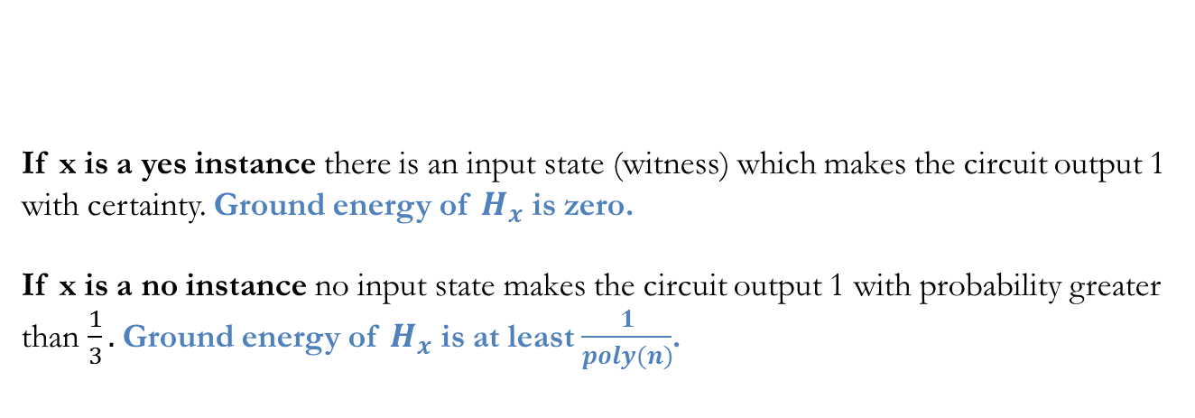

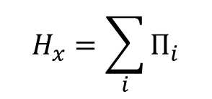

QMA₁-hardness via circuit-to-Hamiltonian mapping
QMA₁ Verification circuit for $x$
Quantum 3-SAT Hamiltonian
$${|0〉}^{⊗n_{a}}$$
W_{m-1}W_{m-2}…W₀
$$H_{x}=\sum_{i}{Π_{i}}$$
$$|ψ〉$$
If x is a yes instance there is an input state (witness) which makes the circuit output 1 with certainty. Ground energy of $H_{x}$ is zero.
If x is a no instance no input state makes the circuit output 1 with probability greater than $\frac{1}{3}.$Ground energy of $H_{x}$ is at least $\frac{1}{poly(n)}$.

Slide 17



Example part 1 [Kitaev 99]
QMA₁ verification circuit
(n qubits, m gates)
$${|0〉}^{⊗n_{a}}$$
W_{m-1}W_{m-2}…W₀
$$|ψ〉$$
Hilbert space
$$|z〉|t〉 z∈{\left\{0,1\right\}}^{n}, t∈\{0,1,2,…,m\}$$

Slide 18
Example part 1 [Kitaev 99]
QMA₁ verification circuit
(n qubits, m gates)
$${|0〉}^{⊗n_{a}}$$
W_{m-1}W_{m-2}…W₀
$$|ψ〉$$
Hilbert space
$$|z〉|t〉 z∈{\left\{0,1\right\}}^{n}, t∈\{0,1,2,…,m\}$$
Transition operators
$$H_{t,t+1}\left(W_{t}\right)=\frac{1}{2}\left(1⊗|t〉〈t|+1⊗|t+1〉〈t+1|−{W_{t}^{}}^{†}⊗|t〉〈t+1|−W_{t}⊗|t+1 〉〈t|\right)$$

Slide 19
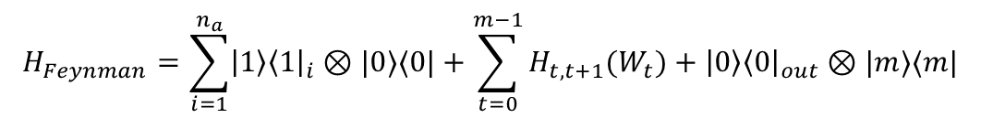
Example part 1 [Kitaev 99]
QMA₁ verification circuit
(n qubits, m gates)
$${|0〉}^{⊗n_{a}}$$
W_{m-1}W_{m-2}…W₀
$$|ψ〉$$
Hilbert space
$$|z〉|t〉 z∈{\left\{0,1\right\}}^{n}, t∈\{0,1,2,…,m\}$$
Transition operators
$$H_{t,t+1}\left(W_{t}\right)=\frac{1}{2}\left(1⊗|t〉〈t|+1⊗|t+1〉〈t+1|−{W_{t}^{}}^{†}⊗|t〉〈t+1|−W_{t}⊗|t+1 〉〈t|\right)$$
$$H_{Feynman}=\sum_{i=1}^{n_{a}}{|1〉{〈1|}_{i}⊗|0〉〈0|}+\sum_{t=0}^{m−1}{H_{t,t+1}(W_{t})}+|0〉{〈0|}_{out}⊗|m〉〈m|$$
Hamiltonian

Slide 20
Example part 1 [Kitaev 99]
QMA₁ verification circuit
(n qubits, m gates)
$${|0〉}^{⊗n_{a}}$$
W_{m-1}W_{m-2}…W₀
$$|ψ〉$$
Hilbert space
$$|z〉|t〉 z∈{\left\{0,1\right\}}^{n}, t∈\{0,1,2,…,m\}$$
Transition operators
$$H_{t,t+1}\left(W_{t}\right)=\frac{1}{2}\left(1⊗|t〉〈t|+1⊗|t+1〉〈t+1|−{W_{t}^{}}^{†}⊗|t〉〈t+1|−W_{t}⊗|t+1 〉〈t|\right)$$
$$H_{Feynman}=\sum_{i=1}^{n_{a}}{|1〉{〈1|}_{i}⊗|0〉〈0|}+\sum_{t=0}^{m−1}{H_{t,t+1}(W_{t})}+|0〉{〈0|}_{out}⊗|m〉〈m|$$
Hamiltonian
Nullspace consists of “history states”
$$\frac{1}{\sqrt{m+1}}\left(|φ〉|0〉+W_{0}|φ〉|1〉+W_{1}W_{0}|φ〉|2〉+…+W_{m−1}W_{m−2}…W_{0}|φ〉|m〉\right)$$

Slide 21

Example part 1 [Kitaev 99]
QMA₁ verification circuit
(n qubits, m gates)
$${|0〉}^{⊗n_{a}}$$
W_{m-1}W_{m-2}…W₀
$$|ψ〉$$
Hilbert space
$$|z〉|t〉 z∈{\left\{0,1\right\}}^{n}, t∈\{0,1,2,…,m\}$$
Transition operators
$$H_{t,t+1}\left(W_{t}\right)=\frac{1}{2}\left(1⊗|t〉〈t|+1⊗|t+1〉〈t+1|−{W_{t}^{}}^{†}⊗|t〉〈t+1|−W_{t}⊗|t+1 〉〈t|\right)$$
$$H_{Feynman}=\sum_{i=1}^{n_{a}}{|1〉{〈1|}_{i}⊗|0〉〈0|}+\sum_{t=0}^{m−1}{H_{t,t+1}(W_{t})}+|0〉{〈0|}_{out}⊗|m〉〈m|$$
Hamiltonian
Nullspace consists of “history states”
$$\frac{1}{\sqrt{m+1}}\left(|φ〉|0〉+W_{0}|φ〉|1〉+W_{1}W_{0}|φ〉|2〉+…+W_{m−1}W_{m−2}…W_{0}|φ〉|m〉\right)$$
A witness accepted
with probability 1
To have zero energy for the other two terms, we must have
$$|φ〉={|0〉}^{n_{a}}|ψ〉$$

Slide 22
Example part 1 [Kitaev 99]
QMA₁ verification circuit
(n qubits, m gates)
$${|0〉}^{⊗n_{a}}$$
W_{m-1}W_{m-2}…W₀
$$|ψ〉$$
Hilbert space
$$|z〉|t〉 z∈{\left\{0,1\right\}}^{n}, t∈\{0,1,2,…,m\}$$
Transition operators
$$H_{t,t+1}\left(W_{t}\right)=\frac{1}{2}\left(1⊗|t〉〈t|+1⊗|t+1〉〈t+1|−{W_{t}^{}}^{†}⊗|t〉〈t+1|−W_{t}⊗|t+1 〉〈t|\right)$$
$$H_{Feynman}=\sum_{i=1}^{n_{a}}{|1〉{〈1|}_{i}⊗|0〉〈0|}+\sum_{t=0}^{m−1}{H_{t,t+1}(W_{t})}+|0〉{〈0|}_{out}⊗|m〉〈m|$$
Hamiltonian
$H_{Feynman}$ has a zero energy ground state if and only if the QMA₁ verification circuit accepts a witness with probability 1. However, it’s not local.
Kitaev used a clock construction to convert it to a local Hamiltonian…

Slide 23

Example part 2: Clock construction [Kitaev 99]
Hilbert space
$$\text{H}\text{comp}⊗\text{H}\text{clock}$$
n qubits
m qubits

Slide 24

Example part 2: Clock construction [Kitaev 99]
Hilbert space
$$\text{H}\text{comp}⊗\text{H}\text{clock}$$
n qubits
m qubits
A sum of 5-local projectors
$$H_{Kitaev}=1⊗\sum_{i=1}^{m−1}{|01〉〈01|_{i,i+1}}+H_{sim}$$
Hamiltonian

Slide 25



Example part 2: Clock construction [Kitaev 99]
Hilbert space
$$\text{H}\text{comp}⊗\text{H}\text{clock}$$
n qubits
m qubits
A sum of 5-local projectors
$$H_{Kitaev}=1⊗\sum_{i=1}^{m−1}{|01〉〈01|_{i,i+1}}+H_{sim}$$
Hamiltonian
Nullspace $\text{S}\text{clock}$ spanned by
$${|t〉}_{u}=|111…1000…0〉 , t=0,…,m$$
$$t$$
$$m−t$$

Slide 26
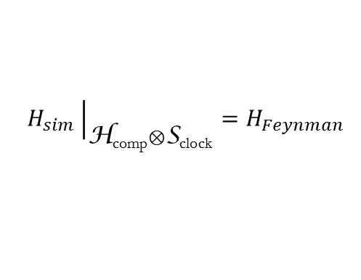

Example part 2: Clock construction [Kitaev 99]
Hilbert space
$$\text{H}\text{comp}⊗\text{H}\text{clock}$$
n qubits
m qubits
A sum of 5-local projectors
$$H_{Kitaev}=1⊗\sum_{i=1}^{m−1}{|01〉〈01|_{i,i+1}}+H_{sim}$$
Hamiltonian
Nullspace $\text{S}\text{clock}$ spanned by
$${|t〉}_{u}=|111…1000…0〉 , t=0,…,m$$
$$t$$
$$m−t$$
$H_{sim}$ is designed so that
$$H_{sim}{\left.​\right|}_{\text{H}\text{comp}⊗\text{S}\text{clock}}=H_{Feynman}$$
This implies $H_{Kitaev}$ has the same nullspace as $H_{Feynman}$

Slide 27

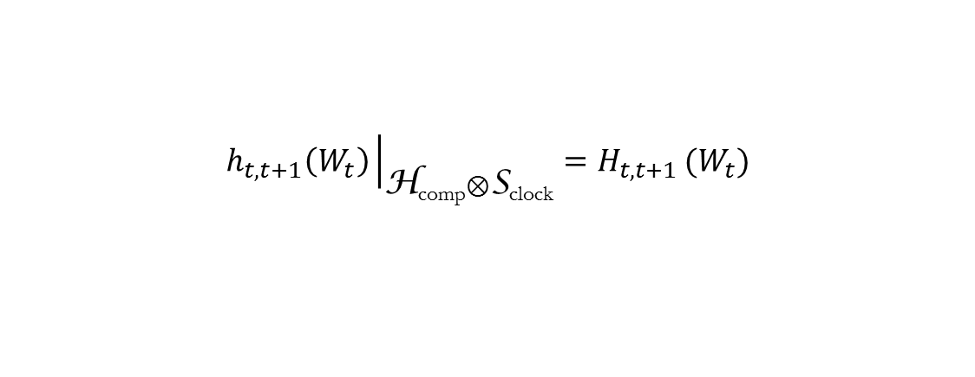

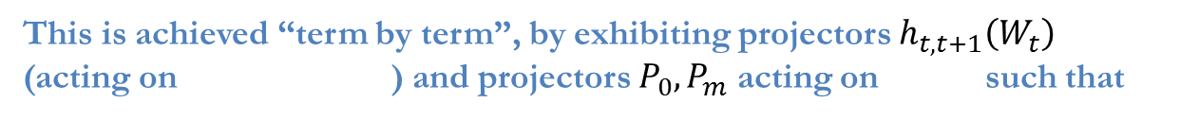


Example part 2: Clock construction [Kitaev 99]
This is achieved “term by term”, by exhibiting projectors $h_{t,t+1}\left(W_{t}\right)$
(acting on ) and projectors $P_{0},P_{m}$ acting on such that
$\text{H}\text{comp}⊗\text{H}\text{clock}$
$\text{H}\text{clock}$
$$h_{t,t+1}\left(W_{t}\right){\left.​\right|}_{\text{H}\text{comp}⊗\text{S}\text{clock}}=H_{t,t+1 }(W_{t})$$
$$P_{m}{\left.​\right|}_{\text{S}\text{clock}}=|m〉〈m|$$
$$P_{0}{\left.​\right|}_{\text{S}\text{clock}}=|0〉〈0|$$

Slide 28
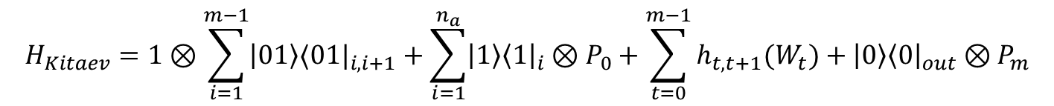
Example part 2: Clock construction [Kitaev 99]
This is achieved “term by term”, by exhibiting projectors $h_{t,t+1}\left(W_{t}\right)$
(acting on ) and projectors $P_{0},P_{m}$ acting on such that
$\text{H}\text{comp}⊗\text{H}\text{clock}$
$\text{H}\text{clock}$
$$h_{t,t+1}\left(W_{t}\right){\left.​\right|}_{\text{H}\text{comp}⊗\text{S}\text{clock}}=H_{t,t+1 }(W_{t})$$
$$P_{m}{\left.​\right|}_{\text{S}\text{clock}}=|m〉〈m|$$
$$P_{0}{\left.​\right|}_{\text{S}\text{clock}}=|0〉〈0|$$
$$H_{Kitaev}=1⊗\sum_{i=1}^{m−1}{|01〉〈01|_{i,i+1}}+\sum_{i=1}^{n_{a}}{|1〉{〈1|}_{i}⊗P_{0}}+\sum_{t=0}^{m−1}{h_{t,t+1}(W_{t})}+|0〉{〈0|}_{out}⊗P_{m}$$

Slide 29

Example part 2: Clock construction [Kitaev 99]
This is achieved “term by term”, by exhibiting projectors $h_{t,t+1}\left(W_{t}\right)$
(acting on ) and projectors $P_{0},P_{m}$ acting on such that
$\text{H}\text{comp}⊗\text{H}\text{clock}$
$\text{H}\text{clock}$
$$h_{t,t+1}\left(W_{t}\right){\left.​\right|}_{\text{H}\text{comp}⊗\text{S}\text{clock}}=H_{t,t+1 }(W_{t})$$
A $\left(j+3\right)$-local projector if $W_{t}$ is j-local
$$P_{m}{\left.​\right|}_{\text{S}\text{clock}}=|m〉〈m|$$
1-local projectors
$$P_{0}{\left.​\right|}_{\text{S}\text{clock}}=|0〉〈0|$$
$$H_{Kitaev}=1⊗\sum_{i=1}^{m−1}{|01〉〈01|_{i,i+1}}+\sum_{i=1}^{n_{a}}{|1〉{〈1|}_{i}⊗P_{0}}+\sum_{t=0}^{m−1}{h_{t,t+1}(W_{t})}+|0〉{〈0|}_{out}⊗P_{m}$$

Slide 30
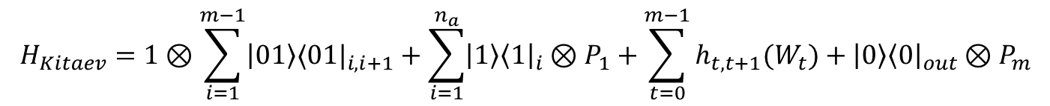
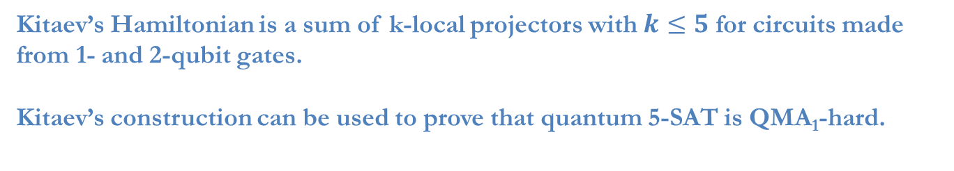
Example part 2: Clock construction [Kitaev 99]
This is achieved “term by term”, by exhibiting projectors $h_{t,t+1}\left(W_{t}\right)$
(acting on ) and projectors $P_{0},P_{m}$ acting on such that
$\text{H}\text{comp}⊗\text{H}\text{clock}$
$\text{H}\text{clock}$
$$h_{t,t+1}\left(W_{t}\right){\left.​\right|}_{\text{H}\text{comp}⊗\text{S}\text{clock}}=H_{t,t+1 }(W_{t})$$
A $\left(j+3\right)$-local projector if $W_{t}$ is j-local
$$P_{m}{\left.​\right|}_{\text{S}\text{clock}}=|m〉〈m|$$
1-local projectors
$$P_{0}{\left.​\right|}_{\text{S}\text{clock}}=|0〉〈0|$$
$$H_{Kitaev}=1⊗\sum_{i=1}^{m−1}{|01〉〈01|_{i,i+1}}+\sum_{i=1}^{n_{a}}{|1〉{〈1|}_{i}⊗P_{1}}+\sum_{t=0}^{m−1}{h_{t,t+1}(W_{t})}+|0〉{〈0|}_{out}⊗P_{m}$$
Kitaev’s Hamiltonian is a sum of k-local projectors with $k≤5$ for circuits made from 1- and 2-qubit gates. Kitaev’s construction can be used to prove that quantum 5-SAT is QMA₁-hard.

Slide 31
The first ingredient in our QMA₁-hardness proof is a new clock construction (with different locality from Kitaev’s)…

Slide 32



Properties of the new clock construction
7N-3 qubits
Clock
Hamiltonian
$$H_{clock}^{N}$$
Sum of 3-local projectors Hamiltonian acting on
$$\text{H}\text{c}\text{lock}$$
Nullspace
$\text{S}\text{clock}\text{= }\text{span}\left\{ |C_{t}〉 : t=1,…,N\right\}$.

Slide 33


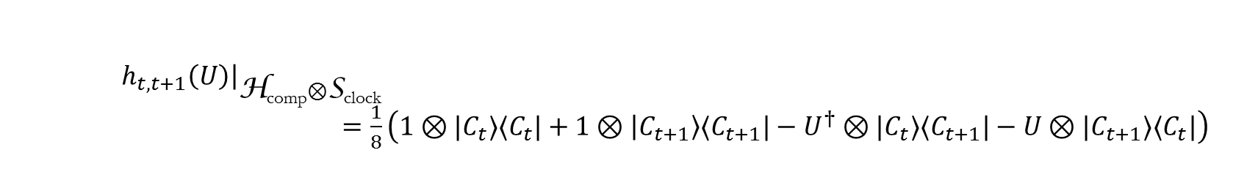
Properties of the new clock construction
7N-3 qubits
Clock
Hamiltonian
$$H_{clock}^{N}$$
Sum of 3-local projectors Hamiltonian acting on
$$\text{H}\text{c}\text{lock}$$
Nullspace
$\text{S}\text{clock}\text{= }\text{span}\left\{ |C_{t}〉 : t=1,…,N\right\}$.
A $\left(j+2\right)$-local projector if U is j-local
Transition operators
$h_{t,t+1}\left(U\right) t=1,…,N−1$
act on
$$\text{H}\text{comp}⊗\text{H}\text{clock}$$
$h_{t,t+1}\left(U\right){\left.​\right|}_{\text{H}\text{comp}⊗\text{S}\text{clock} }$
$=\frac{1}{8}\left(1⊗|C_{t}〉〈C_{t}|+1⊗|C_{t+1}〉〈C_{t+1}|−U^{†}⊗|C_{t}〉〈C_{t+1}|−U⊗|C_{t+1}〉〈C_{t}|\right)$

Slide 34


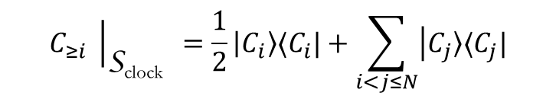
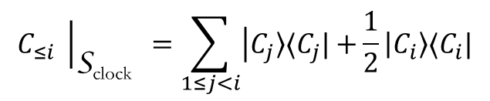

Properties of the new clock construction
7N-3 qubits
Clock
Hamiltonian
$$H_{clock}^{N}$$
Sum of 3-local projectors Hamiltonian acting on
$$\text{H}\text{c}\text{lock}$$
Nullspace
$\text{S}\text{clock}\text{= }\text{span}\left\{ |C_{t}〉 : t=1,…,N\right\}$.
A $\left(j+2\right)$-local projector if U is j-local
Transition operators
$h_{t,t+1}\left(U\right) t=1,…,N−1$
act on
$$\text{H}\text{comp}⊗\text{H}\text{clock}$$
$h_{t,t+1}\left(U\right){\left.​\right|}_{\text{H}\text{comp}⊗\text{S}\text{clock} }$
$=\frac{1}{8}\left(1⊗|C_{t}〉〈C_{t}|+1⊗|C_{t+1}〉〈C_{t+1}|−U^{†}⊗|C_{t}〉〈C_{t+1}|−U⊗|C_{t+1}〉〈C_{t}|\right)$
1-local projectors
Greater than/ Less than operators
$$C_{≤i}$$
$C_{≥i} i=1,…,N$
act on
$$\text{H}\text{clock}$$
$$C_{≤i} {\left.​\right|}_{\text{S}\text{clock} }=\sum_{1≤j<i}{|C_{j}〉〈C_{j}|+}\frac{1}{2}|C_{i}〉〈C_{i}|$$
$$C_{≥i} {\left.​\right|}_{\text{S}\text{clock} }=\frac{1}{2}|C_{i}〉〈C_{i}|+\sum_{i<j≤N}{|C_{j}〉〈C_{j}|}$$

Slide 35
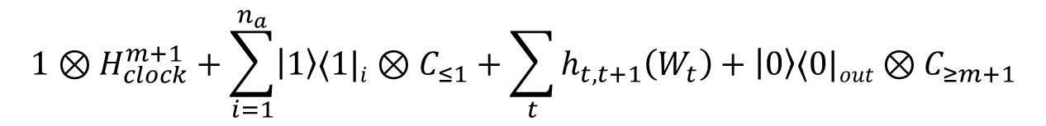
Like Kitaev’s clock construction, ours could be used to emulate Feynman’s Hamiltonian
$$1⊗H_{clock}^{m+1}+\sum_{i=1}^{n_{a}}{|1〉〈1|i⊗C_{≤1}+\sum_{t}{h_{t,t+1}\left(W_{t}\right)+|0〉〈0|out⊗C_{≥m+1}}}$$
3-local
2-local
4-local
2-local
This isn’t good enough for our purposes—it only shows that quantum 4-SAT is QMA₁-hard (already known).
Instead, we use our clock construction in a different way…

Slide 36

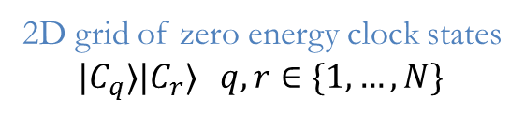
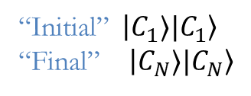
Two clock registers
We map the verification circuit to a Hamiltonian acting on a Hilbert space with one n-qubit
computational register and two clock registers:
$$1⊗H_{clock}^{N}⊗1+1⊗1⊗H_{clock}^{N}$$
2D grid of zero energy clock states
$$|C_{q}〉{|C}_{r}〉 q,r∈\{1,…,N\}$$
“Initial” $|C_{1}{〉|C}_{1}〉$ “Final” $|C_{N}{〉|C}_{N}〉$

Slide 37
Two clock registers
We map the verification circuit to a Hamiltonian acting on a Hilbert space with one n-qubit
computational register and two clock registers:
$$1⊗H_{clock}^{N}⊗1+1⊗1⊗H_{clock}^{N}+H_{prop}$$
Every zero energy groundstate encodes the history of a computation

Slide 38






Two clock registers
We map the verification circuit to a Hamiltonian acting on a Hilbert space with one n-qubit
computational register and two clock registers:
$$1⊗H_{clock}^{N}⊗1+1⊗1⊗H_{clock}^{N}+H_{prop}$$
Every zero energy groundstate encodes the history of a computation
$H_{prop}$ is built out of 3-local projectors such as
$${1⊗C}_{≥k}⊗C_{≤j}$$
$${1⊗h}_{i,i+1}⊗C_{≤k}$$
(writing $h_{i,i+1}\left(1\right)=h_{i,i+1}$)
$${|0〉〈0|a⊗h}_{i,i+1}⊗1$$
$$h_{i,i+1}\left(U\right)⊗1$$
for 1-local U

Slide 39

Two clock registers
We map the verification circuit to a Hamiltonian acting on a Hilbert space with one n-qubit
computational register and two clock registers:
$$1⊗H_{clock}^{N}⊗1+1⊗1⊗H_{clock}^{N}+H_{prop}+\sum_{i=1}^{n_{a}}{|1〉〈1|i⊗C_{≤1}⊗C_{≤1}}+|0〉〈0|out⊗C_{≥N}⊗C_{≥N}$$
Enforce initialization of ancillas and correct output of circuit
$H_{prop}$ is built out of 3-local projectors such as
$${1⊗C}_{≥k}⊗C_{≤j}$$
$${1⊗h}_{i,i+1}⊗C_{≤k}$$
(writing $h_{i,i+1}\left(1\right)=h_{i,i+1}$)
$${|0〉〈0|a⊗h}_{i,i+1}⊗1$$
$$h_{i,i+1}\left(U\right)$$
for 1-local U

Slide 40
Two clock registers
We map the verification circuit to a Hamiltonian acting on a Hilbert space with one n-qubit
computational register and two clock registers:
$$1⊗H_{clock}^{N}⊗1+1⊗1⊗H_{clock}^{N}+H_{prop}+\sum_{i=1}^{n_{a}}{|1〉〈1|i⊗C_{≤1}⊗C_{≤1}}+|0〉〈0|out⊗C_{≥N}⊗C_{≥N}$$
Enforce initialization of ancillas and correct output of circuit
$H_{prop}$ is built out of 3-local projectors such as
$${1⊗C}_{≥k}⊗C_{≤j}$$
$${1⊗h}_{i,i+1}⊗C_{≤k}$$
(writing $h_{i,i+1}\left(1\right)=h_{i,i+1}$)
$${|0〉〈0|a⊗h}_{i,i+1}⊗1$$
$$h_{i,i+1}\left(U\right)$$
for 1-local U
I will now show you how to construct $H_{prop}$ for the case where the verification circuit is a specific two-qubit gate (warning: gadgetry ahead)…

Slide 41


Two clock registers: Example
$$1⊗1⊗H_{clock}^{9}+1⊗H_{clock}^{9}⊗1$$
1
2
3
4
5
6
7
8
9
1
2
3
4
5
6
7
8
9
Zero energy ground states
${|φ〉}_{ab}|C_{i}〉|C_{j}〉 i,j∈\{1,…,9\}$

Slide 42

Two clock registers: Example
$$1⊗1⊗H_{clock}^{9}+1⊗H_{clock}^{9}⊗1$$
$$+1⊗C_{≥3 }⊗C_{≤1}$$
1
2
3
4
5
6
7
8
9
1
2
3
4
5
6
7
8
9
Zero energy ground states
${|φ〉}_{ab}|C_{i}〉|C_{j}〉 \left(i,j\right)$ is a vertex in the above graph

Slide 43

Two clock registers: Example
$$1⊗1⊗H_{clock}^{9}+1⊗H_{clock}^{9}⊗1$$
$$+1⊗C_{≥3 }⊗C_{≤1}$$
$$+1⊗C_{≤1 }⊗C_{≥3}$$
1
2
3
4
5
6
7
8
9
1
2
3
4
5
6
7
8
9
Zero energy ground states
${|φ〉}_{ab}|C_{i}〉|C_{j}〉 \left(i,j\right)$ is a vertex in the above graph

Slide 44

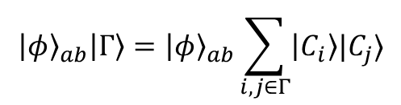

Two clock registers: Example
$$1⊗1⊗H_{clock}^{9}+1⊗H_{clock}^{9}⊗1$$
$$+1⊗C_{≥3 }⊗C_{≤1}$$
$$+1⊗C_{≤1 }⊗C_{≥3}$$
$$+1⊗h_{12}⊗C_{≤2}$$
1
2
3
4
5
6
7
8
9
1
2
3
4
5
6
7
8
9
Zero energy ground states
$${|φ〉}_{ab}|Γ〉={|φ〉}_{ab}\sum_{i,j∈Γ}{|C_{i}〉|C_{j}〉}$$
where $Γ$ is a connected component of the graph

Slide 45
Two clock registers: Example
$$1⊗1⊗H_{clock}^{9}+1⊗H_{clock}^{9}⊗1$$
$$+1⊗C_{≥3 }⊗C_{≤1}$$
$$+1⊗C_{≤1 }⊗C_{≥3}$$
$$+1⊗h_{12}⊗C_{≤2}$$
1
2
3
4
5
6
7
8
9
1
2
3
4
Continuing in this way, we can design a Hamiltonian with ground states described by a more complicated graph…
5
6
7
8
9
Zero energy ground states
$${|φ〉}_{ab}|Γ〉={|φ〉}_{ab}\sum_{i,j∈Γ}{|C_{i}〉|C_{j}〉}$$
where $Γ$ is a connected component of the graph

Slide 46

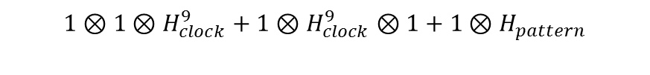


Two clock registers: Example
Built out of terms like
$$h_{i,i+1}⊗C_{≤k}$$
$$1⊗1⊗H_{clock}^{9}+1⊗H_{clock}^{9}⊗1+1⊗H_{pattern}$$
$$C_{≤k}⊗h_{i,i+1}$$
$$C_{≥k}⊗C_{≤j}$$
1
2
3
4
5
6
7
8
9
1
2
3
4
5
6
7
8
9
Zero energy ground states
$${|φ〉}_{ab}|Γ〉={|φ〉}_{ab}\sum_{i,j∈Γ}{|C_{i}〉|C_{j}〉}$$
where $Γ$ is a connected component of the graph

Slide 47
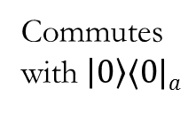
Two clock registers: Example
$$1⊗1⊗H_{clock}^{9}+1⊗H_{clock}^{9}⊗1+1⊗H_{pattern}$$
Commutes with $|0〉〈0|a$
$$+|0〉〈0|a⊗\left(h_{34}+h_{67}\right)⊗1+|1〉〈1|a⊗1⊗\left(h_{34}+h_{67}\right)$$
1
2
3
4
5
6
7
8
9
1
2
3
4
5
6
7
8
9
Zero energy ground states

Slide 48






Two clock registers: Example
$$1⊗1⊗H_{clock}^{9}+1⊗H_{clock}^{9}⊗1+1⊗H_{pattern}$$
$$+|0〉〈0|a⊗\left(h_{34}+h_{67}\right)⊗1+|1〉〈1|a⊗1⊗\left(h_{34}+h_{67}\right)$$
${|0〉〈0|}_{a}$ sector
${|1〉〈1|}_{a}$ sector
1
2
3
4
5
6
7
8
9
1
2
3
4
5
6
7
8
9
1
1
2
2
3
3
4
4
5
5
6
6
7
7
8
8
9
9
Zero energy ground states
Zero energy ground states
$${|0〉a|ψ〉}_{b}|Γ〉$$
$${|1〉a|ψ〉}_{b}|Γ〉$$
$Γ$ is a connected component
$Γ$ is a connected component

Slide 49
Two clock registers: Example
$$1⊗1⊗H_{clock}^{9}+1⊗H_{clock}^{9}⊗1+1⊗H_{pattern}$$
$$+|0〉〈0|a⊗\left(h_{34}+h_{67}\right)⊗1+|1〉〈1|a⊗1⊗\left(h_{34}+h_{67}\right)$$
${|0〉〈0|}_{a}$ sector
${|1〉〈1|}_{a}$ sector
1
2
3
4
5
6
7
8
9
1
2
3
4
5
6
7
8
9
1
1
2
2
3
3
4
4
5
5
6
6
7
7
8
8
9
9
Zero energy ground states
Zero energy ground states
$${|0〉a|ψ〉}_{b}|Γ〉$$
$${|1〉a|ψ〉}_{b}|Γ〉$$
$Γ$ is a connected component
$Γ$ is a connected component

Slide 50
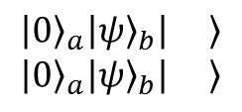
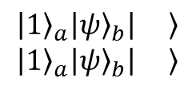
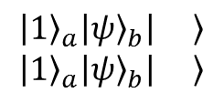
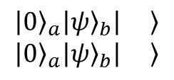
Two clock registers: Example
$$1⊗1⊗H_{clock}^{9}+1⊗H_{clock}^{9}⊗1+1⊗H_{pattern}$$
$$+|0〉〈0|a⊗\left(h_{34}+h_{67}\right)⊗1+|1〉〈1|a⊗1⊗\left(h_{34}+h_{67}\right)$$
${|0〉〈0|}_{a}$ sector
${|1〉〈1|}_{a}$ sector
1
2
3
4
5
6
7
8
9
1
2
3
4
5
6
7
8
9
1
1
2
2
3
3
4
4
5
5
6
6
7
7
8
8
9
9
Zero energy ground states
Zero energy ground states
$${|0〉}_{a}{|ψ〉}_{b}| 〉 \\ {|0〉}_{a}{|ψ〉}_{b}| 〉$$
$${|0〉}_{a}{|ψ〉}_{b}| 〉 \\ {|0〉}_{a}{|ψ〉}_{b}| 〉$$
$${|1〉}_{a}{|ψ〉}_{b}| 〉 \\ {|1〉}_{a}{|ψ〉}_{b}| 〉$$
$${|1〉}_{a}{|ψ〉}_{b}| 〉 \\ {|1〉}_{a}{|ψ〉}_{b}| 〉$$
+ others
+ others

Slide 51






Two clock registers: Example
Acts on first clock
register and qubit b
$$\left[U,V\right]≠0$$
$$1⊗1⊗H_{clock}^{9}+1⊗H_{clock}^{9}⊗1+1⊗H_{pattern}$$
$$+|0〉〈0|a⊗\left(h_{34}+h_{67}\right)⊗1+|1〉〈1|a⊗1⊗\left(h_{34}+h_{67}\right)$$
$$+h_{45}\left(U_{b}\right)⊗1+h_{45}(V_{b}\text{)}$$
Acts on second clock
register and qubit b
${|0〉〈0|}_{a}$ sector
${|1〉〈1|}_{a}$ sector
1
2
3
4
5
6
7
8
9
1
2
3
4
5
6
7
8
9
1
$$U_{b}$$
1
$$U_{b}$$
2
2
3
3
4
$$V_{b}$$
4
$$V_{b}$$
5
5
6
6
7
7
8
8
9
9
Zero energy ground states
Zero energy ground states

Slide 52
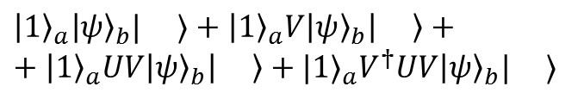
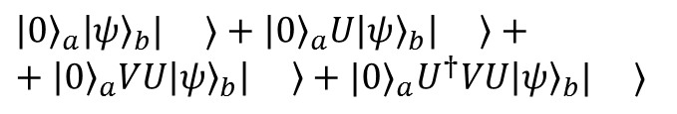
Two clock registers: Example
Acts on first clock
register and qubit b
$$\left[U,V\right]≠0$$
$$1⊗1⊗H_{clock}^{9}+1⊗H_{clock}^{9}⊗1+1⊗H_{pattern}$$
$$+|0〉〈0|a⊗\left(h_{34}+h_{67}\right)⊗1+|1〉〈1|a⊗1⊗\left(h_{34}+h_{67}\right)$$
$$+h_{45}\left(U_{b}\right)⊗1+h_{45}(V_{b}\text{)}$$
Acts on second clock
register and qubit b
${|0〉〈0|}_{a}$ sector
${|1〉〈1|}_{a}$ sector
1
2
3
4
5
6
7
8
9
1
2
3
4
5
6
7
8
9
1
$$U_{b}$$
1
$$U_{b}$$
2
2
3
3
4
$$V_{b}$$
4
$$V_{b}$$
5
5
6
6
7
7
8
8
9
9
Zero energy ground states
Zero energy ground states
${|0〉}_{a}{|ψ〉}_{b}| 〉+$ ${|0〉}_{a}{U|ψ〉}_{b}| 〉+$ $+$ ${|0〉}_{a}{VU|ψ〉}_{b}| 〉+$ ${|0〉}_{a}{U^{†}VU|ψ〉}_{b}| 〉$
${|1〉}_{a}{|ψ〉}_{b}| 〉+$ ${|1〉}_{a}{V|ψ〉}_{b}| 〉+$ $+$ ${|1〉}_{a}{UV|ψ〉}_{b}| 〉+$ ${|1〉}_{a}{V^{†}UV|ψ〉}_{b}| 〉$

Slide 53


Two clock registers: Example
Acts on first clock
register and qubit b
$$\left[U,V\right]≠0$$
$$1⊗1⊗H_{clock}^{9}+1⊗H_{clock}^{9}⊗1+1⊗H_{pattern}$$
$$+|0〉〈0|a⊗\left(h_{34}+h_{67}\right)⊗1+|1〉〈1|a⊗1⊗\left(h_{34}+h_{67}\right)$$
$$+h_{45}\left(U_{b}\right)⊗1+h_{45}(V_{b}\text{)}$$
Acts on second clock
register and qubit b
The point is that every zero energy ground state encodes the history of a two-qubit computation
$${|φ〉}_{ab}|C_{1}〉|C_{1} 〉+…+W{|φ〉}_{ab}|C_{9}〉|C_{9}〉$$
where
$$W=|0〉〈0|⊗VU+|1〉〈1|⊗UV$$
(An entangling two-qubit unitary for suitably chosen $U,V$)
This was achieved without using the transition operator $h_{t,t+1}(W)$

Slide 54
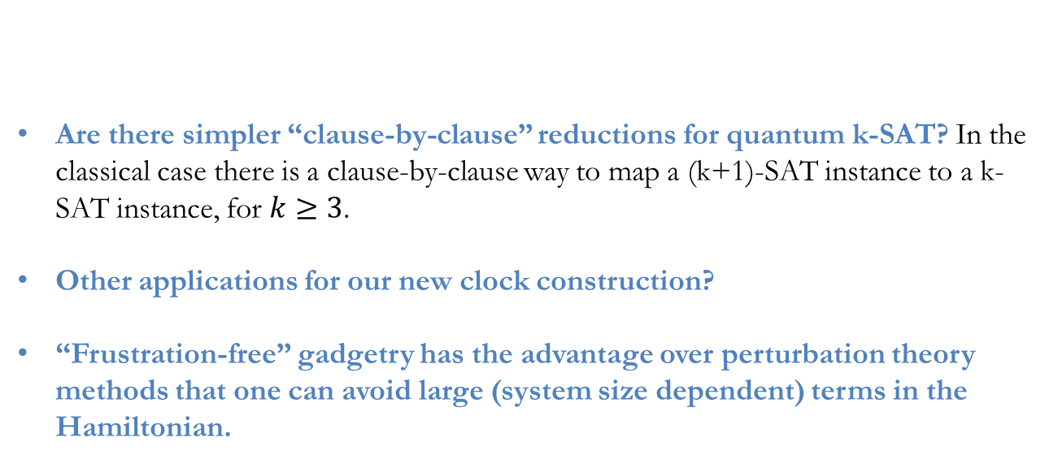
Remarks and open questions
Are there simpler “clause-by-clause” reductions for quantum k-SAT? In the classical case there is a clause-by-clause way to map a (k+1)-SAT instance to a k-SAT instance, for $k≥3$.
Other applications for our new clock construction?
“Frustration-free” gadgetry has the advantage over perturbation theory methods that one can avoid large (system size dependent) terms in the Hamiltonian.

