Slide 1
Robust device independent randomness amplification with few devices
F.G.S.L Brandao¹, R. Ramanathan²
A. Grudka³, K. ⁴, M. ⁵,P. ⁶ Horodeccy
¹Department of Computer Science, University College London
²National Quantum Information Centre in Gdańsku, Sopot
³Department of Physics, Adam Mickiewicz University, Poznań
⁴Institute of Informatics, University of Gdańsk, Gdańsk
⁵Institute of Theoretical Physics and Astrophysic, University of Gdańsk, Gdańsk
⁶Department of Physics and Applied Math, Technical University of Gdańsk, Gdańsk
arXiv:1310.4544
QIP 2014 Barcelona

Slide 2

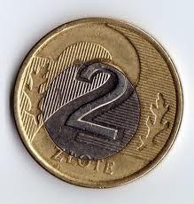
Motivation
or
?
Does anyone know the result of throwing a coin ?
can one decorrelate randomness
from the third person: eavesdropper ?
Example: make your choice of product to buy independent of your knowledge
about commercials

Slide 3
Device independence
Danger: Eve can sell device with imprinted bits in advance
We do not trust that devices are bulit due to specifiation
We only relay on statistics of inputs and outputs of the device
Security proof uses only these statistics

Slide 4

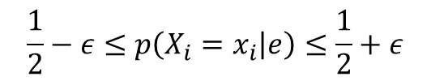
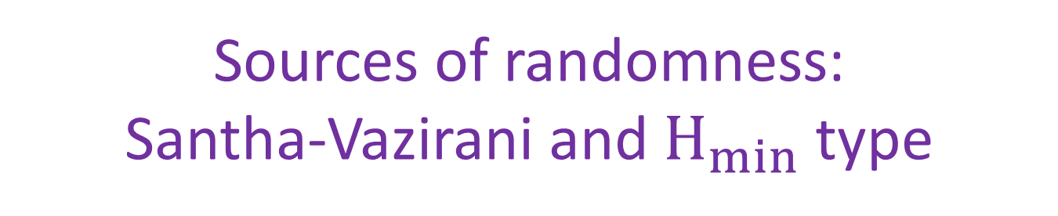
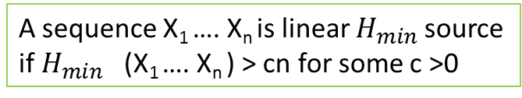
Sources of randomness: Santha-Vazirani and $H_{min}$ type
Definition:
A sequence X₁ …. X_{n} satisfies condition of Santha-Vazirani if for any i
there is:
$$\frac{1}{2}−ε≤p\left(X_{i}=x_{i} | e\right)≤\frac{1}{2}+ε$$
e – any variable that could have influenced the variable X_{i}
Fact: classics =>„no go” [M. Santha, U.V. Vazirani 1984]
Classical processing of SV source does not lead to randomness amplfication
Weaker source of randomness:
A sequence X₁ …. X_{n} is linear $H_{min}$source
if $H_{min}$ (X₁ …. X_{n} ) > cn for some c >0
Fact:
From 2 independent min-entropy sources => fully random bit
Non explicit extractor
From 3 independent min-entropy sources => fully random bit
Explicit extractor
[Chor and Goldreich ’88, Rao]

Slide 5



Quantum mechanics allows for randomness amplification
[R. Colbeck & R. Renner, Nature Physics 2012]
Some measurements on maximally enatangled states are random
Idea: results of these measurements violate certain Bell inequality
Result : For
N-th chained Bell inequality
[A.Grudka et al. arXiv:1303.5591]
$≈$0.0961
optimal
[Gallego et al. arXiv:1210.6514 ]
For any
0$<ε< \frac{1}{2}$
Use of 5-partite Mermin inequality
There exists hash function which outputs perfect bit
Drawbacks: - hash function is not explicit
- asymptotically many non-signaling devices
- tolerance of noise not included
[R. Ramanathan et al. arXiv:1308.4635]

Slide 6

The results
Starting from any epsilon-Santha-Vazirani source:
0$<ε< \frac{1}{2}$
obtain bits of randomness secure with respect to non-signaling Eve
1) Protocol (I) of randomness amplification with:
- single device, but non-explicit function
- tolerance of noise
Main tool: proper use of implicit assumptions
2) Protocol (II) of randomness amplification with:
2 devices
explicit hash function
tolerance of noise
Main tool: SV-version of deFinetti theorem

Slide 7

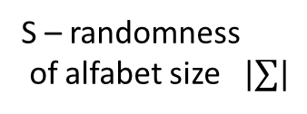
The scheme of randomness amplifier
SV source
ε_{in} source SV
101011000101110101
Eve
Alice
Bob
P(XZ|U,W)
A device
Device:
Extractor
Extractor
ε_{out}
S – randomness
of alfabet size$|∑|$
Task:
0 $≈$ε_{out} < ε_{in}
Quality of
randomness:
small

Slide 8
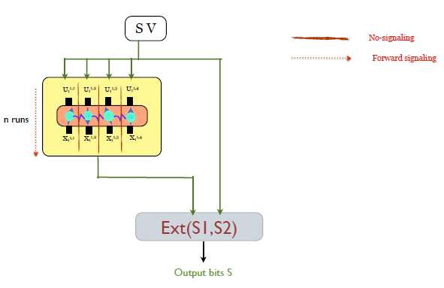
The protocol I
Single
Device
The protocol :
1) Use Device 1 n times taking as inputs bits from SV source
2) Check the level of Bell violation after n runs
4) Upon good level of Bell violation in 2), apply Extractor to device and SV source

Slide 9


Assumptions (I)
Assumption1: (fixed device)
the device does not depend on SV source
$$SV⊗P(x|u)$$
Assumption 1’: (Markovity) : given output of Eve, the device and SV source are
product:
$$SV⊗P(x|uZ=z,W=w)$$
Cf. [Colbeck and Renner 2012]
[Gallego et al. 2012]
Note: these assumptions are independent

Slide 10
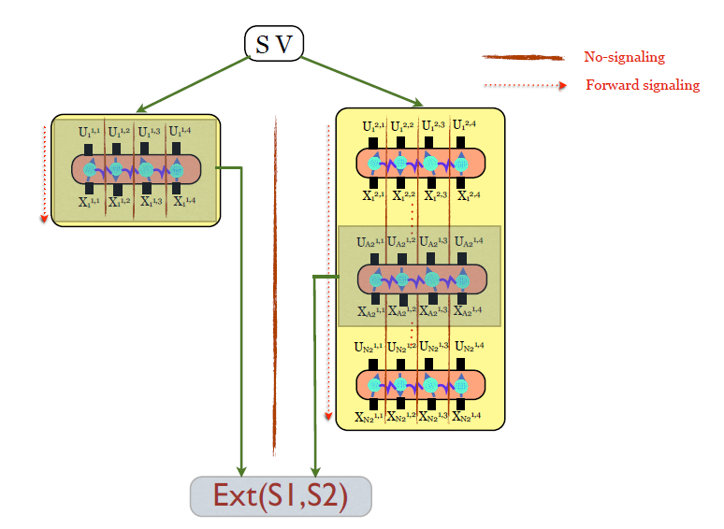
Assumptions (II)
Assumption2: (conditional non-signaling)
Conditionally on
these results…
…these blocks
do not signal
Note: it is reasonable, as quantum devices satisfies it

Slide 11


Idea of the proof for protocol I
By assumption I:
SV source serves itself as source independent
of the output of the devices
$$H_{min}$$
Note: we do not impose independence of the sources, as that would be trivial
u
time
SV source
10100101010111000111010101010
Reason for independence:
u decorrelates two sources
y
Devices: P(x|u)
P(x|y,u) = P(x|u)
x
$$H_{min}$$
Two independent sources => non-explicit
extractor yields secure bit
Note: we have to verify if device violates Bell inequality. If it does not, there is no way
to check if the device is not deterministic function to which a SV no-go applies.

Slide 12
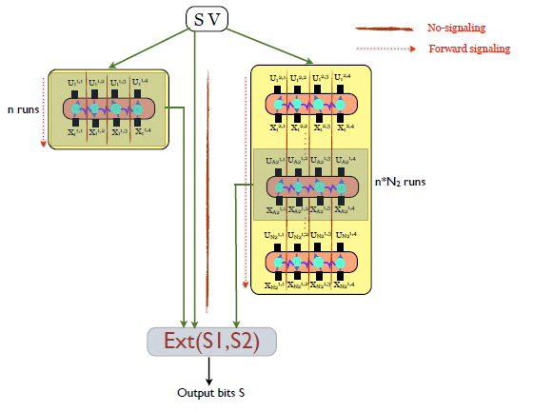
Protocol II
Device 1
Device 2
Block 1
Block 2
Preliminary assumptions:
Devices:
Do not signal between
each other
Are forward signaling
(past can influence the future)
The protocol :
1) Use Device 1 n times taking as inputs bits from SV source forming the block 1
2) Out of n x N₂ uses of Device 2 choose the block 2 of n uses, by means of SV source
3) Check the level of Bell violation in both blocks
4) Upon good level of Bell violation in 3), apply Extractor to these two blocks and SV source
Security claim: protocol I, upon acceptance provides secure bit up to error that vanises with
uses of devices with high probability

Slide 13




Idea of the proof for protocol II
1)
By assumption I:
SV source serves itself as source independent
of the output of the devices
$$H_{min}$$
2)
By assumption II + new type of deFinetti theorem:
The two blocks of uses of devices (#1 and #2)
are product with each other
time
SV source
10101010111000110101010111000000110
$$⊗^{≈}$$
Block 1
$$⊗^{≈}$$
Block 2
$H_{min}$
3 independent sources: good for 3-extractor
[Chore,Goldreich ‚88]
Secure bits
(SECRECY AGAINST NO-SIGNALING ADVERSARY )

Slide 14

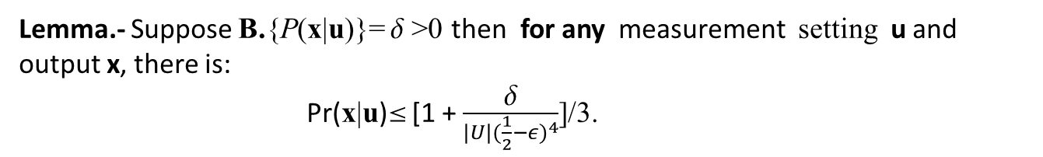

Ingredients of the proof (i)
a Bell inequality
Q
NS
Entangled 4-qubit in state |,
u=0 - measure _{z} , u=1 - measure _{x}
P*
x
A₂
u₁, x₂
LHV
u₁ u₂ u₃ u₄
u₂,x₂
Violated up to NS value
B.P=0
A₁
{P(x|u)}
u₄,x₄
A₃
A₄
u₃,x₃
x₁ x₂ x₃ x₄
Lemma.- Suppose B.{P(x|u)}=  >0 then for any measurement setting u and output x, there is:
Pr(x|u) [1 + $\frac{δ}{{|U|(\frac{1}{2}−ε)}^{4}}$]/3.
$$≡γ<1$$
Interpretation: output of a box is partially random, even when noise is allowed
Proof: by Linear Programming (analytical solution) [Hanggi Renner EUROCRYPT 2010]

Slide 15







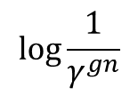


Ingredients of the proof (ii)
Azuma-Hoeffding inequality for estimation
Azuma-Hoeffding inequality enables estimation
Adaptation of
[Pironio et al. 2010,2013 Fahr et al.,
Pironio Massar, 2013]
– for randomness
expansion
With high probability:
There are at least g x n of good boxes (with Bell value at most δ) with g > 0
Hence for any u,x:
$≤$ $γ^{gn}$
$≤$ $γ$
….
$≤$ $γ$
$$H_{min}$$
$$\log{\frac{1}{γ^{gn}}}$$
$$\sim$$
$$\sim$$
Linear in n

Slide 16
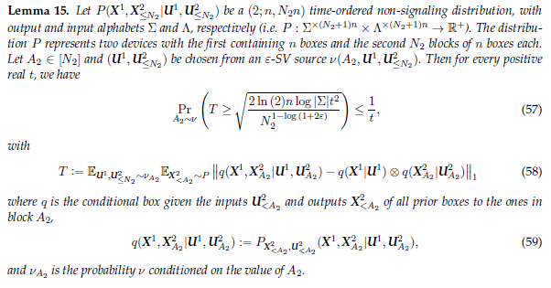
Ingredients of the proof
(iii) de Finetti theorem
[Brandao Harrow STOC’13] + SV correction

Slide 17

Ingredients of the proof
(iii) de Finetti theorem
Device 1
Device 2
Block 1
Uses prior to
Block 2
Recall:
number of Block 2
is chosen
according to bits
from SV source
$$⊗$$
Block 2
Average over the choice of from SV source , and output ,
Outputs are close to product

Slide 18
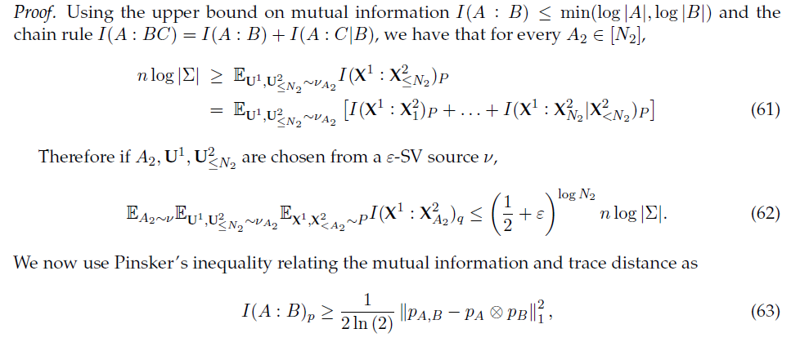
Technical part of de Finetti bound

Slide 19
Putting the pieces together:
We choose a Bell inequality, which is algebraically violated on quantum state
The protocol :
1) Use device #1, N times
2) Out of NxK uses of device #2 choose a block
of N uses, by means of SV source
3) Check the level of Bell violation in both the blocks
4) Upon good level of Bell violation in 3),
apply Extractor to these two blocks
By DeFinetti Block 1 and
Block 2 are almost product
By Azuma-Hoeffding: enough good
boxes for linear Hmin
By assumptions, and the above,
there are 3 Hmin sources close to product:
The rest of SV source and two blocks => Extractors work!

Slide 20



Conclusions and Open problems
Full randomness amplification w.r.t. to non-signaling adversary using small number
of devices ( 1 or 2) is possible. Noise tolarance dependence show.
Drawback 1 of our protocol: to make deFinetti work we need to make t large:
Large number of uses …
Can we obtain a protocol with non-zero rate of amplified randomness and explicit
extractor ?
Drawback 2: for single device nonzero rate but no explicit extractor,
for two devices explicit extractor but zero rate due to error
|$∑|$exp(-cn $η)$
Can one achieve randomness amplification for any epsilon, from bipartite devices ?
(in preparation)
Tolerance of noise – is there a protocol which is more robust against noise ?
$H_{min}$
Could we start not from SV-source, but from the one ?
Finally : proof applies for 2 devices and 3 devices respectively
if we don’t use the SV apart from setting the inputs.

Slide 21
Thank you for your attention !

