Slide 1
Entanglement sampling and applications
Process
Omar Fawzi (ETH Zürich)
Joint work with Frédéric Dupuis (Aarhus University)
and Stephanie Wehner (CQT, Singapore)
arXiv:1305.1316

Slide 2
Uncertainty relation game
Eve
Alice
Choose n-qubit state
EVE
Choose random
Choose n-qubit state
…
Choose random
X₁
X₂
X_{n-1}
X_{n}
Guess X
…
Maximum ?
X₁
X₂
X_{n-1}
X_{n}
Guess X
Maximum P_{guess}?

Slide 3
Uncertainty relation game
Can Eve do better with different ?
No [Damgard, Fehr, Salvail, Shaffner, Renner, 2008]
Measure in
X
Guess X
Between 0 and n
Notation:
Notes:
\ket{\psi} = \ket{0^n} \: \Rightarrow \: P_{\mathrm{guess}} \approx 2^{-n/2}
\entHmin(X|\Theta) \eqdef - \log P_{\textrm{guess}}(X|\Theta)

Slide 4
Uncertainty relations with quantum Eve
Eve has a quantum memory
A
E
Measure in
Guess X
using E and
X
Maximum ?
[Berta, Christandl, Colbeck, Renes, Renner, 2010]

Slide 5
Uncertainty relations with quantum Eve
A
E
Measure in
Measure in
X
X

Slide 6
Uncertainty relations with quantum Eve
E.g., if storage of Eve is bounded?
Uncertainty relation + chain rule →
using maximal entanglement
Converse
Is maximal entanglement necessary for large P_{guess}?
Main result: YES
At least n/2 qubits of memory necessary
Notes:
What if more generally, can we relate guessing probability to “closeness to maximal entanglement”

Slide 7
The uncertainty relation
between –n and n
Max entangled
Measure for closeness to maximal entanglement
Log of guessing prob.
E=X
between 0 and n
Max entangled
Notes:
\entHmin(A|E) = -\log 2^n \max_{\cE_{E \to A'}}F(\cE(\rho_{AE}), \Phi_{AA'})
\entHmin(X|\Theta E) \eqdef - \log P_{\textrm{guess}}(X|\Theta E)
FIGURE:
\begin{tikzpicture}[scale=4]
\draw[very thin,color=gray,step=0.5] (-1,0) grid (1,1);
\draw[->] (-1,0) -- (1,0) node[right] {$\frac{\entHmin(A|E)}{n}$};
\foreach \x in {-1, 0, 1}
\node[below,font=\footnotesize] at (\x cm,0) {\x};
\draw[->] (0,0) -- (0,1) node[above] {$\frac{\entHmin(X|\Theta E)}{n}$};
\foreach \y in {0, 1}
\node[left,font=\footnotesize] at (0,\y cm) {\y};
\draw[blue,ultra thick] plot[smooth, domain=0.0001:0.5, variable=\t] ({-\t*log2(\t) - (1-\t)*log2(1-\t) + \t - 1}, {\t}); % gamma, first piece
\draw[blue,ultra thick] plot[smooth, domain=0.5:1, variable=\t] (\t, \t); % gamma, second piece
\end{tikzpicture}

Slide 8
The uncertainty relation
Max entanglement
Notes:
\frac{\entHmin^{\e}(X|\Theta E)}{n} \geq f\left(\frac{\entHmin(A|E)}{n}\right)

Slide 9
General statement
Meas in Θ
A
X
E
More generally:
Gives bounds on Q Rand Access Codes
M
A
C
E
Example:
Notes:
\frac{\entHmin^{\e}(C|E)}{n} \geq f_{\cM}\left(\frac{\entHmin(A|E)}{n}\right)
$\cM$ samples \\
a random subset $S$

Slide 10
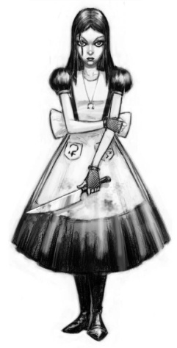

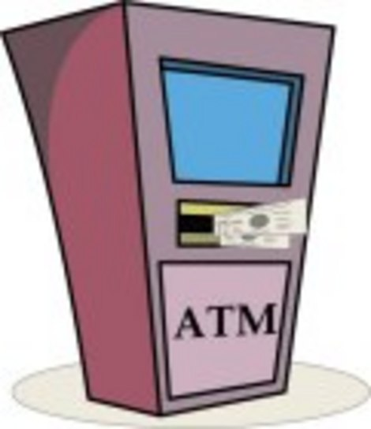

Application to two-party cryptography
??
??
“I’m Alice!”
password
Stored password
Equal?
Yes/No
Malicious ATM: tries to learn passwords
Malicious user: tries to learn other customers passwords

Slide 11
Application to secure two-party computation
Unconditional security impossible
[Mayers 1996; Lo, Chau, 1996]
Physical assumption:
bounded/noisy quantum storage
[Damgard, Fehr, Salvail, Schaffner 2005; Wehner, Schaffner, Terhal 2008]
Security if
Using new uncertainty relation
Security if
n: number of communicated qubits
Notes:
quantum memory $< n - O(\log^2 n)$

Slide 12
Proof of uncertainty relation
Meas in Θ
A
X
Step 1:
E
Conditional state
Notes:
\frac{\entHtwo(X|\Theta E)}{n} \geq f\left( \frac{\entHtwo(A|E)}{n} \right)

Slide 13
Proof of uncertainty relation
Step 2: Write by expanding in Pauli basis
Notes:
\frac{\entHtwo(X|\Theta E)}{n} \geq f\left( \frac{\entHtwo(A|E)}{n} \right)
\entHtwo(A|E)_{\rho} &\eqdef \tr[\tilde{\rho}_{AE}^2] \\
& \text{where} \\
\tilde{\rho}_{AE} &\eqdef \rho_E^{-1/2} \rho_{AE} \rho_E^{-1/2}
2^{-\entHtwo(X|\Theta E)} &= \frac{1}{2^n} \sum_{\ell=0}^n \frac{1}{2^{\ell}} \sum_{\nu \in \{0,1,3\}^n, |\nu| = \ell} \tr\left[ \sigma_{\nu} \tilde{\rho}_{A^nE} \sigma_{\nu} \tilde{\rho}_{A^nE} \right].
Orthogonal basis $\{ \sigma_{\nu}\}_{\nu \in \{0,1,2,3\}^n}$ for operators on $(\CC^2)^{\otimes n}$
$\sigma_{\nu} = \sigma_{\nu_1} \otimes \cdots \otimes \sigma_{\nu_n} \qquad |\nu| = |\{i : \nu_i \neq 0\}|$
$\sigma_0 = \id, \;
\sigma_1 = \left(
\begin{array}{cc}
0 & 1 \\
1 & 0 \\
\end{array}
\right)
,\;
\sigma_2 = \left(
\begin{array}{cc}
0 & -i \\
i & 0 \\
\end{array}
\right),
\;
\sigma_3 = \left(
\begin{array}{cc}
1 & 0 \\
0 & -1 \\
\end{array}
\right)
$

Slide 14
Proof of uncertainty relation
Relate
and
Observation 1:
Not good enough
Notes:
\frac{\entHtwo(X|\Theta E)}{n} \geq f\left( \frac{\entHtwo(A|E)}{n} \right)
\entHtwo(A|E)_{\rho} &\eqdef \tr[\tilde{\rho}_{AE}^2] \\
& \text{where} \\
\tilde{\rho}_{AE} &\eqdef \rho_E^{-1/2} \rho_{AE} \rho_E^{-1/2}
2^{-\entHtwo(X|\Theta E)} &= \frac{1}{2^n} \sum_{\ell=0}^n \frac{1}{2^{\ell}} \sum_{\nu \in \{0,1,3\}^n, |\nu| = \ell} \tr\left[ \sigma_{\nu} \tilde{\rho}_{AE} \sigma_{\nu} \tilde{\rho}_{AE} \right]
2^{-\entHtwo(A|E)} = \tr[\tilde{\rho}_{AE} \cdot \tilde{\rho}_{AE}]

Slide 15
Proof of uncertainty relation
Relate
and
Observation 1:
Observation 2:
Combine 1 and 2 → done!
Notes:
\frac{\entHtwo(X|\Theta E)}{n} \geq f\left( \frac{\entHtwo(A|E)}{n} \right)
\entHtwo(A|E)_{\rho} &\eqdef \tr[\tilde{\rho}_{AE}^2] \\
& \text{where} \\
\tilde{\rho}_{AE} &\eqdef \rho_E^{-1/2} \rho_{AE} \rho_E^{-1/2}
2^{-\entHtwo(X|\Theta E)} &= \frac{1}{2^n} \sum_{\ell=0}^n \frac{1}{2^{\ell}} \sum_{\nu \in \{0,1,3\}^n, |\nu| = \ell} \tr\left[ \sigma_{\nu} \tilde{\rho}_{AE} \sigma_{\nu} \tilde{\rho}_{AE} \right]
\tr[\sigma_{\nu} \tilde{\rho}_{AE} \sigma_{\nu} \tilde{\rho}_{AE}] \leq \tr[\tilde{\rho}_{AE}^2]

Slide 16
Conclusion
Summary
Uncertainty relation with quantum adversary
for BB84 measurements
Generic tool to lower bound output entropy using input entropy
Open question
Combine with other methods to improve?
?
Notes:
\begin{tikzpicture}[scale=4]
\draw[very thin,color=gray,step=0.5] (-1,0) grid (1,1);
\draw[->] (-1,0) -- (1,0) node[right] {$\frac{\entHmin(A|E)}{n}$};
\foreach \x in {-1, 0, 1}
\node[below,font=\footnotesize] at (\x cm,0) {\x};
\draw[->] (0,0) -- (0,1) node[above] {$\frac{\entHmin(X|\Theta E)}{n}$};
\foreach \y in {0, 1}
\node[left,font=\footnotesize] at (0,\y cm) {\y};
\draw[blue,ultra thick] plot[smooth, domain=0.0001:0.5, variable=\t] ({-\t*log2(\t) - (1-\t)*log2(1-\t) + \t - 1}, {\t}); % gamma, first piece
\draw[blue,ultra thick] plot[smooth, domain=0.5:1, variable=\t] (\t, \t); % gamma, second piece
\draw[red,ultra thick] plot[smooth, domain=0.0001:0.5, variable=\t] ({-\t}, {0.5-\t});
\draw[red,ultra thick] plot[smooth, domain=0.0001:1, variable=\t] (\t, 0.5);
%\draw[brown,dashdotted,thick] plot[smooth, domain=0.0001:1, variable=\t]({2\t-1}, {\t});
\end{tikzpicture}

