Slide 1
SCOTT AARONSON (MIT), Andris AmBAINIS (UNIV. OF LATVIA)
Forrelation: A Problem that Optimally Separates Quantum from Classical Computing

Slide 2
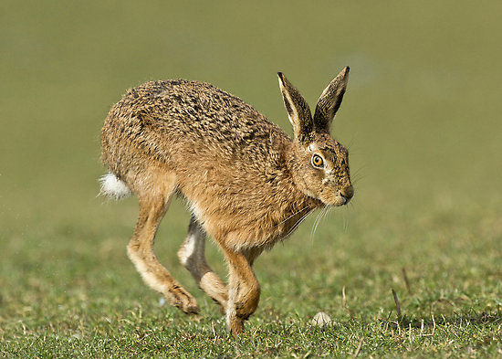
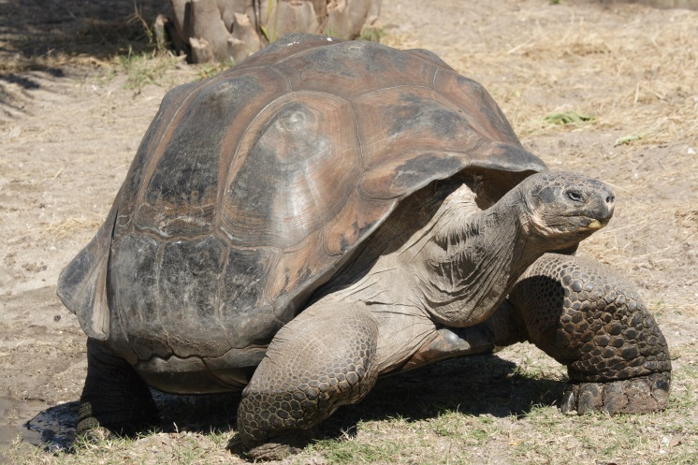
Quantum vs. classical
1 query quantumly
How many queries
classically?

Slide 3
Total vs. partial functions
Total functions f(x₁, ..., x_{N}):
R = O(Q^{2.5}) [previous talk];
D = O(Q⁴) [yesterday];
Partial functions f(x₁, ..., x_{N}):
Much bigger gaps possible.

Slide 4
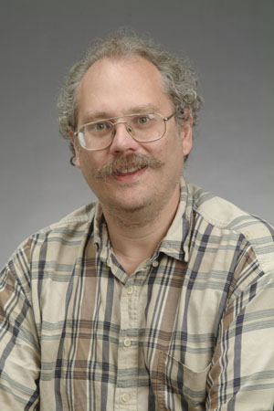
Period finding
x₁, x₂, ..., x_{N} - periodic
i
x_{i}
Find period r
[Shor, 1994]:
1 query quantumly

Slide 5
Period-finding
i
x_{i}
Quantum algorithm works if N ≥ r².
T classical queries – can test T² possible periods.
queries classically

Slide 6
Our result
Task that requires 1 query quantumly, Ω(√N/log N) classically.
1 query quantum algorithms can be simulated by O(√N) query probabilistic algorithms.

Slide 7
FORRELATION = Fourier CORRELATION

Slide 8
Forrelation
Input: (x₁, ..., x_{N}, y₁, ..., y_{N}) ∈{-1, 1}^{2N}.
Are vectors
highly correlated?
F_{N} – Fourier transform over Z_{N}.

Slide 9
More precisely...
Is the inner product
≥ 3/5 or ≤ 1/100?

Slide 10
Quantum algorithm
Generate a superposition of
(1 query).
Apply F_{N} to 2nd state.
Test if states equal (SWAP test).

Slide 11
Classical lower bound
Theorem Any classical algorithm for FORRELATION uses
queries.

Slide 12
REAL FORRELATION
Real-valued vectors
Distinguish between
random (x_{i}’s, y_{i}’s - Gaussian);
random, .

Slide 13
Lower bound
Claim REAL FORRELATION requires queries.
Intuition: if , each variable – Gaussian, correlations between x_{i}’s and y_{j}’s - weak.
o(√N/log N) values x_{i} and y_{j} ≈ uncorrelated random variables.

Slide 14
Reduction
T query algorithm
for FORRELATION
T query algorithm for REAL
FORRELATION
Proof idea: Replace x_{i} → sgn(x_{i}) to achieve x_{i}∈{-1, 1}.

Slide 15
Simulating 1 query quantum algorithms

Slide 16
Simulation
Theorem Any 1 query quantum algorithm can be simulated probabilistically with O(√N) queries.

Slide 17
Analyzing query algorithms
Q
Q
U₁
Q
…
U_{T}
α_{1,1}|1,1⟩+ α_{1,2}|1, 2⟩+ … + α_{N, M}|N, M⟩
α_{i,j} is actually α_{i,j}(x₁, ..., x_{N})

Slide 18
Polynomials method
Lemma [Beals et al., 1998] After k queries, the amplitudes
are polynomials in x₁, ..., x_{N} of degree ≤ k.
Measurement:
Polynomial of degree ≤ 2k

Slide 19
Our task
Pr[A outputs 1] = p(x₁, ..., x_{N}), deg p =2.
0 ≤ p(x₁, ..., x_{N}) ≤ 1.
Task: estimate p(x₁, ..., x_{N}) with precision ε.
Solution: random sampling.

Slide 20
Pre-processing
Problem: large error if sampling omits x_{i} with large influence in p(x₁, ..., x_{N}).
Solution: replace influential x_{i}’s by several variables with smaller influence.

Slide 21
Sampling 1
Requires sampling N variables x_{i}!
Estimator:
Good if we sample N of N² terms independently.

Slide 22
Sampling 2
x₁
x₂
√N variables
x₃
x₄
x₅
x₆
√N •√N = N
terms
x₇
x₁
x₂
x₃
x₄
x₅
x₆
x₇
√N

Slide 23
Extension to k queries
Theorem k query quantum algorithms can be simulated probabilistically with O(N^{1-1/2k}) queries.
Proof:
Algorithm → polynomial of degree 2k;
Random sampling.
Question: Is this optimal?

Slide 24
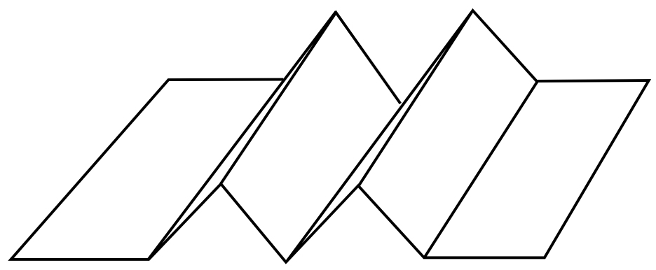
k-fold forrelation

Slide 25
Forrelation: given black box functions f(x) and g(y), estimate
k-fold forrelation: given f₁(x), ..., f_{k}(x), estimate

Slide 26
Results
Theorem k-fold forrelation can be solved with ⎡k/2⎤ quantum queries.
Conjecture k-fold forrelation requires Ω(N^{1-1/k}) queries classically.

Slide 27
Open problem 1
FORRELATION - the biggest gap between quantum from probabilistic.
Provides a precise meaning for «QFT is hard to simulate classically».
Can we find an application for it?

Slide 28
Open problem 2
Does k-fold FORRELATION require Ω(N^{1-1/2k}) queries classically?
Plausible but looks quite difficult matematically.

Slide 29
Open problem 3
Best quantum-classical gaps:
1 quantum query - Ω(√N/log N) classical queries;
2 quantum queries - Ω(√N/log N) classical;
...
log N quantum queries - classical queries.
Any problem that requires O(log N) queries
quantumly, Ω(N^{c}), c>1/2 classically?

