Slide 1

Dualities in quantum information theory
quant-ph/0505138
Igor Devetak
CSI, EE-S, USC

Slide 2
FQRS
RESOURCE
REVERSAL
TIME
REVERSAL
FF
FQSW
SOURCE-CHANNEL
DUALITY

Slide 3
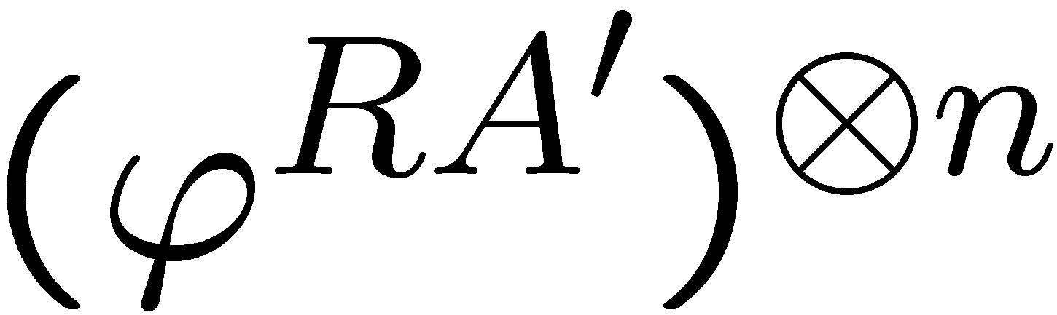
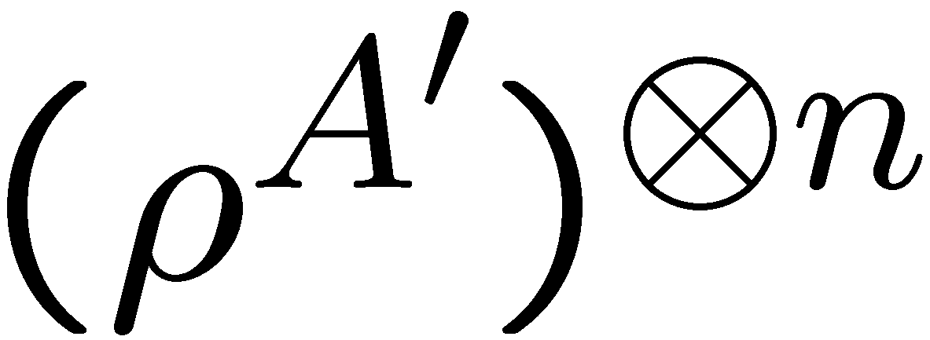


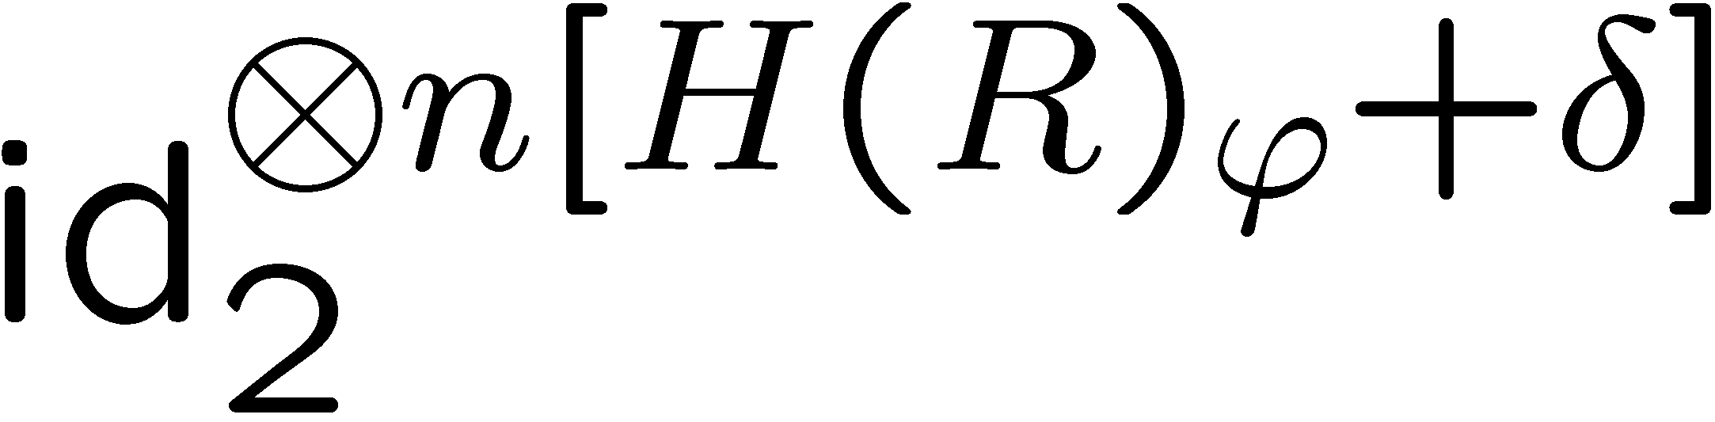



Schumacher (quantum) compression
[Schumacher ’95]
!
Ref
test state
Alice
Bob
SIMULATES
TO PRECISION
…

Slide 4
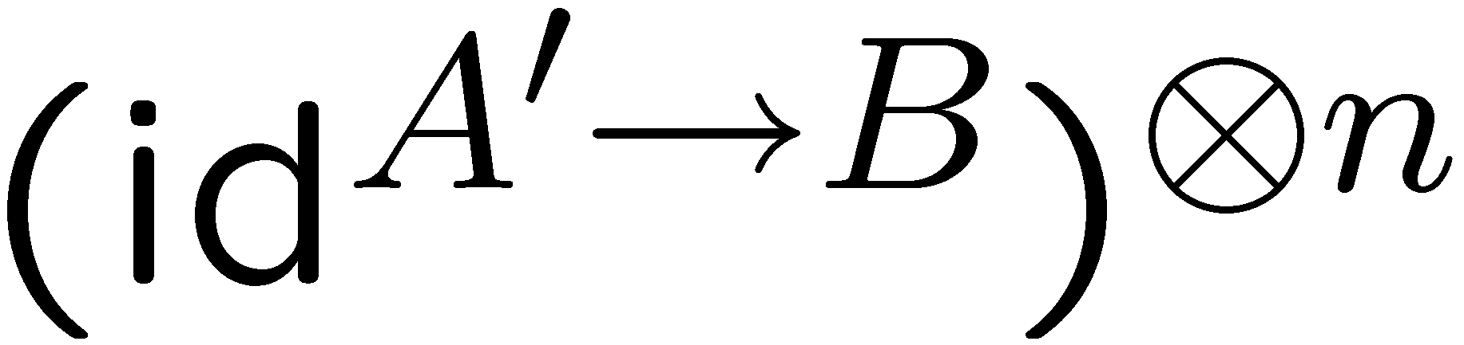
Schumacher (quantum) compression
[Schumacher ’95]
Ref
test state
Would not
work on any
other input!
Alice
Bob
asymptotic
Notes:
Asymptotic, n, eps, delta.

Slide 5
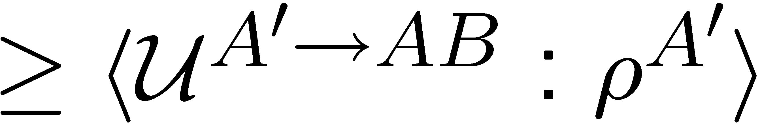
[Devetak, Hayden, Leung, Shor]
!
Fully quantum reverse Shannon (FQRS)
feedback
channel
cf. Schumacher compression

Slide 6

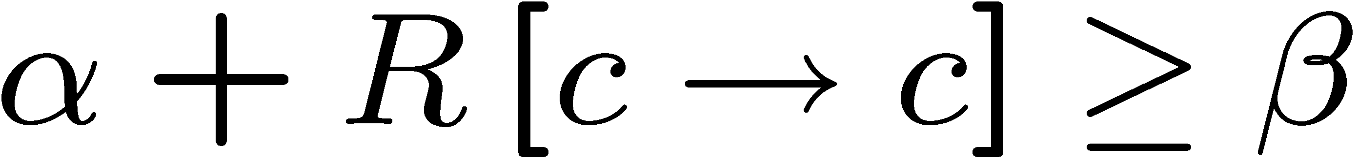
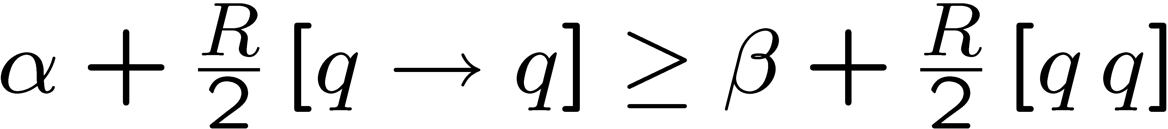
[Bennett, Devetak, Harrow, Shor, Winter]
Quantum reverse Shannon (QRS)
QRS
FQRS
Rule I

Slide 7


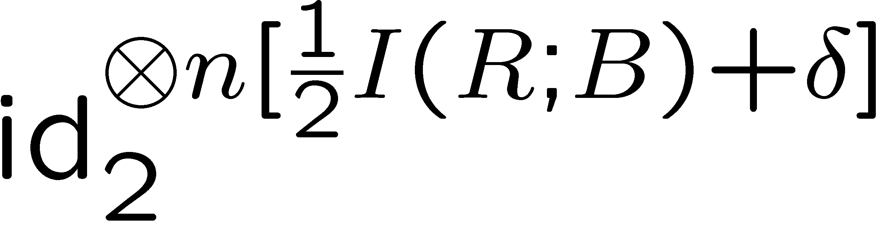
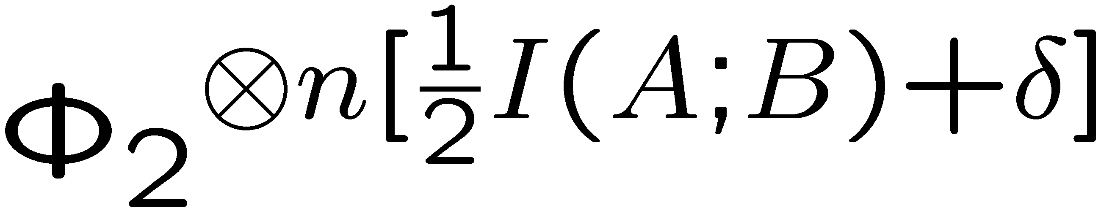

FQRS
[Devetak, Hayden, Leung, Shor]
Ref
Alice
Bob
SIMULATES
TO PRECISION
…
Notes:
Move down a bit. Make an object?

Slide 8
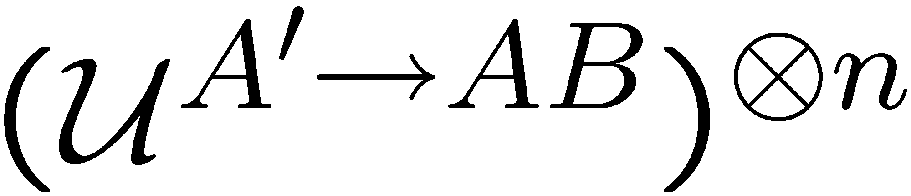
FQRS
[Devetak, Hayden, Leung, Shor]
Ref
Alice
Bob
Notes:
Move down a bit. Make an object?

Slide 9
Quantum reverse Shannon
FQRS
RESOURCE
REVERSAL
TIME
REVERSAL
FF
FQSW
SOURCE-CHANNEL
DUALITY

Slide 10
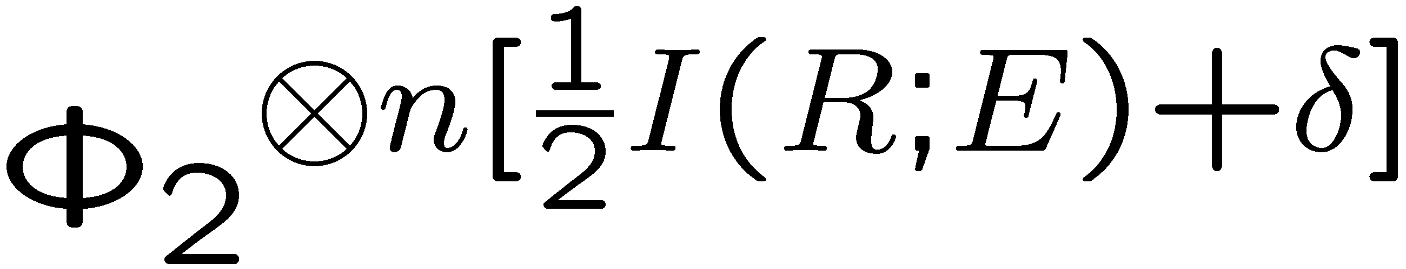
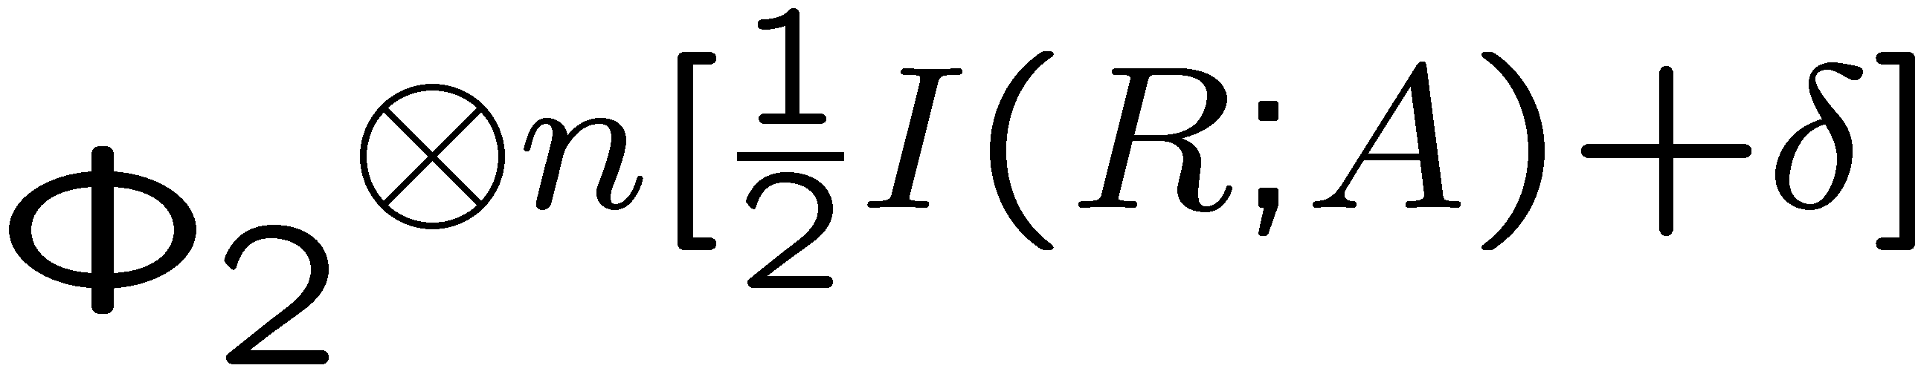

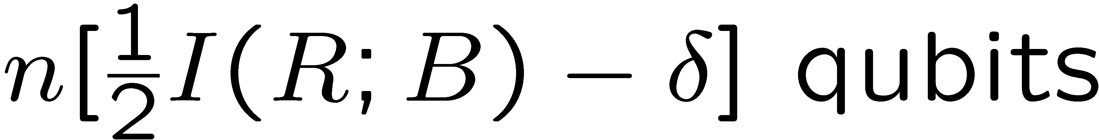
The Feedback Father (FF)
Alice
Bob
Notes:
Move down a bit. Make an object?

Slide 11
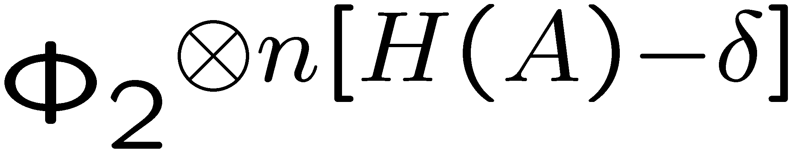
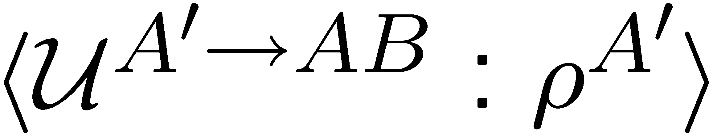
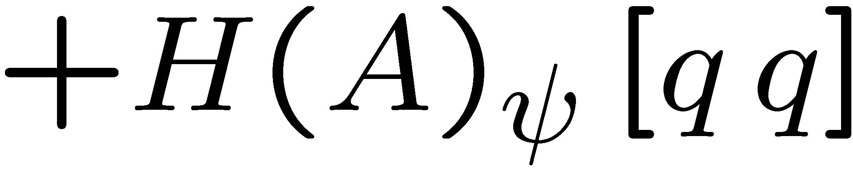
The Feedback Father (FF)
Alice
Bob
Notes:
Move down a bit. Make an object?

Slide 12
The Feedback Father (FF)
FF
cf. FQRS

Slide 13
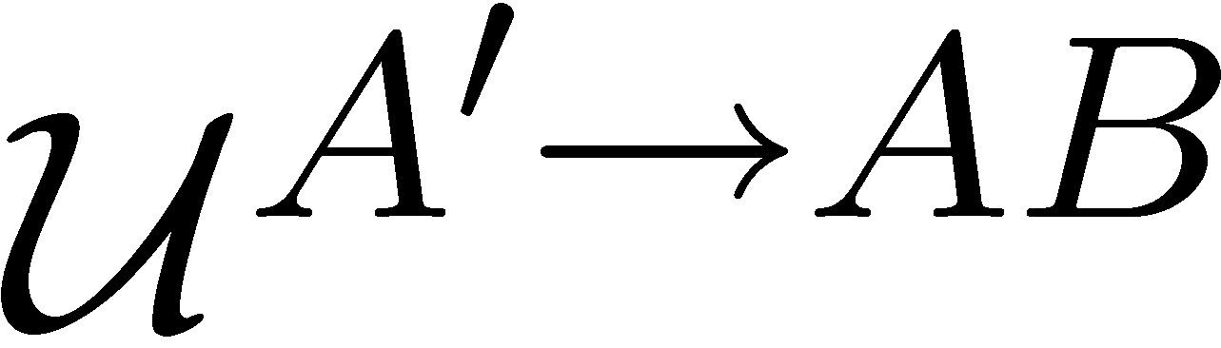

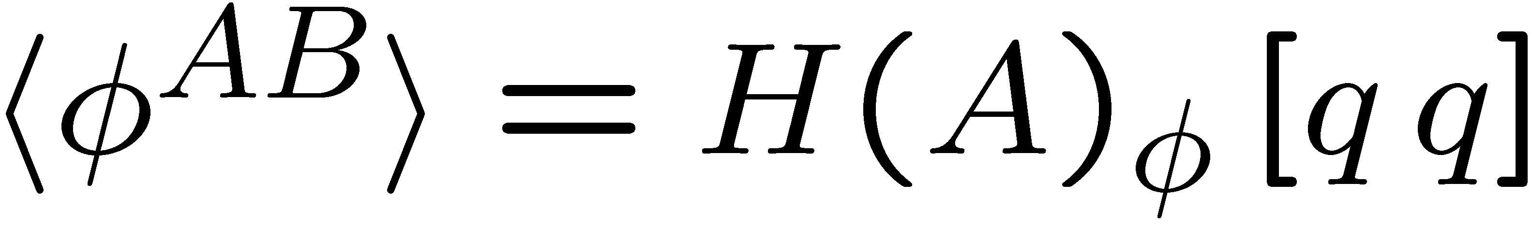
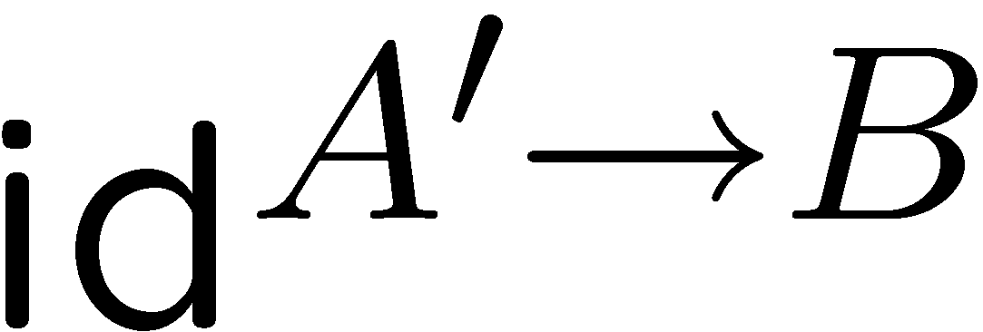
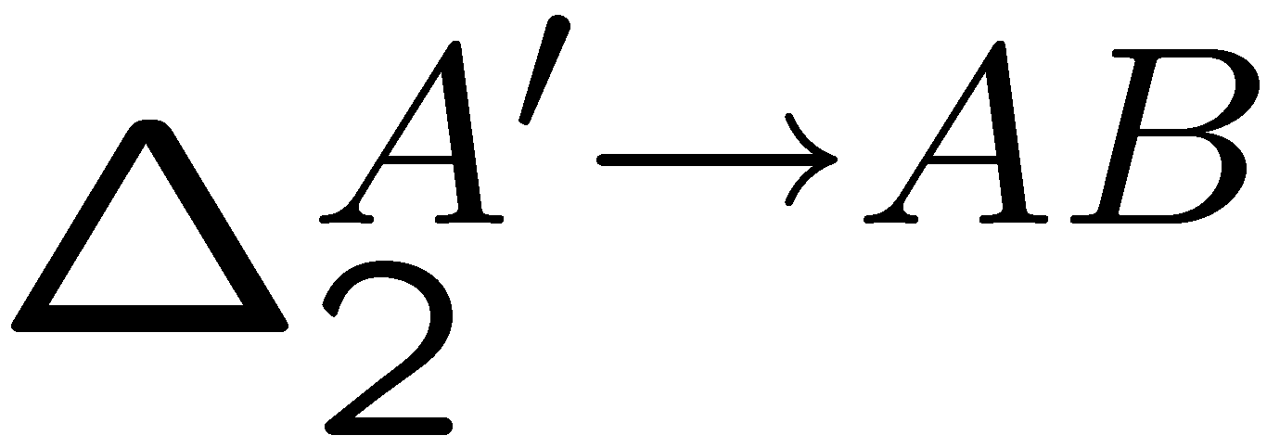
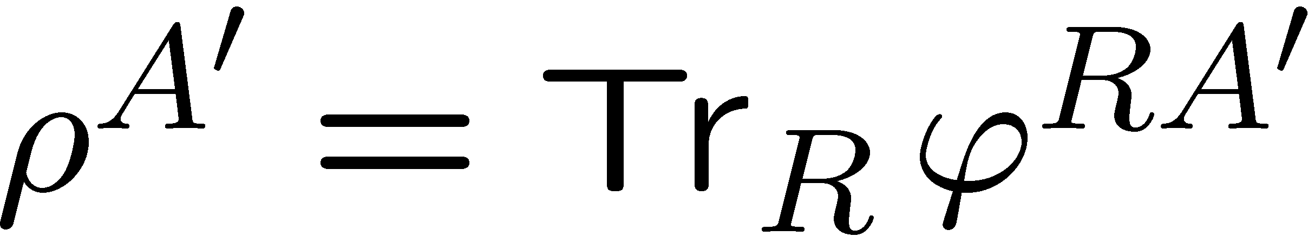
Resource reversal duality: FQRS & FF

Slide 14
Quantum reverse Shannon
FQRS
RESOURCE
REVERSAL
TIME
REVERSAL
FF
FQSW
SOURCE-CHANNEL
DUALITY
Father

Slide 15




The Source
!
Passive protagonist – not allowed to code.
Sends inputs to Alice and/or Bob.
Goal: Redirection of channels originating at the Source (“source coding”)

Slide 16
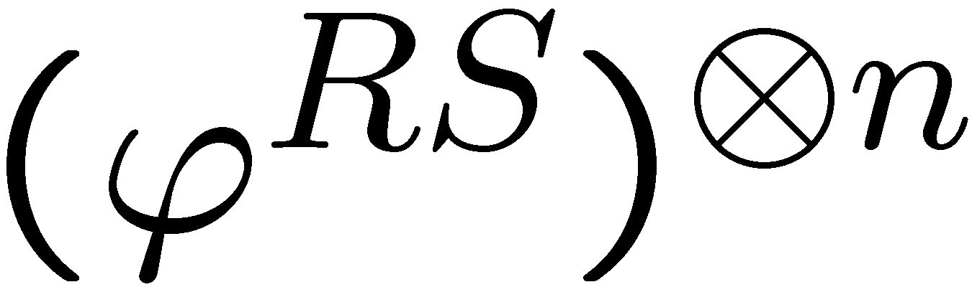

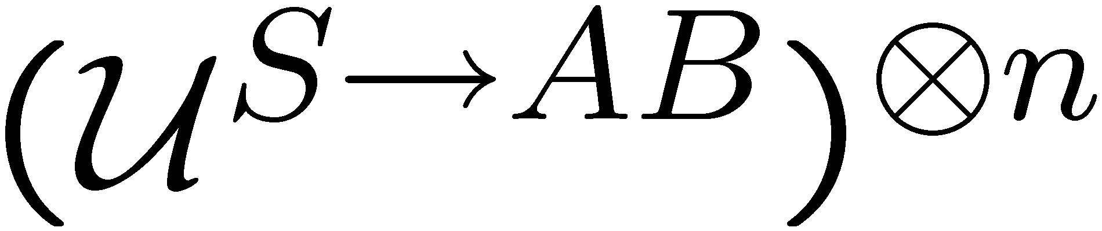
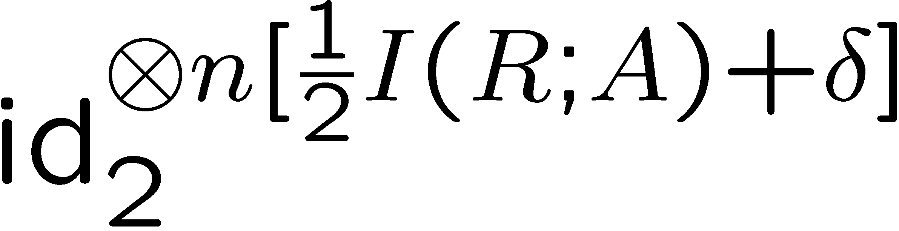
Fully quantum Slepian Wolf (FQSW)
[Abeyesinghe, Devetak, Hayden, Winter]
Ref
Source
Alice
Bob
Notes:
Move down a bit. Make an object?

Slide 17

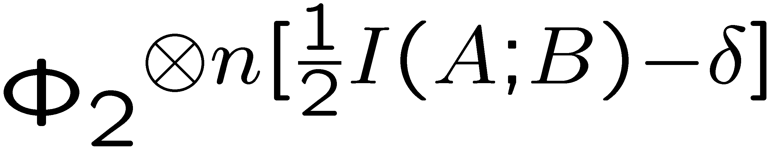
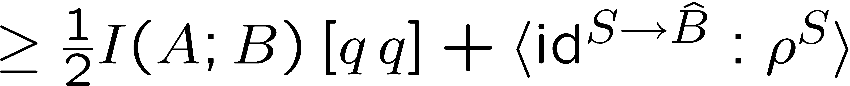
FQSW
[Abeyesinghe, Devetak, Hayden, Winter]
Ref
Source
Alice
Bob
Notes:
Move down a bit. Make an object?

Slide 18
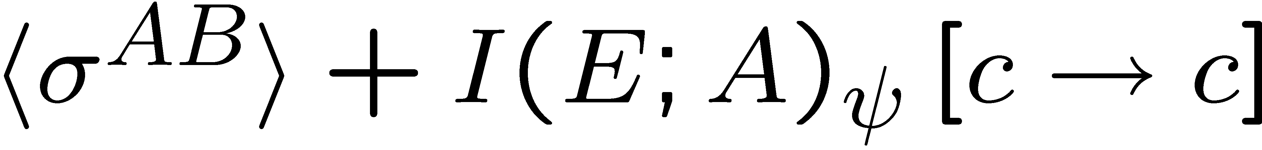
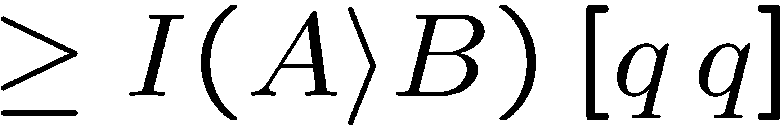



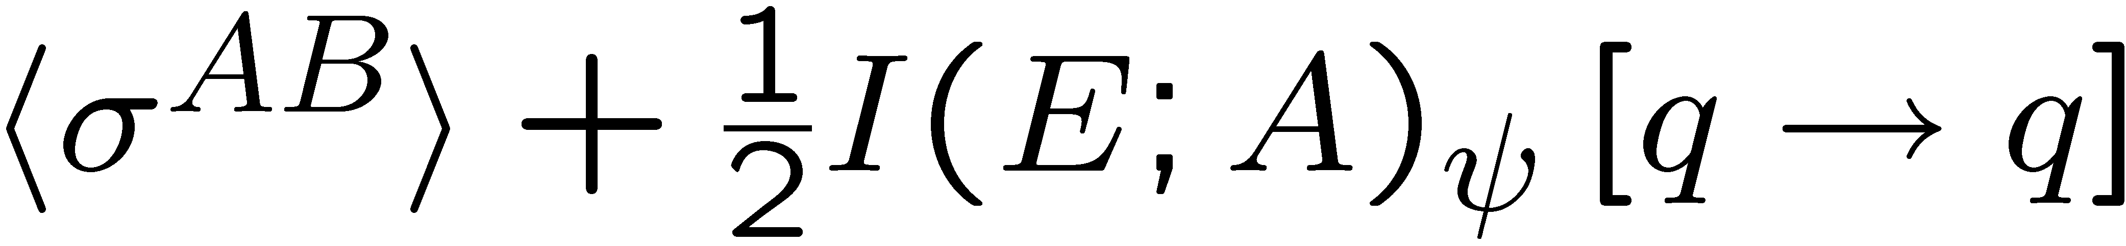
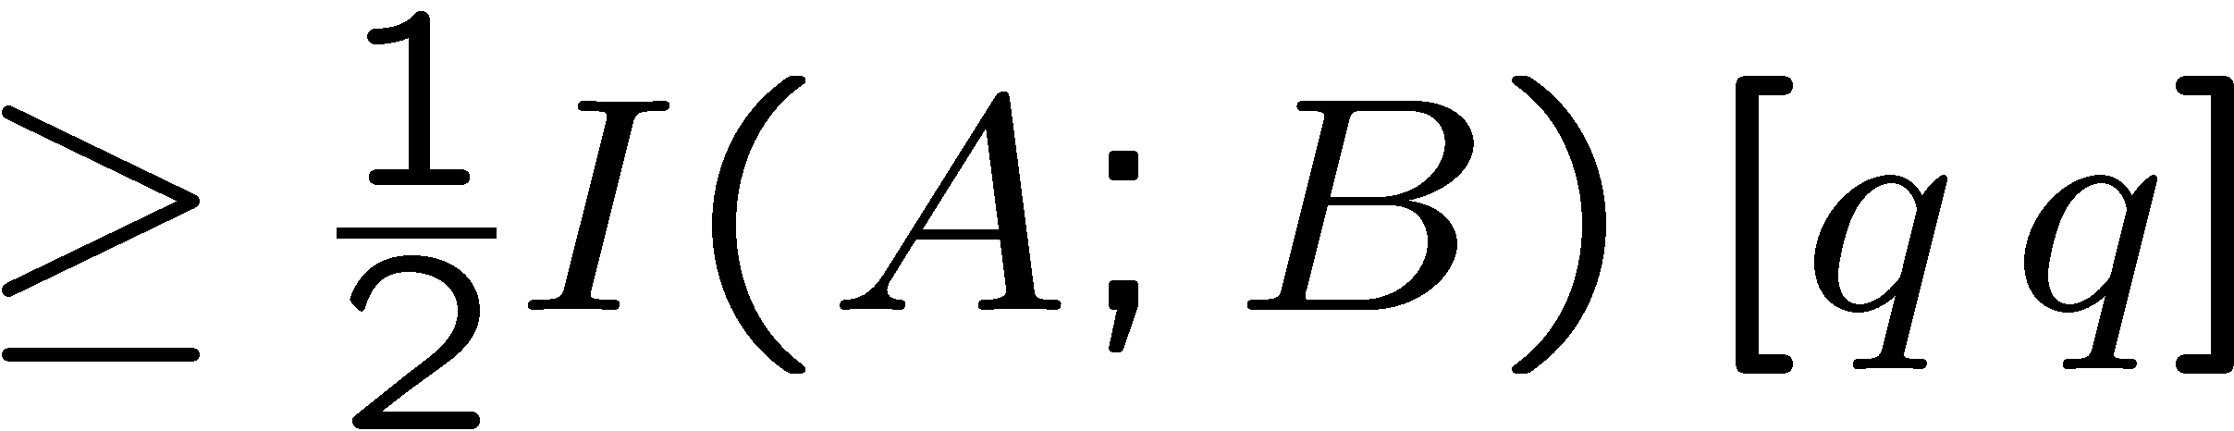
FQSW
[Abeyesinghe, Devetak, Hayden, Winter]
[Devetak, Winter 03]
ED
QSW
= state merging
[Horodecki, Oppenheim,
Winter ’05]
Mother
FQSW
[Devetak, Harrow, Winter 03]

Slide 19
Quantum reverse Shannon
FQRS
RESOURCE
REVERSAL
TIME
REVERSAL
FF
FQSW
SOURCE-CHANNEL
DUALITY
Father
Mother
State merging
Notes:
“LIFTING”

Slide 20
Source-channel duality: FQSW & FF
FF
cf. FQSW

Slide 21
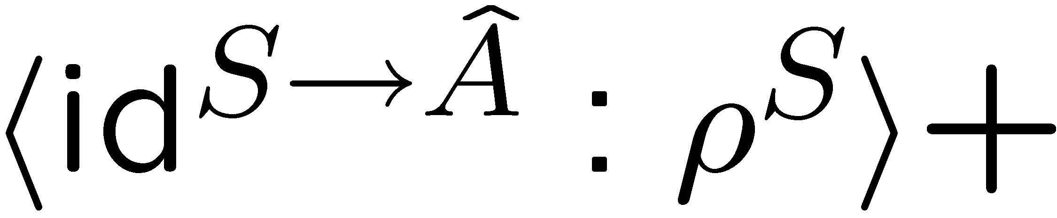
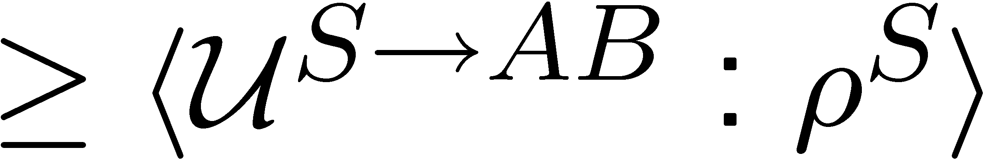
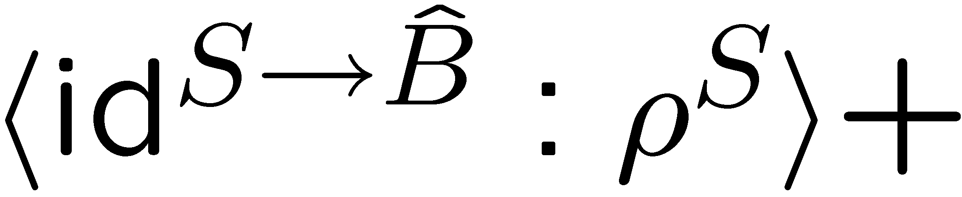
Time-reversal duality: FQSW & FQRS
FQRS
interchange A & B:
cf. FQSW

Slide 22
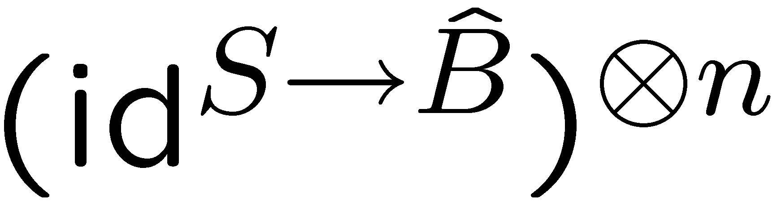
FQSW
FQRS
Ref
Source
Alice
Bob
Notes:
Move down a bit. Make an object?

Slide 23
Summary: Quantum, distributed, closed & relative
FQRS
FF
FQSW

Slide 24
Quantum reverse Shannon
Quantum
Distributed
Closed
Relative
FQRS
RESOURCE
REVERSAL
TIME
REVERSAL
FF
FQSW
SOURCE-CHANNEL
DUALITY
Father
Mother
State merging
Notes:
“LIFTING”

