Slide 1


Efficient Discrete-Time Simulations of Continuous-Time Quantum Query Algorithms
Rolando D. Somma
Joint work with R. Cleve, D. Gottesman, M. Mosca, D. Yonge-Mallo
QIP 2009
January 14, 2009
Santa Fe, NM

Slide 2
Query or Oracle Model of Computation
Given a black-box (BB)
BB
Want to learn a property of the N-tuple
For quantum algorithms, we consider a reversible version of BB:

Slide 3
Query or Oracle Model of Computation
Oracle models are useful to obtain bounds in complexity and to make a fair comparisson between quantum and classical complexities
Quantum algorithms in the oracle model
U₁
U₂
U₃
M
M
Output gives some property of
…
M
M
M
M
Known unitaries
Examples
* Shor’s factorization algorithm: Period-finding
* Grover’s algorithm: find a marked element
* Element Distinctness (Ambainis): finding two equal items

Slide 4
Continuous-Time Quantum Query Model of Computation
1- Query Hamiltonian
Query cost
fractional query
2- Time-dependent Driving Hamiltonian (known)
3- Evolution time (or total query cost) T>0
M
M
Output gives some property of
M
M
M
M
* E. Farhi and S. Gutmann, Phys. Rev. A 57, 2043 (1998)

Slide 5
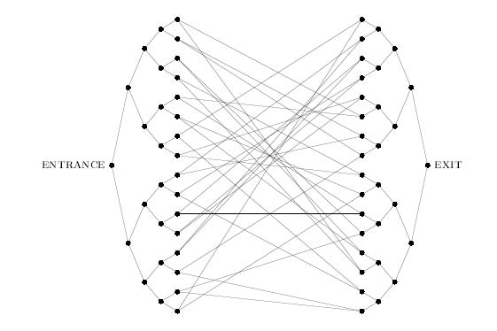
Motivations:
Some quantum algorithms have been discovered in the continuous time query model
“Exponential algorithmic speed up by quantum walk”, Childs et. al.
[Proc. 35th ACM Symp. On Th. Comp. (2003)]
Given: an oracle for the graph, and the name of the Entrance.
Find the name of the Exit.

Slide 6
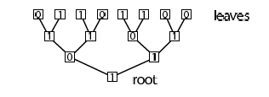
Motivations:
Some quantum algorithms have been discovered in the continuous time query model
“A Quantum Algorithm for Hamiltonian NAND tree”, Farhi, Goldstone, Gutmann
quant-ph/0702144
N
The query Hamiltonian is built from the adjacency matrix of a graph determined by the tree and the input state. It outputs the (binary) NAND in time

Slide 7
Motivations:
Q(1): Is the CT query model more powerful than the conventional query model?
The actual implementation of a quantum algorithm in the CT setting may require knowledge on the query Hamiltonian which my not be an available resource.
Is it possible to convert a quantum algorithm in the CT setting to a quantum algorithm in the more conventional query model?
Yes:
It has been known(2) that this can be done with cost
We present a method to do it at a cost
(1) C. Mochon, Hamiltonian Oracles, quant-ph/0602032
(2) D. Berry, G Ahokas, R. Cleve, and B.C. Sanders, Commun. Math. Phys. 270, 359 (2007)

Slide 8
MAIN RESULTS:
Theorem: Any continuous-time T-query algorithm can be simulated by a discrete-time O(T log T )-query algorithm
Corollary: Any lower bounds on discrete query complexity carry over to continuous query complexity within a log factor

Slide 9
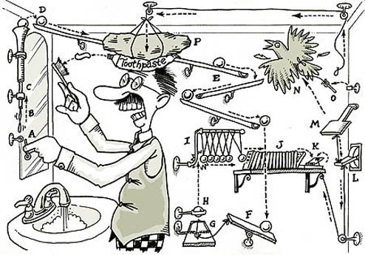
Quantum Algorithm: Overview
The construction has many steps…
• Step 1: Discretization using a (first order) Suzuki-Trotter approximation
• Step 2: Probabilistic simulation of fractional queries using (low-amplitude)
controlled discrete queries
1 and 2 yield simulations of cost O(T²)
Step 3: Reduction on the amount of discrete queries by disregarding high-
Hamming weight control-qubit states
• Step 4: Correction of errors due to step 2

Slide 10
Step 1: Trotter-Suzuki Approximation
Algorithm in the CT setting
Output gives some property of
M
M
M
M
M
U₁
U₂
U₃
M
M
…
M
M
M
Step 1: Fidelity
Still p>>T fractional queries

Slide 11
Step 1: Trotter-Suzuki Approximation
U₁
U₂
U₃
M
M
…
M
M
M
Step 1: Fidelity
Still p>>T fractional queries
It doesn’t work in general…

Slide 12
Step 2: Probabilistic Simulation of Fractional Queries
R1
R2
M
Why do we want this conversion?
The actual query cost is much lower than p.
In step 3, we take advantage of this situation.

Slide 13
Step 2: Probabilistic Simulation of Fractional Queries
U₁
U₂
U₃
U_{p}
M
M
…
M
M
M
R1
R2
M
R1
R2
M
R1
R2
M
U₁
U₂
U₃
M
M
…
M
M
M

Slide 14
Step 3: Reducing the amount of queries
We break the circuit in segments of size m :
R1
R2
M
…
R1
R2
M
R1
R2
M
R1
R2
M
U₁
U₂
U₃
M
M
…
M
M
M
m queries
For a segment of size m,
it is likely to succeed
There are 4T segments of that size
in the total circuit

Slide 15
Step 3: Reducing the amount of queries
R1
R2
M
m
R1
R2
M
R1
R2
M
…
U₁
U₂
U₃
U_{m}
m queries
Density of states
Hamming weight
Poisson distribution: Exponential decay

Slide 16
Step 3: Reducing the amount of queries
R1
m
R1
R1
U₁
U₂
U₃
…
m queries
Density of states
Hamming weight cutoff
At most k<<m full
queries are needed !
Average: A<1/2

Slide 17
Step 3: Reducing the amount of queries
R1
m
R1
R1
U₁
U₂
U₃
…
m full queries
R1
m
R1
R1
U₁
V₂
V₃
V_{k}
…
full queries

Slide 18
Step 3: Reducing the amount of queries
Asks the value of the Hamming weight
m
V_{j}
Implements the desired sequence of U’s
Example:
…
m
V₂
U₂
U₃
U_{m}

Slide 19
Step 3: Reducing the amount of queries
We build Step 4 to error correct and increase the probability of success towards 1

Slide 20
Step 4: Error correction
R1
M
m
R1
M
X
R1
M
U₁
U₂
U₃
…
m queries
1- We undo the circuit:
2- We redo it:

Slide 21
Step 4: Error correction
1- We undo the circuit:
2- We redo it:
Both, the undoing and redoing parts require the simulation of fractional queries with phases ±θ. Therefore, to reduce the total amount of queries, each of these operations have to be simulated probabilistically as explained in step 2.
This yields a branching process, in which we iterate the error correction procedure. In the worst case, the undoing and redoing parts succeed (each) with probability bounded below by 3/4.

Slide 22
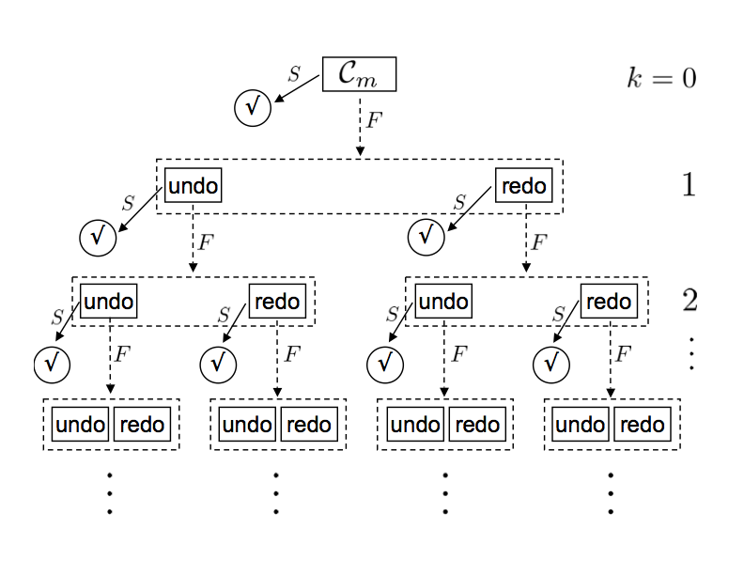
Step 4: Error correction
The probability of success increases towards 1 exponentially fast with k

Slide 23
Step 4: Error correction
Because the size of the tree associated to the branching process is a O(1) constant, to succeed with probability (say) 1- ε₃ , we need to simulate O(T/ ε₃) circuits ONLY.
Each of the circuits in the branching process (of size m or smaller) is simulated using the “trick” of step 3 to reduce the amount of queries

Slide 24
Complexity of the simulation
For fidelity 1-ε, our simulation requires full queries
For classical input/output, the overall complexity is

Slide 25
Step 5: Conclusions!
Improvements?

