Slide 1
Ground State Entanglement in
1-Dimensional Translationally-Invariant Quantum Systems
Sandy Irani
Computer Science Department
University of California, Irvine
Visiting Institute for Quantum Information at Caltech
arXiv:0901.1107

Slide 2
Introduction
What are the minimal set of properties a Hamiltonian must have in order for its ground state to have a high degree of entanglement?
Do symmetries such as translational-invariance limit entanglement?
Notes:
In principle, if we know the Hamiltonian of a quantum system, we know its dynamics completely.
Figuring out the Hamlitonian to describe a particular quantum system can be a very difficult problem – much of 20th c. physics has been dedicated to solving this problem.
The time evolution of a system is easy to solve once you know the energy eigenstates of a system. Also, understanding the state of the system in its lowest energy state is a fundamental entity to learn about a system. Therefore, a great deal of work (and computational power) has been spent on determining the eigenstates and corresponding eigenvalues of a system.
For our purposes, the Hamiltonian will be a 2^n x 2^n matirx – although in all the cases that are interesting for us, it will have a compact represenation.
Note that changing the Hamiltonian by some external means (for example, focusing a laser on an atom) is how one change the Hamiltonian for just the right amount of time so that a desired unitary tranformation is applied to our system.

Slide 3
Introduction
What are the minimal set of properties a Hamiltonian must have in order for its ground state to have a high degree of entanglement?
Do symmetries such as translational-invariance limit entanglement?
  One-dimensional systems.
  Entropy of entanglement when traced down to a contiguous region in the 1D chain.
Notes:
In principle, if we know the Hamiltonian of a quantum system, we know its dynamics completely.
Figuring out the Hamlitonian to describe a particular quantum system can be a very difficult problem – much of 20th c. physics has been dedicated to solving this problem.
The time evolution of a system is easy to solve once you know the energy eigenstates of a system. Also, understanding the state of the system in its lowest energy state is a fundamental entity to learn about a system. Therefore, a great deal of work (and computational power) has been spent on determining the eigenstates and corresponding eigenvalues of a system.
For our purposes, the Hamiltonian will be a 2^n x 2^n matirx – although in all the cases that are interesting for us, it will have a compact represenation.
Note that changing the Hamiltonian by some external means (for example, focusing a laser on an atom) is how one change the Hamiltonian for just the right amount of time so that a desired unitary tranformation is applied to our system.

Slide 4
Previous Work
Local Hamiltonian is QMA-complete, even for 1D systems.
Adiabatic computation on 1D systems can perform universal quantum computation [AIGK07]
    Can these constructions be made translationally-invariant?
      Translationally invariant modification that can be used for 1D universal adiabatic computation.
      [Nagaj-Wocjan, Janzin-Wocjan-Zhang]
        Degenerate
      1D Local Hamiltonian is QMA-complete, even what all two-particle terms are the same. [Kay]
        Requires position-dependent 1-particle terms.
Notes:
In principle, if we know the Hamiltonian of a quantum system, we know its dynamics completely.
Figuring out the Hamlitonian to describe a particular quantum system can be a very difficult problem – much of 20th c. physics has been dedicated to solving this problem.
The time evolution of a system is easy to solve once you know the energy eigenstates of a system. Also, understanding the state of the system in its lowest energy state is a fundamental entity to learn about a system. Therefore, a great deal of work (and computational power) has been spent on determining the eigenstates and corresponding eigenvalues of a system.
For our purposes, the Hamiltonian will be a 2^n x 2^n matirx – although in all the cases that are interesting for us, it will have a compact represenation.
Note that changing the Hamiltonian by some external means (for example, focusing a laser on an atom) is how one change the Hamiltonian for just the right amount of time so that a desired unitary tranformation is applied to our system.

Slide 5
Translation-Invariance
Can we make the 1D construction translationally-invariant with a Hamiltonian which has a non-degenerate ground state?
If the system is described by a single Hamiltonian term applied to all pairs of particles (with bounded precision), how do we encode a circuit?
  Show high entanglement in the ground state.
  For 1D systems, previously known bounds, ground state entanglment entropy scales logarithmically with the region size.
Notes:
In principle, if we know the Hamiltonian of a quantum system, we know its dynamics completely.
Figuring out the Hamlitonian to describe a particular quantum system can be a very difficult problem – much of 20th c. physics has been dedicated to solving this problem.
The time evolution of a system is easy to solve once you know the energy eigenstates of a system. Also, understanding the state of the system in its lowest energy state is a fundamental entity to learn about a system. Therefore, a great deal of work (and computational power) has been spent on determining the eigenstates and corresponding eigenvalues of a system.
For our purposes, the Hamiltonian will be a 2^n x 2^n matirx – although in all the cases that are interesting for us, it will have a compact represenation.
Note that changing the Hamiltonian by some external means (for example, focusing a laser on an atom) is how one change the Hamiltonian for just the right amount of time so that a desired unitary tranformation is applied to our system.

Slide 6
Results
Finite 1D chain:
  Single Hamiltonian term H that operates on two particles of dimension 21, when applied to every neighboring pair in a finite chain of n particles:
    Unique ground state
    Spectral gap 1/poly(n)
    The entropy of entanglement of a region of size m on either end of the chain is (min{m,n-m}).

Slide 7
Results
Cycles and the Infinite Chain:
  Family of translationally-invariant Hamiltonians {H_{n}} for a cycle of nt 21-dimensional particles
    Spectral gap is 1/poly(n)
    For any state in the ground space of H_{n}, and any m, there exist regions of size of m whose entanglement entropy is  (min{m,n}).
      Entanglement bounds for a constant fraction of regions of size m.
  Bounds hold in the limit as t tends towards infinity.

Slide 8
1D Area Law
Upper bound on the entanglement entropy for any ground state of a 1D Hamiltonian H, independent of region size but exponentially dependent on 1/ where  is the spectral gap of H. [Hastings 07]
Gottesman and Hastings: is the dependence on 1/ tight?
  Family of 1D Hamiltonians with unique ground state with regions whose entanglement entropy is (poly(1/)).
  Previously, best known such lower bound was (log(1/))
    arXiv:0901.1108
Construction present here gives a similar result.

Slide 9
Hamiltonian Construction Basics
Type I terms (illegal pairs)
  |ab><ab|
  Energy penalty for: ….xxxabxxxxx….
Type II terms (transition rules)
  ½(|ab><ab| + |cd><cd| - |ab><cd| - |cd><ab|)
…xxxxabxxxx…
…xxxxcdxxxx…
Notes:
In the case of QC, the set of all 2-qubit gates is a continuous set.

Slide 10
Hamiltonian Construction Basics
Type I terms (illegal pairs)
  |ab><ab|
  Energy penalty for: ….xxxabxxxxx….
Type II terms (transition rules)
  ½(|ab><ab| + |cd><cd| - |ab><cd| - |cd><ab|)
…xxxxabxxxx…
…xxxxcdxxxx…
ab -> cd
Notes:
In the case of QC, the set of all 2-qubit gates is a continuous set.

Slide 11
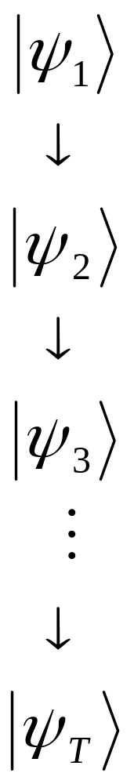
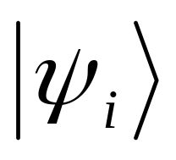
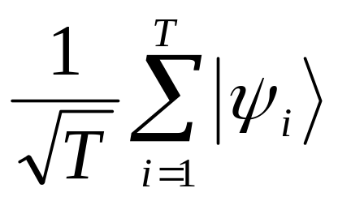
Hamiltonian Construction Basics
Each contains no
illegal pairs.
Ground State =
[Kitaev02]
Notes:
In the case of QC, the set of all 2-qubit gates is a continuous set.

Slide 12
One Dimensional Hamiltonians
Two types of states:
  Control states:      
  Passive States: W w E e U u < >
Transition rules apply to control state and a state to the right or left.
  May move control state to the left or right.
  For example: -->
[AGIK07]
w


W
Notes:
In the case of QC, the set of all 2-qubit gates is a continuous set.

Slide 13
One Dimensional Hamiltonians
Two types of states:
  Control states:      
  Passive States: W w E e U u < >
Transition rules apply to control state and a state to the right or left.
  May move control state to the left or right.
  For example: -->
[AGIK07]
w


W
…
e
e
w

W
E
…
Notes:
In the case of QC, the set of all 2-qubit gates is a continuous set.

Slide 14
One Dimensional Hamiltonians
Two types of states:
  Control states:      
  Passive States: W w E e U u < >
Transition rules apply to control state and a state to the right or left.
  May move control state to the left or right.
  For example: -->
[AGIK07]
w


W
…
e
e
w

W
E
…
Notes:
In the case of QC, the set of all 2-qubit gates is a continuous set.

Slide 15
One Dimensional Hamiltonians
Two types of states:
  Control states:      
  Passive States: W w E e U u < >
Transition rules apply to control state and a state to the right or left.
  May move control state to the left or right.
  For example: -->
[AGIK07]
w


W
…
e
e
w

W
E
…
…
e
e

W
W
E
…
Notes:
In the case of QC, the set of all 2-qubit gates is a continuous set.

Slide 16
Construction Overview
Circles: Single states
w
W
<
>
☺


Diamonds: Two-dimensional subsystems
e₊
E₁
U₀
u



Control states:
Standard basis: specify state type for each site
And then 0 or 1 for each 2D subsystem
☺





Notes:
In the case of QC, the set of all 2-qubit gates is a continuous set.

Slide 17
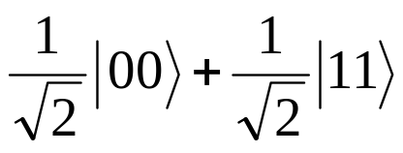
Construction Overview
<
e₊
e₊
e₊
u₊
u₊
u₊
w
₊
W
W
W
E₊
E₊
>
EPR Pairs
e₊
E₁
Entangled states
U₀
u
Unentangled states
Waiting states
w
W
Notes:
In the case of QC, the set of all 2-qubit gates is a continuous set.

Slide 18
Target Ground State
<
e₊

U₊
U₊
W
W
E₊
>

Slide 19
Target Ground State
<
e₊

U₊
U₊
W
W
E₊
>

Slide 20
Target Ground State
<
e₊

U₊
U₊
W
W
E₊
>
<
e₊
e₊

U₊
W
W
E₊
>

Slide 21
Target Ground State
<
e₊

U₊
U₊
W
W
E₊
>
<
e₊
e₊

U₊
W
W
E₊
>

Slide 22
Target Ground State
<
e₊

U₊
U₊
W
W
E₊
>
<
e₊
e₊

U₊
W
W
E₊
>
<
e₊
e₊
u₊

W
W
E₊
>

Slide 23
Target Ground State
<
e₊

U₊
U₊
W
W
E₊
>
<
e₊
e₊

U₊
W
W
E₊
>
<
e₊
e₊
u₊

W
W
E₊
>
<
e₊
e₊
u₊
w

W
E₊
>

Slide 24
Target Ground State
<
e₊

U₊
U₊
W
W
E₊
>
<
e₊
e₊

U₊
W
W
E₊
>
<
e₊
e₊
u₊

W
W
E₊
>
<
e₊
e₊
u₊
w

W
E₊
>
<
e₊
e₊
u₊
w
w

E₊
>

Slide 25
Target Ground State
<
e₊

U₊
U₊
W
W
E₊
>
<
e₊
e₊

U₊
W
W
E₊
>
<
e₊
e₊
u₊

W
W
E₊
>
<
e₊
e₊
u₊
w

W
E₊
>
<
e₊
e₊
u₊
w
w

E₊
>

Slide 26
Target Ground State
<
e₊

U₊
U₊
W
W
E₊
>
<
e₊
e₊

U₊
W
W
E₊
>
<
e₊
e₊
u₊

W
W
E₊
>
<
e₊
e₊
u₊
w

W
E₊
>
<
e₊
e₊
u₊
w
w

E₊
>
<
e₊
e₊
u₊
w
w

E₊
>

Slide 27
Target Ground State
<
e₊

U₊
U₊
W
W
E₊
>
<
e₊
e₊

U₊
W
W
E₊
>
<
e₊
e₊
u₊

W
W
E₊
>
<
e₊
e₊
u₊
w

W
E₊
>
<
e₊
e₊
u₊
w
w

E₊
>
<
e₊
e₊
u₊
w
w

E₊
>
<
e₊
e₊
u₊
w

E₊
E₊
>

Slide 28
Target Ground State
<
e₊

U₊
U₊
W
W
E₊
>
<
e₊
e₊
u₊

W
E₊
E₊
>
<
e₊
e₊

U₊
W
W
E₊
>
<
e₊
e₊
u₊

W
W
E₊
>
<
e₊
e₊
u₊
w

W
E₊
>
<
e₊
e₊
u₊
w
w

E₊
>
<
e₊
e₊
u₊
w
w

E₊
>
<
e₊
e₊
u₊
w

E₊
E₊
>

Slide 29
Target Ground State
<
e₊

U₊
U₊
W
W
E₊
>
<
e₊
e₊
u₊

W
E₊
E₊
>
<
e₊
e₊

U₊
W
W
E₊
>
e₊
e₊
U₊
E₊
E₊
<

W
>
<
e₊
e₊
u₊

W
W
E₊
>
<
e₊
e₊
u₊
w

W
E₊
>
<
e₊
e₊
u₊
w
w

E₊
>
<
e₊
e₊
u₊
w
w

E₊
>
<
e₊
e₊
u₊
w

E₊
E₊
>

Slide 30
Target Ground State
<
e₊

U₊
U₊
W
W
E₊
>
<
e₊
e₊
u₊

W
E₊
E₊
>
<
e₊
e₊

U₊
W
W
E₊
>
e₊
e₊
U₊
E₊
E₊
<

W
>
<
e₊
e₊
u₊

W
W
E₊
>
<
e₊
e₊
u₊
w

W
E₊
>
<
e₊
e₊
u₊
w
w

E₊
>
<
e₊
e₊
u₊
w
w

E₊
>
<
e₊
e₊
u₊
w

E₊
E₊
>

Slide 31
Target Ground State
<
e₊

U₊
U₊
W
W
E₊
>
<
e₊
e₊
u₊

W
E₊
E₊
>
<
e₊
e₊

U₊
W
W
E₊
>
e₊
e₊
U₊
E₊
E₊
<

W
>
<
e₊
e₊
u₊

W
W
E₊
>
<
e₊
e₊

U₊
W
E₊
E₊
>
<
e₊
e₊
u₊
w

W
E₊
>
<
e₊
e₊
u₊
w
w

E₊
>
<
e₊
e₊
u₊
w
w

E₊
>
<
e₊
e₊
u₊
w

E₊
E₊
>

Slide 32
Target Ground State
<
e₊

U₊
U₊
W
W
E₊
>
<
e₊
e₊
u₊

W
E₊
E₊
>
<
e₊
e₊

U₊
W
W
E₊
>
e₊
e₊
U₊
E₊
E₊
<

W
>
<
e₊
e₊
u₊

W
W
E₊
>
<
e₊
e₊

U₊
W
E₊
E₊
>
<
e₊
e₊
u₊
w

W
E₊
>
<
e₊
e₊
u₊
w
w

E₊
>
…
<
e₊
e₊
u₊
w
w

E₊
>
<
e₊
e₊
e₊

E₊
E₊
E₊
>
<
e₊
e₊
u₊
w

E₊
E₊
>

Slide 33
First Round
<
☺
U₊
U₊
U₊
W
W
W
>
<
e₊

U₊
U₊
W
W
W
>
Special control states for
the first round force the
left end and the right end
to agree that it is the first
round.
Will be used to check that
state is symmetric about
center.
<
e₊
u₊

U₊
W
W
W
>
<
e₊
u₊
u₊

W
W
W
>
<
e₊
u₊
u₊
w

W
W
>
<
e₊
u₊
u₊
w
w

W
>
<
e₊
u₊
u₊
w
w
w

>
<
e₊
u₊
u₊
w
w
w

>

Slide 34
The Hamiltonian…so far
H_{trans} = sum of terms from transition rules as applied to all neighboring pairs of particles.
H_{legal} = sum of terms from illegal pairs
H = H_{trans} + H_{legal}
Notes:
In principle, if we know the Hamiltonian of a quantum system, we know its dynamics completely.
Figuring out the Hamlitonian to describe a particular quantum system can be a very difficult problem – much of 20th c. physics has been dedicated to solving this problem.
The time evolution of a system is easy to solve once you know the energy eigenstates of a system. Also, understanding the state of the system in its lowest energy state is a fundamental entity to learn about a system. Therefore, a great deal of work (and computational power) has been spent on determining the eigenstates and corresponding eigenvalues of a system.
For our purposes, the Hamiltonian will be a 2^n x 2^n matirx – although in all the cases that are interesting for us, it will have a compact represenation.
Note that changing the Hamiltonian by some external means (for example, focusing a laser on an atom) is how one change the Hamiltonian for just the right amount of time so that a desired unitary tranformation is applied to our system.

Slide 35
Well-Formed States
A state in the standard basis is well-formed if it is of the form:
  (<+)(e)*(w+u)*(++)(W+U)*(E)*(>+)
  (<+)(e)*(+☺)(W+U)*(E)*(>+)
  (<+)(e)*(w+u)*()(E)*(>+)
…or any substring of these forms
Can be checked by local checks
Notes:
In principle, if we know the Hamiltonian of a quantum system, we know its dynamics completely.
Figuring out the Hamlitonian to describe a particular quantum system can be a very difficult problem – much of 20th c. physics has been dedicated to solving this problem.
The time evolution of a system is easy to solve once you know the energy eigenstates of a system. Also, understanding the state of the system in its lowest energy state is a fundamental entity to learn about a system. Therefore, a great deal of work (and computational power) has been spent on determining the eigenstates and corresponding eigenvalues of a system.
For our purposes, the Hamiltonian will be a 2^n x 2^n matirx – although in all the cases that are interesting for us, it will have a compact represenation.
Note that changing the Hamiltonian by some external means (for example, focusing a laser on an atom) is how one change the Hamiltonian for just the right amount of time so that a desired unitary tranformation is applied to our system.

Slide 36
Well-Formed States
Can not enforce by local checks that a legal state has a control state.
  E.g., eeee……eee must be a legal state.
If the state is bracketed ( a < on left end and a > on the right end), then a legal state must be exactly on of the following three forms:
  (<+)(e)*(w+u)*(++)(W+U)*(E)*(>+)
  (<+)(e)*(+☺)(W+U)*(E)*(>+)
  (<+)(e)*(w+u)*()(E)*(>+)
Notes:
In principle, if we know the Hamiltonian of a quantum system, we know its dynamics completely.
Figuring out the Hamlitonian to describe a particular quantum system can be a very difficult problem – much of 20th c. physics has been dedicated to solving this problem.
The time evolution of a system is easy to solve once you know the energy eigenstates of a system. Also, understanding the state of the system in its lowest energy state is a fundamental entity to learn about a system. Therefore, a great deal of work (and computational power) has been spent on determining the eigenstates and corresponding eigenvalues of a system.
For our purposes, the Hamiltonian will be a 2^n x 2^n matirx – although in all the cases that are interesting for us, it will have a compact represenation.
Note that changing the Hamiltonian by some external means (for example, focusing a laser on an atom) is how one change the Hamiltonian for just the right amount of time so that a desired unitary tranformation is applied to our system.

Slide 37
Properties of Well-Formed States
H_{trans} + H_{legal} is closed over the subspace spanned by well-formed states.
  (All additional terms will be diagonal in standard basis).
For each well-formed state, at most one transition rule applies in the forward direction and at most one transition rule applies in the reverse direction.
Notes:
In principle, if we know the Hamiltonian of a quantum system, we know its dynamics completely.
Figuring out the Hamlitonian to describe a particular quantum system can be a very difficult problem – much of 20th c. physics has been dedicated to solving this problem.
The time evolution of a system is easy to solve once you know the energy eigenstates of a system. Also, understanding the state of the system in its lowest energy state is a fundamental entity to learn about a system. Therefore, a great deal of work (and computational power) has been spent on determining the eigenstates and corresponding eigenvalues of a system.
For our purposes, the Hamiltonian will be a 2^n x 2^n matirx – although in all the cases that are interesting for us, it will have a compact represenation.
Note that changing the Hamiltonian by some external means (for example, focusing a laser on an atom) is how one change the Hamiltonian for just the right amount of time so that a desired unitary tranformation is applied to our system.

Slide 38
State Graph
Nodes – set of all state in standard basis.
Edges - directed edge from state A to state B if B can be obtained by applying one transition rule to A.
  Well-formed states are disconnected from the rest of the graph.
  State graph restricted to well-formed states form disjoint paths.
Notes:
In principle, if we know the Hamiltonian of a quantum system, we know its dynamics completely.
Figuring out the Hamlitonian to describe a particular quantum system can be a very difficult problem – much of 20th c. physics has been dedicated to solving this problem.
The time evolution of a system is easy to solve once you know the energy eigenstates of a system. Also, understanding the state of the system in its lowest energy state is a fundamental entity to learn about a system. Therefore, a great deal of work (and computational power) has been spent on determining the eigenstates and corresponding eigenvalues of a system.
For our purposes, the Hamiltonian will be a 2^n x 2^n matirx – although in all the cases that are interesting for us, it will have a compact represenation.
Note that changing the Hamiltonian by some external means (for example, focusing a laser on an atom) is how one change the Hamiltonian for just the right amount of time so that a desired unitary tranformation is applied to our system.

Slide 39
Hamiltonians Restricted to Paths
Notes:
In principle, if we know the Hamiltonian of a quantum system, we know its dynamics completely.
Figuring out the Hamlitonian to describe a particular quantum system can be a very difficult problem – much of 20th c. physics has been dedicated to solving this problem.
The time evolution of a system is easy to solve once you know the energy eigenstates of a system. Also, understanding the state of the system in its lowest energy state is a fundamental entity to learn about a system. Therefore, a great deal of work (and computational power) has been spent on determining the eigenstates and corresponding eigenvalues of a system.
For our purposes, the Hamiltonian will be a 2^n x 2^n matirx – although in all the cases that are interesting for us, it will have a compact represenation.
Note that changing the Hamiltonian by some external means (for example, focusing a laser on an atom) is how one change the Hamiltonian for just the right amount of time so that a desired unitary tranformation is applied to our system.

Slide 40
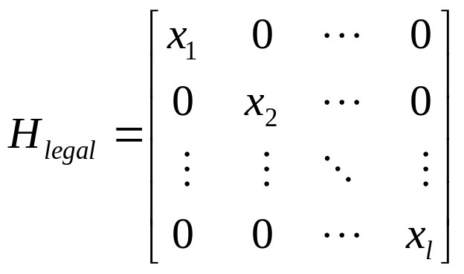
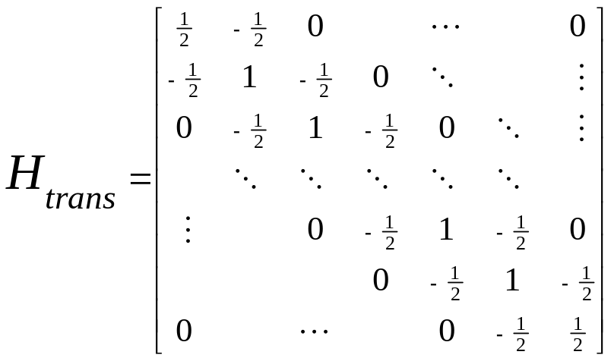
The Hamiltonian restricted to a single path
If H_{legal} has a non-zero entry, the minimum eigenvalue of H restricted to the subspace spanned by states in the path is (1/l³) which is (1/n⁶). [Kitaev 02]
If H_{legal} is all zero, the state which is the uniform superposition of states in the path has zero energy.
Notes:
In principle, if we know the Hamiltonian of a quantum system, we know its dynamics completely.
Figuring out the Hamlitonian to describe a particular quantum system can be a very difficult problem – much of 20th c. physics has been dedicated to solving this problem.
The time evolution of a system is easy to solve once you know the energy eigenstates of a system. Also, understanding the state of the system in its lowest energy state is a fundamental entity to learn about a system. Therefore, a great deal of work (and computational power) has been spent on determining the eigenstates and corresponding eigenvalues of a system.
For our purposes, the Hamiltonian will be a 2^n x 2^n matirx – although in all the cases that are interesting for us, it will have a compact represenation.
Note that changing the Hamiltonian by some external means (for example, focusing a laser on an atom) is how one change the Hamiltonian for just the right amount of time so that a desired unitary tranformation is applied to our system.

Slide 41
Bad States
<
e
e
e
e
u
w
w

E
>
<
e
u
w
w

E
E
E
E
>
<
e
e
u
u
u
u
w

E
>
<
e₁
e
u
u
w
w
w

E₀
>
Will check for these states by showing that they evolve (via forward or backward application of the transition rules) to illegal states.

Slide 42
How To Check for Bad States:
An Example
<
e
e
e
e
u
w
w

E
>
Notes:
In principle, if we know the Hamiltonian of a quantum system, we know its dynamics completely.
Figuring out the Hamlitonian to describe a particular quantum system can be a very difficult problem – much of 20th c. physics has been dedicated to solving this problem.
The time evolution of a system is easy to solve once you know the energy eigenstates of a system. Also, understanding the state of the system in its lowest energy state is a fundamental entity to learn about a system. Therefore, a great deal of work (and computational power) has been spent on determining the eigenstates and corresponding eigenvalues of a system.
For our purposes, the Hamiltonian will be a 2^n x 2^n matirx – although in all the cases that are interesting for us, it will have a compact represenation.
Note that changing the Hamiltonian by some external means (for example, focusing a laser on an atom) is how one change the Hamiltonian for just the right amount of time so that a desired unitary tranformation is applied to our system.

Slide 43
How To Check for Bad States:
An Example
<
e
e
e
u
u
w
w
w

>
<
e
e
e
e
u
w
w

E
>
Notes:
In principle, if we know the Hamiltonian of a quantum system, we know its dynamics completely.
Figuring out the Hamlitonian to describe a particular quantum system can be a very difficult problem – much of 20th c. physics has been dedicated to solving this problem.
The time evolution of a system is easy to solve once you know the energy eigenstates of a system. Also, understanding the state of the system in its lowest energy state is a fundamental entity to learn about a system. Therefore, a great deal of work (and computational power) has been spent on determining the eigenstates and corresponding eigenvalues of a system.
For our purposes, the Hamiltonian will be a 2^n x 2^n matirx – although in all the cases that are interesting for us, it will have a compact represenation.
Note that changing the Hamiltonian by some external means (for example, focusing a laser on an atom) is how one change the Hamiltonian for just the right amount of time so that a desired unitary tranformation is applied to our system.

Slide 44
How To Check for Bad States:
An Example
<
e
e
e
u
u
w
w
w

>
<
e
e
e
u
u
w
w
w

>
<
e
e
e
e
u
w
w

E
>
Notes:
In principle, if we know the Hamiltonian of a quantum system, we know its dynamics completely.
Figuring out the Hamlitonian to describe a particular quantum system can be a very difficult problem – much of 20th c. physics has been dedicated to solving this problem.
The time evolution of a system is easy to solve once you know the energy eigenstates of a system. Also, understanding the state of the system in its lowest energy state is a fundamental entity to learn about a system. Therefore, a great deal of work (and computational power) has been spent on determining the eigenstates and corresponding eigenvalues of a system.
For our purposes, the Hamiltonian will be a 2^n x 2^n matirx – although in all the cases that are interesting for us, it will have a compact represenation.
Note that changing the Hamiltonian by some external means (for example, focusing a laser on an atom) is how one change the Hamiltonian for just the right amount of time so that a desired unitary tranformation is applied to our system.

Slide 45
How To Check for Bad States:
An Example
<
e
e
e

U
U
W
W
W
>
...
<
e
e
e
u
u
w
w
w

>
<
e
e
e
u
u
w
w
w

>
<
e
e
e
e
u
w
w

E
>
Notes:
In principle, if we know the Hamiltonian of a quantum system, we know its dynamics completely.
Figuring out the Hamlitonian to describe a particular quantum system can be a very difficult problem – much of 20th c. physics has been dedicated to solving this problem.
The time evolution of a system is easy to solve once you know the energy eigenstates of a system. Also, understanding the state of the system in its lowest energy state is a fundamental entity to learn about a system. Therefore, a great deal of work (and computational power) has been spent on determining the eigenstates and corresponding eigenvalues of a system.
For our purposes, the Hamiltonian will be a 2^n x 2^n matirx – although in all the cases that are interesting for us, it will have a compact represenation.
Note that changing the Hamiltonian by some external means (for example, focusing a laser on an atom) is how one change the Hamiltonian for just the right amount of time so that a desired unitary tranformation is applied to our system.

Slide 46
How To Check for Bad States:
An Example
<
e
e
☺
U
U
U
W
W
W
>
<
e
e
e

U
U
W
W
W
>
...
<
e
e
e
u
u
w
w
w

>
<
e
e
e
u
u
w
w
w

>
<
e
e
e
e
u
w
w

E
>
Notes:
In principle, if we know the Hamiltonian of a quantum system, we know its dynamics completely.
Figuring out the Hamlitonian to describe a particular quantum system can be a very difficult problem – much of 20th c. physics has been dedicated to solving this problem.
The time evolution of a system is easy to solve once you know the energy eigenstates of a system. Also, understanding the state of the system in its lowest energy state is a fundamental entity to learn about a system. Therefore, a great deal of work (and computational power) has been spent on determining the eigenstates and corresponding eigenvalues of a system.
For our purposes, the Hamiltonian will be a 2^n x 2^n matirx – although in all the cases that are interesting for us, it will have a compact represenation.
Note that changing the Hamiltonian by some external means (for example, focusing a laser on an atom) is how one change the Hamiltonian for just the right amount of time so that a desired unitary tranformation is applied to our system.

Slide 47
Need to Show:
A path that starts with
corresponds to a zero energy state for H.
A path that does not start with
contains a state that has an illegal pair
OR does not have states that are bracketed. (Start with < and end with > ).
…
…
<
☺
U₊
U₊
W
W
>
m
m
…
…
<
☺
U₊
U₊
W
W
>
m
m

Slide 48

Initializing Qubits
H_{init} = | >< | Penalty for state U₋
Ensures that ground state corresponds to a path whose initial state has qubits set to
U₋
U₋
…
…
<
☺
U₊
U₊
W
W
>
m
m
Notes:
In principle, if we know the Hamiltonian of a quantum system, we know its dynamics completely.
Figuring out the Hamlitonian to describe a particular quantum system can be a very difficult problem – much of 20th c. physics has been dedicated to solving this problem.
The time evolution of a system is easy to solve once you know the energy eigenstates of a system. Also, understanding the state of the system in its lowest energy state is a fundamental entity to learn about a system. Therefore, a great deal of work (and computational power) has been spent on determining the eigenstates and corresponding eigenvalues of a system.
For our purposes, the Hamiltonian will be a 2^n x 2^n matirx – although in all the cases that are interesting for us, it will have a compact represenation.
Note that changing the Hamiltonian by some external means (for example, focusing a laser on an atom) is how one change the Hamiltonian for just the right amount of time so that a desired unitary tranformation is applied to our system.

Slide 49
Enforcing Bracketed States
H_{bracket} = I - | >< | - | >< |
H = 3( H_{trans} + H_{legal} ) + H_{init} + H_{bracket}
  3( H_{trans} + H_{legal} ) term ensures there are no bracket terms in the middle.
  H_{bracket} term gives an energy benefit for having brackets at the end
<
<
>
>
Notes:
In principle, if we know the Hamiltonian of a quantum system, we know its dynamics completely.
Figuring out the Hamlitonian to describe a particular quantum system can be a very difficult problem – much of 20th c. physics has been dedicated to solving this problem.
The time evolution of a system is easy to solve once you know the energy eigenstates of a system. Also, understanding the state of the system in its lowest energy state is a fundamental entity to learn about a system. Therefore, a great deal of work (and computational power) has been spent on determining the eigenstates and corresponding eigenvalues of a system.
For our purposes, the Hamiltonian will be a 2^n x 2^n matirx – although in all the cases that are interesting for us, it will have a compact represenation.
Note that changing the Hamiltonian by some external means (for example, focusing a laser on an atom) is how one change the Hamiltonian for just the right amount of time so that a desired unitary tranformation is applied to our system.

Slide 50
Entropy of Entanglement
…
O(n²)
…
Notes:
In principle, if we know the Hamiltonian of a quantum system, we know its dynamics completely.
Figuring out the Hamlitonian to describe a particular quantum system can be a very difficult problem – much of 20th c. physics has been dedicated to solving this problem.
The time evolution of a system is easy to solve once you know the energy eigenstates of a system. Also, understanding the state of the system in its lowest energy state is a fundamental entity to learn about a system. Therefore, a great deal of work (and computational power) has been spent on determining the eigenstates and corresponding eigenvalues of a system.
For our purposes, the Hamiltonian will be a 2^n x 2^n matirx – although in all the cases that are interesting for us, it will have a compact represenation.
Note that changing the Hamiltonian by some external means (for example, focusing a laser on an atom) is how one change the Hamiltonian for just the right amount of time so that a desired unitary tranformation is applied to our system.

Slide 51
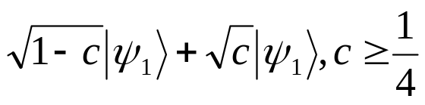
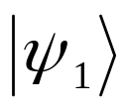
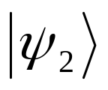
Entropy of Entanglement
…
O(n²)
…
A
Notes:
In principle, if we know the Hamiltonian of a quantum system, we know its dynamics completely.
Figuring out the Hamlitonian to describe a particular quantum system can be a very difficult problem – much of 20th c. physics has been dedicated to solving this problem.
The time evolution of a system is easy to solve once you know the energy eigenstates of a system. Also, understanding the state of the system in its lowest energy state is a fundamental entity to learn about a system. Therefore, a great deal of work (and computational power) has been spent on determining the eigenstates and corresponding eigenvalues of a system.
For our purposes, the Hamiltonian will be a 2^n x 2^n matirx – although in all the cases that are interesting for us, it will have a compact represenation.
Note that changing the Hamiltonian by some external means (for example, focusing a laser on an atom) is how one change the Hamiltonian for just the right amount of time so that a desired unitary tranformation is applied to our system.

Slide 52
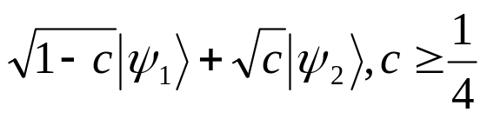
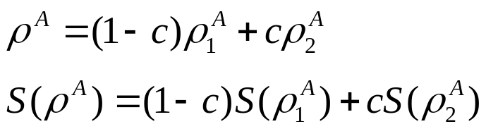
Entropy of Entanglement
…
O(n²)
…
A
Notes:
In principle, if we know the Hamiltonian of a quantum system, we know its dynamics completely.
Figuring out the Hamlitonian to describe a particular quantum system can be a very difficult problem – much of 20th c. physics has been dedicated to solving this problem.
The time evolution of a system is easy to solve once you know the energy eigenstates of a system. Also, understanding the state of the system in its lowest energy state is a fundamental entity to learn about a system. Therefore, a great deal of work (and computational power) has been spent on determining the eigenstates and corresponding eigenvalues of a system.
For our purposes, the Hamiltonian will be a 2^n x 2^n matirx – although in all the cases that are interesting for us, it will have a compact represenation.
Note that changing the Hamiltonian by some external means (for example, focusing a laser on an atom) is how one change the Hamiltonian for just the right amount of time so that a desired unitary tranformation is applied to our system.

Slide 53
Finite Cycle of size tn
Change H_{legal} so that the pair is allowed.
Well-formed states look like:
A sequence from a to a is a segment.
H is closed on the set of well-formed states for a fixed set of segments.
>
<
<
e
e
u

W
W
E
>
<
e
u

W
W
>
<
☺
U
W
>
<
>
Notes:
In principle, if we know the Hamiltonian of a quantum system, we know its dynamics completely.
Figuring out the Hamlitonian to describe a particular quantum system can be a very difficult problem – much of 20th c. physics has been dedicated to solving this problem.
The time evolution of a system is easy to solve once you know the energy eigenstates of a system. Also, understanding the state of the system in its lowest energy state is a fundamental entity to learn about a system. Therefore, a great deal of work (and computational power) has been spent on determining the eigenstates and corresponding eigenvalues of a system.
For our purposes, the Hamiltonian will be a 2^n x 2^n matirx – although in all the cases that are interesting for us, it will have a compact represenation.
Note that changing the Hamiltonian by some external means (for example, focusing a laser on an atom) is how one change the Hamiltonian for just the right amount of time so that a desired unitary tranformation is applied to our system.

Slide 54


Finite Cycle Cont.
H = p(n)(H_{legal} + H_{trans} +H_{init}) + H_{size}
For p(n) large enough, using the Projection Lemma of Kempe-Kitaev-Regev, we can assume that the ground state of H is composed of tensor projects of ground states for finite chains.
Ground state for finite chain of length l is
Ground state for H will have form:
Notes:
In principle, if we know the Hamiltonian of a quantum system, we know its dynamics completely.
Figuring out the Hamlitonian to describe a particular quantum system can be a very difficult problem – much of 20th c. physics has been dedicated to solving this problem.
The time evolution of a system is easy to solve once you know the energy eigenstates of a system. Also, understanding the state of the system in its lowest energy state is a fundamental entity to learn about a system. Therefore, a great deal of work (and computational power) has been spent on determining the eigenstates and corresponding eigenvalues of a system.
For our purposes, the Hamiltonian will be a 2^n x 2^n matirx – although in all the cases that are interesting for us, it will have a compact represenation.
Note that changing the Hamiltonian by some external means (for example, focusing a laser on an atom) is how one change the Hamiltonian for just the right amount of time so that a desired unitary tranformation is applied to our system.

Slide 55
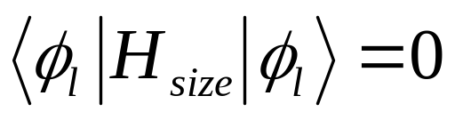
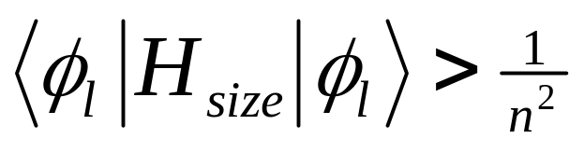
H_{size}
H_{size}= (1/n)I
  - | >< |
  + (n-1)/T_{n}[| >< | + | >< | + | >< | ]
T_{l} is the number of standard basis states in the support of the ground state for a segment of length l.
if and only if l=n
Otherwise
>
>
☺
☺




Notes:
In principle, if we know the Hamiltonian of a quantum system, we know its dynamics completely.
Figuring out the Hamlitonian to describe a particular quantum system can be a very difficult problem – much of 20th c. physics has been dedicated to solving this problem.
The time evolution of a system is easy to solve once you know the energy eigenstates of a system. Also, understanding the state of the system in its lowest energy state is a fundamental entity to learn about a system. Therefore, a great deal of work (and computational power) has been spent on determining the eigenstates and corresponding eigenvalues of a system.
For our purposes, the Hamiltonian will be a 2^n x 2^n matirx – although in all the cases that are interesting for us, it will have a compact represenation.
Note that changing the Hamiltonian by some external means (for example, focusing a laser on an atom) is how one change the Hamiltonian for just the right amount of time so that a desired unitary tranformation is applied to our system.

Slide 56
Ground States for the Finite Cycle
n orthogonal ground states, each a translation one site over.
For any region size a constant fraction of the regions of that size have high entanglement.
Superposition of all n states is translationally invariant and for every region size, all regions of that size have high entanglement.
…
…
…
…
…
<
>
<
>
<
>
<
>
<
>
n
n
n
n
n
Notes:
In principle, if we know the Hamiltonian of a quantum system, we know its dynamics completely.
Figuring out the Hamlitonian to describe a particular quantum system can be a very difficult problem – much of 20th c. physics has been dedicated to solving this problem.
The time evolution of a system is easy to solve once you know the energy eigenstates of a system. Also, understanding the state of the system in its lowest energy state is a fundamental entity to learn about a system. Therefore, a great deal of work (and computational power) has been spent on determining the eigenstates and corresponding eigenvalues of a system.
For our purposes, the Hamiltonian will be a 2^n x 2^n matirx – although in all the cases that are interesting for us, it will have a compact represenation.
Note that changing the Hamiltonian by some external means (for example, focusing a laser on an atom) is how one change the Hamiltonian for just the right amount of time so that a desired unitary tranformation is applied to our system.

Slide 57
Open Problems
Improve gap – lower bound on entropy as a function of 1/.
For a given region size m, can we achieve high entropy for all regions of size m?
Unique ground state for finite cycle and infinite chain?
Can we achieve high entanglement entropy for all region sizes simultaneously for a translationally-invariant Hamiltonian?
Notes:
In principle, if we know the Hamiltonian of a quantum system, we know its dynamics completely.
Figuring out the Hamlitonian to describe a particular quantum system can be a very difficult problem – much of 20th c. physics has been dedicated to solving this problem.
The time evolution of a system is easy to solve once you know the energy eigenstates of a system. Also, understanding the state of the system in its lowest energy state is a fundamental entity to learn about a system. Therefore, a great deal of work (and computational power) has been spent on determining the eigenstates and corresponding eigenvalues of a system.
For our purposes, the Hamiltonian will be a 2^n x 2^n matirx – although in all the cases that are interesting for us, it will have a compact represenation.
Note that changing the Hamiltonian by some external means (for example, focusing a laser on an atom) is how one change the Hamiltonian for just the right amount of time so that a desired unitary tranformation is applied to our system.

