Slide 1
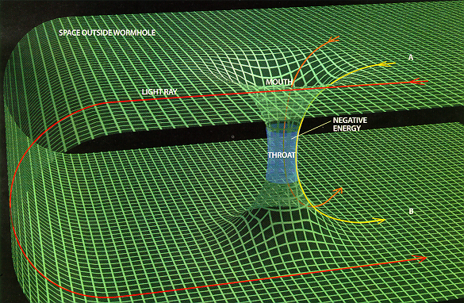
Closed Timelike Curves Make Quantum and Classical Computing Equivalent
BQP
PSPACE
Scott Aaronson
MIT
John Watrous
U. Waterloo

Slide 2
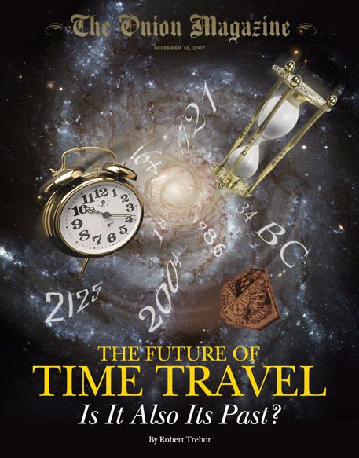
Uh-oh … here goes Scott with another loony talk about time travel or some such … distracting everyone from the serious stuff like quantum multi-prover interactive proof systems...
If you don’t like time travel, then this talk is about a new algorithm for implicitly computing fixed points of superoperators in polynomial space.
But really … you don’t like time travel?!

Slide 3

Everyone’s first idea for a time travel computer: Do an arbitrarily long computation, then send the answer back in time to before you started
THIS DOES NOT WORK
Why not?
Ignores the Grandfather Paradox
Doesn’t take into account the computation you’ll have to do after getting the answer

Slide 4
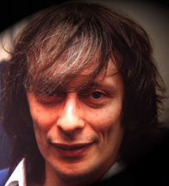
Deutsch’s Model
A closed timelike curve (CTC) is simply a resource that, given an operation f:{0,1}^{n}→{0,1}^{n} acting in some region of spacetime, finds a fixed point of f—that is, an x such that f(x)=x
Of course, not every f has a fixed point—that’s the Grandfather Paradox!
But since every Markov chain has a stationary distribution, there’s always a distribution D s.t. f(D)=D
Probabilistic Resolution of the Grandfather Paradox
- You’re born with ½ probability
- If you’re born, you back and kill your grandfather
- Hence you’re born with ½ probability

Slide 5
CTC Computation
Answer
Polynomial Size Circuit
C
“Closed Timelike Curve Register”
R _{CTC}
R _{CR}
“Causality-Respecting Register”
0
0
0
P_{CTC} is the class of decision problems solvable in this model

Slide 6
You (the “user”) pick a uniform poly-size circuit C on two registers, R_{CTC} and R_{CR}, as well as an input to R_{CR}.
Let C’ be the induced operation on R_{CTC}. Then Nature is forced to find a probability distribution D over states of R_{CTC} such that C’(D)=D.
(If there’s more than one such D, Nature chooses one adversarially.)
Then given a sample from D in R_{CTC}, you read the final output off from R_{CR}.

Slide 7
Theorem: P_{CTC} = PSPACE
Proof: For P_{CTC} ⊆ PSPACE, just need to find some x such that C’^{(m)}(x)=x for some m. Pick any x, then apply C’ 2^{n} times.
For PSPACE ⊆ P_{CTC}: Have C’ input and output an ordered pair ⟨m_{i},b⟩, where m_{i} is a state of the PSPACE machine we’re simulating and b is an answer bit, like so:
The only fixed-point distribution is a uniform distribution over all states of the PSPACE machine, with the answer bit set to its “true” value
m_{T},0
m_{T},1
m_{T-1},0
m_{T-1},1
m₂,0
m₂,1
m₁,0
m₁,1

Slide 8


What About Quantum?
Let BQP_{CTC} be the class of problems solvable in quantum polynomial time, if for any operation E (not necessarily reversible) described by a quantum circuit, we can immediately get a mixed state ρ such that E(ρ) = ρ
Clearly PSPACE = P_{CTC} ⊆ BQP_{CTC} ⊆ EXP
Main Result: BQP_{CTC} = PSPACE
“If time travel is possible, then quantum computers are no more powerful than classical ones”

Slide 9
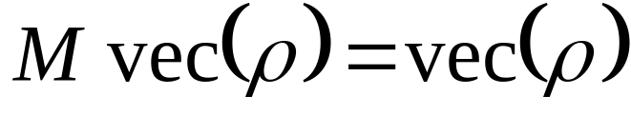
BQP_{CTC} ⊆ PSPACE: Proof Sketch
Let vec(ρ) be the “vectorization” of ρ: i.e., a length-2^{2n} vector of ρ’s entries.
We can reduce the problem to the following: given an (implicit) 2^{2n}×2^{2n} matrix M, prepare a state ρ in BQPSPACE such that

Slide 10
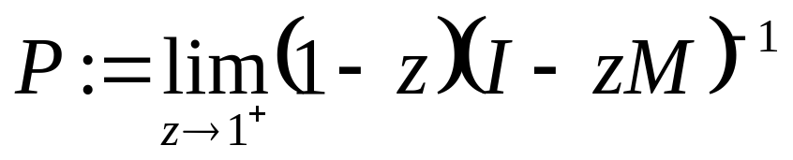
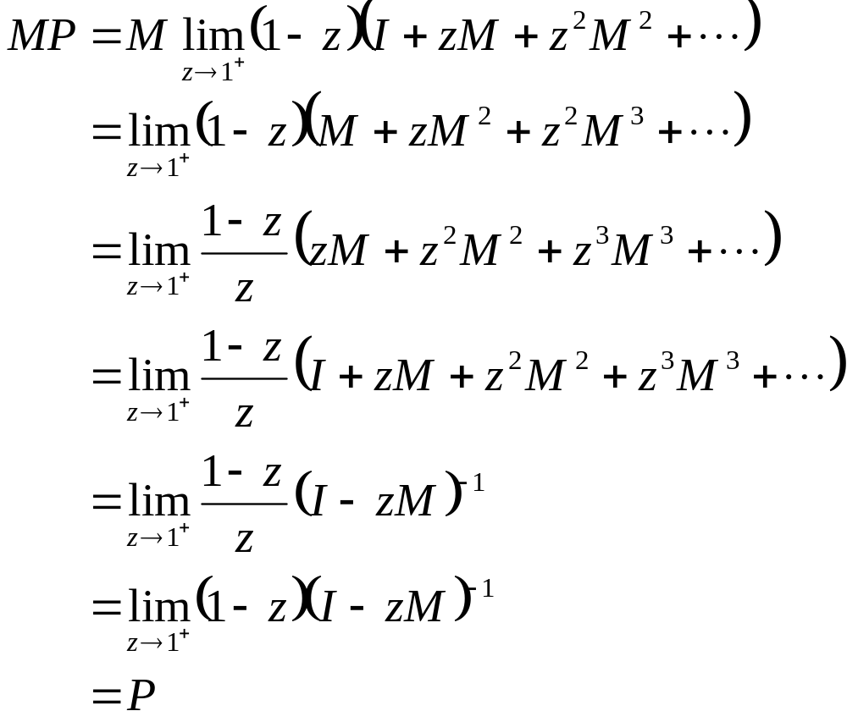
Idea: Let
Then
Furthermore:
We can compute P exactly in PSPACE, by using fast parallel algorithms for matrix inversion (e.g. Csanky’s algorithm)
It’s easy to check that Pv is the vectorization of some density matrix
So then just take (say) Pvec(I) as the fixed-point of the CTC
Hence M(Pv)=Pv, so P projects onto the fixed points of M

Slide 11
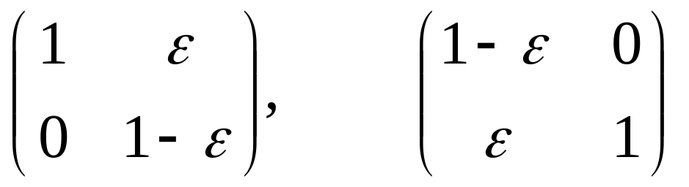
Coping With Error
Problem: The set of fixed points could be sensitive to arbitrarily small changes to the superoperator
E.g., consider the two stochastic matrices
The first has (1,0) as its unique fixed point; the second has (0,1)
However, the particular CTC algorithm used to solve PSPACE problems doesn’t share this property!
Indeed, one can use a CTC to solve PSPACE problems “fault-tolerantly” (building on Bacon 2003)

Slide 12

Application: Advice Coins
Consider an “advice coin” with probability p of landing heads, which a PSPACE machine can flip as many times as it wants
Theorem (A. 2008): BQPSPACE/coin = PSPACE/poly
Proof uses exactly the same technique as for BQP_{CTC}=PSPACE: use parallel linear algebra to implicitly compute fixed-points of superoperators in polynomial space

Slide 13
Discussion
Three ways of interpreting our result:
CTCs exist, so now we know exactly what can be computed in the physical world (PSPACE)!
CTCs don’t exist, and this sort of result helps pinpoint what’s so ridiculous about them
CTCs don’t exist, and we already knew they were ridiculous—but at least we can find fixed points of superoperators in PSPACE!
Our result formally justifies the following intuition:
By making time “reusable,” CTCs make time
equivalent to space as a computational resource.

Slide 14
Closed Timelike Curves Make Quantum and Classical Computing Equivalent
BQP
PSPACE
Scott Aaronson
MIT
John Watrous
U. Waterloo

