Slide 1
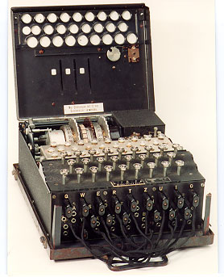
Device-independent security in quantum key distribution
Lluis Masanes
ICFO-The Institute of Photonic Sciences
arXiv:0807.2158

Slide 2
Outline
Why violation of Bell inequalities plus no-signaling imply secure key distribution?
Description of the key distribution protocol
The security definition
Main result (security of privacy amplification)
Analogy between Bell-violation and the min entropy
The device-independent-security model
Imposing quantum mechanics
Estimation without de-Finetti
Sketch of the proof
Conclusions

Slide 3


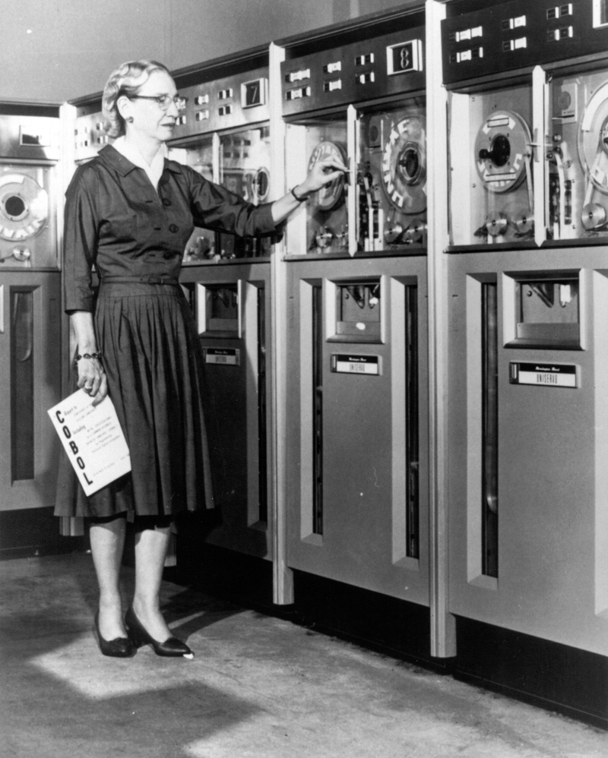
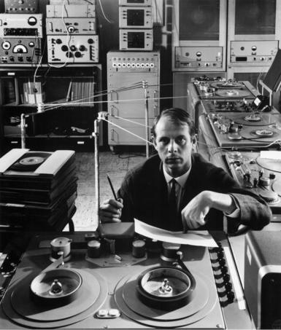


No-signaling plus Bell-violation implies privacy
Forget quantum mechanics
Consider 2 parties (Alice and Bob)

Slide 4

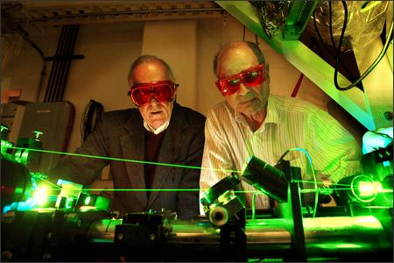


No-signaling plus Bell-violation implies privacy
Suppose a third party (Eve) knows the outcome of Alice’s
are compatible
The correlations do not violate any Bell inequality

Slide 5
No-signaling plus Bell-violation implies privacy
CONCLUSION: If a Bell inequality is violated the outcomes cannot be perfectly known by a third party
Relation between the amount of Bell inequality violation and the degree of privacy

Slide 6
A key distribution protocol
Distribute N pairs of systems

Slide 7


A key distribution protocol
Distribute N pairs of systems
Measure all systems with the observable x=y=0
Error correction

Slide 8
A key distribution protocol
Distribute N pairs of systems
Measure all systems with the observable x=y=0
Error correction
Privacy amplification (with a constant function)

Slide 9

A key distribution protocol
Distribute N pairs of systems
Measure all systems with the observable x=y=0
Error correction
Privacy amplification (with a constant function)

Slide 10

A key distribution protocol
If the numbers are well chosen the 2 keys are identical and secure
To decide we need an estimation step (latter)

Slide 11


The no-signaling assumption
Alice, Bob and Eve share a distribution
None of the systems can signal the rest

Slide 12



The security definition
Consider Alice’s key when M=0
Ideal secret key:
Real secret key (result of the protocol):
Security definition: the real and the ideal distributions are indistinguishable, even if Alice and Eve cooperate for this purpose

Slide 13
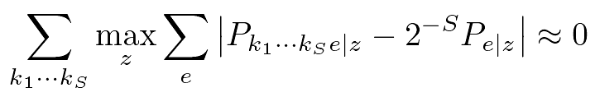
The security definition
Consider Alice’s key when M=0
Ideal secret key:
Real secret key (result of the protocol):
Security definition: the real and the ideal distributions are indistinguishable, even if Alice and Eve cooperate for this purpose
Any use of the the real key will give the same results as the ideal key (Universally-composable security)

Slide 14

Main result: security of privacy amplification
For any nonsignaling distribution
let with all x=0, then
where
CHSH
PR-box
Quantum
Classical

Slide 15
Main result: security of privacy amplification
For any nonsignaling distribution
let with all x=0, then
where

Slide 16
Main result: security of privacy amplification
For any nonsignaling distribution
let then
where
BC
CHSH
Quantum
Classical
PR-box
Quantum
Classical

Slide 17




Bell violation is analogous to the min entropy
Define
Min entropy is the central quantity in standard QKD
allows for deterministic randomness extraction, while needs random hashing

Slide 18
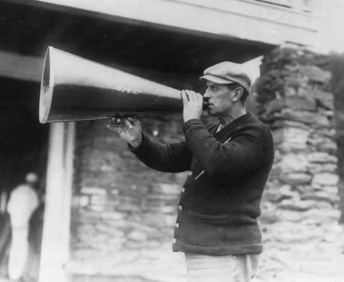

Incorporating public communication
If Alice publishes M bits during the protocol
Efficiency

Slide 19
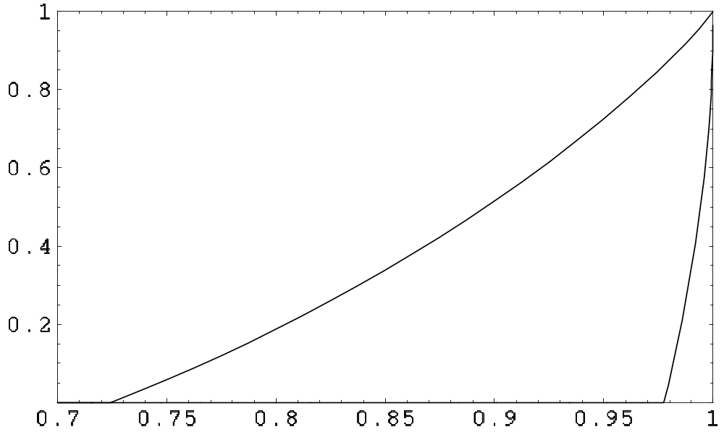

Secret key rates
6 states
No-sign
G obs

Slide 20
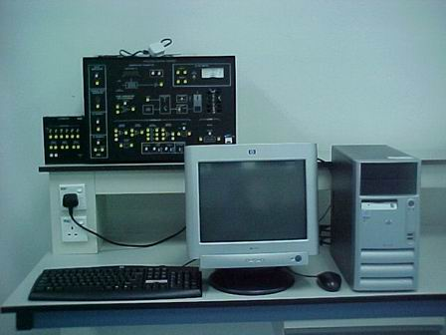
The device-independent security model
Untrusted device: a physical system plus the measurement apparatus
For each system, we can ignore the dimension of the Hilbert space, the operators that correspond to the observables 0 and 1, etc.

Slide 21
The device-independent security model
Untrusted device: a physical system plus the measurement apparatus
Trusted device: classical computer, random number generator, etc

Slide 22
Physical meaning of the no-signaling constrains
Systems must not signal Eve
Systems must not signal the other party
Signaling among Alice’s systems must not occur
Signaling among Bob’s systems is allowed

Slide 23
The device-independent security model
The simplest implementation of QKD is through a sequential distribution of pairs of systems
All systems in one side are observed with the same detector
In this set up, the assumption of full no-signaling in Alice’s side seems unjustified

Slide 24
The device-independent security model
Total relaxation
If we allow signaling between Alice’s systems, privacy amplification is impossible
Although it is fair to assume something stronger

Slide 25
The sequential no-signaling model
We call these constraints sequential no-signaling
If the function used for hashing is XOR or MAJORITY, there is a sequential no-signaling attack (E. Hanggi, Ll. Masanes)
Does this happen with any function?
time

Slide 26
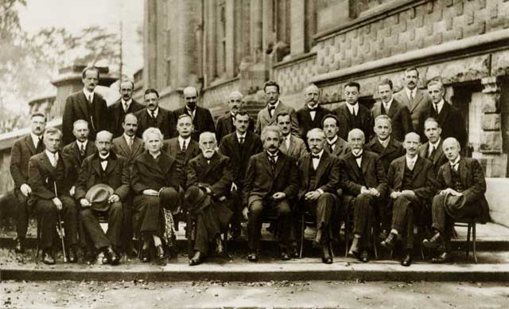
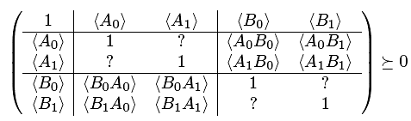
Let’s assume quantum mechanics
Let us impose
Or something weaker

Slide 27

Let’s assume quantum mechanics
Let us impose
Or something weaker
We obtain the same expressions with

Slide 28
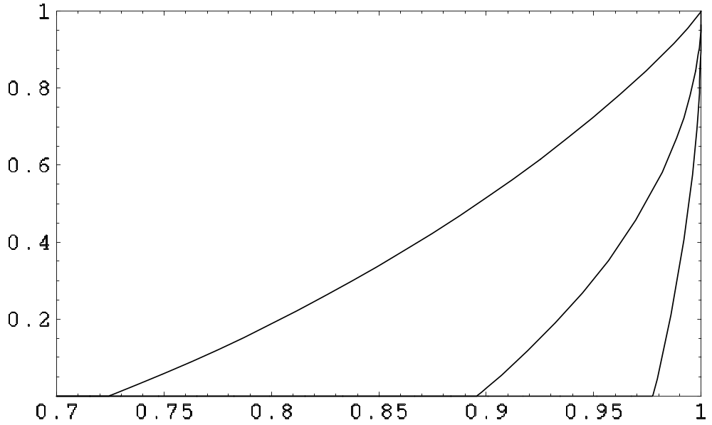
Secret key rates
6 states
No-sign + QM
2 obs
No-sign
G obs

Slide 29



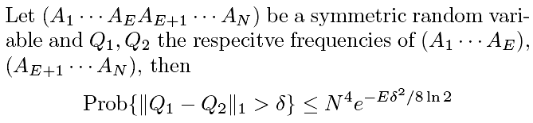
Estimation of and
In the unconditional security scenario, Alice and Bob have no idea about nor
There is no known exponential de Finetti-like theorem
Instead

Slide 30
A problem with the estimation
With this method we do not get the above rates [singlets give: rate = 0.26 < 1!]
Can we find an estimation procedure which gives the expected rates?
Is this something fundamental?

Slide 31
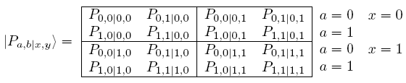
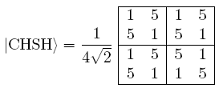
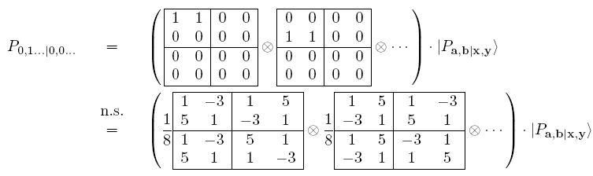
Sketch of the proof

Slide 32
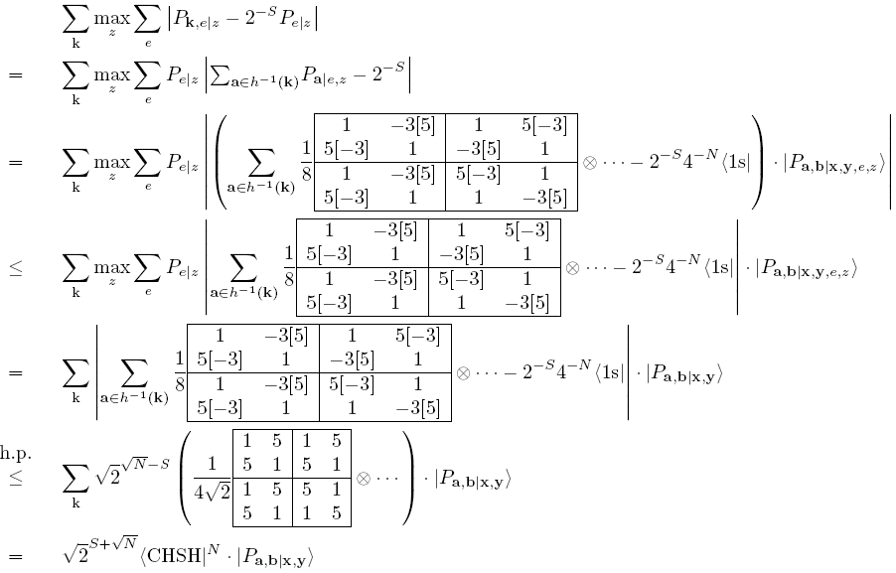
Sketch of the proof

Slide 33
Conclusions
Key distribution from Bell-violating correlations is secure, with the sole assumption of no-signaling
According to the strongest notion of security (universally-composable)
Analogy between Bell-violation and the min entropy
The security of the scheme is device independent
Rates can be improved by assuming QM
Deterministic randomness extraction is possible
Thanks for your attention

Slide 34
Smooth Bell-inequality violation
Define
Bell-inequality violation is asymptotically discontinuous

Slide 35



Analogy with the smooth min entropy
Min entropy is the central quantity in standard QKD
allows for deterministic randomness extraction, while needs random hash

Slide 36
Incorporating public communication
If Alice publishes M bits during the protocol
Efficiency

Slide 37
Sketch of the proof

Slide 38
Sketch of the proof

Slide 39
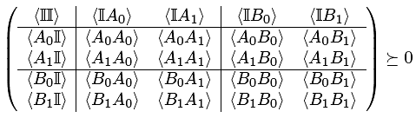
Assuming quantum mechanics
Let us impose
Or something weaker

