Slide 1

Stabilizer codes and a self-correcting quantum memory
Sergey Bravyi
Barbara Terhal
IBM Watson Research Center
Santa Fe, QIP 2009
TexPoint fonts used in EMF.
Read the TexPoint manual before you delete this box.: AAAAAAA

Slide 2
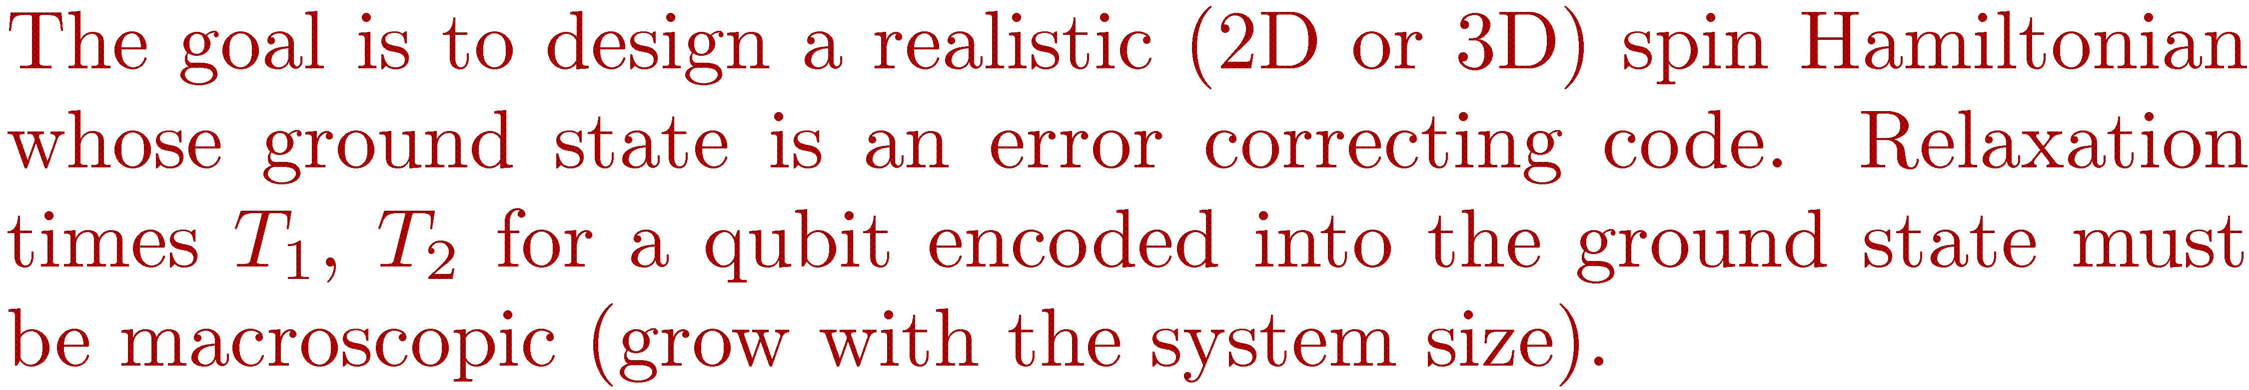
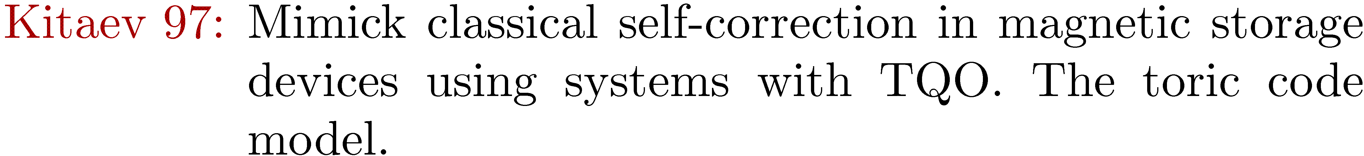
Notes:
What do we mea by a self-correcting quantum memory?
We are looking for a realistic spin Hamiltonian defined on a 2D or 3D lattice whose ground state is an error correcting code.
We are going to encode one or several qubits into the ground state of this Hamiltonian and then let the system interact
With the environment. We want the relaxation times for the encoded qubit to be macroscopic, that is,
It should grow with the system size, ideally exponentially fast.
The field of quantum self-correction is build around two models: the toric code model and the Bacon-Shor model.
The 4D toric code model was shown to be a self-correcting memory by DKLP. Later this result was reproduced by Alicki and Horodecki family
On a more rigorous level.
It is believed that 3D Bacon-Shor model is a self-correcting memory but it remains an open problem to prove it.

Slide 3
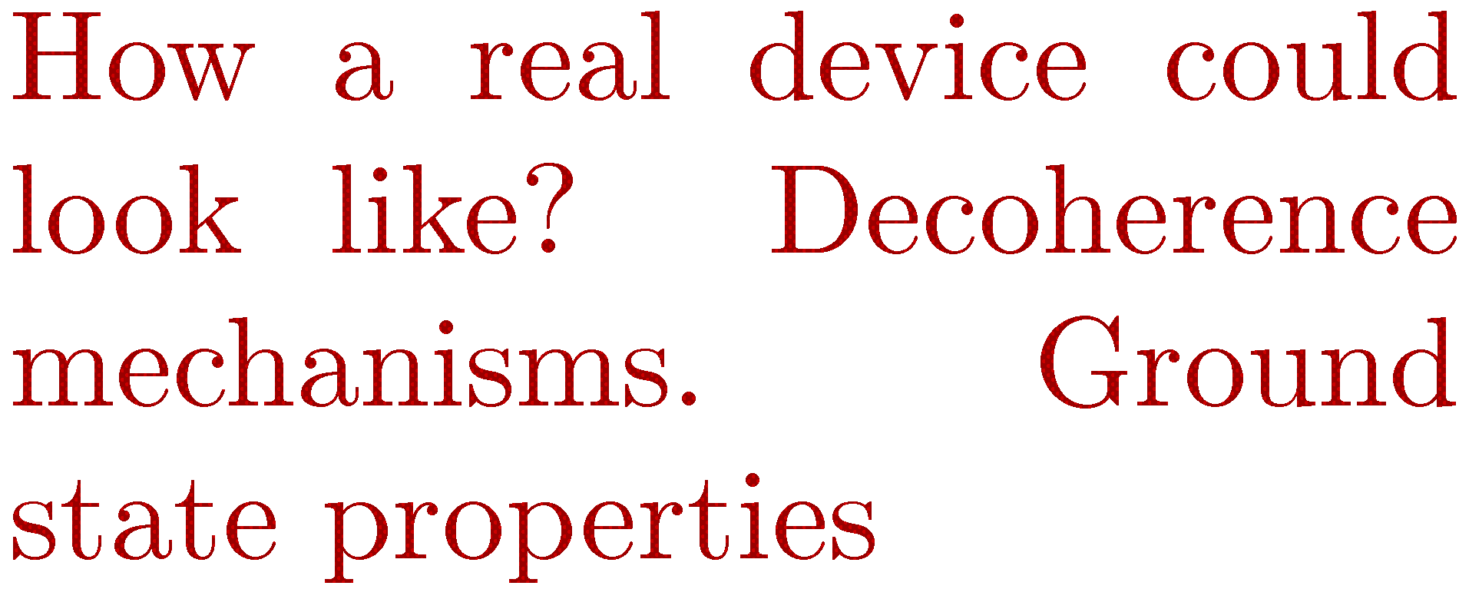
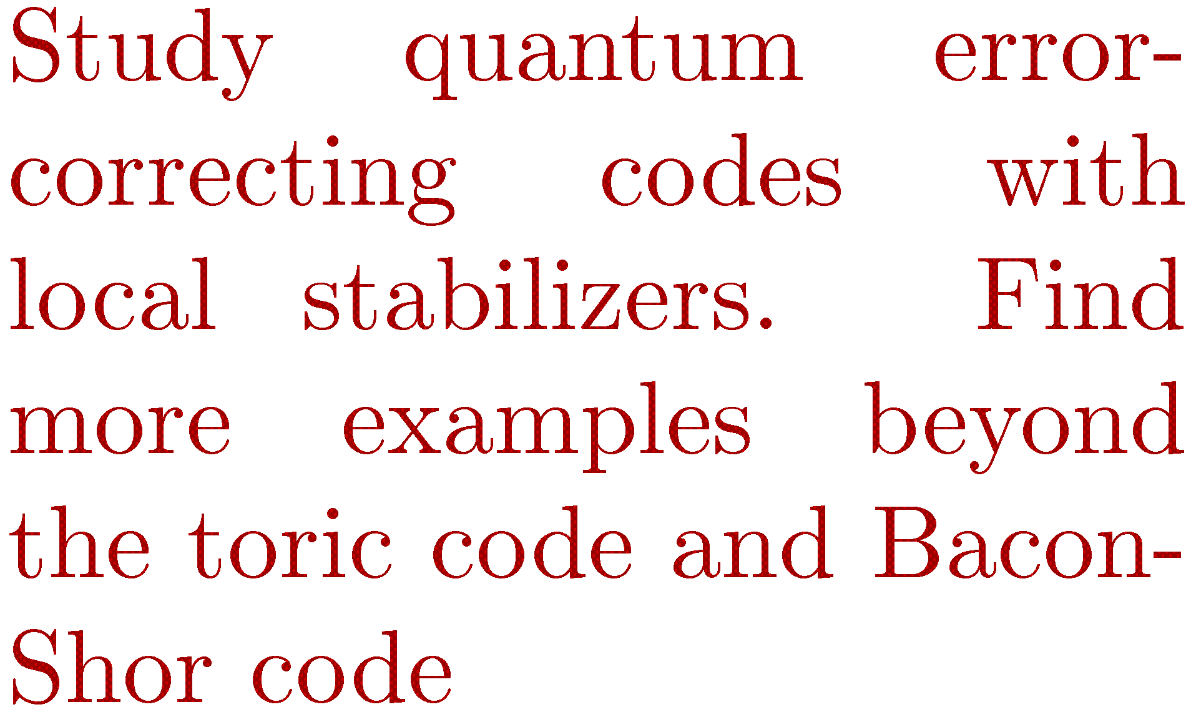

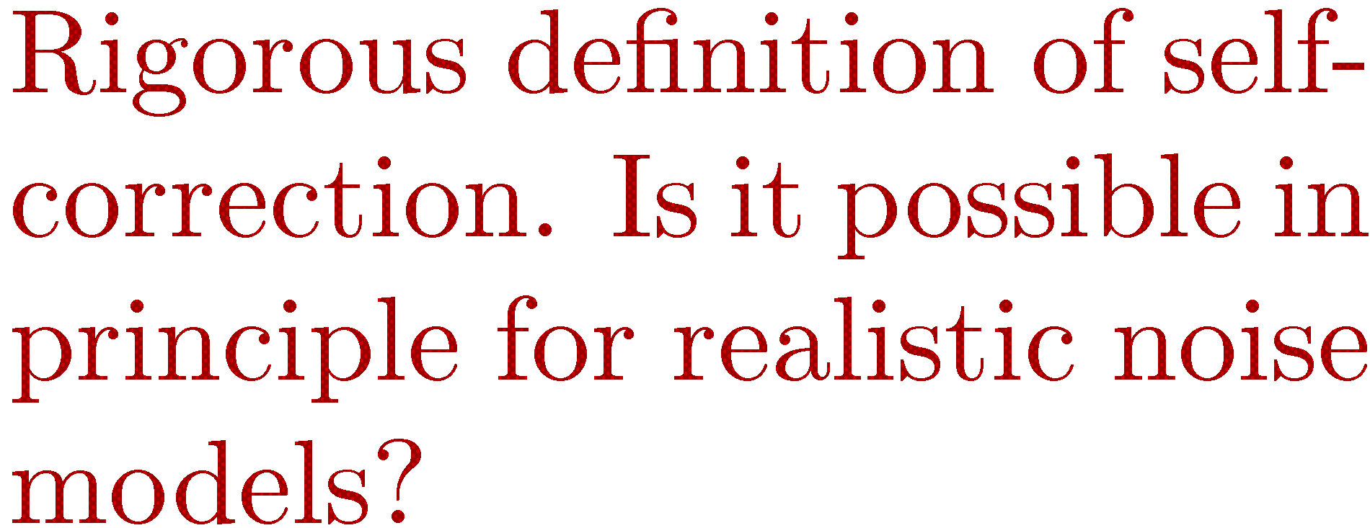

Notes:
In my talk I will give you some insights on feasibility of
Quantum self-correction that come from the coding theory.
We are going to study quantum and classical codes
That can be specified by geometrically local constraints. I will describe
Some general limitations of such codes and
present some new code constructions that go beyond
The toric code and the Bacon-Shor code.
Better understanding of such codes could guide the search for Hamiltonians that have self-correction property.

Slide 4
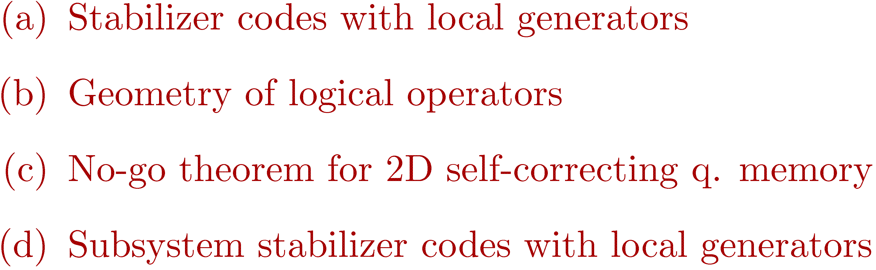
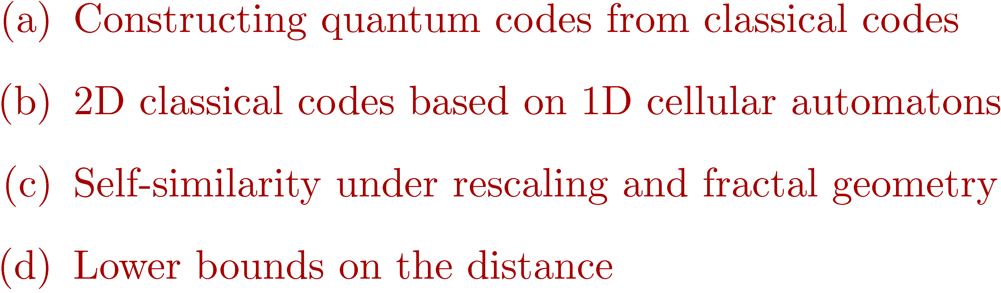
Notes:
My talk consists of two parts.
The main message of the first part is that 2D stabilizer codes are not as good as we hoped for.
I will characterize geometry of logical operators for such codes and argue that they are not suitable for self-correction.
In the second part I will argue that 2D classical codes are actually much better than we hoped for.
I will describe a family of 2D classical codes based on 1D cellular automatons. These codes have nice properties
Such as scale-invariance and fractal geometry of logical operators.

Slide 5

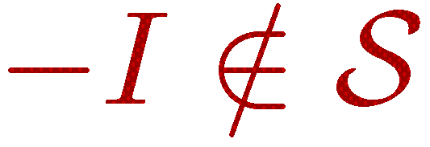
Notes:
Let me remind you some basic things about stabilizer codes.
Suppose we want to encode k logical qubits into n physical qubits using a code-space L.
For stabilizer codes L is spanned by states that invariant under action of some group S called a stabilizer group.
Any element of S must be a Pauli operator, that is, a tensor product of single-qubit Pauli operators and identity operators.
S must be abelian.
S should not contain -1.

Slide 6
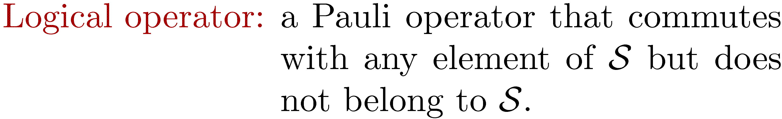
Notes:
A logical operator is a Pauli operator that commutes with any element of S but does not belong to S.
Logical operators preserve the code-space and act non-rivially on encoded qubits.

Slide 7
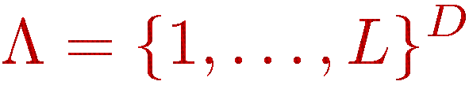
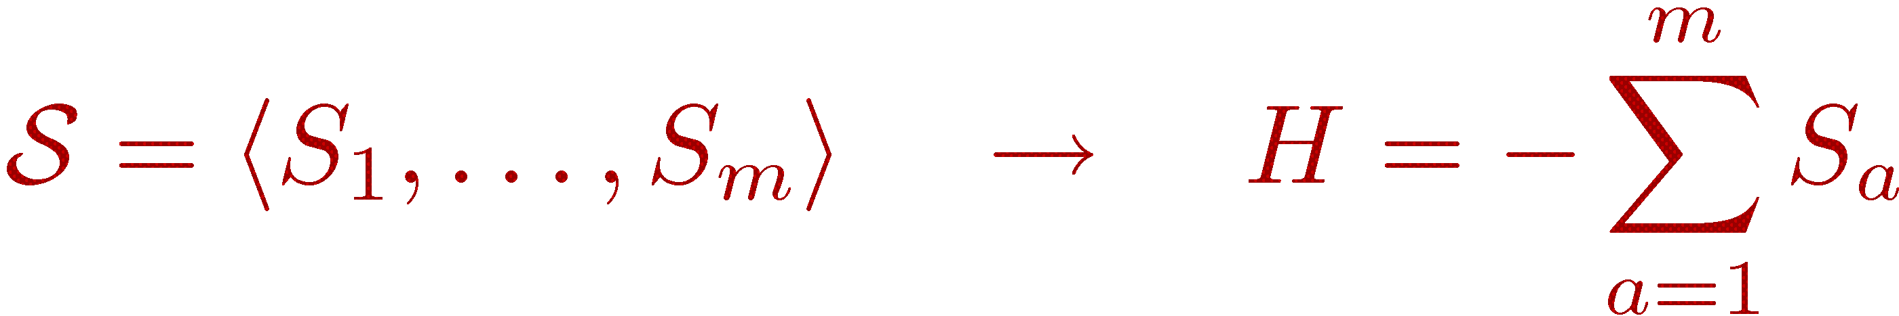
Notes:
We shall assume that the physical qubits are located at vertices of a cubic D-dimensional lattice of linear size L
The lattice may have open or periodic boundary conditions.
Let us say that a Pauli operator is r-local if its support can be covered by a hypercube
Of linear size $r$.
The codes relevant for us are stabilizer codes for which the stabilizer group has r-local generators for some small constant r.
Such codes can be represented as ground states of a local Hamiltonian, for example one can choose a Hamiltonian H as – sum of
All generators.

Slide 8
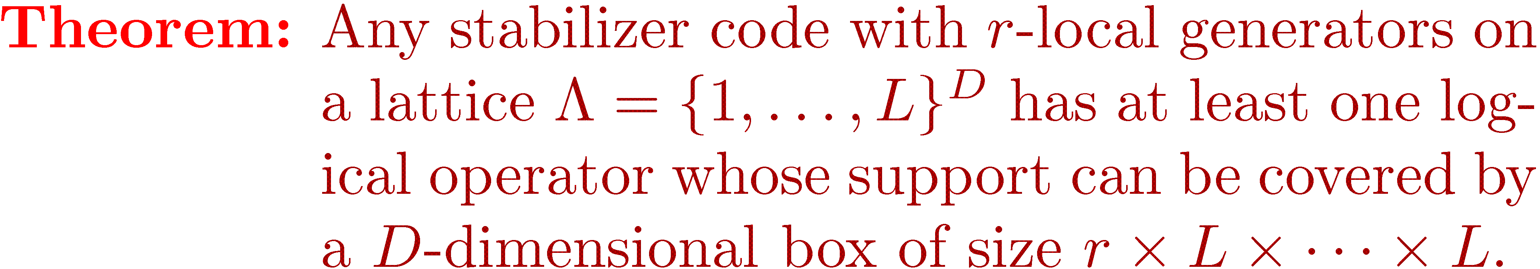
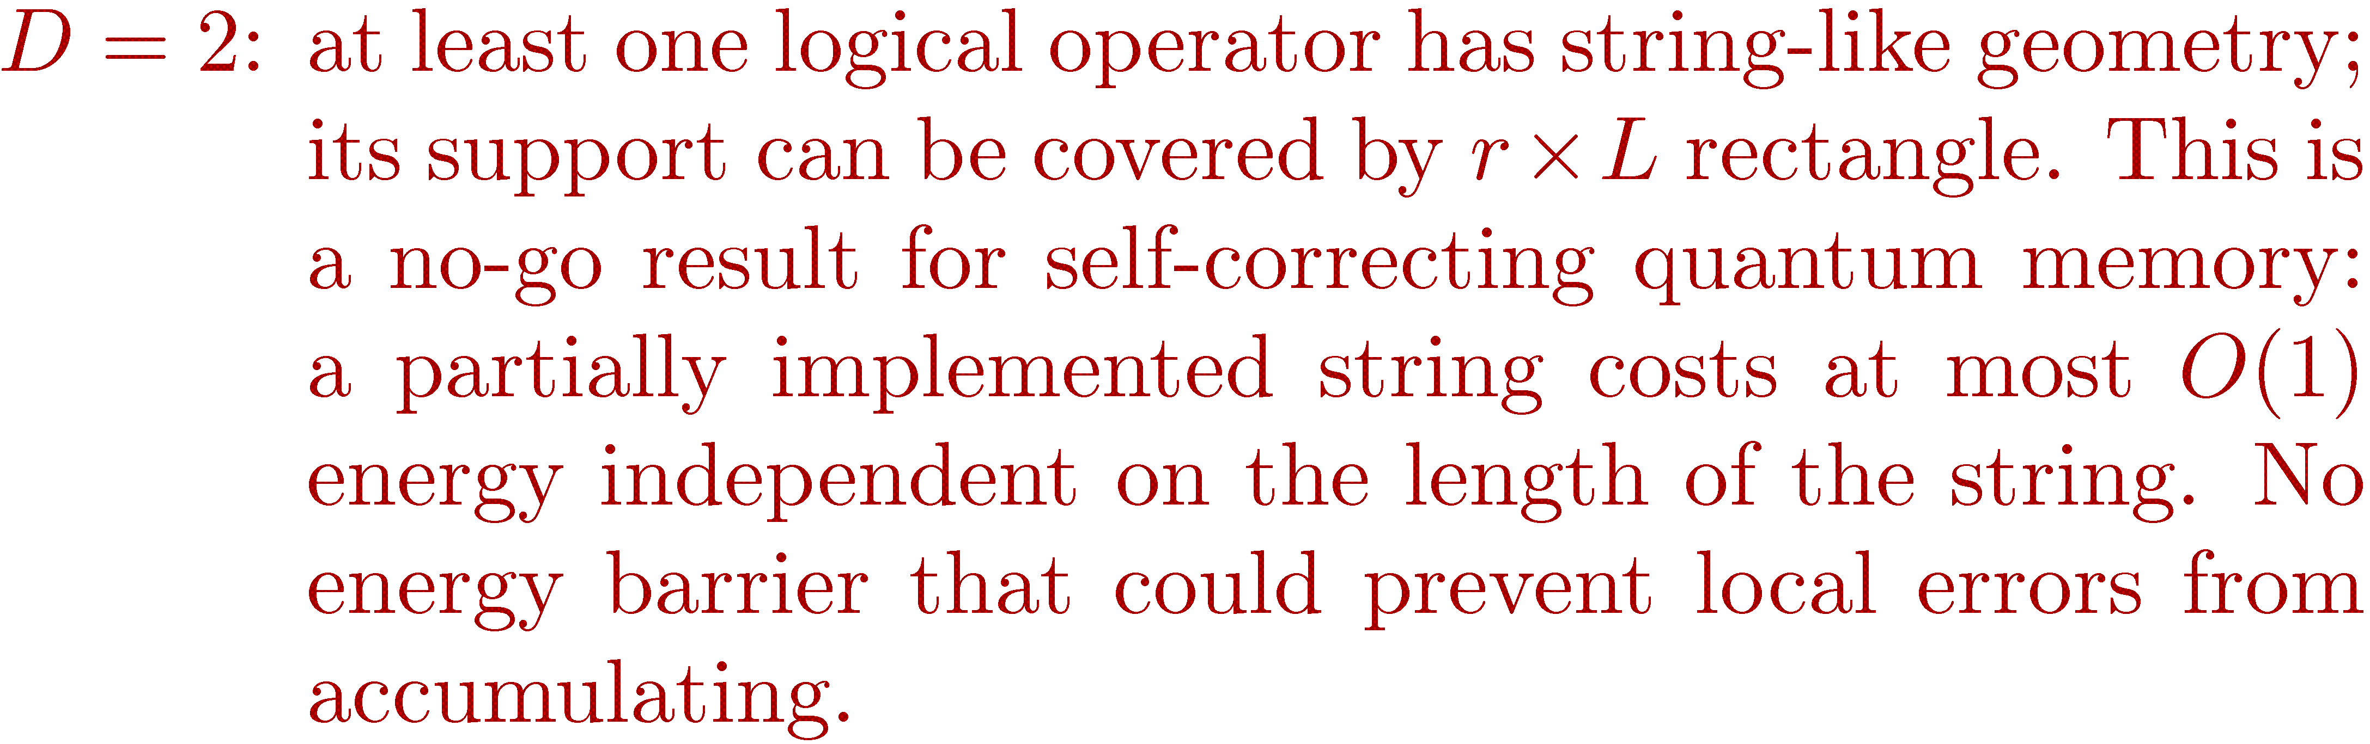
Notes:
Our main results concern geometry of logical operators.
Suppose we take some stabilizer code with r-local generators defined on D-dimensional lattice.
This theorem says that there is at least one logical operator whose support can be covered by a D-dimensional
rectangle with the first dimension r and other dimensions L. In other words, such logical operator acts only on qubits
Located between two hyperplanes separated by distance r.
This theorem is very useful for dimension 1 and 2.
For 1D codes the theorem says that at least one logical operator has point-like geometry, that is it support has
Constant size. Such codes of course cannot be a good quantum memory even if we allow active error correction.
For 2D codes we have at least one logical operator with string-like geometry.
This is a no-go result for a self-correcting quantum memory because a partially implemented string costs at most
Constant energy that is independent from the length of the string. So there is no energy barrier that could prevent local
Errors from accumulating.

Slide 9
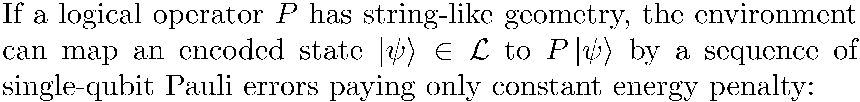
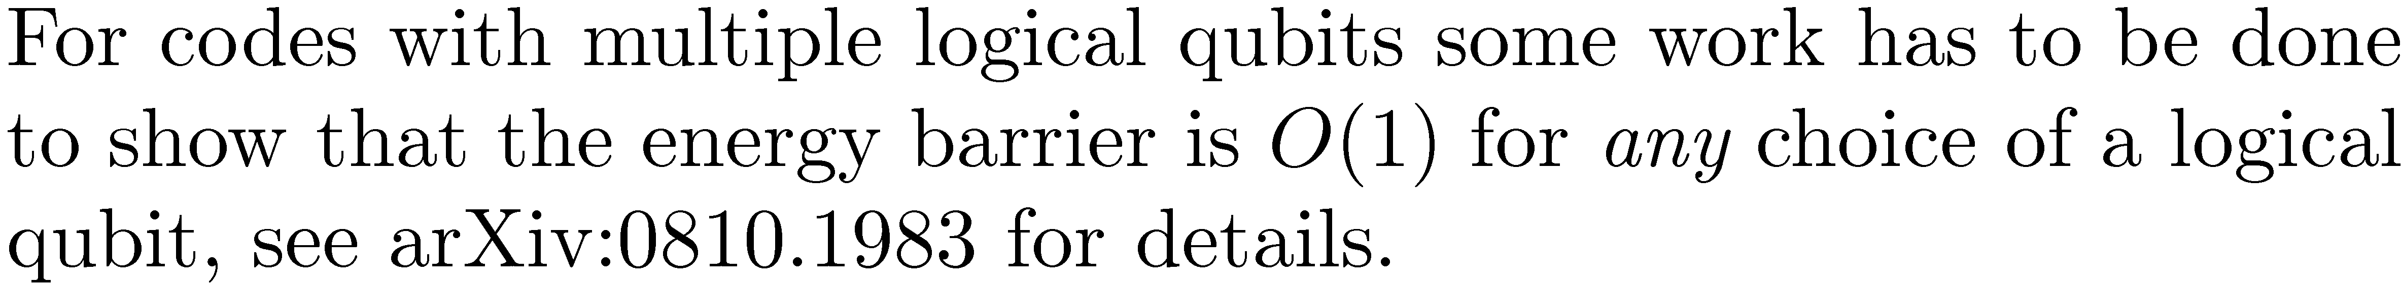


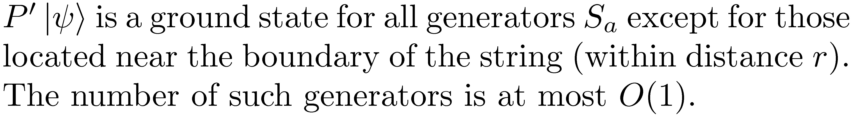
Notes:
This picture illustrates what is going on. Here we have some logical operator P that looks as a horizontal string.
Suppose the environment tries to apply P to some encoded state psi by a sequence of single-qubit Pauli operators
Starting from the left and moving to the right. Let P’ be a partial implementation of P.
Then a state P’|psi> is a ground state for all generators S_a except for those located near the end-point of the string.
Since the number of such generators is constant, the energy cost of P’ is constant and there is no
Macroscopic Energy barrier that could prevent the environment from implementing P.
This argument proves the no-go theorem for codes with 1 logical qubit. If a code has several logical qubit, some more work has to be
Done to show that the energy barrier is constant for any choice of a logical qubit. The proof can be found in our arxiv paper, but I don’;t have
Time to explain it now.

Slide 10
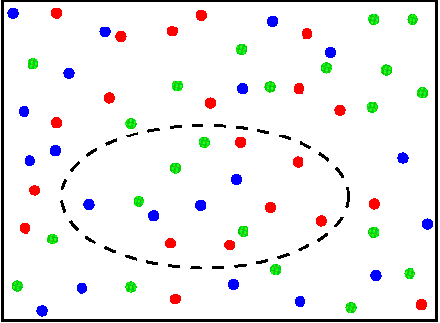
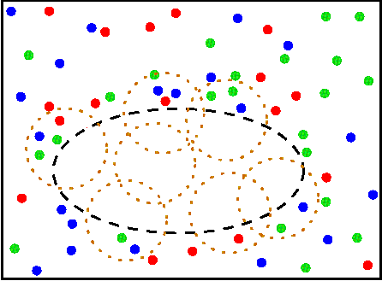


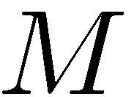
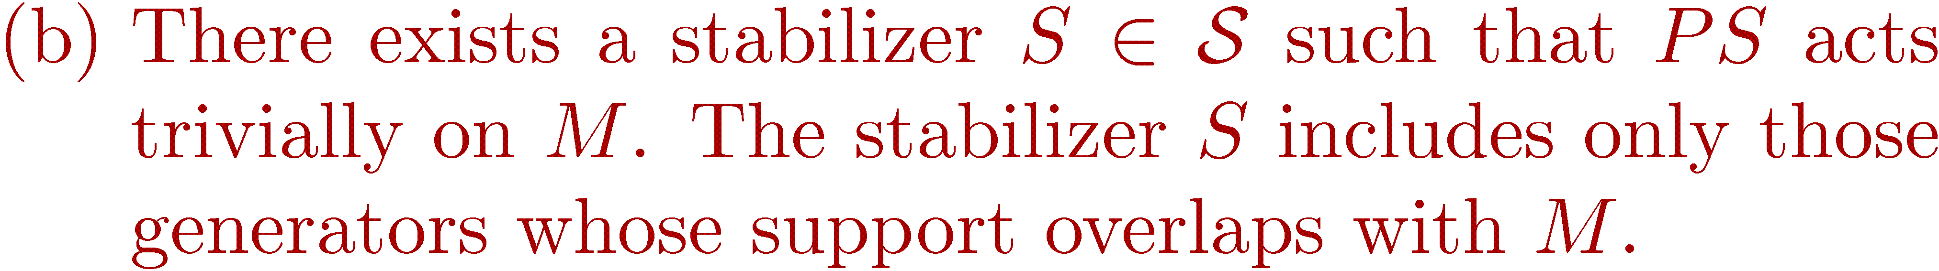
Notes:
Let me sketch the proof of the theorem.
Our main technical tool is the following lemma that we call a cleaning lemma.
Let me explain how it works for 2D lattice. Suppose we have 2D stabilzer code and we choose
Some logical operator P and some region M. Then there are two possibilities:
Either there is a logical operator whose support is contained in M.
Or we can clean out the region M, that is, we can multiply P by some
Elements of the stabilzier group such that the new logical operator acts trivially
On M.
If the stabilzer group has r-local generators, the cleaning can be done locally, meaning that we only multiply
P by generators whose support overlaps with M. This is very useful tool because we can clean out multiple
Regions simultaneosuly and thus we can modify geometry of logical operators.

Slide 11
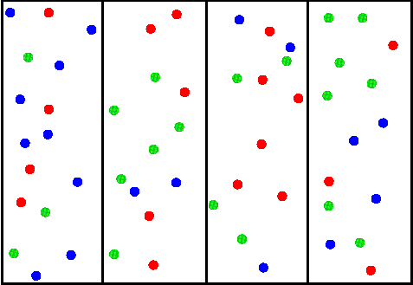
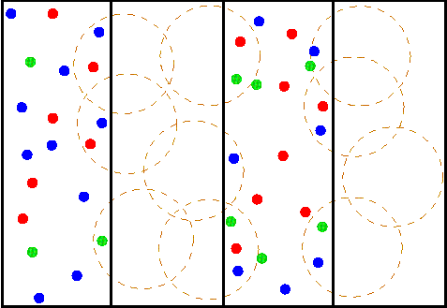


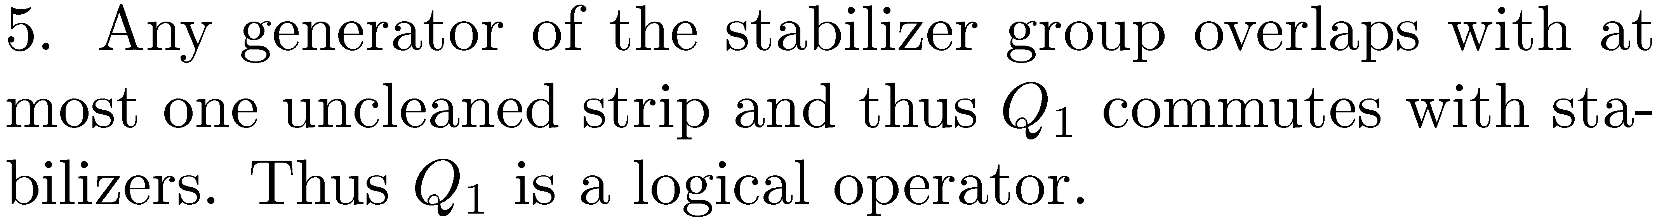
Notes:
Using cleaning lemma I can easily prove any 2D stabilizer code has string-like logical operator.
Indeed, let us partition the lattice into vertical strips of width r.
We want to show that there is a logical operator whose support is contained in a single strip.
Indeed suppose that this is not case.
Then we can choose arbitrary logical operator P
And apply the cleaning lemma to clean out any even strip.
We get a new logical operator Q that is a product over odd strips, in this case
Q=Q_1 Q_3
Since Q is not a stabilizer, at least one of Q_1 or Q_3 is not a stabilizer. Suppose for example that Q_1 is not a stabilizer.
Since any generator of the stabilizer group overlaps with at most one odd strip and commutes with Q,
Any generator of the stabilzer group must commute with Q_1.
Thus Q_1 commutes with stabilzers but is not a stabilizer by itself. It means that
Q_1 is a logical operator with a string-like support.

Slide 12


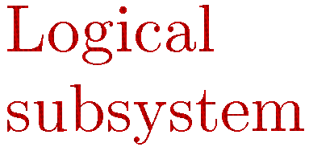
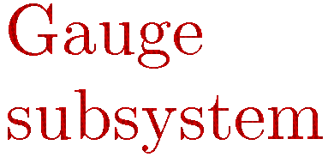
Notes:
Let me move on to subsystem codes.
This picture shows the most general way of encoding quantum information.
We start from choosing a code-space L and then we decompose it
into a tensor product of two smaller subspaces. The 1st subspace is a logical subsystem.
This is the place where we are going to store our logical qubits. The second subspace is a gauge subsystem.
The state of gauge qubits can be completely arbitrary and we don’t care about it.

Slide 13
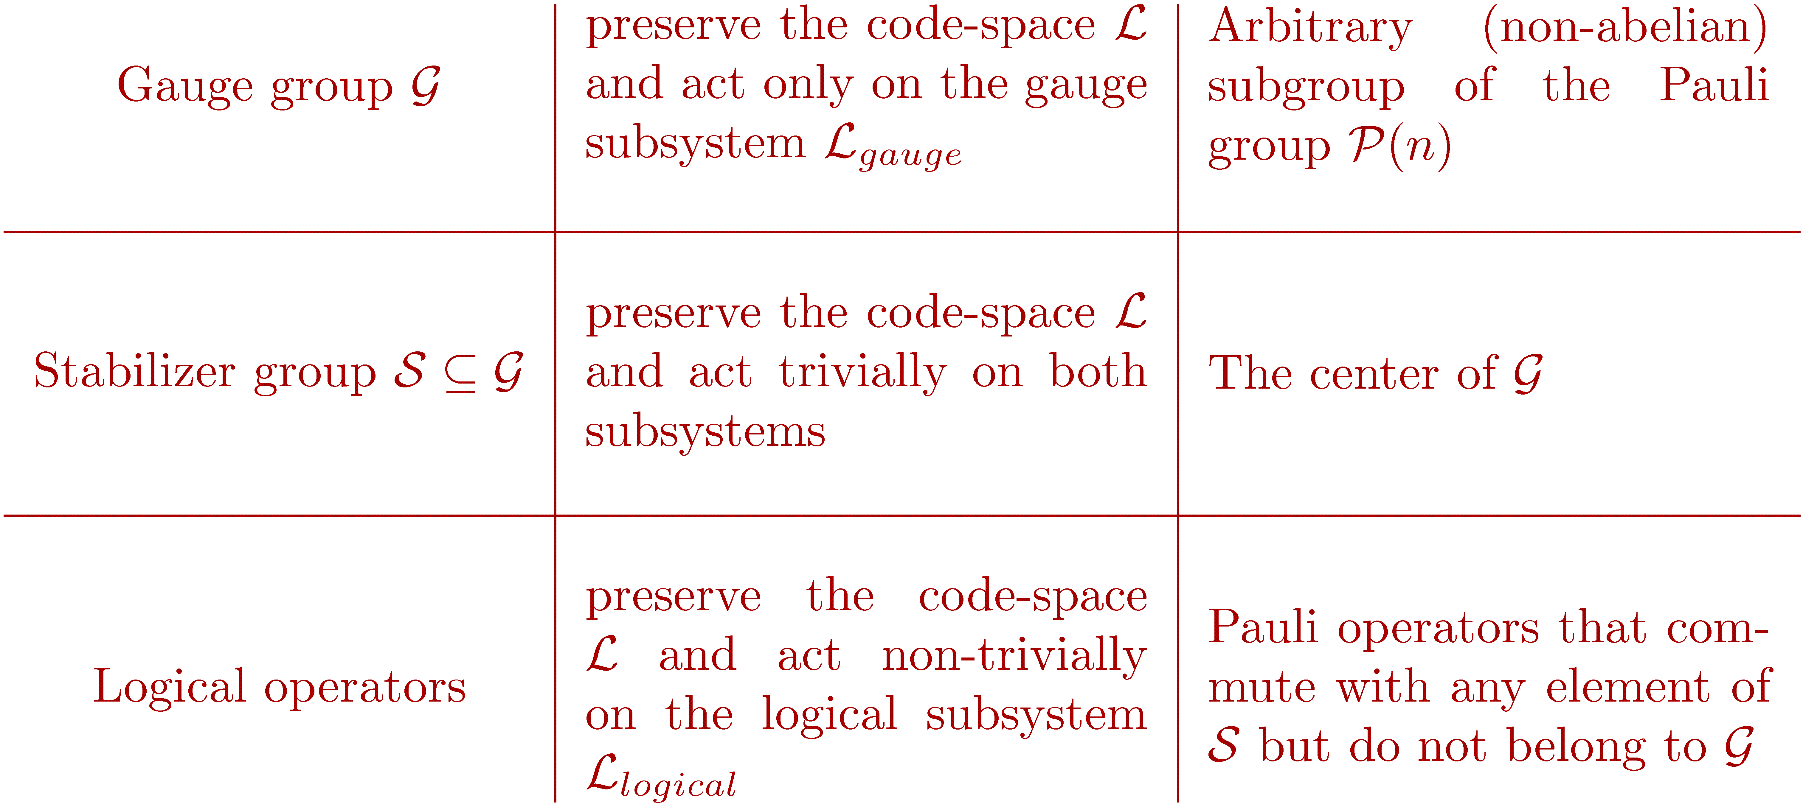
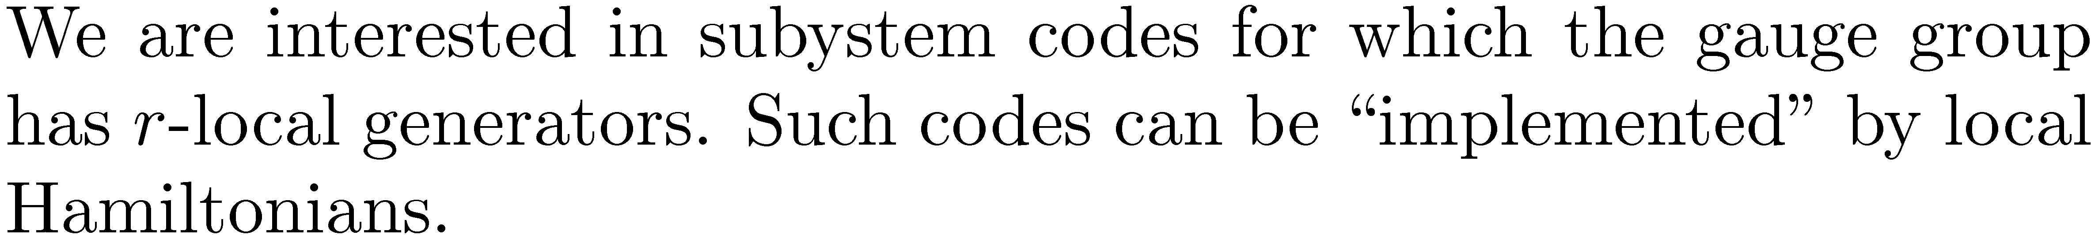
Notes:
In the framework of stabilizer codes we define a subsystem code using several groups of Pauli operators.
operators preserving the code-space and acting only on the gauge subsystem
generate a gauge group. I denote it G. It can be an arbitrary abelian or non-abelian
Subgroup of the Pauli group.
operators preserving the code-space and acting trivially on both subsystems generate a stabilizer group. I denote it S.
S is the center of G.
Finally logical operators preserve the code-space and act non-trivially on the logical subsystem.
These are operators that can change the encoded information.
We are interested in subsystem codes for which the gauge group has r-local generators.
Because such codes can be represented as ground states of local Hamiltonians.

Slide 14




Notes:
Let us consider the 2D Bacon-Shor code as an example.
The generators of the gauge group are associated with edges of the lattice.
There are XX generators on horizontal edges
And ZZ generators on vertical edges.
In order to find the stabilizer group we have to find the center of the gauge group.
It turns out that the stabilzers are double columns of X
And double rows of Z.
This code has one logical qubit, One can choose logical X as a single column of Xs and logical Z as a single row of Z.
The corresponding Hamiltonian can be chosen as a sum of all generators of the gauge group.
It corresponds to the quantum compass model of condensed matter physics.

Slide 15
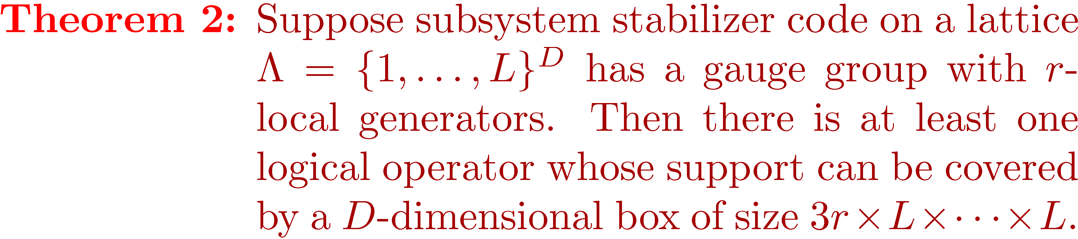
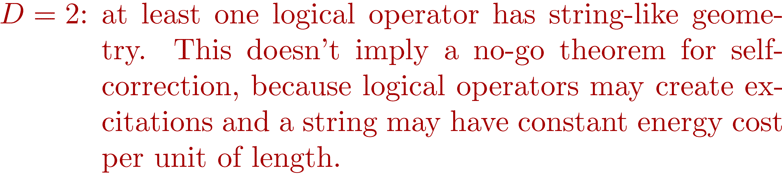
Notes:
Suppose we take some subsystem stabilizer code with r-local generators defined on D-dimensional lattice.
We can prove essentially the same theorem as for stabilizer codes.
Namely, there is at least one logical operator whose support
Is contained between 2 hyperplanes separeted by distance 3r.
For 1D codes the theorem says that at least one logical operator has point-like geometry, that is it support has
Constant size.
For 2D codes we have at least one logical operator with string-like geometry.
However this result does not imply a no-go theorem for self-correction.
The reason is that now logical operators don’t commute with the Hamiltonian, so in principle a string may have
A constant energy cost per unit of length.

Slide 16
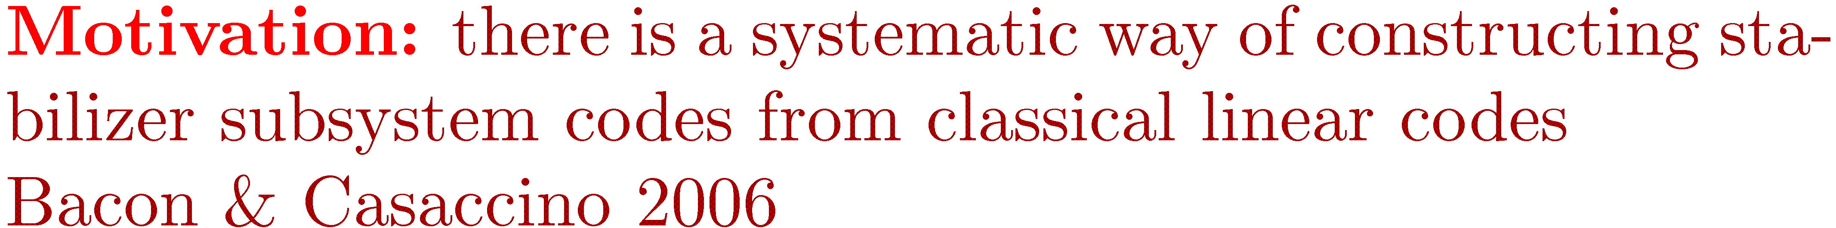


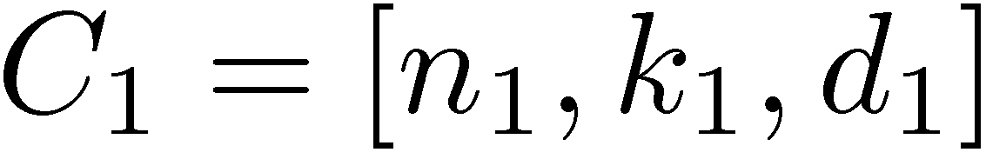
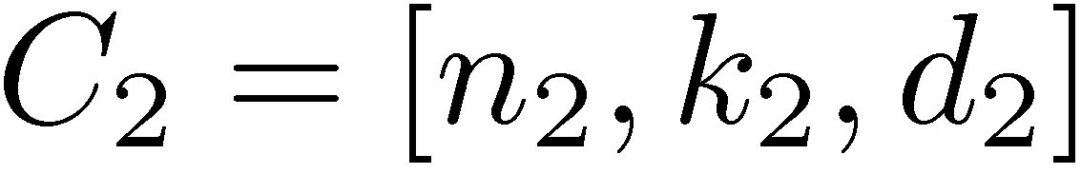
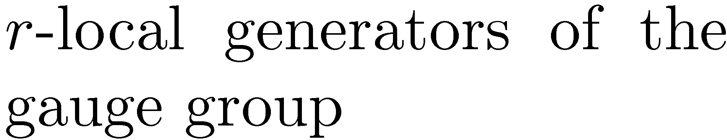
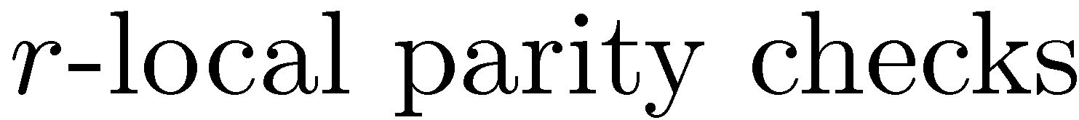
Notes:
Let me move on to the 2nd part which is 2D classical codes.
Why should we be concerned about classical codes? The reason is that there is a systematic way
Of constructing stabilizer subsystem codes from classical linear codes.
The following result is due to Bacon and Casaccino.
Suppose we start form two classical linear codes C_1 C_2 with r-local parity checks
Defined on lattices of dimension D_1 and D_2.
Then we can construct a stabilizer subsystem Q with r-local generators on a lattice of dimension D_1+D_2.
The number of physical and logical qubits get multiplied while the distance of the quantum code
Is the smallest distance of the classical codes.
For example if C_1 and C_2 are 1D rep. code, Q is the 2D Bacon-Shor code

Slide 17


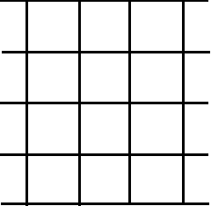
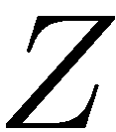

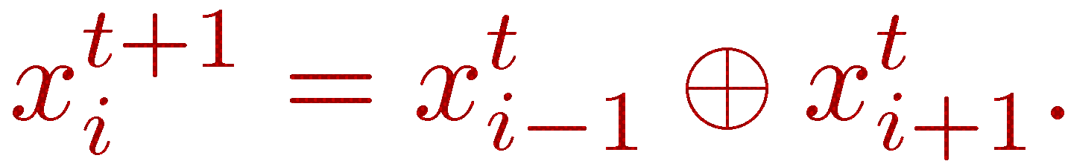
Notes:
Now let me define a 2D classical linear code that I call CA(1). The stabilizer group of this code is generated by
Translations of a single stabilizer shown on this picture. The lattice has open boundary conditions along the vertical axis
And periodic boundary conditions along the horizontal axis.
If you think about the vertical axis as time and horizontal axis as space, any codeword can be identified with a
Computational history of 1D cellular automaton with transition rules shown here. For example if we look on this parity check
It saysy that the value of some bit x_i at time moment t+1 is the XOR of its right and left neighbots at time t.
To the best of our knowledge the idea of contructing classical linear codes from 1D CA was first proposed by Roychowdhury and couathors 1991.

Slide 18
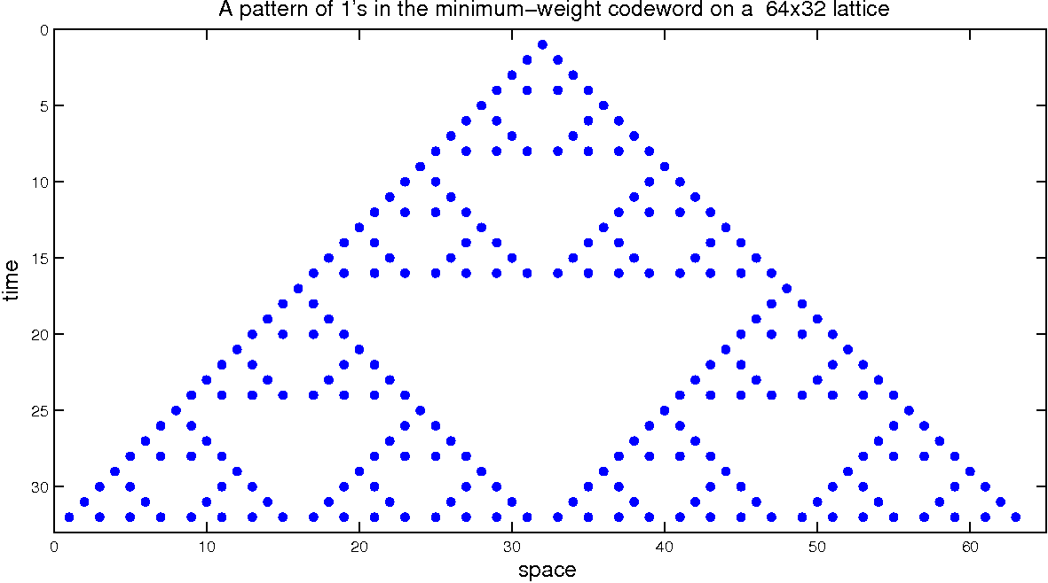
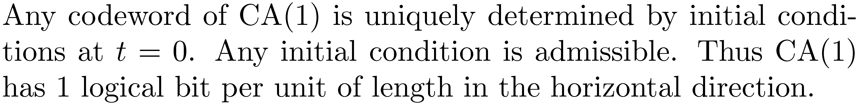
Notes:
This picture shows example of a codeword. Each dot represents a bit set to 1 and all other bits are set to 0.
If we think about this picture as a computationlal hsostory of cellular automaton, we run the automaton for 32 steps,
Starting from the iniital condition at t=0 in which only one bit in the center is set to 1.
It is clear that any codeword is uniquely determined by the initial conditions at t=0. Also any binary string is an admissible
Initial condition. It means that the code CA(1) has 1 logical bit per unit of length in the horizontal direction.

Slide 19

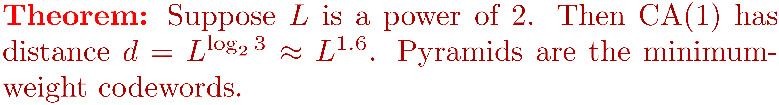
Notes:
One can ask what is the distance of this code?
We can perform a rigorous analysis on a lattice with a finite time dimension L and infinite space dimension.
What we can prove is the following theorem. It says that the distance grows as L to log3 which is approximaltely L to 1.6.
The pyramid that I showed on the previous slide is actually a minimum-weight codeword.
One can think about the the number log3 as the fractal Dimension of this pyramid.
Using numerical simulation we checked that the distance has the same scaling if choose a finite lattice of size L x L.
However for a finite lattice there are some additional issues related to the boundary conditions.
It suggest that CA(1) is classical code with parameters L^2, L, L^{log 3}.

Slide 20

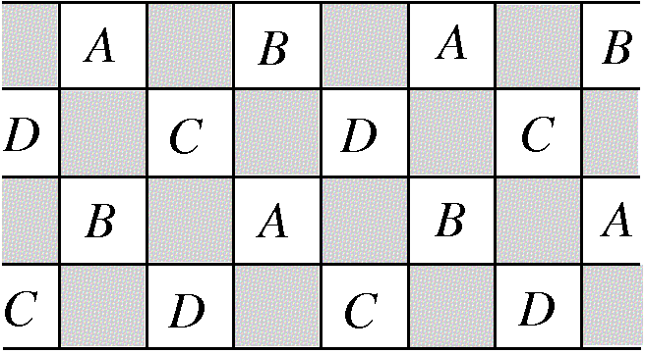
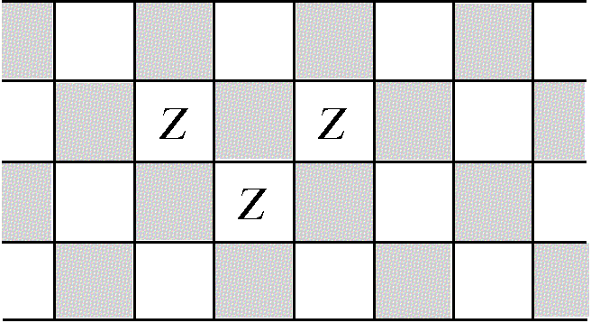
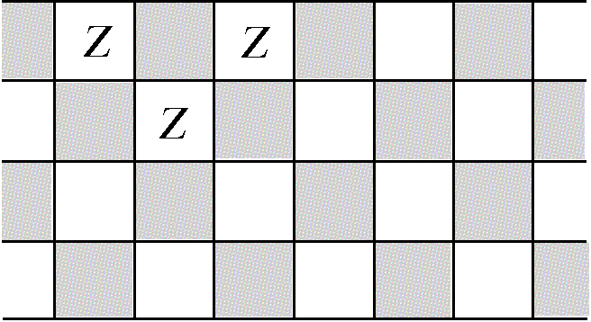
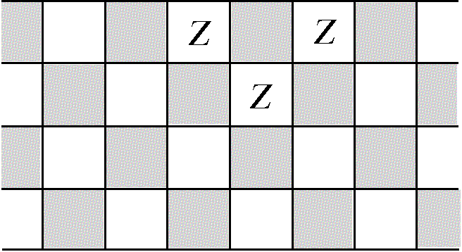
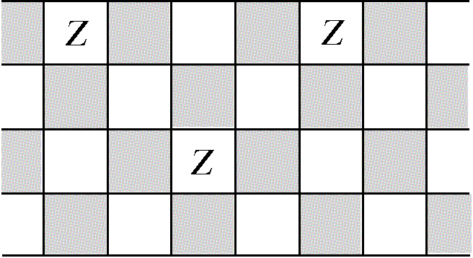


Notes:
A surprising property of the CA(1) is a self-similarity under rescaling of the lattice.
Suppose we partion the lattice into the black and white sublattice, and then we partition the
White into A B C D.
It turns out that the code CA(1) reproduces itslef on each of the sublattices A B C D.
For exampe, if we take a product of three stabilizers shown here, we get a stabilizer of the code CA(1) defined on the sublattice A.
It includes this bit of A, its upper left neohgbor in A and its upper right neighbor in A.
Also note that each of the sublattices A, B,C, D is isomorphic to the white sublattice of the original code with a vertical dimension
Reduced by a factor of 2.

Slide 21
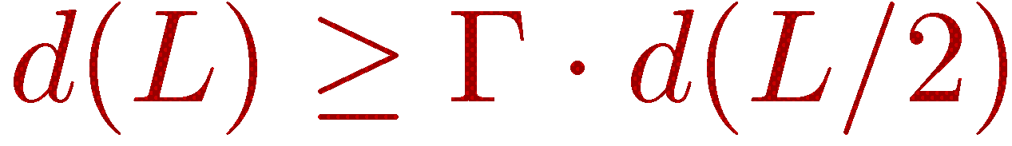
Notes:
Using this observation one can easily show that increasing the lattice size by a factor of 2 can increase the
Distance at most by a factor Gamma, where Gamma is defined as the minimum number of sublattices that
Can be occupied by a non-zero codeword.
Using simple combinatorial arguments one can show that Gamma=3. It yields the desired scaling of the distance.

Slide 22
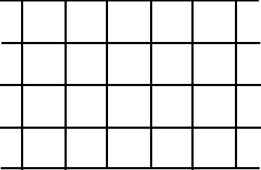

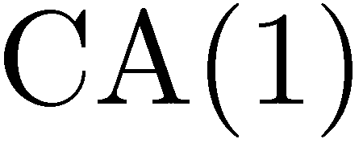
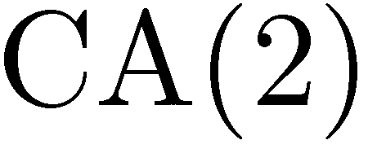
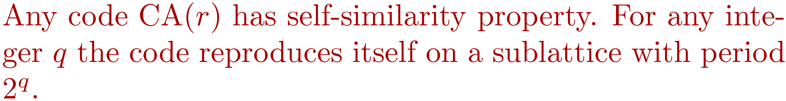

Slide 23



Slide 24



