Slide 1

Can non-private channels
transmit quantum information?
Graeme Smith
John A. Smolin
PRL 102, 010501 (2009)‏
quant-ph/0810.0276

Slide 2
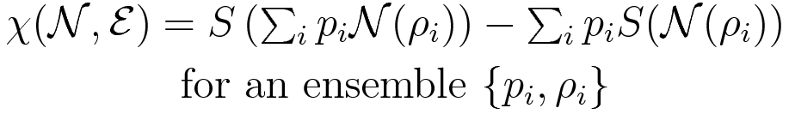

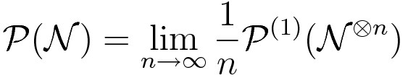
Holevo quantity
Privacy (one-shot)‏
Regularized

Slide 3
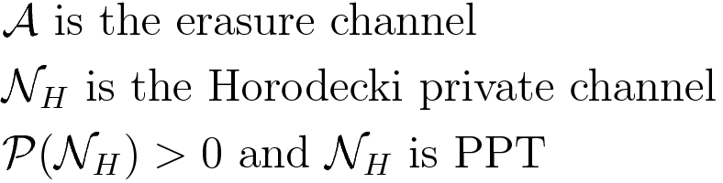
Smith and Yard

Slide 4
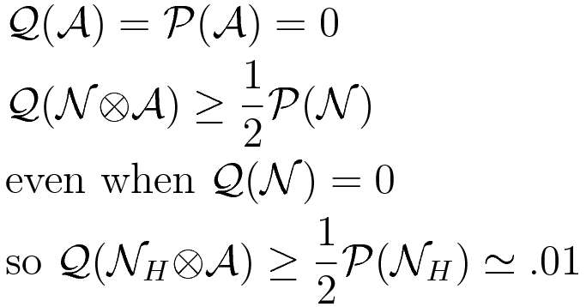

Slide 5

It would appear that the two kinds of
resources are:
Symmetric Assistance (erasure)‏
Privacy

Slide 6
Superadditivity of quantum capacity might well be generic
Even superactivation might be common
The big problem is that we can hardly ever calculate the capacity
In part this is because of additivity problems
We don't even have good bounds on Q or P :
Best bound is the additive extension bound SS08
It can't detect superadditivity because it's an additive bound

Slide 7
Confining our attention to zero-capacity channels
PPT channels (Horodecki channel)‏
Antidegradable channels (Erasure channel)‏
And that's it. Both are used in SY08
Other possibilities:
NPT bound-entangled channels?

Slide 8
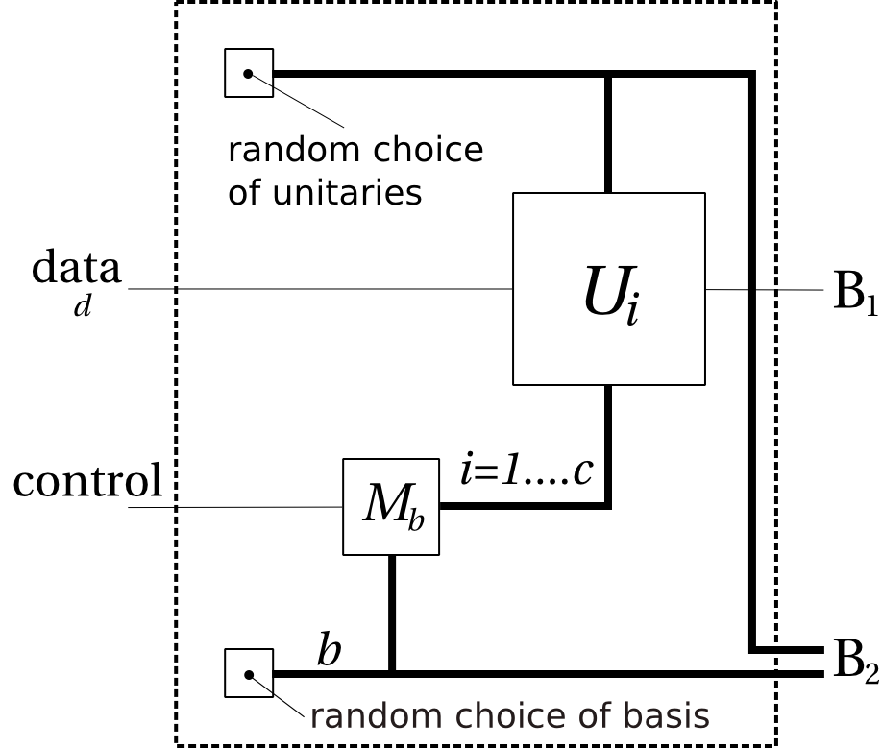
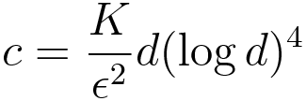
The Retro-correctible channel
set

Slide 9
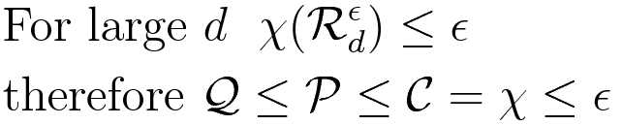
Either classical capacity is small like we want, OR there is a HUGE
violation of the additivity of the Holevo quantity—We can't lose!

Slide 10
Ui
-1
b
T
i
Mb
Capacity with 2-way classical communication is log d

Slide 11

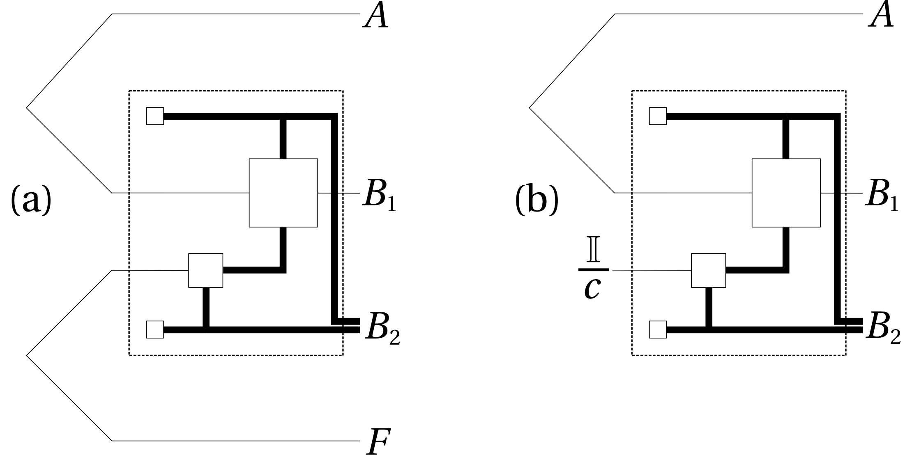

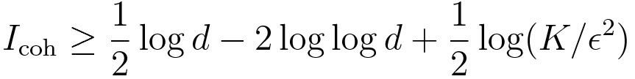
Because of the erasure flag, the coherent
information breaks up into two terms

Slide 12
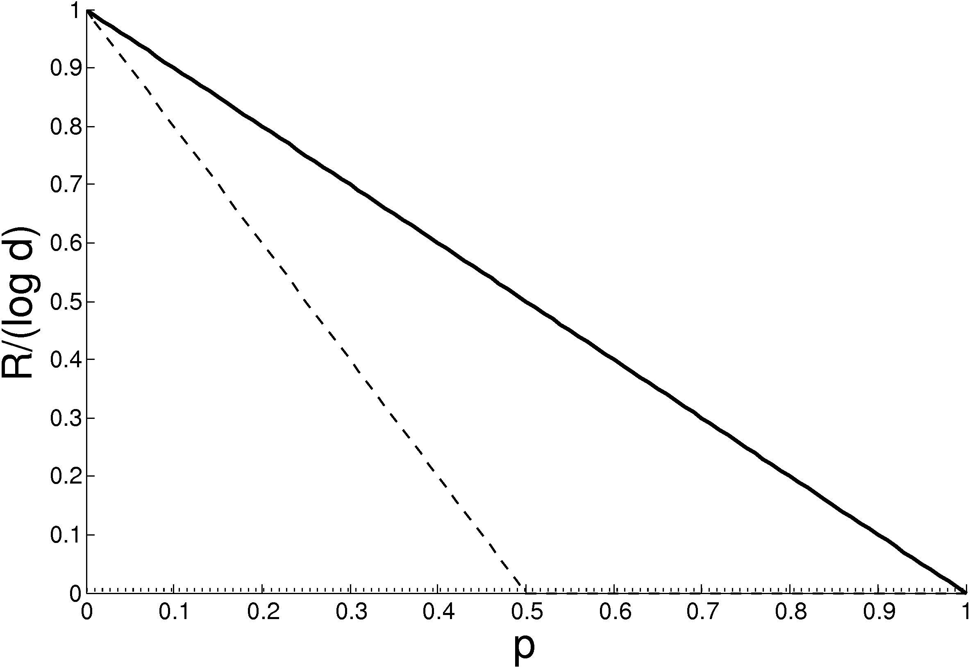

Slide 13
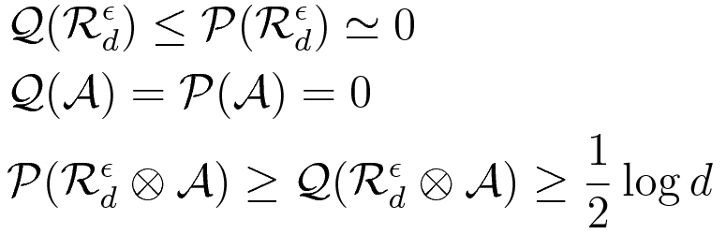
Recap:
Open questions:
Remove the approximately (problem is bounds again)
Reasonable sized output dimensions (and bounds)
Remove dependence of additivity of Holevo quantity
Or could the crazy idea that the Holevo quantity is
extremely nonadditive actually be true?

Slide 14
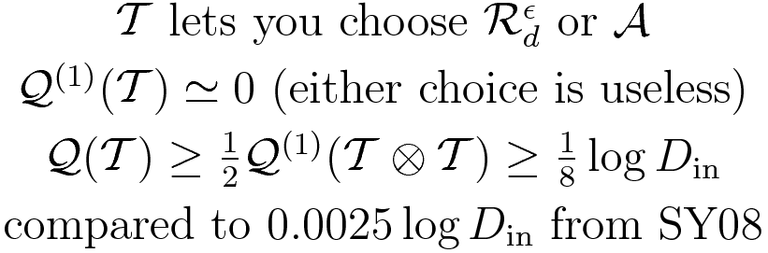
Something that doesn't depend on additivity of Holevo quantity
Wide separation between quantum capacity and
1-shot coherent information

