Slide 1

A Parallel Repetition Theorem for Entangled Projection Games
Thomas Vidick
Simons Institute, Berkeley
Joint work with Irit Dinur (Weizmann) and David Steurer (Cornell)
Notes:
I’ll present what’s known as a parallel repetition theorem, it’s a bound on the success probability achievable when you simultaneously play many copies of a non local game, in parallel

Slide 2
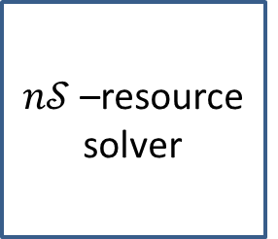
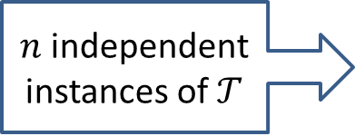
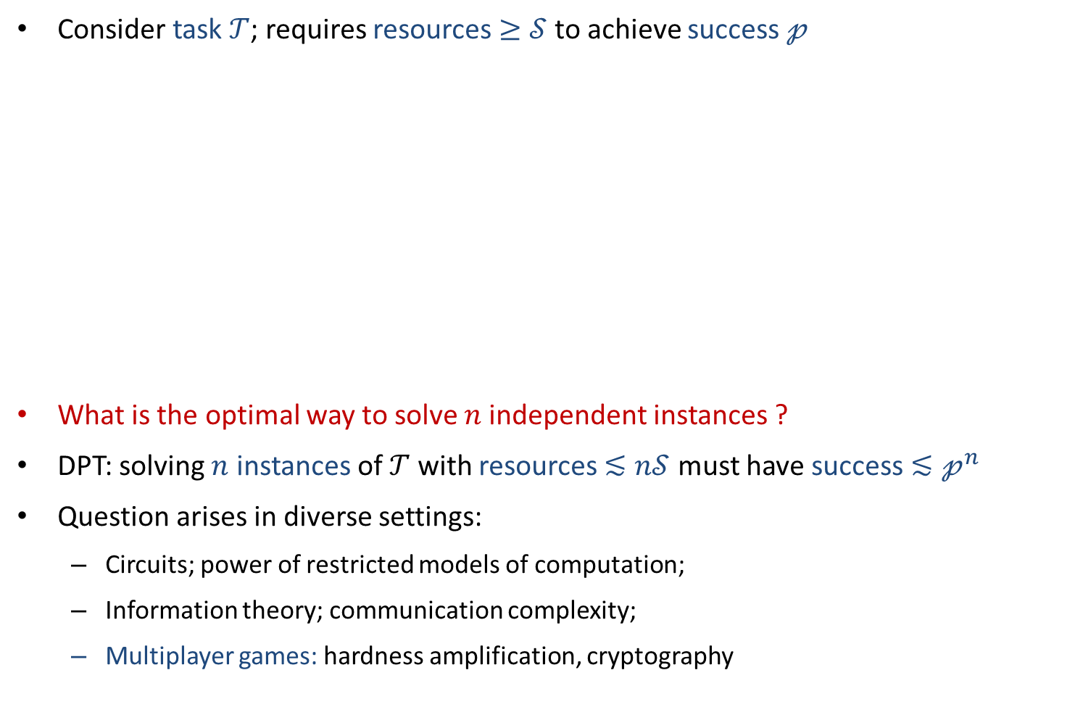
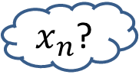

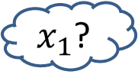
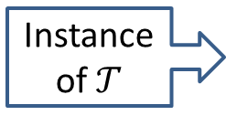
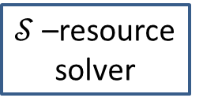

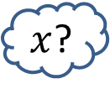
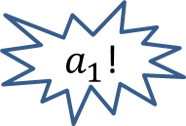
Direct Product Theorems
Consider task $𝒯$; requires resources $≥𝒮$ to achieve success $𝓅$
What is the optimal way to solve $n$independent instances ?
DPT: solving $n$ instances of $𝒯$ with resources $≲n𝒮$ must have success $≲𝓅^{n}$
Question arises in diverse settings:
  Circuits; power of restricted models of computation;
  Information theory; communication complexity;
  Multiplayer games: hardness amplification, cryptography
Answer!
Instance of $𝒯$
$x$?
$𝒮$–resource solver
Success $𝓅$
$x_{1}$?
$n𝒮$–resource solver
$a_{1}$!
$n$ independent instances of $𝒯$
$x_{n}$?
$a_{n}$!
Notes:
I’ll explain what this means, but first to put things in context, a parallel repetition theorem is an instance of something that’s more generally known as a direct product theorem. Informally, imagine that there is a certain task which requires some amount of resource in order to achieve a certain success, so for example multiplying two numbers.
That’s why it’s called a DPT. The challenge is in ruling out that one can take advantage of the multiple instances to save on the resources. And the idea is of course since they’re independent well what can you do, but this is hard to prove in practice!
I’ve stated it in vague terms, but it arises in many different settings. For instance in circuit complexity, you might be trying to construct functions that are very hard to compute using bounded resources, this provides a way to amplify hardness. Or in communication complexity or information theory, the question is very related to strong converses that we’ll hear tomorrow from Andreas Winter. And in this talk we’ll study the question of DPTs in the context of nonlocal games, where it becomes the question of parallel repetition. So I’ll first introduce the games.

Slide 3
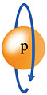



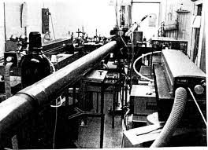
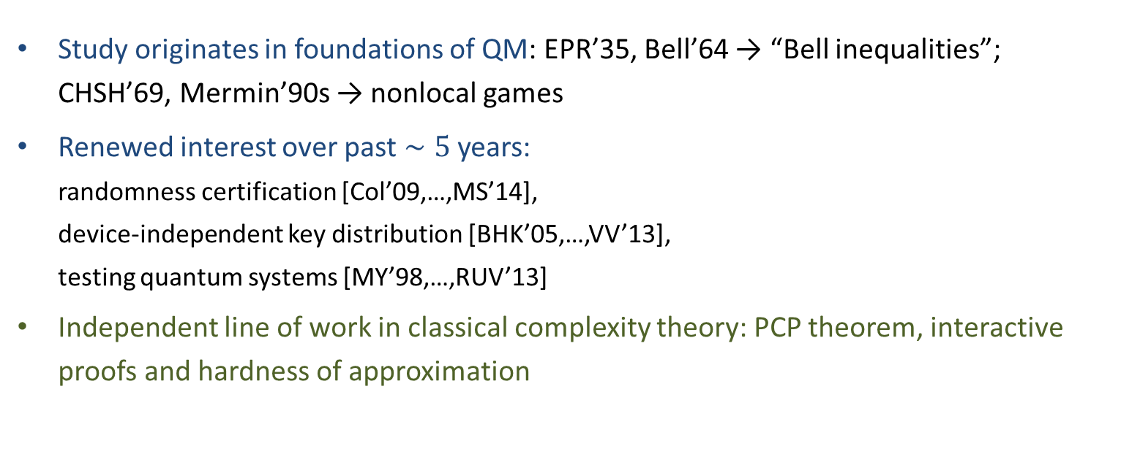

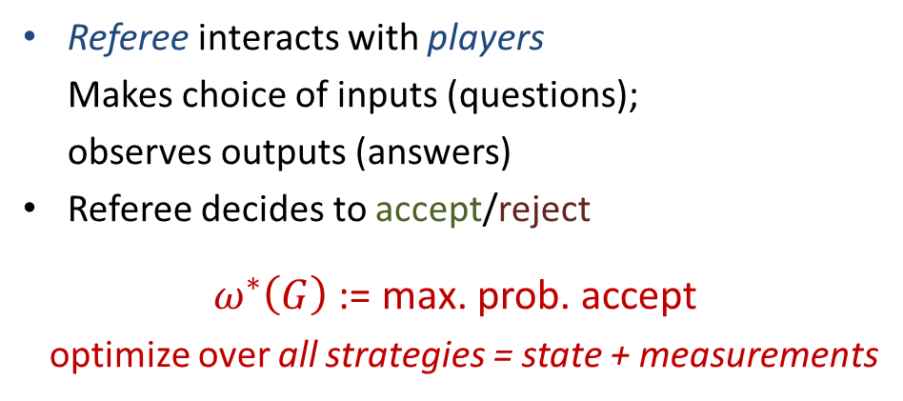

Multiplayer games
Referee interacts with players
Makes choice of inputs (questions);
observes outputs (answers)
Referee decides to accept/reject
$ω^{∗}\left(G\right)$ := max. prob. accept
optimize over all strategies = state + measurements
$ω^{∗}\left(G\right)$ := max. prob. accept
optimize over all quantum strategies
$ω \left(G\right)$ := max. prob. accept
optimize over all classical strategies
Accept! Reject!!
Study originates in foundations of QM: EPR’35, Bell’64 → “Bell inequalities”;
CHSH’69, Mermin’90s → nonlocal games
Renewed interest over past $∼5$ years:
randomness certification [Col’09,…,MS’14],
device-independent key distribution [BHK’05,…,VV’13],
testing quantum systems [MY’98,…,RUV’13]
Independent line of work in classical complexity theory: PCP theorem, interactive proofs and hardness of approximation
Notes:
So what’s a multiplayer game. In this talk I’ll only look at two player one round games, which have the following form.
So the rules of the game are public and the players cooperate to win
Studying the entangled value of a nonlocal game is really studying the strength of the correlations that you can generate by making local measurements on an entangled state, it’s a fundamental question that has a long history that you can trace back to the EPR paradox in the 30s and later Bell’s reformulation using Bell inequalities, which was simplified by CHSH and then Mermin in the 90s started thinking in terms of games, buttons you press, etc. and this has been a useful perspective as it also helped connect those Bell inequalities, and the study of nonlocality, with other areas of quanutm information in which interaction plays a role, most prominently crypography
And these connections have really picked up over the past 5 years, there’s been a lot of new interest because those nonlocal effects that are studied through games are now exploited to achieve an impressive variety of tasks , and we’ll hear some of it on Wednesday.
Let me also mention that games have had a completely independent, but at least as productive, life in classical computer science, where they were introduced in connection with the study of multiprover interactive proof systems and the PCP theorem and played an important role in the host of results in hardness of approximation that followed.

Slide 4
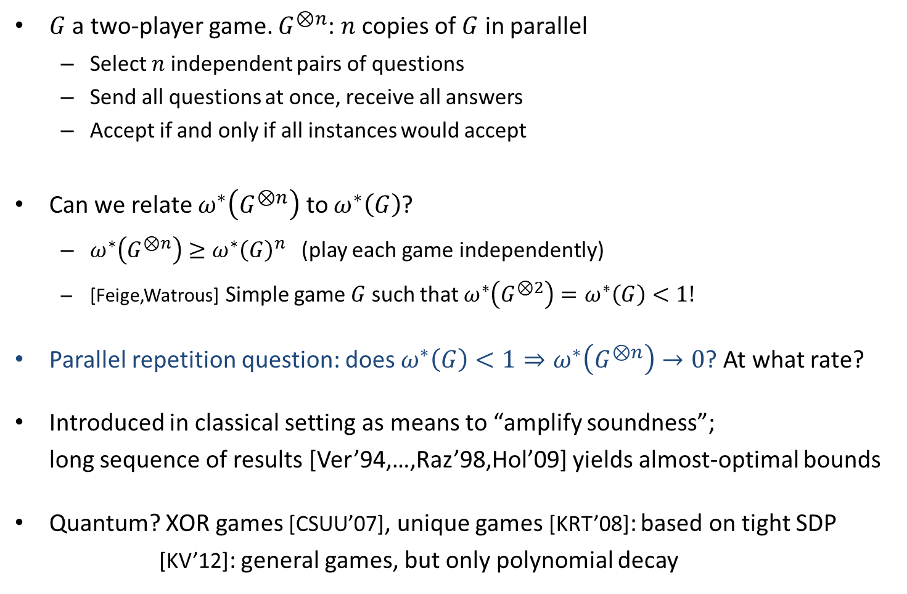
Parallel repetition of multiplayer games
$G$ a two-player game. $G^{⊗n}$: $n$ copies of $G$ in parallel
  Select $n$ independent pairs of questions
  Send all questions at once, receive all answers
  Accept if and only if all instances would accept
Can we relate $ω^{∗}\left(G^{⊗n}\right)$ to $ω^{∗}\left(G\right)$?
  $ω^{∗}\left(G^{⊗n}\right)≥ω^{∗}{\left(G\right)}^{n}$ (play each game independently)
  [Feige,Watrous] Simple game $G$ such that $ω^{∗}\left(G^{⊗2}\right)=ω^{∗}\left(G\right)<1!$
  Parallel repetition question: does $ω^{∗}\left(G\right)<1⇒ω^{∗}\left(G^{⊗n}\right)→0$? At what rate?
Introduced in classical setting as means to “amplify soundness”;
long sequence of results [Ver’94,…,Raz’98,Hol’09] yields almost-optimal bounds
Quantum? XOR games [CSUU’07], unique games [KRT’08]: based on tight SDP
[KV’12]: general games, but only polynomial decay
Check! Check! Check!
Notes:
So in this talk we’re interested in how the optimal success probability varies when you consider many copies of such games in parallel. Precisely
Achieving good bounds requires quite some work, but MP games are also one of the only areas where we do have good bounds… at least for the classical setting.
In the quantum case there is much less known.

Slide 5






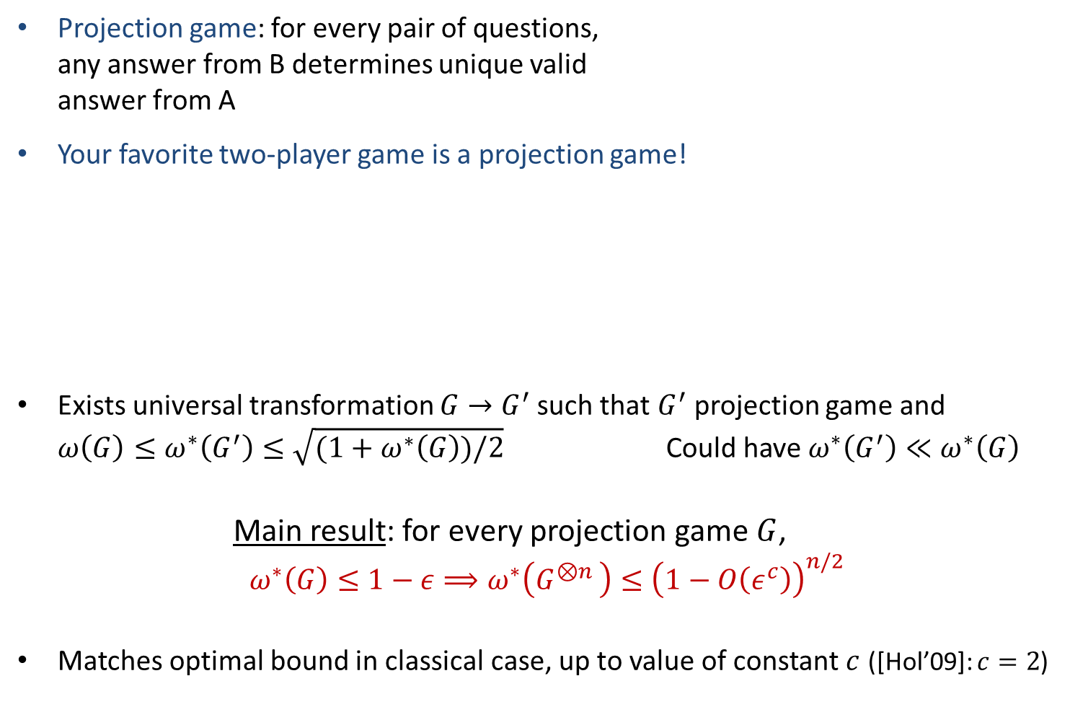

Results: parallel repetition of projection games
$$v$$
Projection game: for every pair of questions,
any answer from B determines unique valid
answer from A
Your favorite two-player game is a projection game!
Exists universal transformation $G→$ $G^{′}$ such that $G^{′}$projection game and
$ω\left(G\right)≤ω^{∗}\left(G^{′}\right)≤\sqrt{(1+ω^{∗}\left(G\right))/2}$ Could have $ω^{∗}\left(G^{′}\right)≪ω^{∗}\left(G\right)$
Main result: for every projection game $G$,
$$ω^{∗}\left(G\right)≤1−ε⟹ω^{∗}\left(G^{⊗n }\right)≤{\left(1−O\left(ε^{c}\right)\right)}^{n/2}$$
Matches optimal bound in classical case, up to value of constant $c$ ([Hol’09]: $c=2$)
$$u$$
$$b_{1}$$
$$a_{1}$$
$$a_{2}$$
$$b_{5}$$
Magic
square
Projection
games
XOR games
Unique
games
3SAT
game
Hidden matching
game
Notes:
Ok, so the result is clear, for any projection game parallel repetition decreases the entangled value at exponential rate. So let’s see how we prove this

Slide 6
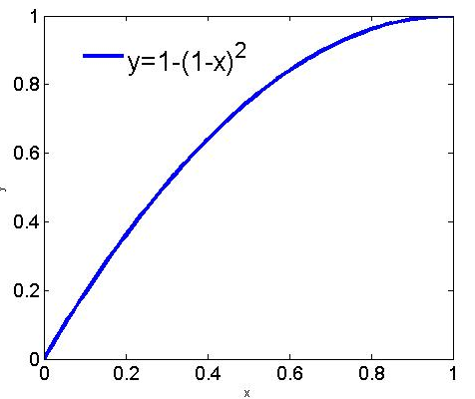

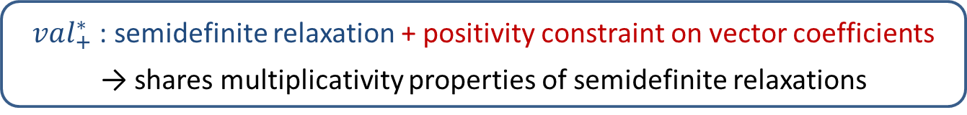

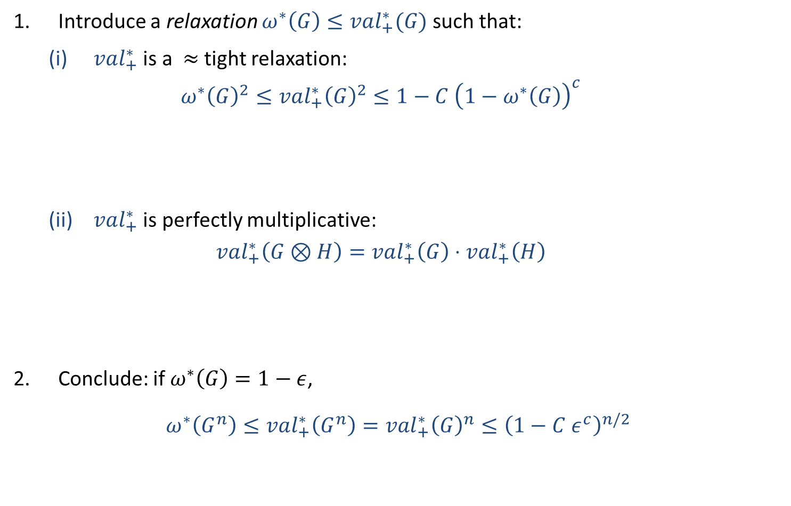
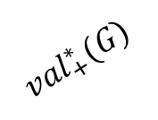
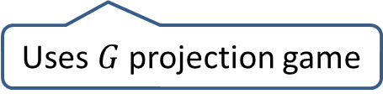
Proof outline
Introduce a relaxation $ω^{∗}\left(G\right)≤val_{+}^{∗}(G)$ such that:
  (i) $val_{+}^{∗}$ is a $≈$tight relaxation:
  $$ω^{∗}{\left(G\right)}^{2}≤val_{+}^{∗}{\left(G\right)}^{2}≤1−C {\left(1−ω^{∗}\left(G\right)\right)}^{c}$$
  (ii) $val_{+}^{∗}$ is perfectly multiplicative:
  $$val_{+}^{∗}\left(G⊗H\right)=val_{+}^{∗}\left(G\right)⋅val_{+}^{∗}\left(H\right)$$
Conclude: if $ω^{∗}\left(G\right)=1−ε$,
$$ω^{∗}\left(G^{n}\right)≤val_{+}^{∗}\left(G^{n}\right)=val_{+}^{∗}{\left(G\right)}^{n}≤{\left(1−C ε^{c}\right)}^{n/2}$$
Rounding argument based on quantum correlated sampling lemma
Uses $G$ projection game
$$val_{+}^{∗}(G)$$
$val_{+}^{∗}$ : semidefinite relaxation + positivity constraint on vector coefficients
→ shares multiplicativity properties of semidefinite relaxations
$$ω^{∗}(G)$$

Slide 7





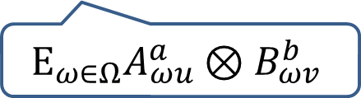
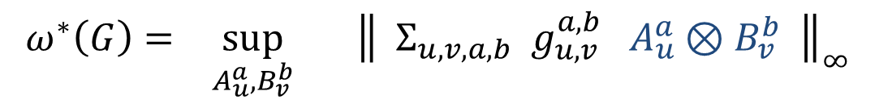

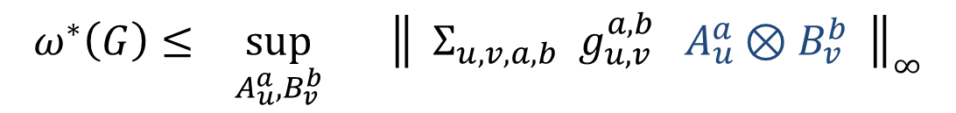

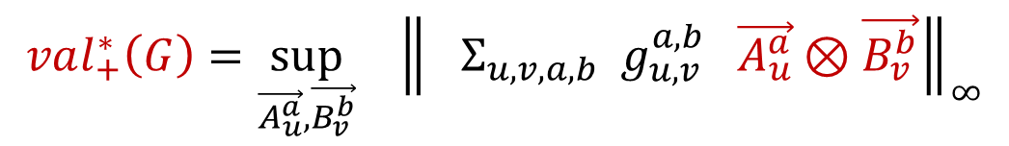
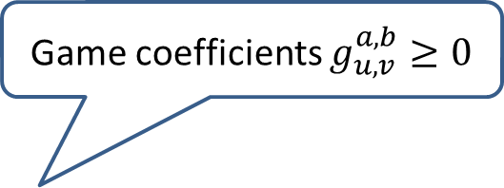
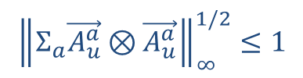
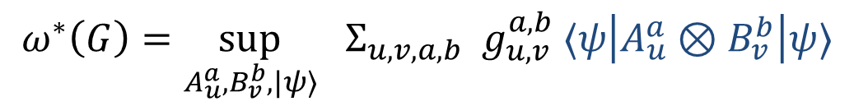

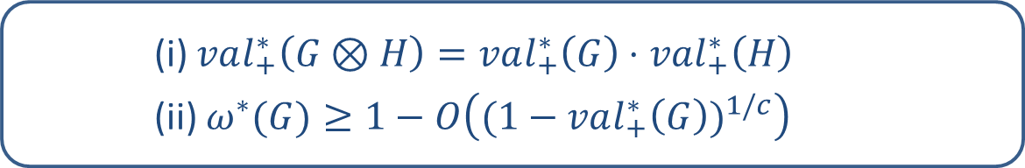
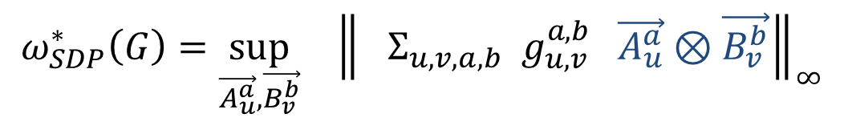

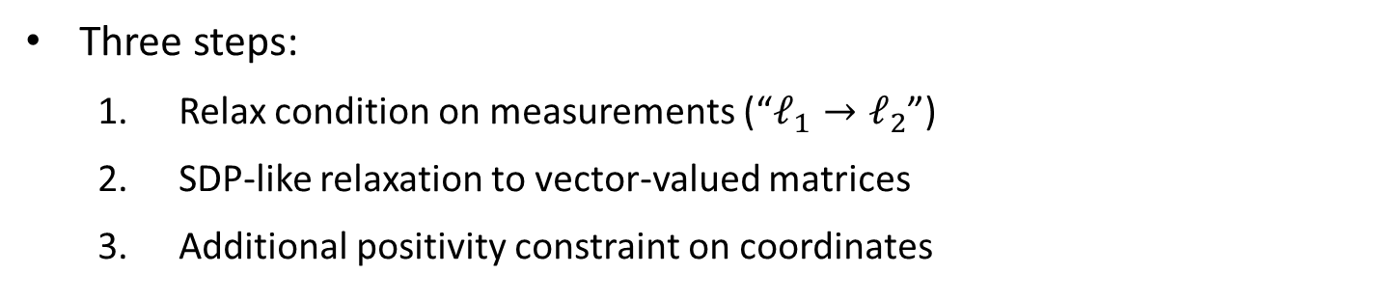



The relaxation $val_{+}^{∗}$
Three steps:
  Relax condition on measurements (“$ℓ_{1}→ℓ_{2}$”)
  SDP-like relaxation to vector-valued matrices
  Additional positivity constraint on coordinates
Game coefficients $g_{u,v}^{a,b}≥0$
$$ω^{∗}\left(G\right)= \sup_{A_{u}^{a}, B_{v}^{b}} { \left\|{ Σ}_{u,v,a,b} g_{u,v}^{a,b} A_{u}^{a}⊗B_{v}^{b} \right\|}_{∞}$$
$$ω^{∗}\left(G\right)=\sup_{A_{u}^{a}, B_{v}^{b}, |ψ〉} Σ_{u,v,a,b} g_{u,v}^{a,b} 〈ψ\left|A_{u}^{a}⊗B_{v}^{b}\right|ψ〉$$
$$ω^{∗}\left(G\right)≤ \sup_{A_{u}^{a}, B_{v}^{b}} { \left\|{ Σ}_{u,v,a,b} g_{u,v}^{a,b} A_{u}^{a}⊗B_{v}^{b} \right\|}_{∞}$$
$${\left\|Σ_{a}A_{u}^{a}⊗A_{u}^{a}\right\|}_{∞}^{1/2}≤1$$
$${\left\|Σ_{a}A_{u}^{a}\right\|}_{∞}≤1$$
$$Σ_{a}A_{u}^{a}=Id$$
$$ω_{SDP}^{∗}\left(G\right)=\sup_{\vec{A_{u}^{a}},\vec{B_{v}^{b}}} { \left\|{ Σ}_{u,v,a,b} g_{u,v}^{a,b} \vec{A_{u}^{a}}⊗\vec{B_{v}^{b}}\right\|}_{∞}$$
$$val_{+}^{∗}\left(G\right)=\sup_{\vec{A_{u}^{a}},\vec{B_{v}^{b}}} { \left\|{ Σ}_{u,v,a,b} g_{u,v}^{a,b} \vec{A_{u}^{a}}⊗\vec{B_{v}^{b}}\right\|}_{∞}$$
$${\left\|Σ_{a}\vec{A_{u}^{a}}⊗\vec{A_{u}^{a}}\right\|}_{∞}^{1/2}≤1$$
$$E_{ω∈Ω}A_{ωu}^{a}⊗B_{ωv}^{b}$$
$$A_{ωu}^{a}≥0 ∀ω,u,a$$
$$A_{Ωu}^{a}$$
$$\vec{a_{1}}$$
(i) $val_{+}^{∗}\left(G⊗H\right)=val_{+}^{∗}\left(G\right)⋅val_{+}^{∗}\left(H\right)$
(ii) $ω^{∗}(G)≥1−O\left((1−val_{+}^{∗}{\left(G\right))}^{1/c}\right)$
Variables are
vector-valued
matrices:
$$\vec{A_{u}^{a}}=$$
$$=$$
$$A_{1u}^{a}$$
$$\vec{a_{9}}$$
Notes:
If val_+ is large then also the value is close to 1. Invovles a rounding argument

Slide 8
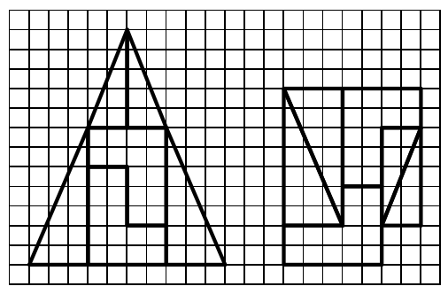


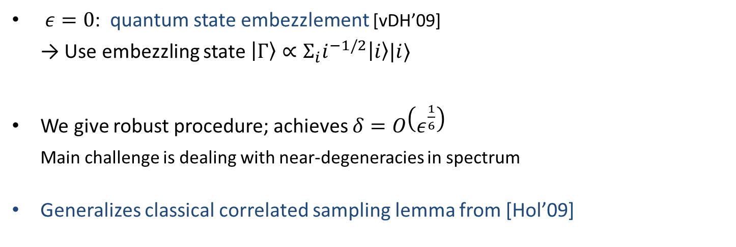
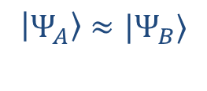
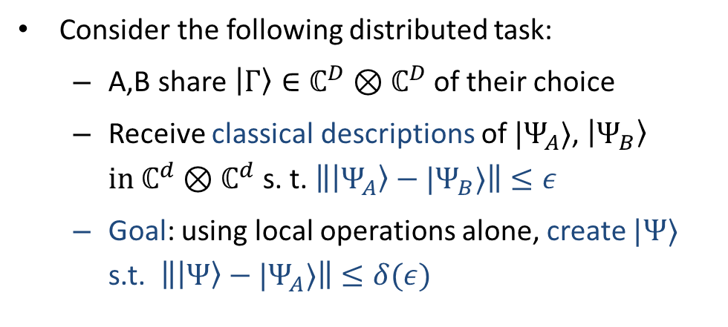


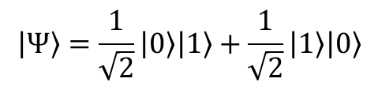
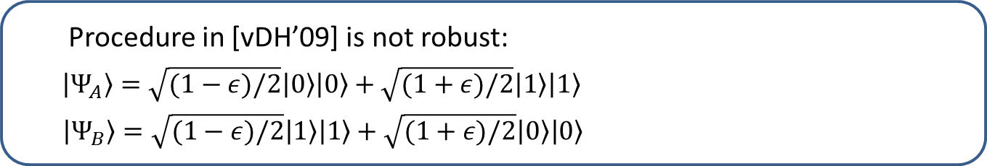

A quantum correlated sampling lemma
LO
$$|Γ〉$$
$$→ |Ψ〉⊗|junk〉$$
Consider the following distributed task:
  A,B share $|Γ〉∈ℂ^{D}⊗ℂ^{D}$ of their choice
  Receive classical descriptions of $|Ψ_{A}〉$, $|Ψ_{B}〉$
  in $ℂ^{d}⊗ℂ^{d}$ s. t. $\left\||Ψ_{A}〉−|Ψ_{B}〉\right\|≤ε$
  Goal: using local operations alone, create $|Ψ〉$ s.t.$\left\||Ψ〉−|Ψ_{A}〉\right\|≤δ(ε)$
$$|Ψ_{A}〉≈|Ψ_{B}〉$$
$ε=0$: quantum state embezzlement [vDH’09]
→ Use embezzling state $|Γ〉∝Σ_{i}i^{−1/2}|i〉|i〉$
  We give robust procedure; achieves $δ=O\left(ε^{\frac{1}{6}}\right)$
  Main challenge is dealing with near-degeneracies in spectrum
Generalizes classical correlated sampling lemma from [Hol’09]
Procedure in [vDH’09] is not robust:
$|Ψ_{A}〉=\sqrt{(1−ε)/2}|0〉|0〉+\sqrt{(1+ε)/2}|1〉|1〉$
$|Ψ_{B}〉=\sqrt{(1−ε)/2}|1〉|1〉+\sqrt{(1+ε)/2}|0〉|0〉$
$$|Γ〉$$
$$→|Ψ〉⊗|junk〉$$
$$|Ψ〉=\frac{1}{\sqrt{2}}|0〉|1〉+\frac{1}{\sqrt{2}}|1〉|0〉$$

Slide 9
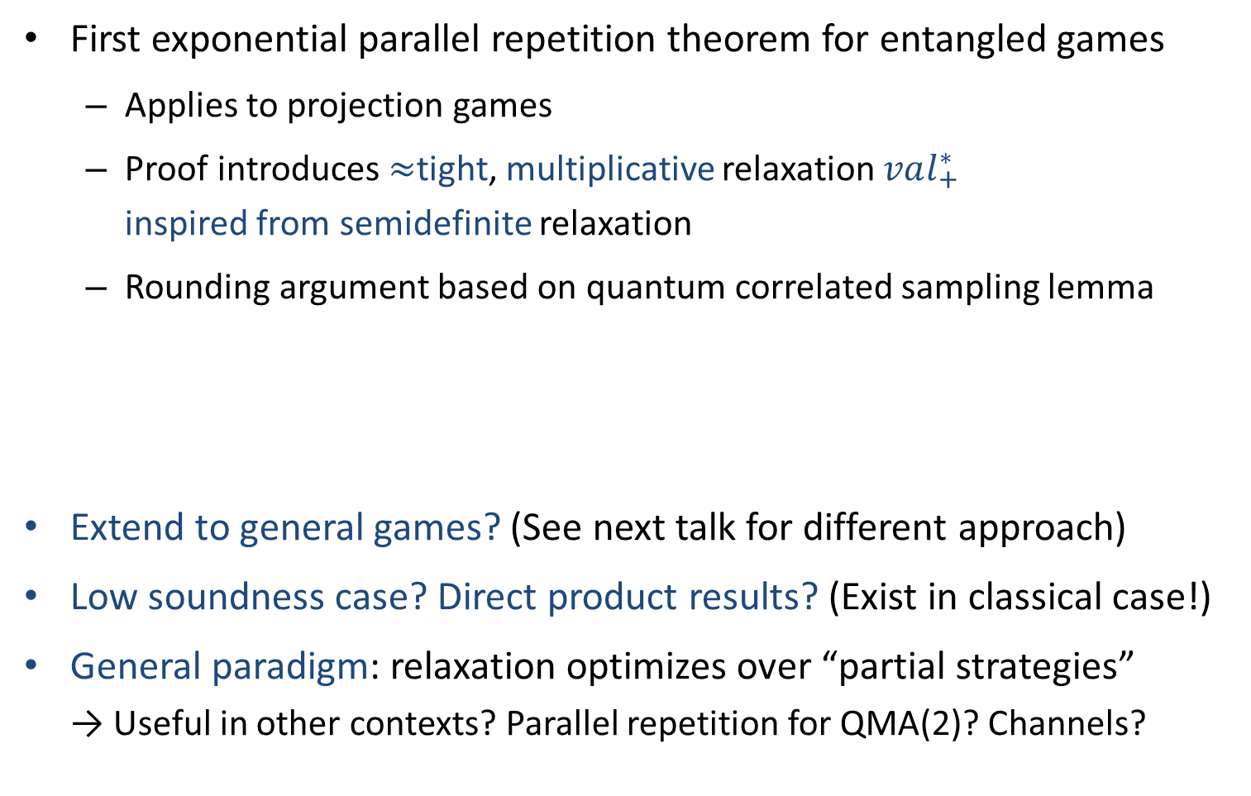
Summary
First exponential parallel repetition theorem for entangled games
  Applies to projection games
  Proof introduces $≈$tight, multiplicative relaxation $val_{+}^{∗}$
  inspired from semidefinite relaxation
  Rounding argument based on quantum correlated sampling lemma
Extend to general games? (See next talk for different approach)
Low soundness case? Direct product results? (Exist in classical case!)
General paradigm: relaxation optimizes over “partial strategies”
→ Useful in other contexts? Parallel repetition for QMA(2)? Channels?
Questions

Slide 10
Thank you!
Notes:
I’ll present what’s known as a parallel repetition theorem, it’s a bound on the success probability achievable when you simultaneously play many copies of a non local game, in parallel

