Slide 1
Simulating quantum chemistry on a classical computer
Garnet Kin-Lic Chan
California Institute of Technology

Slide 2
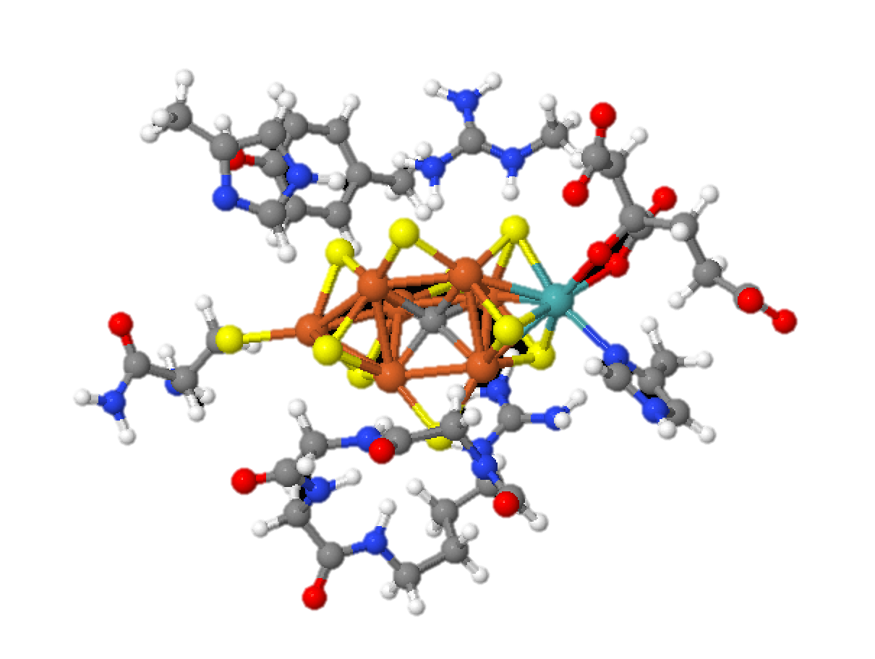
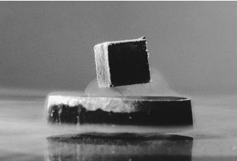
Modern frontiers in chemistry
How do Nature’s enzymes carry out complex
reactions such as photosynthesis and
nitrogen fixation?
Why does a high-temperature
superconductor superconduct?

Slide 3
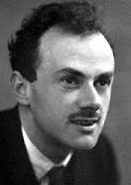
Dirac: Just simulate QM!
The fundamental laws necessary for the mathematical treatment of a large part of physics and the whole of chemistry are thus completely known …
Dirac
the difficulty lies only in the fact that application of these laws leads to equations that are too complex to be solved.
[The Schrodinger equation] cannot be solved accurately when
the number of particles exceeds about 10. No computer existing,
or that will ever exist, can break this barrier because it is a
catastrophe of dimension ...
Pines and Laughlin (2000)

Slide 4
Feynman: use a quantum computer!
Nature isn't classical, dammit, and if you want to make a simulation of nature, you'd better make it quantum mechanical, and by golly it's a wonderful problem, because it doesn't look so easy.
But we don’t have a quantum computer (yet)!

Slide 5
Outline
What is the quantum chemistry problem?
How is possible to simulate quantum chemistry
on a classical computer today?
classical simulation strategies
case studies: molecular crystals, metalloenzymes,
high-temperature superconductors
Where does quantum computing fit in?

Slide 6
Defining quantum chemistry (1)
quantum electrons (fermions)
classical nuclei
solve for low-lying (O(10)) eigenstates
discretize Hilbert space with a single-particle basis (orbitals)
Problem size = #orbitals. What sizes are of interest?

Slide 7
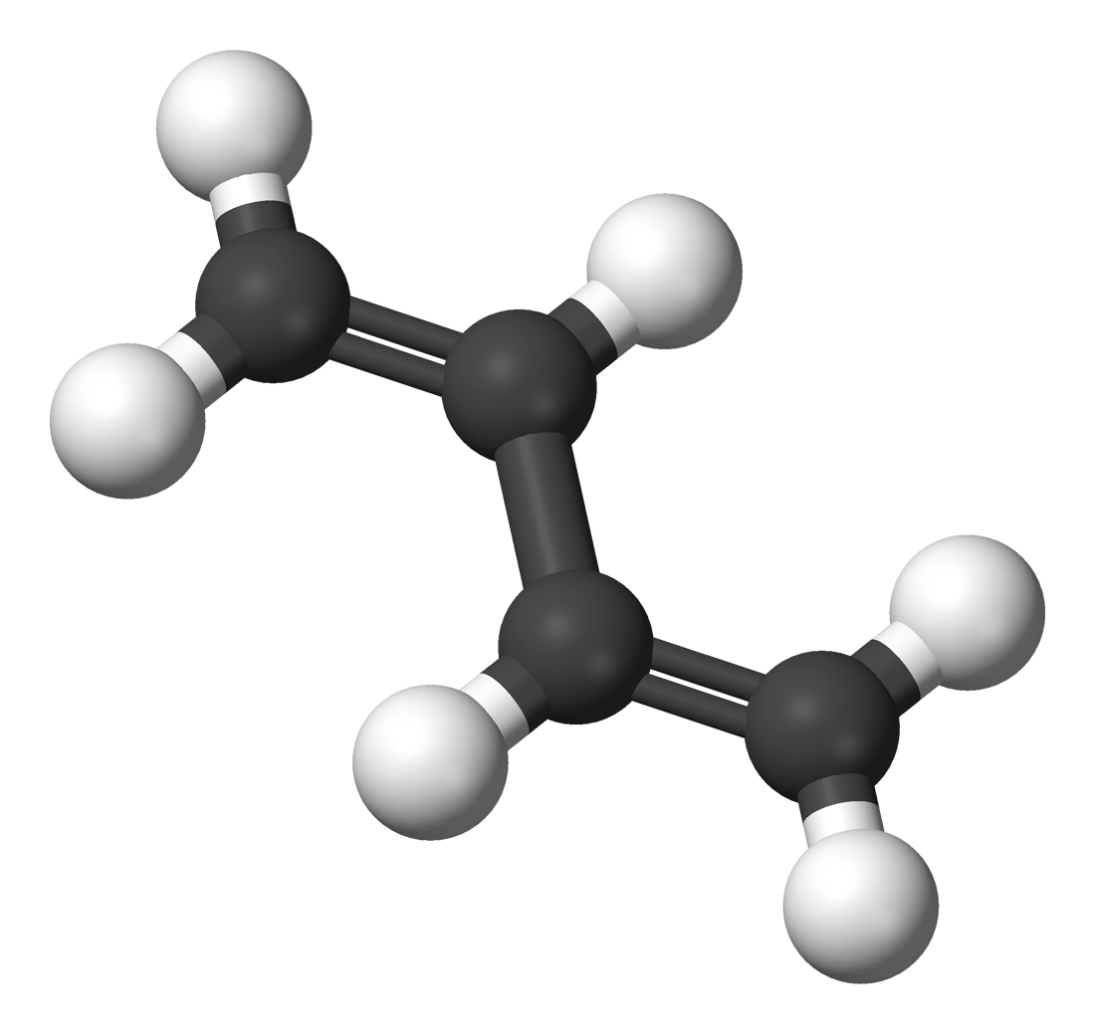
Defining quantum chemistry (2)
excitation energy of butadiene / eV
exptal
resolution
~ 0.1 eV
butadiene
C₄H₆ (10 atoms)
about 40 orbitals per atom
quantum effects typically extend over 10-100 atoms
Problem sizes
400 – 4000 orbitals
Note: representing H₂ by 4 qubits e.g. in recent quantum simulations is not “realistic”

Slide 8
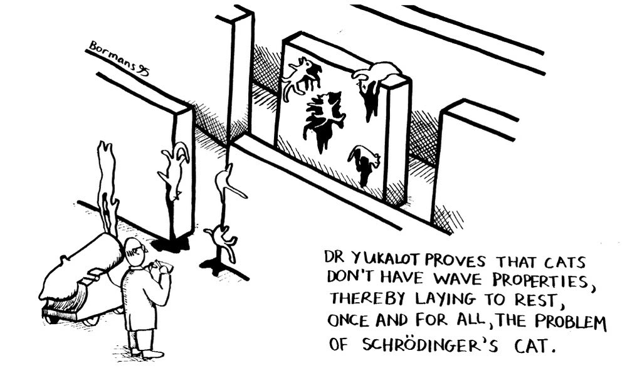
Why can we simulate quantum chemistry on a classical computer?
Nature does not explore all possible quantum states
low-energy physical states have simple structure

Slide 9
Structure of physical quantum states
two main kinds of physical low-energy states
1-particle (KE)
2-particle (repulsion)
kinetic energy
dominates,
e.g. delocalization
repulsions dominate
e.g. localization
mean-field states
+ perturbative expansions
local approximations
+ low entanglement states

Slide 10
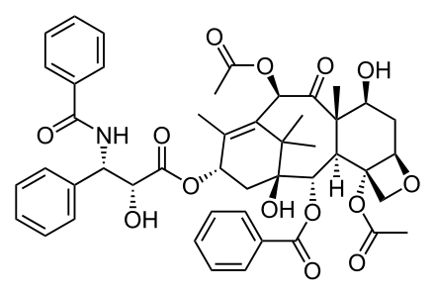
Mean-field + perturbation expansions
chemistry of s, p valence shells
organic chemistry
semiconductors
sum over linked diagrams
for given n_{max}, polynomial cost in problem size, but
polynomial order goes up with n_{max}

Slide 11
Adding up diagrams is familiar: QED
QED: fine-structure constant
experiment (2011)
theory (2012)
up to 10th order Feynman diagrams
same approach used in chemistry for high accuracy

Slide 12
Generating and summing diagrams
generate diagrams, sum subclasses to infinite order
by solving non-linear tensor equations
order of tensors ~ order of exactly summed PT contributions
tensor dimension ~ O(1000)

Slide 13
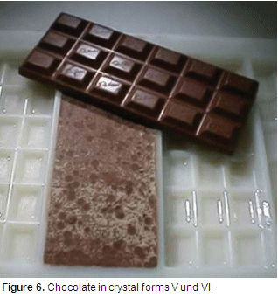
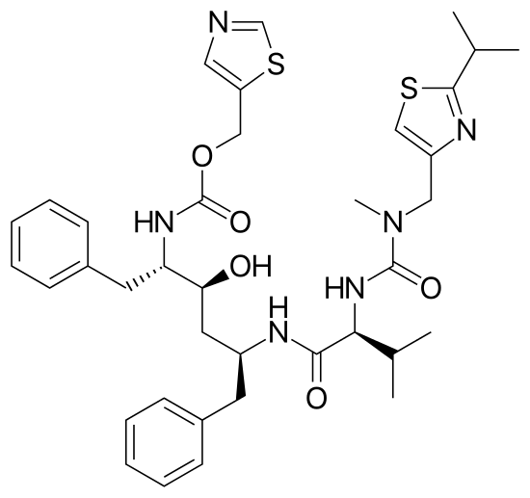
Case study: crystal lattice energies
Molecular compounds crystallize into different structures with different packing – polymorphs – with v. different properties
chocolate polymorphs
ritonavir
predicting relative stability of polymorphs is challenging
as differences of lattice energies are very small ~ 1 kJ / mol

Slide 14
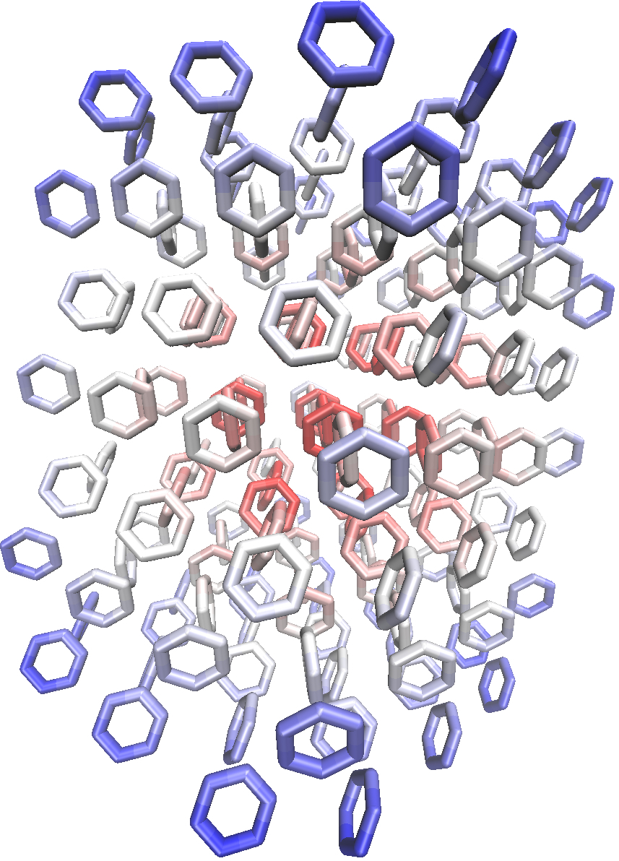
Adding up diagrams: lattice energies
What is the lattice energy of crystalline benzene?
mean-field
2e processes
3e
4e
E_{lat} = 20.17 – 61.88 – 13.25 + 0.29 (kJ/mol)
E_{lat} (theor) = 55.97 +/- 0.86
E_{lat} (expt) = 51.5 +/- 1
does not agree within
error bars
revised (2014)
= 55.3 +/- 1
Exptal thermal extrapolation in error. Revised
by 3.8 kJ/mol, back into agreement with theory!
computation can reach polymorph energy scale
Yang, Hu, Usvyat, Matthews,
Schuetz, Chan, Science (2014)
1 kJ/mol ~ 100K ~ 10 meV

Slide 15
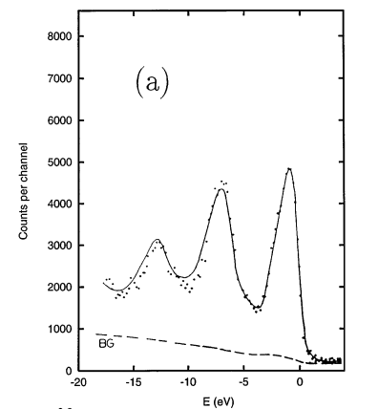
Case study: spectra
exptal Na photo-electron spectrum
Na core-hole spectra
(up to 2-particle diagrams)
(same x-axis scale)
McClain, Lischner, Watson, Matthews, Ronca, Louie, Berkelbach, Chan, Phys. Rev. B (2016)

Slide 16
Structure of physical quantum states
two main kinds of physical low-energy states
1-particle (KE)
2-particle (repulsion)
kinetic energy
dominates,
e.g. delocalization
repulsions dominate
e.g. localization
mean-field states
+ perturbative expansions
low-entanglement states
+ local approximations

Slide 17
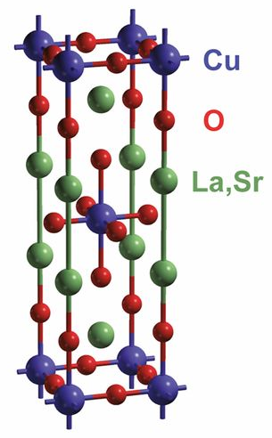
Strongly interacting systems
transition metal chemistry: tightly bound d-orbital electrons
repulsion energy / kinetic energy is high: strongly interacting
rich and complex behaviour
biological catalysis: e.g. photosynthesis
nitrogen fixation
exotic materials
high T_{c} superconductors

Slide 18
Basic physics
strong repulsions – electrons localize
localized e-: S=1/2 particle
competition between
localization, delocalization,
magnetic effects
physics of magnetism
starting from a local picture appears natural

Slide 19
Local approximations
define quantum state in terms of local variables
# parameters
tensor networks
local parameters are tensors: tensor trace yield global state
quantum embeddings
local parameters - expectation values, direct sum gives global values

Slide 20
Tensor networks
global state
local tensors
General
state
MPS
n₁
n₂
n₃
n₁
n₂
n₃
=
i₁
i₂
# parameters
if quantum state satisfies area law

Slide 21
Families of tensor networks
Matrix Product State (DMRG)
1D entanglement for gapped systems
White (1993)
Standard method for strongly interacting
ab-initio quantum chemistry
Tensor Product State (PEPS)
nD entanglement for gapped systems
Verstraete, Cirac (2004)
Increasingly applied to strongly correlated
electron models
MERA
1D/nD entanglement for gapless systems
Vidal (2007)

Slide 22
Ab-initio DMRG
map each orbital onto a tensor
minimize energy of complicated Hamiltonian

Slide 23
Quantum (density matrix) embedding
for each fragment
approximate environment
by a set of “bath” states
break calc. on large system
into calcs. on fragments
define bath from approximate wavefunction for entire problem
approximate global state
fragment
environment Schmidt
states define bath
solve for g.s. of fragment + bath in space
density matrix embedding theory (DMET)
Knizia and Chan, 2012

Slide 24
Case study: nitrogen fixation
Nitrogen in living things originated in the atmosphere,
but we cannot process nitrogen directly
nitrogen fixation
biological nitrogen fixation (bacteria)
ambient conditions
industry (Haber process)
consumes 5% of world’s natural gas and 2% of world’s energy

Slide 25
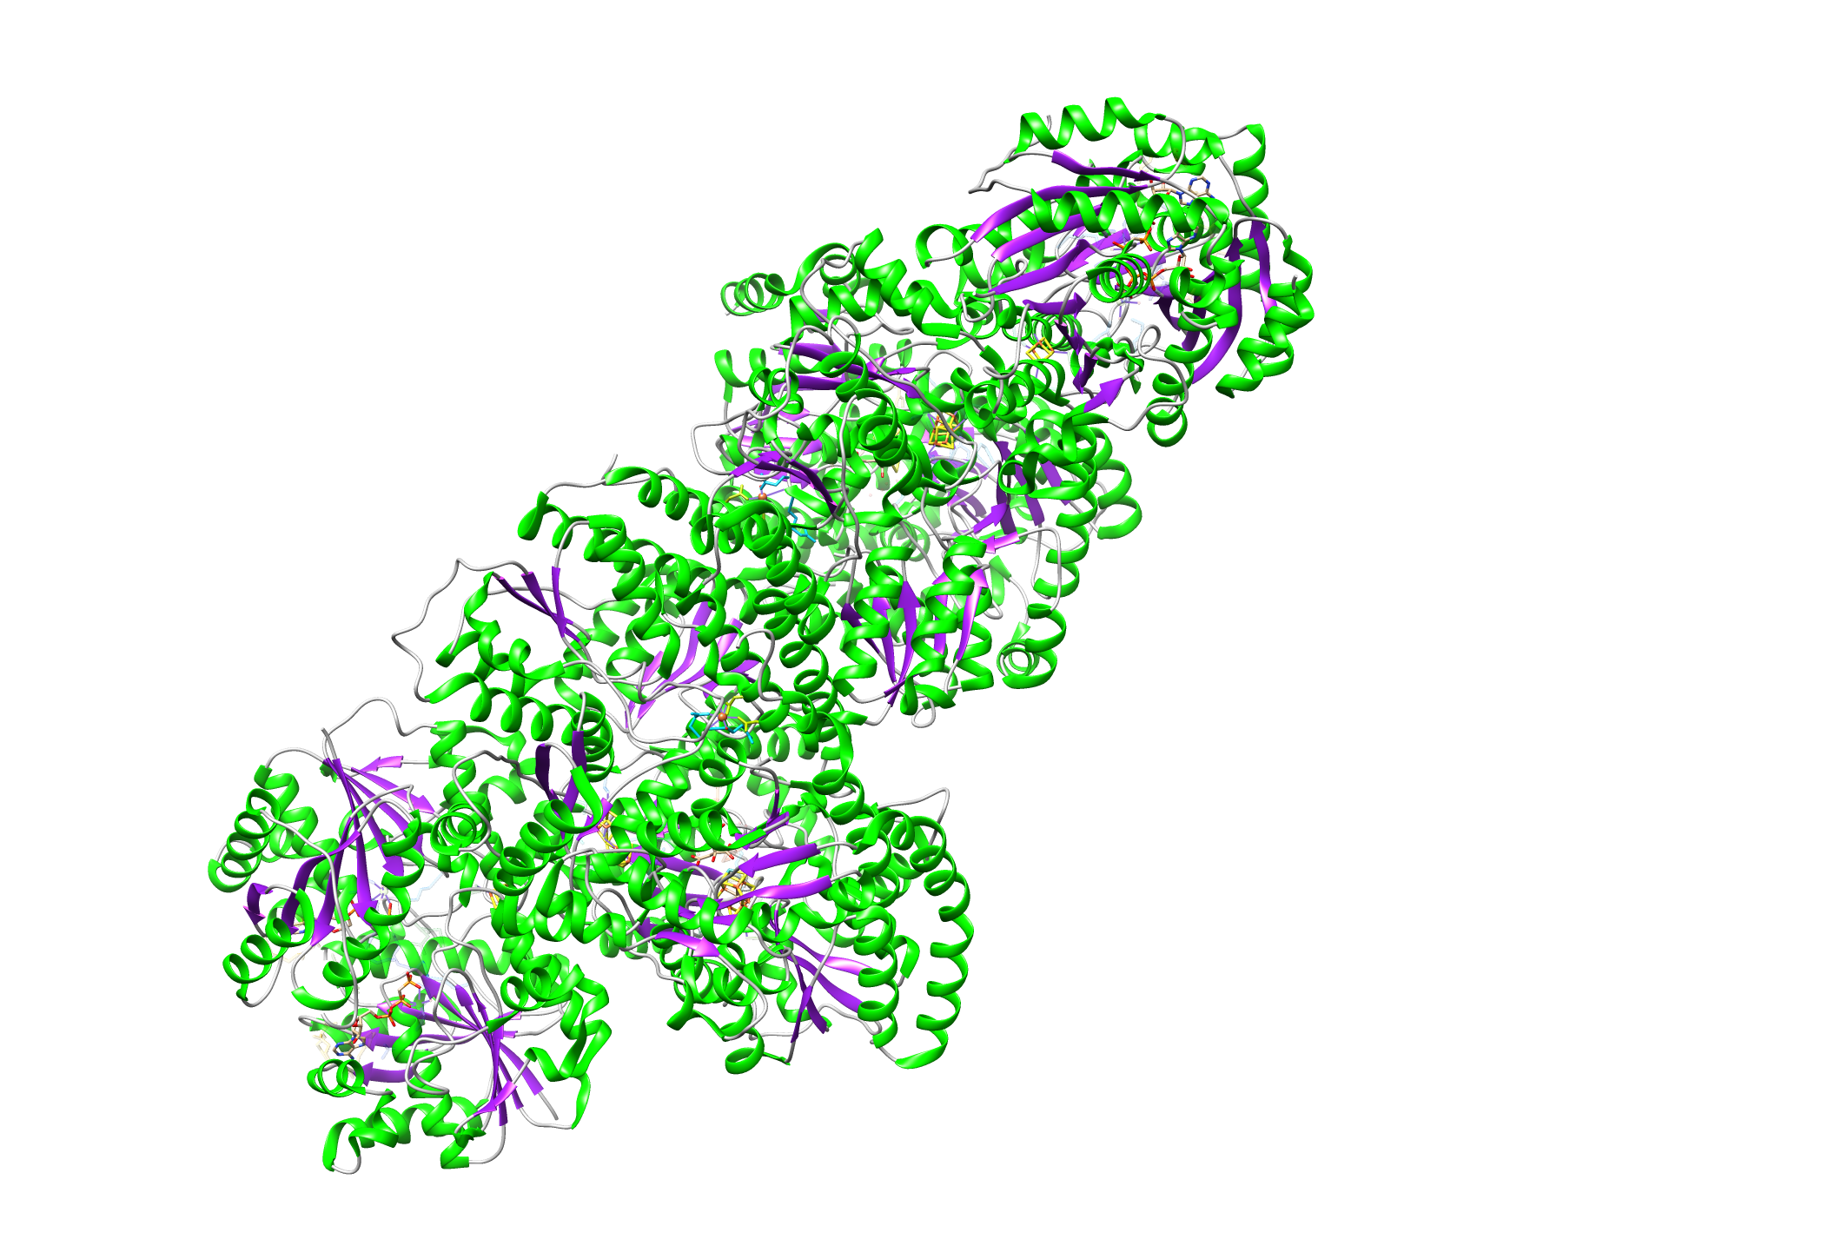
Nitrogenase: FeS clusters
nitrogenase enzyme
FeS clusters
FeS clusters: ubiquituous in nature
up to 8 Fe atoms (transition metals)
50-100 strongly interacting electrons (naively O(4¹⁰⁰) Hilbert space)
until development of low-entanglement wavefunctions (e.g. DMRG)
could only “guess” at the energies of the states

Slide 26
Hidden states of FeS clusters
these calculations enable us to see for the first time
the electronic states of these clusters
Sharma, Sivangulam, Neese, Chan
Nature Chemistry nchem.2041
earlier energies
of low-lying states
(from model)
DMRG energies of
low-lying states
high density of states plus strong coupling to nuclear motion seems
to be key to remarkable catalytic reactivity

Slide 27
Case study: High T_{c} superconductivity
2D Hubbard model
can we compute accurate phase diagram of Hubbard model?
ground-state of model as function of U/t and filling
Notes:
Of course to do this there are many challenges in this task.
Firstly, this phenomena involves transition metals, and transition metals exhibit complex electronic structure, as we have already seen in the case of just very small transition metal clusters in biology.
Next, superconductivity is involves not a finite set of clusters, it is a bulk phenomenon, i.e. it involves not just 4 metal atoms as in the FeS clusters, but an infinity of atoms.
We also need to consider non-adiabatic effects such as the electron-phonon coupling (which is important in superconductivity) as well as the effects of temperature.
And finally to relate
to experiment, it is not sufficient to look a the ground-state energies; we need to connect to spectroscopic probes, i.e. the excited. states

Slide 28
Consensus on the GS is elusive
Practical limitation
DMRG
finite cylinders, width 6
no superconductivity, stripes
finite width error
“DMFT”
impurity clusters in bulk
superconductivity, no stripes
sign problem/T
CP-AFQMC
finite systems (32x32)
no superconductivity, C/SDW
fixed phase error
Var./Diff. MC
finite systems up to 32x32
supercond., phase separation
fixed node error
Small energy scales. For concrete statements, accuracy is important!

Slide 29
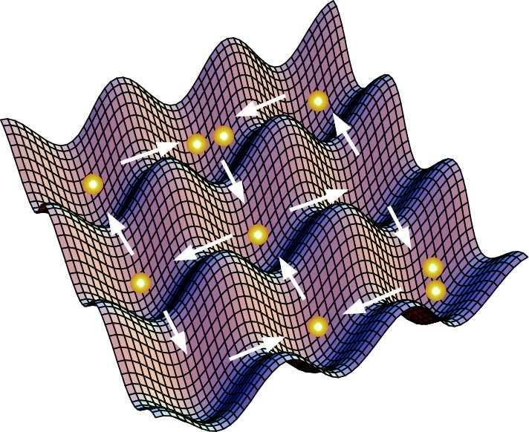
Cold atom simulators
Hubbard model also a holy grail for analog quantum computing!
cold atoms in optical lattice, interactions engineered by laser field
analog “quantum computer” designed to simulate given Hamiltonian
Lowest effective temperature: 1.4 T_{Neel} ~ 500 K (Hulet group, 2014)
still far above T_{c} = 30-150K (but improving)

Slide 30
2D Hubbard model
Recently, using local approximations major leaps have been made –
now possible to nail it down to better than 0.5% (~10 Kelvin)
2015-2016
U=4 half-filling energies
AFQMC (“exact”) : -0.8603 ± 0.0002
DMET (embedding) : -0.8604 ± 0.0003
AFQMC
(exact)
DMRG (tensor net) : -0.8605 ± 0.0005
DMET
DMRG
iPEPS (tensor net) : -0.8604 ± 0.0005
(c.f. VCA (2007) : -0.849) – only 1 s.f.
1-2 orders of magnitude improvement in accuracy in last decade

Slide 31

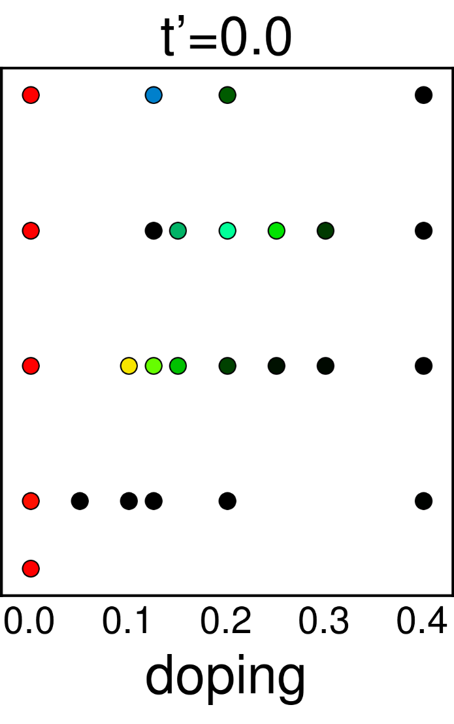
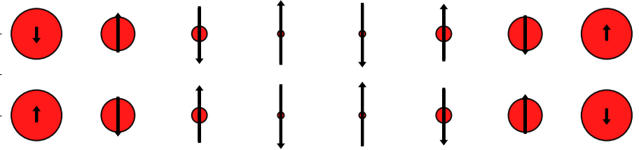
Underdoped ground-state of 2D Hubbard model
definitive resolution of mystery in Hubbard phase diagram
using combination of low entanglement methods (DMET, DMRG, iPEPS) and QMC
charges crystallize into 1D rivers: stripes
?
hints at fluctuating stripes picture
of superconductivity
collaboration of Chan, Corboz, Noack,
White, Zhang groups arxiv:1701.00054

Slide 32

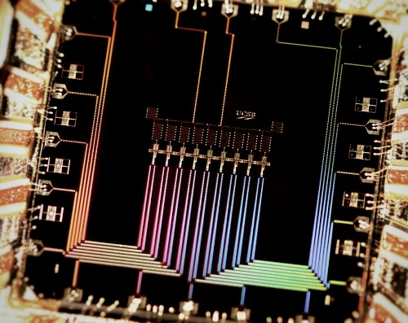
Whither quantum algorithms?
Classical algorithms are often unreasonably effective
Typical chemical / material problems and questions
do not seem to require exponential classical resources
close to limits of classical hardware
far from limits of quantum hardware?
exacale: but hard to use
more than 1-10% of petascale resources
1000’s of qubits
error correction
custom chips – 100 fold speedup
????

Slide 33
Near-term quantum ascendancy (1)
If completely freeze progress in classical methods, where is frontier?
weak coupling systems
ground-state energies: accuracy of 1 kT per bond
classical frontier: 1000-3000 orbitals (30-100 atoms)
ground-state energies: accuracy of 0.1 kT per bond
classical frontier: 100 orbitals (< 10 atoms)
excitations: accuracy of 1 kT
classical frontier: 50 orbitals (< 10 atoms)
High accuracy simulations of arbitrary eigenenergies for
small molecules could beat current classical implementations

Slide 34
Near term quantum ascendancy (2)
If completely freeze progress in classical methods, where is frontier?
Strong coupling systems
1% accuracy, 100 sites
low, finite
temperature
2D Hubbard phase diagram
T
currently no good
methods
U
< 0.1%
accuracy
1000 sites
n (filling)
By tuning strong coupling problems into hard regimes, should
be competitive / beat current classical methods

Slide 35
Quantum-classical interface
good quantum algorithms may implement good classical algorithms
Classical CC algorithm
to get ground-state:
optimize exponential operator
(Coester + Kummel, 1960)
Quantum embeddings
allow us to reach TDL
from small finite clusters
DMFT: Georges + Kotliar, 1992
DMET: Knizia + Chan, 2012
Variational quantum eigensolver
Quantum simulation with DMET, DMFT
Peruzzo, 2014
Bauer et al, 2015; Rubin, 2016
More to come?

Slide 36
Conclusions
Using physical structures of quantum states
can simulate frontier chemistry and materials science
problems on classical computers
No evidence that we need exponential classical resources
By tuning into appropriate regimes, should see
quantum computing crossover
Funding from: DOE, NSF, Simons Foundation

