Slide 1
New quantum lower bound method, with applications to direct product theorems
Andris Ambainis, U. Waterloo
Robert Spalek, CWI, Amsterdam
Ronald de Wolf, CWI, Amsterdam

Slide 2
Query model
i
i
...
0
1
0
0
0
x_{i}
x₁
x₂
x₃
x_{N}
Input x₁, …, x_{N} accessed by queries.
Complexity = the number of queries.

Slide 3
Grover's search
...
0
1
0
0
x₁
x₂
x₃
x_{N}
Is there i such that x_{i}=1?
Queries: ask i, get x_{i}.
Classically, N queries required.
Quantum: O(√N) queries [Grover, 1996].
Speeds up any search problem.

Slide 4
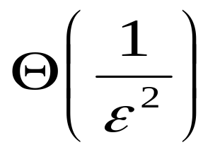
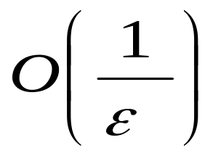
Quantum counting [Boyer et al., 1998]
...
0
1
0
0
x₁
x₂
x₃
x_{N}
Is the fraction of i:x_{i}=1 more than ½+ε or less than ½-ε ?
Classical: queries.
Quantum: queries.

Slide 5
Element distinctness
...
3
1
17
5
x₁
x₂
x₃
x_{N}
Are there i, j such that i≠j but x_{i}=x_{j}?
Classically: N queries.
Quantum: O(N^{2/3}).

Slide 6
Lower bounds
Search requires Ω(√N) queries [Bennett et al., 1997].
Counting: Ω(1/ε) [Nayak, Wu, 1999].
Element distinctness: Ω (N^{2/3}) [Shi, 2002].

Slide 7
Lower bound methods
Adversary: analyze algorithm, prove it is incorrect on some input.
Polynomials: describe algorithm by low degree polynomial.

Slide 8
Which method?
Problem | Adversary | Polynomials
Search | Yes | Yes
Counting | Yes | Yes
Element dist. | ? | Yes

Slide 9
Limits of adversary method
Certificate for f on input (x₁, x₂, …, x_{N}):
set of variables x_{i} which determine
f(x₁, x₂, …, x_{N}).
Search: is there i:x_{i}=1?
...
0
1
0
0
x₁
x₂
x₃
x_{N}

Slide 10
Limits of adversary method
Certificate for f on input (x₁, x₂, …, x_{N}):
set of variables x_{i} which determine
f(x₁, x₂, …, x_{N}).
Search: is there i:x_{i}=1?
...
0
0
0
0
x₁
x₂
x₃
x_{N}

Slide 11
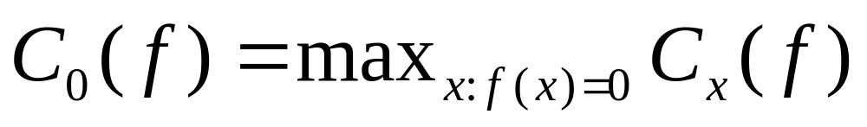
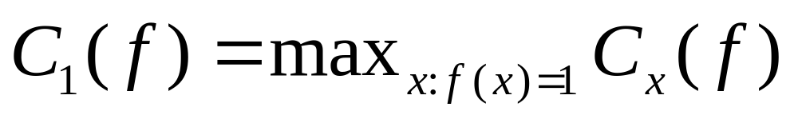
Certificate complexity
C_{x}(f): the size of the smallest certificate for f on the input x.
Search: C₀=N, C₁=1.

Slide 12
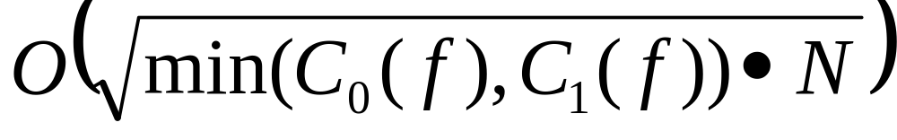
Limits of adversary method
Theorem [Spalek, Szegedy, 2004]
Any quantum adversary lower bound is at most

Slide 13
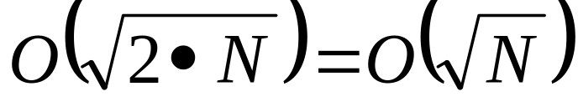
Example:element distinctness
...
3
1
17
5
x₁
x₂
x₃
x_{N}
Are there i, j:x_{i}= x_{j}?
1-certificate: {i, j}, x_{i}= x_{j.}
Adversary bound:
Actual complexity: O(N^{2/3}).

Slide 14
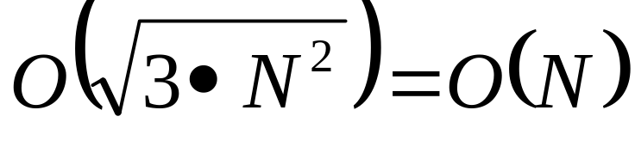
Example: triangle finding
Graph G, specified by N² variables x_{ij}:
x_{ij}=1, if there is edge between i and j.
Does G contain a triangle?
1-certificate:{ij, jk, ik}, x_{ij}= x_{ik}= x_{jk}=1.
Adversary lower bound: at most
The best algorithm: O(N^{1.3}) [MSS 03].

Slide 15
Previous adversary method

Slide 16
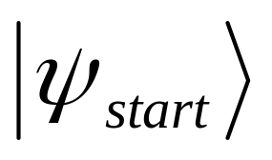
Quantum query model
U₀
Q
Q
U₁
…
U_{T}
Fixed starting state.
U₀, U₁, …, U_{T} – independent of x₁, x₂, …, x_{N}.
Q – queries.
Measuring final state gives the result.

Slide 17
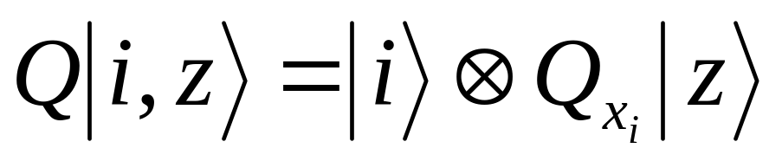
Queries
Basis states for algorithm’s workspace: |i, z⟩, i∈{1, 2, …, N}.
Query transformation:
Example:
  |i, z⟩→|i, z⟩, if x_{i}=0;
  |i, z⟩→-|i, z⟩, if x_{i}=1;

Slide 18
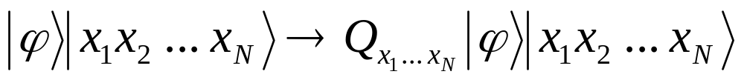
Adversary framework
Quantum
algorithm A
|
x₁ x₂ … x_{N}
⟩
Two registers: H_{A}, H_{I}.
Query Q:

Slide 19
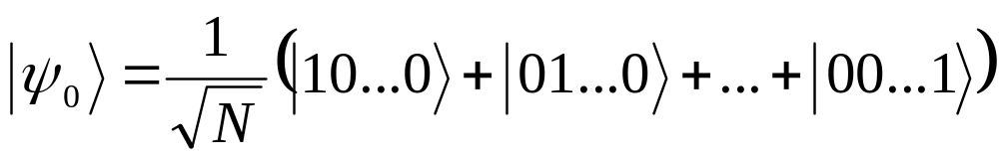
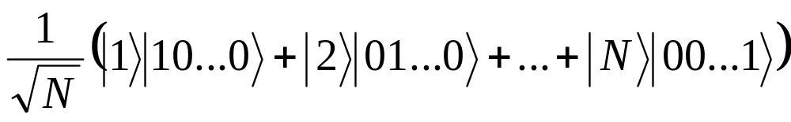
Example:Grover search
Start state: |ψ_{start}⟩⊗|ψ₀⟩,
End state

Slide 20
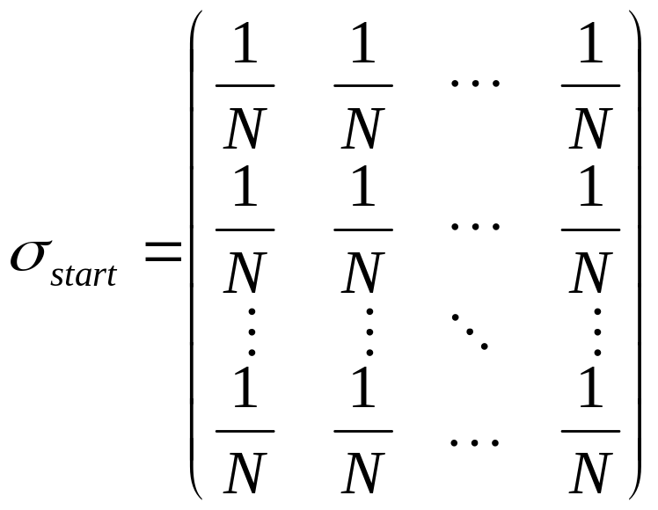
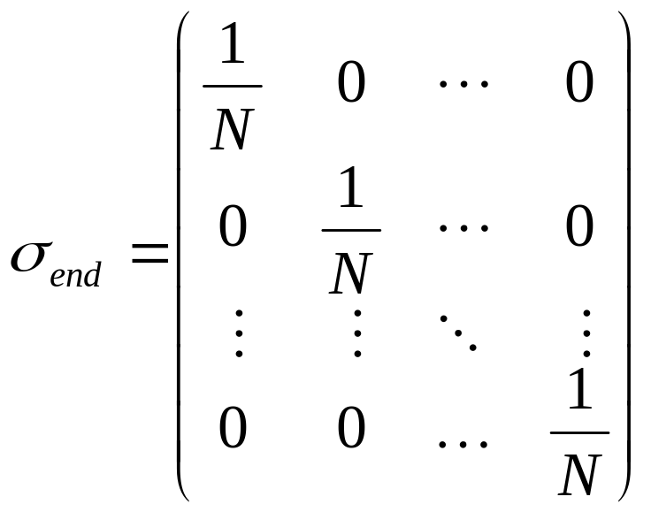
Density matrices
Measure H_{A}, look at density matrix of H_{I}

Slide 21
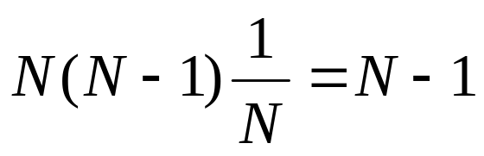
Density matrices
Sum of off-diagonal entries.
N(N-1) entries.
Sum for starting state:
Sum for end state: 0.
Query changes the sym by at most 2√N.
Ω(√N) queries needed.

Slide 22
Limits of this approach
(σ_{end})_{x, y} measures the possibility of distinguishing x from y.
If every (σ_{end})_{x, y} small, we can, given x, y: f(x) ≠f(y), distinguish x from y.

Slide 23
Limits of this approach
It might be that:
  Every x can be distinguished from every y;
  There is no measurement that distinguishes all x from all y.
Adversary method fails
quantum algorithm
f(x)=0
f(y)=1

Slide 24
New method

Slide 25
K-fold search
...
0
1
0
0
x₁
x₂
x₃
x_{N}
K items i:x_{i}=1, find all of them.
O(√NK) queries: O(√N/K) for each item.
This is optimal.

Slide 26
Direct product theorem
Theorem [KSW 04] Solving K-fold search with success probability c^{-K}, c>1 requires ε√NK queries.
Easy to prove for success probability c.
Difficult for probability c^{-K}.
Why is this useful????

Slide 27
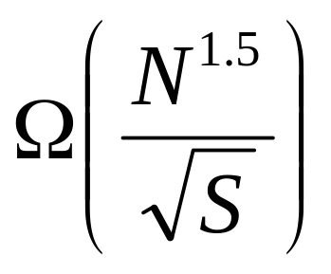
Application:sorting
Theorem [KSW04] A quantum algorithm for sorting x₁, x₂, …, x_{N} with S qubits of workspace must use
queries.

Slide 28
Proof
Divide algorithm into stages: first K items sorted, next K items sorted, …
Suffices to show each stage requires Ω(√NK) queries.
Each stage reduces to K-fold search.

Slide 29
Proof
At the beginning of i^{th} stage, we get S qubits from the previous stage.
Theorem K-fold search requires Ω(√NK) queries, even if we allow K/C qubits of advice.

Slide 30
Proof
Theorem K-fold search requires Ω(√NK) queries, even if we allow K/C qubits of advice.
Proof Replace advice by completely mixed state.
Success probability p with advice => Success probability p2^{-K/C}, no advice.

Slide 31
Direct product theorem
Theorem Solving K-fold search with success probability c^{-K}, c>1 requires ε√NK queries.
[KSW 04]: proof by polynomials method.
This talk: (new) adversary method.

Slide 32
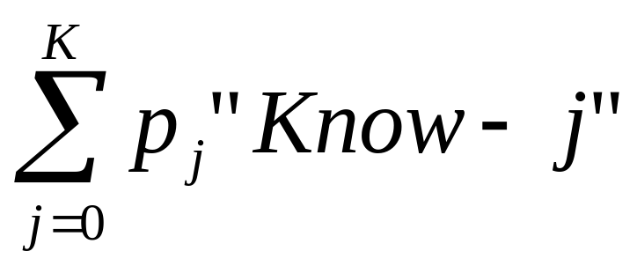
Proof sketch
“Know-0”, “Know-1”, …, “Know-k” states.
Describe quantum state as

Slide 33
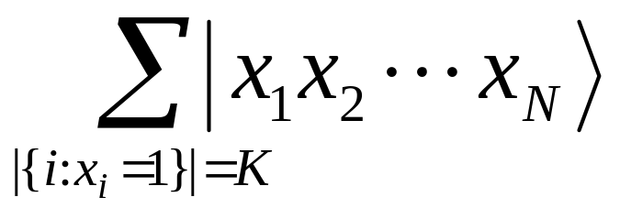
Proof
Adversary framework
Start state for input:
Quantum
algorithm A
|
x₁ x₂ … x_{N}
⟩

Slide 34
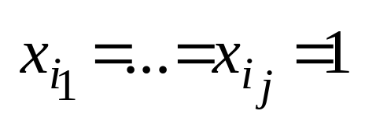
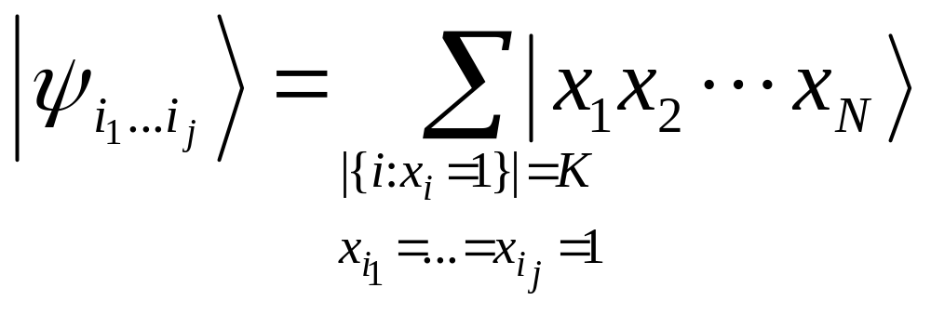
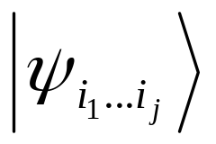
Proof
State of H_{I} if we know
Subspace T_{j} spanned by all

Slide 35
Proof
T₀⊆T₁ ⊆… ⊆ T_{K}.
T₀ – starting state.
T_{K} – entire H_{I}.
T₀
T₁
….
T_{K}
T_{j} – “know at-most j” subspace

Slide 36
Proof
S_{j}=T_{j}∩(T_{j-1})⊥.
T₀
T₁
…
T_{K}

Slide 37
Proof
S_{j}=T_{j}∩(T_{j-1})⊥.
T₀
S₁
…
S_{K}
S_{j} is “know-j” subspace.

Slide 38
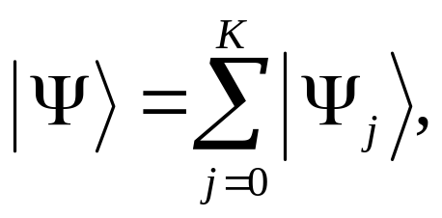
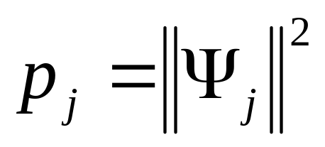
Proof
|Ψ⟩ - state of algorithm including the input register |x₁ … x_{N}⟩.
|Ψ_{j}⟩ belongs to H_{A} ⊗ S_{j}.
Probability of “know-j”:

Slide 39
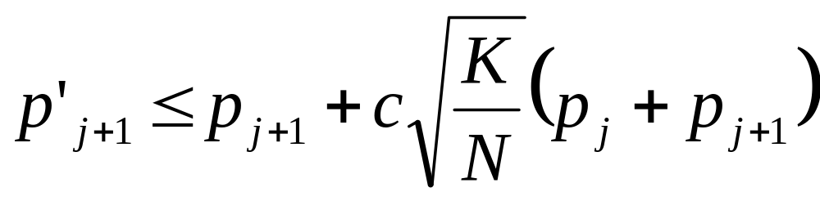
Proof
Start state: p₀=1, p₁=…=p_{K}=0.
Change in one query:
After ε√NK queries, p_{K/2+1}, …, p_{K} are exponentially small.
Success probability exponentially small.

Slide 40
Threshold functions
...
0
1
0
0
x₁
x₂
x₃
x_{N}
F(x₁, x₂, …, x_{N})=1 if x_{i}=1 for at least t values i∈{1, 2, …, N}.
F(x₁, x₂, …, x_{N})=0 if x_{i}=1 for at most t-1 values i∈{1, 2, …, N}.
Query complexity: Θ(√Nt).

Slide 41
Threshold functions
...
0
1
0
0
x₁
x₂
x₃
x_{N}
F(x₁, x₂, …, x_{N})=1 if x_{i}=1 for at least t values i∈{1, 2, …, N}.
F(x₁, x₂, …, x_{N})=0 if x_{i}=1 for at most t-1 values i∈{1, 2, …, N}.
Query complexity: Θ(√Nt).

Slide 42
Threshold functions
K instances of threshold function.
Θ(K√Nt) queries.
Theorem Solving all K instances with probability at most c^{-K} requires εK√Nt queries.

Slide 43
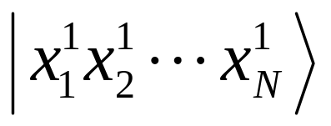
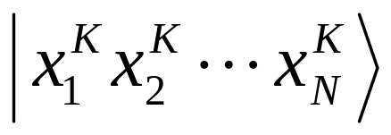
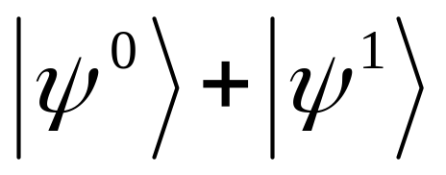
Proof
Algorithm
…
K input registers.
Each input register initially ,
|ψ⁰⟩, |ψ¹⟩ - uniform over |x₁ … x_{N} ⟩ with t-1 and t values i:x_{i}=1.

Slide 44
Proof
For each instance, states “solved”, “know-0”, “know-1”, … “know-(t-1)”.
For K instances, vector of K states.
Progress of a state:
  “solved” – progress t/2.
  “know-t/2”, … “know-(t-1)” – progress t/2.
  “know-j”, j<t/2 – progress j.

Slide 45
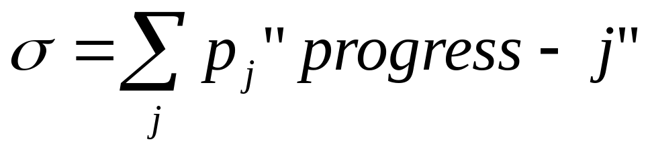
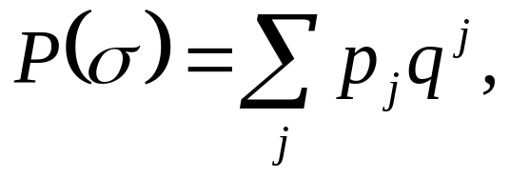
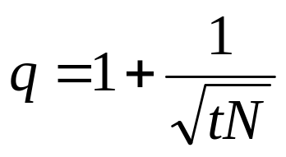
Proof
If progress of final state less than tK/4, the probability of getting all K correct answers is c^{-K}.
Decompose current state
Potential function

Slide 46
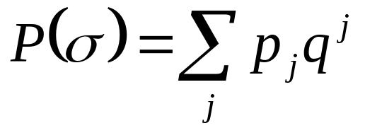
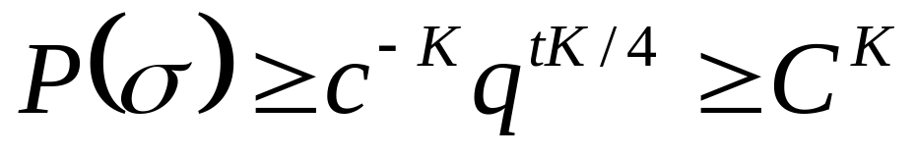
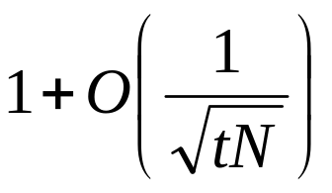
Proof
Start state: P(σ)=1.
For p_{j}, j≥tK/4 to be more than c^{-K},
One query increases P(σ) by at most a factor of

Slide 47
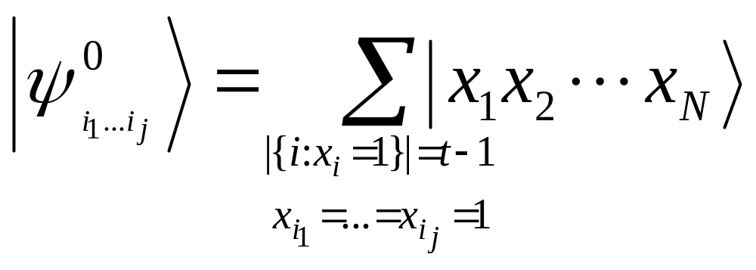
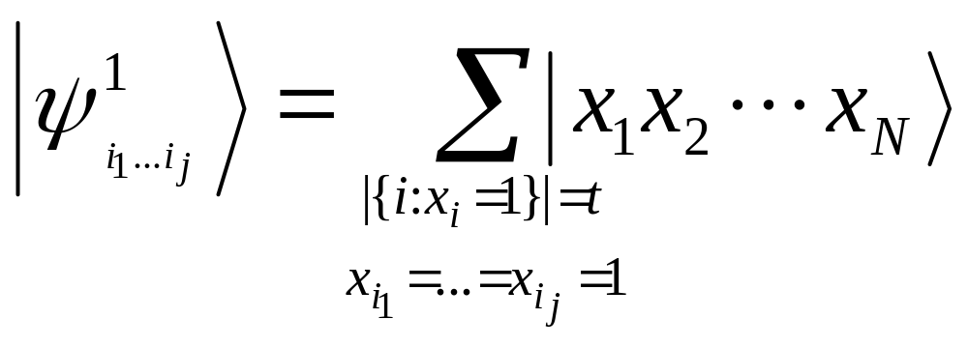
Proof
F(x₁, x₂, …, x_{N})=0, “know-j”:
F(x₁, x₂, …, x_{N})=1, “know-j”:

Slide 48
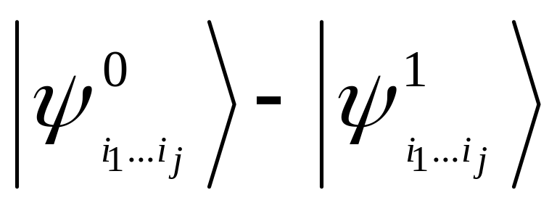
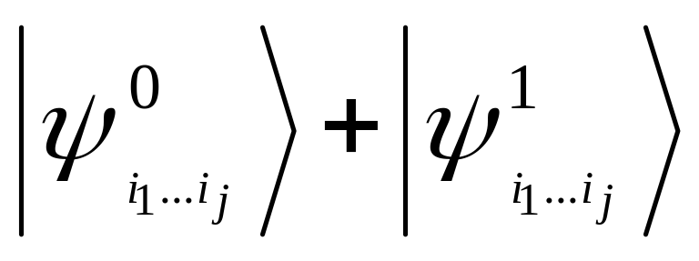
Proof
Starting state:
“Solved”:
“Know-j”

Slide 49
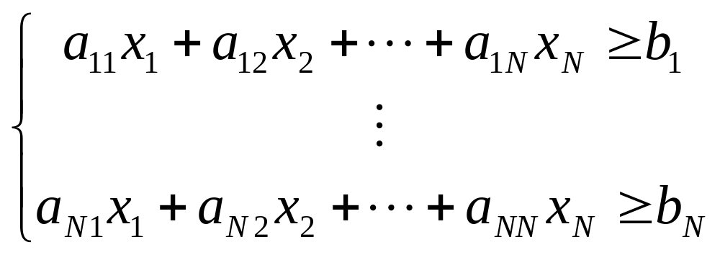
Application: testing linear inequalities
a_{ij} known, x_{i}, b_{j} accessed by queries.
Which inequalities are true?

Slide 50
Our result
Memory limited to S (qu)bits.
Classically: Θ(N²/S) queries.
Quantum: Θ(N^{3/2}t^{1/2}/S^{1/2}) queries.
Lower bound follows from threshold function lower bound.

Slide 51
Conclusion
New quantum lower bound method, by eigenspace analysis.
Direct product theorems for K-fold search and threshold functions.
Consequences for time-space tradeoffs.

Slide 52
More details
A. Ambainis. A new quantum lower bound method, with application to direct product theorem for search, quant-ph/0508200.
A. Ambainis, R. Spalek, R. de Wolf, Quantum direct product theorems for symmetric functions and time-space tradeoffs , quant-ph/0511200.

Slide 53
Open problems
AND-OR tree: best lower bound O(√N), N – number of variables.
Algorithm: O(N^{.753}).
AND
OR
OR
x₁
x₂
x₃
x₄
Adversary lower
bound for element
distinctness?

