Slide 1
Quantum Multi-Prover Interactive Proofs with Communicating Provers
QIP-2009
Michael Ben-Or
Avinatan Hassidim
Haran Pilpel

Slide 2
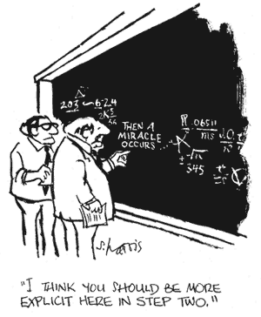
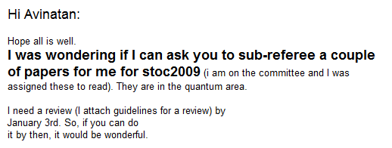
An imaginary scenario
You receive a paper for refereeing
The proof is messy
The deadline is
How can you tell if the paper is correct?
Today
tomorrow

Slide 3

Solution – ask someone
Send an email to the author, asking
  “Is the paper correct?”
Problem: the response is always “the paper is correct”
Can the author prove us the paper is correct?
  And do it without us working hard…
What happens if there are a few co-authors?
The paper is correct. You should accept it!

Slide 4
The PCP theorem
Let ϕ be a 3-SAT formula (the formula says – the proof is correct)
It is possible to generate a new 3-SAT formula ψ such that
  ϕ is satisfiable → ψ is satisfiable
  ϕ is unsatisfiable → ψ is very unsatisfiable
    Every truth assignment refutes at least 1% of the clauses
ψ can be generated efficiently
We can verify any proof by reading just 3 bits!

Slide 5
Proving that ψ is satisfiable
ψ has |V|=N variables
T(v₁)
T(v₂)
T(v₃)
T(v₄)
…
T(v₁₇)
T(v_{N})
c= {v₁,v₂,v₁₇}
Pick a random clause and read the values of the assignment

Slide 6
The deadline is getting closer
c= {v₁,v₂,v₁₇}
Impossible to ask the author for T(v₁), T(v₂), T(v₁₇)
  The author (prover) will cheat
Impossible to write the entire assignment
  It’s a long piece of paper
Solution – use coauthors

Slide 7



Classical Protocol
Assume WLOG provers are deterministic
Bob only gets one question → He could write the complete truth assignment on an imaginary piece of paper before the protocol starts
If Alice deviates from this piece of paper she has at least 1/3 chance to get caught
v_{i}, T(v_{i})
c, T(c) = {T(v₁),T(v₂),T(v₃)}
v_{i}
c
c 2_{R} C, c= (v₁ [ v₂ [ v₃), v_{i} 2_{R} c
Asking Alice k questions and Bob 1 question out of them → Alice answers all questions independently (like an oracle)
Notes:
Start with piece of paper
Bob answers according to piece of paper anyway
We are forcing alice to be non afaptive
פונטים גדולים יותר

Slide 8
Entangled authors – MIP*
What happens if the authors (provers) are entangled?
Can they coordinate their actions and cheat?
Naïve approach – impossible to cheat without passing information
  This intuition is false

Slide 9
The Kocken Specker theorem
S: a set of vectors in R³
M ⊆S : The set of marked vectors
S is good, if there exists M⊆S such that
  For every v_{i},v_{j},v_{k}∈ S, if v_{i}⊥v_{j}, v_{i}⊥v_{k}, v_{j}⊥v_{k}
  Exactly one vector v_{i} ∈ M
  A trivial good set: a set with no two orthogonal vectors
KS: There exists a set S which is bad (no marking possible)
  S has constant size

Slide 10
Kochen Specker Game [Cleve, Toner, Høyer, Watrous]
Entanglement
vector v₂
orthogonal basis v₁,v₂v₃
Input: Verifier gets a set S, wants to know if it’s good
Provers know M, so it is possible to test:
Alice returns the marked vector
Bob says if v₂ is marked

Slide 11
How can Alice and Bob Cheat?
Provers share Maximally Entangled State:
|00> + |11> +|22>
Assume wlog Bob got v₂
Alice measures in the basis v₁,v₂,v₃
  Returns result as the marked vector
Bob just projects on v₂ , POVM elements
I - |v₂><v₂| , |v₂><v₂|
  Returns that v₂ is marked iff the result was v₂
Alice gets v₂ iff Bob does

Slide 12
MIP* - Parallel repetition in XOR-games
Entanglement
Classical communication
XOR games ➔ verifier only looks at Alice’s answer ⊕ Bob’s
One round polynomial size XOR game for NP
Quantum entanglement gives no advantage at this XOR game [Cleve, Slofstra, Unger, Upadhyay]
MIP* ⊇ NP, but verifier sends a linear number of bits

Slide 13

Quantum communication + entanglement QMIP*
Entanglement
A very natural model
Quantum communication
But I would not harm a puppy to know the answer…
We gave provers entanglement. Let’s give the verifier quantum communication
QMIP* ⊇ NP, soundness is 1/n⁴ [Kempe, Kobayashi, Matsumoto, Toner, Vidick]

Slide 14
Summary of related work
MIP = NP | [BFL92] | PCP theorem
MIP*=NP | ]CSUU04] | XOR-games Verifier sends linear communication
QMIP* ⊇NP | [KKMTV08] | Soundness 1/poly
MIP* ⊇NP | [KKMTV08], [IPKSY08] | Soundness 1/poly, 3 provers
MIP* ⊆NP | [KM03] | Assumes limited entanglement
We want:
Logarithmic communication
Verifier can be quantum
Constant success probability

Slide 15
Our model – QMIP&
Classical communication
Quantum communication
Instead of entanglement, provers get unlimited classical communication
Looks very similar to one prover!

Slide 16
Main result
Classical communication
Quantum communication
QMIP& (Unlimited Classical Communication) ⊇ NP
Perfect completeness, constant soundness
Logarithmic communication between verifier and provers
Intuitively: The advantage quantum communication gives over classical communication is the advantage of classical communication over no communication at all

Slide 17
Entanglement + communication
Entanglement
Classical communication
Quantum communication
QMIP*& - provers have both unlimited entanglement and communication
Teleportation → one prover
QMIP& is dual to QMIP*

Slide 18
Main Ideas
Classical
Quantum
Start off with a classical proof scheme:
  ψ is either SAT or very UNSAT, choose a random clause c and a random variable v∈c
Send quantum data to provers
  Something they can’t pass through the channel
First idea: send the provers a superposition of questions
  Provers answer in superposition using unitaries
  Can’t pass through the channel
  Uses classical PCP
Better idea: generate |cc> + |yy>, send second half to Alice

Slide 19
Protocol – round 1
How can I verify the entanglement is not lost?
I do not know T(x),T(v), and thus have a mixed state over
|v>|vT(v)> + |x>|xT(x)>
Classical
(|c>|c> + |y>|y>) ­ |000>
(|v>|v> + |x>|x>) ­ |0>
|v>|vT(v)> + |x>|xT(x)>
|c>|cT(c)> + |y>|yT(y)>
  c,y – random clauses, v,x random variables, v∈c
  T: a truth assignment for ψ. Alice and Bob apply T in superposition
Alice and Bob don’t measure ➔ Reduction to classical scenario
Measurement ➔ State change ➔ entanglement lost ➔V detects

Slide 20
Solution: protocol round 2
Classical
V sends Alice c,y,v,x
  Alice tells him classically T(c),T(y),T(v),T(x)
V verifies that the quantum state he has matches the classical description
  Verify classical checks (consistency, T satisfies clauses)
  Verify provers didn’t measure
  Verify provers didn’t keep entanglement in the first round
    Required for the reduction to the classical scenario, more details later
Quantum

Slide 21
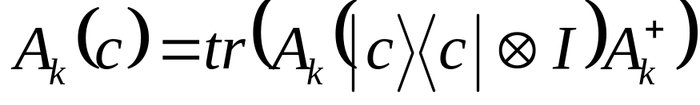
Proof overview
Handling LOCC protocol is hard
  We give cheating provers even more power
Any LOCC protocol can be cast as a single seprable POVM, with operators
(A_{k}­B_{k})(A_{k}­B_{k})^{y}
  k represents the transcript of the communication
If V sent c,y,v,x, Pr(A_{k}­B_{k}) is proportional to
(A_{k}(c)+A_{k}(y))(B_{k}(x)+B_{k}(v))
Fix a pair A_{k}­B_{k}, we prove that Alice and Bob are caught with constant probability

Slide 22
Main Theorem
If formula is unsat, for every k, (A_{k}­B_{k}) is either
  A “measuring” strategy
  An “entangling” strategy
  A “classical-like” strategy
In each type of strategy, verifier has constant probability to catch the provers

Slide 23
What happens if Alice measures?
A measurement by the computational basis, with result c → A_{k}(c) =1, A_{k}(y)=0
In general: if A_{k}(c) > A_{k}(y)
  Alice performed a weak measurement between c,y
  Diminishes the entanglement in the state
  |ccT(c)> + |yyT(y)>
  shared between Alice and the verifier

Slide 24
“Measuring” strategy
Informally: k is a “measuring” strategy, if there is a large variance among A_{k}(c), or among B_{k}(x)
Large variance → large set of big A_{k}(c) value and large set of small A_{k}(c) value
→ Constant probability to choose from these sets
→ Constant probability that provers get caught
We can assume WLOG that A_{k}(c), B_{k}(x) is almost uniform
  For example, ∀c, A_{k}(c)≈1/3
A_{k}(c) > 1/2
A_{k}(c) < 1/4
Choose c
Choose y
Notes:
ציור
להתאים לציור

Slide 25
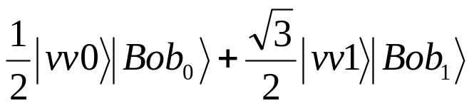
“Entangling” strategy
We want to reduce non-measuring strategies to “classical-like” ones
This may be impossible if B_{k} leaves the verifier entangled with Bob after the first round
Assume Alice sent a non-entangled state
If Alice sent 1 on the relevant variable, there is a probability of ¼ that the provers are caught:
|vv0> |cc010>
This probability is independent of Alice’s classical answers in the second round
  Provers are caught in the consistency check
Similar argument works if Alice sends an entangled state (as long as it is not entangled with the state sent by Bob)
Notes:
Write numbers instead of Bob0, Bob1,
Numbers will make it better

Slide 26
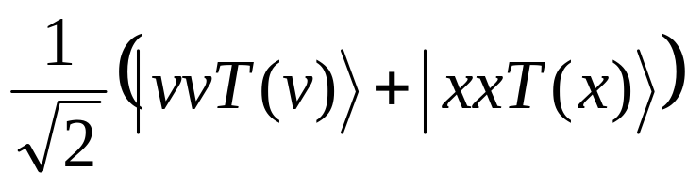
“Classical-like” strategy
Goal: Show that a “classical-like” strategy induces a classical strategy in the classical MIP strategy with similar success probability
Success probability of any classical strategy for MIP is bounded → we get a bound on the success probability of the “classical-like” strategy for QMIP&
Classical success probability is related to the number of queries a classical strategy is good for
Quantum success probability is related to the sum of A_{k}(c) values
A_{k}(c),B_{k}(v) are uniform + high success probability
→ High success probability for many tuples c,y,v,x
→ Gives a classical strategy which is good for many tuples
A_{k} , B_{k} are not “entangling”
→ state after the first round is of the form
With |T(v)> close to either |0> or |1>
Notes:
Induce classical strategy

Slide 27
The induced strategy for MIP
|T(v)> is close to either |0> or |1>
Reduce it to the following MIP strategy:
  Classical-Bob gets v, chooses x at random, and multiplies by B_{k}
  Classical-Bob sends the Classical-verifier the value which is close to T(v)
Classical-verifier has constant probability to detect cheating → a “classical” strategy for QMIP& can not be too good

Slide 28
Summary of Proof
Provers succeed ➔ There is a result k for which they succeed
k can be one out of 3 types:
k discriminates between clauses ➔ “measuring” strategy ➔ state is changed, entanglement is lost
k keeps information between rounds ➔Entanglement test fails
High success probability + k is uniform over tuples ➔ k succeeds on many tuples ➔ k induces a very good strategy for classical protocol ➔ contradiction
Provers’ success probability < 1
  QMIP& ⊇ NP

Slide 29
Open Questions
Thank You
Upper bound
Changing the number of provers \ rounds
  Unknown if QMA(k) = QMA(2)
Parallel repetition (sequential is possible)
QMIP* - no communication, with entanglement – does a similar protocol work?
Provers have bounded entanglement in addition to communication

Slide 30
Bibliography
C. Bennett, D. DiVincenzo, C. Fuchs,T. Mor, E. Rains, P. Shor, J. Smolin, W. Wootters ``QuantumNonlocality Without Entanglement ,'' quant-ph9804053, 1998.
L. Babai, L. Fortnow, C. Lund `` Addendum toNon-Deterministic Exponential Time Has Two-Prover InteractiveProtocols,'' Computational Complexity 2: 374, 1992.
M. Ben-Or, S. Goldwasser, J. Kilian, A. Wigderson``Efficient Identification Schemes Using Two Prover InteractiveProofs ,'' CRYPTO'89: 498-506, 1989.
R. Cleve, P. H\o yer, B. Toner, J. Watrous, ``Consequences and Limits ofNonlocal Strategies, '' CCC'04, 236-249, 2004.
R. Cleve, W. Slofstra, F. Unger, S. Upadhyay``Strong Parallel Repetition Theorem for Quantum XOR ProofSystems'' quant-ph/0608146, 2006.
Ito, H. Kobayashi, D. Preda, X. Sun, A. C. Yao, ``GeneralizedTsirelson Inequalities, Commuting-Operator Provers, andMulti-Prover Interactive Proof Systems'', quant-ph/0712.2163,2007.
J. Kempe, H. Kobayashi, K. Matsumoto, B. Toner, T. Vidick``Entangled Games are Hard to Approximate,'' quant-ph07042903,2007.
H. Kobayashi, K. Matsumoto``Quantum Multi-Prover Interactive Proof Systems with LimitedPrior Entanglement,'' Journal of Computer and System Sciences,66(3):429--450, 2003.
A. Kitaev, J. Watrous ``Parallelization, Amplification,and Exponential Time Simulation of Quantum Interactive ProofSystems,'' STOC'00: 608-617, 2000
D. Preda, Unpublished.

Slide 31
Upper bound for MIP*?
Limited Entanglement
Classical communication
QMIP*( Limited Entanglement) ½ NP [Kobayashi Mastumoto]

