Slide 1

quantum computing hardware
with highly biased noise
panos aliferis
IBM Jan. 09

Slide 2

biased noise
- for a resting qubit, biased noise means ,i.e., relaxation and
leakage much weaker than dephasing.

Slide 3
biased noise
- for a resting qubit, biased noise means ,i.e., relaxation and
leakage much weaker than dephasing.
j
2
i
leakage
j
i
dephasing
1
energy
relaxation
j
0
i

Slide 4
biased noise
noise superoperator
ideal superoperator
- for a qubit undergoing a noisy operation ,
N
¢
O
N
(
X
)
P
N
X
N
y
=
k
k
k

Slide 5
biased noise
noise superoperator
ideal superoperator
- for a qubit undergoing a noisy operation ,
N
¢
O
identity
diagonal qubit operator
N
k
=
I
k
+
N
k
l
+
N
k
d
+
N
k
d
;
;
:
;
leakage operator
non-diagonal qubit operator
N
(
X
)
P
N
X
N
y
=
k
k
k

Slide 6
biased noise
noise superoperator
ideal superoperator
- for a qubit undergoing a noisy operation ,
N
¢
O
identity
diagonal qubit operator
N
k
=
I
k
+
N
k
l
+
N
k
d
+
N
k
d
;
;
:
;
leakage operator
non-diagonal qubit operator
N
(
X
)
P
N
X
N
y
=
k
k
k
³
^
´
(
)
=
I
+
F
l
+
F
d
+
F
d
X
:

Slide 7
biased noise
noise superoperator
ideal superoperator
- for a qubit undergoing a noisy operation ,
N
¢
O
identity
diagonal qubit operator
N
k
=
I
k
+
N
k
l
+
N
k
d
+
N
k
d
;
;
:
;
leakage operator
non-diagonal qubit operator
N
(
X
)
P
N
X
N
y
=
k
k
k
³
^
´
(
)
=
I
+
F
l
+
F
d
+
F
d
X
:
j
j
j
j
.
j
j
j
j
j
j
j
j
noise is biased if .
F
l
¦
F
d
¦
¿
F
d
¦
:

Slide 8
biased noise
noise superoperator
ideal superoperator
- for a qubit undergoing a noisy operation ,
N
¢
O
identity
diagonal qubit operator
N
k
=
I
k
+
N
k
l
+
N
k
d
+
N
k
d
;
;
:
;
leakage operator
non-diagonal qubit operator
N
(
X
)
P
N
X
N
y
=
k
k
k
³
^
´
(
)
=
I
+
F
l
+
F
d
+
F
d
X
:
j
j
j
j
.
j
j
j
j
j
j
j
j
noise is biased if .
F
l
¦
F
d
¦
¿
F
d
¦
:
- most resting qubits have biased noise; but noisy operations may not.
- highly biased noise can be engineered by using (quasi) adiabatic control.

Slide 9
e.g., integrated-circuit qubits
- dissipation in metallic parts must be low at the operating temp. and freq.
use low-temperature superconductors ( Al, Nb, etc. )
- energy spectrum must be unharmonic ( ) so qubits are usable
¢
E
6
¢
E
0
1
=
1
2
build circuits with non-linear components

Slide 10
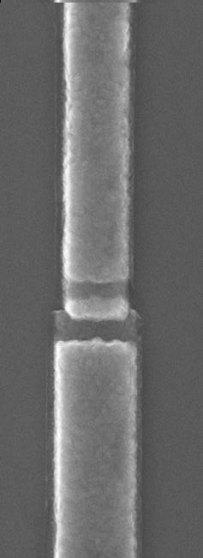
e.g., integrated-circuit qubits
- dissipation in metallic parts must be low at the operating temp. and freq.
use low-temperature superconductors ( Al, Nb, etc. )
- energy spectrum must be unharmonic ( ) so qubits are usable
¢
E
6
¢
E
0
1
=
1
2
build circuits with non-linear components
the Josephson junction: a nondissipative nonlinear inductor
=
L
J
C
J
L
¼
1
n
m

Slide 11
flux qubits zoo
©
0
j
0
i
j
L
i
+
j
R
i
2
/
j
1
i
/
j
L
i
¡
j
R
i
j
L
i
j
R
i
energy

Slide 12
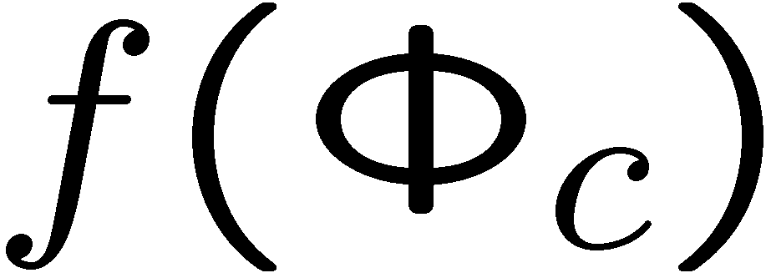
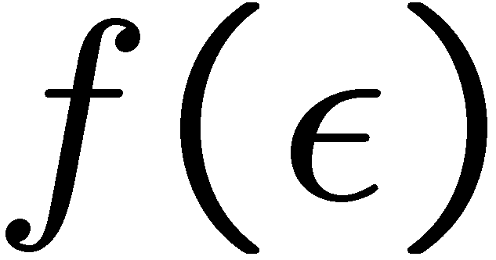
flux qubits zoo
©
0
j
0
i
j
L
i
+
j
R
i
2
/
j
1
i
/
j
L
i
¡
j
R
i
j
L
i
j
R
i
©
c
©
0
2
©
c
energy
¡
©
0
©
0
2
2

Slide 13
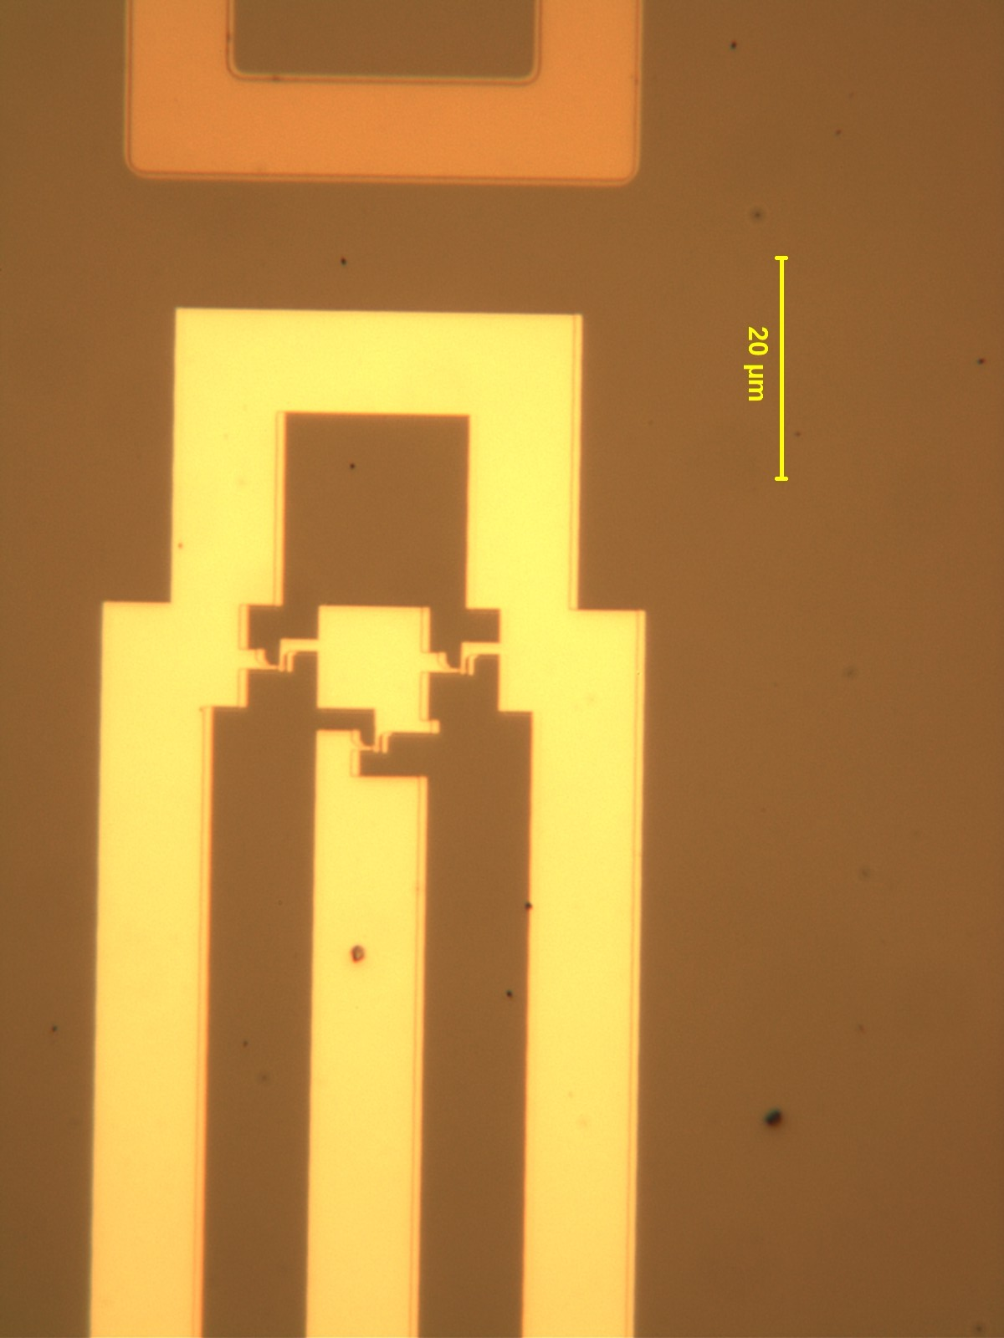
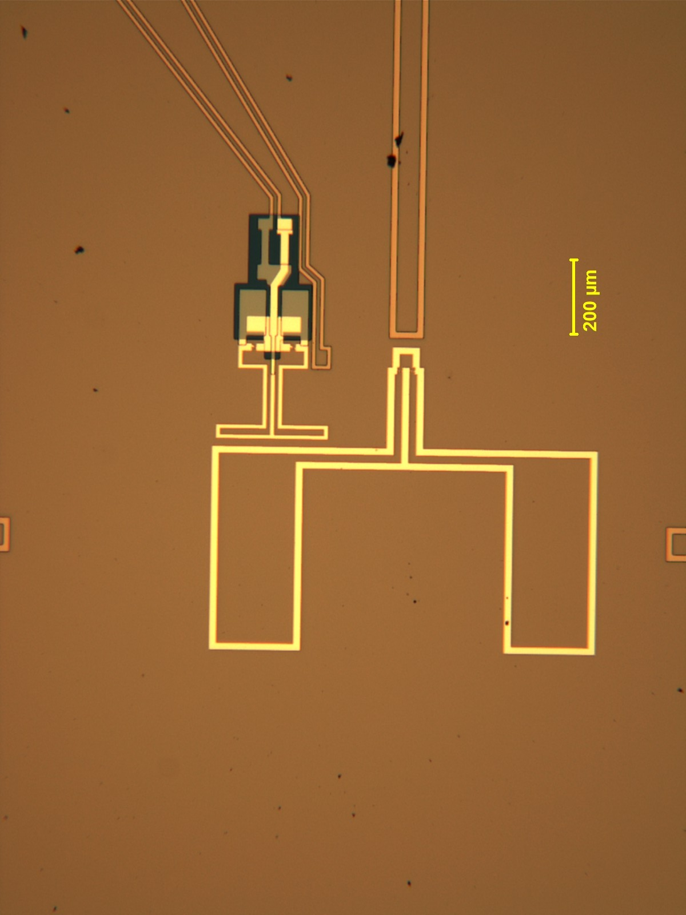
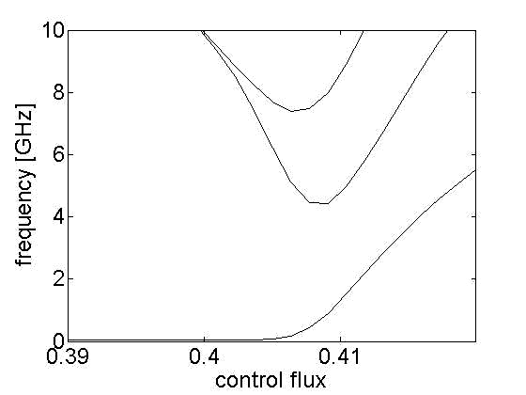
IBM flux qubit
©
c
¡
©
0
©
0
2
2
²
=
0

Slide 14
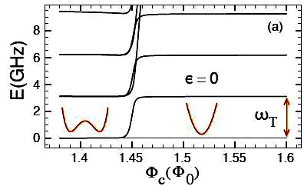
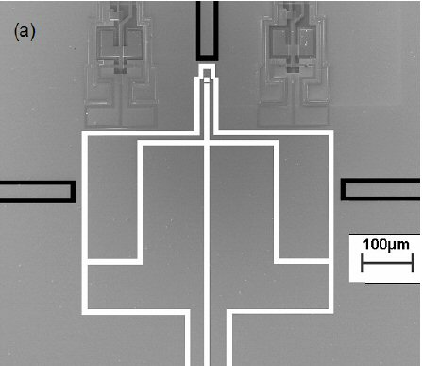
IBM flux qubit
²
=
0
bare
(unstabilized)
qubit
oscillator-
stabilized
qubit

Slide 15
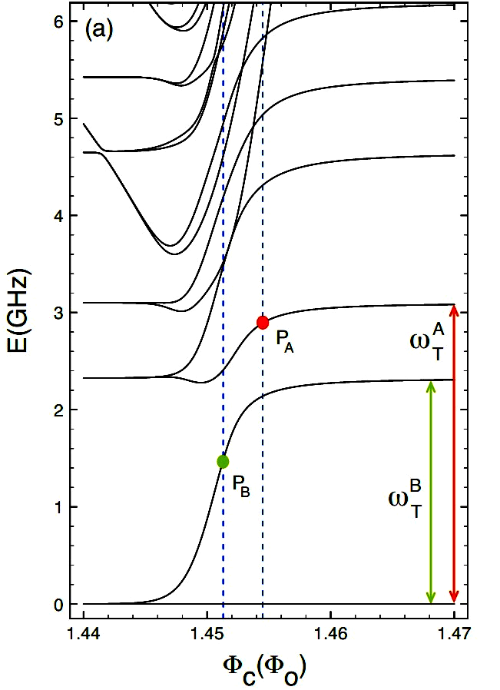
IBM flux qubit

Slide 16
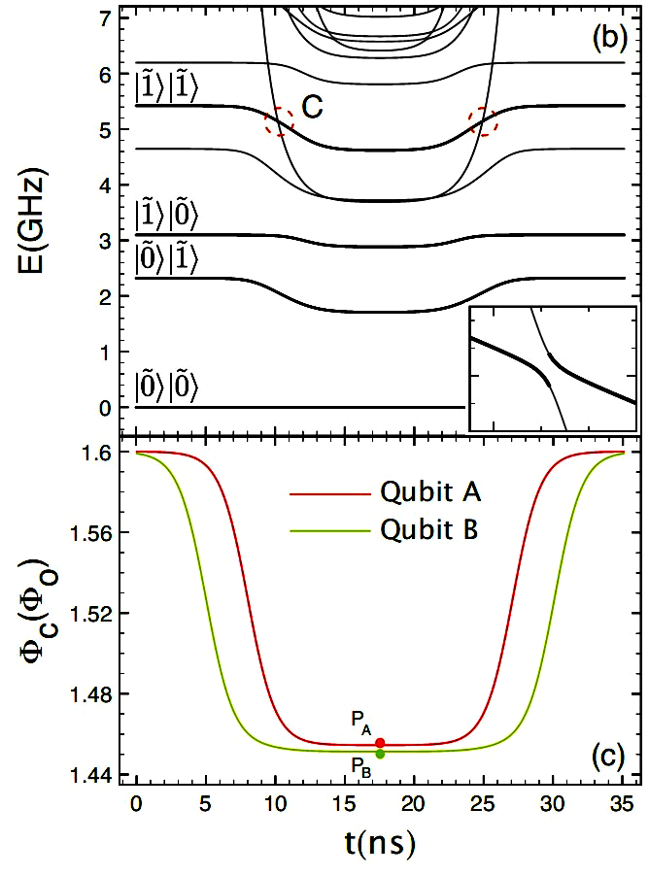
IBM flux qubit

Slide 17
IBM flux qubit
during the 35ns pulsing,
E
6
E
+
E
1
1
=
0
1
1
0
and we can implement a
conditional phase gate.
the pulses are adiabatic,
except at the two
level crossings where
we want to tunnel
perfectly through the
very small gap.

Slide 18
IBM flux qubit
µ
I
O
¶
O
¾
z
- by numerical simulations, we can estimate the effect of noise on this CPHASE
j
j
F
l
j
j
.
j
j
F
d
j
j
¿
j
j
F
d
j
j
¦
:
¦
¦
;
¼
¼
¼
3
5
£
1
0
¡
6
3
5
£
1
0
¡
6
2
£
1
0
¡
3
:
:
j
i
j
i
j
i
i
µ
which also apply for preparing , and measuring .
+
/
0
+
1
e
¾
z
¾
x

Slide 19
IBM flux qubit
µ
I
O
¶
O
¾
z
- by numerical simulations, we can estimate the effect of noise on this CPHASE
j
j
F
l
j
j
.
j
j
F
d
j
j
¿
j
j
F
d
j
j
¦
:
¦
¦
;
¼
¼
¼
3
5
£
1
0
¡
6
3
5
£
1
0
¡
6
2
£
1
0
¡
3
:
:
j
i
j
i
j
i
i
µ
which also apply for preparing , and measuring .
+
/
0
+
1
e
¾
z
¾
x
- since noise is mostly diagonal, we can encode in a classical code, e.g.,
j
+
i
!
j
+
i
­
j
+
i
­
¢
¢
¢
­
j
+
i
j
¡
i
!
j
¡
i
­
j
¡
i
­
¢
¢
¢
­
j
¡
i
;
|
{
z
}
|
{
z
}
n
n
then, the error-correction
circuit looks like
and similar circuits allow
implementing a universal set of
logical operations.

Slide 20

hard realities
IBM experiments:
T
3
- resonators:
1
¼
¹
s
- flux qubits:
T
1
¼
1
0
n
s

Slide 21
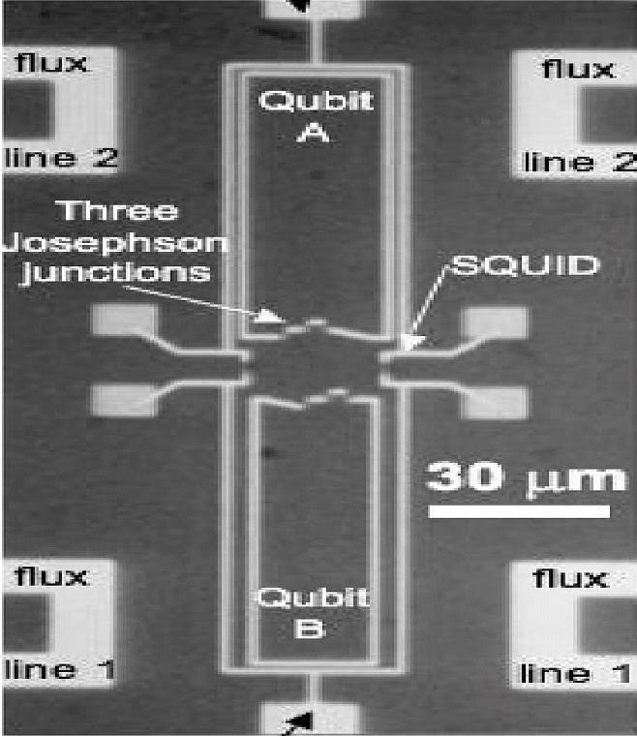
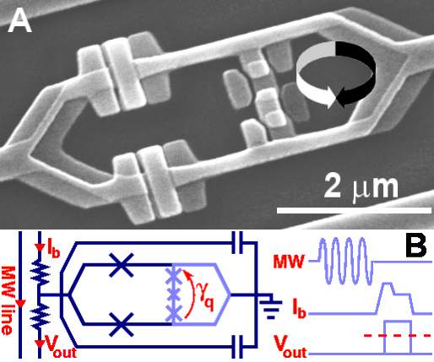
hard realities
IBM experiments:
T
3
- resonators:
1
¼
¹
s
- flux qubits:
T
1
¼
1
0
n
s
- however, other flux qubits work much better…
Berkeley:
large & symmetric
Delft: small & symmetric

Slide 22
hard realities
- why is symmetry important ?
C
c
©
0
L
J
L
I
Z
0
2
=
C
J
C
g

Slide 23
hard realities
- why is symmetry important ?
C
c
©
0
L
J
L
I
Z
0
2
=
C
J
C
g
C
g
vs.
L
I
2
C
c
L
J
Z
0
C
J
L
2
I
C
g

Slide 24
hard realities
Berkeley qubit
T
1
¼
2
0
0
n
s

Slide 25
hard realities
Berkeley qubit
IBM qubit
T
1
¼
2
0
0
n
s
- also, play with the UCSB phase qubit.

Slide 26
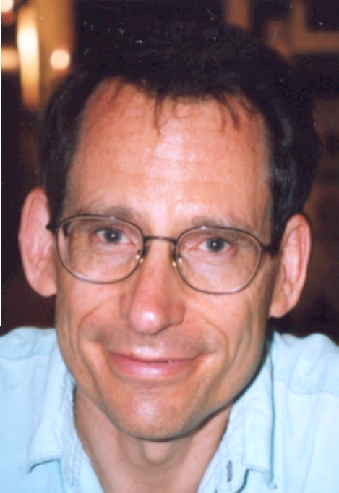
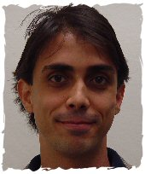



references
quantum computing against biased noise
PA and Preskill, arXiv:0710.1301
PA, Brito, DiVincenzo, Preskill, Steffen, and Terhal, arXiv:0806.0383
IBM flux qubit
Koch et. al., PRL 96 (2006) 127001
Koch et. al., PRB 72 (2005) 092512
Berkeley flux qubit
Plourde et. al., PRB 72 (2005) 060506
Hime et. al., Science 314 (2006) 1427

Slide 27

quantum computing
against highly biased noise
panos aliferis
IBM, January 09

